Slide 1

Hotel Management System
Using Python GUI
Presented by
-T.JANUSRI
Under the guidance of
J.MRUDHULA,
Assistant,Professor,
RGUKT Ongole.

Slide 2
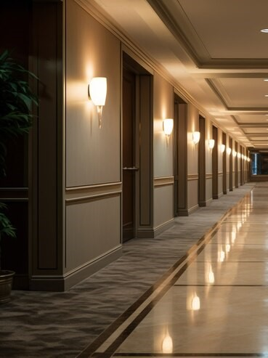
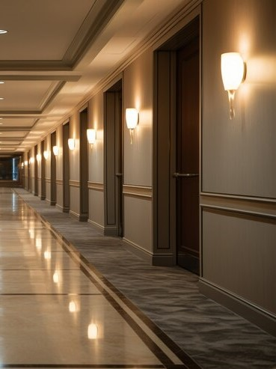
CONTENTS
Abstract
Requirements
Modules
Implementation
UML Diagrams
Existed system
Proposed system
Future scope
Conclusion

Slide 3

ABSTRACT
Hotel management system is a efficient software solution for managing various hotel operations.
The system includes functionalities such as room booking, payment processing, check-in and check-out procedures, food ordering, and a feedback mechanism. Additionally, the system allows administrators to manage and add rooms to better serve customers.

Slide 4

REQUIREMENTS
Hardware Requirements
RAM 4BG
Processor speed – 2GHz
Key board
Software Requirements
Python
Tkinter
MySQL

Slide 5
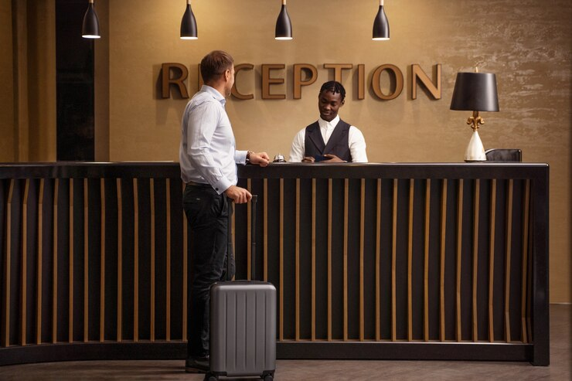
MODULES
CUSTOMER / USER
Services provided to the user are as follows:
Check-in
Check-out
Order food
Feedback

Slide 6

MODULES
ADMIN
Features that can be implemented by admin are as follows:
Adding rooms
Checking / Monitoring hotel rooms

Slide 7
IMPLEMENTATION
Initially there is a main page of our hotel management system which includes customer and admin login.
Upon successful login of customer and admin the home page of our project displays which contains a nav bar with Home, Services , Aboutus ,logout.
Services like check-in,booking rooms,ordering food,payment.
Admin receives feedback and can access all details regarding customers.

Slide 8
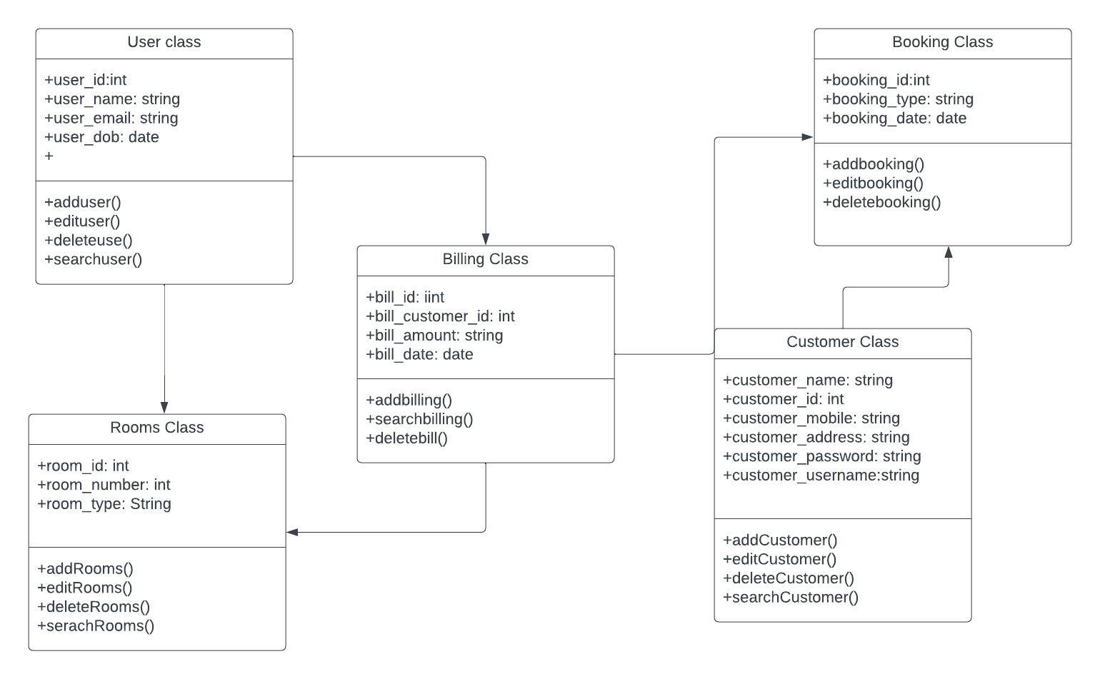
1.Class Diagram
UML Diagrams

Slide 9
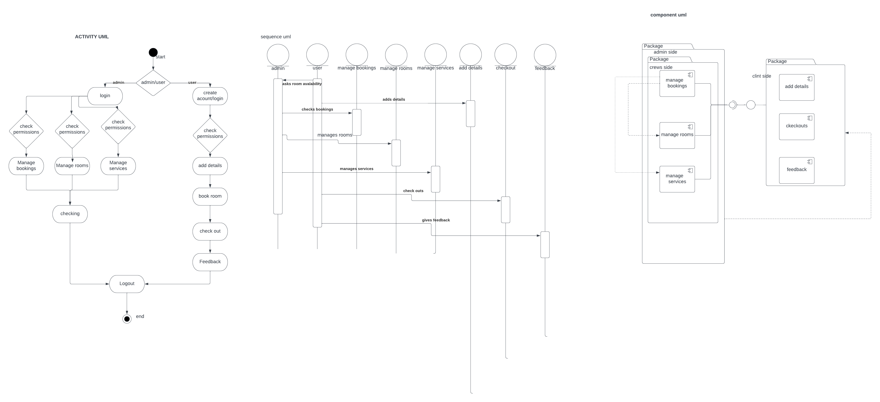
2.Activity Diagram
UML Diagrams

Slide 10
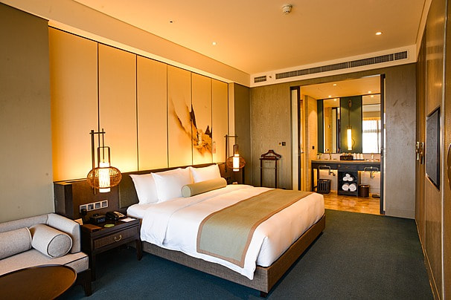
EXISTED SYSTEM
RoomKeyPMS and Hotelogix:
It is a cloud based system which manages all hotel operations and the data stores in the cloud.
THMS Hotel:
It is a system for hospitality industry to manage operations like check-in / check-out, hotel reservation system & booking management, front desk, hotel billing etc.

Slide 11
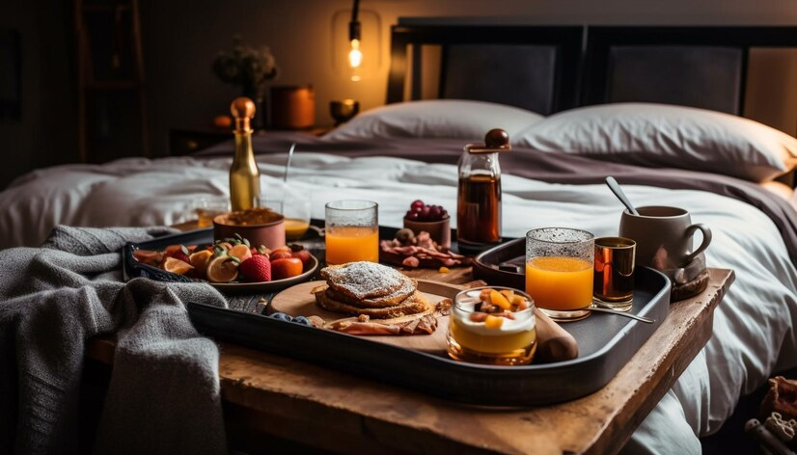
PROPOSED SYSTEM
Here are the additional features I’ve included:
Ordering food : Customers can order their food directly using this system .In this there had an customer choice to choose their food .
Ensuring that admin can check manage all details simultaneously.
Developing using Tkinter makes it easy to code and understandable.

Slide 12
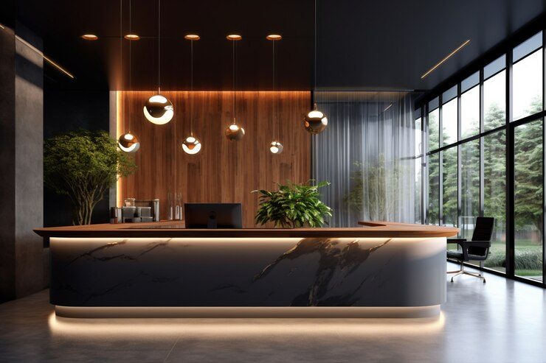
FUTURE SCOPE
Integrating ordering food from popular websites like Zomato and Swiggy,
Introducing careers or job roles present in the hotel.
Mobile app development for the project

Slide 13
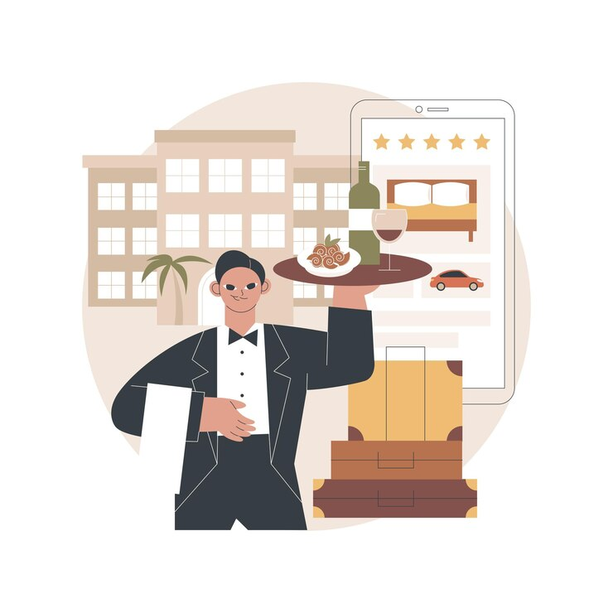
CONCLUSION
In conclusion our project provides ultimate security in keeping customers information secure and store in the database for certain amount of time.
It contains the implementation of all the hotel operations at place according to the customers preference.

Slide 14
THANK YOUU

