Slide 1
Project Presentation Android App For Tailor FabricFit
Janvi Umesh Dhonde 22313
MCA-II C
Project Guide: Dr. Milind Godase

Slide 2
INTRODUCTION
The Fabicfit app is a android base app development platform designed to support tailor in In an era where digital innovation is reshaping industries and revolutionizing the way businesses operate. To transform the way tailors manage their business, interact with customers, and streamline their operations.
The Fabicfit app consists of various modules that allows Appointment Scheduling, Digital Catalogs, Tailor Management, Measurement Recording, Order Tracking, Payment Processing, Customer Engagement.
By addressing these specific points in these Android app development project for tailors, fabicfit create a comprehensive and effective solution that meets the needs of both tailors and their clients.

Slide 3
EXISTING SYSTEM
Existing System: Traditional Tailoring Practices :
Manual Record Keeping, Appointment Booking, Measurement Recording, Order Tracking, Inventory Management, Payment Handling, Customer Engagement.
Challenges with the Existing System:
Inefficiency: Manual record-keeping and appointment scheduling can be time-consuming and prone to errors.
Lack of Transparency: Customers may not have easy access to order progress, leading to frustration.
Limited Growth Potential: Traditional methods can hinder a tailor's ability to scale their business and reach a broader customer base.
Security Concerns: Handling payments and customer data manually can pose security and privacy risks.
Missed Opportunities: Without efficient customer engagement tools, tailors may miss out on opportunities for marketing and client retention.

Slide 4
NEED FOR SYSTEM
Efficiency and Productivity: The app can significantly improve the efficiency of tailoring businesses by automating manual tasks such as appointment scheduling, measurement recording, and order tracking. This streamlining of operations can lead to increased productivity and reduced errors.
Improved Customer Experience: Tailor apps offer a more convenient and transparent experience for customers. They can easily book appointments, track orders, and receive updates, ultimately leading to higher customer satisfaction and retention.
Access to Digital Tools: The app provides tailors with access to digital tools for managing their business. This includes digital catalogs for fabric and design selection, which can help them stay organized and offer a wider range of options to customers.
Enhanced Measurement Accuracy: Measurement recording within the app ensures accurate and consistent measurements, reducing the likelihood of errors in the tailoring process.
Secure Payment Processing: With integrated payment processing, tailors can securely accept payments, reducing the need for handling cash and enhancing financial security.
Business Growth: The app can support business growth by providing insights through analytics tools, enabling tailors to make informed decisions about inventory, pricing, and marketing strategies.
Customer Engagement: Tailoring businesses can use the app to engage with customers, send promotions, and maintain ongoing relationships. This can lead to repeat business and word-of-mouth referrals.
Adaptation to Digital Trends: As digital innovation continues to reshape industries, adapting to these trends is crucial for the long-term sustainability of tailoring businesses.

Slide 5
OBJECTIVES & SCOPE
User Roles: The app caters to two primary user roles: tailors (business owners) and customers. Each role has specific functionalities and access levels.
Data Security: The scope encompasses robust data security measures to protect sensitive customer data and payment information.
Compatibility: The app should be compatible with a range of Android devices and screen sizes to ensure broad accessibility.
Documentation: The development includes the creation of user documentation and tutorials to guide tailors and customers on using the app effectively.
Support and Maintenance: Ongoing support and maintenance will be required to address issues, provide updates, and ensure the app's continued functionality.
Scalability: Plan for the app's scalability as the user base grows, allowing for increased usage and additional features in the future.
Marketing: The scope may include initial marketing efforts to promote the app to tailors and potential customers through various channels.
Feedback and Iteration: Continuously gather user feedback and iterate on the app to improve functionality and address user needs and concerns.

Slide 6
TECHNOLOGY DETAILS
HARDWARE REQUIREMENT:
Processor: Intel Core i7 & 2.00Hz
RAM: 8 GB And Above
Hard Disk: 128 GB
Cache Memory : 514 KB
SOFTWARE REQUIREMENT:
Frontend Language: XML, JSON,JS
Backend Language: JAVA,FIREBASE
Additional Tools: Android Studio IDE
Operating System: Window 10

Slide 7
MODULES & FUNCITIONALITIES
CATALOG MODULE: The catalog module serves as a digital showcase of fabrics designs, accessories, browse catalog items, offered by the tailoring administrator.
ORDER MODULE: This module allowing customers to Place Orders, Modification, Cancellation, Order tracking.
PAYMENT MODULE: The payment module handles payment processing for customer order.
DELIVERY MODULE: The delivery module focuses on providing delivery notifications to customers.
PROFILE MODULE:
ADMIN MODULE: This module is for administrative purposes Registration, Login, Monitoring orders, Overseeing payment, Delivery processes.Tailor & customer management, Managing catalog items.
CUSTOMER MODULE: This module is designed for customers who want to engage with Registration, Login, Book appointments, Browse catalog, Provide measurements, Order status.
TAILOR MODULE: Tailors use this module to manage their day-to-day operations and interact with customers such as Appointment scheduling, Measurement recording, Catalog management, Order tracking, Customer Order Status.

Slide 8
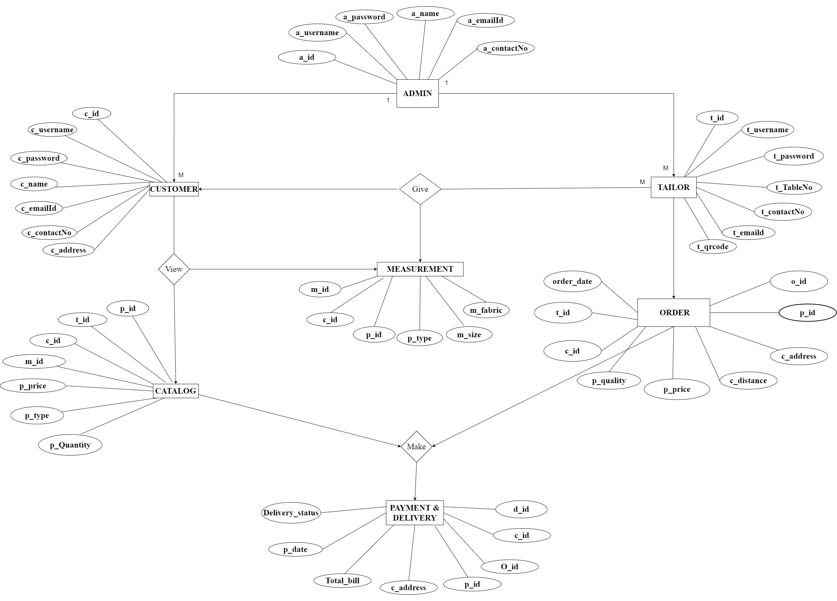
ENTITY RELATIONSHIP DIAGRAM (ERD) :

Slide 9
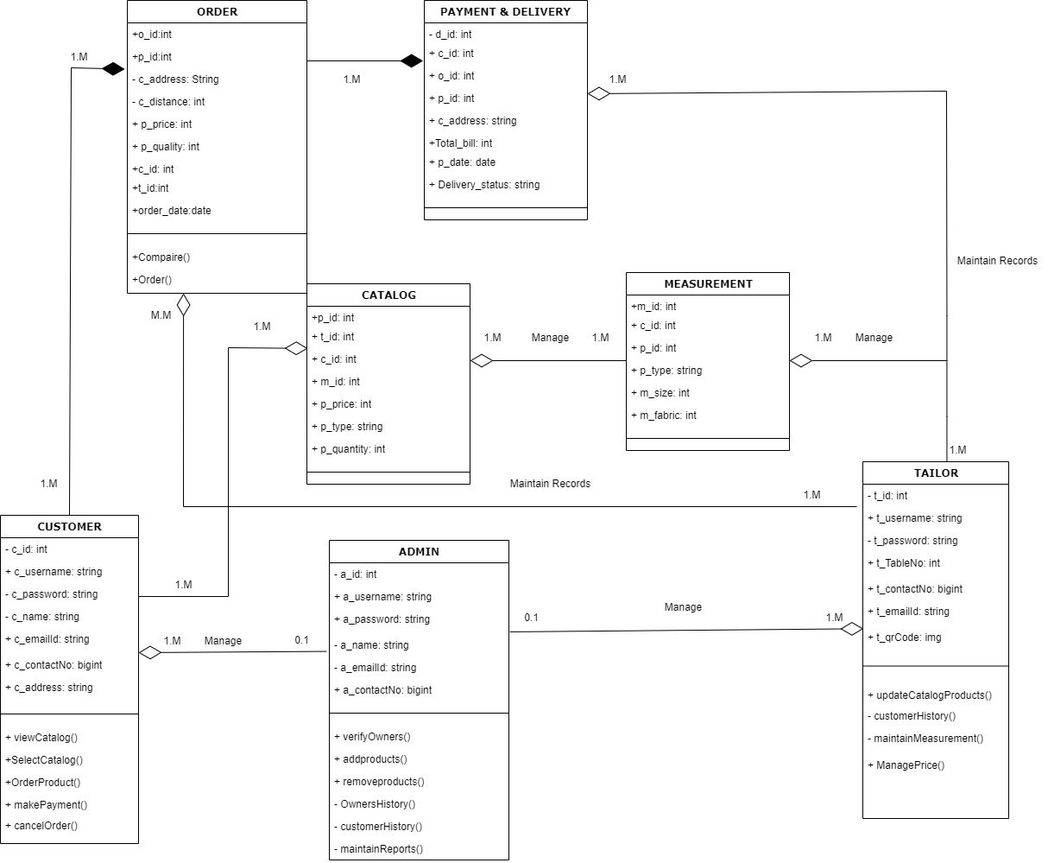
CLASS DIAGRAM :

Slide 10
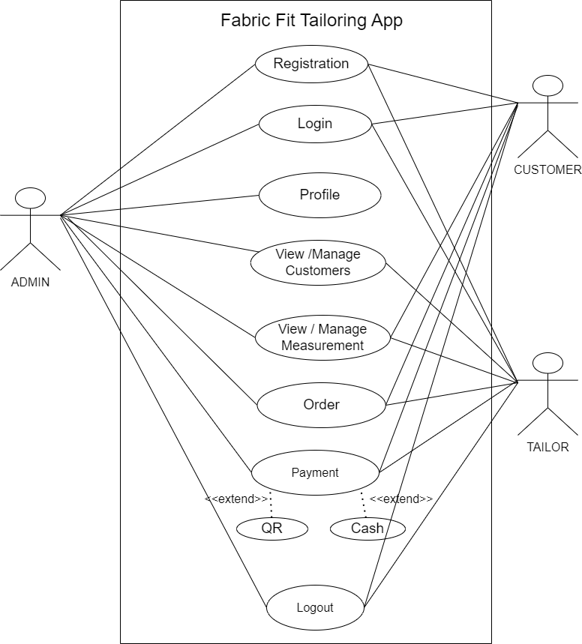
USE CASE DIAGRAM : PROFILE MODULE

Slide 11
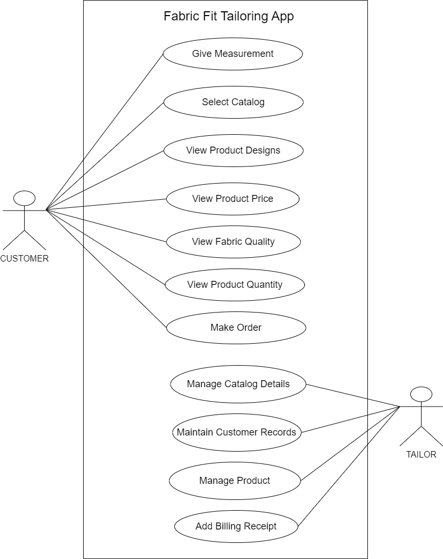
USE CASE DIAGRAM : CATALOG MODULE

Slide 12
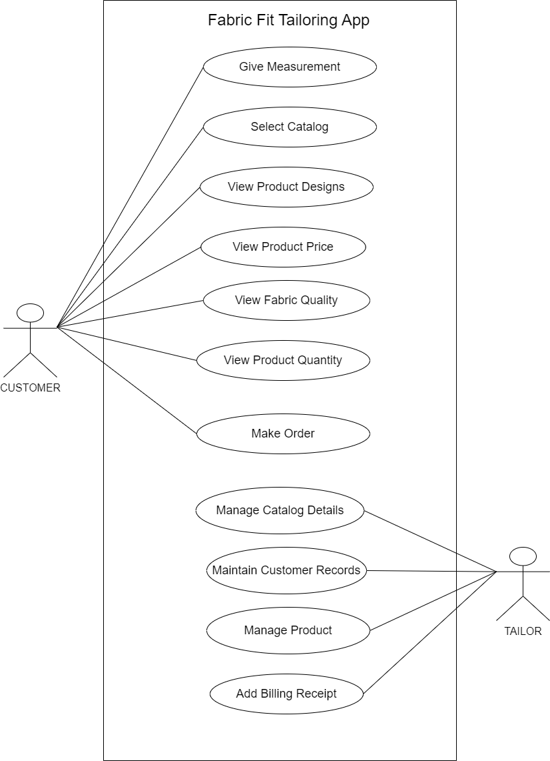
USE CASE DIAGRAM : MEASUREMENT MODULE

Slide 13
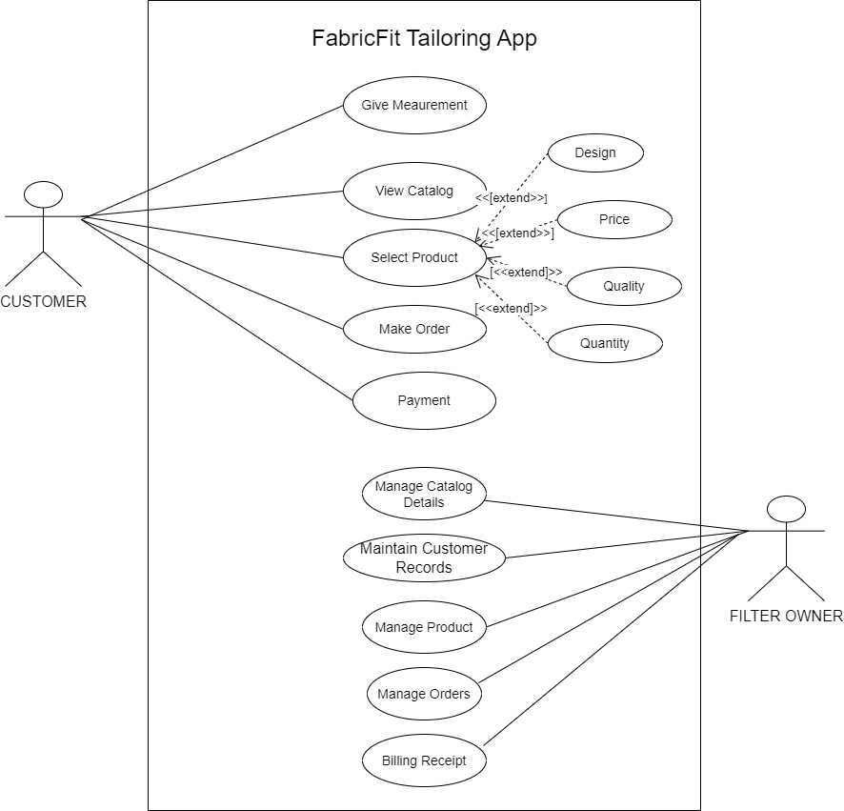
USE CASE DIAGRAM : ORDER MODULE

Slide 14
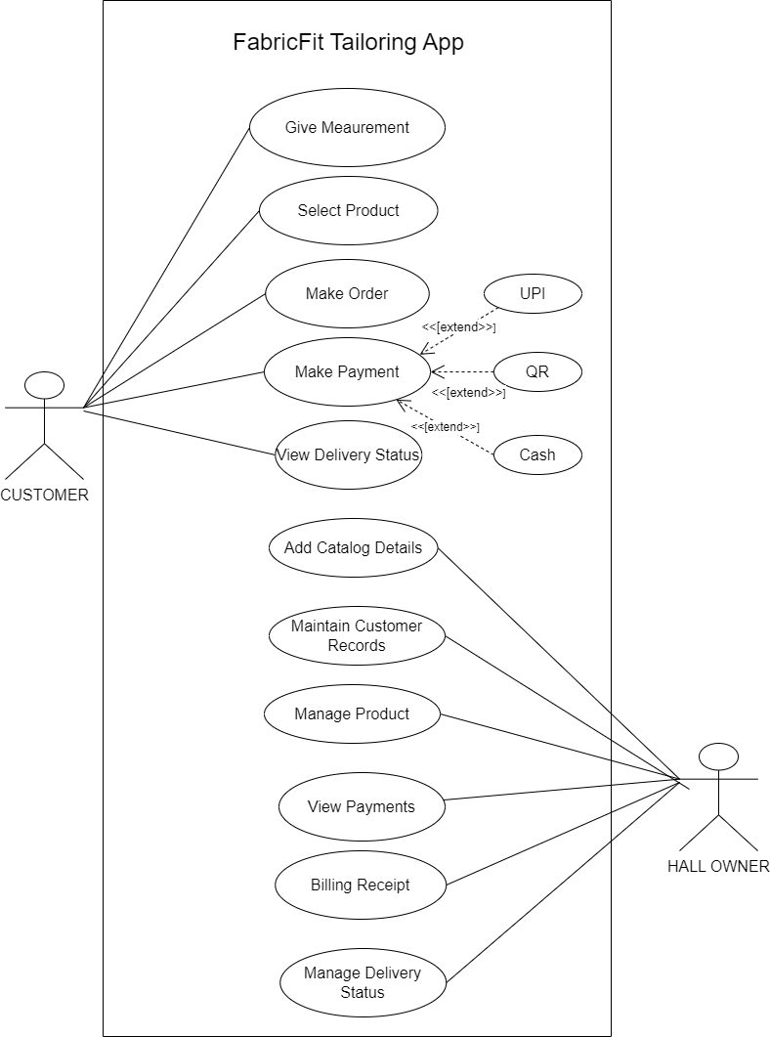
USE CASE DIAGRAM : PAYMENT/DELIVERY MODULE

Slide 15
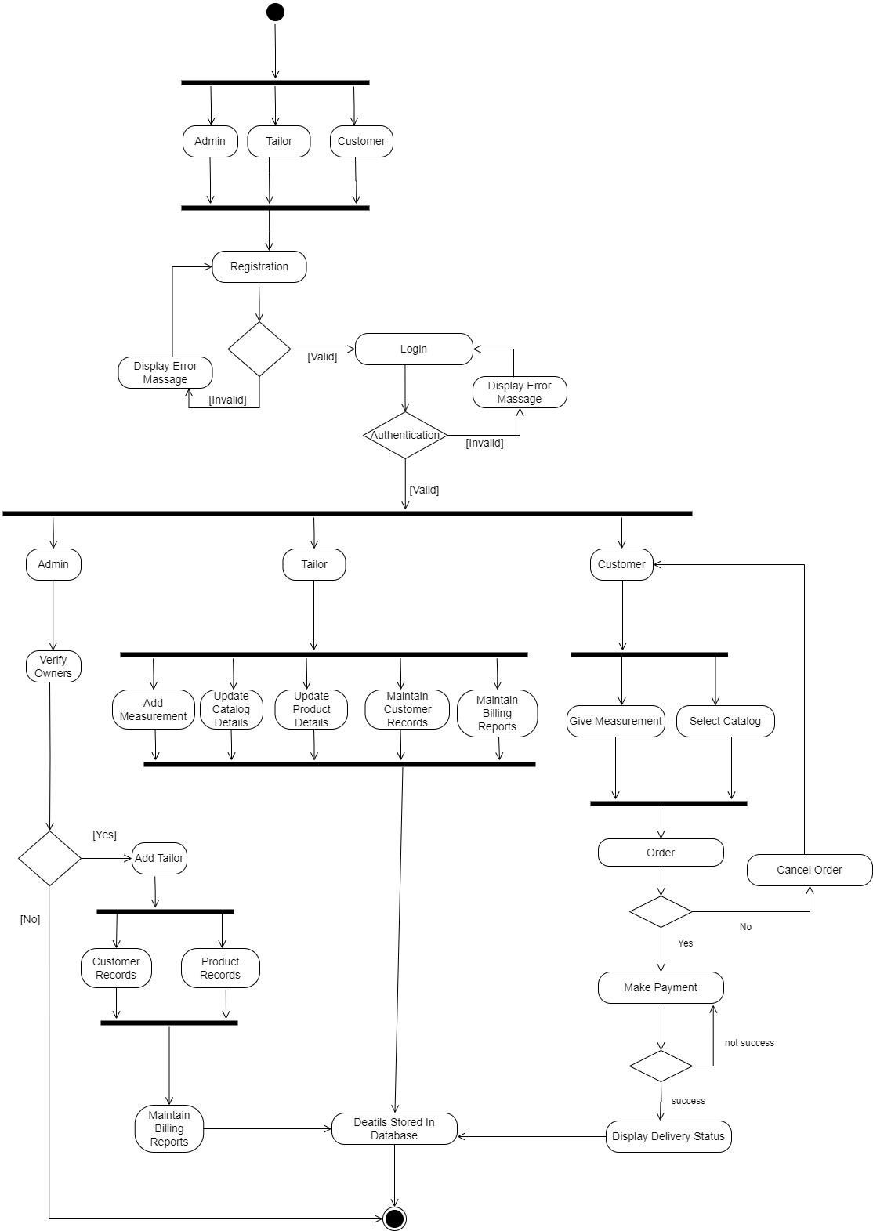
ACTIVITY DIAGRAM : PROFILE MODULE

Slide 16
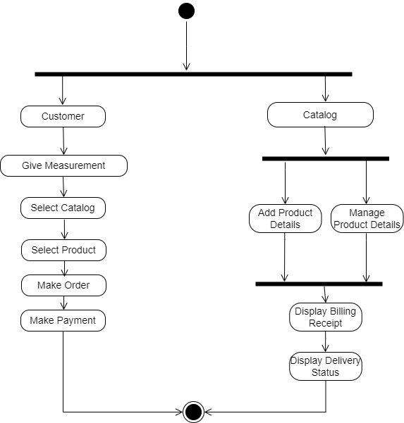
ACTIVITY DIAGRAM : CATALOG MODULE

Slide 17
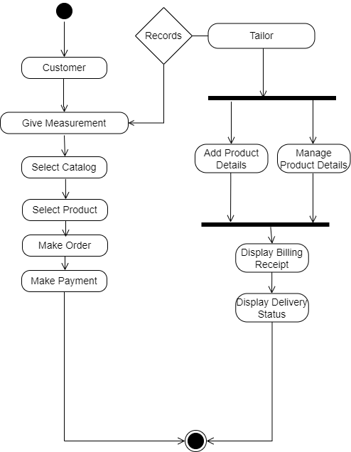
ACTIVITY DIAGRAM : MEASUREMENT MODULE

Slide 18
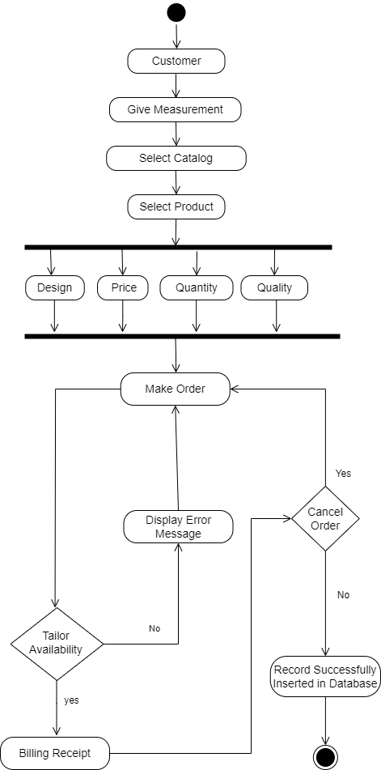
ACTIVITY DIAGRAM : ORDER MODULE

Slide 19
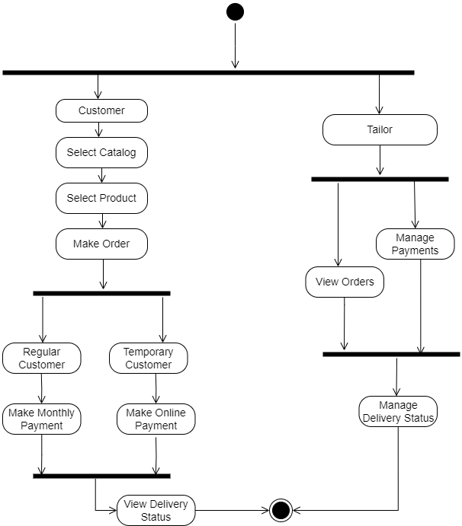
ACTIVITY DIAGRAM : PAYMENT/DELIVERY MODULE

Slide 20
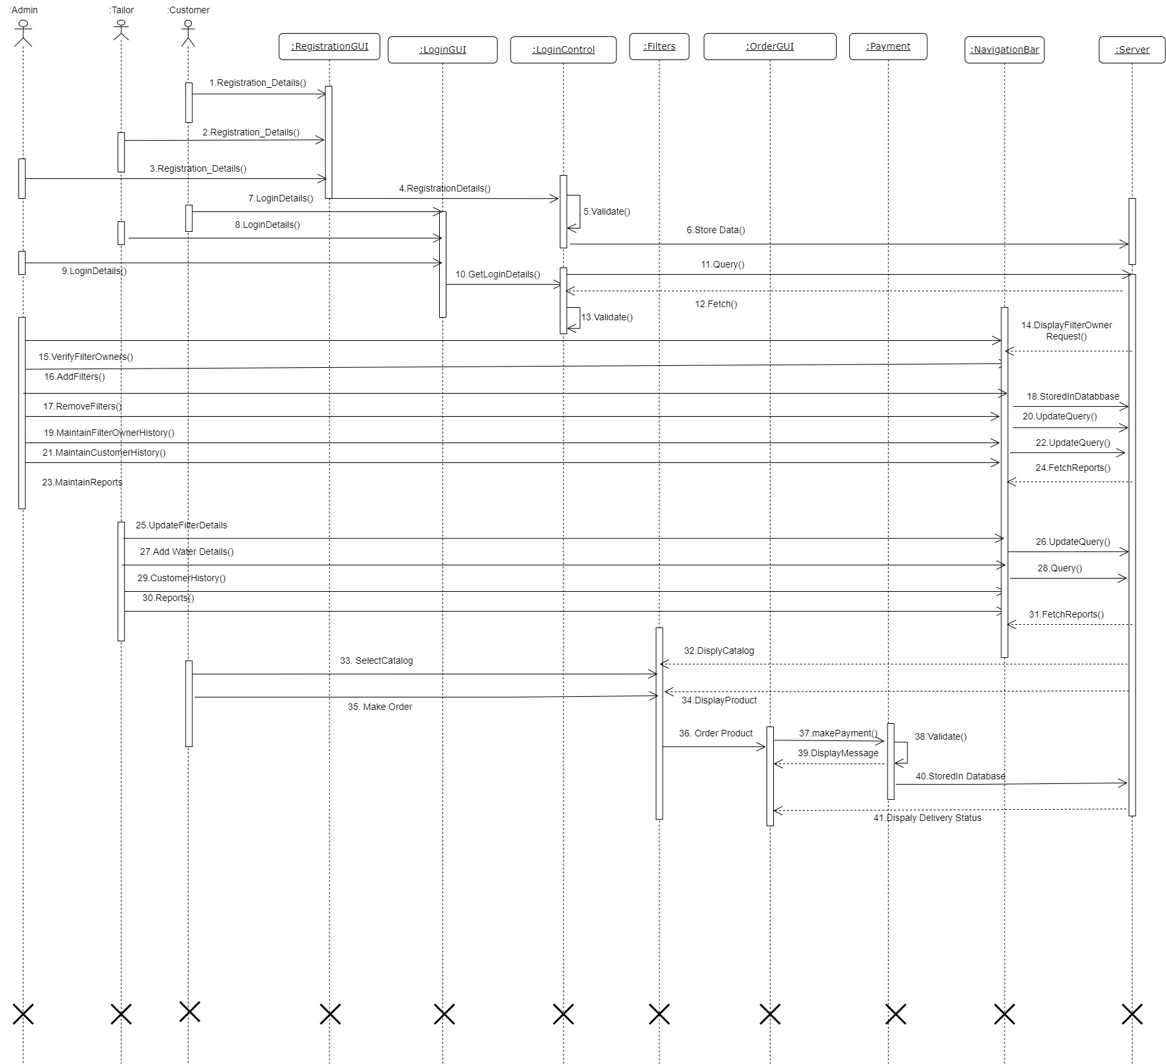
SEQUENCE DIAGRAM : PROFILE MODULE

Slide 21
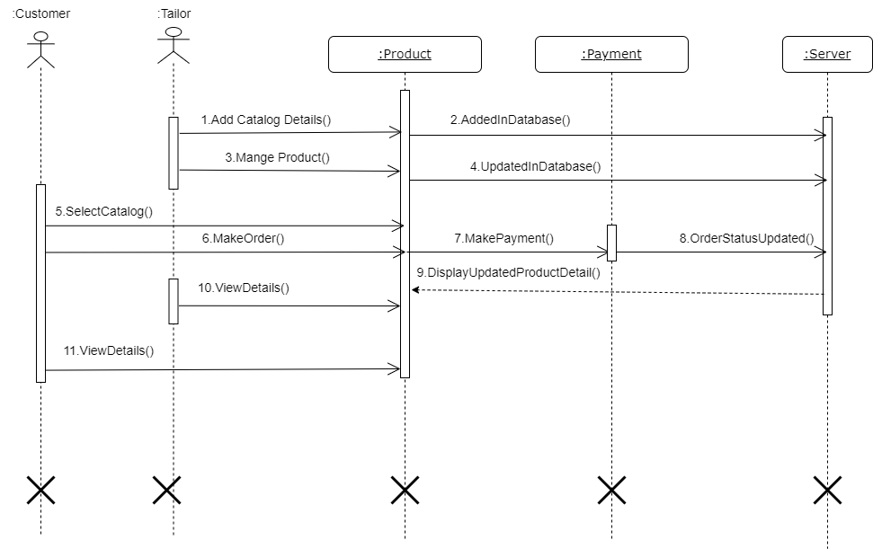
SEQUENCE DIAGRAM : CATALOG MODULE

Slide 22
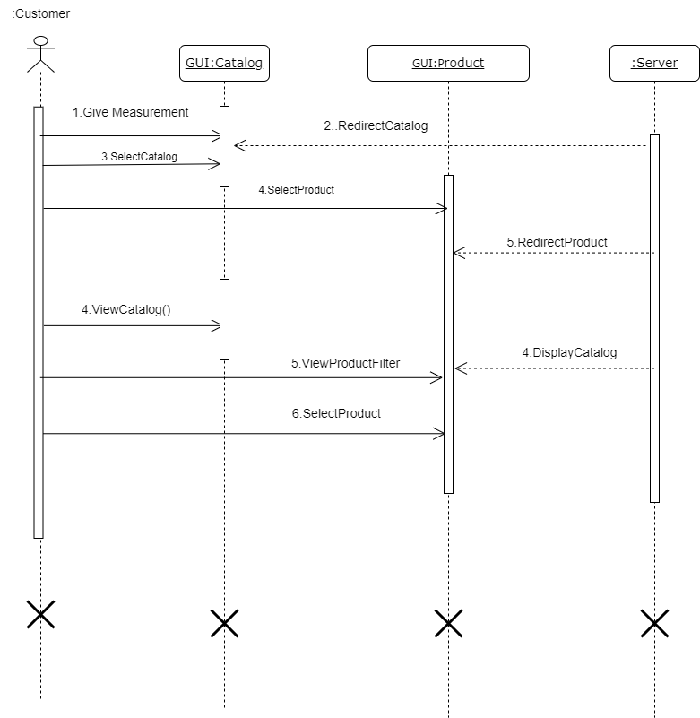
SEQUENCE DIAGRAM : MEASUREMENT MODULE

Slide 23
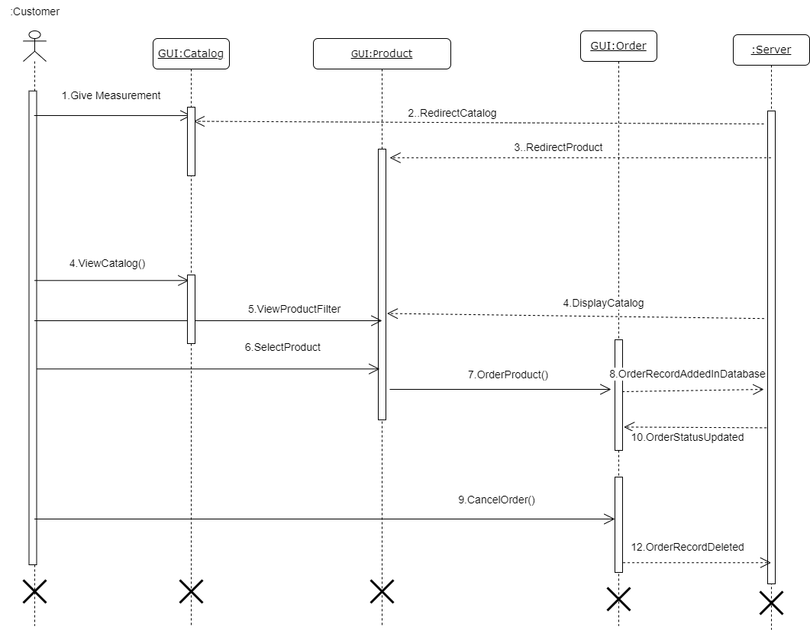
SEQUENCE DIAGRAM : ORDER MODULE

Slide 24
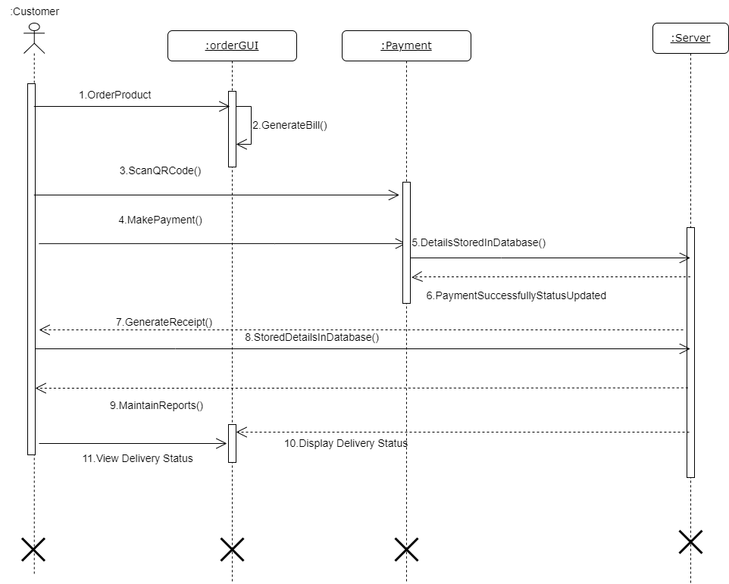
SEQUENCE DIAGRAM : PAYMENT/DELIVERY MODULE

Slide 25
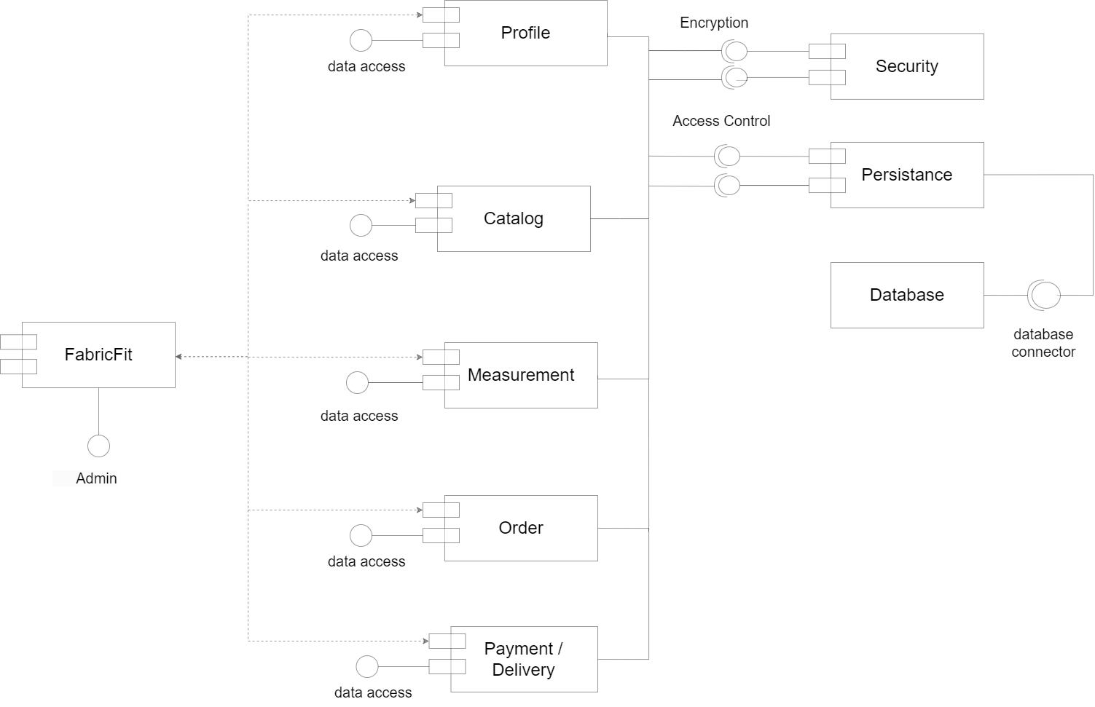
COMPONENT DIAGRAM :

Slide 26
DATA DESIGN : ADMIN TABLE
Sr.no | Field Name | Field Size | Data Type | Description | Constraints
1 | a_id | 8 | Int | Admin Id | Primary Key
2 | a_username | 10 | Varchar | Admin Username | Not Null
3 | a_password | 12 | Varchar | Admin Password | Not Null
4 | a_name | 12 | Varchar | Admin Name | Not Null
5 | a_emailId | 27 | Varchar | Admin Email Id | Not Null
6 | a_contactNo | 11 | Int | Admin Contact | Not Null

Slide 27
DATA DESIGN : CUSTOMER TABLE
Sr.no | Field Name | Field Size | Data Type | Description | Constraints
1 | c_id | 8 | Int | Customer Id | Primary Key
2 | c_username | 10 | Varchar | Customer Username | Not Null
3 | c_password | 12 | Varchar | Customer Password | Not Null
4 | c_name | 12 | Varchar | Customer Name | Not Null
5 | c_emailId | 27 | Varchar | Customer Email Id | Not Null
6 | c_contactNo | 11 | Int | Customer Contact | Not Null
7 | c_address | 30 | Varchar | Customer Address | Not Null

Slide 28
DATA DESIGN : TAILOR TABLE
Sr.no | Field Name | Field Size | Data Type | Description | Constraints
1 | t_id | 8 | Int | Tailor Id | Primary Key
2 | t_username | 10 | Varchar | Tailor Username | Not Null
3 | t_password | 12 | Varchar | Tailor Password | Not Null
4 | t_TableNo | 12 | Int | Tailor Table No | Not Null
5 | t_emailId | 27 | Varchar | Tailor Email Id | Not Null
6 | t_contactNo | 11 | Int | Tailor Contact | Not Null
7 | t_qrcode | 1 | int | Tailor QR code | Not Null

Slide 29
DATA DESIGN : CATALOG TABLE
Sr.no | Field name | Field size | Data type | Description | Constraint
1 | p_id | 8 | Int | Product id | Primary key
2 | t_id | 8 | Int | Tailor id | Foreign key
3 | c_id | 8 | Int | Customer id | Foreign key
4 | m_id | 8 | Int | measurement id | Foreign key
5 | p_price | 5 | Varcher | Product Price | Not null
6 | p_type | 5 | Varcher | Product type | Not null
7 | p_quantity | 10 | Varcher | Product Quantity | Not null

Slide 30
DATA DESIGN : MEASUREMENT TABLE
Sr.no | Field Name | Field Size | Data Type | Description | Constraints
1 | m_id | 8 | Int | Measurement id | Primary key
2 | c_id | 8 | Int | Customer id | Foreign key
3 | p_id | 8 | Int | Product id | Foreign key
4 | p_type | 9 | varcher | Product type | Not null
5 | m_size | 4 | Int | Material size | Not null
6 | m_fabric | 10 | Varcher | Material fabric | Not null

Slide 31
DATA DESIGN : ORDER TABLE
Sr.no | Field Name | Field Size | Data Type | Description | Constraints
1 | order_date | 8 | Int | order date | Not null
2 | t_id | 8 | Int | Tailor id | Primary key
3 | c_id | 8 | Int | Customer id | Foreign key
4 | p_quality | 10 | Varcher | Product Quality | Not null
5 | p_price | 5 | Int | Product Price | Not null
6 | c_distance | 10 | Varcher | Customer Distance | Not null
7 | c_address | 30 | Varcher | Customer Address | Not null
8 | p_id | 8 | Int | Product id | Foreign key
9 | o_id | 8 | Int | Order id | Foreign key

Slide 32
DATA DESIGN : PAYMENT/DELIVERY TABLE
Sr.no | Field Name | Field Size | Data Type | Description | Constraints
1 | delivery_status | 10 | Varcher | Delivery Status | Not null
2 | p_date | 8 | Int | Produst Date | Not null
3 | Total_bill | 5 | Int | Total Bill | Not null
4 | c_address | 30 | Varcher | Customer Address | Not null
5 | p_id | 8 | Int | Product id | Primary key
6 | o_id | 8 | Int | Order id | Foreign key
7 | c_id | 8 | Int | Customer id | Foreign key
8 | d_id | 8 | Int | Delivery id | Foreign key

Slide 33
DATA DICTIONARY
Sr.no | Field Name | Field Size | Data Type | Description | Constraints
1 | a_contactNo | 11 | Int | Admin contact | Not null
2 | a_emailId | 27 | varchar | Admin email | Not null
3 | a_id | 8 | Int | Admin id | Primary key
4 | a_name | 12 | varchar | Admin name | Not null
5 | a_password | 12 | varchar | Admin password | Not null
6 | a_username | 10 | varchar | Admin username | Not null
7 | c_address | 10 | varchar | Customer Address | Not null
8 | c_address | 30 | Varcher | Customer Address | Not null
9 | c_address | 30 | Varcher | Customer Address | Not null
10 | c_contactNo | 11 | Int | Customer contact | Not null
11 | c_distance | 10 | Varcher | Customer Distance | Not null
12 | c_emailId | 27 | varchar | Customer email | Not null
13 | c_id | 8 | Int | Customer id | Primary key
14 | c_id | 8 | Int | Customer id | Foreign key
15 | c_id | 8 | Int | Customer id | Foreign key
16 | c_id | 8 | Int | Customer id | Foreign key
17 | c_id | 8 | Int | Customer id | Foreign key
18 | c_name | 12 | varchar | Customer name | Not null

Slide 34
DATA DICTIONARY
Sr.no | Field Name | Field Size | Data Type | Description | Constraints
19 | c_password | 12 | varchar | Customer password | Not null
20 | c_username | 10 | varchar | Customer username | Not null
21 | d_id | 8 | Int | Delivery id | Foreign key
22 | delivery_status | 10 | Varcher | Delivery Status | Not null
23 | m_fabric | 12 | Varcher | Measurement fabric | Not null
24 | m_id | 8 | Int | Measurement id | Primary key
25 | m_id | 8 | Int | measurement id | Foreign key
26 | m_size | 10 | Int | Measurement size | Not null
27 | o_id | 8 | Int | Order id | Foreign key
28 | o_id | 8 | Int | Order id | Foreign key
29 | order_date | 8 | Int | order date | Not null
30 | p_date | 8 | Int | Produst Date | Not null
31 | p_id | 8 | Int | Product id | Foreign key
32 | p_id | 8 | Int | Product id | Foreign key
33 | p_id | 8 | Int | Product id | Primary key
34 | p_id | 8 | Int | Product id | Primary key
35 | p_price | 5 | Int | Product Price | Not null
36 | p_price | 5 | Varcher | Product Price | Not null

Slide 35
DATA DICTIONARY
Sr.no | Field Name | Field Size | Data Type | Description | Constraints
37 | p_quality | 10 | Varcher | Product Quality | Not null
38 | p_quantity | 10 | Varcher | Product Quantity | Not null
39 | p_type | 9 | varcher | Product type | Not null
40 | p_type | 5 | Varcher | Product type | Not null
41 | t_contactNo | 11 | Int | Tailor contact | Not null
42 | t_emailId | 27 | varchar | Tailor email | Not null
43 | t_id | 8 | Int | Tailor id | Primary key
44 | t_id | 8 | Int | Tailor id | Primary key
45 | t_id | 8 | Int | Tailor id | Foreign key
46 | t_password | 12 | varchar | Tailor password | Not null
47 | t_qrcode | 1 | varchar | Tailor QR Code | Foreign key
48 | t_TableNo | 12 | Int | Tailor name | Not null
49 | t_username | 10 | varchar | Tailor username | Not null
50 | Total_bill | 5 | Int | Total Bill | Not null

Slide 36
THANK YOU

