Slide 1
KNOWLEDGE DISCOVERY AND DATA MINING PROJECT 5 JANVI KOTHARI

Slide 2


How well do we understand President Trump’s words?
WHAT IS THE DATASET ?
Mr. Donald Trump’s speeches from February,2016 to August,2017
WHERE IS IT FROM & WHAT IS THE EXTRACTION PROCESS?
Downloaded from Kaggle.com
Recorded speeches on YouTube
Subtitles used as text corpus
PARAMETERS AVAILABLE?
ID: Unique ID of the video
UPLOAD_DATE: Date when video was uploaded on YouTube(speech recorded date).
VIEW_COUNT: Number of views per speech
LIKE/DISLIKE_COUNT: Total number of likes/dislikes per speech
TITLE: Title of the speech.
AVERAGE_RATING: Rating of each video (1.0 to 5.0)
SUBTITLE: Translated text from video.
PLAYLIST: YouTube Playlists to which videos belong.

Slide 3
Can we predict average rating for every video based on features from speech and count of likes & dislikes?
Parameters used?
Like & Dislike count
Feature extracted from subtitles using TF-IDF Vectorizer
Use feature weights as a parameter for every instance.
Sum, mean, median, standard deviation of weights as added parameters
Methods implemented?
Linear regression
Random Forests

Slide 4
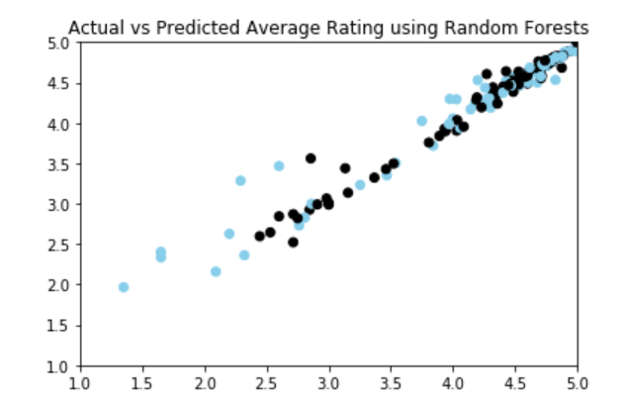
Yes, we can!
LINEAR REGRESSION
RANDOM FORESTS
AVERAGE RATING
ACTUAL | 4.33
PREDICTED | 4.35
MSE | 0.44
AVERAGE RATING
ACTUAL | 4.33
PREDICTED | 4.35
MSE | 0.0232

Slide 5
Can we see any significant change in sentiments before and after presidency?
Parameters used & pre-processing?
Divide data into two periods of before and after presidency using upload_date.
Methods implemented?
Natural Language Processing using nltk
Used Polarity, p_pos, p_neg
Results?
Speeches are throughout extremely positive.
However, measure of negativity in speech has risen slightly.
Overall, sentiments of the speech have remained more or less constant.

Slide 6
Are we able to find any groups in the data using the speeches based on the timeline of campaign/election/presidential phase?
Parameters used & pre-processing?
Feature extracted from subtitles using TF-IDF Vectorizer, use sum of weights parameter for every instance.
Average Rating & View Count
Divide data into five periods for assessing clusters such as :
Time period | Label
01st Feb 2016 to 20th July 2016 | RNC-Campaign
21st July to 8th Nov 2016 | Presidential-Campaign
09th Nov 2016 to 19th Jan 2017 | President-Elected
20th Jan 2017 | Inaugural-Day
21st Jan 2017 to 03rd August | President
Notes:
01st Feb 2016 to 20th July 2016 – Republican National Convention Campaigns (RNC-Campaign)
21st July to 08th Nov 2016 –Republican Presidential Nomination campaign(Presidential Campaign)
09th Nov 2016 to 19th Jan 2017 - President-Elected
20th Jan 2017 – Inaugural-Day
21st Jan 2017 to 03rd August – President

Slide 7
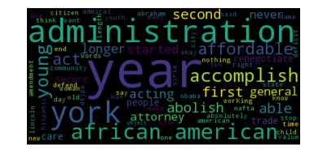
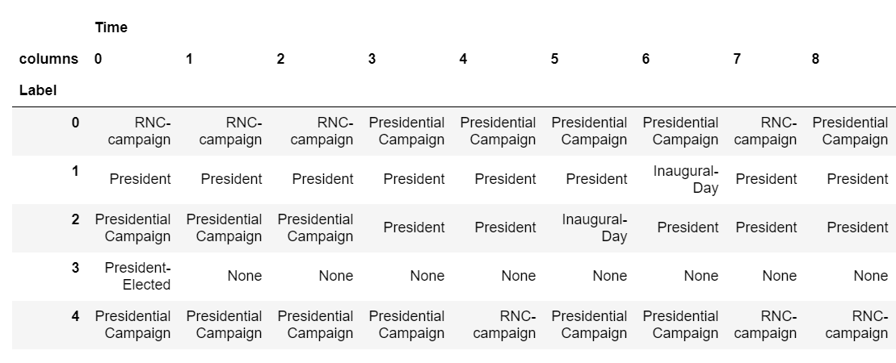
Yes, we can!
Methods implemented?
K-means clustering (k=5)
Results?
Campaign-based speeches are clustered together.
Post-inaugural and Presidential speeches are clustered together.

Slide 8
THANK YOU!

