Slide 1
PROJECT BLOOD PRESSURE PREDICTION USING PPG SIGNALS
Efforts By:-
GROUP-III
Janvi Pangoriya(A1-18)
Kajol Gupta(A1-19)
Nidhi Gupta(A2-30)
Pranav Tomar(A2-33)

Slide 2

Learning Objective
The ultimate idea of the project is to devlop the algorithm which allows us
to predict the Blood Pressure of a patient using the PPG Signals.
→Also identify the symptoms of cardiac arrest caused due to high Blood Pressure
beforehand ,hence saving life of the patients .
→Describe how hypertension can be measured in the body by using the
photoplethysmogram Signals.
→Understand the barriers faced by the patients
in measuring their Blood Pressure and
hence working on the number of samples.

Slide 3
Why we chose this project?
As observed from the data of World Health Organization (WHO)
raised Blood Pressure is estimated to cause 7.5 million deaths, about 12.8% of all the total deaths.
Raised Blood Pressure is a major risk factor for the coronary disease
as well as the hemorrhagic stroke. In some age group,the risk of cardiovascular diseases doubles for each increament of 20/10 mm of Hg of Bloop pressure
Few other complications may lead to visual impairment ,renal impairment ,heart failure, perphiral vascular diseases and a many more fatal causes.
IN ORDER TO AVOID ALL THESE CONSEQUENCES ITS VERY IMPORTANT FOR BLOOD PRESSURE PATIENTS TO HAVE THEIR REGULAR CHECKUP AND HENCE WE ARE HERE WITH ONE SUCH GESTURE.

Slide 4
About the Dataset !
Description of our dataset:
The dataset also includes some information about subjects such as:
Gender , age , height, weight, and body-mass-index(BMI) about the
subject.
The dataset covers :
Individual aged between 21 ad 86 years
Systolic BP levels between 80 and 182 mmHg
Diastolic BP levels between 42 and 107 mmHg
The dataset also covers several different CVDs, including hypertension, cerebral infarction, and insufficient brain blood supply and other related diseases such as diabetes.

Slide 5
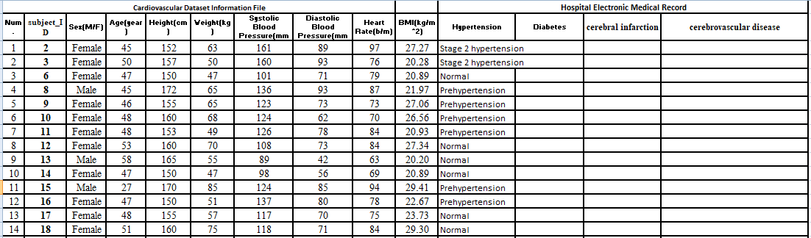
Here is snapshot of the dataset we are going to use as samples for the project. All the information stated here has been studied from PPG Signals.

Slide 6
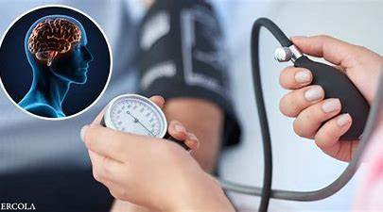
Expected Outcome
At the end of the project ,we will be able to give the analytics
of the data and prove that data derived from PPG Signals give
us enough information to identify the Blood Pressure of the person.
The use of PPG signals as a replacement for cuff-based or
invasive BP measurement is relatively new, and most PPG analysis methods
are still relatively simple.
Whenever possible, use additional physiological cardiovascular measurements
(e.g., ECG etc.) to PPG, in order to increase accuracy.
Motivate the patients to control and manage their Blood Pressure Level.

Slide 7
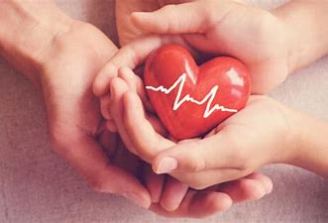
Applications
Hypertension or high blood pressure is a leading cause of death throughout the world
and a critical factor for increasing the risk of serious diseases including heart attack
,stroke and heart failure .So if we could measure the blood pressure beforehand we
could easily prevent uncertain death and chaos.
A successful app “Instant Heart Rate” from Azumio uses the cell phone
camera and the flash light to measure heart rate. Similarly we could use this algorithm
and implement it to analyse the PPG signals and hence report their blood pressures
regularly giving them a gesture of regular treatment.

