Slide 1

“BOOKOPEDIA”
Mini Project-Android Application
Mentor: Mr. Madeep Singh
Efforts By:-
Ashita Goyal
Bharti Gautam
Janvi Pangoriya
Naina Agarwal
Nidhi Gupta

Slide 2
OBJECTIVE
The main objective of this project is to create a Book Finder app named “Bookopedia”.
User can search any book to read by the use of any keyword like the author, name, book name, the name of the subject. After the search there will be list of related books and one can view and read more about the details of the book and can further purchase it.

Slide 3
MOTIVATION
Books have been the greatest source of learning all the while and having them at the reach of our fingertips would be an opportunity hardly any student would afford to miss.
The goal of the app was to provide a way to the learners and users to get all the books they desire to read at a particular location rather than randomly surfing the Internet.

Slide 4
TECHNOLOGY USED
Android is a Linux based operating system designed primarily for touch screens devices such as Smartphone, tablets and computers. Released in late 2008,is now owned by Google. Currently, the Android platform serves 35 billion users, which is more than any other mobile operating system.
Android App Development : It is the process by which applications are created for the devices running the Android OS. Google states that android apps can be written using Kotlin, Java and C++, using the Android SDK.
Android Studio: Android Studio is the official Integrated Development Environment (IDE) for Android app development. It has IntelliJ’s powerful code editor and developer tools, and various other features that enhance productivity while developing Android apps

Slide 5
LANGUAGES USED
Languages used in building an Android Application are classified as per the Front End and Back End. For designing the Front End of an application we have used XML and for designing the Back End we have used Kotlin.
XML is the extensible Markup Language. It is the metalanguage which allow users to define their own customized markup language especially in order to display documents on Internet.
Kotlin is cross platform, general purpose programming language with type inference. It can interoperate fully with Java but type inference allow its syntax to be more concise. Kotlin is the fundamental language of Android since 2017 as declared by Google

Slide 6

HARDWARE AND SOFTWARE REQUIREMENTS
Hardware Requirement
Processor :Intel i5
Operating System :Any Operating System
RAM : 8 GB (or higher)
Hard disk : 256GB
Software Requirement
Software used: Android Studio
Language used : Kotlin, XML
Database: Firebase
User Interface Design : Android Application

Slide 7
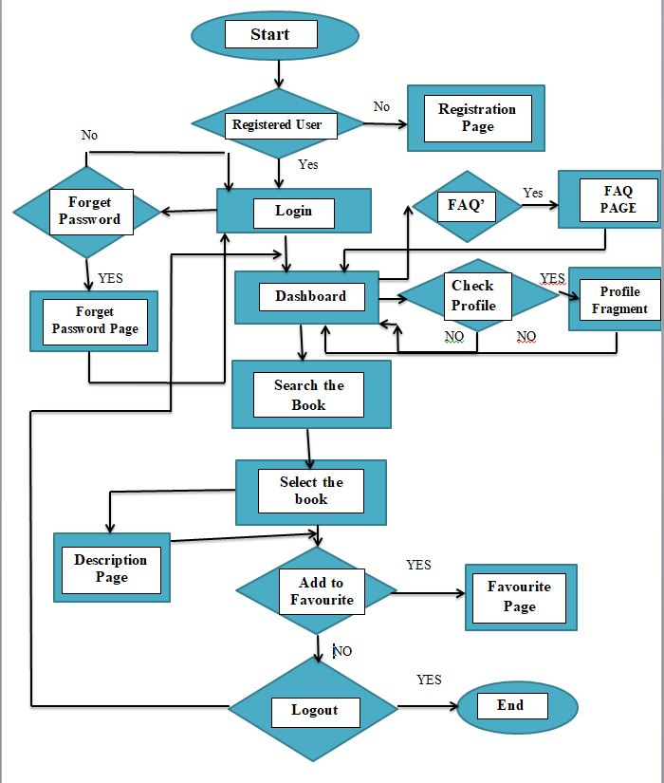
Flow Chart for User

Slide 8
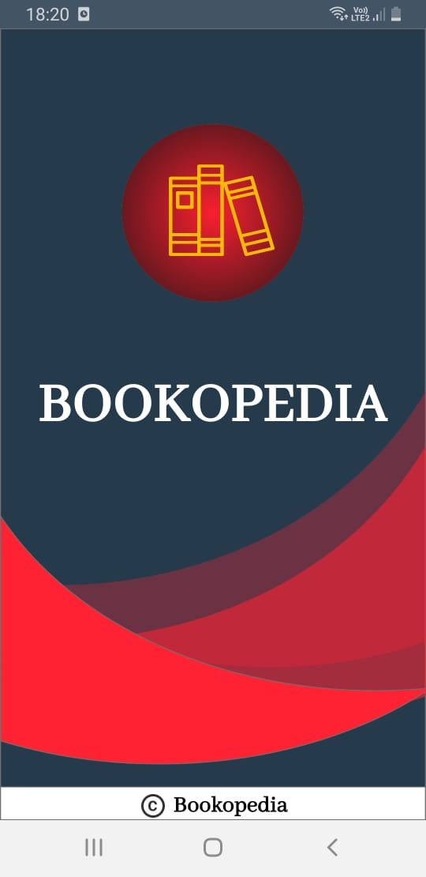
USER INTERFACE
Splash Screen: The first screen with which the user interacts will be this screen containing the logo and the app name .This will disappear within 5 seconds after the app is displayed.

Slide 9
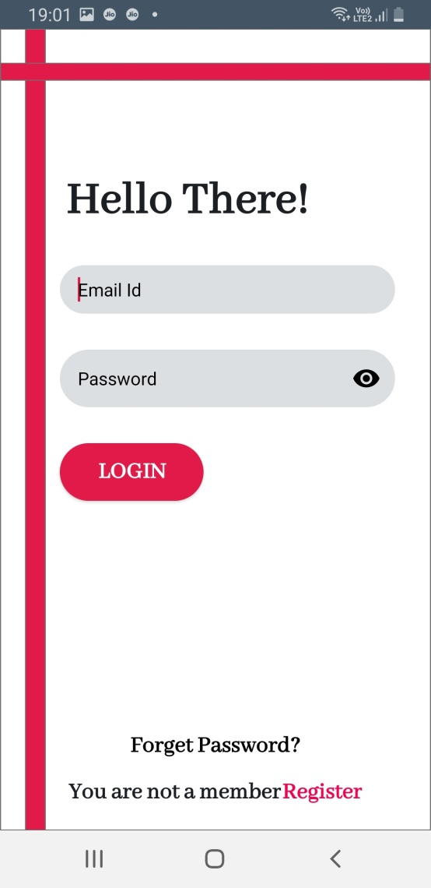
Login Page: This page is for those users who have already registered themselves on the app and have a username and a password.

Slide 10
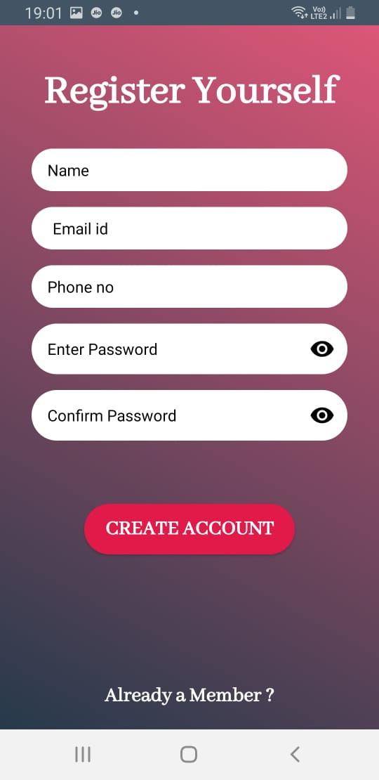
Registration Page: This is page is solely designed for the new users of the app who are willing to register themselves. This page takes input of the various details of the user and stores it in the database, later helping the user to login into the account with credentials they have provided.

Slide 11
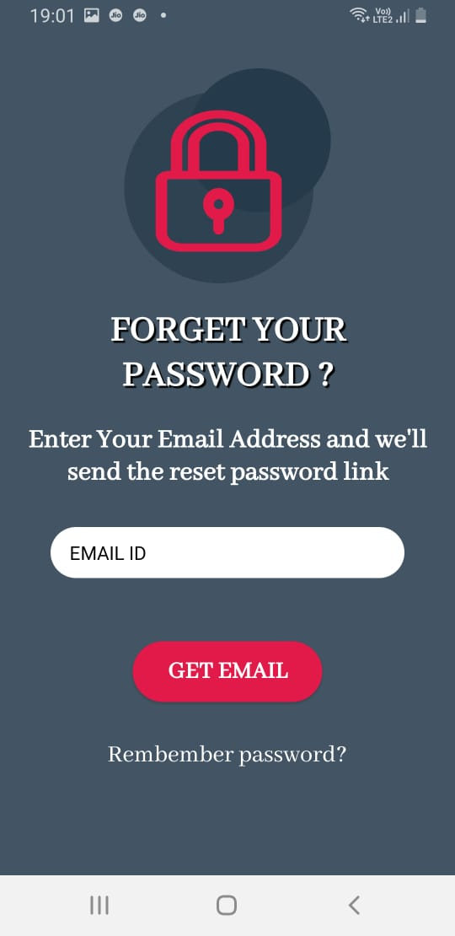
Forget Password Page: This page comes into picture when one of the user forgets the login credentials. In this case this page asks for the email-id with which the user has already registered. The app will check if there is any entry in its database with the id and if there a mail will be sent to the same id for recovering the credentials and notification will be given to the user

Slide 12
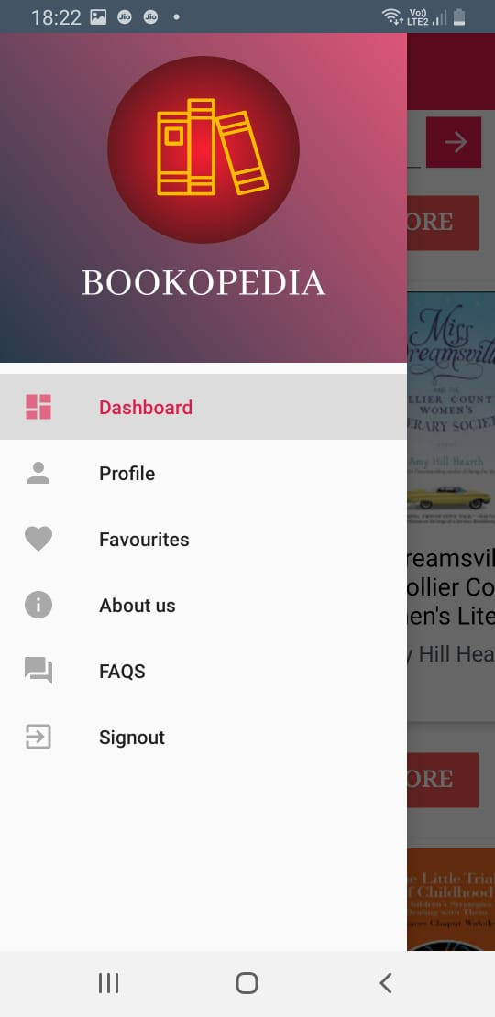
Navigation Drawer: This is the most important part of the application that provides interactivity within the app as it connects the various activities together like it is a side bar on which the profile, the dashboard, the favourites section, the FAQ section ,the About page of the page are linked and on clicking on each you can visit the pages.

Slide 13
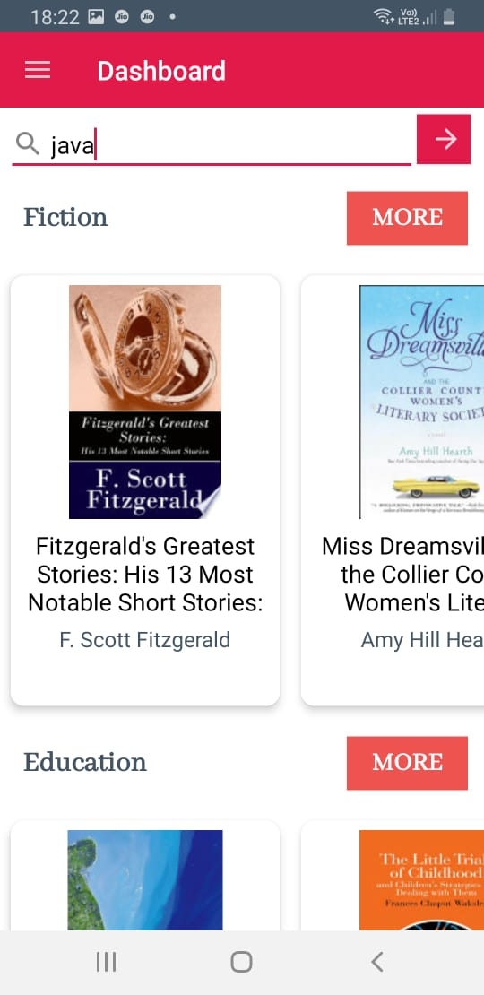
Dashboard Page: This is the page displayed for every user after entering the app successfully. It contains the search bar where the user can search the book according to the wish as well as some of the books are suggested with the most popular genres.

Slide 14
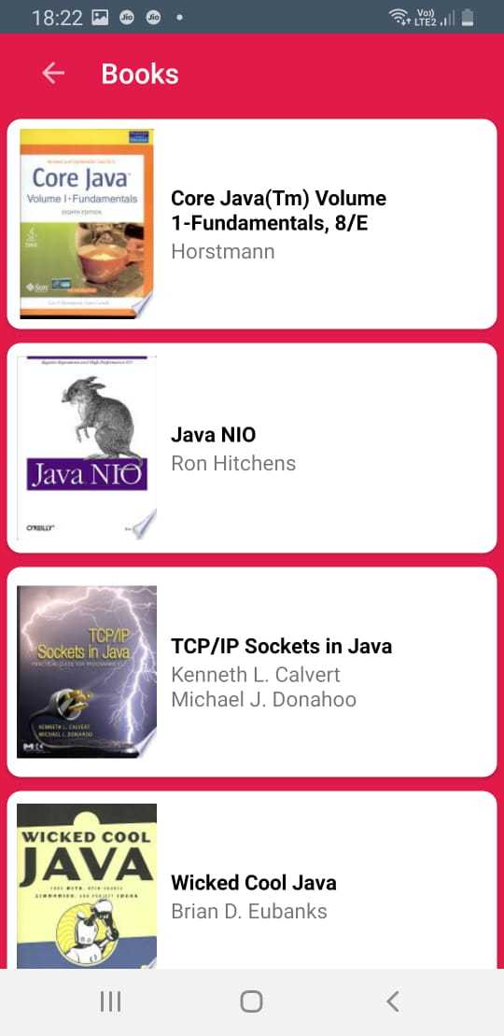
Book List Page: This is the page displayed when user search book, it display all the possible book which are related to the query enter by the user

Slide 15
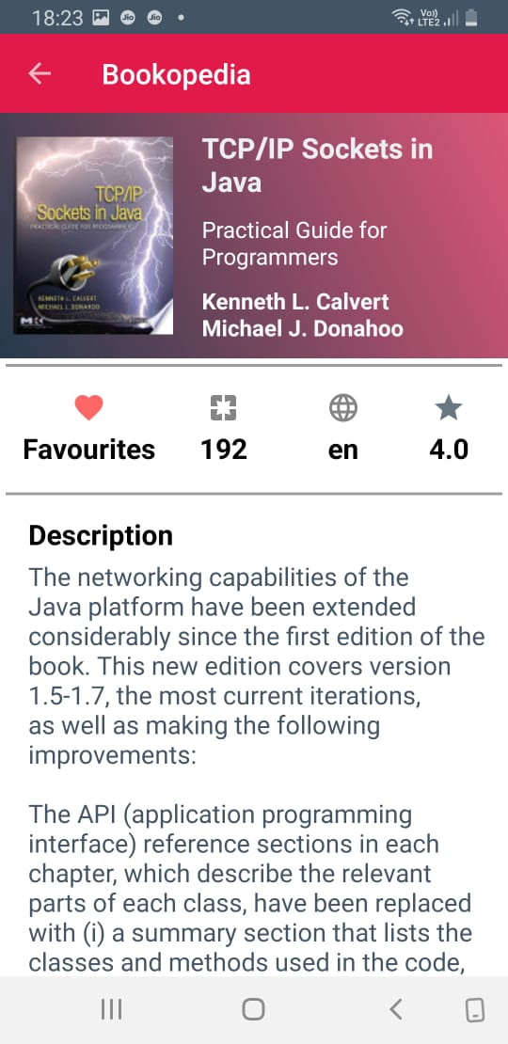
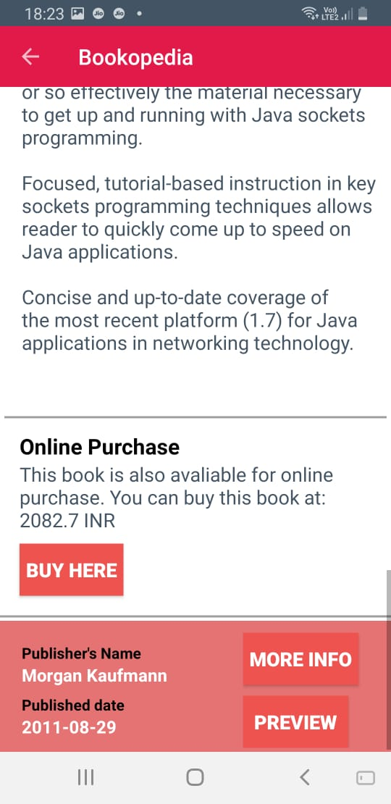
Book Description Page: After searching the book there are a number of books that appear, when the user select one of the book the page will be displayed that will contain all the details of that book i.e. the book poster author name, price and a short summary of the book and the link to buy the e-book

Slide 16
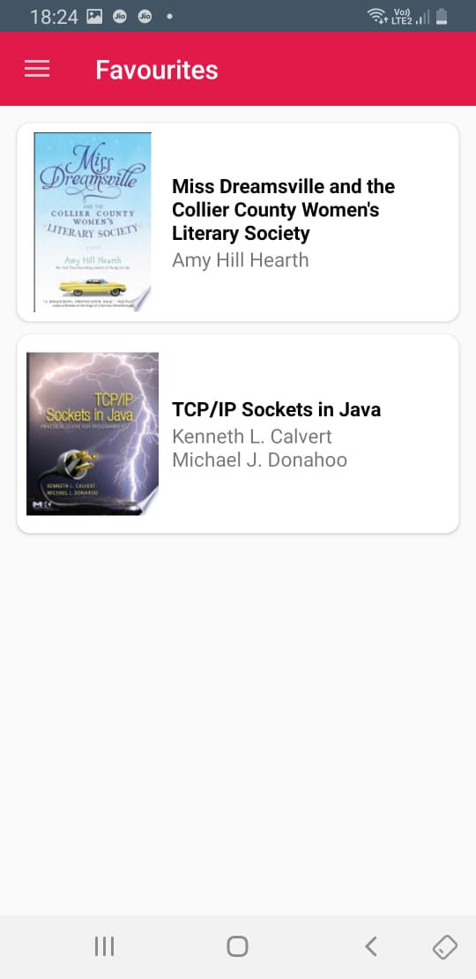
Favourites Page: Initially the page is empty, but when the users search for a book and like it then one can add it to the favourites section. This place is a user’s personal space to store any book he likes or want to mark.

Slide 17
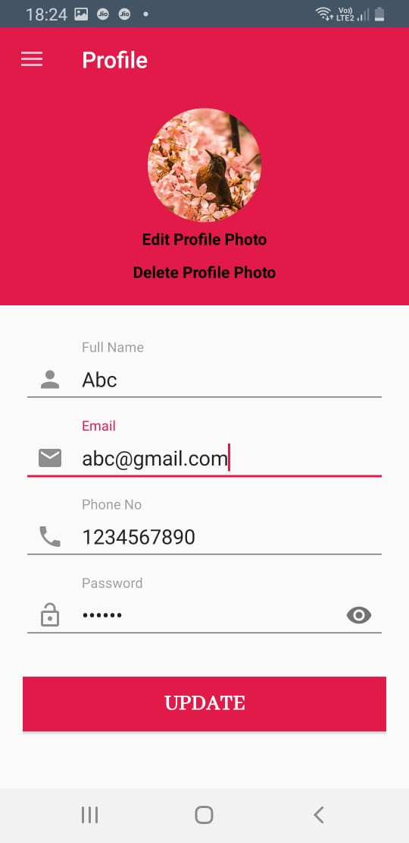
Profile: This page will contain all the user details that the user entered while creating the account on the app. The user can update and make changes to all this information as desired.

Slide 18
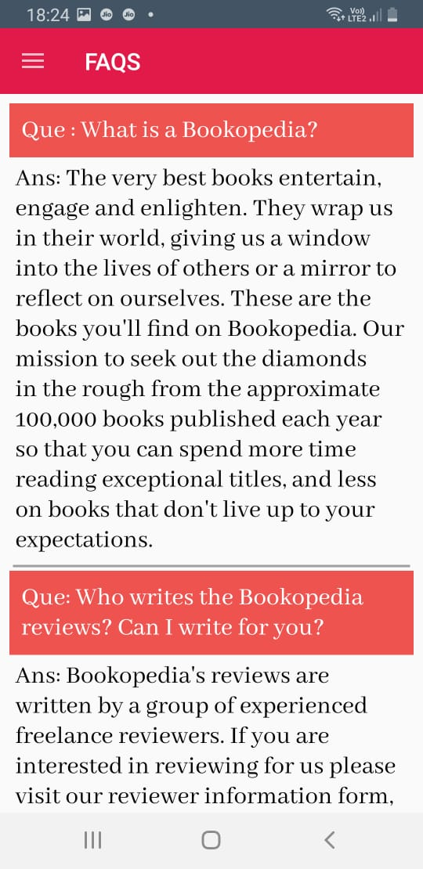
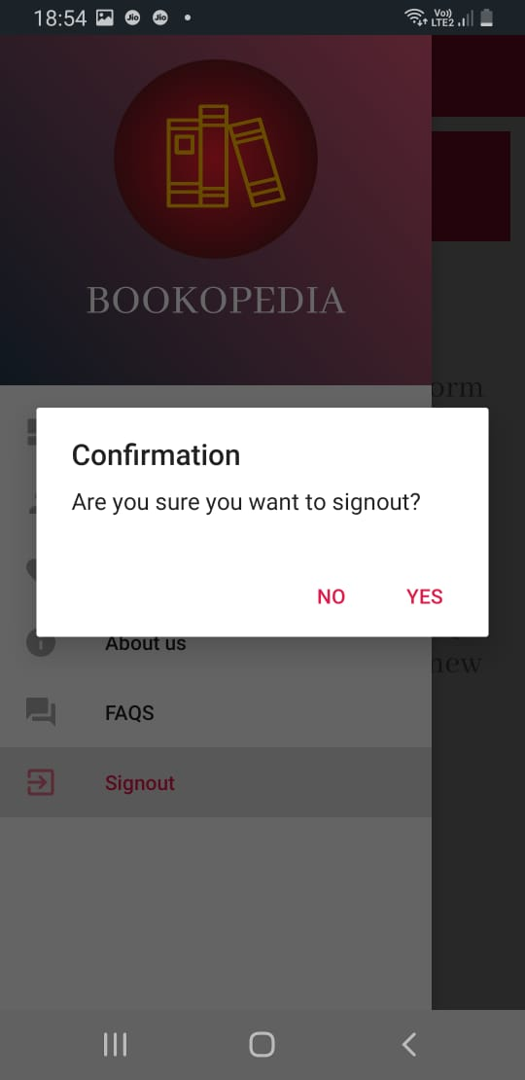
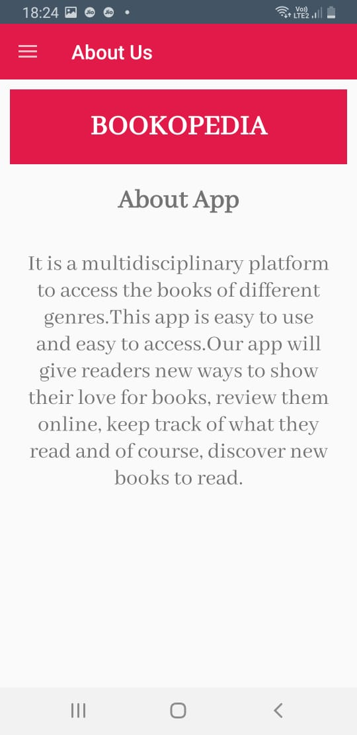
FAQ PAGE
SIGNOUT
ABOUT US PAGE

Slide 19

PROJECT
The source code of our project including all the project work, documentations and presentations is available at the following link:
https://github.com/JanviPangoriya/Book_finder_app_mini_project

Slide 20
REFERENCES
https://developer.android.com/guide/index.html
https://stackoverflow.com/
https://trainings.internshala.com/
https://www.journaldev.com/9319/android-studio-project-structure-compiler-proguard

Slide 21


