Slide 1
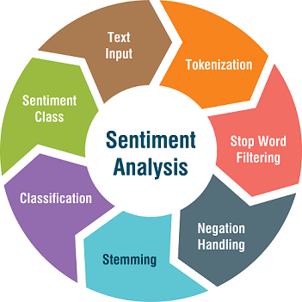

SOCIAL MEDIA: SENTIMENTAL ANALYSIS
Session 20-21
Machine Learning Project
PRESENTED BY:-
Janvi Pangoriya(A1-18)
Kajol Gupta(A1-19)
Nidhi Gupta(A2-30)
Pranav Tomar(A2-32)

Slide 2
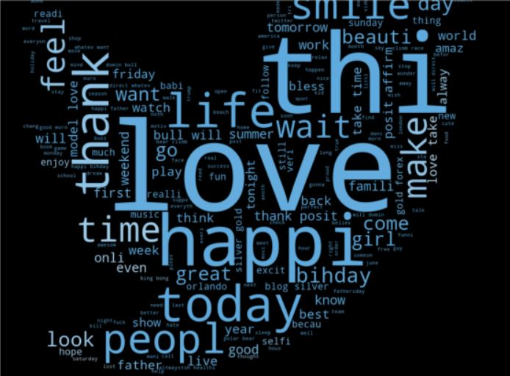
LEARNING OBJECTIVE :
The aim of this project is to develop a machine learning model which allow us to detect the sentiments expressed through the tweets and classify them as racist and non-racist.
This model hence can be used to distinguish between the positive tweets and negative tweets and prevent the chaos beforehand.

Slide 3
IMPORTANCE AND NEED OF THE PROJECT
In Today's world , Social media is the great source to gather the information about different fields. Social media has opened a new world for the people around the globe. People are just a click away from getting huge chunk of information.
Sometimes this leads to bullying and passing hate comments on someone and something which may further lead to sense of outrage among the people and may cause chaos. So, there is a need to recognize those tweets beforehand and delete it from the server side of social media

Slide 4
STEPS OF THE PROJECT
Understanding the Problem Statement.
Finding, understanding and loading the dataset.
Data Cleaning-Removing punctuations, Stops words Tokenization and Stemming.
Data Visualization-Word Cloud, Pie Chart and Bar Chart.
Feature Extraction-Count Vectorizer and Tf-idf Vector.
Building Model.
Deployment

Slide 5
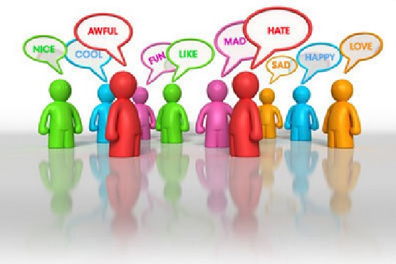
PROBLEM STATEMENT
With the advances in technology about sentiment analysis and predictive analytics, it has opened many avenues for researchers and enterprises to understand human mental state better. The proposed challenge is to know the emotion/mood of a person, to help in eliminating any negative state of mind that might have adverse effect on his/her daily life.
By analyzing the opinion of the people it differentiate that it is either positive tweets or negative tweets.

Slide 6
Dataset
The dataset is taken from Kaggle’s Dataset : Twitter Sentiment Analysis Dataset
The dataset that we have chosen consists of training samples of tweets and labels where the label
'1' denotes the tweet is racist/sexist and the label '0' denotes the tweet is not racist/sexist, our objective
is to predict the labels on the given dataset.
There are three columns:-
id:- The id is associated with the tweets in the given dataset.
tweets:- The tweets collected from various sources either positive or negative
sentiment associated with it.
3. label:- A tweet with the label '0' is positive sentiment and of the label '0' is negative sentiment.

Slide 7
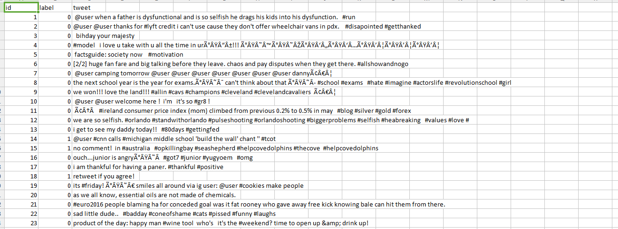
Dataset Overview:
Above is the snapshot of the dataset, opened in Excel.

Slide 8
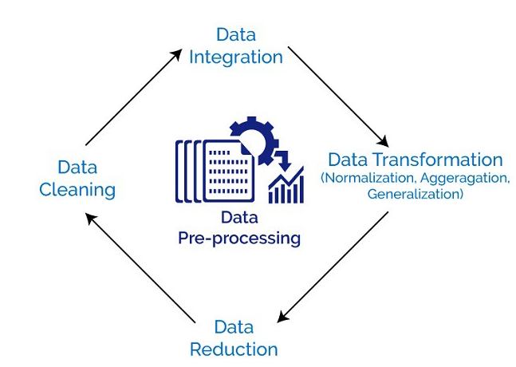
Data Pre-Processing
Data preprocessing is done by following steps :
Cleaning the data
Removing handles
Removing punctuation’s, numbers and symbols
Tokenizing the words
Stemming the words

Slide 9
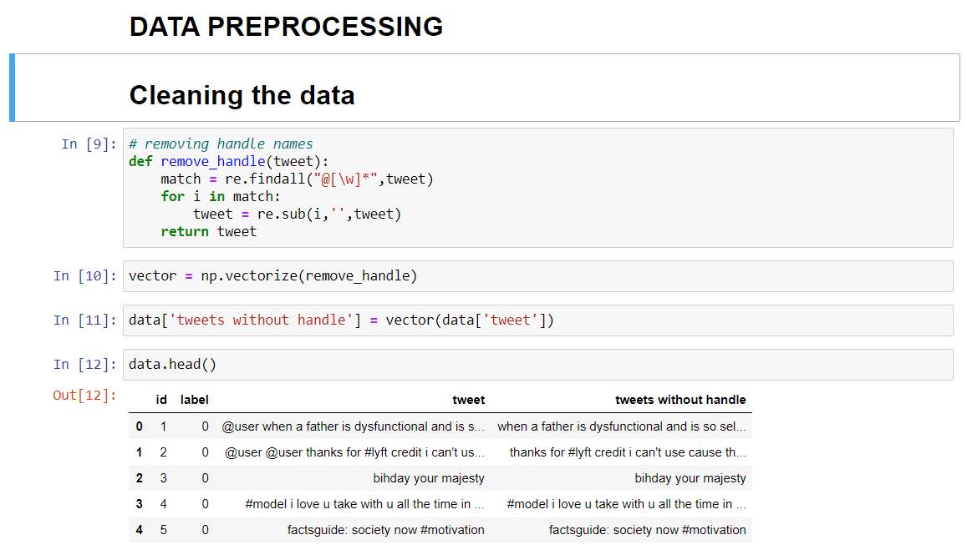
Removing handles :
We use regular expression to clean data and remove user handles.

Slide 10
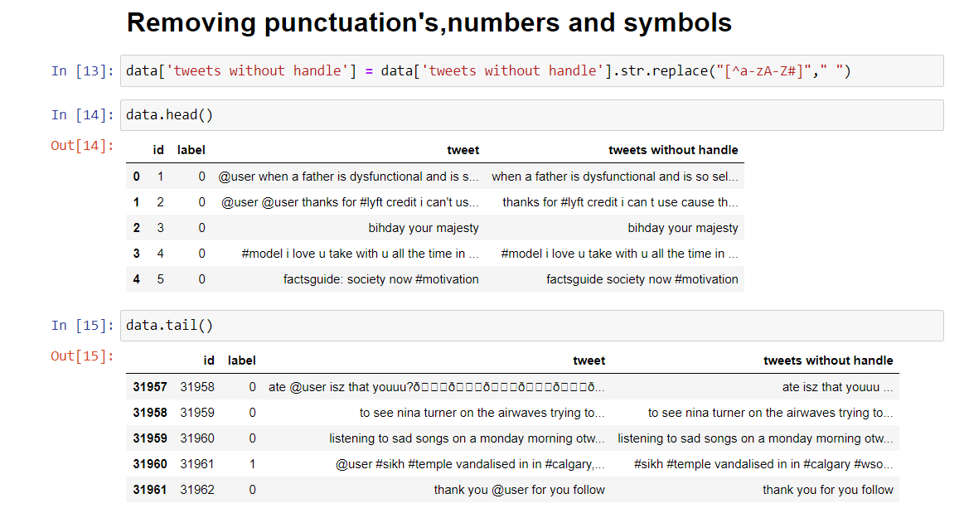
Removing punctuation’s, numbers and symbols
Punctuation’s, numbers and symbols are removed using regular expressions by simple replace method

Slide 11
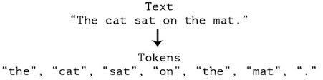
Tokenization :
Tokenization is a way of separating a piece of text into smaller units called tokens.
Tokens can be either words, characters, or sub words.

Slide 12
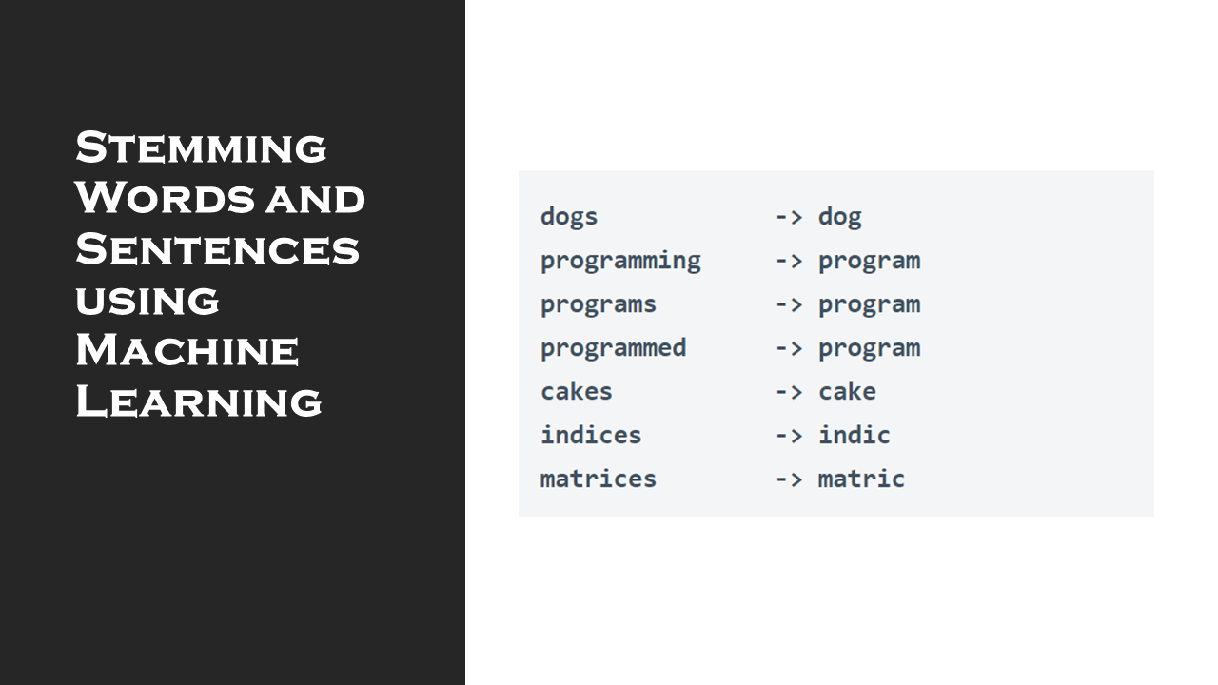
Stemming
Stemming is a process where words are reduced to a root by removing
inflection through dropping unnecessary characters.
Removal of suffix
2 Types of stemming :
1. Porter
2. Snowball

Slide 13
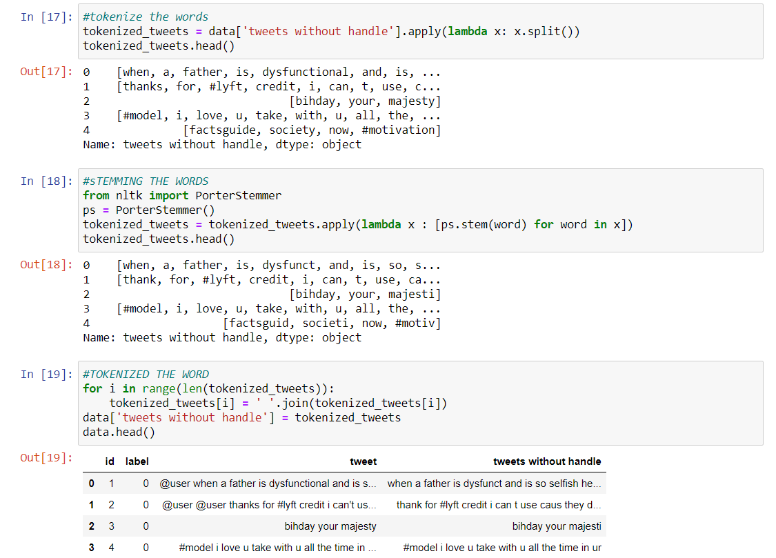
Tokenizing and Stemming the words:

Slide 14
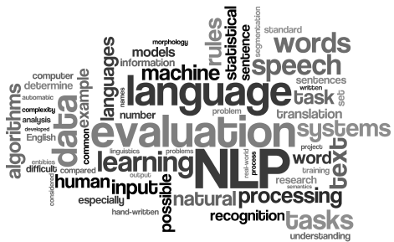
DATA VISUALIZATION
Visualization has been done using :
Word Cloud
Bar plot
Pie Chart

Slide 15
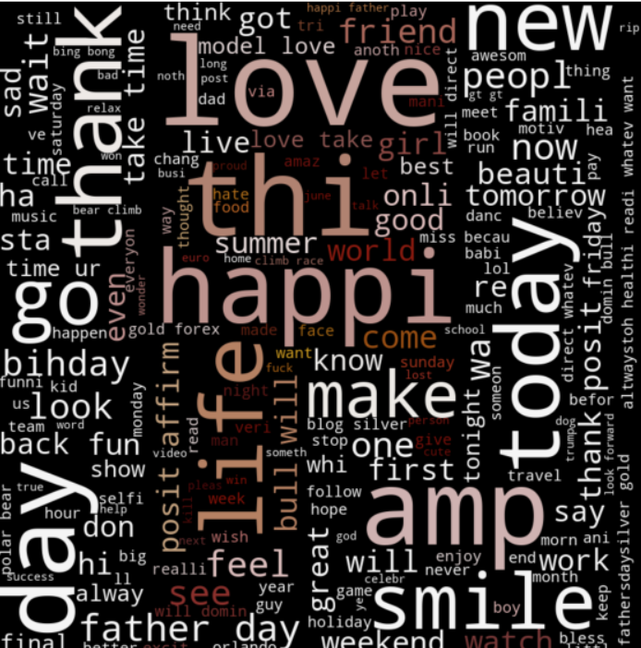
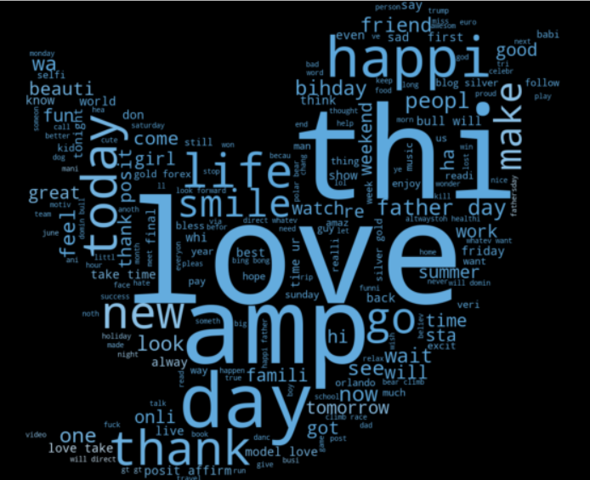
Word Clouds for Positive Tweets

Slide 16
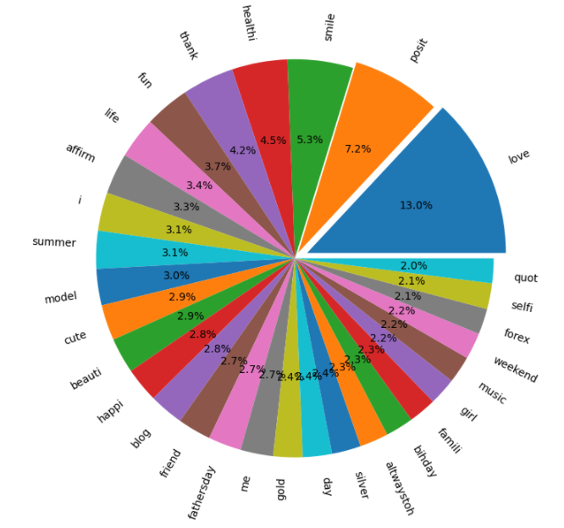
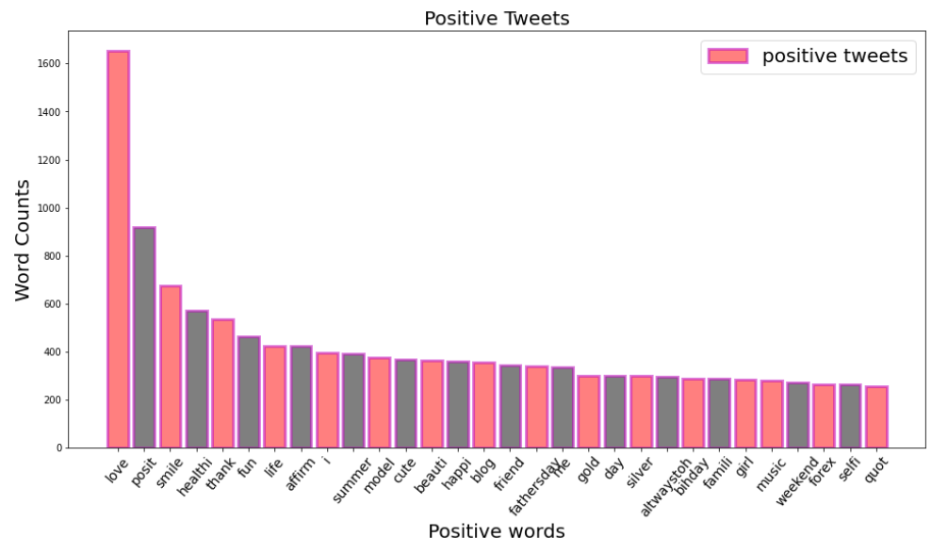
Bar plot and Pie chart for positive tweets

Slide 17
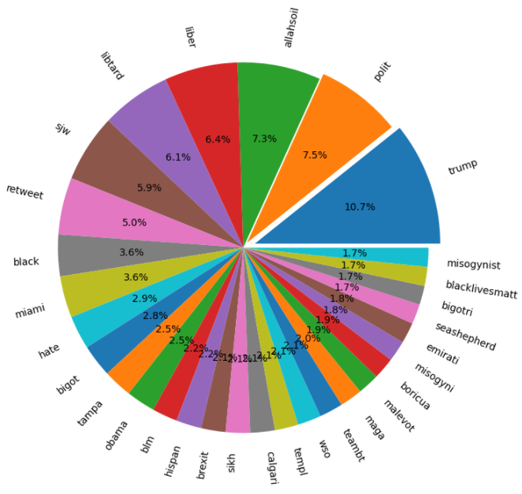
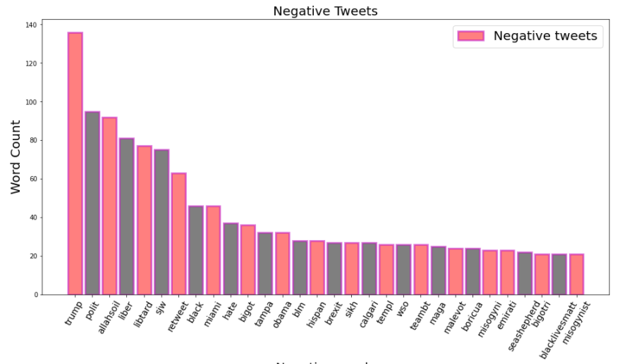
Bar plot and Pie Chart for Negative Words

Slide 18
Feature Extraction
Feature Extraction is done using below 2 methods :
1. TF – IDF Vectorizer
Convert a collection of raw documents to a matrix of TF-IDF features.
2. Count Vectorizer:
Convert a collection of text documents to a matrix of token counts

Slide 19
TF - IDF
TF(t) = (Number of times term t appears in a document)
(Total number of terms in the document)
IDF(t) = log(Total number of documents / Number of documents with term t in it)

Slide 20
Example :
Consider a document containing 100 words wherein the word apple appears 5 times.
The term frequency (i.e., TF) for apple is
(5 / 100) = 0.05.
Now, assume we have 10 million documents and the word apple appears in one thousand of these. Then,
the inverse document frequency (i.e., IDF) is
log(10,000,000 / 1,000) = 4.
Thus, the TF-IDF weight is the product of these quantities:
0.05 * 4 = 0.20.

Slide 21
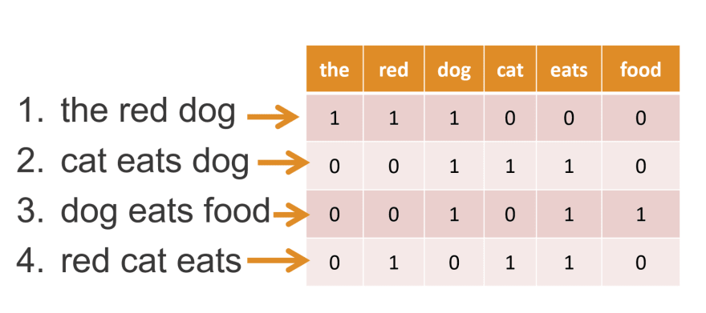
Count Vectorizer

Slide 22
Building Model
In this phase ,All the algorithms are applied which are suitable for the project which gives best accuracy to analyze the tweets that are either negative tweets and negative tweets.
Many algorithms are applied that named are:-
i.) Multinomial Naive Bayes
ii.) Logistic Regression
iii.) K nearest neighbors
iv.) Passive Aggressive Classifier
v.) Decision Tree Classifier

Slide 23
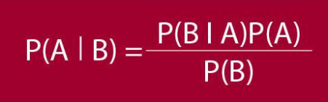
Multinomial Naïve Bayes
Classify data on the basis of probability
Based on Bayes Theorem
also known as Maximum a Posterior Naïve Bayes
Calculate the probability of each tag of the given text and then predicts the class with higher probability

Slide 24
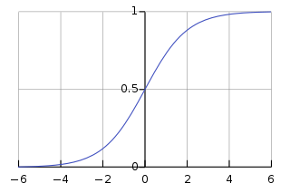
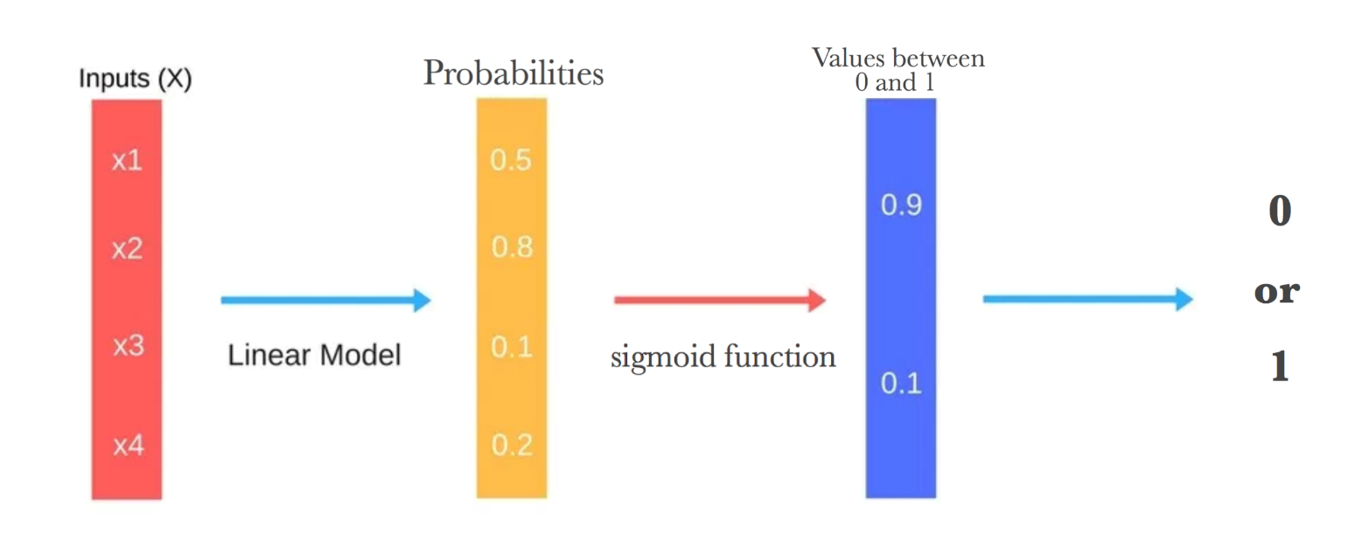
Logistic Regression
extends the ideas of linear regression to the situation where
the dependent variable, Y, is categorical.
Logistic Function or logistic curve

Slide 25
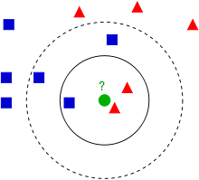
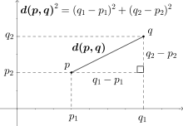
K Nearest Neighbors
Based on Euclidian Distance
K neighbors are kept 2 or more
Classify using minimum Euclidian Distance
Euclidian distance using Pythagoras Theorem
Euclidian Distance in multi-dimensional space

Slide 26
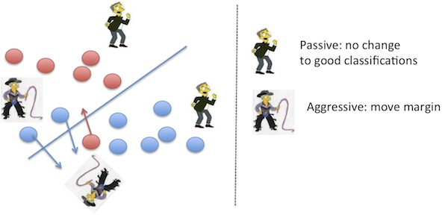
Passive Aggressive Classifier
The family of algorithm used for large scale learning
The data is inputted in a sequential iterative way and the model is trained step by step
Useful in conditions where we have a large scale of data.

Slide 27

Decision Tree Classifier
Decision Tree is a Supervised Learning Algorithm
It can be used for both classification and regression
also known as Maximum a Posterior Naïve Bayes
Characteristics of Decision Tree:
Internal nodes are features
Branches are decision rules
Leaf node represents the outcome

Slide 28
Accuracy From the various algorithms used
Name of Algorithm | Accuracy using CountVectorizer | Accuracy using tf-idf Vectorizer
Multinomial Naïve Bayes | 94.9475 | 94.8381
Logistic Regression | 96.0112 | 95.3230
K Nearest Neighbors | 94.4783 | 94.5252
Passive Aggressive Classifier | 94.4783 | 95.6827
Decision Tree Classifier | 94.3375 | 94.9475

Slide 29
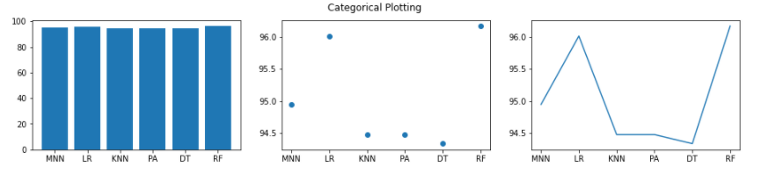
Comparison of accuracy of algorithms used

Slide 30
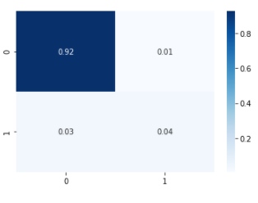
Experimental Analysis and Results
After applying various methods and algorithms, we have seen that Logistic Regression Classifier
renders the best result for our purpose. The accuracy of Logistic Regression with countVectorizer
is 96.0112%.
The performance of Logistic regression is very high and can be used for our purpose.
Confusion Matrix for
Logistic Regression Algorithm :

Slide 31
About project:
The entire project, dataset, and all the resources and work is store at GitHub repository
as the project was built and shared using GitHub.
The Main notebook is also stored at GitHub repository.
The deployment of project is done using Heroku app, also stored at GitHub.
GitHub Repository Link : https://github.com/JanviPangoriya/social_media_sentiments-analaysis
Deployed webapp link: https://sentiments-analaysis.herokuapp.com/

Slide 32
APPLICATIONS
In the present scenario, a lot of people are dependent on social media for their source of information ,so we can apply this algorithm on all the social media platforms from the server side so that if any of the negative post is being encountered ,it is immediately deleted before the conflicts among individuals arise.
Many a time in past ,instances have been recorded where a lot of time misunderstandings have been created among the people or citizens of a country due to the outrage of few people and their negative comments .So this can be recorded and social made platforms may not be the source of chaos.

Slide 33
References:
https://github.com/
https://en.wikipedia.org/
https://www.kaggle.com/
https://towardsdatascience.com/

Slide 34
THANK YOU

