Slide 1
PROJECT SOCIAL MEDIA : SENTIMENTAL ANALYSIS
Efforts By:-
GROUP-III
Janvi Pangoriya (A1-18)
Kajol Gupta (A1-19)
Nidhi Gupta (A2-30)
Pranav Tomar (A2-33)

Slide 2
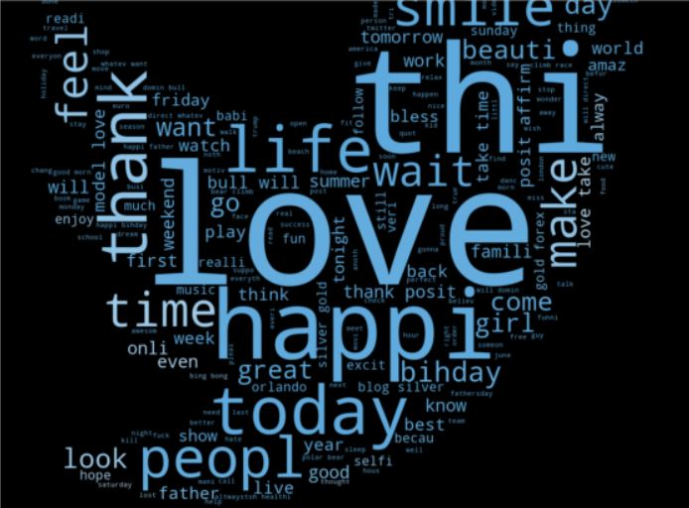
Learning Objective
The aim of this project is to develop a machine learning algorithm which allow us analyse the sentiments expressed through the tweets and classify them as racist and non racist.
This algorithm hence can be used to distinguish between the positive tweets and the negative tweets and prevent the chaos beforehand.

Slide 3
Why we chose this project?
Social media has opened a whole new world for the people around the globe. People are just a click away from the whole bunch of information. People from all age groups use social media for their source of information in different fields.
With information comes people’s opinion and with this their comes positive and negative outlook .
Sometimes this leads to bullying and passing hate comments on someone and something which may further lead to sense of outrage among the people and may cause chaos ,so with this we could recognise those tweets beforehand and delete it from the server side of social media.

Slide 4
About the Dataset !
The dataset that we have chosen consists of training samples of tweets and labels where the label ‘1’ denotes the tweet is racist/sexist and the label ‘0’ denotes the tweet is not sexist/racist , our objective is to predict the labels on the given dataset.
There are three columns:-
→ id: The id is associated with the tweets in the given dataset
.
→ tweets: The tweets collected from various sources having either positive or negative sentiment associated with it .
→ label :
A tweet with the label ‘0’ is of the positive sentiment and of the label ‘0’ is of negative sentiment.

Slide 5
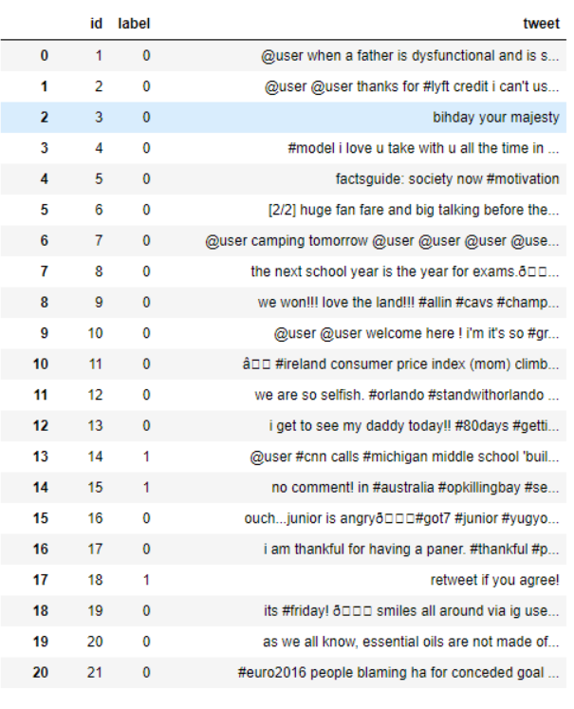
al
Here is the snapshot of the dataset we are going to use for training our model .

Slide 6
Expected Outcome
We will be starting our project by the data cleaning procedure where we will be removing the twitter handles as they do not contribute anything significant and then we will be removing punctuations ,numbers and special characters that do not help much. And at last removing the stop words .
Then we’ll be applying a number of machine learning algorithm that can be used in text-processing and check the accuracy of the model .
By the end we will be able to classify the tweets into the two separate classes racist or non racist and the model will work efficiently on testing set as well .

Slide 7

Applications
Applications
→ In the present scenario, a lot of people are dependent on social media
for their source of information ,so we can apply this algorithm on all
the social media platforms from the server side so that if any of the negative
post is being encountered ,it is immediately deleted before the conflicts among
individuals arise.
Many a time in past ,instances have been recorded where a lot of time
misunderstandings have been created among the people or citizens of a country
due to the outrage of few people and their negative comments .
So this can be recorded and social made platforms may not be the source of any
chaos.

