Slide 1
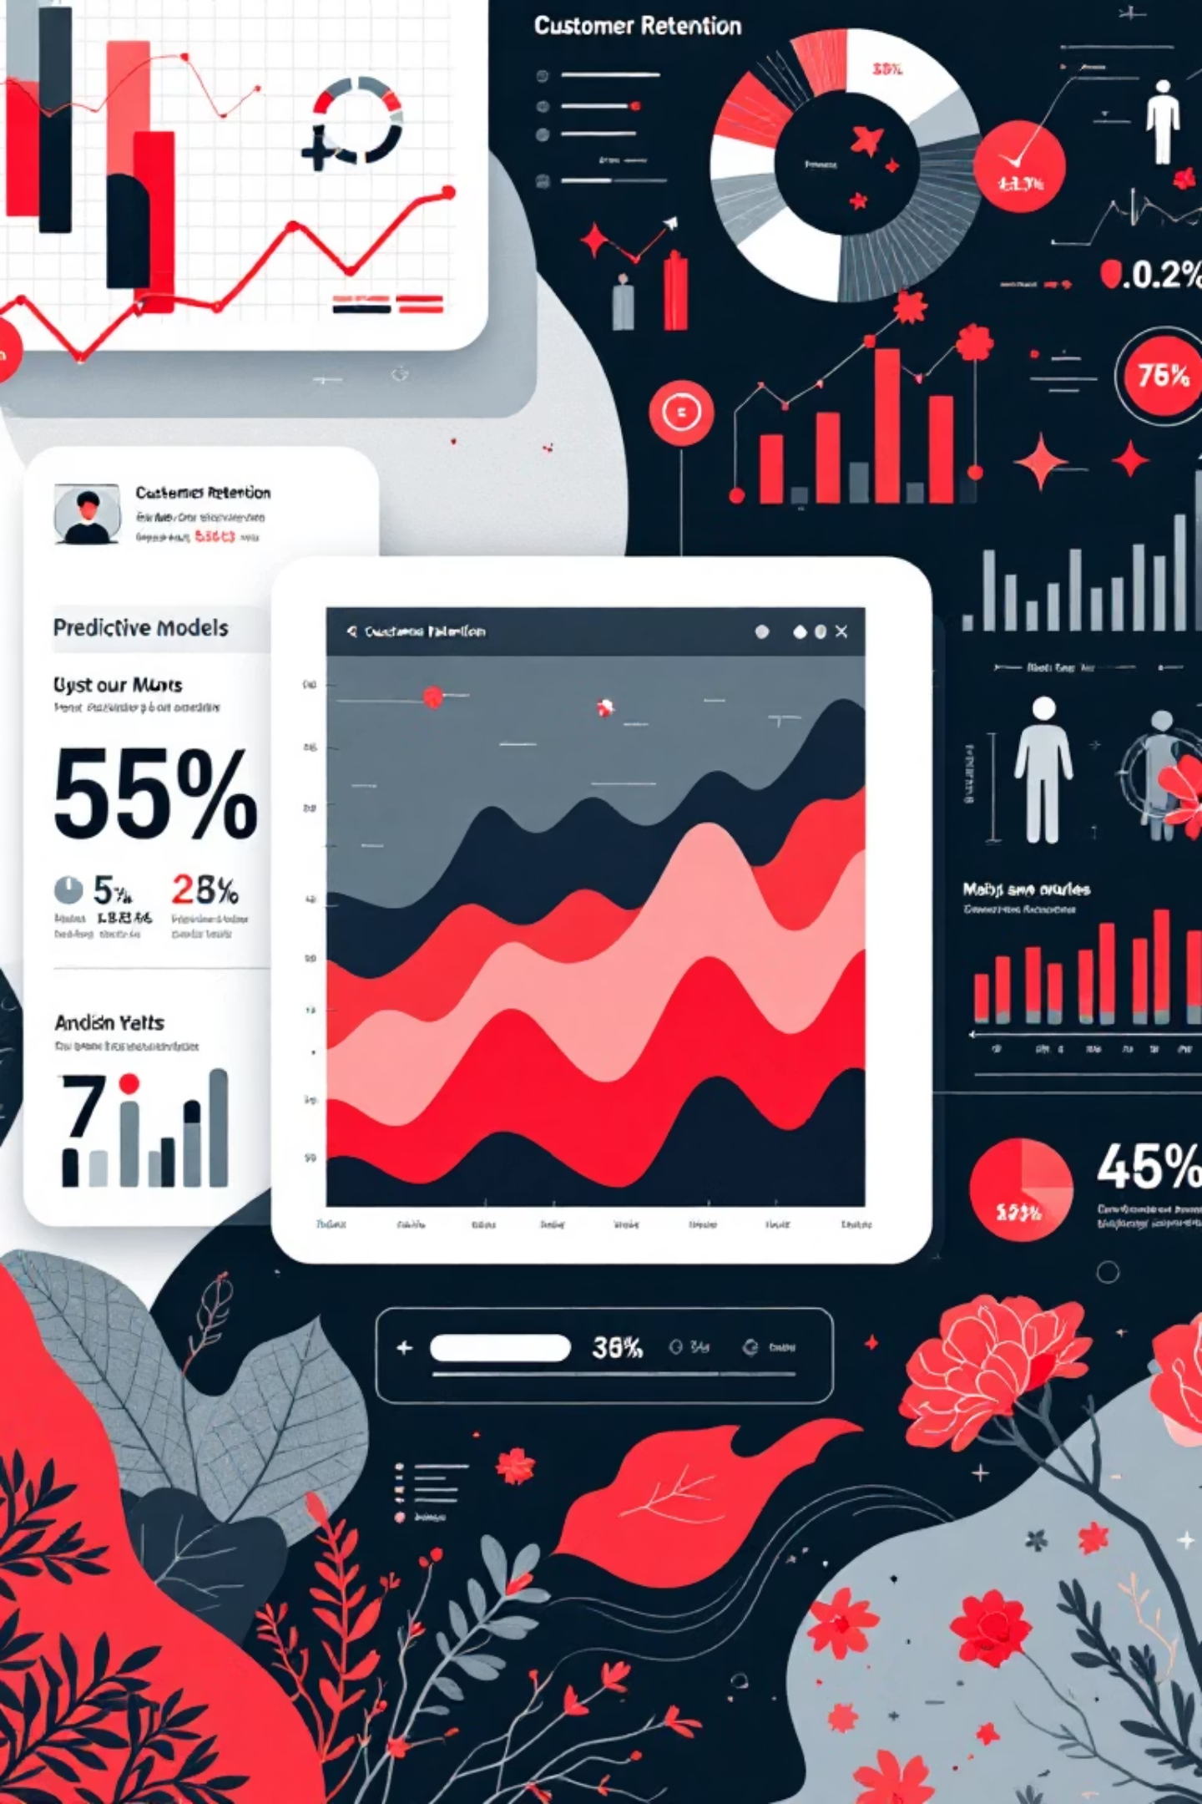
Customer Churn Analysis and Prevention
This presentation analyzes customer churn in the telecom industry. We'll explore key factors and suggest data-driven retention strategies.

Slide 2





Agenda
Dataset Overview
Data Preprocessing
Churn Rate Analysis
Root Cause Investigation
Retention Strategies

Slide 3
Dataset Overview: Initial Glimpse
This analysis uses a comprehensive dataset of 7,043+ customer entries with 21 attributes. Key features include:
Demographics: Gender, Senior Citizen status, Partner, Dependents.
Service Information: Phone, Internet, Multiple Lines, Online Security, Tech Support, Streaming TV & Movies.
Contract & Billing: Contract type, Paperless Billing, Payment Method, Monthly & Total Charges.
Target Variable: Churn (indicating if a customer left the company).

Slide 4
Data Preprocessing: Ensuring Data Quality
We performed two key data cleaning steps to ensure accurate analysis:
Handling Missing Values: 'TotalCharges' blanks were replaced with '0' and converted to numerical for accurate spending calculations.
Improving Readability: The 'SeniorCitizen' column (0 or 1) was converted to 'Yes' or 'No' for clearer demographic understanding.

Slide 5
Customer Churn Rate Overview
Our comprehensive analysis of the 7,043 customer dataset reveals a significant churn rate of 26.5%. This translates to approximately 1,860 customers who have discontinued their services, posing a substantial challenge to revenue stability and growth for our telecommunications company. This alarming figure underscores the urgent need to identify the precise factors driving customer attrition and develop highly targeted, data-driven retention strategies to mitigate further losses.
26.5%
1,860
Customer Churn Rate
Customers Lost

Slide 6
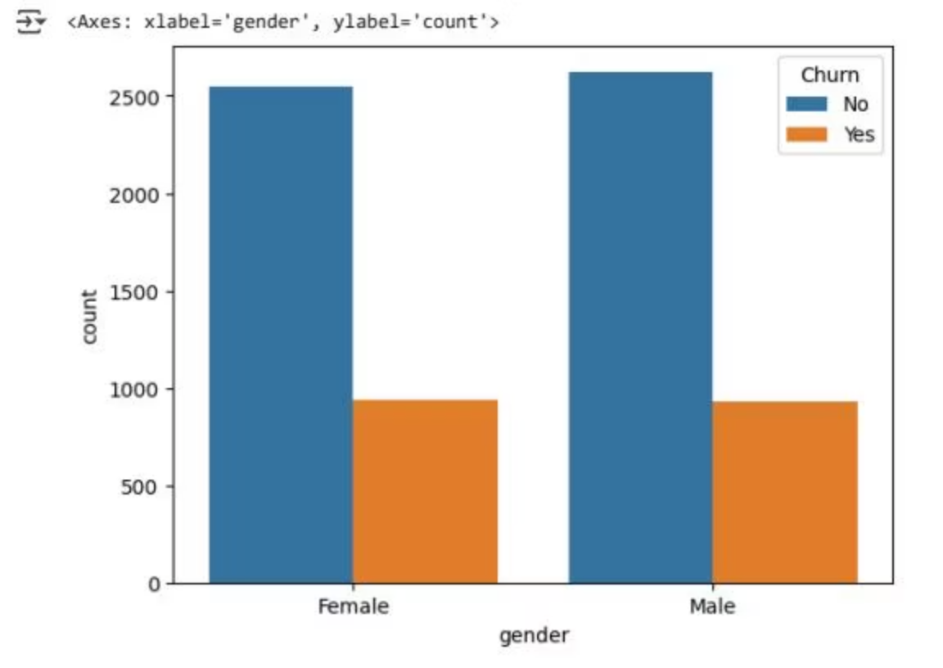
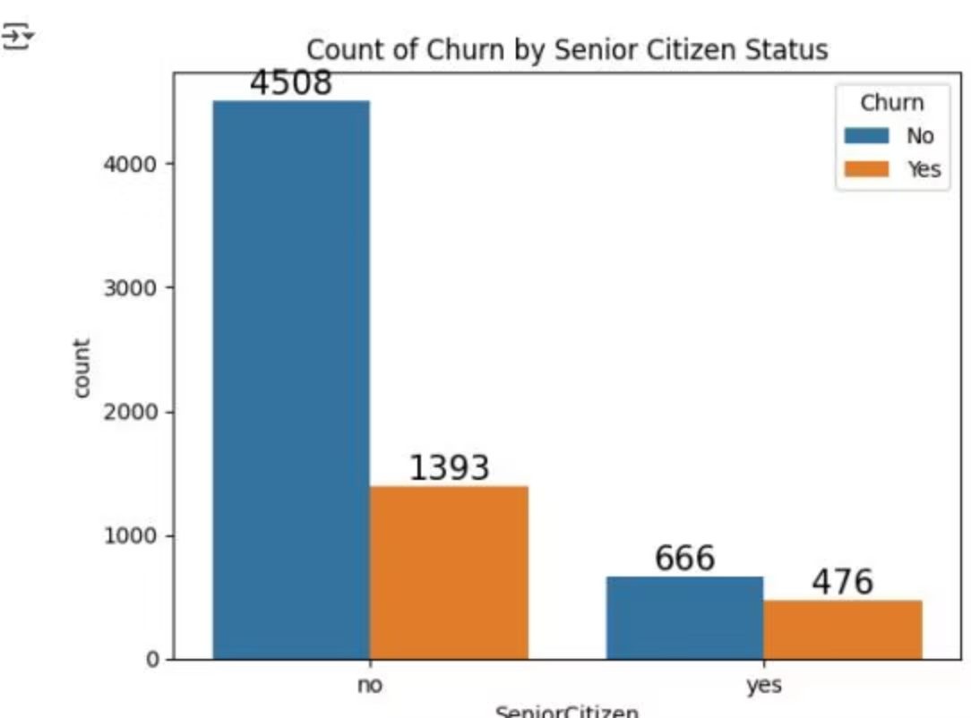
Demographic Factors in Churn
Gender: Gender does not significantly influence churn rates, showing no primary pattern.
Senior Citizens: Senior citizens show higher churn, possibly due to unmet specific needs or challenges.

Slide 7
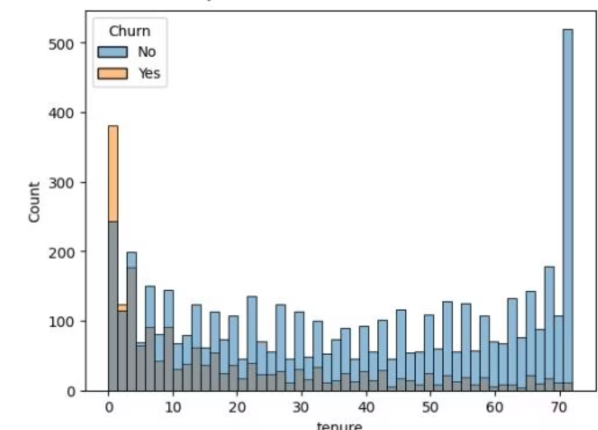
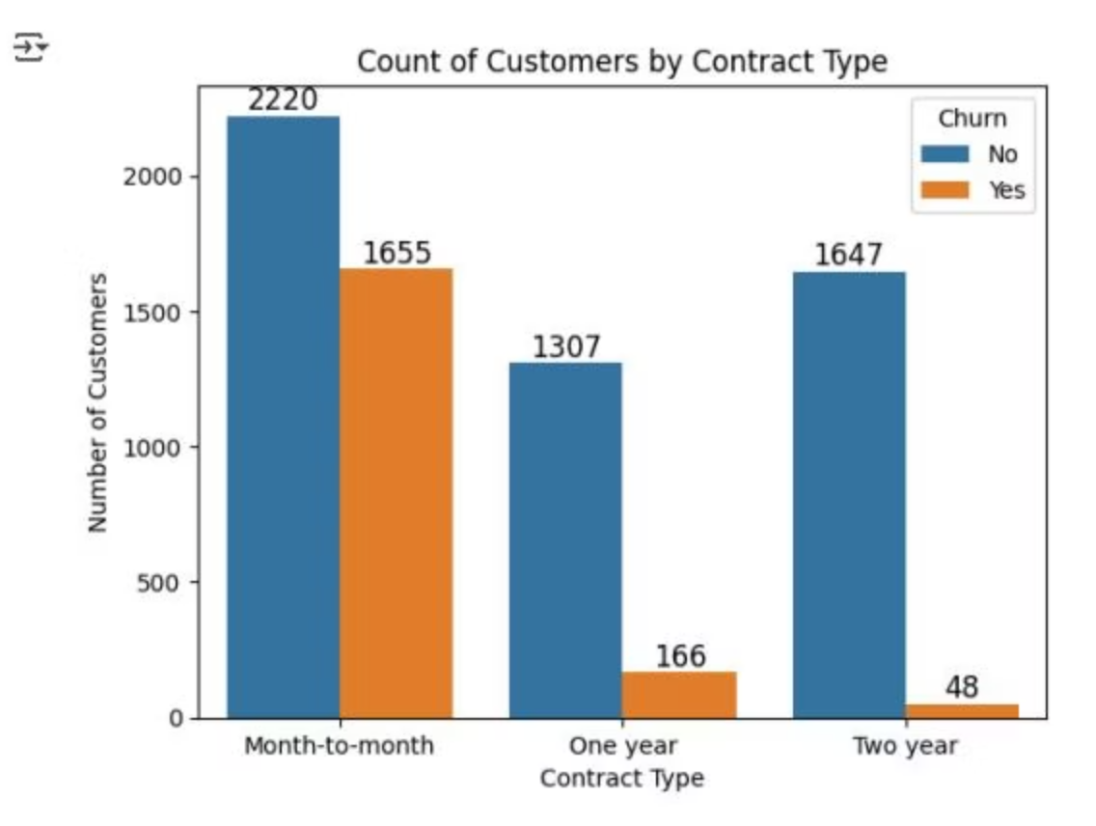
Tenure and Contract Type Impact on Churn
Tenure: Shorter-term customers (1-2 months) have a significantly higher churn rate, while long-term customers remain more loyal.
Contract Type: Month-to-month contracts show higher churn probability compared to one-year and two-year contracts.

Slide 8
Service-Specific Churn Analysis
Our analysis reveals distinct churn patterns tied to specific customer services:
1
Absence of Supplementary Services
2
Internet Service Type
3
Streaming Services Impact
Fiber Optic internet users show a higher churn rate (29%) than DSL users (18%). This disparity suggests potential reliability issues or unmet expectations for Fiber Optic service.
Customers without supplementary services (Online Security, Online Backup, Tech Support) exhibit significantly higher churn (35-40%) compared to those utilizing them (15%). These services are critical retention factors.
Streaming TV and Movies services have a minimal impact on customer churn rates. They are viewed as entertainment add-ons, not core drivers of satisfaction or churn.

Slide 9
Payment Method and Churn Correlation
Customers using Electronic Checks show a significantly higher churn rate compared to other payment methods. This highlights a potential area of dissatisfaction or specific challenges within this customer segment.
Electronic Checks
Mailed Checks
Highest churn rate.
Lowest churn rate.

Slide 10




Key Takeaways and Next Steps
Target Short-Term Customers
Enhance Support Services
Implement enhanced onboarding and early engagement for new subscribers to improve retention.
Prioritize improvements in online security, backup, and tech support, especially for fiber optic users.
Address Payment Method Issues
Promote Long-Term Contracts
Investigate electronic check issues and encourage stable payment methods through incentives.
Develop attractive incentives for customers to opt for one-year or two-year contracts.

