Slide 1
Micro processor
Group No. B 04
Janvi Patel (201501072)
Nishi Patel (201501076)
Grishma Shah (201501095)

Slide 2
Motivation
To understand the designing and process of working of pipeline processor.
To obtain the knowledge of how to dump code on FPGA.
To obtain good marks.
To obtained the knowledge of the working of processors in computers and laptops .

Slide 3
Specification
It consists of 8 bit CPU.
There are in total 28 instructions.
All instructions are 20 bits long, has 3 formats
R-type
I-type
J-type
Opcode | RA | RB | Rd
5 bits | 5 bits | 5 bits | 5 bits
Opcode | RA | RB | Immediate
5 bits | 5 bits | 5 bits | 5 bits
Opcode | Immediate target address
5 bits | 15 bits

Slide 4
This architecture operates at 1MHz frequency (10^6 cycles per second).
It is Pipeline base processor.
It is RISC based architecture.
It consists of 5 stages pipeline architecture.
CPI for addition = no. of clocks / no. of Instructions = 9/7 =1.2
CPI for multiplication = no. of clocks/ no. of Instructions = 39/26 = 1.5
Speedup factor < 5
Total no. of pins = data in ( 8 bits) + data out(8 bits) + interrupt (1 bit) + clk ( 1 bit) + reset(1bit) = 19 pins
It consists of 32 registers.

Slide 5
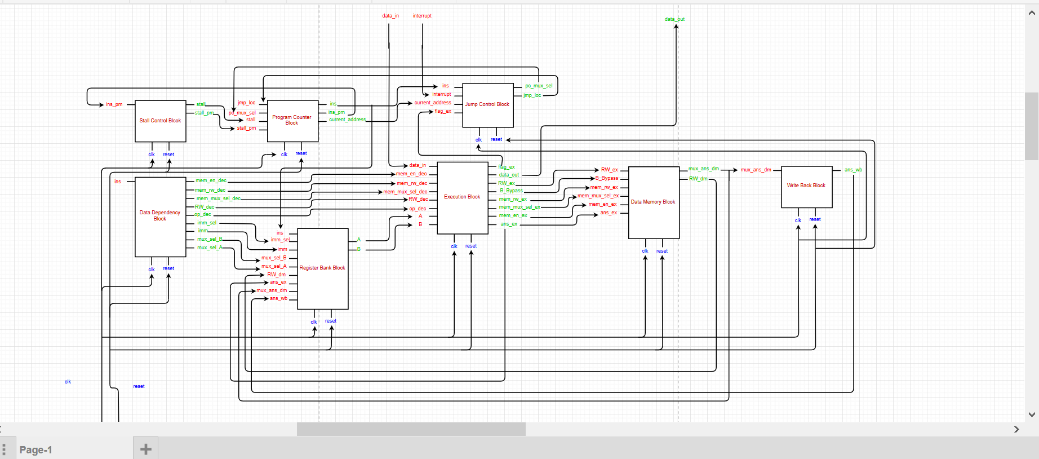
Block diagram

Slide 6
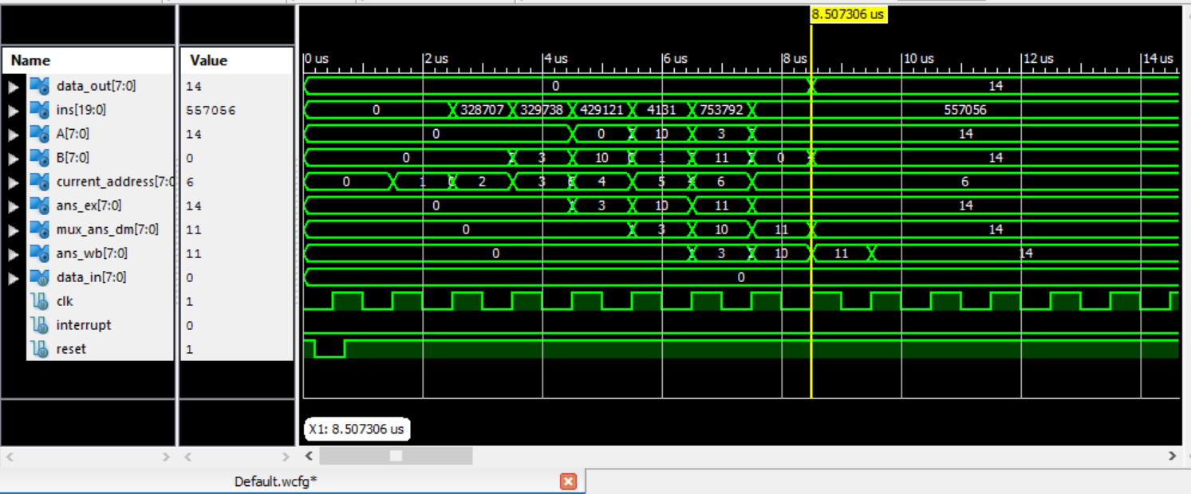
Simulation results (Addition – post route)

Slide 7
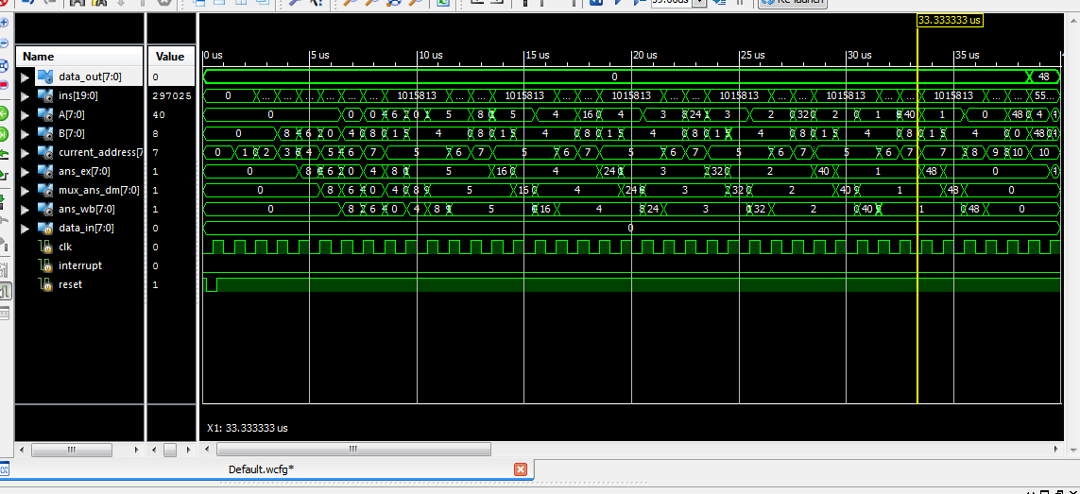
Multiplication result ( Post route )

Slide 8
Comparison with 8085
Microprocessor | 8085
8 bit CPU | 8 bit CPU
1 MHz Clock frequency | 3-6 MHz Clock frequency
8 bit address | 16 bit address
32 registers | 6 registers : B,C,D,E,H,L
RISC base | Semi CISC base
Pipeline | Single cycle ( Non – pipeline)
19 pins | 40 pins
No Accumulator present | 8 bits Accumulator
28 instructions | 74 instructions

Slide 9
Challenges faced during design and implementation
In Execution block , in hold previous flags and ans_ex holds the previous instruction instead of the list of instruction.
While creating IP core the module name and IP core name were same so initially we could not generate IP core . And then we realized that the name should be different .
Difference of opinions of individual working in group.

Slide 10
Feedback
Our doubts were solved by the professors and TAs .
We wanted to dump the code on FPGA .
Because of this course ,we could implement our theoretical knowledge in practical way.
We experienced how to work in group.

Slide 11
Thank you.

