Slide 1

File System Management
Group no. 10 Ashna Jain (201501008) Janvi Patel (201501072)
Subject: Operating system
Guided by: Sanjay Chaudhary
M. T. Savaliya

Slide 2
Index:
Project definition
OS concept used
Project modules
Technical details
Block diagram
flow chart
Live demo
Future work
Results & conclusion

Slide 3
Project definition:
Implementation of File system Management using I-node Concept used by Linux operating system.
“On a system, everything is a file; if something is not a file, it is a process”. The file system is an important part of any operating system. After all, it’s where users keep their stuff.
The organization of the file system plays an important role in helping the user find files. The organization also makes it easier for apps and the system itself to find and access the resources they need to support the user.
Implementation of a virtual disk.
Storing using Indexed allocation schemes.
Access using index access and sequential access.

Slide 4
Features which our file system supports are:
Creating a directory (mkdir command).
Creating a empty file (touch command).
Inserting data in a file (vi editor).
Display the file contents (cat command).
Delete a file (remove command).
List the contents of the current directory (ls command).
Shows the path to the current directory (pwd command)
Renaming a file (rename command)
Updating the file contents (update command).
Implementing the tree feature of windows (tree command).
Copying the contents of one file to other file (copy command).

Slide 5
Operating system concepts used:
Creation of a virtual disk which emulates the real disk:
A virtual disk is created which works similar to disk in terms of storage and retrieval of data.
Implementation using INODE structure:
The type and access mode of the file.
The size of the file in bytes.
Sequence of block pointers.
The generation number of the file
The block size of the data blocks referenced by the I-node.

Slide 6
Continued…
Superblock: Contains attributes and information about the file system, such as partition size and I-node table size.
I-node table: The collection of I-nodes for each file.
Access mode: Sequential & indexed.
Indexed based storage mechanism.

Slide 7
Project modules:
Module | Description
Create directory | Creating a new directory by accepting input such as directory name.
Create file | Creating a new empty file by accepting input such as directory name & file name.
Inserting data | Asking for the file name, accepting and storing content of the file.
Reading the content | Asking for the file name, accepting and storing content of the file.
Remove & Rename the file | Accepting file name & delete the file or rename the file
Listing the contents | List the contents of the current directory
Current directory path | Shows the path to the current directory
Update | Accepting the file name & update the file content.
Copy | Copy the file & Make the same file.

Slide 8
Technical details:
A hypothetical disk size of 1 GB (10000 blocks) is created. This facilitated the number of blocks that Superblock and I-node struct list would span on the Fisk, and helps to determine the beginning of data blocks.
Block size:
Hypothetical Fisk Size = 1000 blocks (1 MB)
Super Block + I-node struct list = 5% = 50 blocks
Data Blocks = 95% = 950 blocks
Calculating Super Block size (total = 5808 bytes):
Block free list = 950 * 4 (integer is 4-bytes) = 3800 bytes
I-node free list = 500 * 4 = 2000 bytes
Free data space = 4 bytes
Root I-node # = 4 bytes

Slide 9
Continued…
Calculating I-node size:
File code = 4 bytes
File size = 4 bytes
I-node number = 4 bytes
Disk map = 15 * 4 = 60 bytes (array of references to 15 data block numbers)
Total size of each I-node = 72 bytes
Total number of I-nodes = 5% of Fisk * 10 = 5% * 1000 * 10 = 50
Calculating Directory size:
File count = 4 bytes
50 I-node numbers = 50 * 4 = 200 bytes
50 filenames of 10 characters each = 50 * 10 = 500 bytes

Slide 10
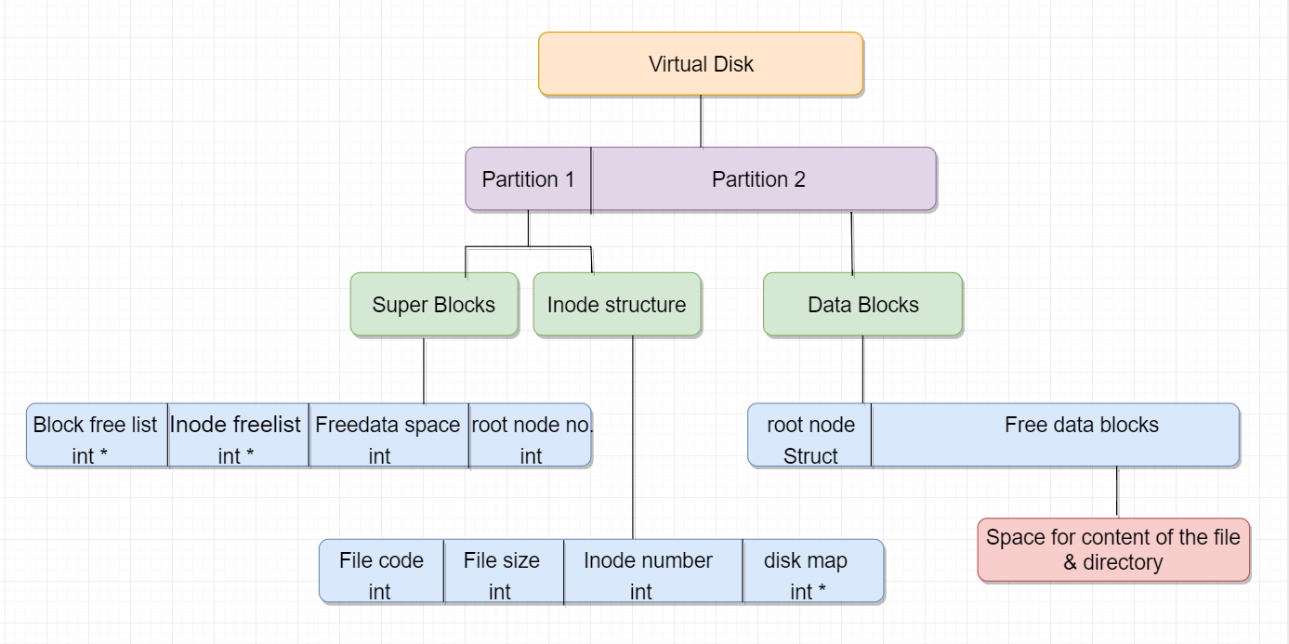
The virtual disk is divided in two partition. The first partition contains the superblock and the inode structure which constitute 5% of the total space. The second partition contains the data blocks which constitute 95% of the total space allocated.The structure of superblock constitute block free list, inode free list, free data space and root node number.The structure of inode constitute file code,file size ,inode number and disk map. The data blocks contain root node struct and free data blocks where contents of file and directories are stored.
Block diagram:

Slide 11
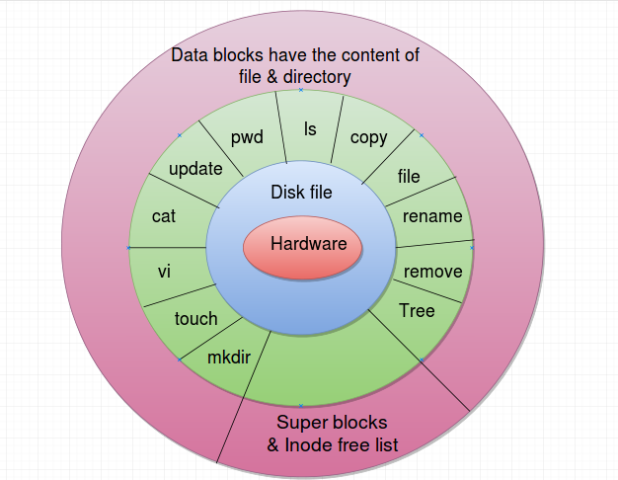
The above figure shows the architecture of the project and logical analysis of the features implemented. The diskfile created works at logical level in the same way as kernel does. The various commands (tree, remove,rename etc.) logically work like the kernel level file management system. After the various command then there are data block for storing and managing files.

Slide 12
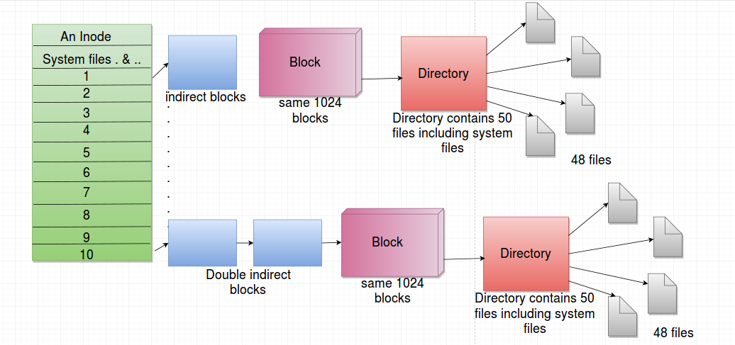
An Inode contains many pointers which store the data of the file. When the allocated data block becomes full then indirect blocks are created and those blocks are pointed by direct blocks. A directory is allocated a block and a directory can contain at most 48 files.

Slide 13
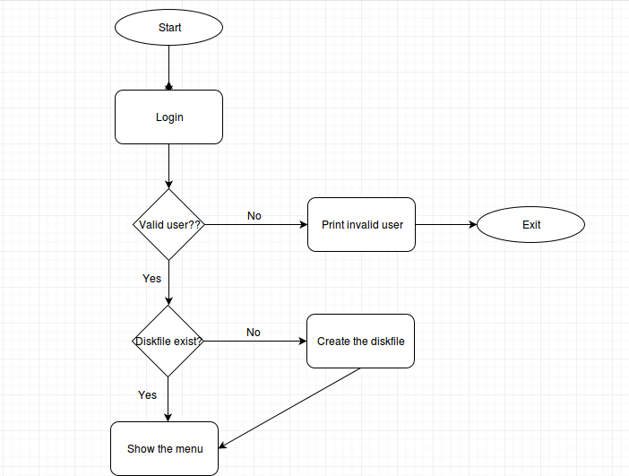
Flow chart:

Slide 14
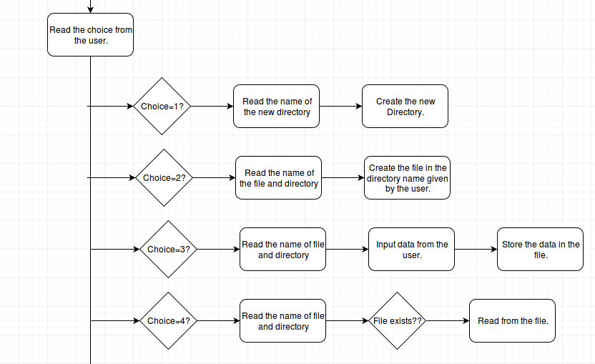
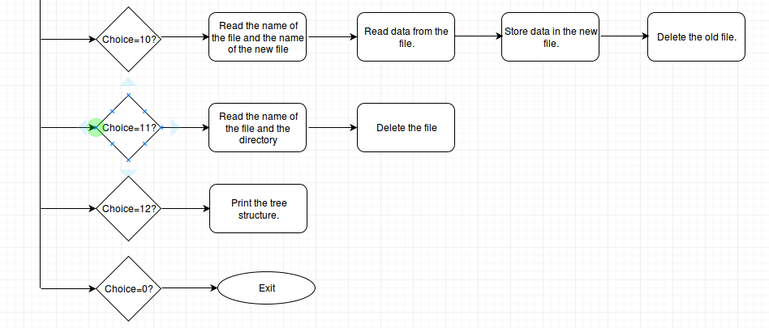
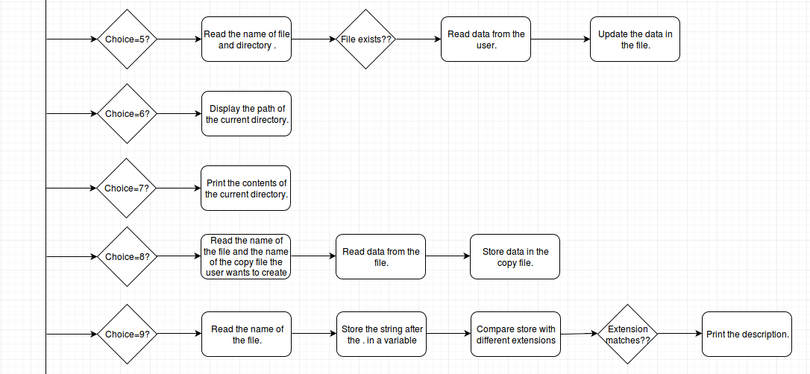

Slide 15
Live demo…

Slide 16
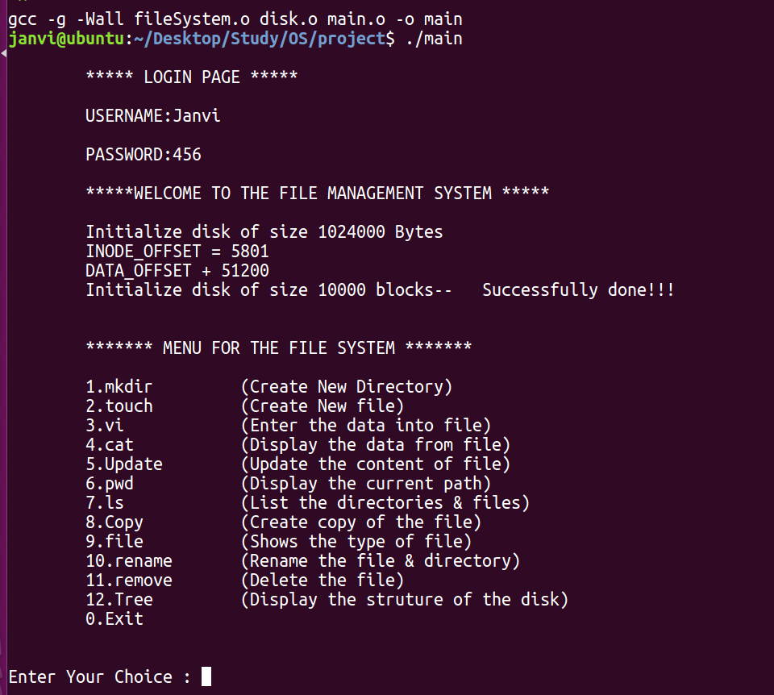
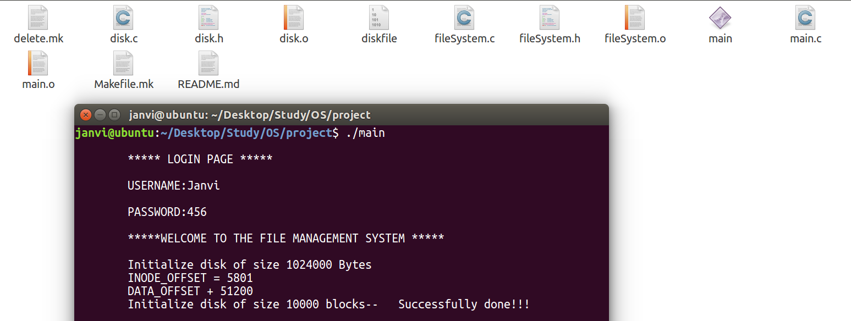
Results:

Slide 17
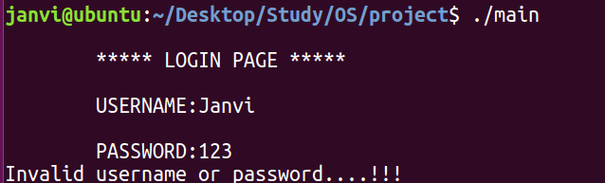
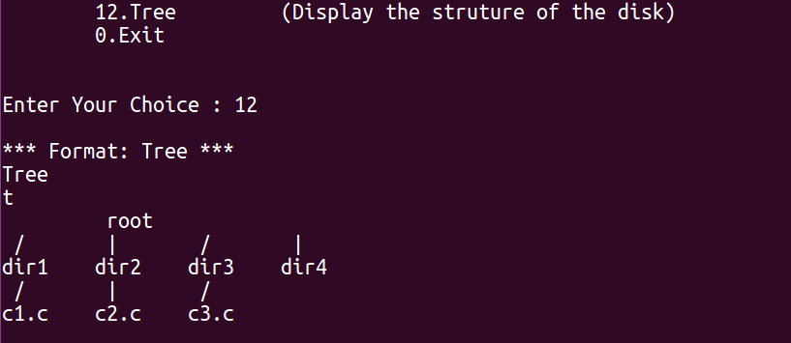
Continued…

Slide 18
Future work
Including implementation of system files and hidden files.
Working upon storage of files with different extensions such as jpeg, png.etc.
Implementation of this file system at kernel level.
Providing access control mechanisms.

Slide 19
Conclusion:
In general file system management is a very important aspect in the design of an Operating System.
Creating file system using inode makes the file system agile and easy to work with.
As memory is limited we need to utilise it efficiently and hence proper memory features of management should be applied. We have used contagious storage mechanism which writes a block to the disk.
It is important that the time to read the file is less and hence while designing file system proper mechanism should be applied which takes less time to read from disk.

Slide 20
Thank You…

