Slide 1


Extended probability model for nutrient accumulation by crops
Group No : 16
Group Members:
Janvi Patel 201501072
Nishi Patel 201501076
1/11

Slide 2
Background:
There are many probabilities in production of crops in agriculture filed. Following are some dependent aspects,
Weather, rain fall, wind blow, sunlight, photosynthesis.
Types of soil.
Nutrients.
Methods of irrigation.
We majorly focused on three crops corn, tobacco, soybean. We model based on Nutrients – Nitrogen, Phosphorus, sulfur, Potassium present in soil for these 3 crops.
2/11

Slide 3
Motivation:
Talk-‘Geospatial Big Data’ on 11th January,2017 in our college by Arup Dasgupta.
Talk - Big Data and also mentioned about agriculture field.
India - most of people depend on agriculture
Help farmers - to make their work easy by predicting intensity of nutrients needed for various crops for the next year.
3/11

Slide 4
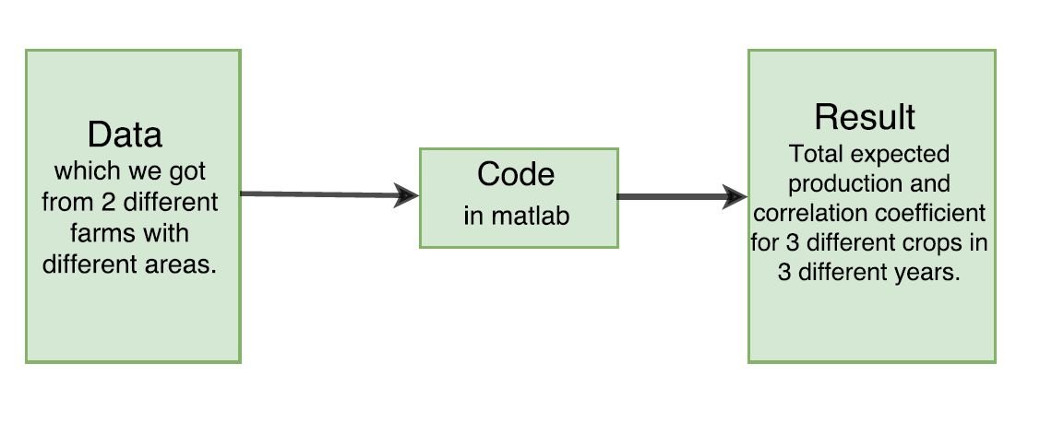
Block diagram:
Probabilistic model:
joint probability, Marginal probability, Conditional probability, Relative frequency, Expectation, Pearson’s correlative coefficient.
we don’t use specific model.
4/11

Slide 5
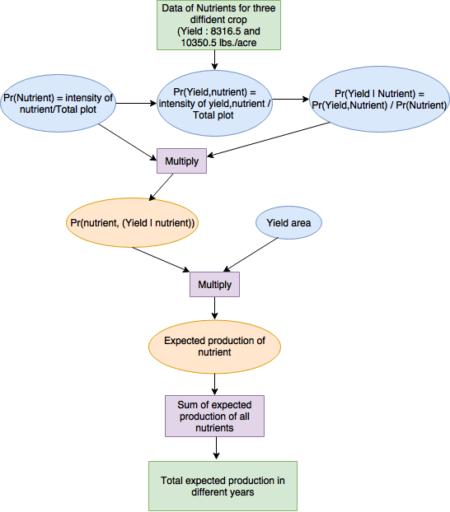
Flowchart:
by
5/11

Slide 6
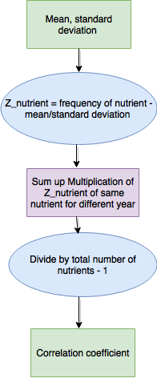
6/11
Correlation coefficient methodology-
https://www.thoughtco.com/how-to-calculate-the-correlation-coefficient-3126228

Slide 7
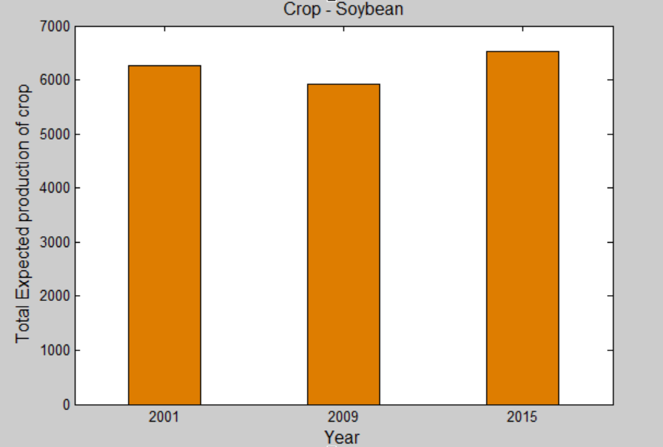
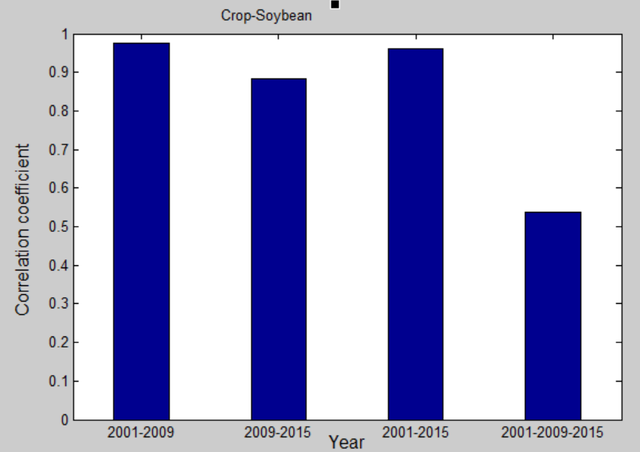
Results(MATLAB Plots):
Crop - Soybean
Nutrient (kg/acre) | Year 2001 | Year 2009 | Year 2015
Nytrogen(N) | 10 | 17 | 20
Phosphorus(P) | 40 | 35 | 32
Sulfur(S) | 10 | 15 | 20
Potassium(K) | 23 | 28 | 22
7/11

Slide 8
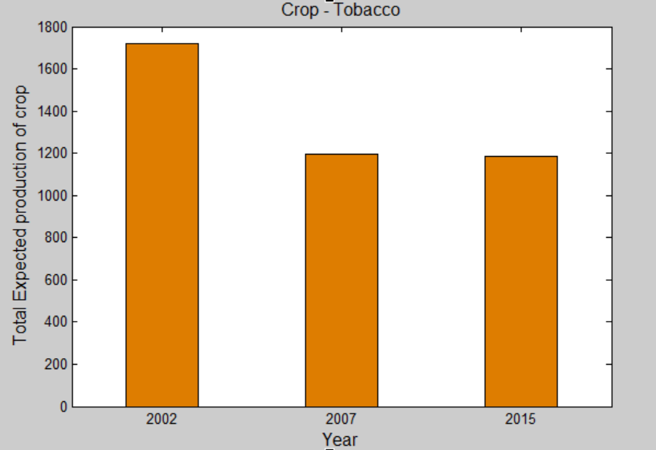
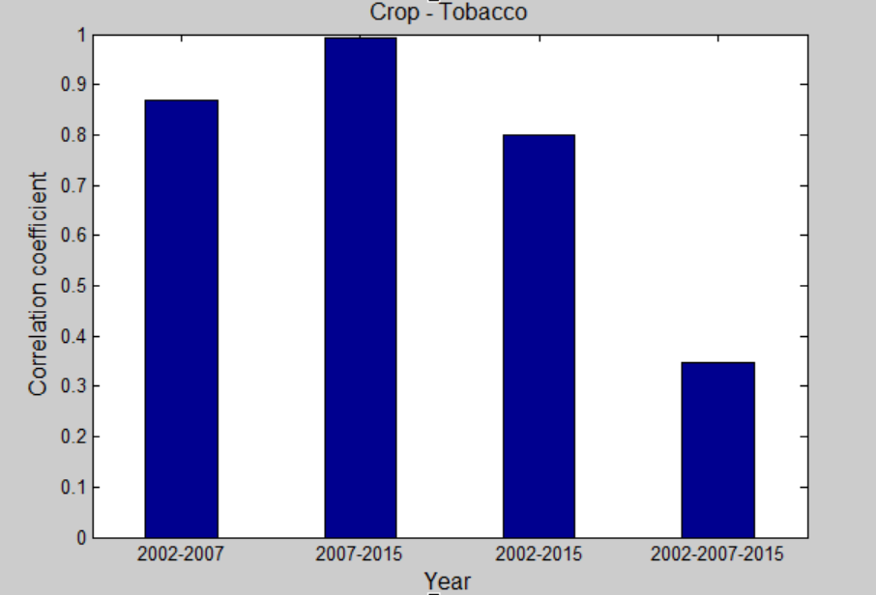
Crop – Tobacco:
Nutrient (kg/acre) | Year 2002 | Year 2007 | Year 2015
Nytrogen(N) | 70 | 75 | 80
Phosphorus(P) | 65 | 50 | 40
Sulfur(S) | 40 | 30 | 20
Potassium(K) | 53 | 30 | 13
8/11

Slide 9
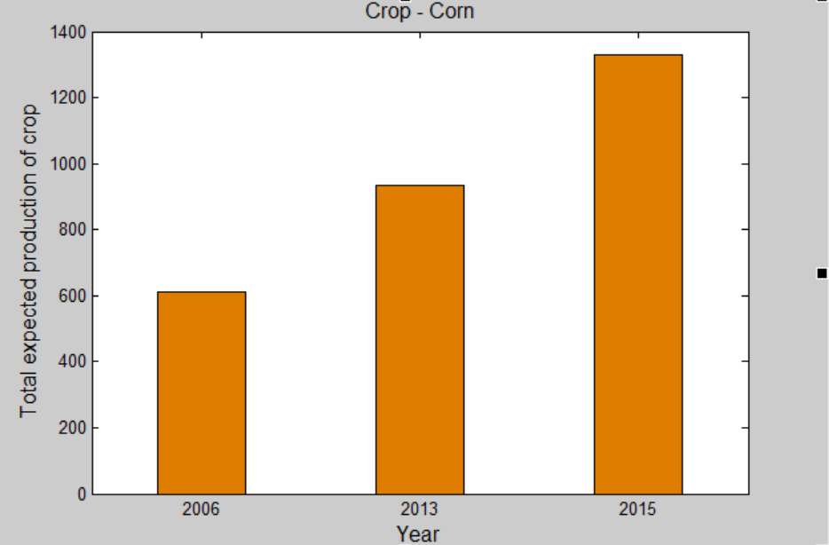
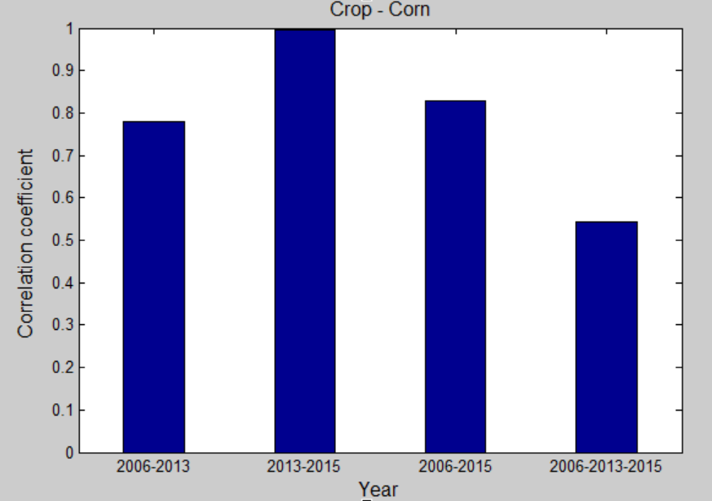
Crop – Corn:
Nutrient (kg/acre) | Year 2006 | Year 2013 | Year 2015
Nytrogen(N) | 87 | 104.3 | 120
Phosphorus(P) | 33 | 55.7 | 60
Sulfur(S) | 10 | 27 | 23
Potassium(K) | 60 | 34 | 22
9/11

Slide 10
Future scope/Inference:
Soybean:
More proportion of Nitrogen and sulfur and less proportion of potassium and phosphorus will help to produce more soybean.
In year 2009, there is least production and in year 2015, there is highest production. So, correlation coefficient is low for year 2009-2015.
Tobacco:
Less proportion of Nitrogen and more proportion of potassium, phosphorus, sulfur will help to produce more tobacco.
In year 2007 and 2015 the production of tobacco is almost same so correlation between them is highest.
Corn:
More proportion of Nitrogen and phosphorus will help to produce more corn.
Production of corn grow like stair case year by year.
10/11

Slide 11
Thank you
11/11

