Slide 1
Gen AI for Stem Education

Slide 2
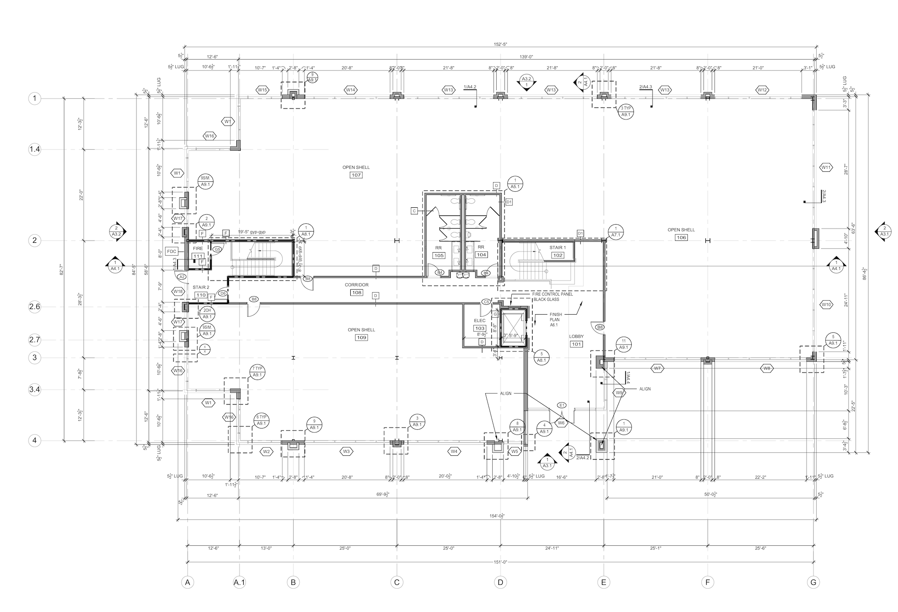
Pdf splitting

Slide 3
Circle Detection:
Performed Hough transformation and detected circles with min radius of 50 and max radius of 100 pixels
Text Recognition:
EasyOCR is a deep learning based optical character recognition (OCR) library that detects text regions using CRAFT and recognizes characters with a CRNN model

