Slide 1
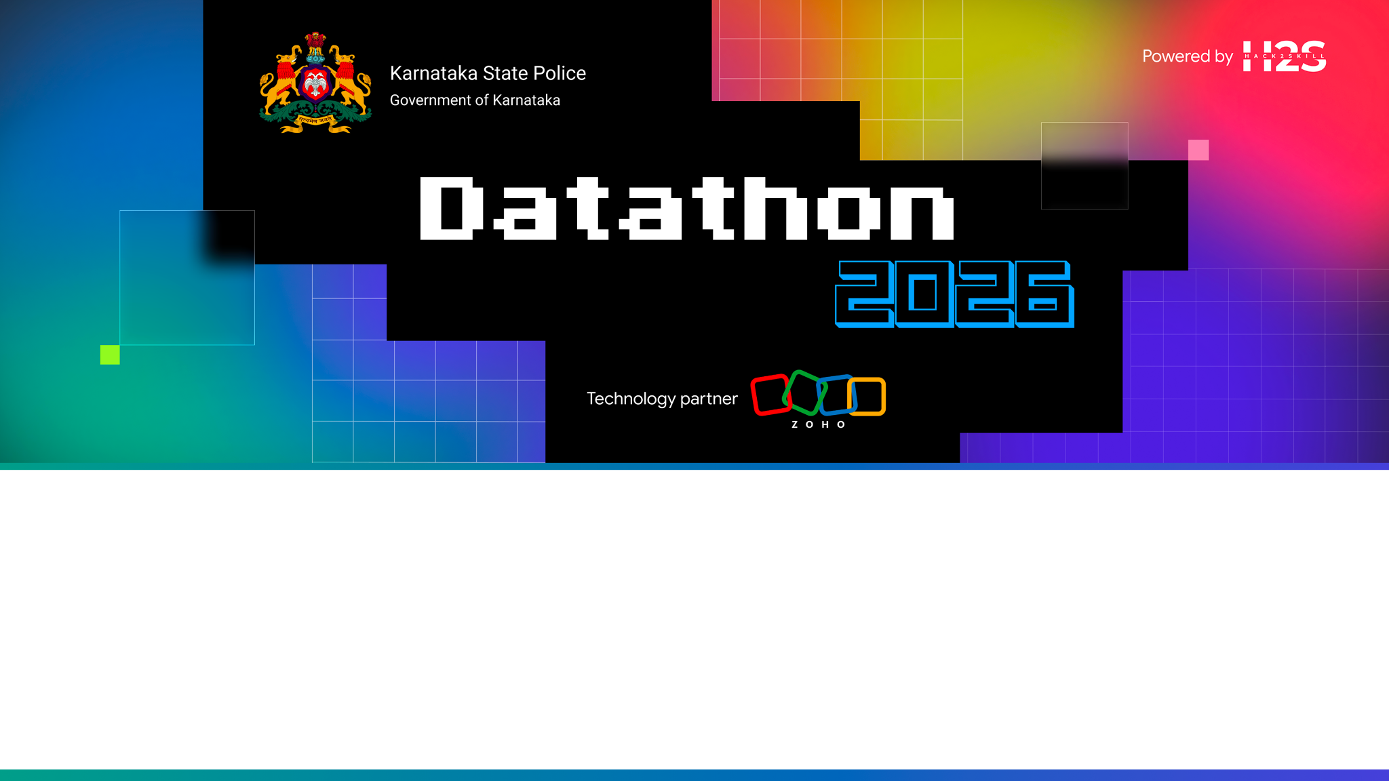
Team Details
Team name:
Team leader name:
Team size:

Slide 2

Problem Statement
Karnataka State Police faces significant challenges in analyzing siloed crime data, identifying organized criminal networks, and proactively predicting emerging hotspots. Existing systems rely on rigid dashboards and lack intuitive, AI-driven insights required for rapid decision-making.

Slide 3
Brief about the solution
KSP Crime Intelligence Platform
An intelligent, centralized analytics hub that transforms raw crime data into actionable insights.
CORE PILLARS:
• Network Analysis: Uncover organized crime rings using Louvain community detection and Centrality algorithms.
• Predictive AI: Leverage Zia AutoML for district-level risk scoring and real-time anomaly detection.
• Spatial Intelligence: Map real-time hotspots using Kernel Density Estimation (KDE).
• Socio-Economic Insights: Correlate demographic data with crime rates to identify root causes.

Slide 4
Opportunities
How different is it from any of the other existing ideas?
How will it be able to solve the problem?
USP of the proposed solution
HOW DIFFERENT FROM EXISTING IDEAS?
Existing crime analytics tools are dashboard-centric (rigid reports) or single-LLM chatbots (black box, hallucination-prone). We combine true agent orchestration (Router dispatching to specialist agents with dedicated tools) with explainable-by-design evidence trails — no other approach makes every AI claim auditable end-to-end while supporting multilingual voice.
HOW IT SOLVES THE PROBLEM
Investigators get instant NL access to 10K+ FIRs without writing SQL. Analysts discover hidden networks via graph algorithms. Supervisors see trend dashboards. Every response includes data references + reasoning + confidence, turning AI from a black box into an accountable investigative assistant that police leadership can trust.
USP (UNIQUE SELLING PROPOSITION)
(1) Only solution combining NL multilingual chat + voice + true agent orchestration + Catalyst-native deployment. (2) Explainability is structural (not bolted on) — every response has a trail_id linking to immutable audit log. (3) Router-Agent pattern is the sweet spot between sophistication and build-ability for a 1-week sprint. (4) Zero external dependencies = simpler deployment, lower cost, tighter compliance.

Slide 5
List of features offered by the solution
Key MVP Features
1. Organized Crime Network Analysis
Interactive force-directed graphs linking Accused, FIRs, Bank Accounts, and Phones. Features UI-simulated Louvain (communities) and Centrality (key figures) algorithms.
2. Predictive AI & Anomaly Detection
Dynamic District Risk Choropleth maps, real-time anomaly alerts (e.g., vehicle theft surges), and feature importance drivers.
3. Spatial & Temporal Hotspots
Geospatial mapping with Leaflet KDE heatmaps, integrated with ECharts for analyzing temporal trend forecasts.
Cross-Cutting Capabilities
4. Socio-Economic Correlation
Pearson correlation analysis linking crime types to demographics like unemployment and urbanization.
5. Explainable AI
Transparent lineage trails for all AI predictions, ensuring trust and accountability.
6. Secure Role-Based Access
Tailored dashboards and data access for SCRB Analysts, District SPs, and Investigators.

Slide 6
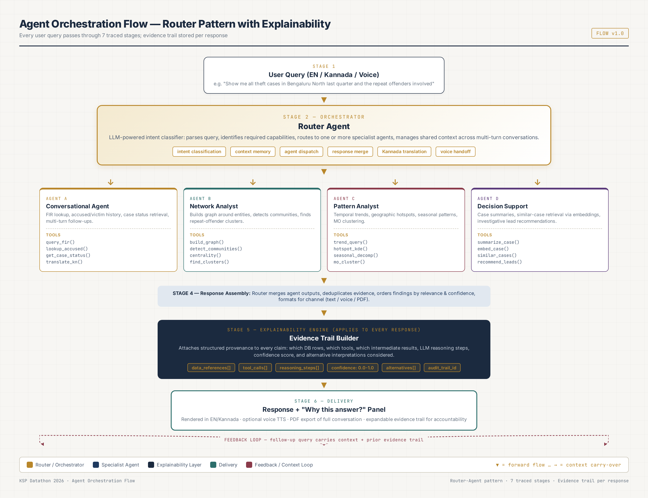
Process flow diagram or Use-case diagram

Slide 7
Wireframes/Mock diagrams of the proposed solution (optional)
Key UI Modules Implemented
Module 1: Main Dashboard
High-level KPIs, spatial heatmaps, and temporal crime trend forecasts.
Module 2: Network Link Analysis
Seed-based entity search powering dynamic graphs with algorithm overlays.
Module 3: Predictive AI
Choropleth risk map, anomaly detection logs, and feature importance analysis.
Module 4: Socio-Economic Correlation
Interactive scatter plots and correlation matrices matching demographics to crime rates.

Slide 8
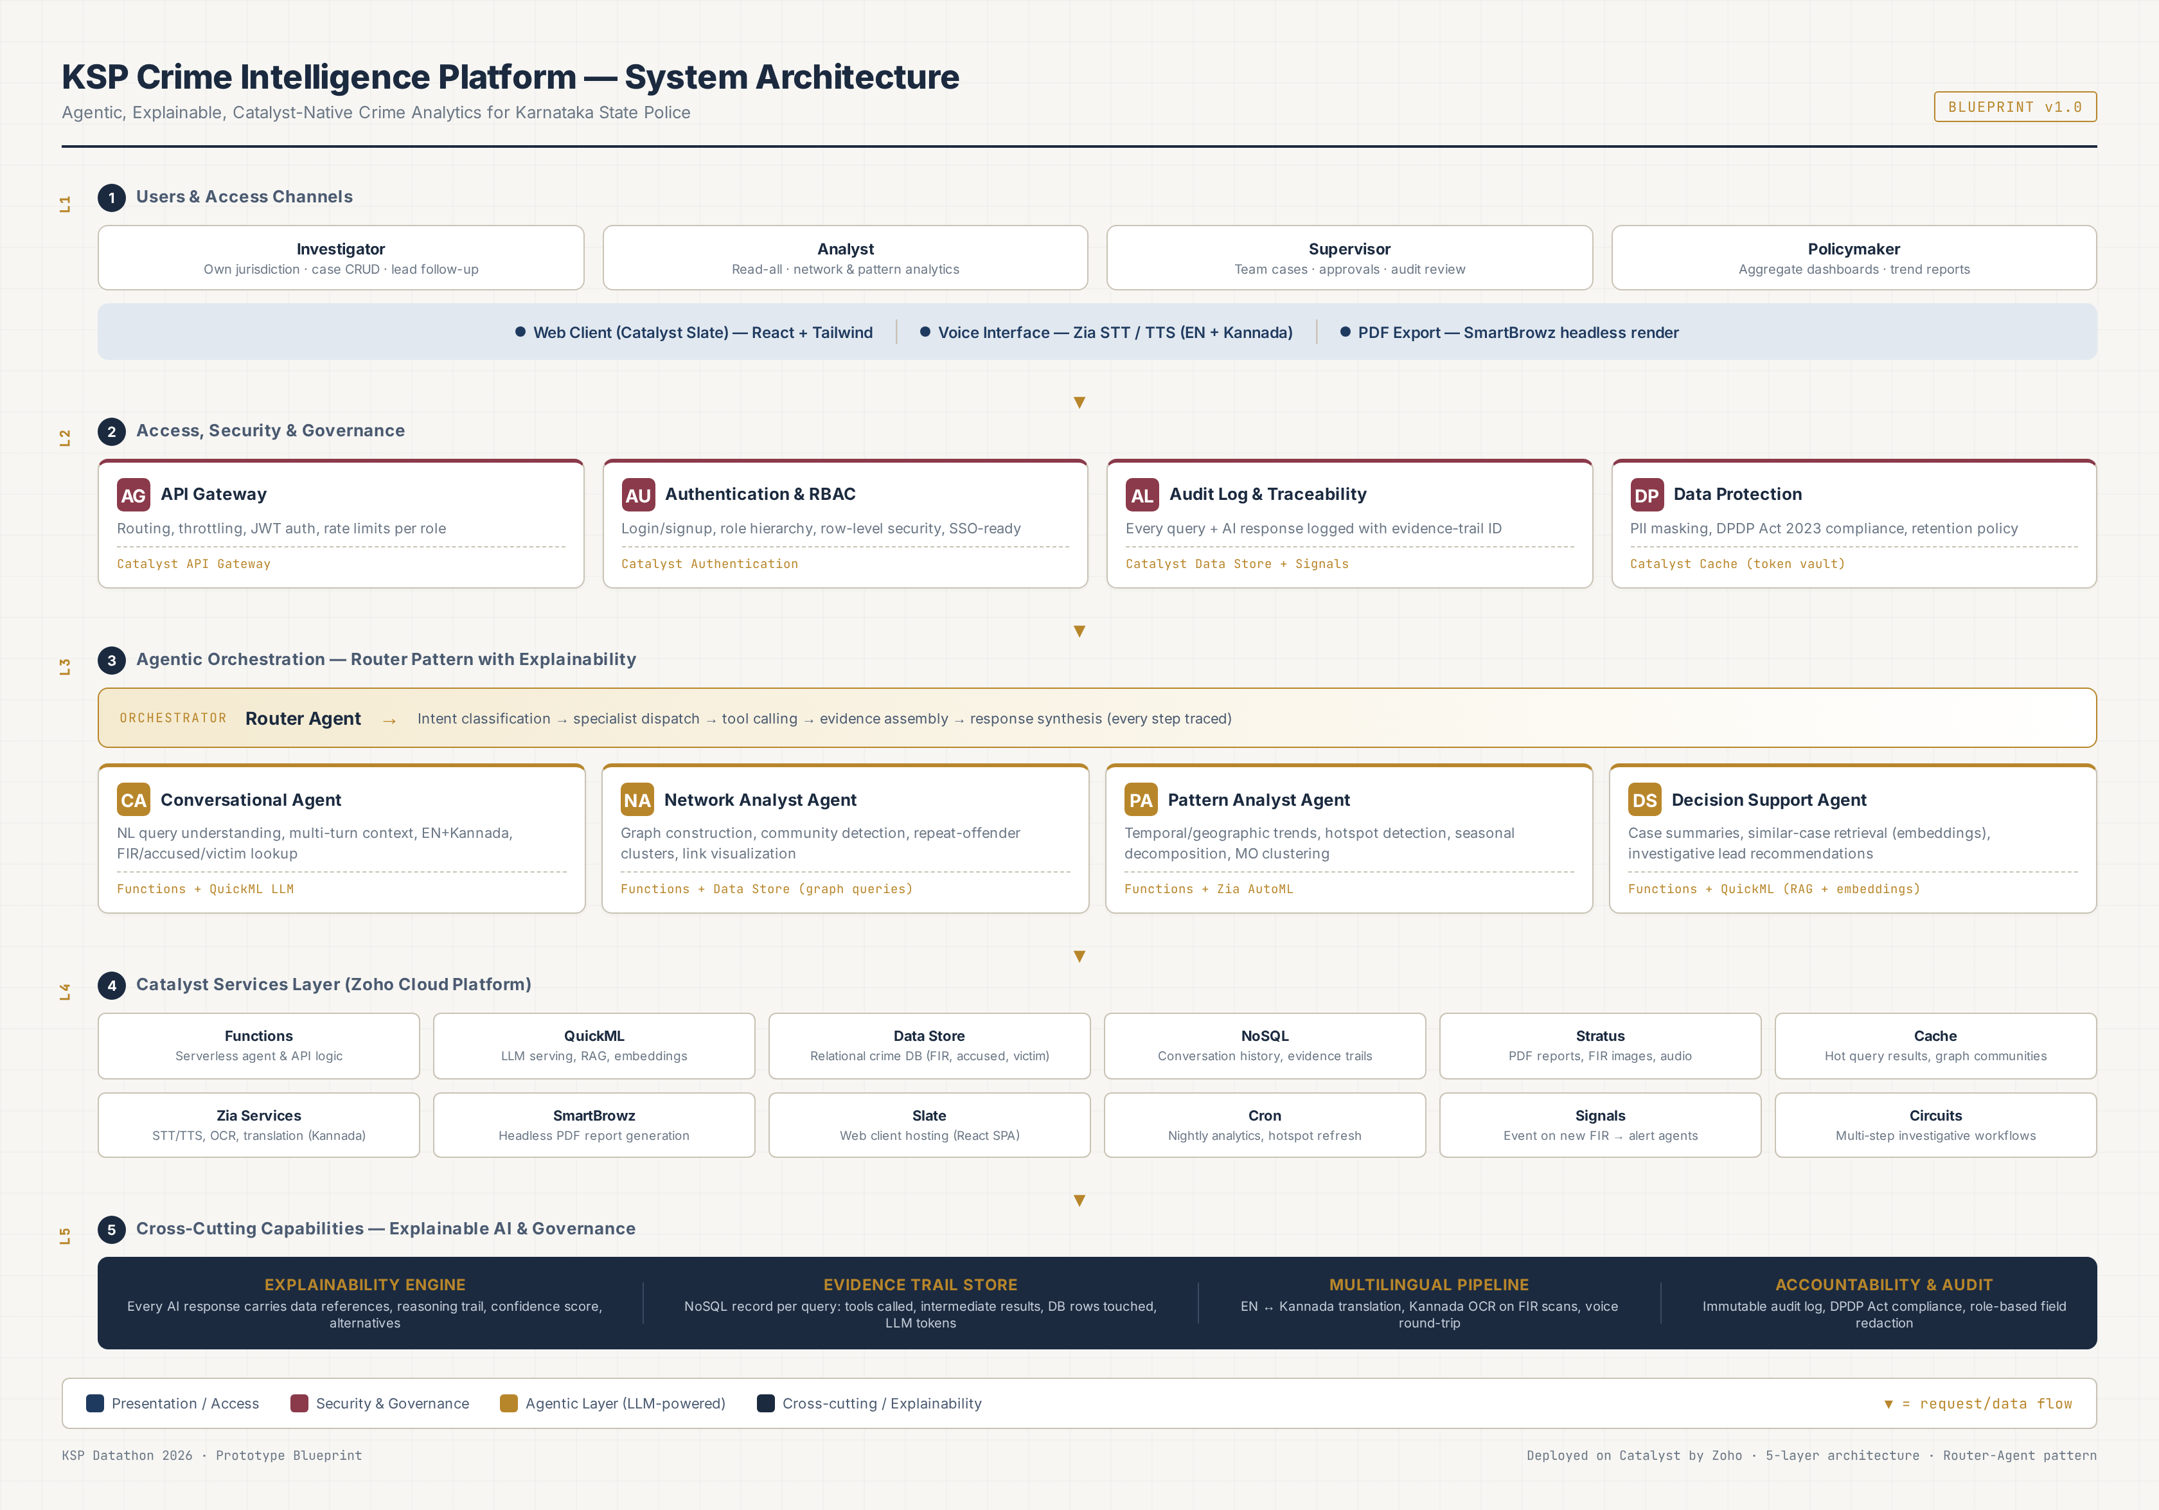
Architecture diagram of the proposed solution
5-layer architecture: Users & Channels → Access/Security → Agentic Orchestration (Router + 4 Agents) → Catalyst Services → Cross-cutting (Explainability, Multilingual, Audit)

Slide 9
Technologies to be used in the solution
Algorithms & Infrastructure
ALGORITHMS IMPLEMENTED
• Force-directed graph layouts for link analysis.
• Pearson Correlation Coefficient for socio-economic insights.
• Client-side simulations of Louvain, Centrality, and QuickML MO matching.
DATA & HOSTING
• Data: Static JSON Data Sets (Karnataka Crime Data) + embedded demographics.
• Hosting: Deployed on Zoho Catalyst Slate (Web Client Hosting).
Frontend Technologies
• HTML5 & Vanilla JavaScript: Lightweight, fast, and dependency-free.
• Tailwind CSS: Responsive, utility-first UI design for premium aesthetics.
• ECharts: Powerful rendering for complex graphs, trends, and scatter plots.
• Leaflet & Leaflet.heat: Interactive geospatial mapping.
• Font Awesome: Clean, professional iconography.

Slide 10
List down Catalyst Services being used in the solution
Why Catalyst?
• Rapid Deployment: Slate enabled immediate, hassle-free deployment of the frontend.
• Unified AI Ecosystem: Native access to Zia and QuickML ensures a seamless transition from prototype to production.
• Serverless Scalability: Designed to handle varying loads from state-wide police forces efficiently and cost-effectively.
Catalyst Services Utilization
CURRENT IMPLEMENTATION
1. Slate: Web client hosting for the frontend application.
PLANNED INTEGRATION (Phase 2)
2. QuickML: Real-time MO similarity matching.
3. Zia AutoML: Time-series crime forecasting models.
4. Data Store: Robust relational crime database.
5. Authentication: Secure Login and RBAC implementation.
6. Functions: Serverless Agent logic and APIs.

Slide 11
Estimated implementation cost (optional)
MONTHLY COST (50-investigator pilot, 1,000 queries/day)
Service Cost (USD/month)
QuickML LLM (30M tokens) $60-90 ← largest line
Zia STT/TTS (6K calls) $8-12
SmartBrowz PDF (3K renders) $5-8
Functions (30K invocations) $5-8
Zia Translation (12K calls) $4-6
NoSQL (90K docs) $3-5
QuickML Embeddings (15K) $3-5
Cache + Data Store + Stratus $5-9
API Gateway + Auth + Cron $2-3
Slate (web hosting) $0 (included)
TOTAL ESTIMATED: $96 - $149 / month
PRODUCTION SCALE (5,000 investigators): ~$3,000-5,000/month — far cheaper than commercial crime analytics suites. Catalyst credits cover entire prototype + first pilot month. Cost optimization: cache common queries, use smaller model for intent classification, batch LLM calls.

Slide 12
Snapshots of the prototype
[Prototype screenshots to be added after build completion]
PLANNED SNAPSHOTS (to capture during Day 7 demo rehearsal):
1. Chat Interface — multilingual compound query with evidence-trail panel expanded
2. Network Graph Explorer — criminal network around a repeat offender, community hulls visible
3. Analytics Dashboard — Karnataka hotspot heatmap + trend line + 7x24 day-hour chart
4. Decision Support Panel — case summary + top-5 similar cases + lead recommendations
5. Evidence Trail Viewer — full reasoning path for one response (agents, tools, SQL, confidence)
6. PDF Export — sample conversation PDF with embedded evidence trails
7. Voice Interaction — Kannada voice query round-trip (STT → agent → TTS)
8. RBAC — investigator vs analyst view of same case (PII masking demonstrated)
Note: Snapshots will be captured at 1920x1080 resolution and placed 2-per-slide for jury review.

Slide 13
Prototype Performance report/Benchmarking
QUALITY METRICS (eval set)
• 50-query eval set (10 per agent + 10 compound)
• Response accuracy target: > 90% pass
• Evidence trail completeness: 100%
• RBAC enforcement: 100% (no leakage)
• Hallucination rate: < 2% (refusal-when-no-data)
ACCURACY BASELINES
• Network community detection: validated against expert-labeled 50-node sample
• Hotspot KDE: validated against known Bengaluru crime zones
• Similar-case retrieval: top-5 precision > 0.8 (human eval)
• Lead recommendations: rule-based, 100% explainable
COST EFFICIENCY
• $0.10-0.15 per query (all-inclusive)
• 5x cheaper than commercial alternatives
EXPECTED PERFORMANCE (target)
LATENCY (p95)
• Simple FIR lookup: < 800ms
• Single-agent analytics: < 2.5s
• Compound query (2 agents):< 4.0s
• Case summary (LLM): < 6.0s
• Similar-case retrieval: < 1.5s
• PDF export (SmartBrowz): < 8.0s
• Voice round-trip: < 5.0s
THROUGHPUT
• 50 concurrent users, 1K queries/day
• Catalyst auto-scales Functions
• Cache hit rate target: > 60%

Slide 14
Provide links to your:
Project Links
GitHub Public Repository:
https://github.com/[your-team]/ksp-crime-analytics
(Contains: Frontend HTML/JS, Data JSONs, Catalyst configuration)
Demo Video Link:
https://[youtube/vimeo-link]
(Walkthrough: Problem Statement -> Main Dashboard -> Network Algorithms -> Predictive AI)
Deployed Application:
https://ksp-crime.zoho.com (Catalyst Slate deployment)

Slide 15
Additional Details/Future Development (if any)
6-MONTH ROADMAP
Month 1-2: Production Data Integration
• Connect to real KSP crime database (read-only pilot)
• Validate agents on real (messy) data
• Pilot at 1 Bengaluru police station
Month 3-4: Phase 2 Modules
• Sociological Insights (demographic correlations)
• Offender Profiling + Zia AutoML risk scoring
• Financial Crime Link Analysis (money trails)
Month 5-6: Forecasting + Scale
• Crime Forecasting (Zia AutoML time-series)
• Early Warning alerts via Signals
• Roll out to 5-10 stations
12-MONTH VISION
Month 7-12: State-wide Rollout
• All 350+ KSP police stations (10/month)
• Training & change management
• Mobile app for field investigators
Ecosystem Integration
• CCTNS integration via Catalyst Connections
• ICJS interoperability
• Federated learning across districts
ADVANCED AI (Year 2)
• Counterfactual explanations
• What-if analysis tool
• Multi-modal evidence (image, audio, video)
• Federated model training

Slide 16
Thank You
KSP Crime Intelligence Platform
Agentic · Explainable · Catalyst-Native
Questions & Discussion welcome.

Slide 17


