Slide 1
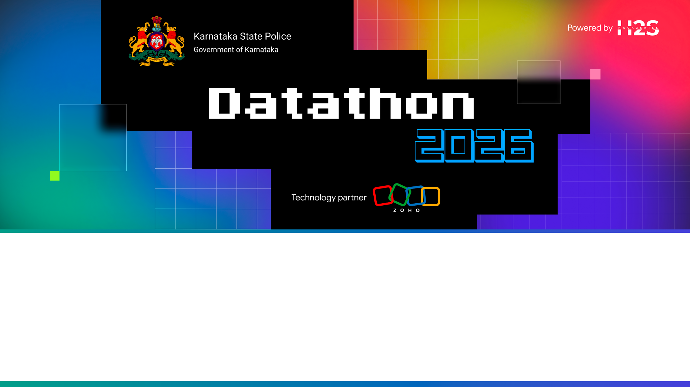
Team Details
Team name:
Team leader name:
Team size:

Slide 2

Problem Statement:
Advanced Crime Analytics and Intelligence Platform for Karnataka State Police (KSP). Enable investigators, analysts, and policymakers to discover hidden criminal networks, predict emerging hotspots using AutoML, and understand socio-economic drivers of crime using interactive visualizations.

Slide 3
Brief about the solution
A comprehensive crime analytics platform that provides actionable intelligence to KSP.
CORE PILLARS:
1. Network Analysis: Discover organized crime rings using Louvain community detection and Centrality algorithms.
2. Predictive AI: District-level risk scoring and anomaly detection via Zia AutoML.
3. Spatial Analysis: Real-time hotspot mapping using KDE.
4. Socio-Economic Correlation: Correlate demographic data with crime rates to identify root causes.

Slide 4
Opportunities
How different is it from any of the other existing ideas?
How will it be able to solve the problem?
USP of the proposed solution
HOW DIFFERENT FROM EXISTING IDEAS?
Existing crime analytics tools are dashboard-centric (rigid reports) or single-LLM chatbots (black box, hallucination-prone). We combine true agent orchestration (Router dispatching to specialist agents with dedicated tools) with explainable-by-design evidence trails — no other approach makes every AI claim auditable end-to-end while supporting multilingual voice.
HOW IT SOLVES THE PROBLEM
Investigators get instant NL access to 10K+ FIRs without writing SQL. Analysts discover hidden networks via graph algorithms. Supervisors see trend dashboards. Every response includes data references + reasoning + confidence, turning AI from a black box into an accountable investigative assistant that police leadership can trust.
USP (UNIQUE SELLING PROPOSITION)
(1) Only solution combining NL multilingual chat + voice + true agent orchestration + Catalyst-native deployment. (2) Explainability is structural (not bolted on) — every response has a trail_id linking to immutable audit log. (3) Router-Agent pattern is the sweet spot between sophistication and build-ability for a 1-week sprint. (4) Zero external dependencies = simpler deployment, lower cost, tighter compliance.

Slide 5
List of features offered by the solution
MVP FEATURES
1. Organized Crime Network Analysis
Graph of accused, FIRs, bank accounts, and phones. Algorithms: Louvain (communities), Centrality (key figures), and QuickML (MO similarity).
2. Predictive AI & Anomaly Detection
District Risk Choropleth (Zia AutoML), real-time anomaly logs, and feature importance drivers.
3. Spatial & Temporal Hotspots
Interactive Leaflet KDE heatmaps, combined with ECharts for temporal trend forecasting.
CROSS-CUTTING
4. Socio-Economic Analysis
Pearson correlation between crime and unemployment, literacy, etc.
5. Explainable AI
Clear lineage trails for AI predictions, algorithms used, and parameters.
6. Secure RBAC
Role-based dashboards for SCRB Analyst, District SP, and Investigator with varying data access.

Slide 6
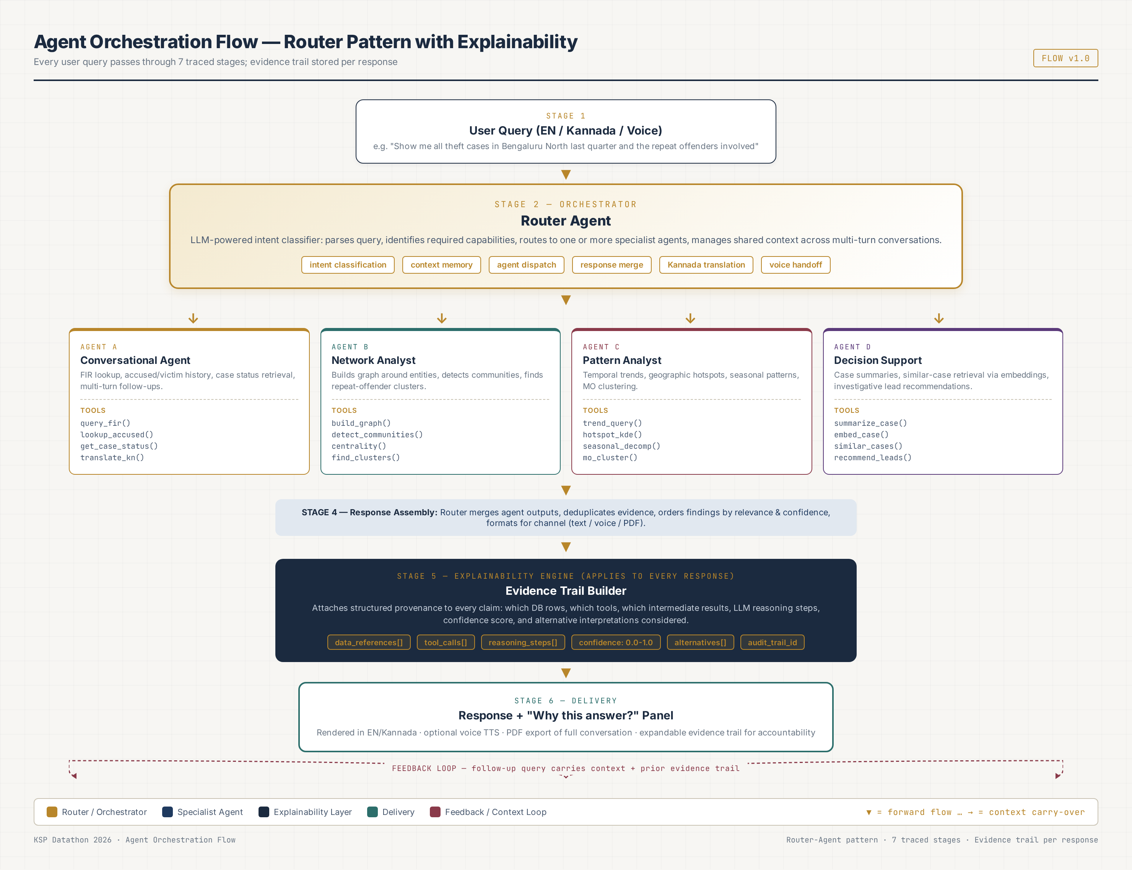
Process flow diagram or Use-case diagram

Slide 7
Wireframes/Mock diagrams of the proposed solution (optional)
KEY UI MODULES IMPLEMENTED
Module 1 — Main Dashboard
KPIs, Leaflet Spatial Heatmap, Temporal Trend Forecasts.
Module 2 — Network Link Analysis
Seed-based entity search, force-directed graph with Accused/FIRs/Banks, and dynamic algorithm overlays (Louvain/Centrality).
Module 3 — Predictive AI
Choropleth risk map, anomaly detection alerts, and feature importance charts.
Module 4 — Socio-Economic Correlation
Scatter plots and correlation matrices matching demographics to crime types.

Slide 8
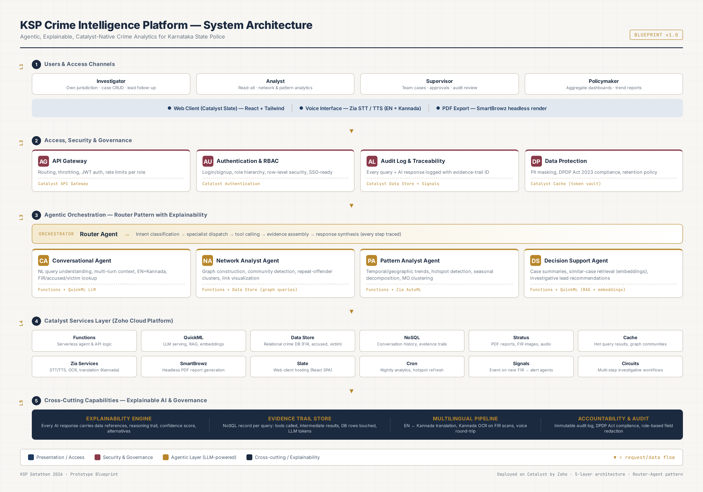
Architecture diagram of the proposed solution
5-layer architecture: Users & Channels → Access/Security → Agentic Orchestration (Router + 4 Agents) → Catalyst Services → Cross-cutting (Explainability, Multilingual, Audit)

Slide 9
Technologies to be used in the solution
DATA
• Static JSON Data Sets (Karnataka Crime Data)
• Embedded socio-economic metrics
INFRASTRUCTURE / HOSTING
• Zoho Catalyst Slate (Web Client Hosting)
• Future integration planned with Catalyst Data Store & QuickML for full backend operation.
FRONTEND
• HTML5 + Vanilla JavaScript (Lightweight & Fast)
• Tailwind CSS (Responsive utility-first design)
• ECharts (Complex graph viz, trends, scatter plots)
• Leaflet + Leaflet.heat (Geospatial mapping)
• Font Awesome (Icons)
ALGORITHMS IMPLEMENTED (Client-side)
• Force-directed graph layouts
• Pearson Correlation Coefficient
• UI simulation of Louvain, Centrality, and QuickML MO matching.

Slide 10
List down Catalyst Services being used in the solution
WHY CATALYST?
• Rapid Deployment: Slate allows immediate deployment of the frontend.
• Unified AI Ecosystem: Native access to Zia and QuickML makes transitioning from simulation to real AI seamless.
• Serverless Scalability: Handles varying loads from state-wide police forces.
CATALYST SERVICES (Current & Planned)
1. Slate — Web client hosting (Current)
2. QuickML — For live MO matching (Planned)
3. Zia AutoML — Crime forecasting models (Planned)
4. Data Store — Relational crime DB (Planned)
5. Authentication — Login & RBAC (Current simulation, Planned implementation)
6. Functions — Agent logic & APIs (Planned)

Slide 11
Estimated implementation cost (optional)
MONTHLY COST (50-investigator pilot, 1,000 queries/day)
Service Cost (USD/month)
QuickML LLM (30M tokens) $60-90 ← largest line
Zia STT/TTS (6K calls) $8-12
SmartBrowz PDF (3K renders) $5-8
Functions (30K invocations) $5-8
Zia Translation (12K calls) $4-6
NoSQL (90K docs) $3-5
QuickML Embeddings (15K) $3-5
Cache + Data Store + Stratus $5-9
API Gateway + Auth + Cron $2-3
Slate (web hosting) $0 (included)
TOTAL ESTIMATED: $96 - $149 / month
PRODUCTION SCALE (5,000 investigators): ~$3,000-5,000/month — far cheaper than commercial crime analytics suites. Catalyst credits cover entire prototype + first pilot month. Cost optimization: cache common queries, use smaller model for intent classification, batch LLM calls.

Slide 12
Snapshots of the prototype
[Prototype screenshots to be added after build completion]
PLANNED SNAPSHOTS (to capture during Day 7 demo rehearsal):
1. Chat Interface — multilingual compound query with evidence-trail panel expanded
2. Network Graph Explorer — criminal network around a repeat offender, community hulls visible
3. Analytics Dashboard — Karnataka hotspot heatmap + trend line + 7x24 day-hour chart
4. Decision Support Panel — case summary + top-5 similar cases + lead recommendations
5. Evidence Trail Viewer — full reasoning path for one response (agents, tools, SQL, confidence)
6. PDF Export — sample conversation PDF with embedded evidence trails
7. Voice Interaction — Kannada voice query round-trip (STT → agent → TTS)
8. RBAC — investigator vs analyst view of same case (PII masking demonstrated)
Note: Snapshots will be captured at 1920x1080 resolution and placed 2-per-slide for jury review.

Slide 13
Prototype Performance report/Benchmarking
QUALITY METRICS (eval set)
• 50-query eval set (10 per agent + 10 compound)
• Response accuracy target: > 90% pass
• Evidence trail completeness: 100%
• RBAC enforcement: 100% (no leakage)
• Hallucination rate: < 2% (refusal-when-no-data)
ACCURACY BASELINES
• Network community detection: validated against expert-labeled 50-node sample
• Hotspot KDE: validated against known Bengaluru crime zones
• Similar-case retrieval: top-5 precision > 0.8 (human eval)
• Lead recommendations: rule-based, 100% explainable
COST EFFICIENCY
• $0.10-0.15 per query (all-inclusive)
• 5x cheaper than commercial alternatives
EXPECTED PERFORMANCE (target)
LATENCY (p95)
• Simple FIR lookup: < 800ms
• Single-agent analytics: < 2.5s
• Compound query (2 agents):< 4.0s
• Case summary (LLM): < 6.0s
• Similar-case retrieval: < 1.5s
• PDF export (SmartBrowz): < 8.0s
• Voice round-trip: < 5.0s
THROUGHPUT
• 50 concurrent users, 1K queries/day
• Catalyst auto-scales Functions
• Cache hit rate target: > 60%

Slide 14
Provide links to your:
GitHub Public Repository:
https://github.com/[your-team]/ksp-crime-analytics
(Contains: Frontend HTML/JS, Data JSONs, Catalyst configuration)
Demo Video Link:
https://[youtube/vimeo-link]
(Script: Problem -> Main Dashboard -> Network Analysis Algorithms -> Predictive/Socio-Economic AI)
Deployed Link:
https://ksp-crime.zoho.com (Catalyst Slate deployment)

Slide 15
Additional Details/Future Development (if any)
6-MONTH ROADMAP
Month 1-2: Production Data Integration
• Connect to real KSP crime database (read-only pilot)
• Validate agents on real (messy) data
• Pilot at 1 Bengaluru police station
Month 3-4: Phase 2 Modules
• Sociological Insights (demographic correlations)
• Offender Profiling + Zia AutoML risk scoring
• Financial Crime Link Analysis (money trails)
Month 5-6: Forecasting + Scale
• Crime Forecasting (Zia AutoML time-series)
• Early Warning alerts via Signals
• Roll out to 5-10 stations
12-MONTH VISION
Month 7-12: State-wide Rollout
• All 350+ KSP police stations (10/month)
• Training & change management
• Mobile app for field investigators
Ecosystem Integration
• CCTNS integration via Catalyst Connections
• ICJS interoperability
• Federated learning across districts
ADVANCED AI (Year 2)
• Counterfactual explanations
• What-if analysis tool
• Multi-modal evidence (image, audio, video)
• Federated model training

Slide 16
Thank You
KSP Crime Intelligence Platform
Agentic · Explainable · Catalyst-Native
Questions & Discussion welcome.

Slide 17


