Slide 1

Signal Processing lab project - 2023
By (Filter Force)
Bhaskar Bhatt ( 2022102003 )
Aditya Raj Singh ( 2022102067 )
Janya Gupta ( 2022102033 )

Slide 2

CONTENT
Introduction
Part-1: Echo Creation
Result and Observation
Part-2: Cancel the echo
Result and Observation
Part-3: What is this noise?
Result and Observation
Conclusion

Slide 3
Introduction
In this project, we are required to do three tasks.
Part-1: Echo Creation
In this section we will use signal processing techniques t generate echo effect for a given audio file
Part-2: Cancel the echo
In this section we implement an echo cancellation algorithm to remove the echo components from the signal, leaving only the original, clean audio.
Part-3: What is this noise?
In this section we have to classify background noise in music recordings, without removing the noise. We have to identify and categorize the type of noise present in the recording, distinguishing source of origin.

Slide 4
Part-1: Echo creation:
Problem Statement:
Apply signal processing techniques to generate a subtle yet audible echo effect for a provided audio file, simulating natural echoes found in acoustic environments.
Tasks:
Input:
Receive an audio file in WAV or MP3 format.
Echo Creation:
Utilize signal processing methods to introduce a perceptible echo.
Ensure the echo is noticeable but not overwhelming, resembling natural acoustic echoes.
Adjustable Parameters:
Implement a feature to vary the echo's delay time (in seconds).
Allow experimentation with different delay times for versatile echo characteristics.
Output:
Generate and play new audio file containing the echo effect.

Slide 5
Approach:
Since, "echo" refers to a delayed and attenuated version of a sound or signal.
So, to represent an echoed signal the general difference is:
y[n] = x[n]+ ax[n-n_{o}]
Where a represents the attenuation factor and n_{o} represents the delay in the signal.
From the above difference equation, we find the generalized transfer function i.e.,
H(Z) = 1 + aZ^{-no}
We can construct an echoed signal by using the built-in filter(num,den,signal) function with the aid of this transfer function.
y = filter(num,den,x)
Where num = [1, zeros(1,n_{o}), a) and den = 1 as observed from the transfer function.
We have two parameters n_{o} and a, which we can vary to generate different echoed signal.

Slide 6
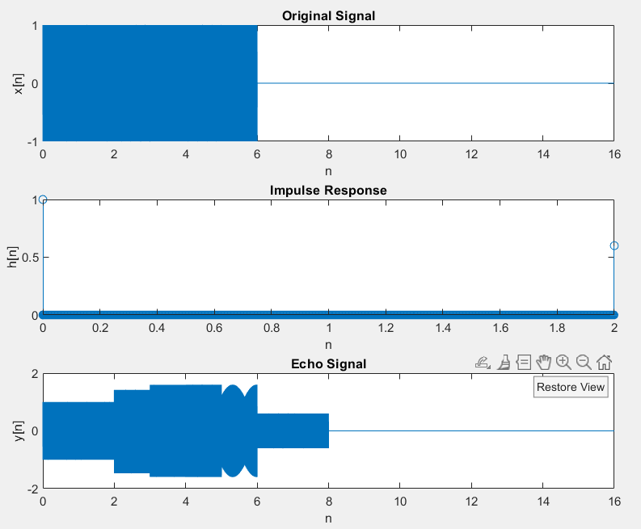
Plot for : q1

Slide 7
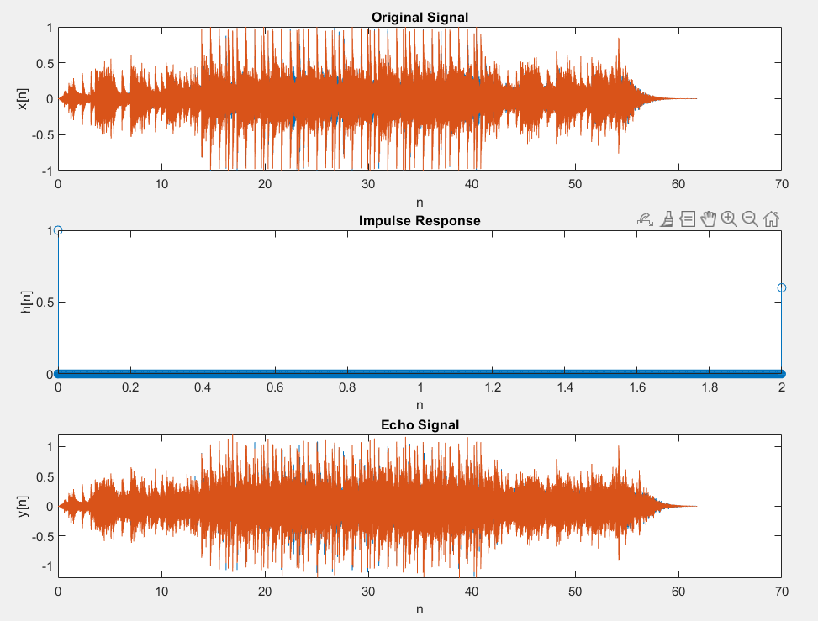
Plot for : q1_hard:

Slide 8
Part-2: Cancel the echo:
Problem Statement:
In this task, you will be provided with an audio signal containing both the original audio and echoes with non-uniform delays. The objective is to develop and implement an effective echo cancellation algorithm that removes the echo components, resulting in a clean, original audio signal.
Tasks:
Input Audio Signal:
Receive an audio signal in a specific format (e.g., WAV or MP3), incorporating both the original audio and echoes with non-uniform delays.
Echo Cancellation:
Design and implement an algorithm for echo cancellation.
The algorithm should identify and effectively remove the non-uniform echo delays, leaving only the original, clean audio.
Algorithm Implementation:
Utilize signal processing techniques or any appropriate algorithms for echo cancellation.
Encourage experimentation and creativity in finding a solution.
Consider the need for identifying and modeling non-uniform delays in the signal.
Output Clean Audio Signal:
Play the resulting audio, aiming for an output that ideally contains only the unechoed, original sound.

Slide 9
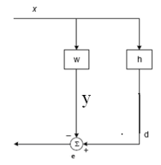
Approach:
To cancel/ remove the echo from the given non-uniform echoed signal, we use a method called Least Mean Square Algorithm.
A path that changes the signal x is called h. Transfer function of this filter is not known in the beginning. The task of LMS algorithm is to estimate the transfer function of the filter. The result of the signal distortion is calculated by convolution and is denoted by d. In this case d is the echo and h is the transfer function of the hybrid.
The adaptive algorithm tries to create a filter w. The transfer function in turn is used for calculating an estimate of the echo. The echo estimate is denoted by y. The signals are added so that the output signal from the algorithm is
e = d – y where e denotes the error signal.
The error signal and the input signal x are used for the estimation of the filter coefficient vector w.

Slide 10
Approach:
One of the main problems associated with choosing filter weight is that the path h is not stationary. Therefore, the filter weights must be updated frequently so that the
adjustment to the variations can be performed. The filter is a FIR filter with the form
W = W₀(n) + W₁(n)Z⁻¹ +….+ W_{N-1}(n)Z^{-(N-1)}
With each iteration of the LMS algorithm , the filter tap weights of the adaptive filter are updated according to the following formula
W(n+1)=w(n)+2µe(n)x(n)
Here x(n) is the input vector of time delayed input values,
x(n) = [x(n) x(n-1) x(n-2) …..x(n-N+1)^{T} .
The vector w(n) = [w0(n) w1(n) w2(n) .. wN-1(n)] ^{T}
represents the coefficients of the adaptive FIR filter tap weight vector at time n.
The parameter µ is known as the step size parameter and is a small positive constant.

Slide 11


Implementation of LMS Algorithm:
Each iteration of the LMS algorithm requires 3 distinct steps in this order:
1. The output of the FIR filter, y(n) is calculated using equation
2. The value of the error estimation is calculated using equation
e(n) = d(n) – y(n)
3. The tap weights of the FIR vector are updated in preparation for the next iteration, by equation
The main reason for the LMS algorithms popularity in adaptive filtering is its computational simplicity, making it easier to implement than all other commonly used adaptive algorithms.

Slide 12
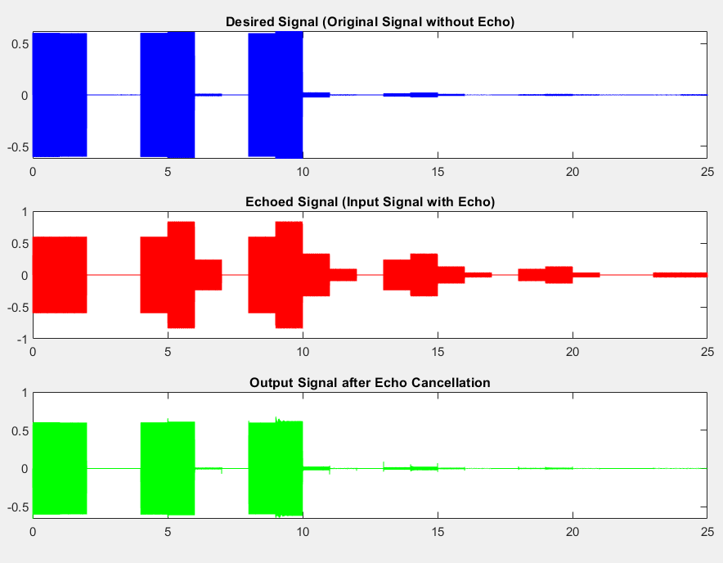
Plots for test input for: q2_not_so_easy:

Slide 13
Observation:
Using Least Mean Square algorithm we were able to cancel/remove the non-unform delay from an echoed signal.
The main features that attracted the use of the LMS algorithm are low computational complexity.
We can vary channel length and the step size parameter (µ) to get more precise results.

Slide 14
Part-3: What is this echo:
Problem Statement:
In this task, the objective is to develop an algorithm for accurately classifying background noises present in music recordings without removing them. The goal is to identify and categorize the types of noise, distinguishing their sources of origin. The potential noise sources include :
fan
pressure cooker
water pump, and
traffic.
Tasks:
Input Music Recording:
Receive a music recording in a specific audio format (e.g., WAV or MP3), containing both the original music and background noise from various sources, both indoor and outdoor.
Background Noise Classification:
Develop an algorithm for classifying background noise sources and Identify and categorize the type of noise, such as fan, pressure cooker/mixer, water pump, and traffic.
Algorithm Implementation:
Utilize signal processing techniques to achieve accurate noise classification.
Consider the characteristics unique to each noise source for effective identification.
Output Noise Classification:
Indicate the presence of specific noise sources and label them accordingly (e.g., fan, pressure cooker/mixer, water pump, traffic).

Slide 15
Approach:
We are using the concept of cross-correlation to classify the noise.
1) We made 6 combinations of noises by subtracting the given two pair of noisy signal and obtaining the outputs as follows:
Water Pump – Fan
Water Pump – Traffic
Water Pump – Pressure cooker
Traffic – Pressure cooker
Traffic – Fan
Pressure cooker – Fan
On observing the above, on taking any of the three combinations one of the noise is always present.
2) We performed cross-correlation of these 6-noise signal with the input signal and obtained the peaks from each correlated signal, then we found the max 3 peaks out of the 6.
3) The Common noise present in the 3 peaks will give us noise present in the input signal

Slide 16
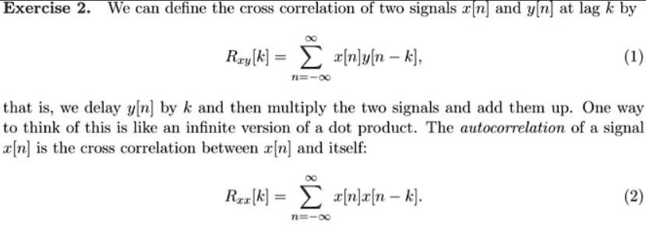
Cross-Correlation:
Cross-correlation is a technique used to analyze the similarity between two signals. It involves sliding one signal over another and computing a similarity measure at each step. The result is a correlation function that indicates how well the signals match at different time offsets. Positive peaks in the correlation function suggest alignment, while negative peaks indicate an inverted match

Slide 17
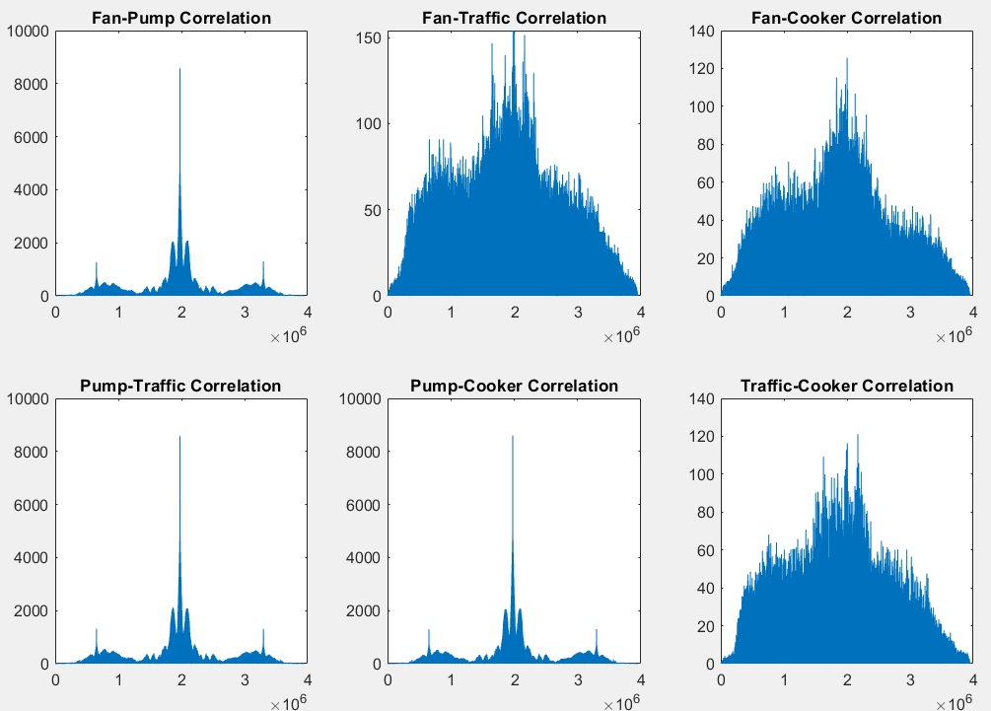
Plots for Cross-Correlation of Music + Pump signal as an input with all noise signal:

Slide 18
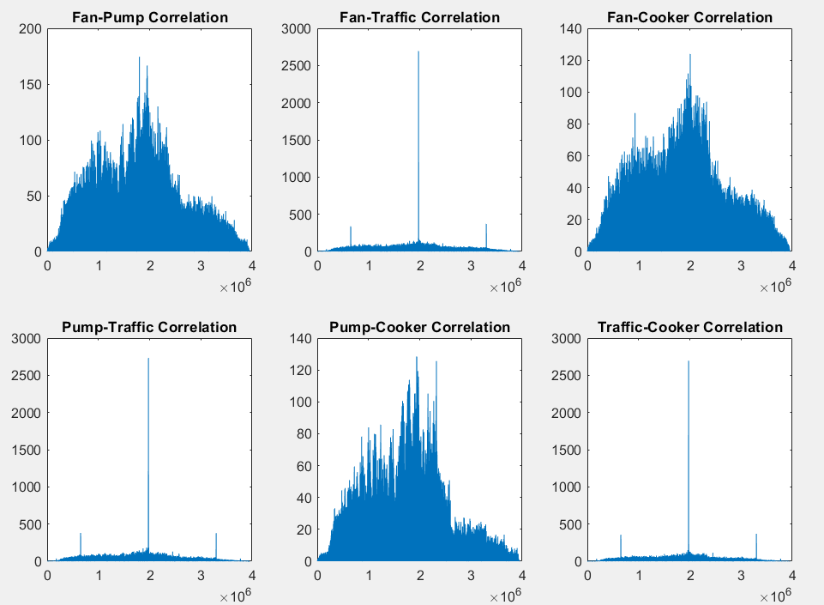
Plots for Cross-Correlation of Music + Traffic signal as an input with all noise signal:

Slide 19
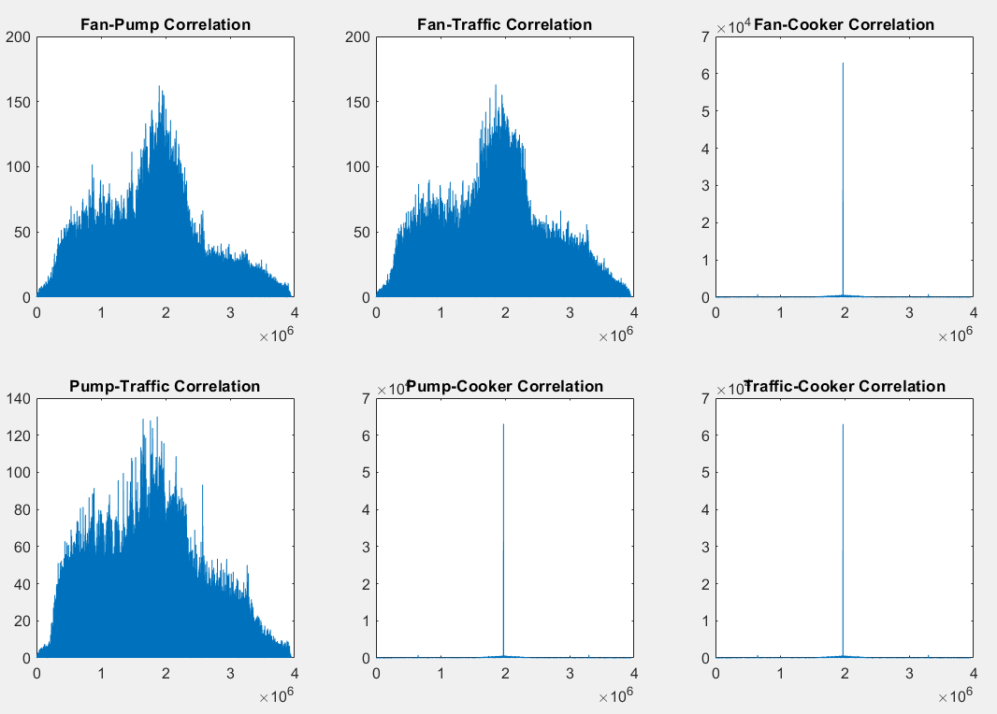
Plots for Cross-Correlation of Music + Pressure Cooker signal as an input with all noise signal:

Slide 20
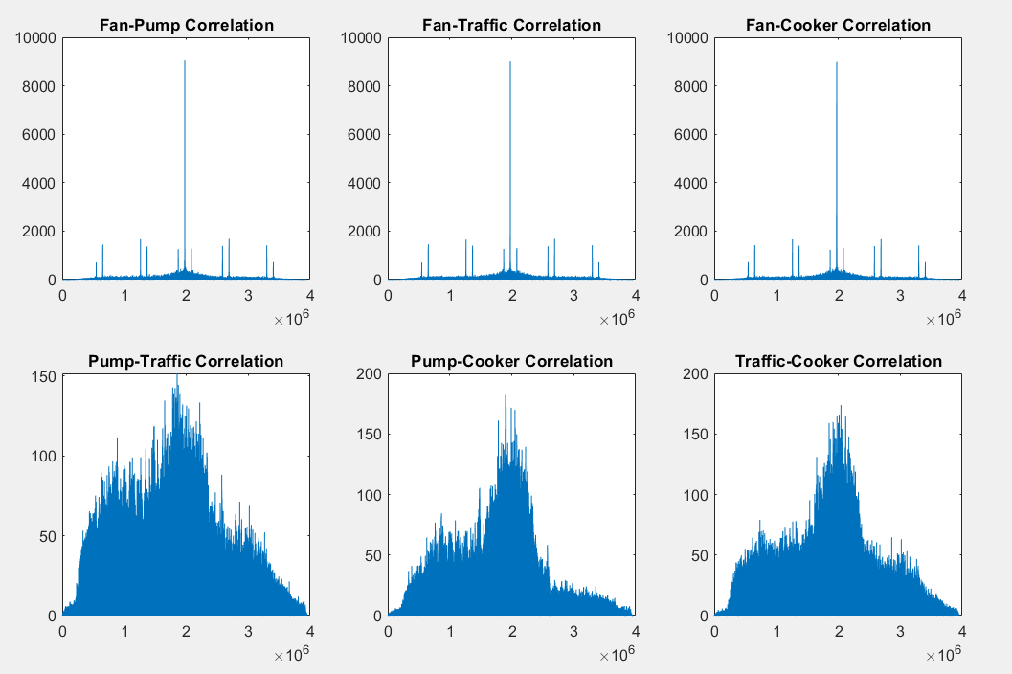
Plots for Cross-Correlation of Music + Fan signal as an input with all noise signal:

Slide 21
Observation:
From these four plots, we can see that, of the six correlation plots, three of the peak values share a common noise, and that this common noise is present inside the given signal.
So, we are successfully classifying the background noise present in music recordings without removing the noise. We can accurately identify and categorize the type of noise present in the recording, distinguishing source of origin.

Slide 22
Challenges:
1) It is important to remember that a signal may have two or more channels. Therefore, we need to adjust our code for those signals.
2) We must ensure that the vectors have the proper length to carry out computation operations such as convolution and others.
3) We made certain assumptions, such as the assumption that noise is naturally additive and that this has an impact on our output.

Slide 23
CONCLUSION
This project has provided a comprehensive overview of the applications of signal processing techniques in real life. We have explored some real-life problems and their solutions while doing the project.
We get a thorough understanding of how we will apply the techniques discussed during the course to solve real-life problems.
By understanding and applying signal processing techniques, we gain powerful tools for addressing real-world challenges across various domains.

