Slide 1
VOTERS VERIFICATION SYSTEM
Giodeelyn B. Albayda
Juan Paolo A. Coloma

Slide 2
WHAT DOES IT DO?

Slide 3
WHAT DOES IT DO?
Voters Verification System (VVS)
a system that is used during elections. Specifically, during the voting period.
verify the votes casted by the voters.
This verification is done by sending a text message to the voter, which contains the list of candidates that they voted.

Slide 4
PROCESS
Register
Vote
Verify

Slide 5
TARGET USERS
&
IMPORTANCE

Slide 6
TARGET USERS & IMPORTANCE
COMELEC
can be used a long side with the printing of the voting receipt or it could also be used as an alternative.
Faster Results
VOTERS
Faster Voting Process
Confidence in Votes Casted

Slide 7
BLUEMIX SERVICES

Slide 8


BLUEMIX SERVICES USED
SQL Database
Used to store the information about the voter.
Twilio
Used to send the verification message to the voter.

Slide 9
DEMONSTRATION

Slide 10
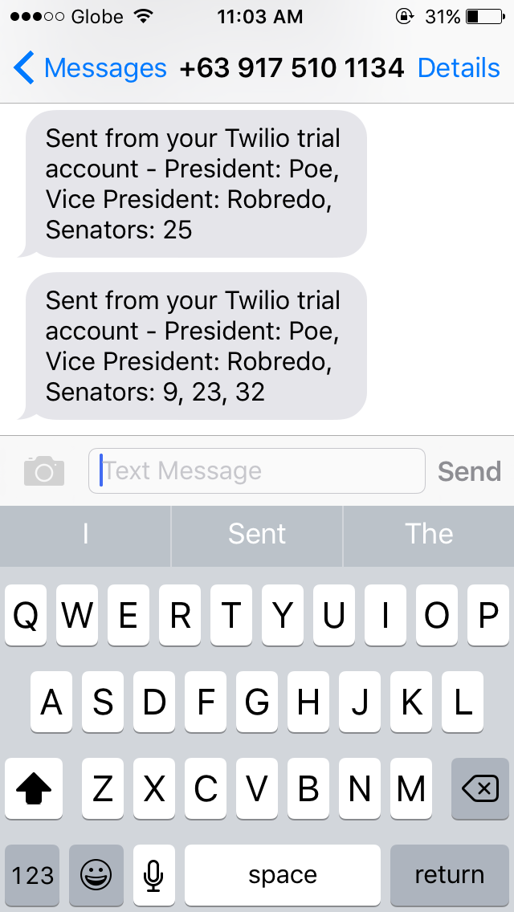
Sample Output

Slide 11
THANK YOU!

Slide 12
VOTERS VERIFICATION SYSTEM
Giodeelyn B. Albayda
Juan Paolo A. Coloma

