Slide 1
VOTERS VERIFICATION SYSTEM
Giodeelyn B. Albayda
Juan Paolo A. Coloma

Slide 2
WHAT DOES IT DO?

Slide 3
WHAT DOES IT DO?
Voters Verification System (VVS)
a system that is used during elections. Specifically, during the voting period.
verify the votes casted by the voters.
This verification is done by sending a text message to the voter, which contains the list of candidates that they voted.

Slide 4
PROCESS
Register
Vote
Verify

Slide 5
TARGET USERS
&
IMPORTANCE

Slide 6
TARGET USERS & IMPORTANCE
COMELEC
can be used a long side with the printing of the voting receipt or it could also be used as an alternative.
Less Cost
Faster Results
VOTERS
Faster Voting Process
Confidence in Votes Casted

Slide 7
BLUEMIX SERVICES

Slide 8


BLUEMIX SERVICES USED
SQL Database
Used to store the information about the voter.
Twilio
Used to send the verification message to the voter.

Slide 9
DEMONSTRATION

Slide 10
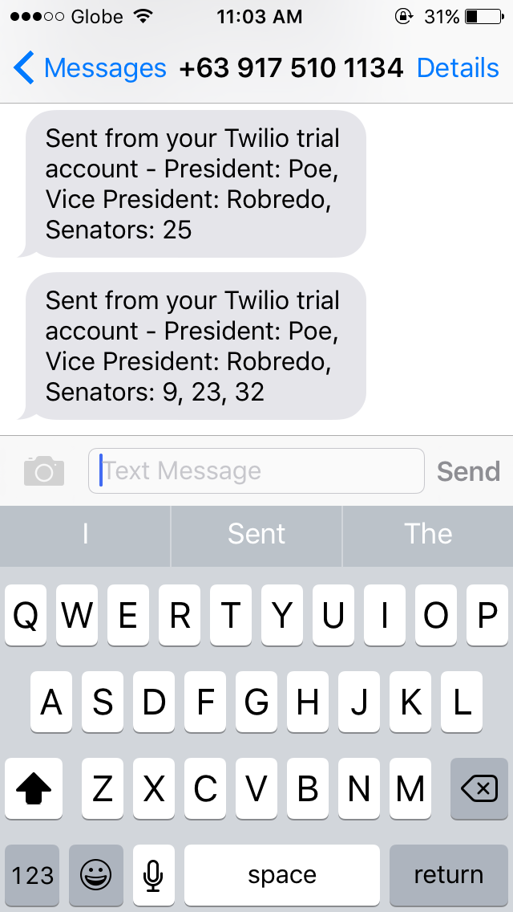
Sample Output

Slide 11
THANK YOU!

Slide 12
VOTERS VERIFICATION SYSTEM
Giodeelyn B. Albayda
Juan Paolo A. Coloma

