Slide 1
Part 1 of GIK29B:
Data Manipulation
with R
Charlie Lindgren, PhD
Microdata analysis

Slide 2
Presentation structure: Color interpretation
R syntax/code/output (while in console note the > sign in the beginning)
Base R/Rstudio menu interface
Keyboard shortcuts

Slide 3
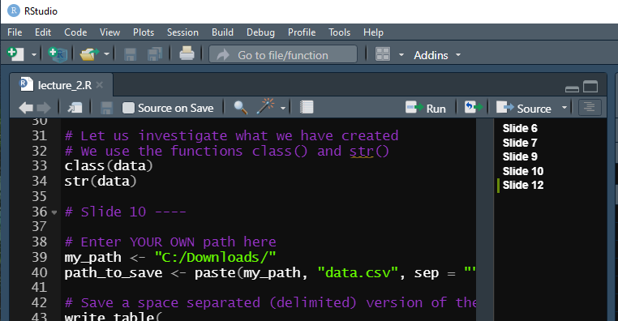
Document outline is handy since you may jump to sections of the code easily
To create a document outline code section: # write any comment as title and add four dashes ----
1
2
3

Slide 4

If you do not supply the complete syntax, the console will not produce output, and will thus be contingent on what has been written earlier until it is completed without error
Note that this is therefore not an error occurring, but rather incomplete syntax.
1
This is depicted to the right by the “+” signs, where the ENTER key has been pressed repeatedly until I finally supplied 1 assigned to the object A.
2

Slide 5

If you’d like to “escape” this state, just simply press the ESC key and control of the console will be given back.
1
2 hit ESC key

Slide 6
Pro tip for Rstudio!
A lovely keyboard shortcut sequence to remember!
Highlight everything… Ctrl + A or Cmd + A
…then run this keyboard shortcut… Ctrl + Shift + A or Cmd + Shift + A
…voilà! You have cleaned up the script code as it should be written with good coding practice in mind! Also works if you highlight individual parts, but I tend to run it across whole script when I want to structure things quickly (lazy guy… ☺)

Slide 7
The rep() function is useful to repeat values.
It also works for characters.
# Use combine function to enter a numeric vector x <- c(2, 3, 4, 4)
y <- c(1, 1, 1, 1)
# Instead use rep() to obtain y, since repeated values
# e.g., repeat the numerical value 1 as a vector of length 4
y <- rep(1, 4)

Slide 8
We create a character vector and logical vector, and also use the numeric vector x presented earlier.
These will be used in the example on the next slide concerning data frames.
# Character data Names <- c("John", "Danie", "Mary", "Oskar")
# Logical data
Male <- c(TRUE, TRUE, FALSE, TRUE)
# The numeric vector x
x <- c(2, 3, 4, 4)

Slide 9
Data frames (data.frame)
Data frames, or data.frame() function, is an R object designed for handling different classes of data.
# Construct a data frame with columns x, Names, and sex, # where the latter is a logical vector indicating # the sex Male/Female. # We construct this vector using characters as below. indicator <- rep("Female", 4) indicator[Male] <- "Male"
data <- data.frame(x, Names, sex = indicator)

Slide 10
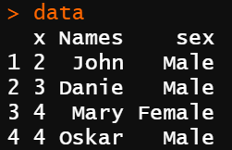
Data frames (data.frame)
Note how the columns are named according to how we entered the code
x and Names received column headers based on the object names while sex received column name based on the argument in the data.frame() function

Slide 11
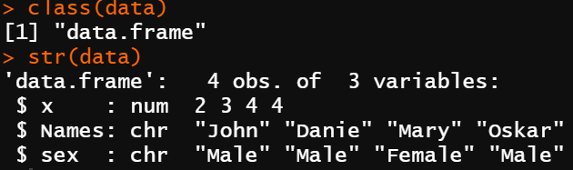
Data frames (data.frame)
# Let us investigate what we have created # We use the functions class() and str() class(data) str(data)
We see that data.frame is a class in R, much like numerical and character. str() function is short for ‘structure’ and tells us what this object is made up of. We see that column x is numerical, while Names and sex is characters, for instance!

Slide 12
Save data
# Enter YOUR OWN path here.
# Note that I added extension "csv" short for "comma separated value".
my_path <- "C:/Downloads/"
path_to_save_space <- paste(my_path, "data_space.csv", sep = "")
path_to_save_comma <- paste(my_path, "data_comma.csv", sep = "")
# Save a space separated (delimited) version of the data named ‘data’
write.table(data, file = path_to_save_space, sep = " ", na = "NA", dec = ".", row.names = FALSE, col.names = TRUE)
# Save a comma separated (delimited) version of the data named ‘data’
write.table(data, file = path_to_save_comma, sep = ",", na = "NA", dec = ".", row.names = FALSE, col.names = TRUE)

Slide 13
Exercise for home!
Try save the data frame “data” in one of your own folders.
Then try opening it using excel or a text editor.

Slide 14
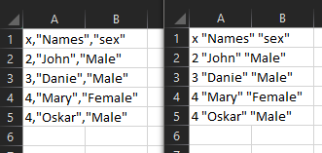
This is the expected excel output
Comma separated values (left) and space separated values (right)

Slide 15

Import data
One may open data in a variety of ways but read.table() is commonly used. If not using an R project or setting the working directory, one must again specify the path
# Save a space separated (delimited) version of the data named ‘data’
data_space <- read.table(file = path_to_save_space, header=TRUE, sep= " ", dec=".", na.string="NA")
# Open a comma separated (delimited) version of the data named ‘data’
data_comma <- read.table(file = path_to_save_comma, header=TRUE, sep= ",", dec=".", na.string="NA")
# Try run this and see that we have the same data opened!
identical(data_space, data_comma)

Slide 16
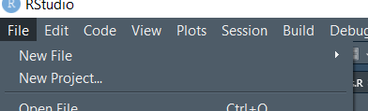
Pro tip for Rstudio!
Use an R project to run your analysis!

Slide 17
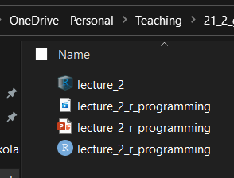
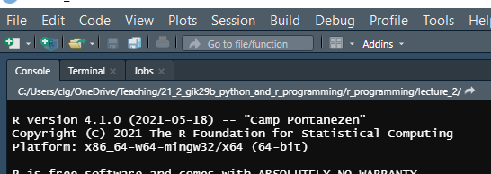
Rstudio project
Opening your R session as an R project will resolve issues with path dependencies. The folder that the .Pproj file resides in will also provide the path in the R session.
Code is therefore also much more easily shared with others (besides Github and the like…)

Slide 18
Exercise for home!
Provided you have managed to save “data_comma.csv” and “data_space.csv”… …try saving and opening while working with an R project, i.e., save them inside the R project and open them within the same project. Make sure the path is shorter than before! ☺

Slide 19
Saving extensions .Rdata and .Rds
R can save objects with other extensions rather than .csv extension.
This comes in handy since it is quite convenient to use, even R itself access such files frequently.
There are two extensions, .Rdata and .Rds
The former can save multiple objects
The latter can save only 1 object.
The .Rds extension is (in my opinion) more useful and I will hence show it here.

Slide 20
Saving extensions .Rdata and .Rds
The save() and load() functions for .Rdata are easy to remember by name, but since the .Rds extension is more useful, I will therefore show you saveRDS() and readRDS()
# Create an object
test_object <- c(1, 2, 3)
# Saving the object to .rds extension file
saveRDS(test_object, file = "…/path/name_of_file.rds")
# read the object from .rds extension file
check_object <- readRDS(file = "…/path/name_of_file.rds")

Slide 21
Why then use .Rdata and .Rds over .csv files?
.Rds and .Rdata files maintain the structure of the object(s) you have saved.
When using .csv files one must take care to make sure that classes are not changed.
It makes much less sense to use .Rds and .Rdata for large files.
Also .csv files are more universal to use and is generally accepted by many software.
.Rdata and .Rds can therefore be used efficiently when managing intermediate steps in analysis, but most likely be refrained from being used in the beginning and end of analysis, as well as when “Big Data” is involved.

Slide 22
Load data from R packages
Many R packages include a sample data, for trying out the packages or make speed comparisons of functions, or the like.
We may, however, use these this data to learn R! Let us load a package with library() and then use data() to access the data in the package, namely ‘Prestige’ describing prestige of Canadian occupations. # Load data ‘Prestige’ from the R package ‘car’ # Uncomment line below if have not installed yet: # install.packages("car") library(car) data(Prestige) ?Prestige

Slide 23
Debugging data files
Use summary() to control that the variables makes sense. str() is also useful in this regard!
Control means, variance, number of NA:s etc. using summary()
Use str() to make sure that our data has the proper classes.

Slide 24
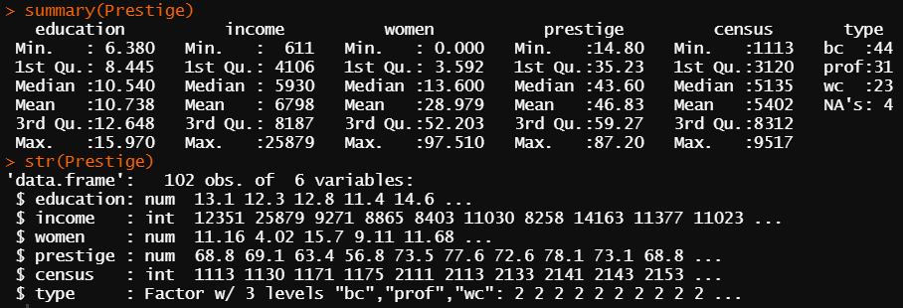
Take note of $ symbol for later!
Check classes!
Some sample values can give indications
Summary values can give a sense of the data, especially if NA values are abundant, as an early warning sign

Slide 25
Working with data.frame in R!
Now it is time to start working the data frames in R.
If you attach() the data frame, you can retrieve variables (columns) of the data frame in the same way you would type an object.
Let us attach Prestige and try. When one is finished simply use detach() the data frame. Note that ‘education’ on the next slide does not show up in the environment as an object!

Slide 26
# Try to print the ‘education’ variable in ‘Prestige’
# (This will fail with error message if not attached)
education
# Now attach the ‘Prestige’ data frame...
attach(Prestige)
# ...and try to print the ‘education’ variable in ‘Prestige’
# (This should now succeed since attached)
education
# Detach Prestige
detach(Prestige)

Slide 27
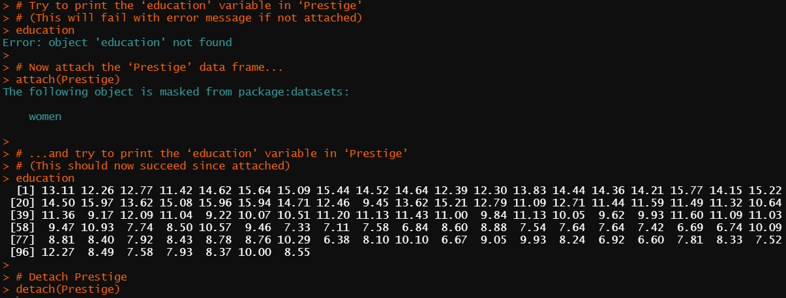
Object masked since already existed in another package

Slide 28
Two problems with using attach() and detach()
Masked variables when using multiple data frames: If you have attached one data frame and attach a second data frame variables with equal variable names will be ‘masked’ from the first data frame. (as seen in the previous slide)
If you make changes to a data frame which is attached, the changes are not made in the copy created by attach(). You must attach the data frame again.
Instead of attaching a data frame, you can always reference a variable by name.frame$name.variable where you may take note of the $ symbol for referencing.

Slide 29
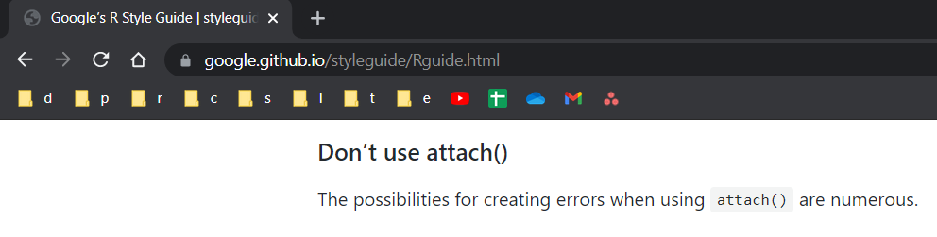
As best described in Google’s R Style Guide… ☺
…which of course can be good to review ☺☺☺

Slide 30
# Attach Prestige
attach(Prestige)
# Change variable ‘income’ in attached copy of Prestige
income <- income/1000
# Compute the average of income in the attached copy of Prestige
mean(income)
# Compute the average of income in the data frame Prestige
mean(Prestige$income)
# Detach Prestige
detach(Prestige)

Slide 31
Factors
Character data is usually stored as ‘factors’ in data frames.
You can create factors with the function factor ().
The function levels(factor ) give the categories of the factor.
Many functions in R know how to deal with factors (e.g., ggplot2 package), and it is important to distinguish from character whenever relevant.

Slide 32
# Create a vector with character data
y <- c(rep("yes", 2), rep("no", 3), rep("maybe", 4), "Don’t know")
y
# Define it as a factor
y <- factor(y)
y
# Check the categories
levels(y)
# Check the number of categories
length(levels(y))
# Check the numbers in each category
summary(y)

Slide 33
Matrices in R
The function matrix() is used to create matrices in R
Similar to vectors, and as opposed to data.frames, matrices must contain the same class in each element.
You can add a vector or a matrix to a matrix or joint two or more vectors into a matrix by cbind() (column-wise) and rbind() (row-wise). Remember that vectors are interpreted as columns in R.
dim(), ncol(), nrow() are also useful functions.

Slide 34
# Some matrices and related functions
A <- matrix(c(1, 2, 3, 4), nrow = 3, ncol = 4)
A
dim(A)
ncol(A)
nrow(A)
length(A)
B <- matrix(c(1, 2, 3, 4), 3, 4, byrow = TRUE)
B
AB <- cbind(A, B)
AB
AB <- rbind(A, B)
AB

Slide 35
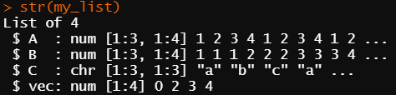
Lists in R
In lists you can store heterogenous vectors, matrices and data types!
# A List
my_list <- list(A=A,B=B,C=matrix(c("a","b","c"),3,3), vec=c(0,2,3,4))
# Check str() of list
str(my_list)
# Print the whole list
my_list
# Only print the matrix A within the list
my_list$A
Again, take note of $ symbol!
We are combining matrices of different classes in the list!

Slide 36
Missing values
Missing values is denoted as NA (Not Available).
You must think about this when you are exporting and importing data.
The function is.na() is used to identify missing values in R objects.
The default way to treat missing data in R is to remove missing values, e.g., using na.rm(), na.omit() or similar functions.
This is NOT always OK to do by default, as it goes against sound research methodology…

Slide 37
# NA values in data
y <- c(1, 3, 4, 5, NA, 5, NA)
# When you use the mean() function
# you now HAVE TO specify the na.rm option
# otherwise, no success in evaluating any mean
mean(y, na.rm = TRUE)
# With the summary function you don’t have to do this.
summary(y)
# You can identify which elements are NA with is.na()
is.na(y)

Slide 38
Indexing
This is arguably the most essential skill when working with R.
Indexing is used to extract or identify certain elements in different kinds of R objects: Matrices, lists, vectors, data frames and more.
Mastering this skill will make managing data a breeze.

Slide 39
Indexing in general
# Recreate previous dataset
Names <- c("John", "Danie", "Mary", "Oskar")
Male <- c(TRUE, TRUE, FALSE, TRUE)
#Select Danie
Names[2]
# Or by a logical argument
Names[Names == "Danie"]
# "Danie" is actually "Daniel". Change this.
Names[names == "Danie"] <- "Daniel"
Names
# Select the men
Names[Male]
# Select the only woman (‘!’ is negation)
Names[!Male]

Slide 40
Indexing factors
# Make names as factor
f_names <- factor(Names)
f_names
# Select the first element
f_names[1]
# Select the boys
Male <- c(TRUE, TRUE, FALSE, TRUE)
f_names[Male]

Slide 41
Indexing in matrices
# Create a matrix M
M <- matrix(c(1, 2, 3, 4), 4, 3)
M
# Select the first row of matrix M
M[1, ]
# Select the second column
M[, 2]
# Remove row 2 and 3 (‘-’ is not)
M[-c(2, 3), ]
# Select all value less than 3 from column 1
arg <- M[, 1] < 3
M[arg, 1]

Slide 42
Indexing data frames
# Check that Prestige is actually a data.frame
class(Prestige)
# Check the variable names of Prestige
names(Prestige)
# Compute the average of income using indexing
arg <- names(Prestige) == "income"
mean(Prestige[,arg])
# Select a sub-sample consisting of "prof" type of jobs
sub_Prestige <- subset(Prestige, type=="prof")
summary(sub_Prestige)
# Select without subset
summary(Prestige[Prestige$type=="prof",])

Slide 43
Logical operators == equal to != not equal to < less than > greater than <= less or equal >= greater or equal − not & and | or ! negation of a logical object

Slide 44
More indexing…
# Create matrix
vec1 <- c(2, NA, 1, 3, 4, 6, NA)
vec2 <- c(NA, 2, 3, 4, 5, 4, NA)
Mat <- cbind(vec1, vec2)
# And
arg <- is.na(vec1) & is.na(vec2)
Mat[!arg,]
# Or
arg <- is.na(vec1) | is.na(vec2)
Mat[!arg,]

Slide 45
Indexing lists
Indexing lists are a bit different
You use double square brackets to obtain a listed object

Slide 46
# Select the first object (matrix A) in my_list
my_list[[1]]
#Select the first row of matrix A in the my_list my_list[[1]][1,]

