Slide 1

Name :- Jai Kumar Goel Roll No :- 2210991693 Group :- G-22
Title - Pinogram
A Social media platform
Submitted to :- Harpreet kaur

Slide 2
Info about Platform
Social media platforms are complex systems designed to facilitate communication, content sharing, and interaction among users. Here's a high-level overview of how they work:
1. User Accounts and Authentication
Registration: Users sign up with personal details, such as email, username, and a password.
Authentication: To ensure secure access, platforms use authentication mechanisms like passwords.
2. User Interface (UI)
Homepage: Users see a feed of content, which can include posts from friends, followed pages, or recommended content.
Profile Pages: Each user has a profile page displaying their information, posts, and activity.
Navigation: Search button to access feed and post from friends.

Slide 3
Blueprints and UI of Platform…

Slide 4

Sign up Page
Sign up
Email - _________
Username- _______
Full name- ________
Password-________
Sign up button
Log in button

Slide 5
Login Page
Login to Pinogram
Username- ______
Password- _______
Login buttton

Slide 6
User Home Page
Write caption for image
Choose file
Upload

Slide 7
Profile Page
Search Feed Userprofile
Image will be posted
with the captions
Comments of the people

Slide 8
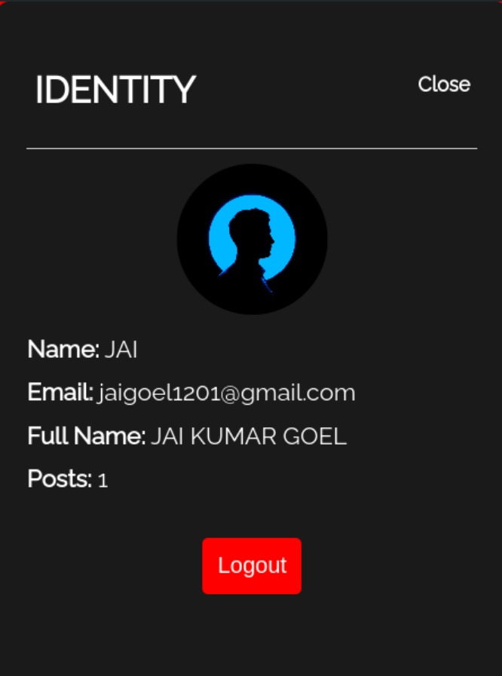
Identity
Name:- ______
Email:- _______
Full Name:- _______
Posts:- _____________

Slide 9
Express.js
Express.js, often simply referred to as Express, is a minimalist and flexible web application framework for Node.js. It provides a robust set of features for building web and mobile applications, including:
Routing:
Defining endpoints (URLs) and associating them with specific functions to handle different HTTP requests (GET, POST, etc.).
Middleware:
Functions that execute during the request-response cycle, allowing for tasks like authentication, logging, and error handling.
Templating engines:
Integration with various templating engines (e.g., EJS, Pug) to generate dynamic HTML content.

Slide 10
MongoDB
Using MongoDB as a data-storing function involves leveraging its features to efficiently store, retrieve, and manage data. Here's how MongoDB can be used for data storage, including a basic overview of its key components and a simple example.
Key Components
Database:
A database in MongoDB is a container for collections. Each database has its own set of files on the file system.
Collection:
A collection is a group of MongoDB documents. It is the equivalent of a table in a relational database. Collections do not enforce a schema, so documents within a collection can have different fields.
Document:
A document is a set of key-value pairs. Documents are analogous to rows in a relational database but are much more flexible. They are stored in a format called BSON (Binary JSON).
Index:
Indexes are used to improve the efficiency of search queries in MongoDB. They can be created on any field in a document.

Slide 11
Changes we can make Further
We can add an edit button to the profile section which can edit name and password.
We can upgrade its UI for better visuals.
We can connect it to online server for storing data.
We can also use google or facebook authentication for profile verification.

Slide 12


