Slide 1
Skills vs Labels
SAS CU HACKATHON
Is a data professional paid for what they can do, or for what their job is called?
Team AkuuJii · Japneet Kour Khanduja (24BCS12959) · [Members] · Chandigarh University
Notes:
Good morning. Our team asked one simple question about data-science careers: are people paid for their skills, or for the label on their job? We used all four hackathon datasets to answer it at three stages of a career.

Slide 2
Two signals on every job — which one sets the pay?
SKILLS
LABELS
What you can do
What your job is called
Python
SQL
Machine learning
Data Analyst
Data Scientist
ML Engineer
Statistics
Storytelling
Senior …
Manager
Five questions across the career: the market (Q1–Q3), the junior pay review (Q4) and senior success (Q5).
Notes:
Every job carries a skill list and a label. Students are told to collect skills, but employers advertise and pay by title. We test which one actually drives reward: in the job market, in junior salary hikes, and in senior success.

Slide 3
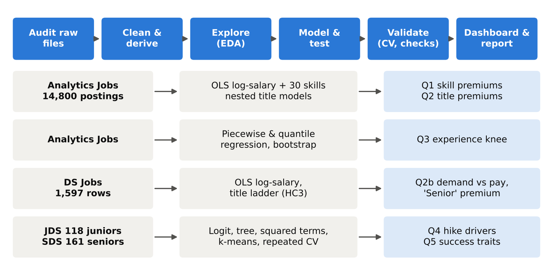
Four datasets, one reproducible pipeline
14,800
1,597
118
161
analytics job postings (after cleaning)
data-science job rows, 608 companies
junior data scientists, 5 skill scores
senior data scientists, Big-Five traits
Notes:
Two job-market files and two people files. Twelve scripted steps take the raw files to cleaned data, five statistical studies, trained models and a dashboard. One command reruns everything in about two minutes.

Slide 4
Cleaning: every fix counted and justified
1,041
2,273
7
duplicate postings removed
location spellings standardised
title families from free-text titles
30
95
21
skill columns from free-text skills
company-name variants merged
repeated junior records dropped
Text salaries and experience parsed to numbers · log salary used in all models · logs saved for every step
Notes:
The data was messy. We removed 1,041 repeated postings, standardised 2,273 location spellings, grouped thousands of titles into seven families, and turned free-text skills into 30 columns. Every step prints a log that is in our report appendix.

Slide 5
Q1 · A few skills pay — some even cost you
Q1
1.4 yrs
Java's premium equals 1.4 years of experience; SQL and business analysis about 1.1
17 of 30 skills have a reliable effect
Big data, Spark add nothing once the title is known
Excel, SEO signal lower-paid roles
Notes:
Holding title, city and experience fixed, Java, business analysis and SQL each add around 18 to 23 percent, worth more than a year of experience. But big data and Spark add nothing once the title is known, and Excel and SEO carry penalties. Grey means not significant.

Slide 6
Q2 · Labels keep most of their premium after 30 skills
Q2
62%
of the average title premium survives the skill controls
ML Engineer +31%, Data Scientist +16% at equal skills
R² 0.480 → 0.493 when all 30 skills are added
DA vs DS skill profiles: cosine 0.47
Notes:
This is our core test. Model A explains pay with title, city and experience. Model B adds all 30 skills. If titles were just skills in disguise, the orange bars would collapse to zero. They don't: on average 62 percent of the premium survives, and R squared barely moves. The label itself carries pay.

Slide 7
Q2 · Same experience, different title, very different pay
Q2
14–36%
what the word 'Senior' adds on top of the base role at the same experience
55% of postings are Business/Data Analyst roles: the two lowest-paid titles
Demand vs pay: Spearman −0.65
Notes:
An independent check in the Data Science Jobs file. At the same required experience, a Senior Data Scientist posting pays 194 percent more than a Data Analyst posting. The word Senior alone adds 14 to 36 percent. And the volume of jobs sits in the lowest-paid labels.

Slide 8
Q3 · Pay growth is front-loaded: the first 6.5 years decide it
Q3
+36%
+7%
a year, up to 6.5 years
a year after
Break at 6.5 yrs (bootstrap 95% CI 6.0–7.0)
Top earners keep climbing until ~10 years
Median ₹1.5 L → ₹12.5 L in the first 6–9 years
Notes:
Piecewise regression finds a clear break at 6.5 years: about 36 percent a year before it, 7 percent after. That early window is exactly when people move from Analyst to Scientist to Senior labels.

Slide 9
Q4 · Juniors are paid for maths and storytelling, not coding
Q4
Decision rule
Storytelling > 4.15
AND Maths & stats > 3.55
AND AI & ML > 4.0
→ high hike
Coding alone: n.s. (p = 0.19)
+1 SD maths ≈ 4× the odds
Logistic regression, 118 juniors · CV AUC 0.89 · accuracy 84% vs 51% by guessing
Notes:
Inside the company, skills do matter. Maths and statistics and dashboard storytelling roughly quadruple and triple the odds of a high hike. Coding alone is not significant. A simple tree turns it into a rule a manager can use.

Slide 10
Q5 · Seniors succeed on conscientiousness and openness
Q5
89%
success rate of the 'driven achievers' archetype (n = 88); two other archetypes never succeed
Rule: Openness > 38.5 AND Conscientiousness > 36.5
Descriptive of this sample, not a hiring test
161 seniors · linear logit CV AUC 0.96 · with squared terms 0.975 · accuracy 93% vs 53%
Notes:
For senior customer-facing data scientists, personality separates success almost perfectly. Conscientiousness and openness dominate. One personality archetype, the driven achievers, accounts for nearly all success. Because the separation is so clean, we treat this as descriptive, not as a hiring test.

Slide 11
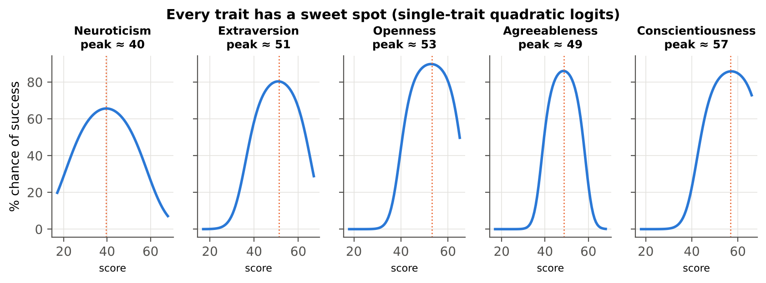
Q5 · More is not always better: every trait has a sweet spot
Q5
Optima: conscientiousness ≈ 57, openness ≈ 53, extraversion ≈ 51, agreeableness ≈ 49, neuroticism ≈ 40 (scale 17–68). Squared terms lift CV AUC 0.964 → 0.975 (p < 0.001): aim high, then plateau.
Notes:
We tested whether more is always better. For all five traits it is not: each has an inverted-U with a peak inside the observed range. The effect is real but modest, so the practical message is aim high, then plateau.

Slide 12
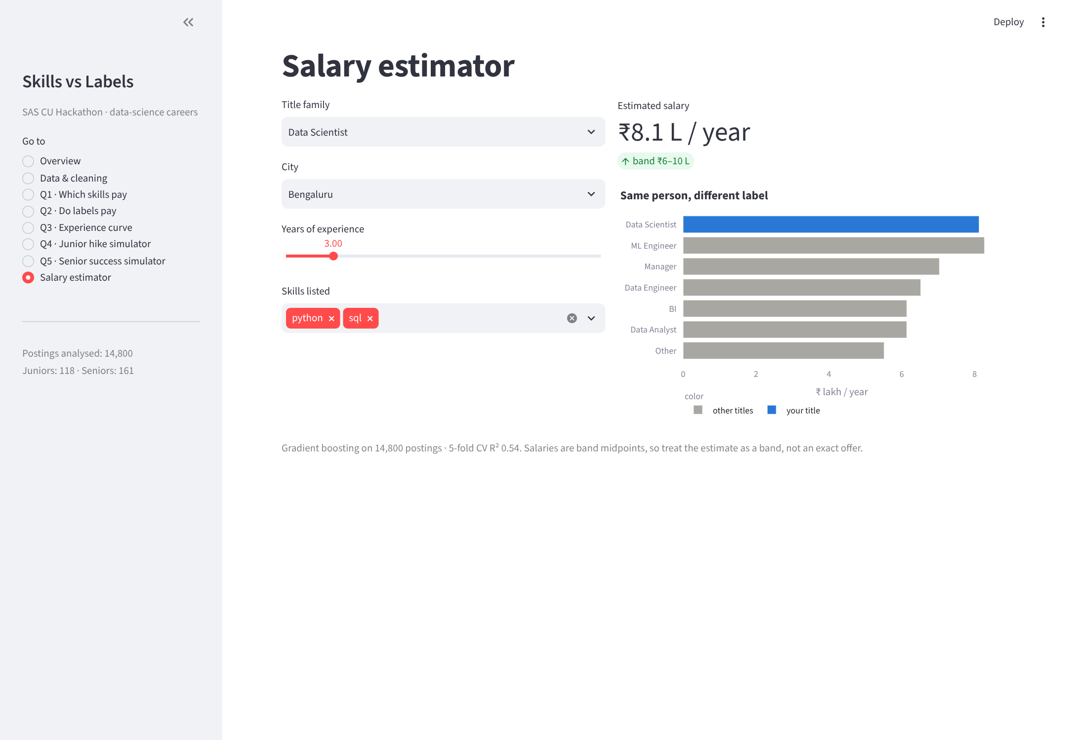
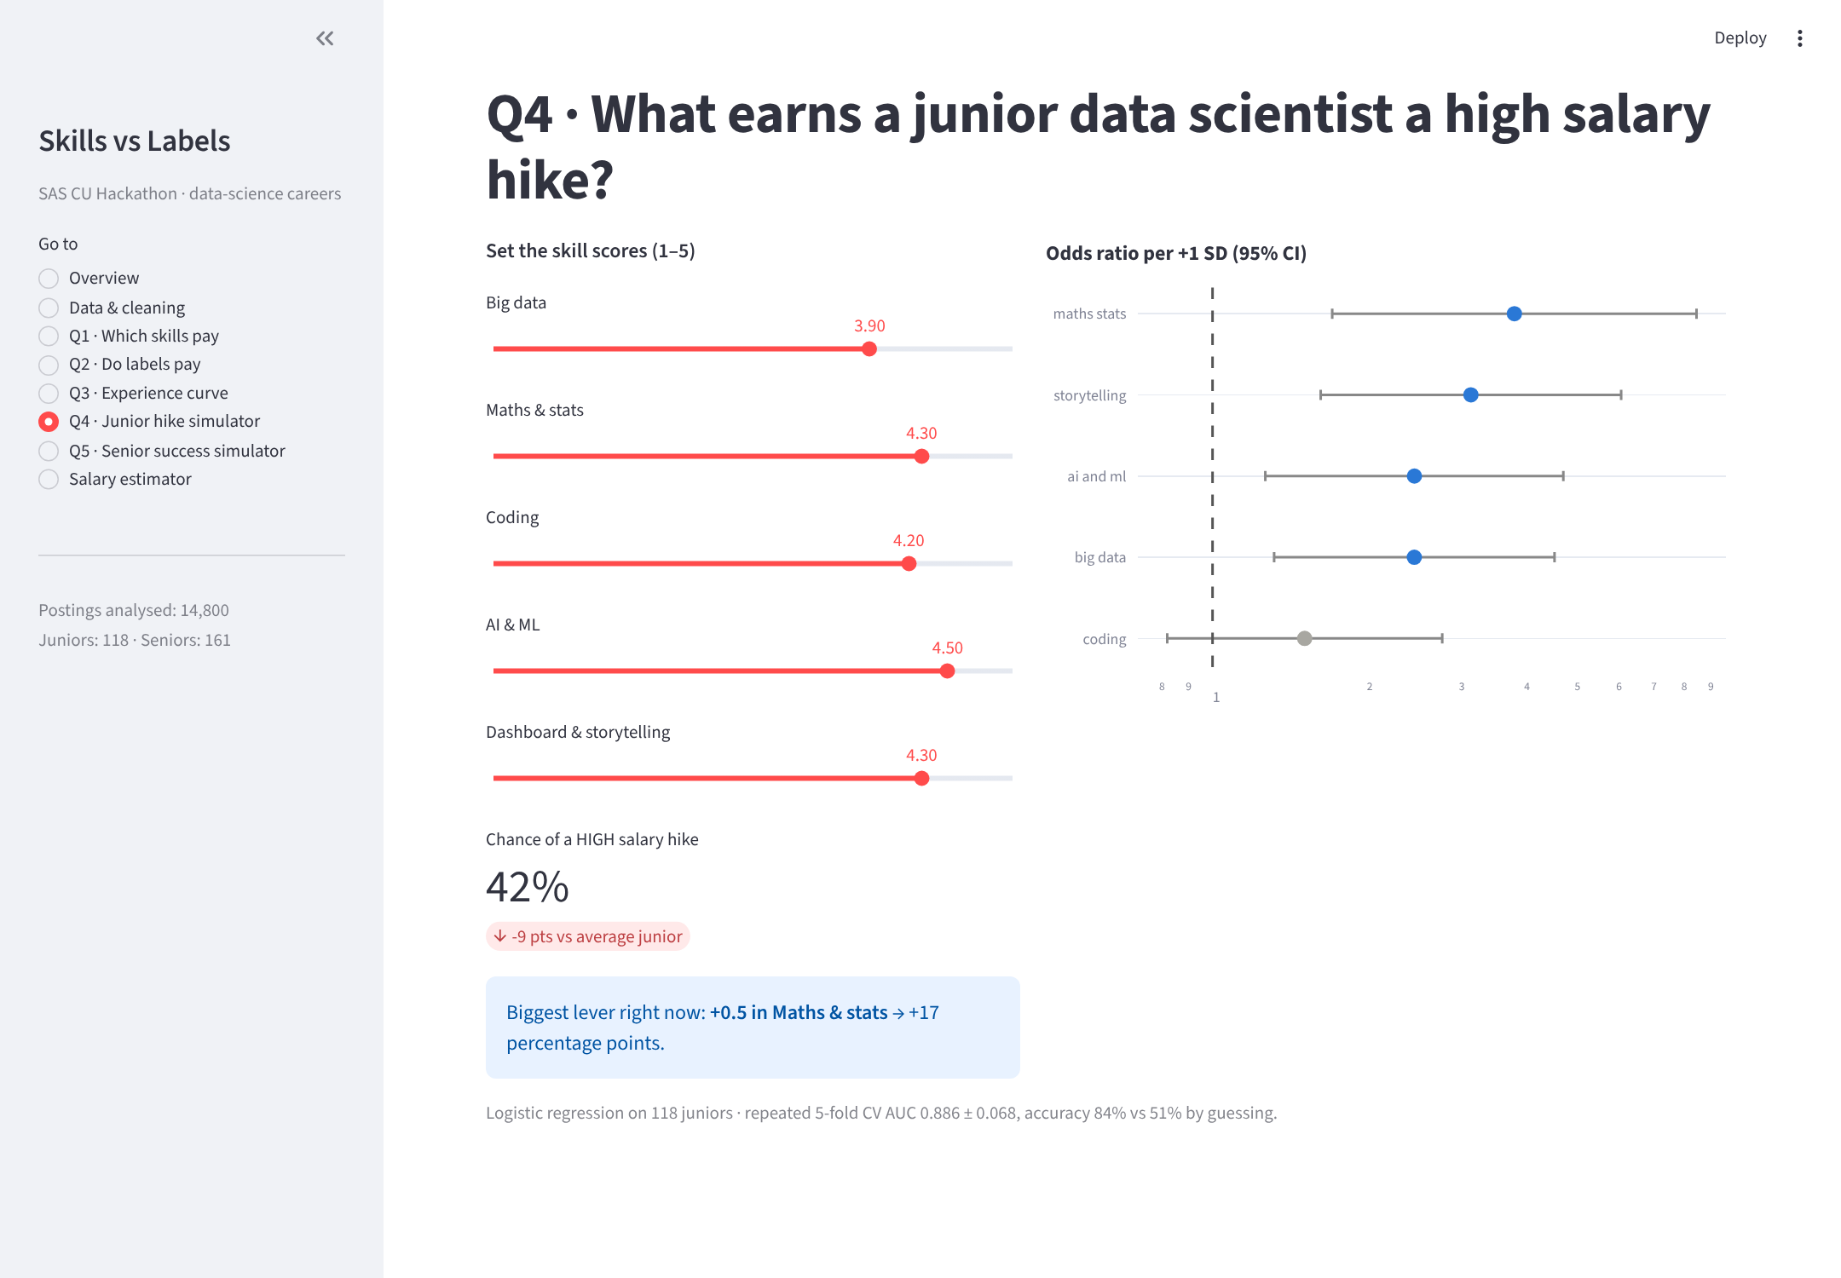
The dashboard: our results as a decision tool
Salary estimator — 'same person, different label'
Junior hike simulator — shows the biggest lever
8 pages · 3 trained models · Streamlit · `python run_all.py` then `streamlit run app.py`
Notes:
We packaged everything into a Streamlit dashboard. The salary estimator shows the same person under different labels, which makes the title premium tangible. The hike and success simulators show which change would help most. I can demo it live if time allows.

Slide 13
Hypotheses: what held and what did not
 | Hypothesis | Verdict | Evidence
H1 | Advanced skills carry the largest premiums | Partly | Java, SQL lead; big data n.s.
H2 | Titles are 'skills in disguise' | Rejected | 62% of premium survives
H3 | Pay growth slows after early years | Supported | Break at 6.5 yrs
H4 | Coding and AI/ML drive junior hikes | Rejected | Maths & storytelling lead
H5 | Success rises steadily with C and O | Partly | Sweet spots for all 5 traits
Notes:
Two of our starting beliefs were wrong. Titles are not skills in disguise, and junior hikes are not driven by coding. Experience front-loading held, and the personality story holds with an important twist: sweet spots.

Slide 14
Skills open the door. Labels and experience set the price.
Market: the label pays — 62% of title premiums survive 30 skill controls; 'Senior' alone is worth 14–36%.
Career: pay grows ~36% a year until 6.5 years — the window for moving up the ladder.
Inside the firm: maths, storytelling, conscientiousness and openness are rewarded.
Notes:
Our conclusion in one line: skills open the door, but labels and experience set the price. In the market, the label pays. The early years are decisive. Inside the firm, capability is rewarded: maths, storytelling, and for seniors conscientiousness and openness.

Slide 15
What each stakeholder should do
Students
Employers & HR
Universities & SAS
Aim for the better-paid label your skills justify
Learn SQL, statistics and a production language first
Use the first 6 years to climb
Practise storytelling
Audit title-based pay bands
Standardise job titles
Make storytelling an assessed competency
Use personality models for development, not hiring
Weight statistics and communication like coding
Capstones end in a business presentation
Bundle modelling with visual analytics in certifications
Promote transparent, skill-based job architecture
Notes:
For students: aim for the label your skills justify and use the early years. For employers: audit title-based pay and standardise titles. For universities and SAS: weight statistics and communication as heavily as coding.

Slide 16
Limits, next steps — and thank you
Observational data: associations, not causes
Skills are keywords in postings, not verified proficiency
Salaries are bands; people samples are single-company (118, 161)
Senior data separates almost perfectly: likely synthetic or pre-screened
Next: NLP on job descriptions for seniority and scope
Employer fixed effects to separate brand from label
Re-run in SAS Model Studio for governed deployment
Thank you — questions?
Notes:
These are associations from observational data, salaries are bands, and the people samples are small and single-company. Next we would add NLP on job descriptions and employer effects, and re-run in SAS Model Studio. Thank you, we are happy to take questions.

