Slide 1
MINI GAMES
Submitted to Department of Computer Science &
Engineering in Course B.E – 1st Sem
Submitted By :
Japit Arora(2210991695)
Jappanjot Singh(2210991696)
Jashan(2210991697)
Supervised By:
Dr. Neha Sharma

Slide 2
Acknowledgement
We would like to express my special thanks of gratitude to my teacher Dr. Neha Sharma, who gave us the golden opportunity to do this wonderful project of python coding on “Mini Games”, who also helped us in completing our project. We came to know about so many things. We are really thankful to them. Secondly we would also like to thank are companion friends who also helped us out in finalizing this project within the limited time frame

Slide 3
CONTENT
1 | History
2 | Objective
3 | Case Study
4 | Methodology
5 | Python Code
6 | Result
7 | Concept Used In Program
8 | Applications
9 | References

Slide 4
History
-Tic Tac Toe is started from Roman Empire around first century BC. During that time players have three pieces to play with and player has to move pieces around the empty spaces and when pieces are three in a row , that person wins.
-Earlier it was named as ‘Noughts and Crosses’ from British, then first print reference of ‘Tik Tack Toe’ was published. With reference to this name , it’s name changed to ‘Tic Tac Toe’.

Slide 5
The first known mention of the game , Stone/Paper/Scissors was in the book Wuzazu by the Ming-Dyanasty , writer Xie Zhaozhe . He named this game as ‘Shoushiling’.
But spread of this game is Asia as ‘Rock Paper Scissors’ or ‘Stone Paper Scissors’ was in around 20th century. Some countries used ‘cloth’ word instead of paper.

Slide 6
Objective
The project that we have developed provides the user with two Mini Games that is Tic Tac Toe which improve hand-eye coordination and Stone Paper Scissors which increases mental focus and allows user to play such games online now and outdating the days of playing physically sitting in front of each other they are fun games which can be played by two users at the same time facing opposite to each other or with computer .

Slide 7
Case study
The program has overall 2 options for the user to enter .
To enter the password to initiate the program
The program asks the user which game to play
    Tic Tac Toe
    Stone Paper Scissors

Slide 8
Methodology
  Tic Tac Toe
This game is very popular and is fairly simple by itself. It is actually a two player game. In this game, there is a board with n x n squares. In our game, it is 3 x 3 squares.
The goal of Tic-Tac-Toe is to be one of the players to get three same symbols in a row - horizontally, vertically or diagonally - on a 3 x 3 grid. This game is in the form of 3x3 grid . The game can be played by two players.

Slide 9
Stone Paper Scissors
Considering Player playing with a computer as an opponent.
If the player selects Paper and Computer Selects Scissor – Computer wins
If the player selects Rock and Computer Selects Scissor – Player wins
If the player selects Paper and Computer Selects Rock – Player wins
And If the player selects Paper and Computer Selects Paper – Draw
If the player selects Rock and Computer Selects Rock – Draw
If the player selects Scissor and Computer Selects Scissor – Draw

Slide 10
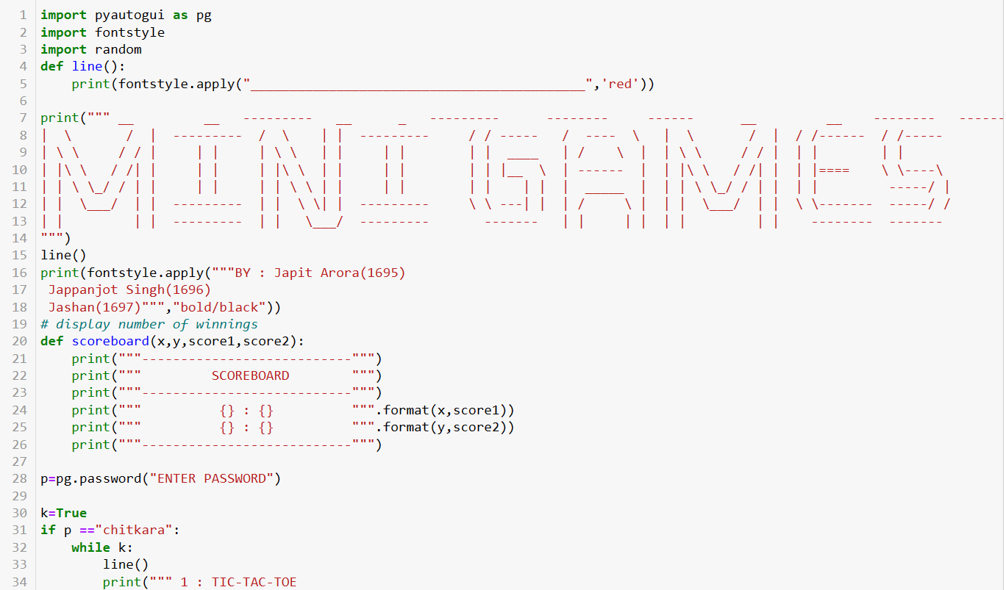
Python Code

Slide 11
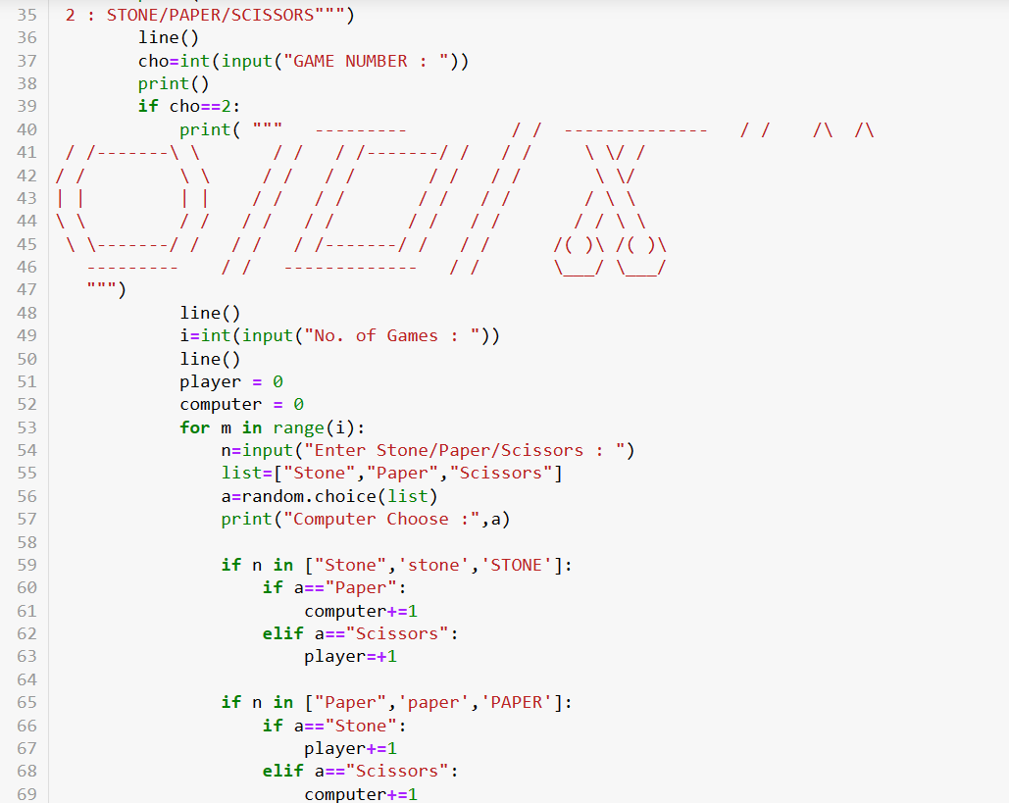

Slide 12
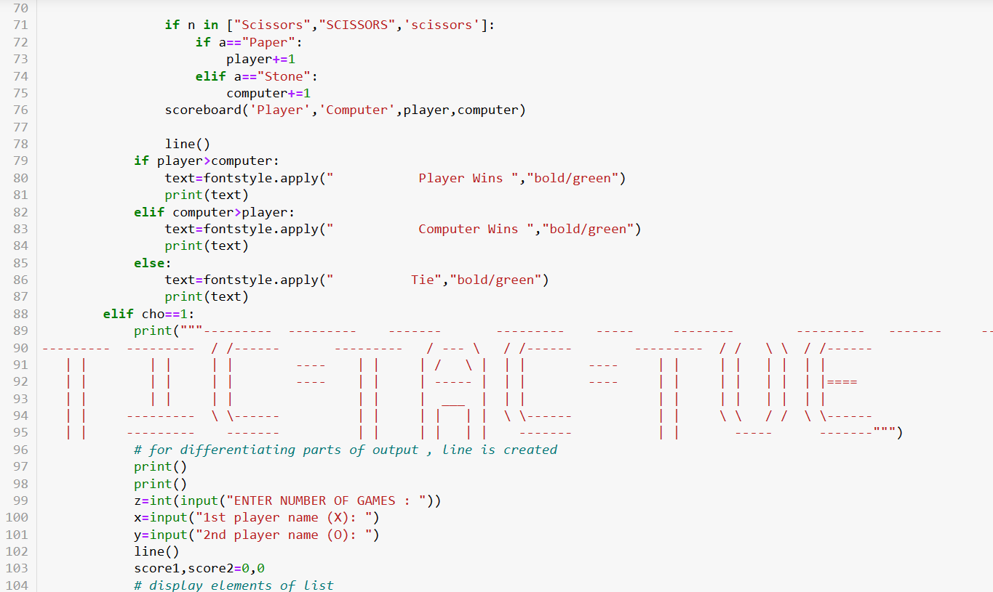

Slide 13
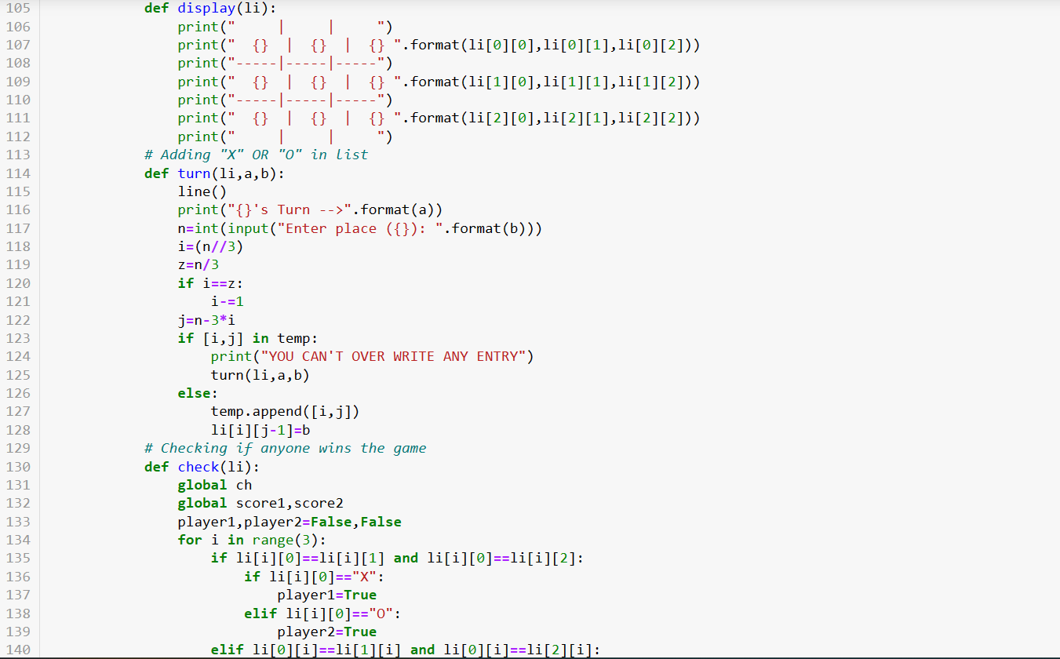

Slide 14
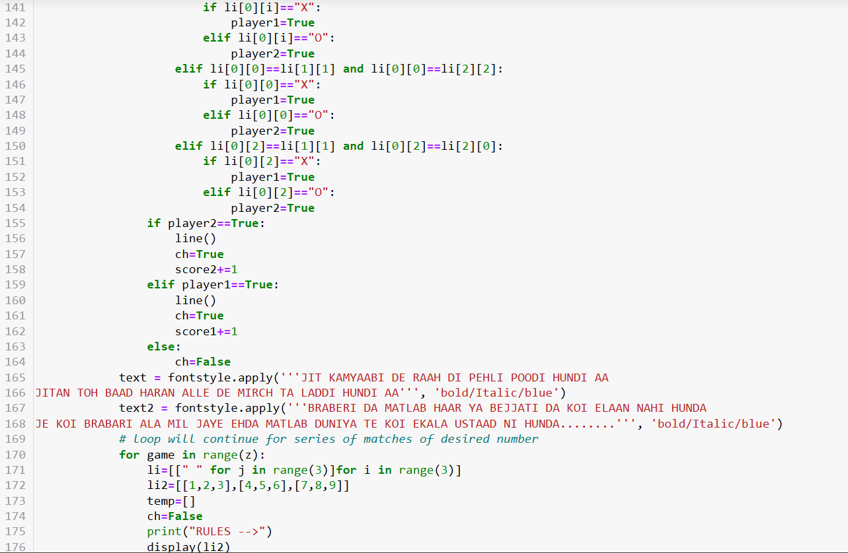

Slide 15
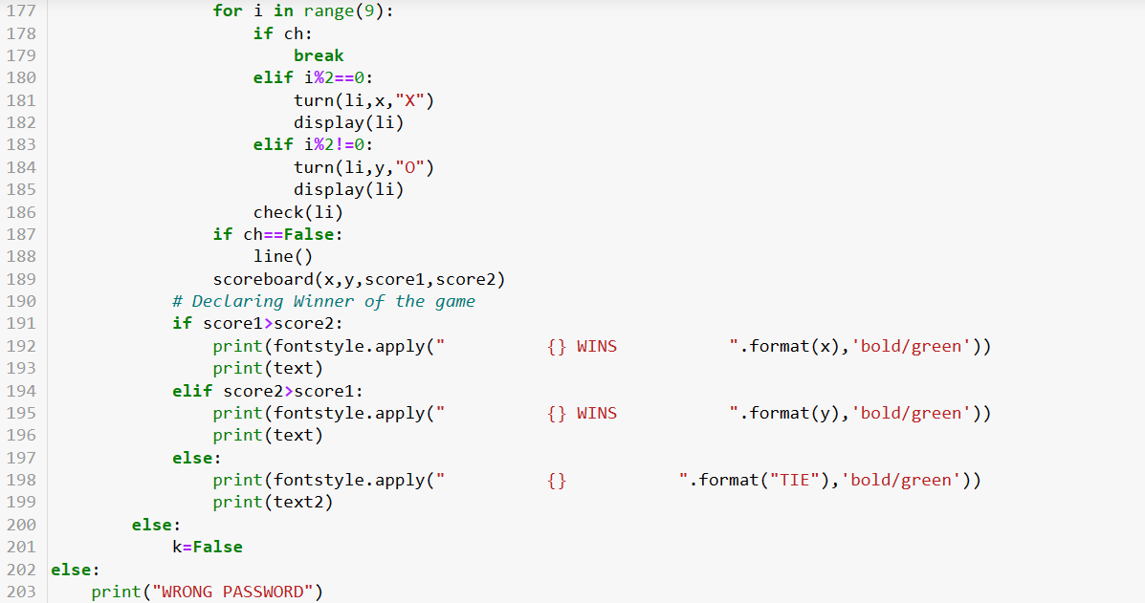

Slide 16
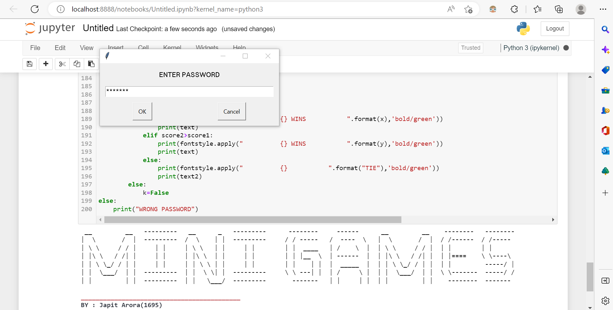
OUTPUT
Output Interference 1:

Slide 17
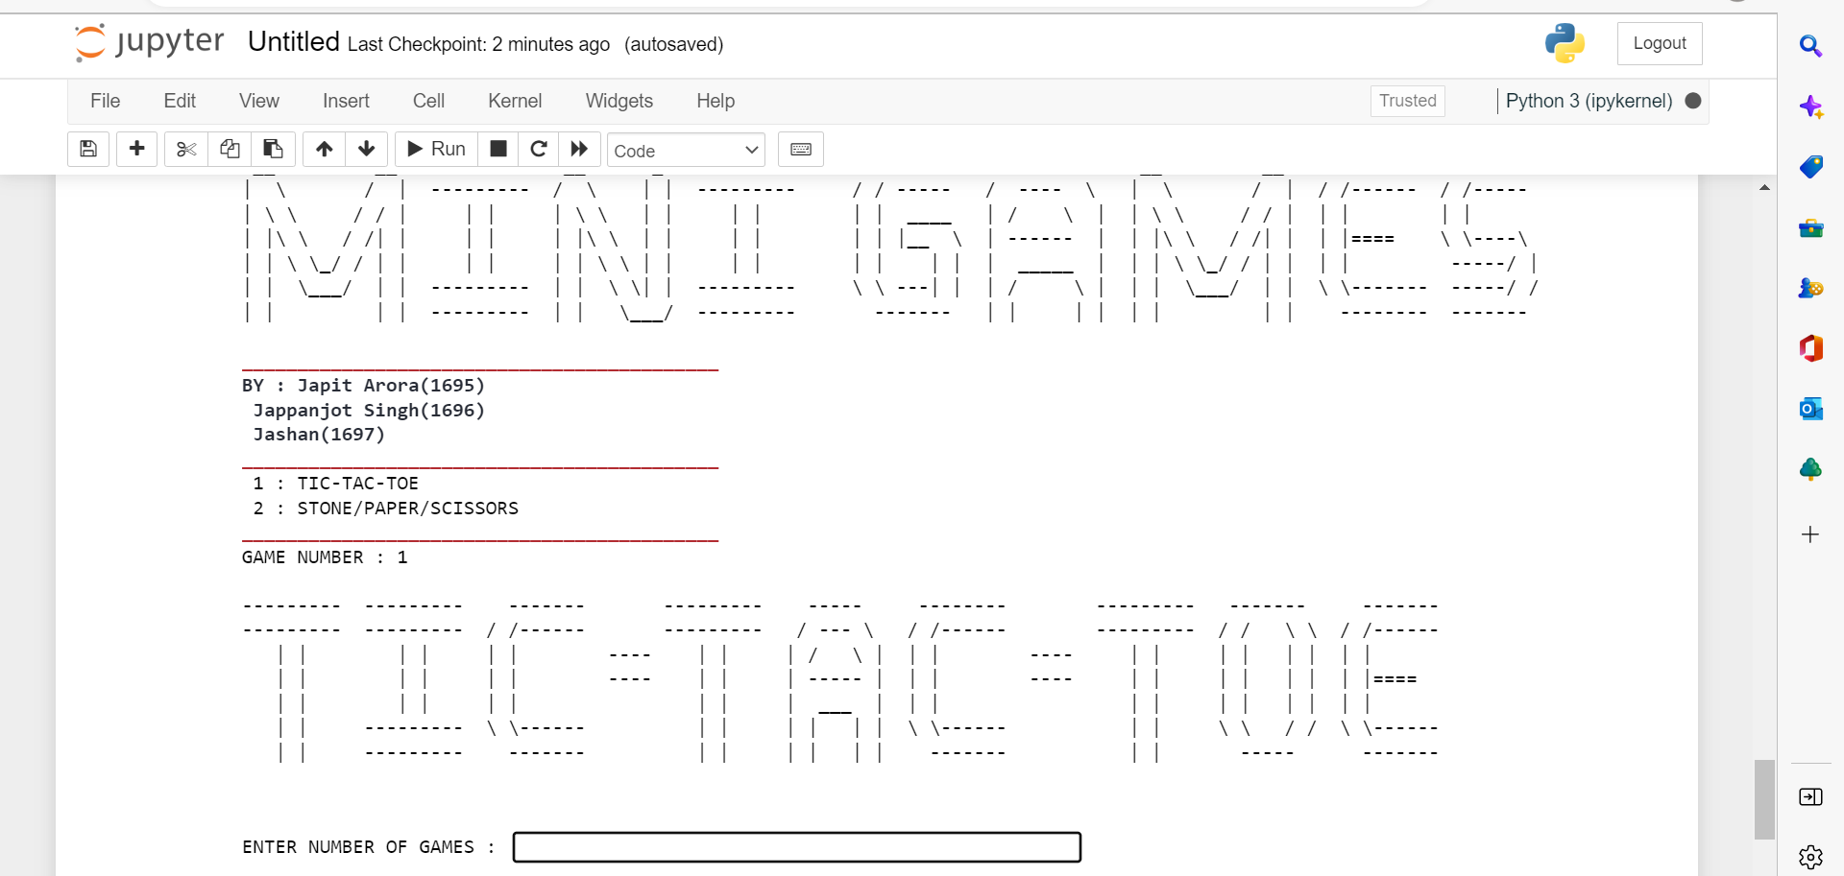
Output Interference 2:

Slide 18
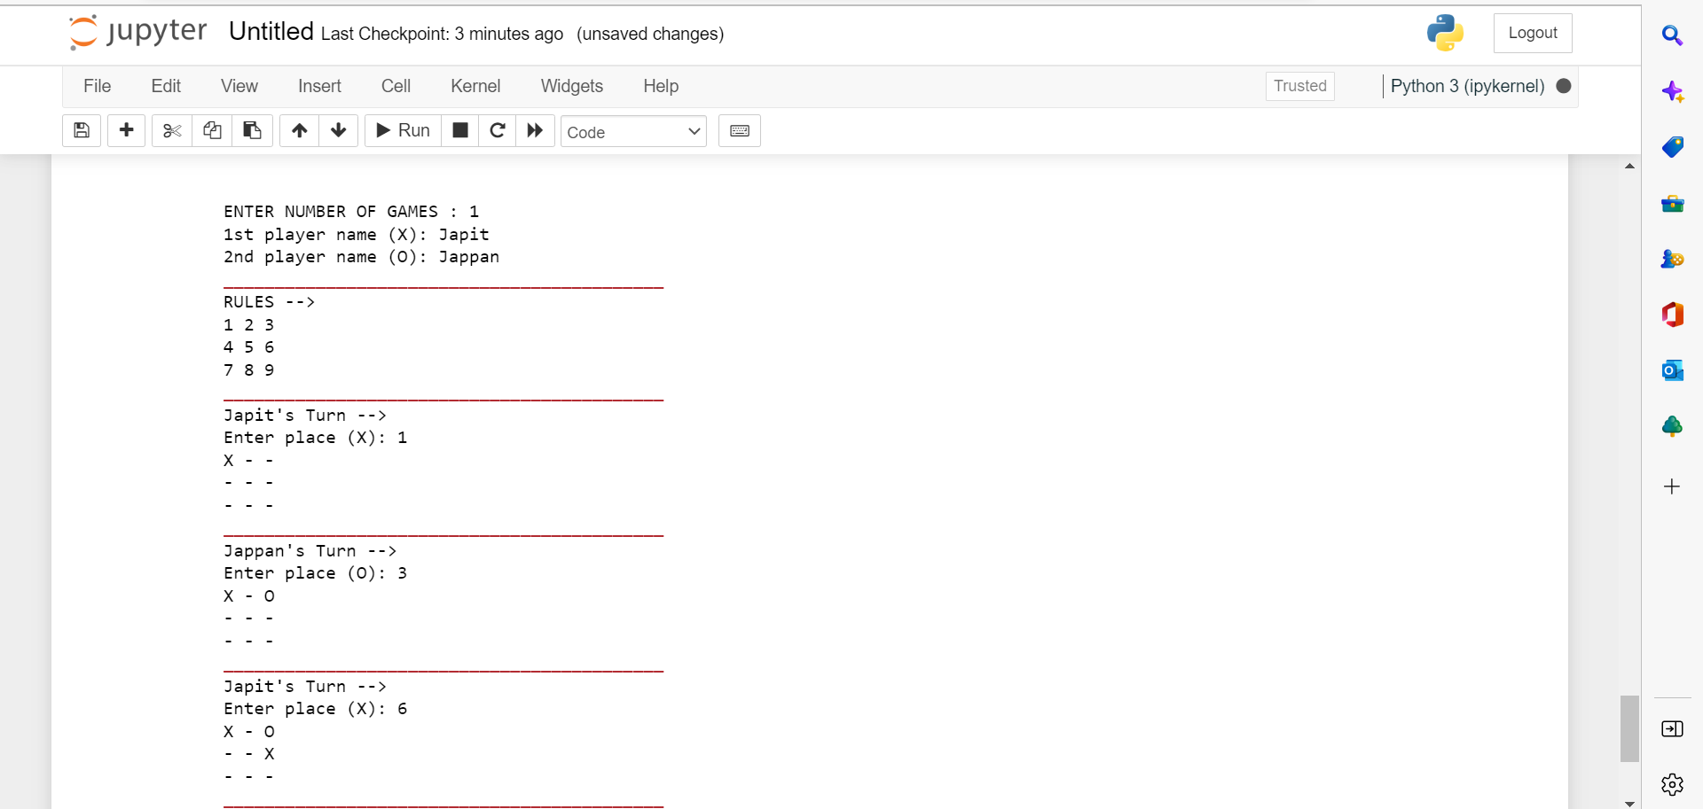
Output Interference 3:

Slide 19
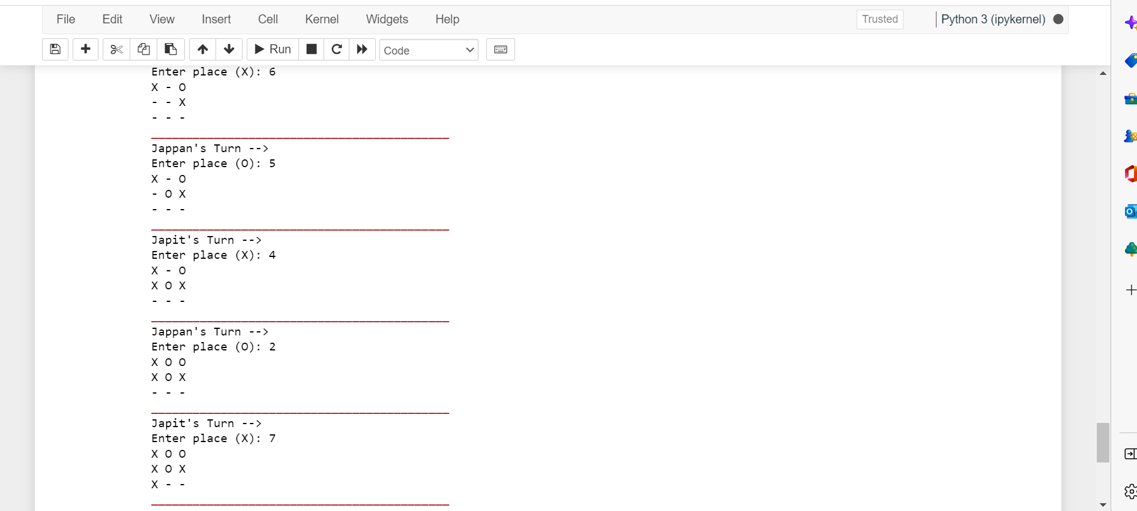
Output Interference 4:

Slide 20
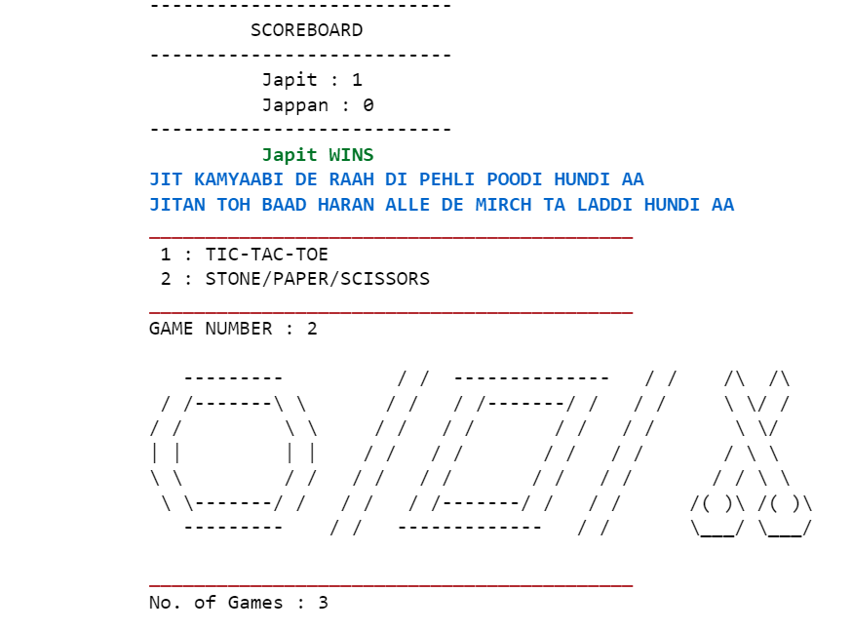
Output Interference 5:

Slide 21
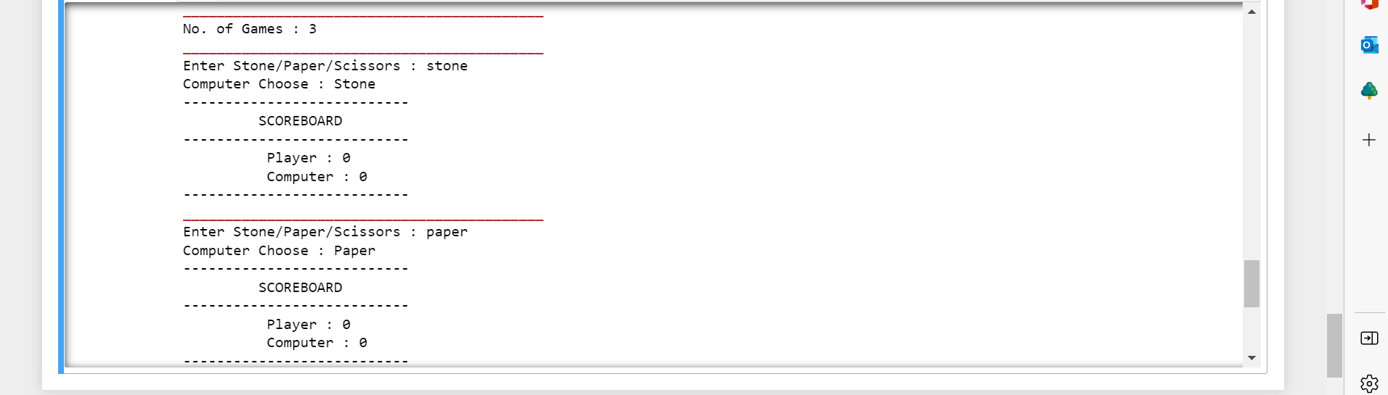
Output Interference 6:

Slide 22
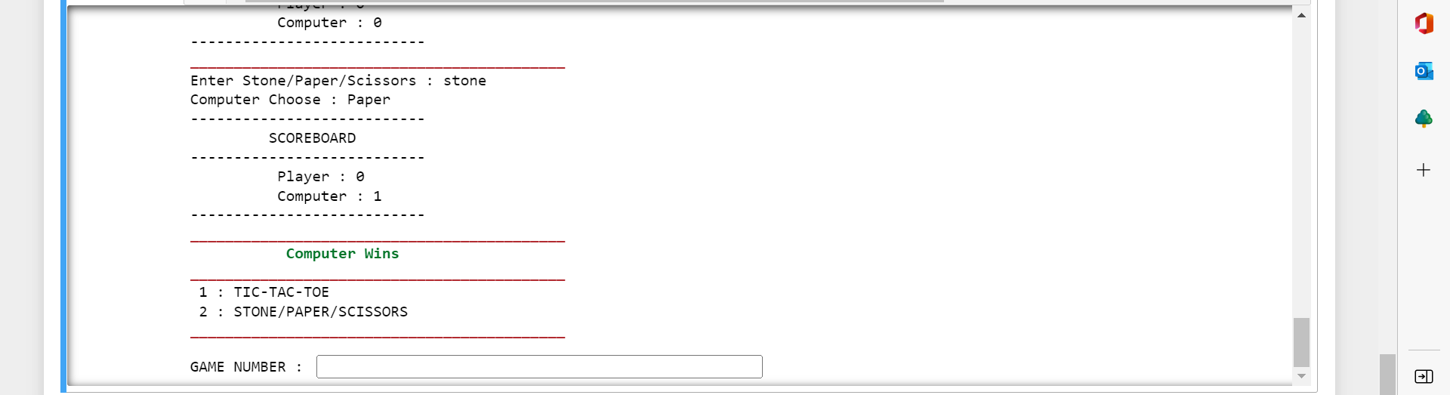
Output Interference 7:

Slide 23
Concepts used in program
Loops (For and While )
Functions
Lists
Conditional Statements
Modules

Slide 24
Applications
Stone Paper Scissor :Helps one with mental concentration
Tic Tac Toe : A game with competing goals
Fun games which can be played by two users at the same time facing opposite to each other.

Slide 25
References
Book : Python Programming By Reema Thareja
Importing Module Tutorial

Slide 26
Thank You

