Slide 1
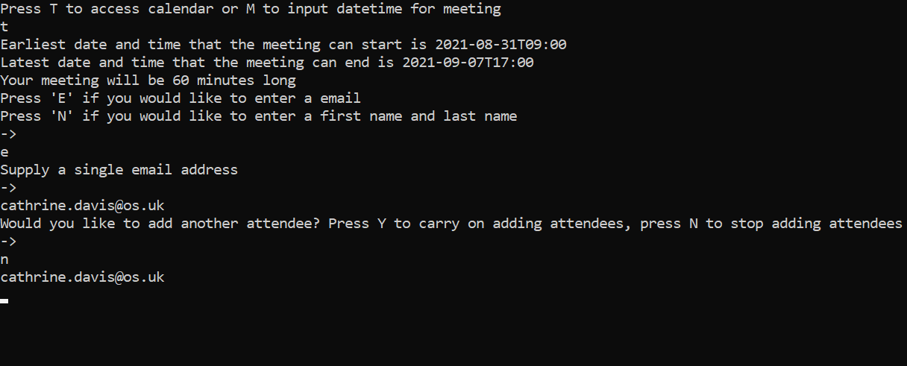
Scheduling
Assistant
Developed by
Cathrine Davis | Harjaap Singh

Slide 2
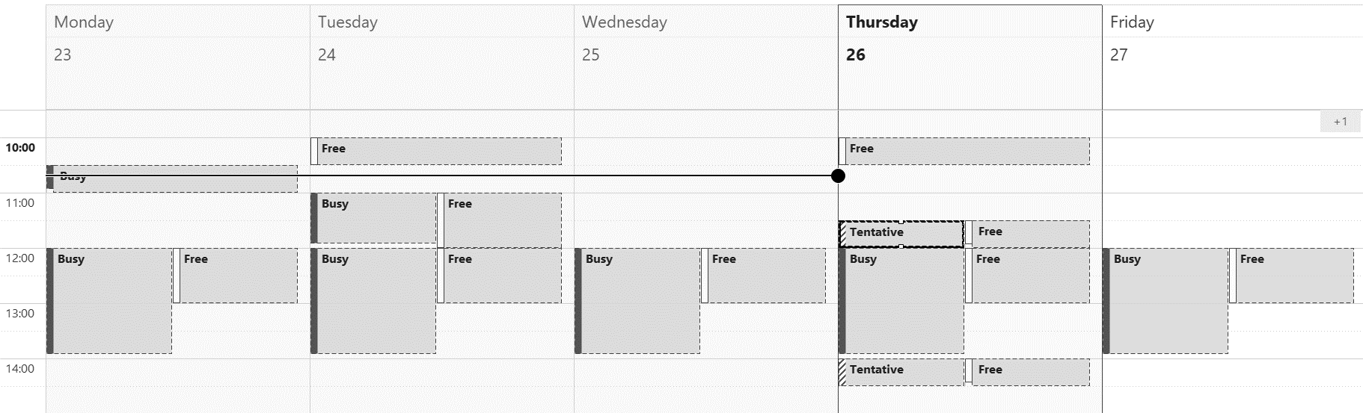
#1 Problem Statement
A rise in the number of meetings being held across the organisation
Senior members of the department have their calendars filled with meetings all day
Booking meetings with multiple people is becoming:
Difficult
Time consuming
Automating this process would save time and effort.

Slide 3
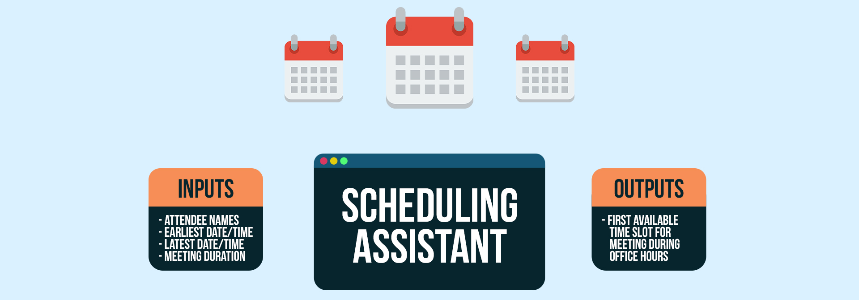
#2 Solving the Problem
Making a tool that takes the following data:
User-specified names of the preferred attendees
Earliest date/time at which the meeting could start
Latest date/time at which the meeting could end
Meeting duration
The assistant then reviews everyone’s calendar
and displays the first available time slot

Slide 4
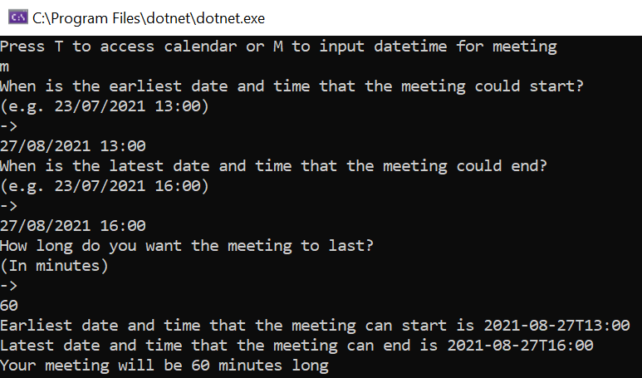
How to Use The Scheduling Assistant Step 1
#3
To begin with the user is told to input ‘M’ then asked for information:
Earliest date and time that your meeting can start
Latest date and time that your meeting can end
Preferred meeting duration

Slide 5


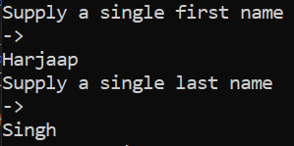
How to Use The Scheduling Assistant Step #2
#3
How to Use The Scheduling Assistant Step 2
After this the user is asked to specify the preferred meeting attendee(s) either by:
Inputting their email address
Or inputting their first and last name

Slide 6
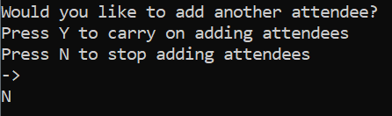
How to Use The Scheduling Assistant Step #3
#3
How to Use The Scheduling Assistant Step 3
The user is then asked if they would like to:
Add more attendees
Or stop adding more attendees

Slide 7
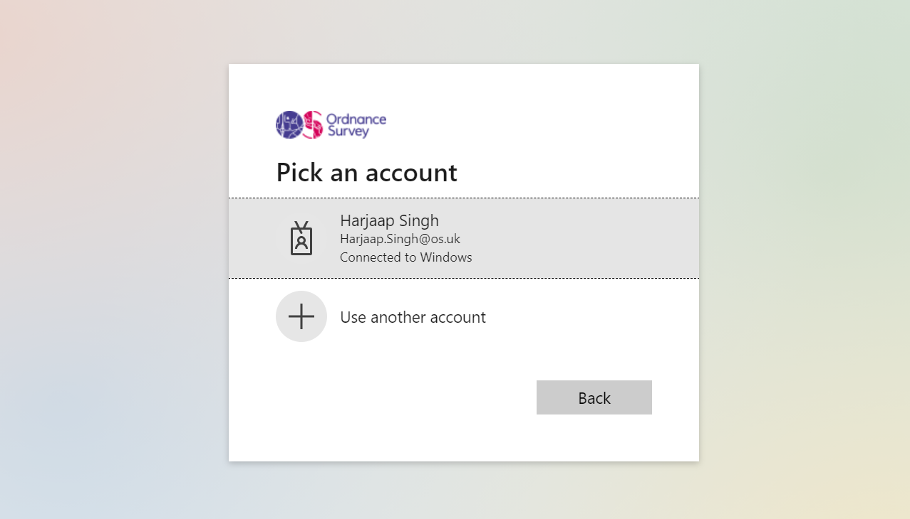
How to Use The Scheduling Assistant Step #4
#3
How to Use The Scheduling Assistant Step 4
Then the user authenticates themself via signing into their Microsoft account
This gives the user access to all of the calendars they can usually see

Slide 8
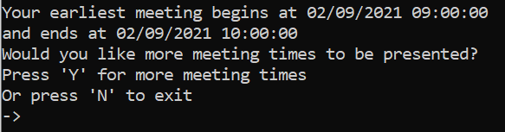
How to Use The Scheduling Assistant Step #5
#3
How to Use The Scheduling Assistant Step 5
The user will then be shown the date/time when their earliest meeting slot begins and ends
The user can then decide whether or not they would like to:
See more meeting times presented
Or to Exit

Slide 9

#4 What could we do to expand this project?
Reference pre-stored groups:
Gives the days and times that everyone in a group (e.g. Common Engineering) are free for a meeting
Allows for team meetings to be booked easier
Provide an option to book an actual meeting through the program:
Would make it faster and easier to book meetings

Slide 10
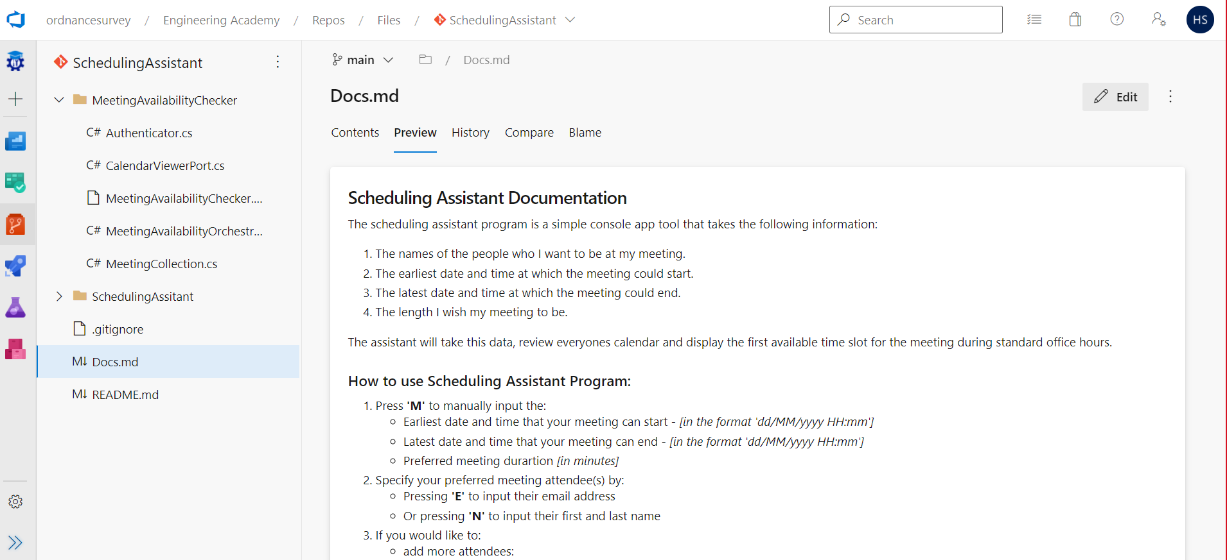
#9 The Documentation
Documentation can be found in Azure DevOps in the Engineering Academy project
It can be found in the SchedulingAssistant repo

Slide 11
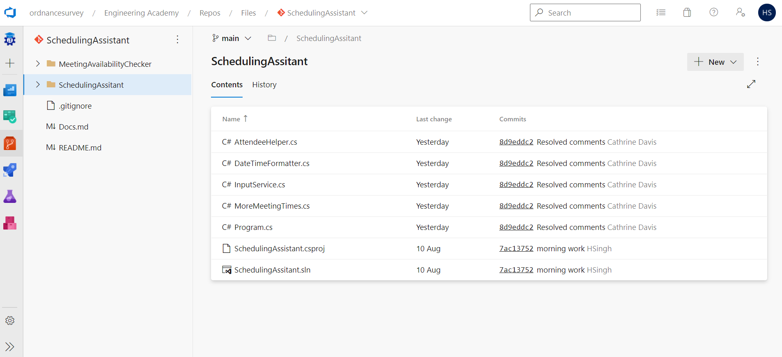
#10 How can you access this project?
This is a proof of concept
Currently, it is a console app in the repo, if you want to use it, you can download it from the repo
Now that we have proved it works, the team will be looking to add this tool to an easily accessible dashboard

Slide 12
Any
Questions?
Presented by
Cathrine Davis | Harjaap Singh

