Slide 1
ESEM 2026 — emerging-results submission · colleague briefing
The Civic-Tech
Open-Source Landscape
Sustainability challenges across 37 projects.
37 repos · 16 organisations · 6 continents · 15 years · 178k commits · 2,506 contributor records

Slide 2
02 / 09
WHY THIS MATTERS
Civic tech is public infrastructure.
We don't actually know how it's holding up.
WHAT CIVIC TECH ACTUALLY IS
WHY MEASURE IT
Elections and voter information
Government services and benefits portals
Freedom-of-information platforms
Environmental monitoring
Federated social infrastructure
Civic mapping, deliberation, transparency tools
Mostly volunteer-led. Intermittently funded. Small non-profit teams. When a project fails, the cost falls on democratic participation and public-service delivery — not on private customers.
Existing literature is qualitative civic-tech work or quantitative OSS-health work on commercial flagships. No quantitative landscape of civic-tech specifically.
Our question: what does the civic-tech OSS landscape look like, and where are its sustainability stresses?

Slide 3
03 / 09
WHAT WE HAVE
A purposive sample covering scale, age, and topic.
All artefacts open-source under CC-BY 4.0 / MIT; Zenodo-archived.
37
6
15
2,506
repositories
continents
years of history
contributor records
from 16 organisations
Pan-African, EU, US, JP, AR, AU
earliest commit 2011-04
22,486 contributor-weeks
INCLUSION CRITERIA (C1–C3, applied by two coders)
C1 Public-interest design intent
C2 Public-interest steward
C3 Open development
Civic mission at project inception, not incidental use
Non-profit, government, academic, or civic collective
Public Git forge with public commit history
64 candidate repositories → 21 failed C1 · 6 failed C3 → 37 in sample

Slide 4
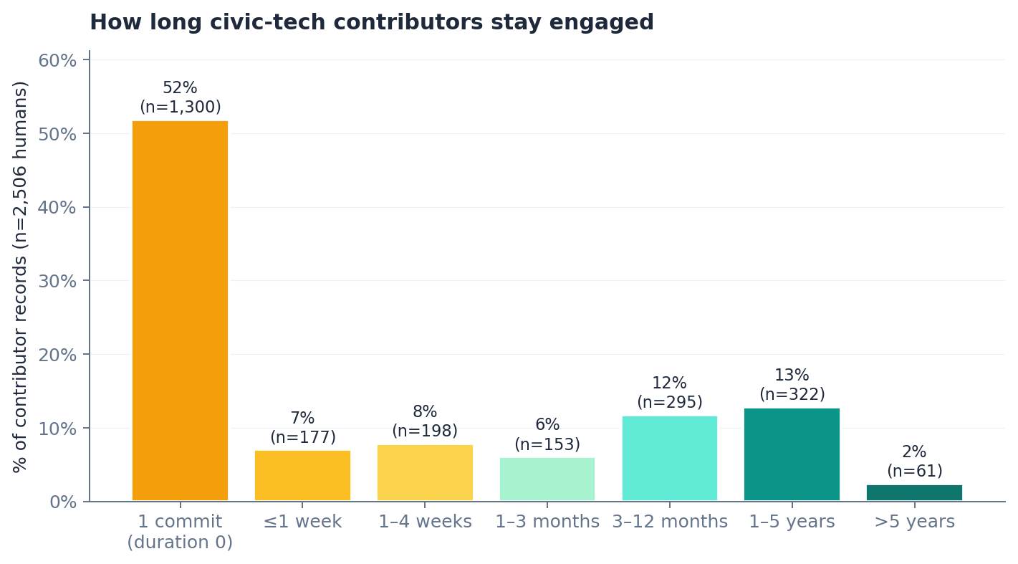
04 / 09
DRIVE-BY CONTRIBUTION
CHALLENGE 01
More than half of contributors never come back.
52%
of 2,506 human contributor records made a single commit and never returned.
73%
within 3 months of first commit
2.4%
sustain activity > 5 years
Why it matters: the 'total contributors' number on a repo's landing page is a poor proxy for current engagement. Drive-by patches are valuable — but they don't sustain a project.
11.5 : 1
departed-to-active ratio (humans)

Slide 5



05 / 09
CONCENTRATION
CHALLENGE 02
Cores are dangerously thin.
46%
2
median bus factor
of repositories have bus factor 1.
96.6%
A single developer accounts for ≥50% of project commits.
median per-repo elephant-week share
p=7×10⁻⁶
bots inflate HHI (Wilcoxon paired, n=37)
For half the 37 repositories, almost every active week is dominated by a single contributor.

Slide 6
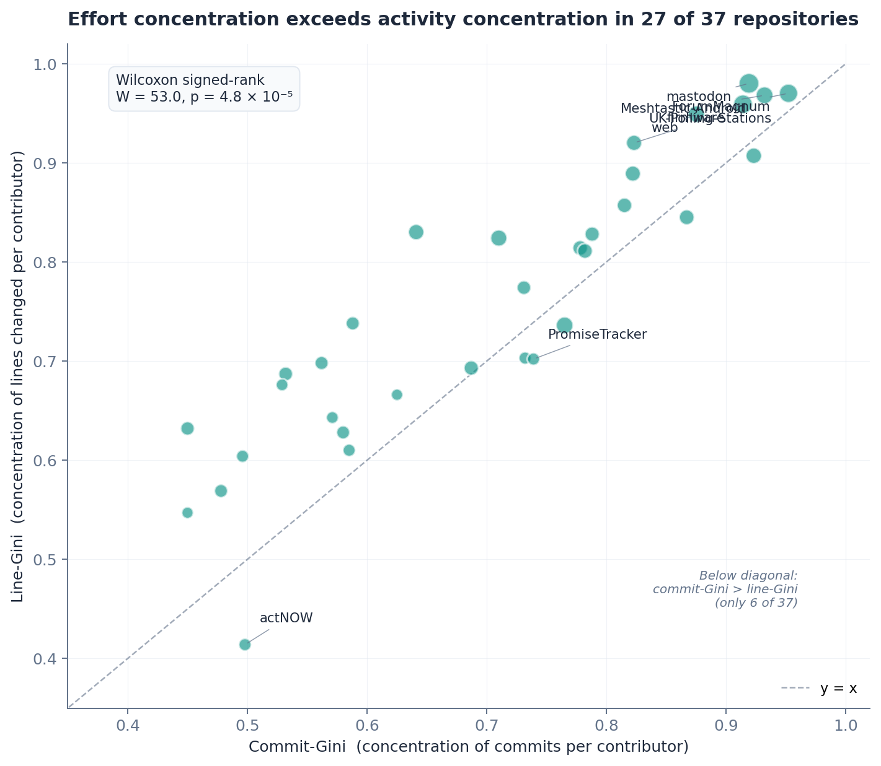
06 / 09
EFFORT VS ACTIVITY
CHALLENGE 03
Counting commits hides how concentrated effort actually is.
THE TEST
Per repo, two Ginis: commits-per-contributor (activity) and lines-changed-per-contributor (effort). Paired Wilcoxon across the 37 repos — within-repository design, robust to coverage problems.
RESULT
p = 4.8 × 10⁻⁵
Effort-Gini exceeds commit-Gini in 27 of 37 repositories (Wilcoxon W = 53.0). Mean Δ = +0.052.
At flagship scale the line-Gini saturates near 1 while the commit-Gini stays at 0.76–0.95 — large refactor commits dominate effort even when commit counts look balanced.

Slide 7


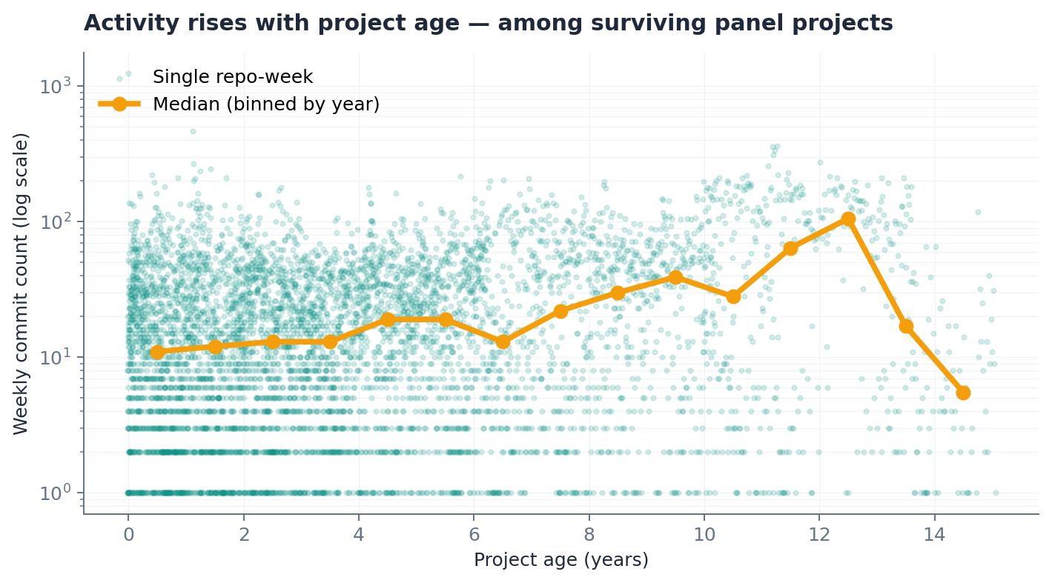
07 / 09
BACKLOGS · SURVIVAL
CHALLENGE 04
CHALLENGE 05
Backlogs accumulate. Survivors intensify.
BACKLOGS
THE SURVIVOR PARADOX
0.98
median stale-issue ratio (n=26 repos with open issues).
AND no release discipline:
20 of 37 repositories (54%) have never tagged a release.
Including five projects more than 9 years old — a 15-year-old FOI platform, an 11-year-old polling-station service.
Median weekly commits rise with project age — but the projects that died aren't in this sample. Survivor bias, not health.

Slide 8
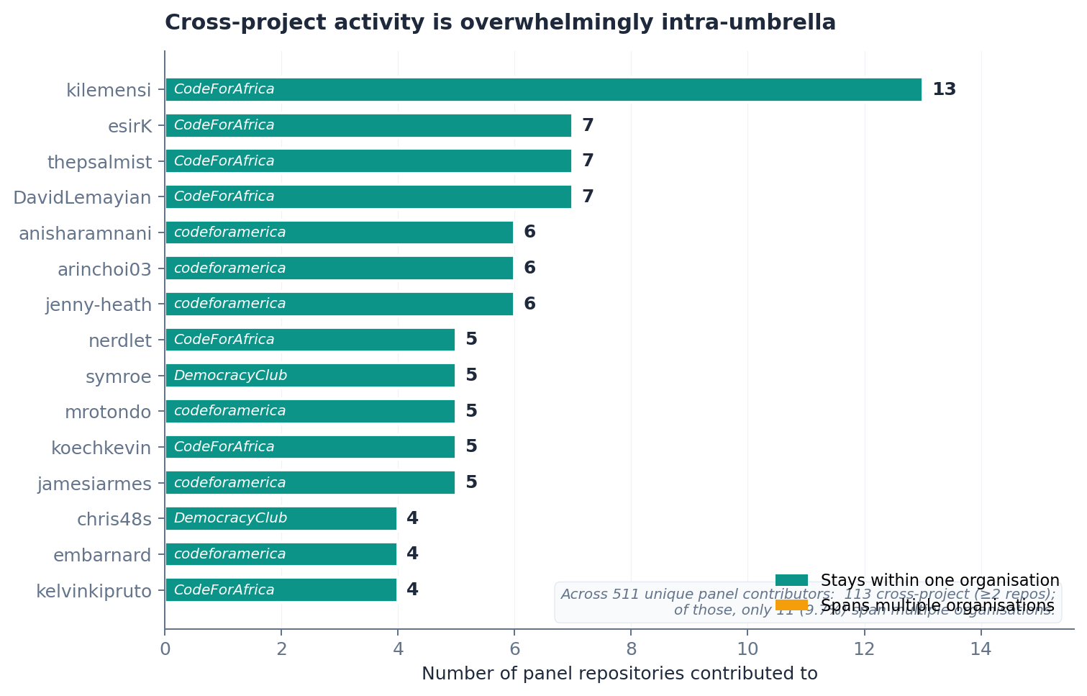
08 / 09
CROSS-PROJECT ECOSYSTEM
CHALLENGE 06
The civic-tech ecosystem is thin and umbrella-bounded.
5.5%
of unique humans contribute to ≥ 2 of our 37 repositories.
112 of 2,055 humans, after bot filtering.
THE SENSITIVITY CHECK
of those 112 multi-repo humans, only 8.9% (10) span ≥ 2 distinct organisations.
Across the whole sample that leaves ≈ 0.5% of all humans across the 37 repositories as genuinely cross-organisational. Invariant to umbrella over-representation in our frame.
Implication: the cross-project contributor pool is small AND umbrella-bounded. Sustainability interventions assuming cross-cutting volunteer flow don't have that flow to work with.

Slide 9
09 / 09
WHAT'S NEXT
Three axes for the longer-term programme.
ESEM 2026 abstract due May 22 · full submission May 29.
L1
L2
L3
Longitudinal tracking
Replication & extension
Failed-projects comparison
Quarterly recrawls of the 37 repositories over 24 months. Change-over-time on the six challenges. Event-study designs around governance changes.
Non-GitHub hosts (GitLab, Codeberg, self-hosted Gitea). Larger civic-tech population (target n ≥ 100). Cross-platform consistency checks.
Parallel sample of civic-tech repositories that ceased activity. Convert survivor observations into causal claims about lifecycle.
Where I'd love your input: framing of the six challenges · candidates for L1/L2/L3 · recent (2023–25) OSS-health refs

