Slide 1
Distribuições de Probabilidade
Jaqueline V Moreira

Slide 2
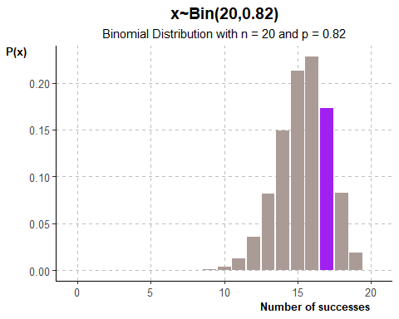
Binomial Distribution
According to Statistics Canada life tables, the probability a randomly selected 90 year-old Canadian male survives for at least another year is approximately 0.82. If twenty 90-year-old Canadian males are randomly selected,
what is the probability exactly 18 survives for at least another year?
what is the probability that last than 11 survives for another year?
Successes: The man survives for at least on year
Failure: The man dies within one year Since the sampling of men are random, it’s reasonable to consider them independent
Let x represent the number of men that survive for at least one year n = 20 p = 0.82
## [1] "P(x = 18) = 0.17296"

Slide 3
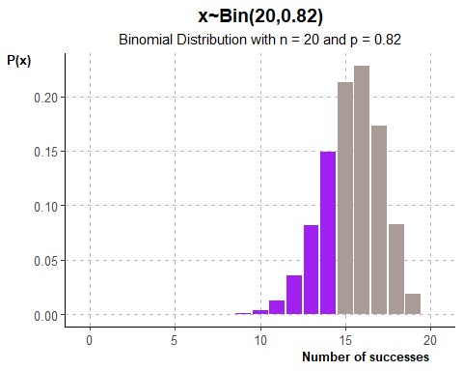
## [1] "P(x<15) = 0.2849"

Slide 4
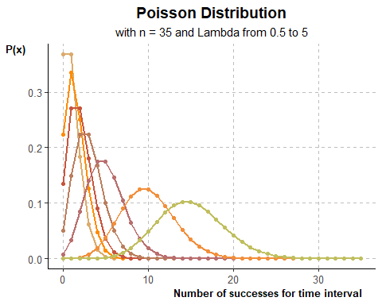
Poisson Distribution

Slide 5
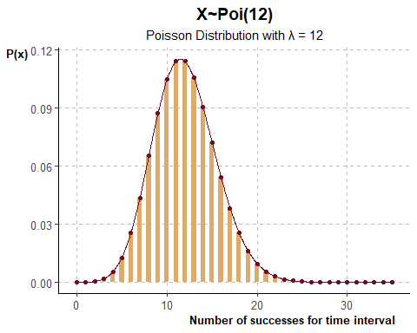
Exclusive Vines import Argentinian wine into australia. They’ve begun advertising on Facebook to direct traffic to their website where customers can order wine online. The number of click-through sales from the ad is Poisson distributed with a mean of 12 click-through sales per day.
μ = 12 click-through sales per day E(x) = μ = λ
Find the probability of getting:
exaclty 8 click-through sales in the first day
at least 10 click-through sales in the first day
## [1] "P(x=8) = 0.0655"
## [1] "P(x>=10) = 1-P(x<10)"
## [1] "P(x>=10) = 0.7576"

Slide 6

exaclty 8 click-through sales in the first day

Slide 7
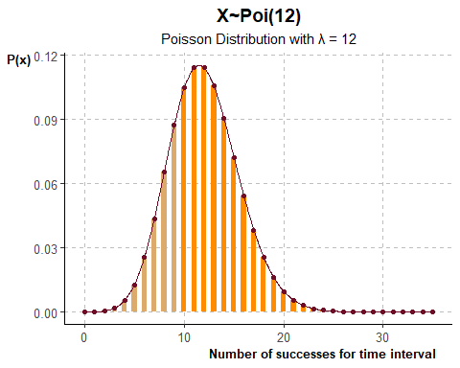
at least 10 click-through sales in the first day

Slide 8
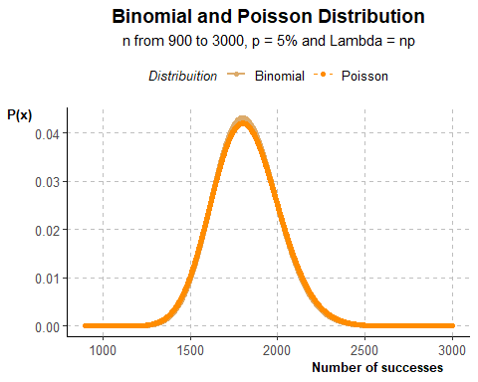
Relationship between binomial and poisson distribution
p = 0.05 # 5% n = c(900:3000) x = 90 bin = rep(NA, length(n)) poi = rep(NA, length(n)) for (b in n) { bin[b-899] = dbinom(x=x,size = b, prob = p) } for (i in n) { poi[i-899] = dpois(x=x, lambda = i*p) } bin_poi = data.frame("x_axis" = n, "bin" = bin, "poi" = poi)
bin_poi_plots = bin_poi %>% ggplot(mapping = (aes(x=x_axis))) + # Construindo gráficos geom_line(mapping = (aes(y = bin, color = "Binomial")), linewidth = 0.9)+ geom_point(mapping = (aes(y = bin, color = "Binomial")))+ geom_line(mapping = (aes(y = poi, color = "Poisson")), linewidth = 0.7, linetype = 2)+ geom_point(mapping = (aes(y = poi, color = "Poisson")))+ # # definindo cores scale_color_manual(values=color_poisson)+ # definindo Titulos labs(title = "Binomial and Poisson Distribution", subtitle = "n from 900 to 3000, p = 5% and Lambda = np", y = "P(x)", x= "Number of successes", color = "Distribuition")+ # alterando aparecia theme_classic()+ theme(# titles plot.title = element_text(hjust = 0.5, size=14, face="bold"), axis.title.x = element_text(size=10, hjust = 0.9, face = "bold"), axis.title.y = element_text(size=10, hjust = 0.9, face = "bold", angle = 0), legend.title = element_text(size=10, face = "italic"), plot.subtitle = element_text(hjust = 0.5, size=11), #legend legend.position="top", legend.text = element_text(size=10), #axis axis.text.x = element_text(size=10), axis.text.y = element_text(size=10), #axis.line = element_line(color = "black", size = 1, linetype = 1)) #grid panel.grid.major = element_line(color = "grey", linewidth = 0.5, linetype = 2)) #panel.grid.major.y = element_line(color = "grey", size = 0.5, linetype = 2)) bin_poi_plots

Slide 9
bin_x_90 = round(dbinom(x=x,size = 2500, prob = p),6) poi_x_90 = round(dpois(x=x,lambda = 2500*p),6) paste0("X~Bin(2500,0.05)")
## [1] "X~Bin(2500,0.05)"
paste0("P(X = 90) = ",bin_x_90 )
## [1] "P(X = 90) = 0.000144"
paste0(" and ")
## [1] " and "
paste0("X~Poi(2500*0.05)")
## [1] "X~Poi(2500*0.05)"
paste0("P(X = 90) = ",poi_x_90 )
## [1] "P(X = 90) = 0.000183"
paste0("Uma diferença de apenas ",round(poi_x_90 - bin_x_90,6))
## [1] "Uma diferença de apenas 3.9e-05"
binomial and poisson example
Albinism is a rare genetic disorder that affects one in 20.000 europeans. People with albinism produce little or none of the pigment melanin. In a random sample of 1.000 europeans, what is the probability that exactly 2 have albnism?
In a random sampling the events can be considered independent. In this case each trial can be considered a bernoulli trial with
p = 1/20000
In a Binomial distribution: n = 1000 x = 2
in a Poisson distribution: Lambda = np lambda = 10001/20000
x = 2 p = 1/20000 n = 1000 lambda = n*p bin_x_2 = round(dbinom(x=x,size = n, prob = p),6) poi_x_2 = round(dpois(x=x,lambda = lambda),6) paste0("In a Binomial distribution P(X = 2) = ", bin_x_2)
## [1] "In a Binomial distribution P(X = 2) = 0.001188"
paste0("In a Poisson distribution P(X = 2) = ", poi_x_2)
## [1] "In a Poisson distribution P(X = 2) = 0.001189"
paste0("a difference of ", round(poi_x_2 -bin_x_2,6))
## [1] "a difference of 1e-06"

Slide 10
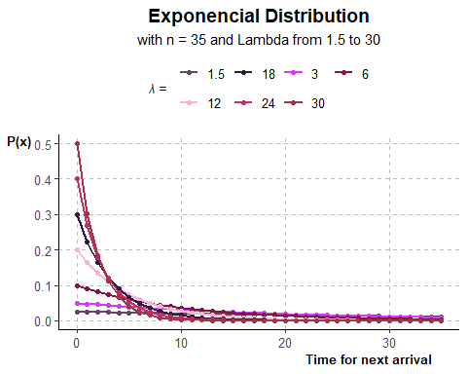
Exponential Distribution
## x lambda_1_5 lambda_3 lambda_6 lambda_12 lambda.18 lambda_24 ## 1 0 0.02500000 0.050000000 0.100000000 0.2000000000 3.000000e-01 4.000000e-01 ## 2 1 0.02438275 0.047561471 0.090483742 0.1637461506 2.222455e-01 2.681280e-01 ## 3 2 0.02378074 0.045241871 0.081873075 0.1340640092 1.646435e-01 1.797316e-01 ## 4 3 0.02319359 0.043035399 0.074081822 0.1097623272 1.219709e-01 1.204777e-01 ## 5 4 0.02262094 0.040936538 0.067032005 0.0898657928 9.035826e-02 8.075861e-02 ## 6 5 0.02206242 0.038940039 0.060653066 0.0735758882 6.693905e-02 5.413411e-02 ## 7 6 0.02151770 0.037040911 0.054881164 0.0602388424 4.958967e-02 3.628718e-02 ## 8 7 0.02098643 0.035234404 0.049658530 0.0493193928 3.673693e-02 2.432403e-02 ## 9 8 0.02046827 0.033516002 0.044932896 0.0403793036 2.721539e-02 1.630488e-02 ## 10 9 0.01996291 0.031881408 0.040656966 0.0330597776 2.016165e-02 1.092949e-02 ## 11 10 0.01947002 0.030326533 0.036787944 0.0270670566 1.493612e-02 7.326256e-03 ## 12 11 0.01898930 0.028847491 0.033287108 0.0221606317 1.106495e-02 4.910936e-03 ## 13 12 0.01852046 0.027440582 0.030119421 0.0181435907 8.197117e-03 3.291899e-03 ## 14 13 0.01806318 0.026102289 0.027253179 0.0148547156 6.072573e-03 2.206626e-03 ## 15 14 0.01761720 0.024829265 0.024659696 0.0121620125 4.498673e-03 1.479145e-03 ## 16 15 0.01718223 0.023618328 0.022313016 0.0099574137 3.332699e-03 9.915009e-04 ## 17 16 0.01675800 0.022466448 0.020189652 0.0081524408 2.468924e-03 6.646229e-04 ## 18 17 0.01634424 0.021370747 0.018268352 0.0066746540 1.829024e-03 4.455101e-04 ## 19 18 0.01594070 0.020328483 0.016529889 0.0054647445 1.354974e-03 2.986343e-04 ## 20 19 0.01554713 0.019337051 0.014956862 0.0044741544 1.003790e-03 2.001806e-04 ## 21 20 0.01516327 0.018393972 0.013533528 0.0036631278 7.436257e-04 1.341851e-04 ## 22 21 0.01478888 0.017496887 0.012245643 0.0029991154 5.508914e-04 8.994693e-05 ## 23 22 0.01442375 0.016643554 0.011080316 0.0024554680 4.081104e-04 6.029323e-05 ## 24 23 0.01406762 0.015831838 0.010025884 0.0020103671 3.023356e-04 4.041576e-05 ## 25 24 0.01372029 0.015059711 0.009071795 0.0016459494 2.239757e-04 2.709149e-05 ## 26 25 0.01338154 0.014325240 0.008208500 0.0013475894 1.659253e-04 1.815997e-05 ## 27 26 0.01305114 0.013626590 0.007427358 0.0011033129 1.229205e-04 1.217299e-05 ## 28 27 0.01272891 0.012962013 0.006720551 0.0009033162 9.106174e-05 8.159801e-06 ## 29 28 0.01241463 0.012329848 0.006081006 0.0007395727 6.746020e-05 5.469678e-06 ## 30 29 0.01210811 0.011728514 0.005502322 0.0006055109 4.997574e-05 3.666435e-06 ## 31 30 0.01180916 0.011156508 0.004978707 0.0004957504 3.702294e-05 2.457685e-06 ## 32 31 0.01151759 0.010612399 0.004504920 0.0004058861 2.742727e-05 1.647435e-06 ## 33 32 0.01123322 0.010094826 0.004076220 0.0003323115 2.031862e-05 1.104309e-06 ## 34 33 0.01095587 0.009602495 0.003688317 0.0002720736 1.505240e-05 7.402405e-07 ## 35 34 0.01068537 0.009134176 0.003337327 0.0002227550 1.115110e-05 4.961980e-07 ## 36 35 0.01042155 0.008688697 0.003019738 0.0001823764 8.260935e-06 3.326115e-07 ## lambda_30 ## 1 5.000000e-01 ## 2 3.032653e-01 ## 3 1.839397e-01 ## 4 1.115651e-01 ## 5 6.766764e-02 ## 6 4.104250e-02 ## 7 2.489353e-02 ## 8 1.509869e-02 ## 9 9.157819e-03 ## 10 5.554498e-03 ## 11 3.368973e-03 ## 12 2.043386e-03 ## 13 1.239376e-03 ## 14 7.517196e-04 ## 15 4.559410e-04 ## 16 2.765422e-04 ## 17 1.677313e-04 ## 18 1.017342e-04 ## 19 6.170490e-05 ## 20 3.742591e-05 ## 21 2.269996e-05 ## 22 1.376822e-05 ## 23 8.350850e-06 ## 24 5.065047e-06 ## 25 3.072106e-06 ## 26 1.863327e-06 ## 27 1.130165e-06 ## 28 6.854795e-07 ## 29 4.157644e-07 ## 30 2.521738e-07 ## 31 1.529512e-07 ## 32 9.276957e-08 ## 33 5.626759e-08 ## 34 3.412802e-08 ## 35 2.069969e-08 ## 36 1.255500e-08
expo_plots = expo_data %>% ggplot(mapping = (aes(x=x_axis))) + # Construindo gráficos geom_line(mapping = (aes(y = lambda_1_5, color = "1.5")), linewidth = 0.9)+ geom_point(mapping = (aes(y = lambda_1_5, color = "1.5")))+ geom_line(mapping = (aes(y = lambda_3, color = "3")), linewidth = 0.9)+ geom_point(mapping = (aes(y = lambda_3, color = "3")))+ geom_line(mapping = (aes(y = lambda_6, color = "6")), linewidth = 0.9)+ geom_point(mapping = (aes(y = lambda_6, color = "6")))+ geom_line(mapping = (aes(y = lambda_12, color = "12")), linewidth = 0.9)+ geom_point(mapping = (aes(y = lambda_12, color = "12")))+ geom_line(mapping = (aes(y = lambda_18, color = "18")), linewidth = 0.9)+ geom_point(mapping = (aes(y = lambda_18, color = "18")))+ geom_line(mapping = (aes(y = lambda_24, color = "24")), linewidth = 0.9)+ geom_point(mapping = (aes(y = lambda_24, color = "24")))+ geom_line(mapping = (aes(y = lambda_30, color = "30")), linewidth = 0.9)+ geom_point(mapping = (aes(y = lambda_30, color = "30")))+ # # definindo cores scale_color_manual(values=Color_violet)+ # definindo Titulos labs(title = "Exponencial Distribution", subtitle = "with n = 35 and Lambda from 1.5 to 30", y = "P(x)", x= "Time for next arrival", color = "λ = ")+ # alterando aparecia theme_classic()+ theme(# titles plot.title = element_text(hjust = 0.5, size=14, face="bold"), axis.title.x = element_text(size=10, hjust = 0.9, face = "bold"), axis.title.y = element_text(size=10, hjust = 0.9, face = "bold", angle = 0), legend.title = element_text(size=10, face = "italic"), plot.subtitle = element_text(hjust = 0.5, size=11), #legend legend.position="top", legend.text = element_text(size=10), #axis axis.text.x = element_text(size=10), axis.text.y = element_text(size=10), #axis.line = element_line(color = "black", size = 1, linetype = 1)) #grid panel.grid.major = element_line(color = "grey", linewidth = 0.5, linetype = 2)) #panel.grid.major.y = element_line(color = "grey", size = 0.5, linetype = 2)) expo_plots

Slide 11
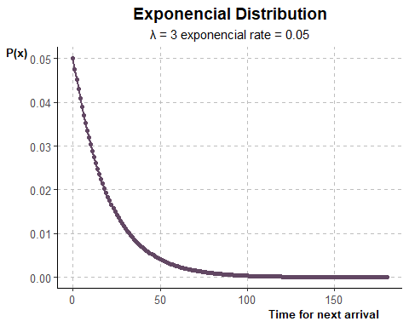
Unique visitors arrive at a certain site by a Poisson distribution at an average rate of 3 per hour.
the average rate of an poisson distribution is lambda so in this case lambda is iqual to 3/hour
What is the probability that the next visitor arrives:
Within 10 mins
after 30 mins passes
between 40 and 60 mins
The questions references the time interval for the next arrival NOT THE AMOUNT OF VISITORS. In this case, the exponential distribution will be used.
lambda of 3 means that 3 visitors arrive by hour or one visitor every 20 min on average. To make the graph more intuitive, the scale will be build in terms of minutes.
3 per hour = 3/60 = 0.05 clientes per minute (rate in the graph)
## x_axis lambda_3 ## 1 0 5.000000e-02 ## 2 1 4.756147e-02 ## 3 2 4.524187e-02 ## 4 3 4.303540e-02 ## 5 4 4.093654e-02 ## 6 5 3.894004e-02 ## 7 6 3.704091e-02 ## 8 7 3.523440e-02 ## 9 8 3.351600e-02 ## 10 9 3.188141e-02 ## 11 10 3.032653e-02 ## 12 11 2.884749e-02 ## 13 12 2.744058e-02 ## 14 13 2.610229e-02 ## 15 14 2.482927e-02 ## 16 15 2.361833e-02 ## 17 16 2.246645e-02 ## 18 17 2.137075e-02 ## 19 18 2.032848e-02 ## 20 19 1.933705e-02 ## 21 20 1.839397e-02 ## 22 21 1.749689e-02 ## 23 22 1.664355e-02 ## 24 23 1.583184e-02 ## 25 24 1.505971e-02 ## 26 25 1.432524e-02 ## 27 26 1.362659e-02 ## 28 27 1.296201e-02 ## 29 28 1.232985e-02 ## 30 29 1.172851e-02 ## 31 30 1.115651e-02 ## 32 31 1.061240e-02 ## 33 32 1.009483e-02 ## 34 33 9.602495e-03 ## 35 34 9.134176e-03 ## 36 35 8.688697e-03 ## 37 36 8.264944e-03 ## 38 37 7.861858e-03 ## 39 38 7.478431e-03 ## 40 39 7.113704e-03 ## 41 40 6.766764e-03 ## 42 41 6.436745e-03 ## 43 42 6.122821e-03 ## 44 43 5.824208e-03 ## 45 44 5.540158e-03 ## 46 45 5.269961e-03 ## 47 46 5.012942e-03 ## 48 47 4.768458e-03 ## 49 48 4.535898e-03 ## 50 49 4.314679e-03 ## 51 50 4.104250e-03 ## 52 51 3.904083e-03 ## 53 52 3.713679e-03 ## 54 53 3.532561e-03 ## 55 54 3.360276e-03 ## 56 55 3.196393e-03 ## 57 56 3.040503e-03 ## 58 57 2.892216e-03 ## 59 58 2.751161e-03 ## 60 59 2.616985e-03 ## 61 60 2.489353e-03 ## 62 61 2.367946e-03 ## 63 62 2.252460e-03 ## 64 63 2.142606e-03 ## 65 64 2.038110e-03 ## 66 65 1.938710e-03 ## 67 66 1.844158e-03 ## 68 67 1.754218e-03 ## 69 68 1.668663e-03 ## 70 69 1.587282e-03 ## 71 70 1.509869e-03 ## 72 71 1.436232e-03 ## 73 72 1.366186e-03 ## 74 73 1.299556e-03 ## 75 74 1.236176e-03 ## 76 75 1.175887e-03 ## 77 76 1.118539e-03 ## 78 77 1.063987e-03 ## 79 78 1.012096e-03 ## 80 79 9.627351e-04 ## 81 80 9.157819e-04 ## 82 81 8.711187e-04 ## 83 82 8.286338e-04 ## 84 83 7.882208e-04 ## 85 84 7.497788e-04 ## 86 85 7.132117e-04 ## 87 86 6.784280e-04 ## 88 87 6.453406e-04 ## 89 88 6.138670e-04 ## 90 89 5.839283e-04 ## 91 90 5.554498e-04 ## 92 91 5.283602e-04 ## 93 92 5.025918e-04 ## 94 93 4.780801e-04 ## 95 94 4.547639e-04 ## 96 95 4.325848e-04 ## 97 96 4.114874e-04 ## 98 97 3.914189e-04 ## 99 98 3.723292e-04 ## 100 99 3.541704e-04 ## 101 100 3.368973e-04 ## 102 101 3.204667e-04 ## 103 102 3.048373e-04 ## 104 103 2.899702e-04 ## 105 104 2.758282e-04 ## 106 105 2.623759e-04 ## 107 106 2.495797e-04 ## 108 107 2.374075e-04 ## 109 108 2.258290e-04 ## 110 109 2.148152e-04 ## 111 110 2.043386e-04 ## 112 111 1.943729e-04 ## 113 112 1.848932e-04 ## 114 113 1.758758e-04 ## 115 114 1.672983e-04 ## 116 115 1.591390e-04 ## 117 116 1.513777e-04 ## 118 117 1.439950e-04 ## 119 118 1.369722e-04 ## 120 119 1.302920e-04 ## 121 120 1.239376e-04 ## 122 121 1.178931e-04 ## 123 122 1.121434e-04 ## 124 123 1.066741e-04 ## 125 124 1.014715e-04 ## 126 125 9.652271e-05 ## 127 126 9.181524e-05 ## 128 127 8.733736e-05 ## 129 128 8.307786e-05 ## 130 129 7.902611e-05 ## 131 130 7.517196e-05 ## 132 131 7.150578e-05 ## 133 132 6.801840e-05 ## 134 133 6.470111e-05 ## 135 134 6.154560e-05 ## 136 135 5.854398e-05 ## 137 136 5.568876e-05 ## 138 137 5.297278e-05 ## 139 138 5.038927e-05 ## 140 139 4.793176e-05 ## 141 140 4.559410e-05 ## 142 141 4.337045e-05 ## 143 142 4.125525e-05 ## 144 143 3.924320e-05 ## 145 144 3.732929e-05 ## 146 145 3.550872e-05 ## 147 146 3.377694e-05 ## 148 147 3.212962e-05 ## 149 148 3.056264e-05 ## 150 149 2.907208e-05 ## 151 150 2.765422e-05 ## 152 151 2.630551e-05 ## 153 152 2.502257e-05 ## 154 153 2.380221e-05 ## 155 154 2.264136e-05 ## 156 155 2.153713e-05 ## 157 156 2.048675e-05 ## 158 157 1.948760e-05 ## 159 158 1.853718e-05 ## 160 159 1.763311e-05 ## 161 160 1.677313e-05 ## 162 161 1.595510e-05 ## 163 162 1.517696e-05 ## 164 163 1.443677e-05 ## 165 164 1.373268e-05 ## 166 165 1.306293e-05 ## 167 166 1.242584e-05 ## 168 167 1.181983e-05 ## 169 168 1.124337e-05 ## 170 169 1.069502e-05 ## 171 170 1.017342e-05 ## 172 171 9.677255e-06 ## 173 172 9.205290e-06 ## 174 173 8.756342e-06 ## 175 174 8.329291e-06 ## 176 175 7.923066e-06 ## 177 176 7.536654e-06 ## 178 177 7.169087e-06 ## 179 178 6.819446e-06 ## 180 179 6.486858e-06 ## 181 180 6.170490e-06
expo_3_plot = expo_3_df %>% ggplot(mapping = (aes(x=x_axis))) + # Construindo gráficos geom_line(mapping = (aes(y = lambda_3, color = "3")), linewidth = 0.9)+ geom_point(mapping = (aes(y = lambda_3, color = "3")))+ # # definindo cores scale_color_manual(values=Color_violet)+ # definindo Titulos labs(title = "Exponencial Distribution", subtitle = "λ = 3 exponencial rate = 0.05", y = "P(x)", x= "Time for next arrival", color = "λ = ")+ # alterando aparecia theme_classic()+ theme(# titles plot.title = element_text(hjust = 0.5, size=14, face="bold"), axis.title.x = element_text(size=10, hjust = 0.9, face = "bold"), axis.title.y = element_text(size=10, hjust = 0.9, face = "bold", angle = 0), legend.title = element_text(size=10, face = "italic"), plot.subtitle = element_text(hjust = 0.5, size=11), #legend legend.position="none", legend.text = element_text(size=10), #axis axis.text.x = element_text(size=10), axis.text.y = element_text(size=10), #axis.line = element_line(color = "black", size = 1, linetype = 1)) #grid panel.grid.major = element_line(color = "grey", linewidth = 0.5, linetype = 2)) #panel.grid.major.y = element_line(color = "grey", size = 0.5, linetype = 2)) expo_3_plot

Slide 12
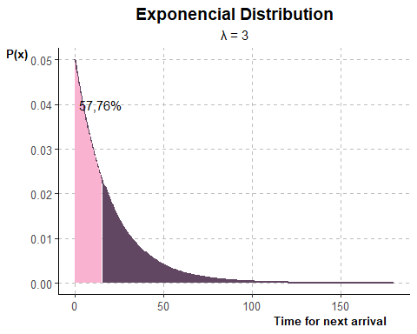
a) within 10 min
## [1] "P(x<15) = 0.5276"
expo_3_plot = expo_3_df %>% ggplot(mapping = (aes(x=x_axis))) + # Construindo gráficos geom_line(mapping = (aes(y = lambda_3, color = "3")), linewidth = 0.9)+ #geom_point(mapping = (aes(y = lambda_3, color = "3")))+ geom_area(mapping = (aes(y = lambda_3, fill = x_menor_15)))+ annotate("text", x=15, y = 0.04, label = "57,76%")+ # # definindo cores scale_color_manual(values=Color_violet)+ scale_fill_manual(values=Color_violet)+ # definindo Titulos labs(title = "Exponencial Distribution", subtitle = "λ = 3", y = "P(x)", x= "Time for next arrival", color = "λ = ")+ # alterando aparecia theme_classic()+ theme(# titles plot.title = element_text(hjust = 0.5, size=14, face="bold"), axis.title.x = element_text(size=10, hjust = 0.9, face = "bold"), axis.title.y = element_text(size=10, hjust = 0.9, face = "bold", angle = 0), legend.title = element_text(size=10, face = "italic"), plot.subtitle = element_text(hjust = 0.5, size=11), #legend legend.position="none", legend.text = element_text(size=10), #axis axis.text.x = element_text(size=10), axis.text.y = element_text(size=10), #axis.line = element_line(color = "black", size = 1, linetype = 1)) #grid panel.grid.major = element_line(color = "grey", linewidth = 0.5, linetype = 2)) #panel.grid.major.y = element_line(color = "grey", size = 0.5, linetype = 2)) expo_3_plot

Slide 13
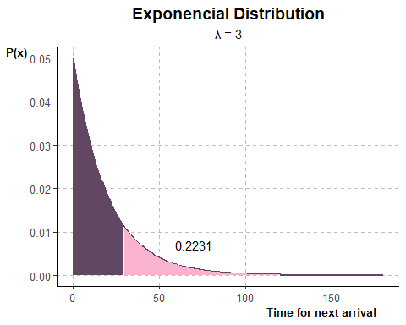
b) after 30 min
## [1] "P(x>30) = 0.2231"
expo_3_plot = expo_3_df %>% ggplot(mapping = (aes(x=x_axis))) + # Construindo gráficos geom_line(mapping = (aes(y = lambda_3, color = "3")), linewidth = 0.9)+ #geom_point(mapping = (aes(y = lambda_3, color = "3")))+ geom_area(mapping = (aes(y = lambda_3, fill = x_maior_30)))+ annotate("text", x=70, y = 0.007, label = round(expo_maior_30,4))+ # # definindo cores scale_color_manual(values=Color_violet)+ scale_fill_manual(values=Color_violet)+ # definindo Titulos labs(title = "Exponencial Distribution", subtitle = "λ = 3", y = "P(x)", x= "Time for next arrival", color = "λ = ")+ # alterando aparecia theme_classic()+ theme(# titles plot.title = element_text(hjust = 0.5, size=14, face="bold"), axis.title.x = element_text(size=10, hjust = 0.9, face = "bold"), axis.title.y = element_text(size=10, hjust = 0.9, face = "bold", angle = 0), legend.title = element_text(size=10, face = "italic"), plot.subtitle = element_text(hjust = 0.5, size=11), #legend legend.position="none", legend.text = element_text(size=10), #axis axis.text.x = element_text(size=10), axis.text.y = element_text(size=10), #axis.line = element_line(color = "black", size = 1, linetype = 1)) #grid panel.grid.major = element_line(color = "grey", linewidth = 0.5, linetype = 2)) #panel.grid.major.y = element_line(color = "grey", size = 0.5, linetype = 2)) expo_3_plot

Slide 14
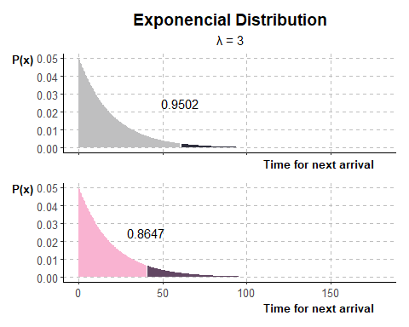
b) between 40 and 60 min
## [1] "P(x>40 e x<60) = 0.0855"
expo_3_60_plot = expo_3_df %>% ggplot(mapping = (aes(x=x_axis))) + # Construindo gráficos #geom_line(mapping = (aes(y = lambda_3, color = "3")), linewidth = 0.9)+ #geom_point(mapping = (aes(y = lambda_3, color = "3")))+ geom_area(mapping = (aes(y = lambda_3, fill = x_menor_60)))+ annotate("text", x=60, y = 0.025, label = round(pexp(60,rate = 0.05),4))+ # # definindo cores scale_color_manual(values=color_urban)+ scale_fill_manual(values=color_urban)+ # definindo Titulos labs(title = "Exponencial Distribution", subtitle = "λ = 3", y = "P(x)", x= "Time for next arrival", color = "λ = ")+ # alterando aparecia theme_classic()+ theme(# titles plot.title = element_text(hjust = 0.5, size=14, face="bold"), axis.title.x = element_text(size=10, hjust = 0.9, face = "bold"), axis.title.y = element_text(size=10, hjust = 0.9, face = "bold", angle = 0), legend.title = element_text(size=10, face = "italic"), plot.subtitle = element_text(hjust = 0.5, size=11), #legend legend.position="none", legend.text = element_text(size=10), #axis axis.text.x = element_blank(), axis.text.y = element_text(size=10), #axis.line = element_line(color = "black", size = 1, linetype = 1)) #grid panel.grid.major = element_line(color = "grey", linewidth = 0.5, linetype = 2)) #panel.grid.major.y = element_line(color = "grey", size = 0.5, linetype = 2)) ###################################### expo_3_40_plot = expo_3_df %>% ggplot(mapping = (aes(x=x_axis))) + # Construindo gráficos #geom_line(mapping = (aes(y = lambda_3, color = "3")), linewidth = 0.9)+ #geom_point(mapping = (aes(y = lambda_3, color = "3")))+ geom_area(mapping = (aes(y = lambda_3, fill = x_menor_40)))+ annotate("text", x=40, y = 0.025, label = round(pexp(40,rate = 0.05),4))+ # # definindo cores scale_color_manual(values=Color_violet)+ scale_fill_manual(values=Color_violet)+ # definindo Titulos labs(title = "Exponencial Distribution", subtitle = "λ = 3", y = "P(x)", x= "Time for next arrival", color = "λ = ")+ # alterando aparecia theme_classic()+ theme(# titles plot.title = element_blank(), axis.title.x = element_text(size=10, hjust = 0.9, face = "bold"), axis.title.y = element_text(size=10, hjust = 0.9, face = "bold", angle = 0), legend.title = element_text(size=10, face = "italic"), plot.subtitle = element_blank(), #legend legend.position="none", legend.text = element_text(size=10), #axis axis.text.x = element_text(size=10), axis.text.y = element_text(size=10), #axis.line = element_line(color = "black", size = 1, linetype = 1)) #grid panel.grid.major = element_line(color = "grey", linewidth = 0.5, linetype = 2)) #panel.grid.major.y = element_line(color = "grey", size = 0.5, linetype = 2)) ###################################### expo_3_60_plot/expo_3_40_plot

Slide 15
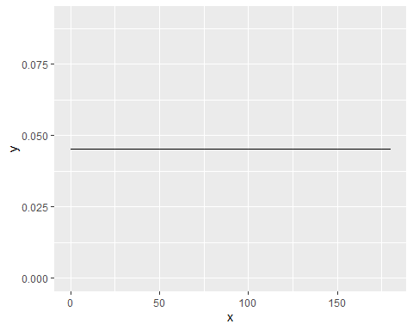
Weibull distribution and Reliability
Definir o conceito de reliability
apresentar a Bathtub theory
introduzir a weibull distribution
exercicios com diferentes shapes
REFAZER DISTRIBUIÇÕES COM A FORMULA
## [1] 4.539993e-05

