Slide 1
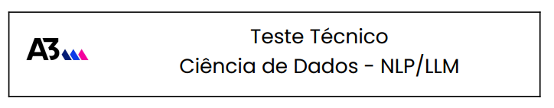

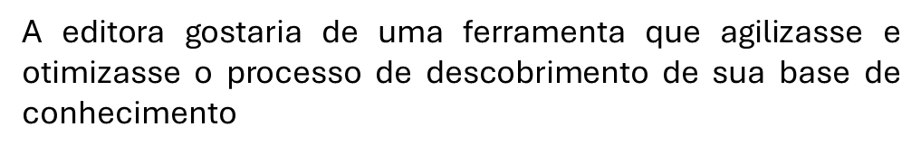

https://github.com/JaquesZanon/A3-Desafio
Jaques Zanon
Jaques Zanon

Slide 2

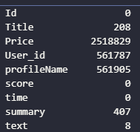
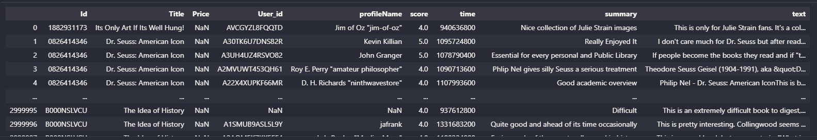
df_rating
Jaques Zanon

Slide 3
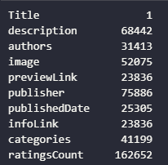
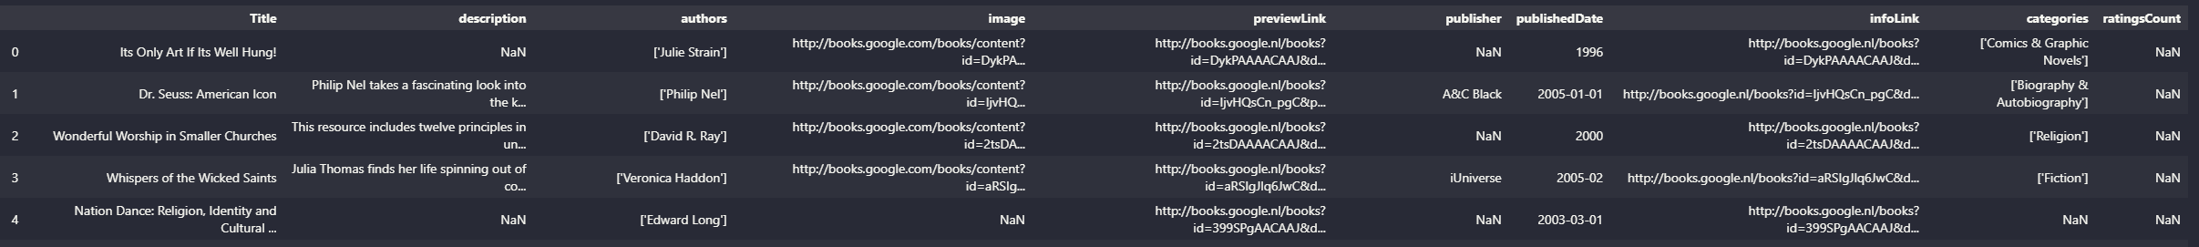
df_books
Jaques Zanon

Slide 4
1
2
.
.
.
.
2438K
df_ratings_a
1
2
.
.
.
.
212K
df_books
Base de conhecimento
1
2
.
.
.
.
2438K
df_total
1
2
.
.
.
.
3000K
df_ratings
1
2
.
.
.
.
562K
df_ratings_c
Base de conhecimento cinza
Jaques Zanon

Slide 5
Títulos
206 711
Autores
124 098
Publisher
15 727
1
2
.
.
.
.
2438K
df_total
User
1 008 972
Top 5
Botton 5
score qtde
['J. R. R. Tolkien'] 5 24019
['Jane Austen'] 5 21942
['Charles Dickens'] 5 11481
['John Steinbeck'] 5 8401
['C. S. Lewis'] 5 8111
score qtde
['Robert Jordan'] 1 1643
['Jane Austen’] 1 1184
['BusinessNews Publishing'] 1089
['Charles Dickens'] 1 963
['Tom Clancy'] 1 801
Jaques Zanon

Slide 6
Planejamento de entregáveis - Roadmap
Fase 1: Análise de requisitos
Stakeholders
Definição de objetivos de curto a longo prazo
Alinhamento de expectativas
Fase 2: Dados
Definir coleta e limpeza (o que é importante?) : Id_reviwers?
Alinhamento de expectativas
Fase 3: Desenvolvimento
Explorar diferentes arquiteturas, frameworks
Experimentos preliminares
Dívida técnica
Avaliar desempenho, otimizar hyperparametros
Aumento gradual do tamanho da base
Definição de indexes do bando de dados vetorial
Alinhamento de expectativas
Fase 4: Avaliação
Desempenho do modelo, acurácia nas respostas
Identificar pontos francos
Ajustes de pipelines, hyperparametros
Validação externa com usuários
Fase 5: Implantação, Manutenção
Modelo em produção
Entrega contínua, ajustes
Atualizações
Documentação
Fase 6: Suporte ao usuario
Treinamentos
Suporte técnico
Continuar acompanhando o progresso na área de modelos de linguagem
Jaques Zanon

Slide 7
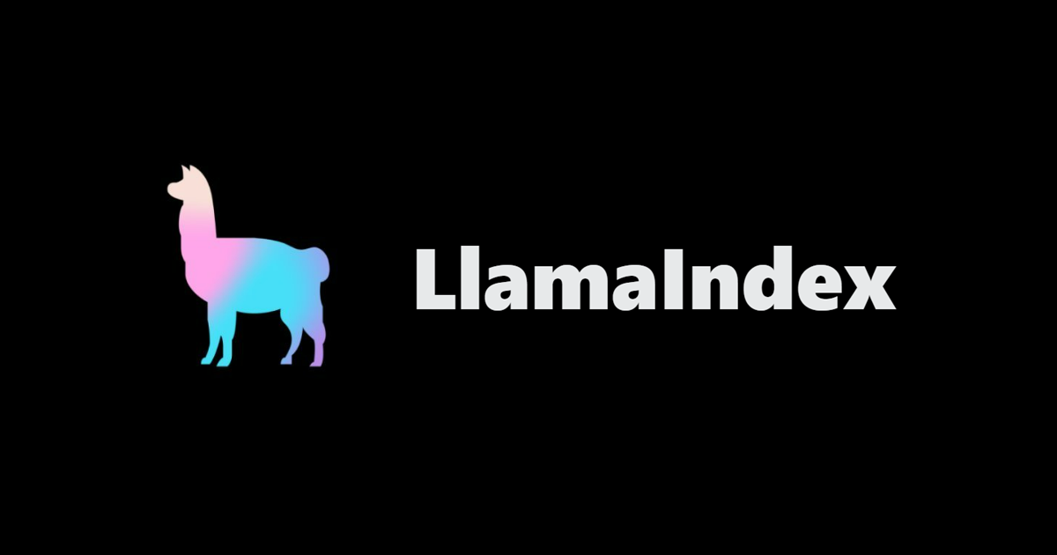





Vector index
node1
node1
node2
node2
text
node3
node3
node4
node4
.
.
.
.
.
.
Text: embedding
Metadata: Title, Id, Author, Score, User_id
Gpt 3.5 turbo
cashed
Node n
Node n
Search index
Summary index
MongoDB – Atlas
cosine dissimilarity
Jaques Zanon

Slide 8
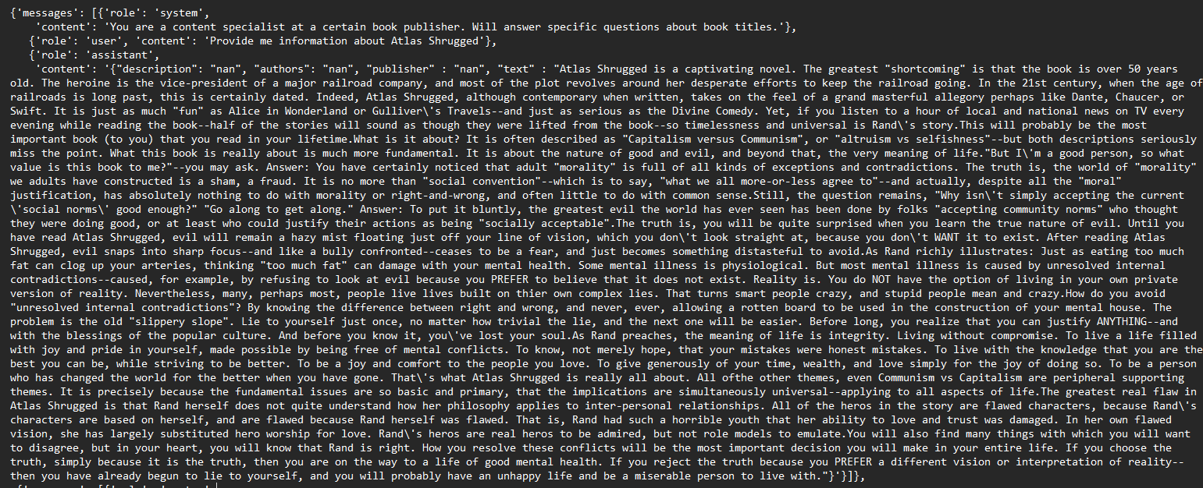
[{'messages': [{'role': 'system',
'content': 'You are a content specialist at a certain book publisher. Will answer specific questions about book titles.'},
{'role': 'user', 'content': 'Provide me information about Atlas Shrugged'},
{'role': 'assistant',
'content': '{"description": "nan", "authors": "nan", "publisher" : "nan", "text" : "Atlas Shrugged is a captivating novel. The greatest "shortcoming" is that the book is over 50 years old. The heroine is the vice-president of a major railroad company, and most of the plot revolves around her desperate efforts to keep the railroad going. In the 21st century, when the age of railroads is long past, this is certainly dated. Indeed, Atlas Shrugged, although contemporary when written, takes on the feel of a grand masterful allegory perhaps like Dante, Chaucer, or Swift. It is just as much "fun" as Alice in Wonderland or Gulliver\'s Travels--and just as serious as the Divine Comedy. Yet, if you listen to a hour of local and national news on TV every evening while reading the book--half of the stories will sound as though they were lifted from the book--so timelessness and universal is Rand\'s story.This will probably be the most important book (to you) that you read in your lifetime.What is it about? It is often described as "Capitalism versus Communism", or "altruism vs selfishness"--but both descriptions seriously miss the point. What this book is really about is much more fundamental. It is about the nature of good and evil, and beyond that, the very meaning of life."But I\'m a good person, so what value is this book to me?"--you may ask. Answer: You have certainly noticed that adult "morality" is full of all kinds of exceptions and contradictions. The truth is, the world of "morality" we adults have constructed is a sham, a fraud. It is no more than "social convention"--which is to say, "what we all more-or-less agree to"--and actually, despite all the "moral" justification, has absolutely nothing to do with morality or right-and-wrong, and often little to do with common sense.Still, the question remains, "Why isn\'t simply accepting the current \'social norms\' good enough?" "Go along to get along." Answer: To put it bluntly, the greatest evil the world has ever seen has been done by folks "accepting community norms" who thought they were doing good, or at least who could justify their actions as being "socially acceptable".The truth is, you will be quite surprised when you learn the true nature of evil. Until you have read Atlas Shrugged, evil will remain a hazy mist floating just off your line of vision, which you don\'t look straight at, because you don\'t WANT it to exist. After reading Atlas Shrugged, evil snaps into sharp focus--and like a bully confronted--ceases to be a fear, and just becomes something distasteful to avoid.As Rand richly illustrates: Just as eating too much fat can clog up your arteries, thinking "too much fat" can damage with your mental health. Some mental illness is physiological. But most mental illness is caused by unresolved internal contradictions--caused, for example, by refusing to look at evil because you PREFER to believe that it does not exist. Reality is. You do NOT have the option of living in your own private version of reality. Nevertheless, many, perhaps most, people live lives built on thier own complex lies. That turns smart people crazy, and stupid people mean and crazy.How do you avoid "unresolved internal contradictions"? By knowing the difference between right and wrong, and never, ever, allowing a rotten board to be used in the construction of your mental house. The problem is the old "slippery slope". Lie to yourself just once, no matter how trivial the lie, and the next one will be easier. Before long, you realize that you can justify ANYTHING--and with the blessings of the popular culture. And before you know it, you\'ve lost your soul.As Rand preaches, the meaning of life is integrity. Living without compromise. To live a life filled with joy and pride in yourself, made possible by being free of mental conflicts. To know, not merely hope, that your mistakes were honest mistakes. To live with the knowledge that you are the best you can be, while striving to be better. To be a joy and comfort to the people you love. To give generously of your time, wealth, and love simply for the joy of doing so. To be a person who has changed the world for the better when you have gone. That\'s what Atlas Shrugged is really all about. All ofthe other themes, even Communism vs Capitalism are peripheral supporting themes. It is precisely because the fundamental issues are so basic and primary, that the implications are simultaneously universal--applying to all aspects of life.The greatest real flaw in Atlas Shrugged is that Rand herself does not quite understand how her philosophy applies to inter-personal relationships. All of the heros in the story are flawed characters, because Rand\'s characters are based on herself, and are flawed because Rand herself was flawed. That is, Rand had such a horrible youth that her ability to love and trust was damaged. In her own flawed vision, she has largely substituted hero worship for love. Rand\'s heros are real heros to be admired, but not role models to emulate.You will also find many things with which you will want to disagree, but in your heart, you will know that Rand is right. How you resolve these conflicts will be the most important decision you will make in your entire life. If you choose the truth, simply because it is the truth, then you are on the way to a life of good mental health. If you reject the truth because you PREFER a different vision or interpretation of reality--then you have already begun to lie to yourself, and you will probably have an unhappy life and be a miserable person to live with."}'}]},
{'messages': [{'role': 'system',
'content': 'You are a content specialist at a certain book publisher. Will answer specific questions about book titles.'},
{'role': 'user',
'content': 'Provide me information about The Root of Chinese Qigong: Secrets of Health, Longevity, & Enlightenment'},
{'role': 'assistant',
'content': '{"description": "The Root of Chinese Qigong: Secrets for Health, Longevity, and Enlightenment is the absolutely best book for revealing the what, the why, and the how of qigong. When you know what qigong is, this will help you make the right decision; "is qigong going to be a good choice for me?" When you know why qigong is so effective, this will help you set realistic goals for your use of qigong in your health or martial arts training. When you know how qigong should be practiced, this will absolutely help you to attain your health or martial arts goals in an efficient and timely manner. We strongly recommend this book for everyone who wants to study qigong, tai chi, or marital arts. Qigong training can improve your health, cure illness, and help you overcome the stress of daily living. Qigong is the study of Qi, or vital energy, that circulates in the human body, and it has been practiced by the Chinese for thousands of years. Qigong is a unique and comprehensive approach to health and longevity, and can be trained by anyone. Get the most from your practice by understanding the principles and foundation of this ancient science. Dr. Yang teaches sitting and standing meditation, demonstrates massage techniques, and explores the Qi pathways in your body. He explains correct breathing methods, shares secrets for quieting the mind, and discusses how to increase your body\'s Qi supply. In addition, he also explains important concepts such as the Three Treasures and regulating the body, breath, and mind. Whatever style you practice, you\'ll find the keys to successful training in the Root of Chinese Qigong. Improve your health with Qi (vital energy) training. Relieve stress with simple breathing techniques. Learn the secrets that will advance your practice. Discover the foundations of Chinese medicine. Eliminate tension with soothing relaxation exercises. Includes more than sixty detailed photos and illustrations.", "authors": "[\'Jwing-Ming Yang\']", "publisher" : "Ymaa Publications", "text" : "This is an outstanding beginning for anyone interested in Qi theory whether you are studying Qi Gong, Tai Chi Chuan, or TCM. I wish that I had known about this book years ago."}'}]},
{'messages': [{'role': 'system',
Fine-tuning
Jaques Zanon

Slide 9
Hipóteses levantadas
Índices
Melhor distribuição dos índices.
Índices para determinadas categorias possibilita comparação, contraste e melhor organização da informação.
Combinação de Search index e summary index.
Melhoria de metadados, palavras-chave, descrição de nodos.
VectorDB
Diferentes similarity seach.
Impacto na velocidade
Relação custo-benefício.
LLMs
Open souce x paid
Custo de performance
Jaques Zanon

Slide 10
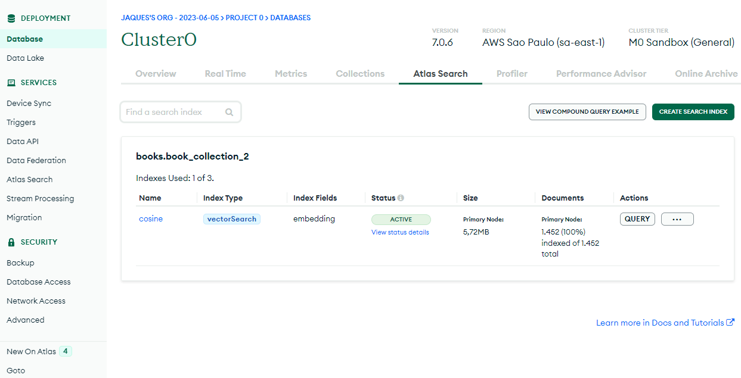
Jaques Zanon

Slide 11
Estimativa de impacto das ações sugeridas
Empoderamento e Acesso à Informação
Melhorias na Eficiência e Produtividade
Personalização e Adaptação às Preferências do Usuário
Maior Variedade e Relevância de Conteúdo
Respostas Mais Rápidas e Precisas
Jaques Zanon

