Slide 1
Memory Movement Avoidance
Brian Castellon Rosales, Jared Ho, Samuel Shaaban

Slide 2
Project Overview & Goal
Develop a movement avoidance controller for Linux memory management using zwap compression
Monitor system metrics including memory pressure, CPU usage, swap activity, and NUMA behavior
Dynamically adjust compression algorithms and pool size based on system conditions
Reduce expensive disk swapping by keeping compressed pages in RAM
Evaluate performance under CPU and memory stress workloads
Visualize results to analyze compression efficiency and system pressure trends

Slide 3
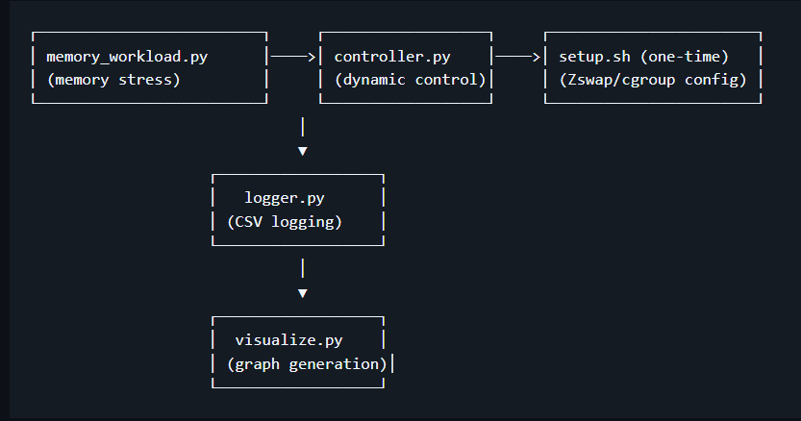
System Architecture
Workload script creates memory stress on the system
Controller monitors CPU, memory pressure, and swap activity
Controller dynamically adjusts compression algorithm and pool size
Metrics are recorded by a logging module and results are visualized using auto-generated graphs

Slide 4
Controller
Continuously monitor system metrics
Collects data from Linux interfaces like PSI and system statistics
Dynamically adjusts zswap compression settings to respond to system conditions
Selects the most appropriate compression algorithm (lzo, lz4, zstd) based on CPU and memory pressure
Logs system behavior for analysis and visualization of performance trends

Slide 5
Metrics
System Metrics:
Memory Pressure: indicates how often process stall due to lack of memory.
CPU Usage: measures system CPU load to avoid excessive compression overhead
Swap Activity: detects when memory pages are moved to disk
NUMA Miss Rate: measures cross-node memory access inefficiencies
Compression Metrics:
Compression Ratio: effectiveness of zswap memory compression
Selected Compression Algorithm: tracks switching between lzo, lz4, and zstd
Compression Pool Size: percentage of RAM used for compressed pages
Per-Node Memory Statistics: monitors memory availability on each NUMA node

Slide 6
Difficulties
Generating consistent memory pressure without immediately triggering swap
Designing workloads that stress memory while leaving CPU available for compression
Measuring system performance while using adaptive compression
Balancing compression overhead with CPU usage during heavy workloads

Slide 7
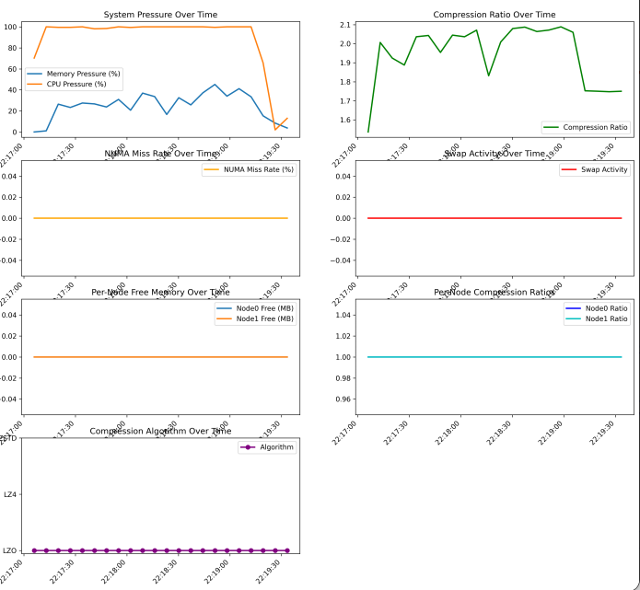
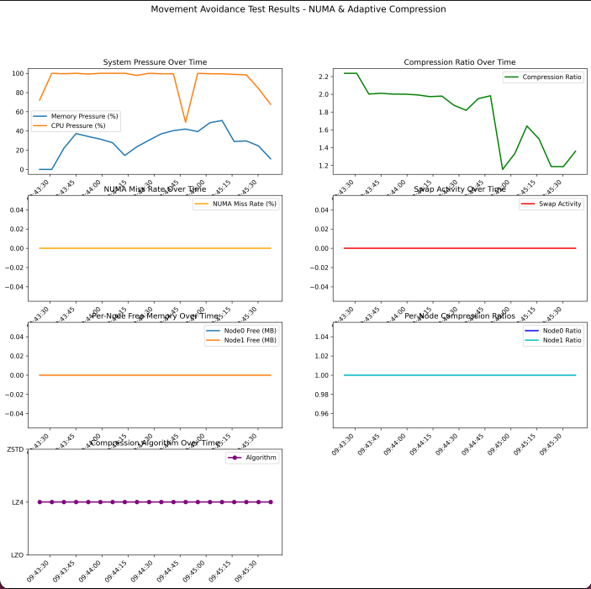
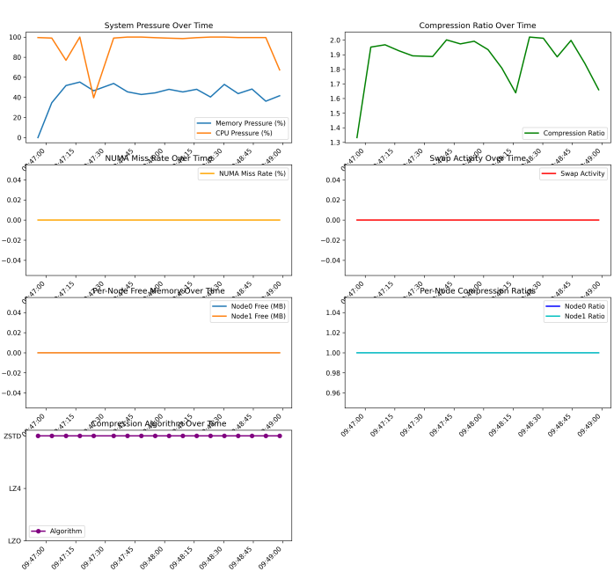
Results
LZO:
LZ4:
ZSTD:

Slide 8
Key Findings
Memory allocation often happens in large chunks, it is difficult to have a system react in time when this happens, as the sudden allocations use a large amount of CPU
Once memory fills up, it is difficult to maintain compression as page swaps begin competing for CPU time
Might be more helpful in a precomputed setup based on workload that would maintain a constant compression level

Slide 9
Future Work
Improve workload design to create stable high memory pressure without excessive CPU usage
Add performance monitoring and testing for real-world applications
Analyze runtime and power usage compared to default
Test across a wider range of VM CPU configurations and memory sizes
Compare adaptive compression against a fixed compression policy

Slide 10
Conclusion
Memory compression can reduce swap usage and access latency by keeping compressed pages in low latency RAM
Memory workloads often increase pressure suddenly, making dynamic compression control difficult
Among tested algorithms, LZO generally provided the best and more ideal results
A stable compression configuration may outperform dynamic switching for many workloads

Slide 11
THANK YOU
Brian Castellon Rosales: castelbr@oregonstate.edu
Jared Ho: hojar@oregonstate.edu
Samuel Shaaban: shaabans@oregonstate.edu

