Slide 1
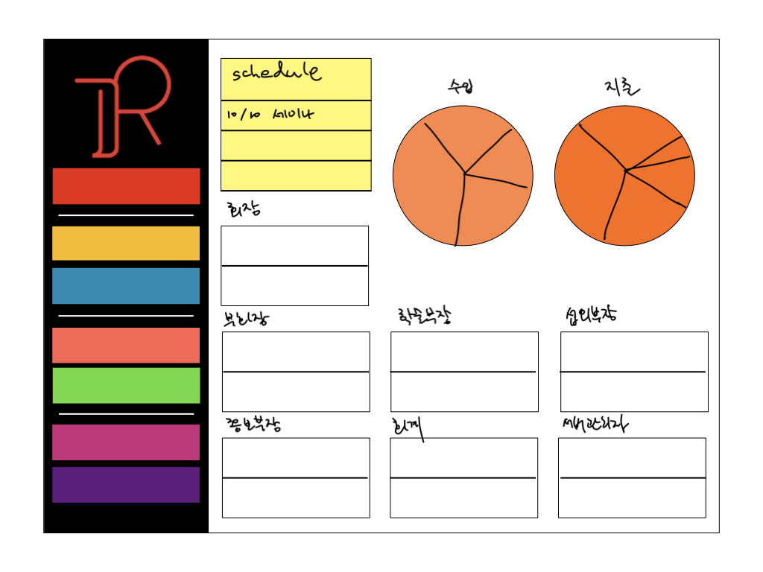
After clicking this button, a popup window(or modal…) appears. You can create a new notice message and share it to kakaotalk, facebook, e-mail etc.
Dashboard
Members
Attendance
%
Notice
Schedule
10월 10일 세미나에 대해..
If you click each message, you can read the full message by popup window or modal
Study
Meeting
Accounts
The percentages of how many members vote in each questions which is from google forms
돕바
mt
etc

