Slide 1
Change Management
TCS Internal

Slide 2
About Change Management:
Changes can arise as a result of Problems or business requirements.
The goal of the Change Management process is to ensure that standardized
methods and procedures are used for efficient and prompt handling of all Changes,
in order to minimize the impact of Change-related Incidents upon service quality,
and consequently to improve the day-to-day operations of the organization.
TCS Internal

Slide 3
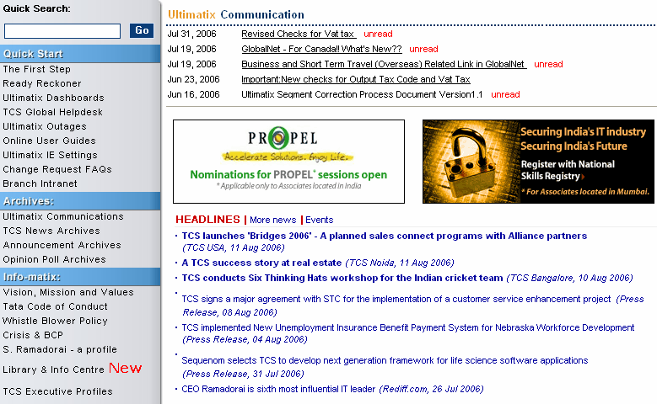
Steps to raise a Change Request (CR)
Login to Ultimatix and click on “TCS Global Helpdesk”
TCS Internal

Slide 4
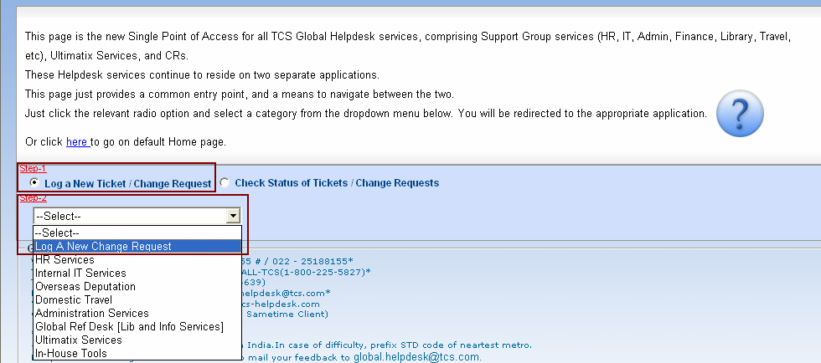
Steps to raise a Change Request (CR)
Select the option “Log a New Ticket/Change Request”
and select “Log A New Change Request” from the drop down list
and in the Home Page click on “Confirm”.
TCS Internal

Slide 5
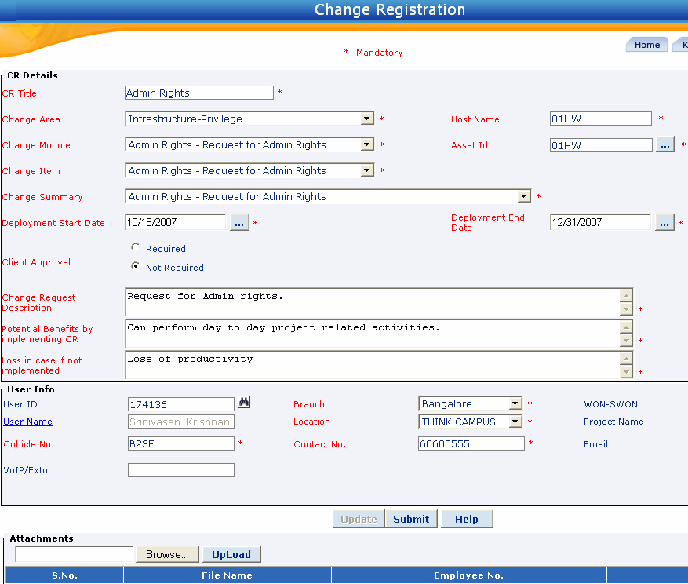
Steps to raise a Change Request (CR)
“Deployment Start and End Date” indicates period for which the implemented CR task or request is valid.
Note : You can find the Change Area, Module, Item & Summary available in the system through the link
Change Approval Matrix
In the “Change Registration” screen, fill in all the *mandatory fields and Upload document, if any.
Note: Please upload the approval document, if Client Approval option is checked.
TCS Internal

Slide 6
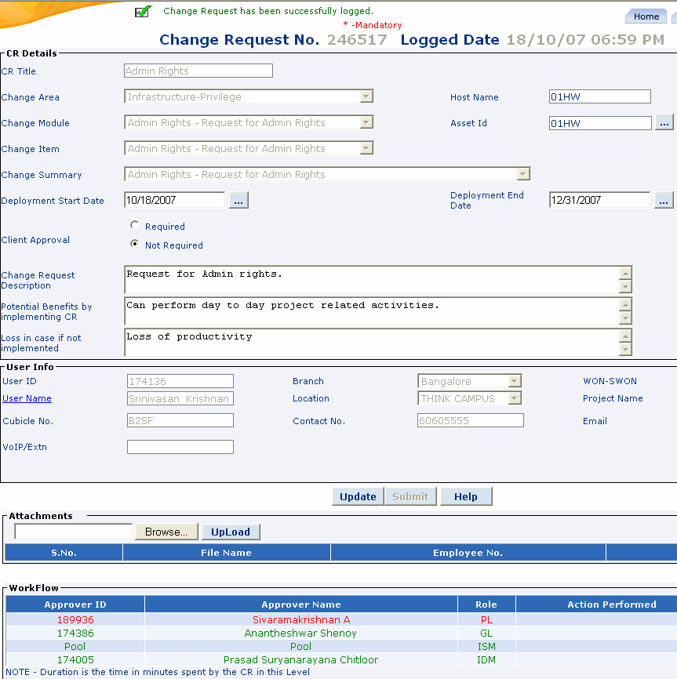
Steps to raise a Change Request (CR)
Once the CR is Submitted, CR# and workflow approvers details will be displayed.
TCS Internal

Slide 7
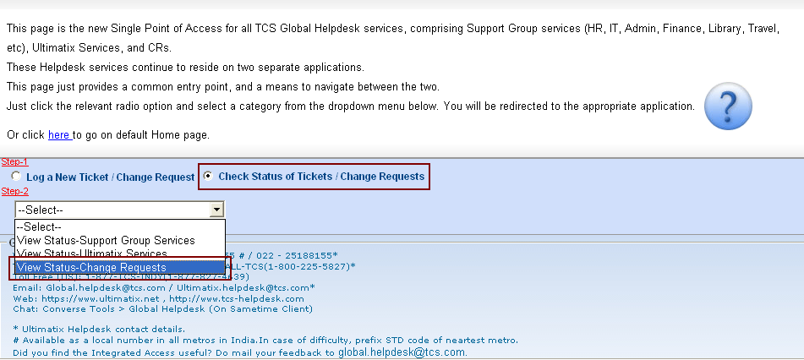
Steps to check status of Change Request (CR)
Select the option “Check Status / Change Requests”
and select “View Status-Change Requests” from the drop down list
and in the Home Page click on “Confirm”.
TCS Internal

Slide 8
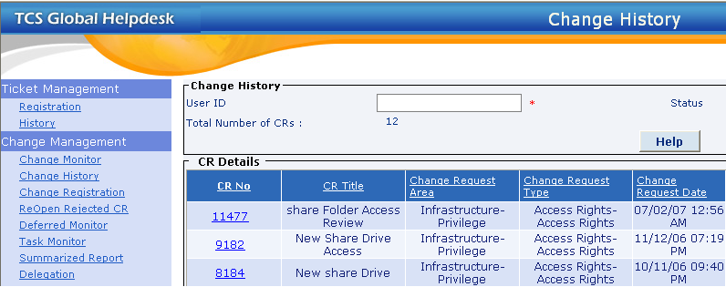
Steps to check status of Change Request (CR)
Click on “Change History” and the CR # to check the Status of the CR
Note : Change Monitor link will be visible only for Approvers
TCS Internal

Slide 9
Change Request (CR) – Life Cycle & Status
Life Cycle of a CR
Rejected by - User
Re-Open
Open
WIP
Sent back
to last
approver *
Resolved**
Closed
* “Sent back to last approver” status indicates that CR has been sent back to previous approver
for more information or clarification.
** Once the CR is Resolved by the implementer, CR initiator will have option to Re-Open or Close the CR.
Note: User can Cancel the CR at any stage of approval.
TCS Internal

Slide 10
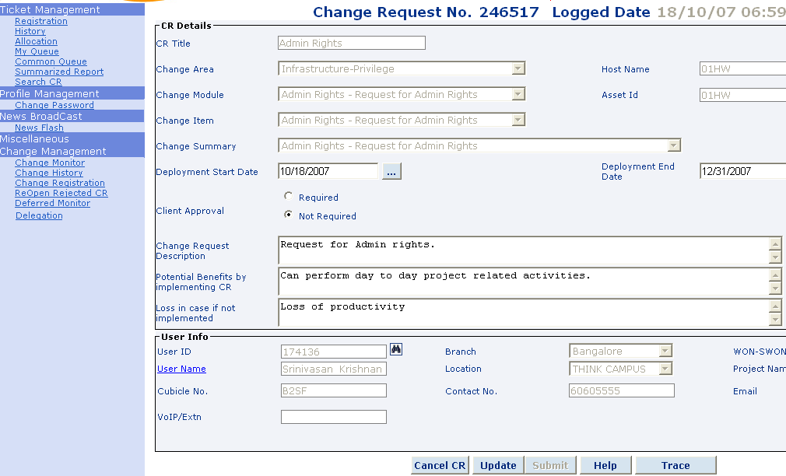
Links or Options in Change Request (CR)
1
2
3
4
5
6
7
8
TCS Internal

Slide 11
Links or Options in Change Request (CR)
1) Change Monitor : (Available only for approvers)
Approver will be able to view CRs in this link, which is pending for the approval.
2) Change History :
By accessing Change History link, one can view CRs raised by them .
3) Change Registration :
Link to access new CR Registration page.
4) Re-Open Rejected CR :
User can Re-Open the Rejected CR, if required.
5) Delegation: (Available only for approvers)
Approver can create a Delegate/Backup through Delegation link.
6) Cancel CR :
User can Cancel the CR at any stage of approval.
7) Update :
User can update only the problem description when the CR status is open.
Note: Users will not be able to change the selected Change Area, Module, Item/Summary or User Info details.
8) Trace :
Users can view the approver’s comments in “Message to User”.
TCS Internal

Slide 12
Steps to check status of a CR
Select the option “Check Status / Change Requests”
and select “View Status-Change Requests” from the drop down list
and in the Home Page click on “Confirm”.
TCS Internal

Slide 13
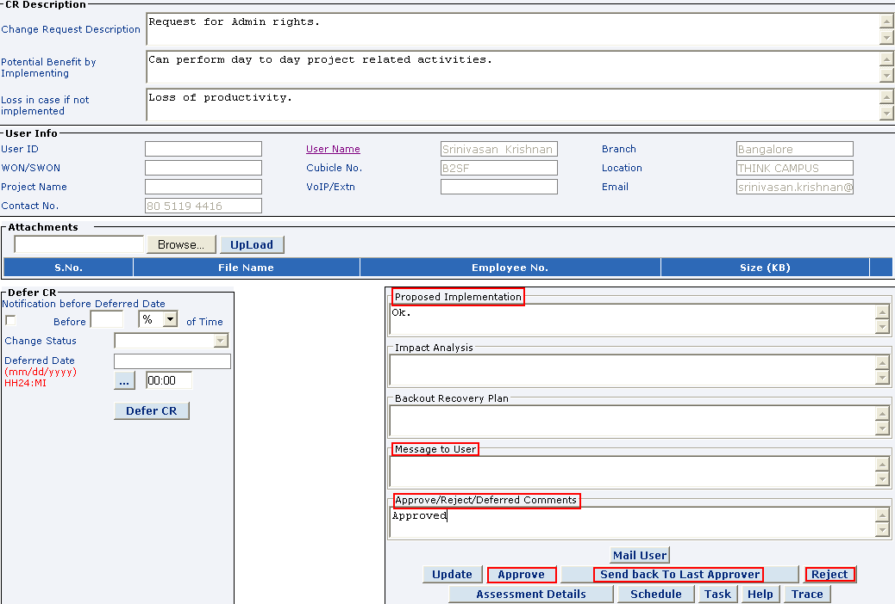
Steps to action a CR:
Steps to action on a CR:
Step 1: Click on Change Monitor.
Step 2: Click on the CR No.
For Approving a CR:
Enter the comments in fields:
1) Proposed Implementation
2) Approve/Reject/Defer Comments
and click on Approve.
For Rejecting a CR:
Enter the comments in fields:
1) Message to User &
2) Approve/Reject/Deffered
Comments field and click on Reject.
For Sending back a CR to previous
approver for more information:
Enter the comments in fields:
1) Proposed Implementation
2) Message to User
3) Approve/Reject/Defer Comments
and click on
Sent back to Last Approver
TCS Internal

Slide 14
About Delegation and Backup:
Delegation :
In case of a planned leave, approver can identify a delegate. Delegation screen can be accessed from the link Delegation link. Approver needs to mention Delegation Start, Delegation End Date, and duration for which CRs needs to be delegated.
CRs approved by delegate will be approved in the name of Delegate and not actual approver.
During the delegation period, CRs will appear in the queue of Delegate and not actual approvers.
After the delegation period, CRs which is pending with Delegate’s queue will move back to the Change Monitor queue of actual approver.
Backup:
An approver can identify a backup. This backup will see all the CRs in Change monitor of approver. On explicit instruction of Approver, Backup can approve the CR. The action performed by backup – approved, rejected, etc will be marked as done by actual approver only.
TCS Internal

Slide 15
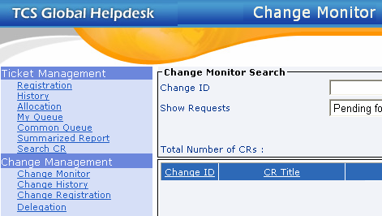
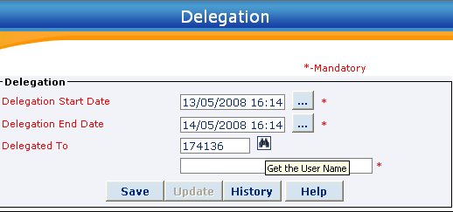
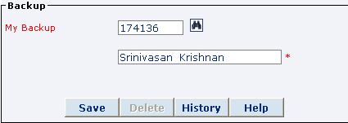
About Delegation and Backup:
Steps to Delegate :
Step 1: Click on Delegate.
Step 2: Enter the Delegation Start & End Date.
Step 3: Enter the Emp No. in the Delegate To field and click on the Get the User Name
and click on Save.
* Delegation details will be revoked on the Delegation End Date & Time.
Steps to create Backup :
Step 1: Click on Delegate.
Step 2: Enter the Emp No. in the My Backup field and click on Get the User Name and click on Save.
* Backup details can be removed by clicking on the Delete button in the Delegation link.
TCS Internal

Slide 16
Frequently Asked Questions (FAQs)
From where does CR tool takes the Supervisor (PL & GL) details ?
Supervisor (PL & GL) details are taken from Ultimatix >>> HR Management >>> TCS Employee Self Service >>> Workflow Approvers >>> Supervisor 1 (PL) and Supervisor 2 (GL).
How can I change the Supervisor or Allocation details in a CR ?
Once the Supervisor or WON/SWON allocation details are updated in Ultimatix, after 24 hours, even CR tool gets updated accordingly.
I have raised a CR and it is pending with wrong approver, should I Cancel the CR and raise a new one, once the supervisor details are updated correctly.
Once the Supervisor details are updated correctly in Ultimatix, during the batch run, automatically CR will move to correct supervisor’s queue.
4) What is Deployment Start and Deployment End date in a CR?
Deployment Start and End date indicates the period for which the implemented CR task /request will be valid and then the CR status will Expire.
TCS Internal

Slide 17
Abbreviations Used:
CR : Change Request
DCH : Delivery Center Head
GL : Group Leader
IDM : Infrastructure, Development and Management
ISM : Information Security Manager
LAO : Location Asset Officer
NOC : Network Operating Centre
N/W Lead : Network Lead
PL : Project Leader
SDO : Service Delivery Owner
SOC : Security Operating Centre
TCS Internal

