Slide 1
Depth Map Estimation on Microcontrollers
Juan Felipe Jaramillo Hernández

Slide 2
Key items
Problem
Design and implementation
Difficulties
Results

Slide 3
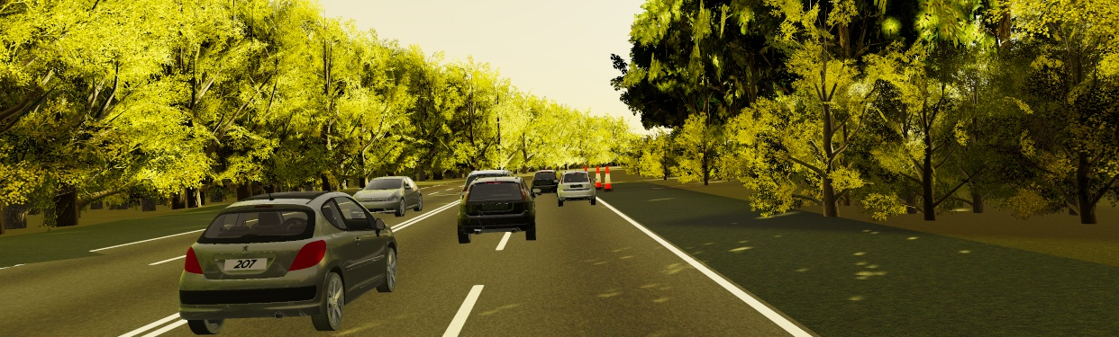
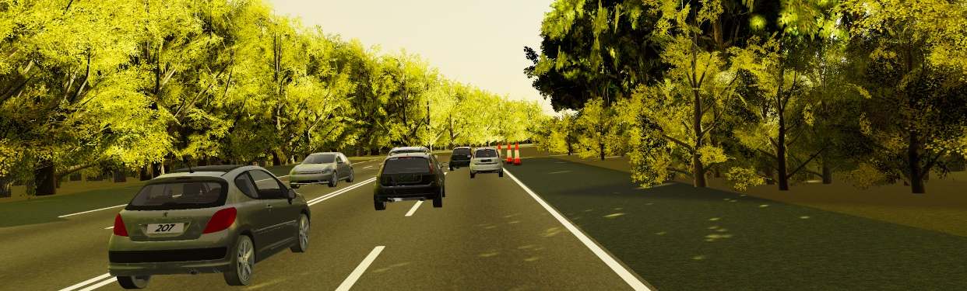

Depth Map
Imágenes tomadas de Virtual KITTI Dataset https://europe.naverlabs.com/research/computer-vision/proxy-virtual-worlds-vkitti-1/

Slide 4
Depth Map
Imágenes tomadas de Virtual KITTI Dataset https://europe.naverlabs.com/research/computer-vision/proxy-virtual-worlds-vkitti-1/

Slide 5
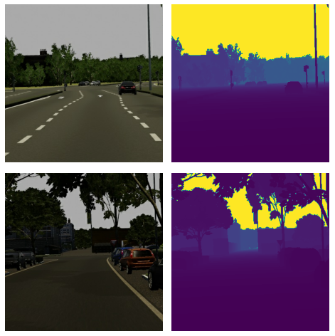
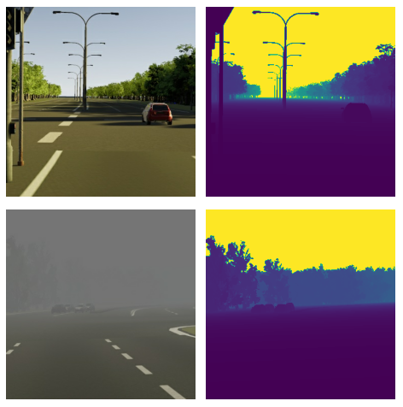
Depth Map
Imágenes tomadas de Virtual KITTI Dataset https://europe.naverlabs.com/research/computer-vision/proxy-virtual-worlds-vkitti-1/

Slide 6
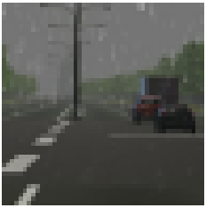
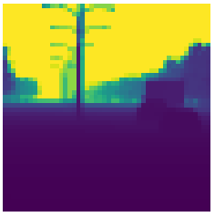
Pyramidal Feature Extraction Network
48x48x3
48x48x1
3x3 Conv
(stride 1)
3x3 Conv
(stride 2)
2x2 TransposeConv
(upsample)
1x1 Conv
(tanh)
Inspirada en Monocular Depth Perception on Microcontrollers for Edge Applications https://ieeexplore.ieee.org/document/9422776

Slide 7
Block Diagram
Microcontroller ESP-EYE: ESP32 80MHz-240MHz, 4MB PSRAM, 4 MB Flash, WiFi 2.4 GHz
Preprocessing and inference
Transmision
Adqusition
Camera
(2MP)
Web
Socket

Slide 8
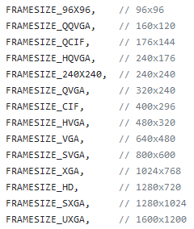
Adquisition
Image resolution
Image codification
Data structure

Slide 9
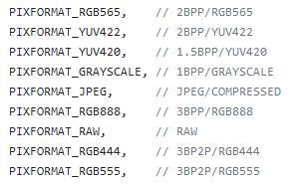
Adquisition
Image resolution:
240x240
Image codification
Data structure

Slide 10
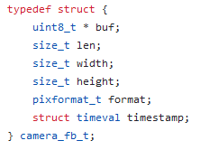
Adquisition
Image resolution :
240x240
Image codification:
JPEG -> Conversion to RGB
Data structure:

Slide 11
Adquisition
Image resolution:
240x240
Image codification :
JPEG -> Conversión a RGB
Data structure :
Hosting the Image in PSRAM (Pseudo Static RAM)

Slide 12
Preprocessing and Inference
Model Training
Integration with TensorFlow Lite for Microcontrollers
Input and Output Structure of the Embedded Model

Slide 13
Preprocessing and Inference
Model Training:
200 epochs ≈ 8 training hours aprox.
Number of parameters: 116,000 -> 79,000
Three loss functions: MSE, BCE, Perceptual
Preprocessing Layers: subsampling y normalization to [-1, 1]
Integration with TensorFlow Lite for Microcontrollers:
8-Bit Integer Quantization -> Representative Dataset
Area size of model: 3465 * 1024 ≈ 3.5 MB (PSRAM)
Input and Output Structure of the Embedded Model

Slide 14
Transmision
Frame and Depth Map Encoding :
JPEG codification -> (Significant Effort with Information Loss)
Conversion from Bytes to HEX:
Message: “Image-Format={gray/rgb}\Image-Size={width}\Image-Data={HEX(imagen)}”
WebSocket Protocol:
Raspberry Pi as Server and Message Receiver
Visualization on an HTML Page

Slide 15
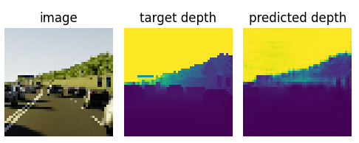
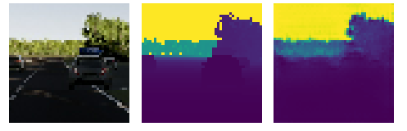
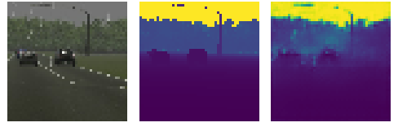
Results

