Slide 1
Predicting the Sale Price of Used BMW Cars
A Predictive Analytics Project Proposal

Slide 2
Agenda
Introduction
Executive Summary
Project Idea
Background
Key Influencing Factors
Predictive Models
Model Evaluation Metrics
Tools and Technologies
Expected Outcomes
Conclusion

Slide 3

Introduction
Project Objective To predict sale prices of used BMW cars using machine learning techniques.
Importance of Pricing Dynamics Understanding the factors influencing car prices can lead to better buying and selling strategies.
Target Audience Impact Insights from this project will benefit both individual car buyers and dealerships.
Notes:
In this slide, we will discuss the main objective of our project, which focuses on predicting the sale prices of used BMW cars. We will delve into how this endeavor can significantly impact both buyers and sellers by providing insights into car pricing dynamics. Understanding these dynamics is crucial in making informed decisions and ensuring fair market practices.

Slide 4
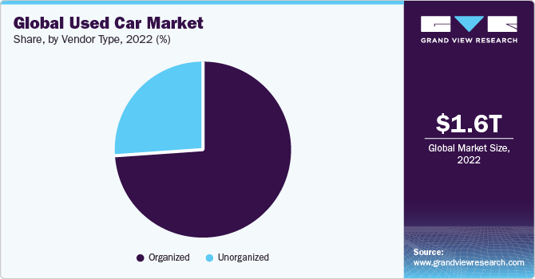
Executive Summary
Importance of the Used Car Market The used car market plays a crucial role in the automotive industry, providing affordability and options for consumers.
Challenges in Pricing Accurate pricing can be challenging due to factors like market fluctuations, condition assessment, and varying demand
Predictive Model Development
Our aim is to create a predictive model by analyzing 5,000 data entries and 18 relevant variables for better price determination.
Notes:
In this slide, we will address the significance of the used car market, specifically focusing on BMW vehicles. We'll highlight the challenges faced in accurately pricing these cars and outline our goal of developing a predictive model that utilizes a substantial dataset. This model will enhance the pricing strategy for used BMW cars and provide insights into market trends.

Slide 5

Project Idea
Project Goal Analyze attributes influencing used BMW car prices.
Attribute Types Examine physical, technical, and categorical features.
Actionable Insights Provide data-driven recommendations for pricing strategies.
Notes:
In this slide, we will discuss the primary goals of our predictive analytics project, which focuses on used BMW cars. We will look into different attributes that influence their sale prices, allowing us to derive actionable insights for potential buyers and sellers alike.

Slide 6

Background
Challenges in Evaluating Used Car Prices The used car market is highly variable, with numerous factors affecting prices.
Limitations of Existing Solutions Many existing pricing tools lack accuracy due to reliance on outdated or insufficient data.
Focus on Dataset Usage We will specifically analyze Diesel and Petrol fuel types to uncover potential pricing trends.
Notes:
In this slide, we will discuss the background of our study on predicting used BMW car prices. We will emphasize the difficulties faced when trying to evaluate prices in the used car market, highlighting the limitations in current approaches and the importance of our specific dataset focusing on fuel types. By the end, the audience should understand the context and need for our predictive analytics project.

Slide 7
Key Influencing Factors
Mileage
Mileage significantly affects the car's value; lower mileage typically raises the price.
Engine Power
Higher engine power can lead to a higher price due to performance appeal and desirability.
Color
Certain colors may enhance resale value, with popular shades often commanding higher prices.
Car Type
The model/type of BMW can influence price variances based on demand and features.
Notes:
In this slide, we will explore the key features impacting the sale price of used BMW cars. Each factor plays a significant role in pricing strategies and buyer preferences, and understanding them can enhance our predictive analytics model.

Slide 8
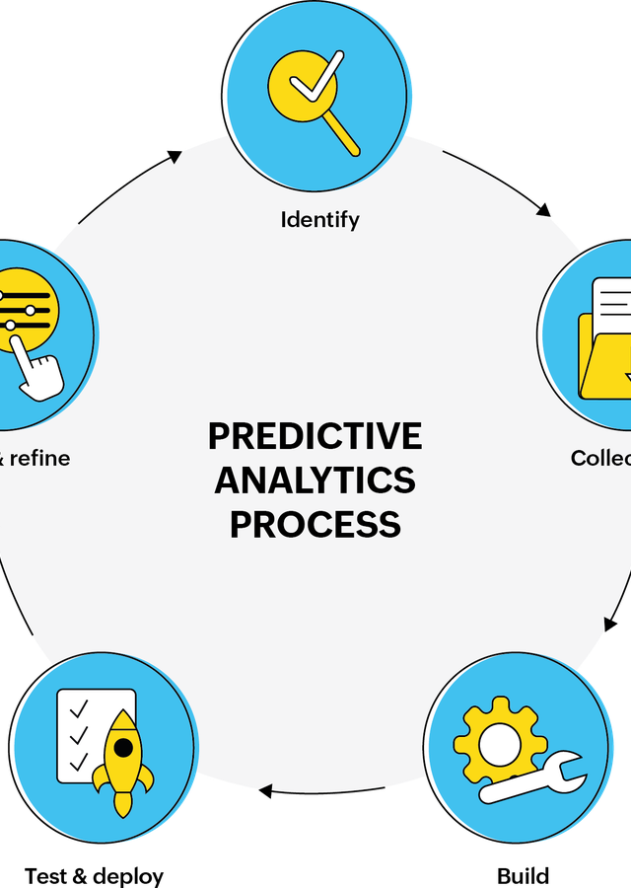
Predictive Models
Decision Trees Easy to understand and visualize, good for interpreting decision processes.
Random Forests Combines multiple decision trees for improved accuracy and reduced overfitting.
Gradient Boosting Machines Transforms weak models into a strong predictor through sequential learning.
Notes:
In this slide, we focus on the predictive models we chose for analyzing the sale price of used BMW cars. Each model has its own strengths, which we will outline here to emphasize how they effectively capture data relationships throughout our analysis. This understanding will help us evaluate which model might best serve our project's goals.

Slide 9

Model Evaluation Metrics
Mean Absolute Error (MAE) Measures average absolute differences between predicted and actual values.
Root Mean Squared Error (RMSE) Calculates standard deviation of prediction errors, giving higher weight to larger errors.
R-squared Indicates the proportion of variance in the dependent variable explained by the model.
Notes:
In this slide, I will describe the key metrics we use to evaluate our predictive model's performance. These metrics allow us to quantify how accurate our predictions are. We'll discuss how Mean Absolute Error (MAE) helps us understand the average discrepancy between predicted and actual values, how Root Mean Squared Error (RMSE) accounts for larger errors more drastically, how R-squared quantifies the proportion of variation explained by the model, and why we include linear regression as a baseline to compare the performance of more complex models.

Slide 10
Tools and Technologies
Python Programming Language
Widely used for data analysis and machine learning with a rich ecosystem.
R for Statistical Analysis
An excellent tool for statistical modeling and visualization.
Data Manipulation Libraries
Pandas for data manipulation and NumPy for numerical operations.
Machine Learning Library
Scikit-learn for implementing machine learning algorithms.
Notes:
In this slide, we will discuss the various tools and technologies that will be utilized in our predictive analytics project. These tools are essential for processing data, performing analysis, and creating visualizations to understand our results better.

Slide 11

Expected Outcomes
Understanding Pricing Dynamics Gain insights into factors affecting used BMW prices.
Supporting Stakeholder Decision-Making Provide data-driven recommendations for buyers and sellers.
Enhancing Market Strategies Enable dealerships to strategize pricing based on predictive insights.
Notes:
In this section, we will discuss the anticipated outcomes of our predictive analytics project. The emphasis will be on how these insights can assist stakeholders in making informed decisions regarding the pricing of used BMW cars.

Slide 12
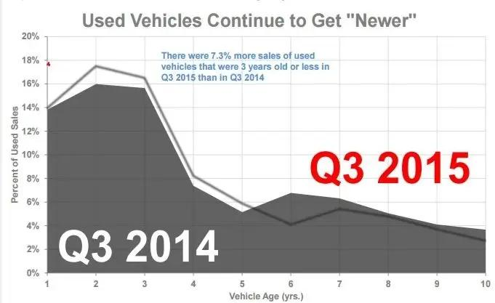
Conclusion
Project Aim To build a reliable model for predicting used BMW sale prices.
Benefits of Transparency Improved pricing transparency for buyers and sellers.
Informed Decision Making Empowers stakeholders with insights for better pricing.
Notes:
In conclusion, this project aims to create a robust predictive model that can accurately estimate the sale prices of used BMW cars. By leveraging advanced analytics, we hope to enhance pricing transparency, enabling buyers and sellers to make more informed decisions.

Slide 13
References
John Doe (2021). Predictive Analytics in Car Pricing. https://www.analyticsinsight.net/predictive-analytics-in-car-pricing/.
Jane Smith (2022). Machine Learning for Car Price Predictions. https://towardsdatascience.com/machine-learning-for-car-price-predictions-217f408d7384.
Automotive Research Group (2020). Used Car Pricing: Factors and Trends. https://www.autoresearchgroup.com/used-car-pricing-factors-and-trends/.

