Slide 1
1.0 Standards and Concepts
By Connor and Jared.

Slide 2
Agenda
1.1: OSI vs. TCP/IP, data encapsulation (frames/packets).
1.2: Differentiating bandwidth from throughput, latency and delay understanding.
1.3: Understanding PAN, LAN, CAN, MAN, WAN, and WLAN, Start, Bus, Ring, Mesh, and Hybrid Physical/Logical layouts
1.4: SaaS, PaaS, IaaS models, Public, Private, and Hybrid cloud environments.
1.5: TCP vs. UDP, DHCP, DNS, HTTP/S, and NTP.

Slide 3
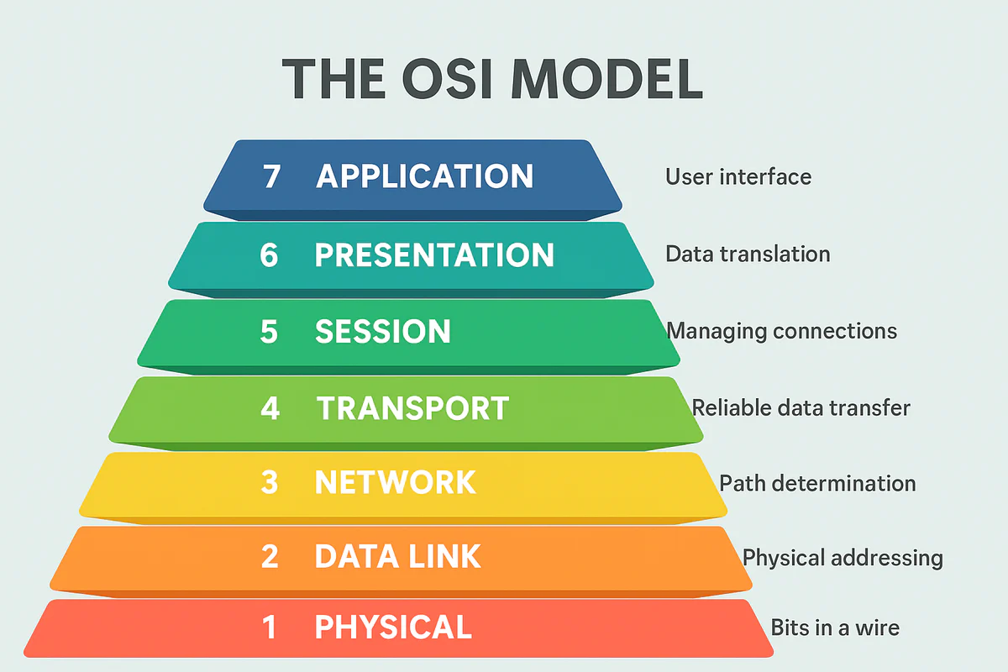
OSI Model

Slide 4
Layer 7 - Application Layer
The Application Layer is what the user interacts with. Its responsibilities include:
Presenting data in a readable format using HTML
Allowing applications and users to use protocols such as HTTP, FTP, SMTP, and DNS

Slide 5
Layer 6 - Presentation Layer
The Presentation Layer is responsible for formatting data
Handles encryption and decryption
Is responsible for compression and decompression
Converts data into the correct format

Slide 6
Layer 5 - Session Layer
The Session Layer manages the connection between devices.
Manages data exchange and integrity
Initiates, manages, and tears down the connection

Slide 7
Layer 4 - Transport Layer
The Transport Layer delivers data across network connections
Segments, transfers, and reassembles data packets
Supports flow control and delivery errors
Delivers data to the correct port number

Slide 8
Layer 3 - Network Layer
The Network Layer provides the services to exchange data between devices
Provides the map between physical and logical addresses
Delivers the data to the correct IP address
Delivers the data using the provided route

Slide 9
Layer 2 - Data Link Layer
The Data Link Layer transfers data to different devices on the same network
Delivers data to the correct Mac address
Encapsulates data into frames

Slide 10
Layer 1 - Physical Layer
The Physical Layer transfers bits over a physical medium
Turns raw data into electrical signals
Controls how bits are transferred

Slide 11
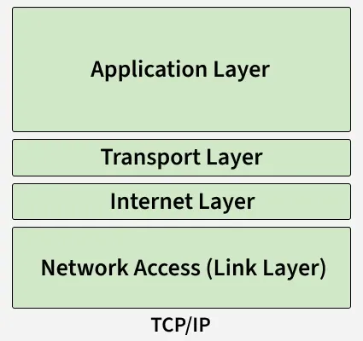
TCP/IP Model

Slide 12
Data Encapsulation
Data is encapsulated at each layer to provide information of where to go.
Application, Presentation, and Session Layer - No data is added
Transport Layer - A header with the destination and source port number is added. The encapsulated data is called segments if using TCP, and datagrams if using UDP
.Network Layer - A header with the destination and source IP address is added. The encapsulated data is called packets.
Data Link Layer - A header and trailer with the destination and source Mac address is added. The encapsulated data is called Frames.
Physical Layer - The frames are received and turned into bits.

Slide 13
Network Traffic
Bandwidth - Maximum amount of data that can be transferred at a time.
Throughput - Rate at which bits are being sent.
Latency - Time it takes for data to travel from one end to the other.
Delay - Total time it takes for a packet to reach its destination.

Slide 14
Different Types of Networks and Sizes
Local Area Network (LAN) - Network over a small geographical area such as a home or office.
Wide Area Network (WAN) - Network over a large geographical area such as a city or country.
Metropolitan Area Network (MAN) - Network over a city or large area. Not as big as a WAN.
Personal Area Network (PAN) - Network that connects devices tied to a single person such as a phone, watch, headphones, etc.
Campus Area Network (CAN) - Network that connects multiple LANs in a spread out area such as a university campus or business park.
Wireless Local Area Network (WLAN) - A LAN that is connected wirelessly.

Slide 15
Different Physical/Logical Layouts
Ring - Design where each device is connected to two devices to form a circle.
Star - Design where each device is connected to a central device or hub.
Mesh - Design where each device is connected to many or all of the other devices to create redundancy.
Bus - Design where each device is connected to the same cable.
Hybrid - Design that uses multiple different topologies in the network.

Slide 16
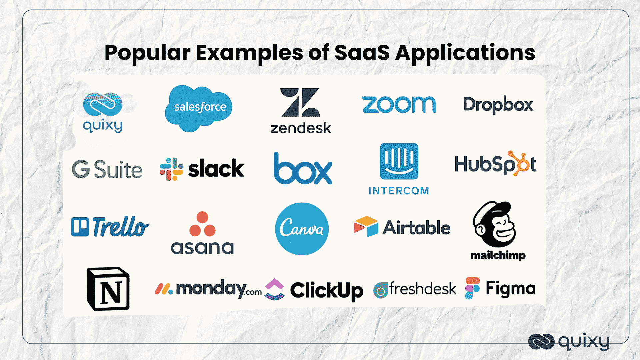
SaaS
SaaS or software as a service is when software is being sold as a service, usually used over the internet via the cloud. It often is used with subscription based monetization. SaaS can be anything from, Zoom to Microsoft 365.
Benefits:
Cost effectiveness, SaaS can be a better financial decision for some companies, because it is a better financial decision to buy from a different company than to create a in house solution.

Slide 17
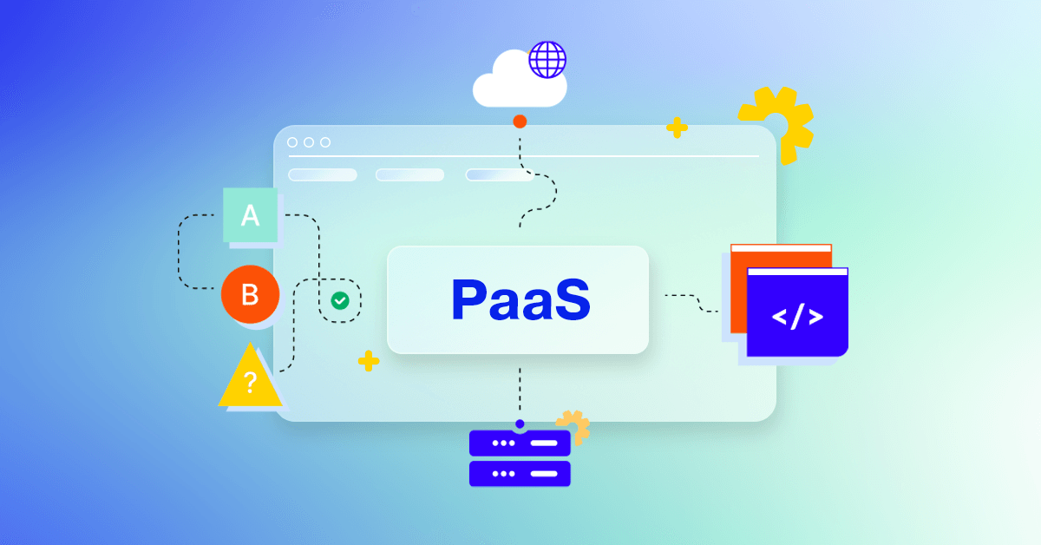
PaaS
Platform as a service, serves as a cloud pre-built platform for developers to build deploy and manage applications. This provides a easy to maintain way to scale up and manage infrastructure such as servers and storage without have to setup a efficient system themselves.
Credit CloudBlue
Benefits:
This could help companies and developers create and launch their applications faster while also possibly reduce costs and increase scalability.

Slide 18
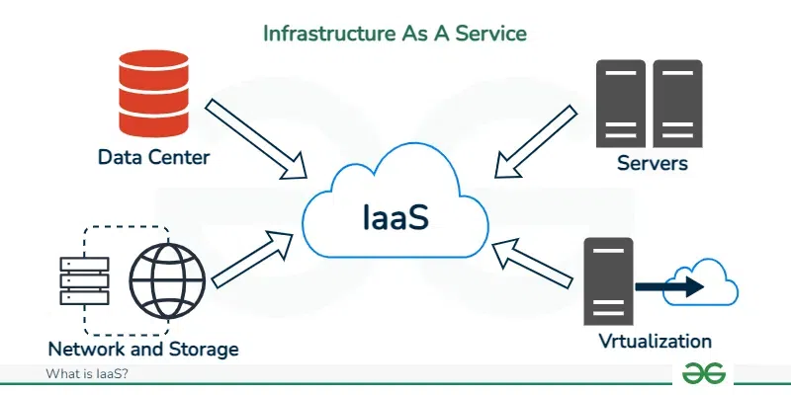
IaaS models
Infrastructure as a Service, is a cloud computing model that provides fundamental network infrastructure such as, servers storage and networking. It usually is a pay-as-you-go model so the company only pays for what they need and how much they need.
Credit GeeksforGeeks
Benefits:
With this model it eliminates the need to for companies to buy or store physical hardware it also allows companies to scale instastly and easier, it may also reduce the cost because there is not need to store the hardware.

Slide 19
Public Cloud
Public Cloud, is a cloud computing based module that the hosting company has made open to public and free (usually only a trail/small bit of it.) some of the most used are Google drive, AWS, and Azure.
BENEFITS:
Some benefits for companies that use Public Cloud are: Low maintenance, for some companies cloud products are a better financial decision because they do not have to implement computer infrastructure.

Slide 20
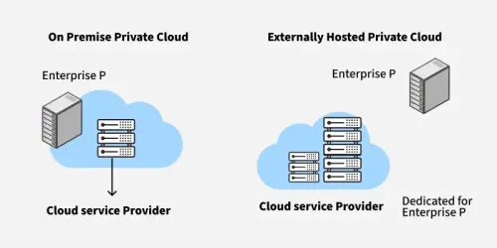
Private Cloud
A private cloud is a cloud computing model that is usually exclusively to a single organization, providing isolated access to computing resources such as storage, processing power, and networking without sharing them with other tenants
geeksforgeeks.org
Benefits: This model offers greater control, enhanced security, and customization, allowing organizations to tailor infrastructure to specific regulatory compliance needs or sensitive data requirements

Slide 21
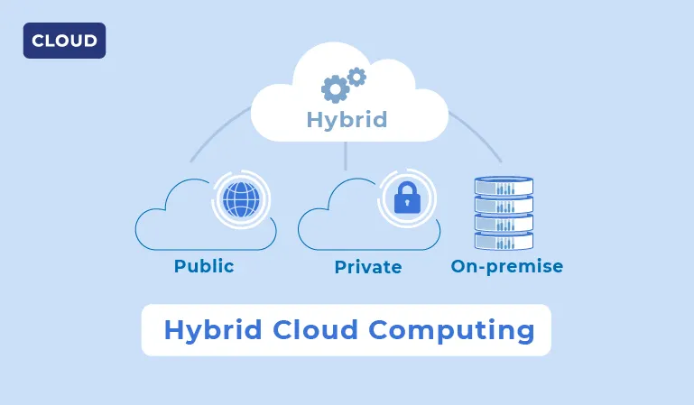
Hybrid cloud environments
A hybrid cloud is a mixed computing environment that combines a company’s on-premises infrastructure, private cloud services, and third-party public cloud services (ex. AWS, Microsoft Azure, or Google Cloud) This architecture allows organizations to share data and applications between the different environments, creating a unified IT infrastructure where workloads can be moved and managed flexibly
sam-solutions.us
Benefits: The biggest benefit of this model is the agility and flexibility it give to organizations that implement this model. I enables an easy way to keep private data on secure systems while also giving them the a great deal of control and flexibility

Slide 22
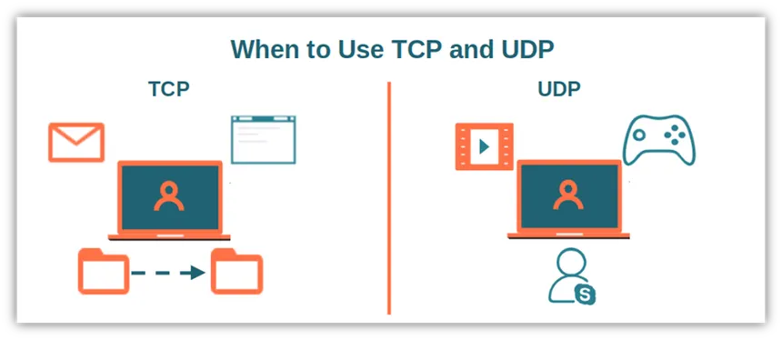
TCP vs. UDP
TCP (Transmission Control Protocol) and UDP (User Datagram Protocol) are both different protocols for internet data transmission. The main difference is how they approach reliability and speed.
cheapsslsecurity.com
TCP is the more reliable and slower it makes sure that the data arrives and is intact (used in Web Browsing, email, and file.)
UDP is connectionless and unreliable, prioritizing low latency and speed by sending data without checking for delivery. (used in VoIP calls, and video streaming)

Slide 23
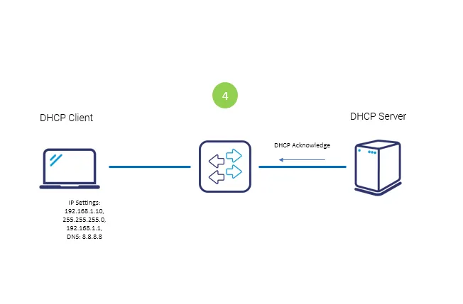
DHCP
DHCP (Dynamic Host Configuration Protocol) is a network management protocol that automatically assigns IP addresses and other communication parameters to devices on an IP network, eliminating the need for manual configuration. It operates on a client-server architecture, where a central DHCP server manages a pool of available addresses and configuration details, such as subnet masks, default gateways, and DNS server addresses
grandmetric.com

Slide 24
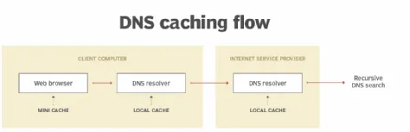
DNS
Domain Name System (DNS) is the database that translates human readable domain names (like www.example.com) into machine-readable IP addresses (like 192.0.2.44) DNS allows users to access websites and services using memorable names rather than numeric identifiers, acting as an essential application-layer protocol
techtarget.com

Slide 25
HTTP/S
HTTPS (Hypertext Transfer Protocol Secure) is an extension of the HTTP communications protocol that uses Transport Layer Security (TLS) encryption to support secure communication over a computer network. It is the secure version of HTTP, widely used on the Internet to protect data integrity and privacy.

Slide 26
NTP
NTP stands for Network Time Protocol, a networking protocol designed to synchronize the clocks of computer systems over packet-switched, variable-latency data networks. NTP ensures that devices operate on a consistent and highly accurate time base, typically within tens of milliseconds over the public Internet and better than one millisecond in local area networks

Slide 27
References
TCP/IP Model - GeeksforGeeks
https://www.geeksforgeeks.org/computer-networks/tcp-ip-model/
The OSI Model Explained - NetworkSupply
https://www.network-supply.com/blogs/knowledge/the-osi-model-explained?srsltid=AfmBOoq0x8l-VW_b6oJElZS2NFkuFlrHpNcxxUP2bWWIlIFzHMCYlzkV
Application Layer in OSI Model - GeeksforGeeks
https://www.geeksforgeeks.org/computer-networks/application-layer-in-osi-model/
Presentation Layer in OSI Model - GeeksforGeeks
https://www.geeksforgeeks.org/computer-networks/presentation-layer-in-osi-model/
How Data Encapsulation and De-encapsulation Works - GeeksforGeeks
https://www.geeksforgeeks.org/computer-networks/how-data-encapsulation-de-encapsulation-works/

Slide 28
References cont.
What is Public - Microsoft Azure
SaaS - Wikipedia
DCHP - Wikipedia
DNS - Cloudflare
NTP - Wikipedia

