Slide 1


PROJECT BUXS
BROWSER USER EXFILTRATION SYSTEM
BY JARED R. ANDRASZEK | BS CYBER SECURITY & COMPUTER SCIENCE | ADVISOR: PROFESSOR HENDERSON

Slide 2
PROBLEM STATEMENT
Cybersecurity students feel a lower retention in Cyber Security hands-on exercises
Students may graduate college with a degree, but with no firm understanding of common exploits
No environment to practice ethical hacking and penetration testing
Solution Requirements:
Promoting user creativity with multiple solutions to a problem
Covering multiple common web exploits
Self-paced sandbox environment

Slide 3
RESEARCH & BACKGROUND
Capture The Flag and Hack The Box inspired
Researched common web application vulnerabilities
Apache server running the HTML, PHP, JS, CSS, MySQL development stack
How to secure File inclusion, Cross Site Scripting (XSS), and SQL injections (SQLi) vulnerabilities and purposefully make them less secure

Slide 4

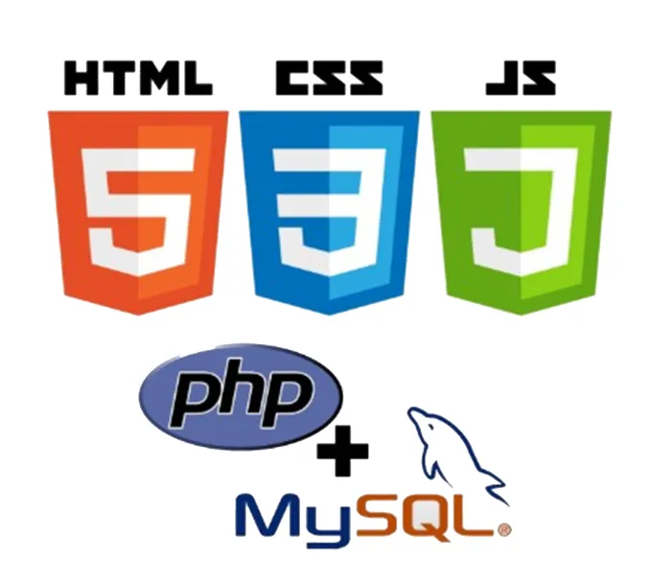


LANGUAGES, SOFTWARE, AND HARDWARE
Languages:
HTML/CSS
JS
PHP
SQL
BASH
Python
Software/OS:
Vmware ESXi server
Apache webserver
Debian 12 OS
MariaDB (MySQL)
Hardware:
CSU’s Lazarus ESXiserver

Slide 5
PROJECT REQUIREMENTS
Make it accessible to students
Create a network of VMs hosting webservers
Contains common exploits built-in to the servers
Feel realistic to where it looks like you are working with a real tech company
Include guidance and tips to progress the students forward

Slide 6
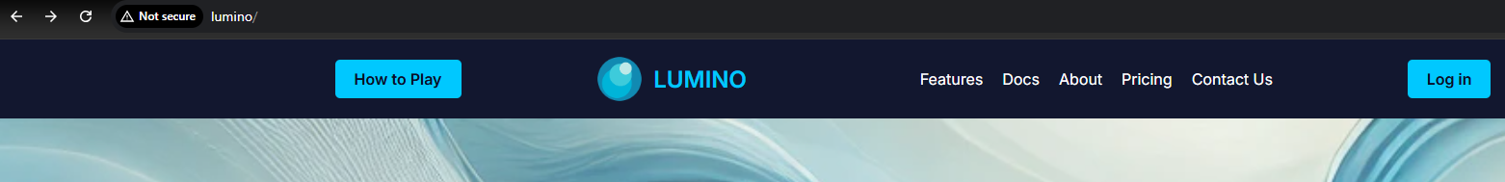
HOW TO GET STARTED – ON CAMPUS
You must have connection to the Lazarus server. So on a lab device in Ashby Hall 203, 207, or208
Or a laptop/personal device with an ethernet port plugged into the ethernet wall jacks
Go to http://Lumino
Click on How To Play in the top left
Have fun

Slide 7
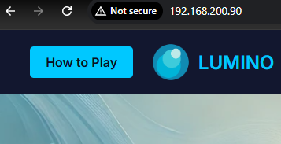
HOW TO GET STARTED – OFF CAMPUS
Request VPN permissions and then follow ON CAMPUS instructions
Or set up VMs on a personal network (Recommend Oracle VirtualBox)
Change the hidden file to point to the VM2 IP address
Go to the IP address set for VM1 and only after completing VM1 should you move to VM2’s IP address
Have Fun

Slide 8
DEMO
DEMO TIME
Go to http://lumino

Slide 9
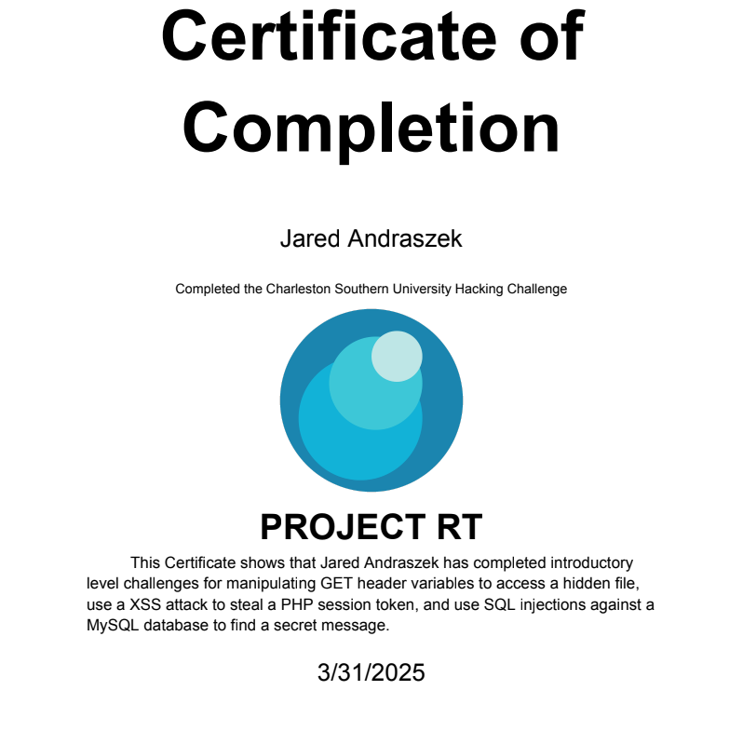
CERTIFICATE OF COMPLETION
Upon completion of the Google form:
Puts the player’s name in
Puts the date
Sends the completed certificate to their email

Slide 10
TEST PLAN
Testing Plan:
Unit tests during development
Design and improvement feedback during development
User acceptance and bug hunting from Cyber Security students
Main Testing Cases:
Users can access the webservers and properly use their functionalities
The websites feel like a real website
The exploits function as intended
The hints work and direct and guide players as intended
The VMs restores from to a snapshot every night

Slide 11
TEST RESULTS - IMPLEMENTED
Users requested a domain name for more realism
Created a How to Play with the Google submission form built in to the website
Created a Certificate of Completion based on Google form submission
Implemented bug and unnecessary vulnerability fixes

Slide 12
TEST RESULTS – NOT IMPLEMENTED
Not yet implemented/Work in progress
XSS inject that does not require the player to create a remote listener
VMs do not restore from a snapshot every night
Do not plan to implement (in this version)
More levels

Slide 13
CHALLENGES OVERCAME
Creating a narrative and realistic design
Apache, HTML, CSS, JS, PHP, MySQL full-stack environment
Prioritizing quality of the exploits over the number of exploits
Automating the XSS check
Developing in Oracle Virtualbox and transferring to Vmware ESXi
Creating a Certificate of Completion

Slide 14
FUTURE ENHANCEMENTS
In future versions of this application, I would like to see/add:
More levels
Wireshark
Buffer Overflow
More common web exploits
Microservices that communicate over a network that can be captured or read
Fixing unintended user reported bugs
Creating a better Certificate of Completion
Transition to Docker for easy transportation and setup

Slide 15

QUESTIONS?

