Slide 1
Sensor Technologies
Technology | Detectivity (pT/√Hz @1Hz) | Optimal Speed | Volume (cm³) | Power | Cost | CMOS Integrable
TMR | 10 | Hz – kHz | 1e-5 | uW | <$ 1 | Yes
GMR | 100 | Hz – MHz | 1e-5 | mW | <$ 1 | Yes
AMR | 100 | Hz – MHz | 1e-4 | mW | <$ 1 | Yes
Hall | 30,000 | Hz – kHz | 1e-4 | mW | $ 0.1 | Kind-of
Fluxgate | 1 | Hz | 1 | W | 0.1 k$ | No
Vapor | 0.01 | Hz | 1 | W | 1 k$ | No
Squid | 0.001 | Hz | 0.5 | W | >1 k$ | No
Rough order of magnitude estimates
TMR/GMR Market driven by best performance for small size, low power and cost

Slide 2
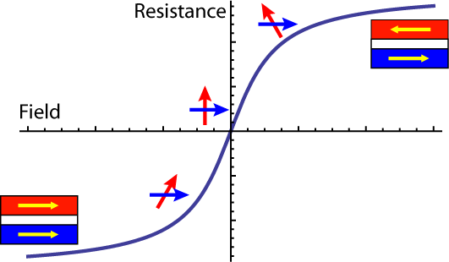
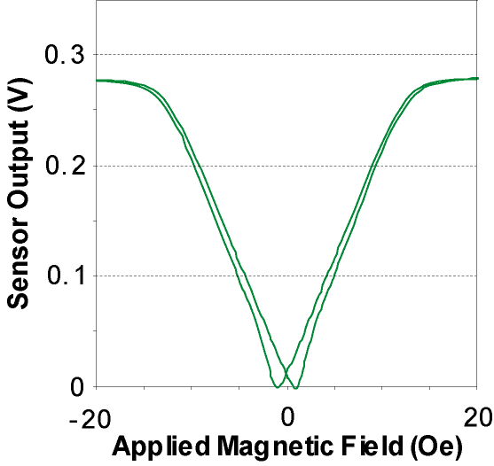
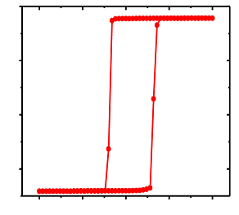
Device configurations
Magnetic property tailoring enables different device types
Digital
Bipolar
Unipolar
Resistance
Field
Cross-axis anisotropy
Magnetometry
Current sensing
Navigation
Multilayer stack
Proximity sensing
Unipolar switches
Strong uniaxial anisotropy
Memory/Switches

Slide 3
Sensor Marketspace
Mechanical position sensing
Cylinder positioning, flow meters, geartooth sensors, encoders
Magnetic field anomaly detection
Medical devices/biosensors
Defect/particle detections
Electric current sensing
Electric vehicles, precision motor/power control

Slide 4
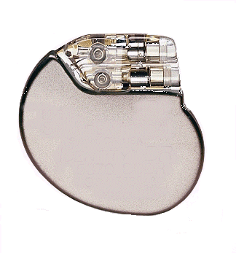
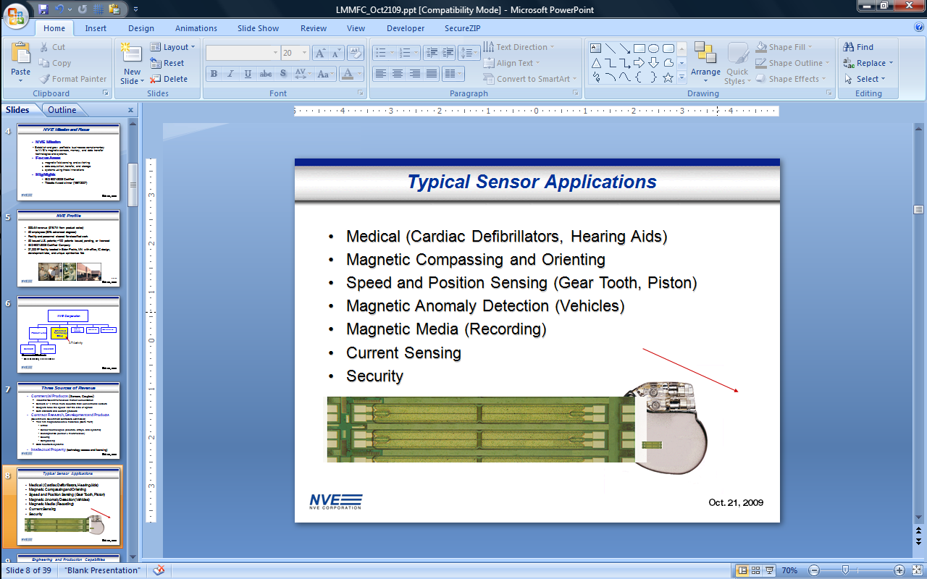
Applications
Medical device sensors (e.g., pacemakers and hearing aids)
Biomagnetics/particle detection
Anomaly detection (e.g., vehicles)
Compassing
Speed, position, and angle sensors
Data storage
Current sensors
Security
Implantable
Cardiac Defibrillator

Slide 5
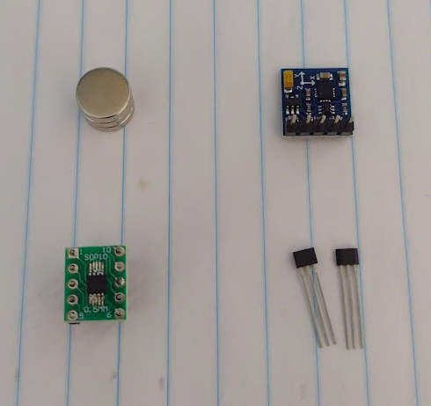
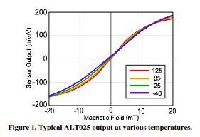
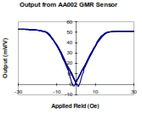

Sensors
3-axis AMR compass sensor
Magnets
Unipolar GMR Sensor
Hall Digital Switch

