Slide 1
CPSC 131
Data Structures
AVL Trees
6
v
3
8
z
4

Slide 2
Tree Depth and Height and BST Issue

Slide 3
Depth
Depth of a node: number of ancestors (between the node and the root)
Root has depth 0
Depth of p’s node is recursively defined:
if (p.isRoot()) return 0; // root has depth 0
else return 1 + depth(p.parent()); // 1 + (depth of parent)
SearchTree<Entry<int, string>> ds;
ds.insert(5, "Monday");
ds.insert(15, "Tuesday");
ds.insert(25, "Wednesday");
ds.insert(11, "Thursday");
5
What is the depth at each node?
15
11
25

Slide 4
Height
Height of a node p in a tree T is defined recursively:
If p is the external node, then the height of p is 0
Otherwise, the height of p is 1 + the maximum height of children of p
Height of a tree == maximum depth of its external nodes
Height of a tree T is the height of the root of T
SearchTree<Entry<int, string>> ds;
ds.insert(5, "Monday");
ds.insert(15, "Tuesday");
ds.insert(25, "Wednesday");
ds.insert(11, "Thursday");
5
What is the height at each node?
15
11
25

Slide 5
Issue with Binary Search Tree Performance
A binary search tree (BST) with n items
The space used is O(n)
Methods find, insert and erase take O(height) time
height = n, worst case ➔ long skinny tree
Example: insert 2, 4, 6, 8, 10 into a BST
What is the issue? Lack of balance!
2
long skinny tree
4
6
8
10
height = log n, best case ➔ balanced tree
balanced tree

Slide 6
Perfect Binary Search Tree
Height h | Number of Nodes n
1 | 1
2 | 3
3 | 7
4 | 15
h | 2^{h} - 1
3
n = 2^{h} – 1
n + 1 = 2^{h} – 1 + 1
n + 1 = 2^{h}
log₂ (n + 1) = log₂ (2^{h})
log₂ (n + 1) = h
➔ In a perfect tree, h is O(log n)
2
2
1
1
1
1

Slide 7
Self-Balancing Trees
Always ensure that BST is balanced
IF an insert (or delete) makes the BST not balanced, then rearrange the nodes so that the tree stays balanced
Challenge: the node rearrangement should not take too long!
Otherwise, lost the performance benefit
Node rearrangement still keeps the same nodes in sorted order but in a different layout
May types of balanced trees
AVL trees
The first self-balancing tree
Invented in 1962 by Russian mathematicians Georgy Adelson-Velsky and Evgenii Landis
Red-Black trees
Splay trees
(2,4) trees

Slide 8
AVL Trees
AVL trees are height-balanced binary search trees such that for every internal node v of T, the heights of left and right subtrees of v can differ by at most 1
1 + max of ( height(left subtree) and height(right subtree) )
Balance factor of a node calculated at each node
abs( height(left subtree) -
height(right subtree) )
4
44
2
3
17
78
1
2
1
32
50
88
1
1
48
62
good but not perfect balanced

Slide 9
Trinode Restructuring - Rotations
A single insert or delete will at most upset balance to | 2 |
Balancing a tree after an insertion or deletion will be through rotations
A rotations maintains the inorder of nodes, but makes for a more balanced tree

Slide 10
Insert and Rotation in AVL Trees
Insert operation may cause balance factor to become an absolute value of 2 for some node
Only nodes on the path from insertion point to root node have possibly changed in height
So after the Insert, go back up to the root node by node, updating heights
If a new balance factor (the difference abs(h_{left}-h_{right})) is 2, adjust tree by rotation around the node

Slide 11
Insertion
Inserting a new key-value same as in a binary search tree
Always done by expanding an external node.
Example: insert key 54
44
44
17
78
17
78
c=z
a=y
Balance factor:
| (3 – 1) | = 2
No longer AVL!
3
1
32
50
88
32
50
88
1
2
Balance factor:
| (1 – 2) | = 1
48
62
48
62
1
b=x
54
w
before insertion
after insertion

Slide 12
Trinode Restructuring
Focus on only three nodes
44
17
78
z (first imbalanced node)
y (child of z)
3
1
32
50
88
1
2
48
62
1
x (child of y)
54
newly inserted node
4 combinations: Y and X can be left/right child of Z

Slide 13
Trinode Restructuring
Input: A node x of a binary search tree T that has a parent y and a grandparent z
Output: Tree T after a trinode restructuring (a single or double rotation) involving nodes, x, y, and z
let (a,b,c) be a left-to-right (inorder) listing of x, y, z
perform the rotations needed to make b the topmost node of the three
a=z
T₀
b=y
case 1: single rotation
(a left rotation about a)
b=y
T₁
c=x
a=z
c=x
T₂
T₃
T₀
T₁
T₂
T₃
(rotating a left slanting tree is similar – see next slide)

Slide 14
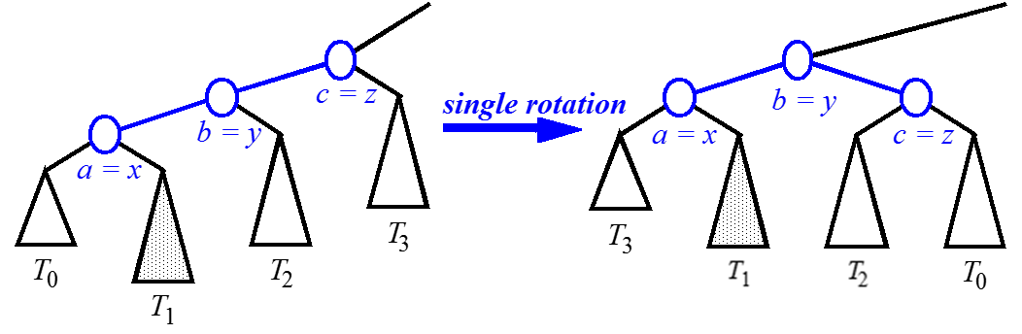
Restructuring – as Single Rotations
inorder(node):
if node == NULL
return
inorder(node->left)
visit(node)
inorder(node->right)

Slide 15
Trinode Restructuring
Let (a,b,c) be an inorder listing of x, y, z
Perform the rotations needed to make b the topmost node of the three
Case 2: double rotation
(a right rotation about c, then a left rotation about a)
a=z
b=x
T₀
c=y
a=z
c=y
b=x
T₃
T₀
T₁
T₂
T₃
T₁
T₂
(left skewed tree is similar – next slide)

Slide 16
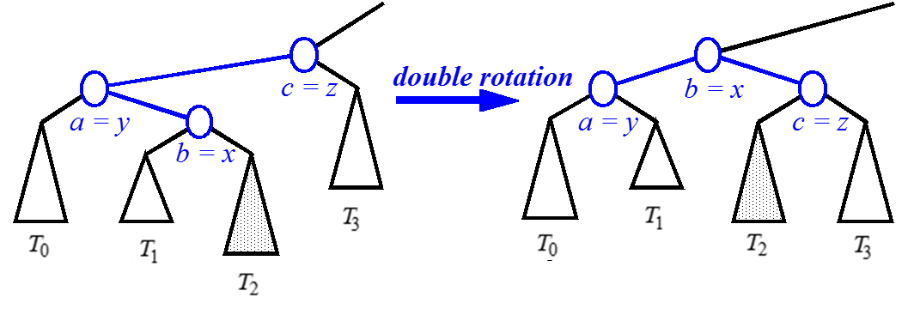
Restructuring – as Double Rotations

Slide 17
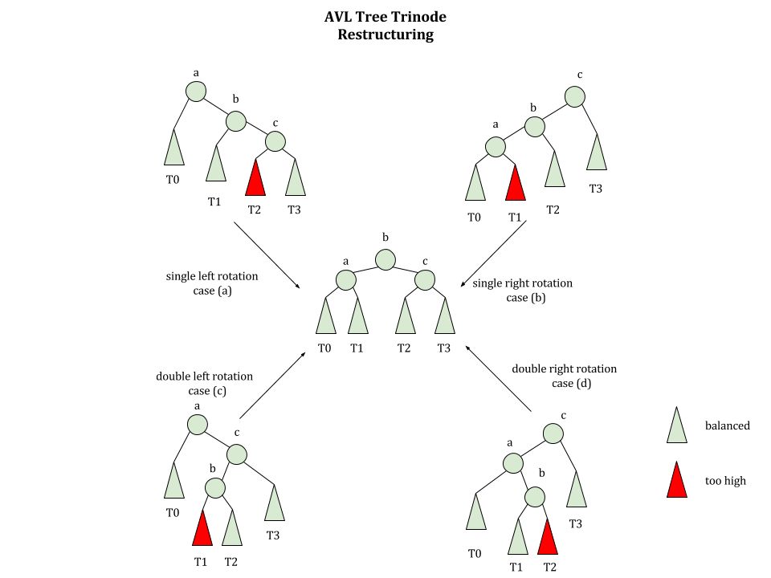

Slide 18
Trinode Restructuring Pseudocode
restructure (x,y,z) { // z is parent of y, y is parent of x
// Don’t need 4 separate left/right child cases
Let (a,b,c) be inorder listing of the nodes x,y,z
Let T0,T1,T2,T3 be the subtrees below x,y,z from left to right
// The rotation:
Replace subtree at z with subtree at b
Make a left child of b; make T0 and T1 subtrees of a
Make c right child of b; make T2 and T3 subtrees of c
Interactive visualization
http://visualgo.net/bst

Slide 19
Trinode Restructuring (cont)
Focus on only three nodes
44
z (first imbalanced node)
44
17
78
y (child of z)
rotate
3
1
17
62
32
50
88
1
2
32
50
78
48
62
1
48
54
88
x (child of y)
54
newly inserted node
after rotation (balanced)

Slide 20
Insertion Example
unbalanced...
T
4
1
44
2
3
x
17
y
62
z
1
2
2
32
50
78
1
1
1
...balanced
48
54
88
T
2
T
T
T
0
1
3

Slide 21
Removal
Removal begins as in a binary search tree, which means the node removed will become an empty external node. Its parent, w, may cause an imbalance
Example:
44
44
17
62
17
62
imbalance
32
50
78
50
78
48
54
88
48
54
88
before deletion of 32
after deletion

Slide 22
Rebalancing after a Removal
Let z be the first unbalanced node encountered while travelling up the tree from w. Also, let y be the child of z with the larger height, and let x be the child of y with the larger height
We perform restructure(x) to restore balance at z
If this restructuring upsets the balance of another node higher in the tree, we would continue checking for balance until the root of T is reached
a=z
imbalance
62
44
rotate
44
78
w
17
62
b=y
c=x
17
50
88
50
78
48
54
48
54
88

Slide 23
AVL Tree Performance
a single restructure takes O(1) time
using a linked-structure binary tree
find takes O(log n) time
height of tree is O(log n), no restructures needed
put takes O(log n) time
initial find is O(log n)
Restructuring up the tree, maintaining heights is O(log n)
erase takes O(log n) time
initial find is O(log n)
Restructuring up the tree, maintaining heights is O(log n)

Slide 24
References
Data Structures and Algorithms in C++, 2nd Edition by Goodrich, Tamassia, and Mount
Sections: 7.2, 10.2

