Slide 1
Singly-Linked Lists

Slide 2
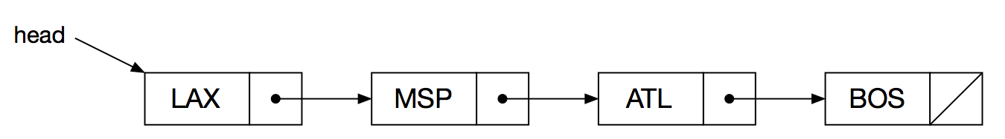
Singly-Linked List of Airport Nodes

Slide 3
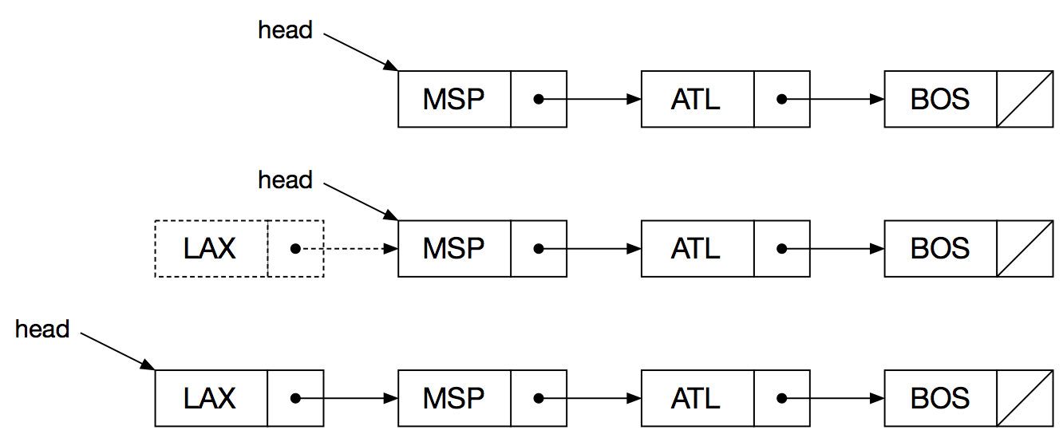
Adding an Airport to the Front of the Singly-linked List

Slide 4
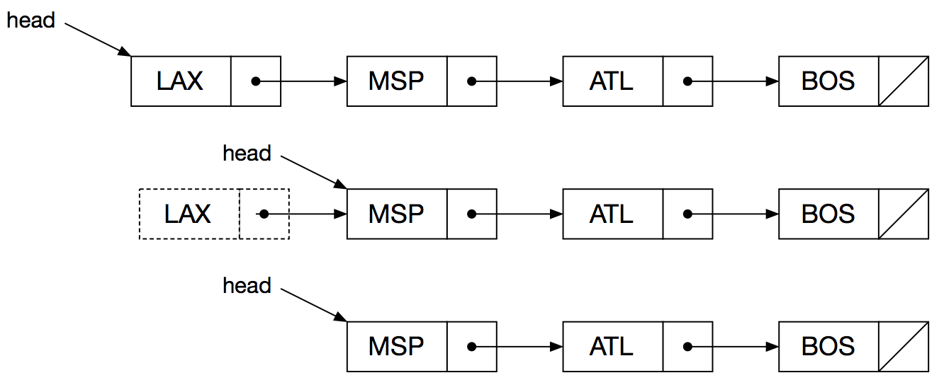
Removing an Airport from the Front of the Singly-linked List

Slide 5
struct Node
{
Node() : next_(nullptr) { };
Node* next_;
int data_;
};
class List
{
public:
List() : head_(nullptr), tail_(nullptr) { };
void Append(Node* node);
void InsertAfter(Node* currentNode, Node* newNode);
void Prepend(Node* node);
void RemoveAfter(Node* node);
private:
Node* head_;
Node* tail_;
};

Slide 6
void List::Append(Node* node)
{
if (head_ == nullptr)
{
head_ = node;
tail_ = node;
}
else
{
tail_->next_ = node;
tail_ = node;
}
}

Slide 7
void List::InsertAfter(Node* currentNode, Node* newNode)
{
if (head_ == nullptr)
{
head_ = newNode;
tail_ = newNode;
}
else if (currentNode == tail_)
{
tail_->next_ = newNode;
tail_ = newNode;
}
else
{
newNode->next_ = currentNode->next_;
currentNode->next_ = newNode;
}
}

Slide 8
void List::Prepend(Node* node)
{
if (head_ == nullptr)
{
head_ = node;
tail_ = node;
}
else
{
node->next_ = head_;
head_ = node;
}
}

Slide 9
void List::RemoveAfter(Node* node)
{
Node* successor;
if (node == nullptr)
{
successor = head_->next_;
head_ = successor;
if (successor == nullptr)
{
tail_ = nullptr;
}
}
else if (node->next_ != nullptr)
{
successor = node->next_->next_;
node->next_ = successor;
if (successor == nullptr)
{
tail_ = node;
}
}
}

