Slide 1
CPSC 131
std::map

Slide 2
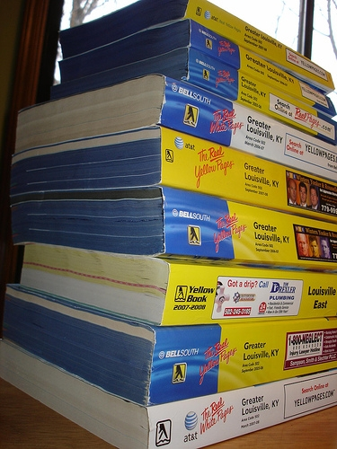

Telephone book

Slide 3
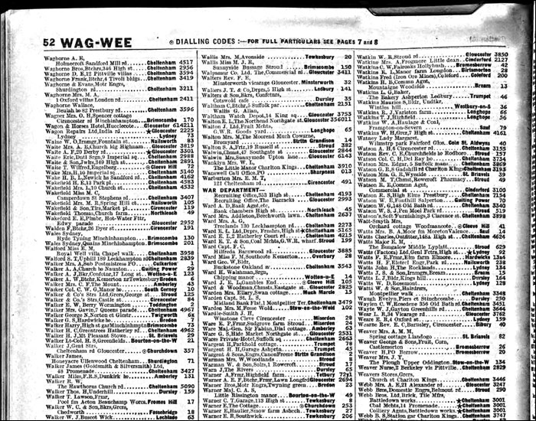
How to use a Telephone book?

Slide 4
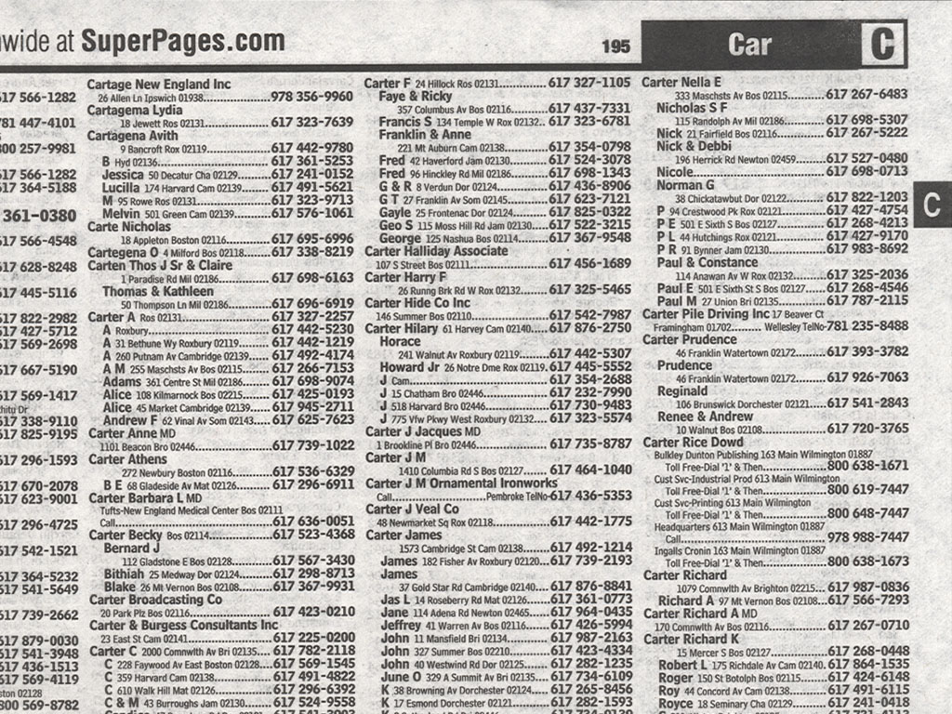
How do we use a telephone book?
 | How do we search? | What do we get?
Phone book

Slide 5
How do we use a telephone book?
 | How do we search? | What do we get?
Phone book | Person’s name | Address, phone number

Slide 6
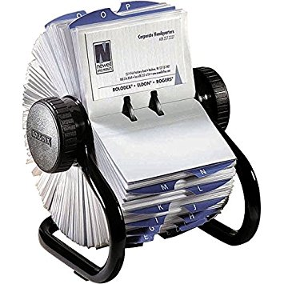
Rolodex

Slide 7
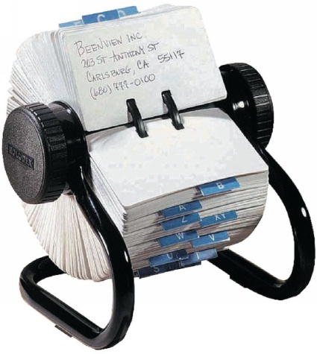
How do we use a Rolodex?

Slide 8
 | How do we search? | What do we get?
Phone book | Person’s name | Address, phone number
Rolodex

Slide 9
 | How do we search? | What do we get?
Phone book | Person’s name | Address, phone number
Rolodex | Company name | Address, phone number

Slide 10

Book index

Slide 11
 | How do we search? | What do we get?
Phone book | Person’s name | Address, phone number
Rolodex | Company name | Address, phone number
Book index

Slide 12
 | How do we search? | What do we get?
Phone book | Person’s name | Address, phone number
Rolodex | Company name | Address, phone number
Book index | Word | Page numbers

Slide 13
MAP
Data structure
 | How do we search? | What do we get?
Phone book | Person’s name | Address, phone number
Rolodex | Company name | Address, phone number
Book index | Word | Page numbers
KEY
VALUE

Slide 14
 | How do we search? | What do we get?
Phone book | Person’s name string | Address, phone number class Address { string line1, line2; string city; int zipcode; }
Rolodex | Company name | Address, phone number
Book index | Word string | Page numbers vector<int>

Slide 15
Maps and Key-Value Entries
A map models a searchable collection of key-value entries
An entry stores a key-value pair (k, v)
The main operations of a map are for searching, inserting, and deleting items
Multiple entries with the same key are not allowed
Applications:
address book
student-record database
Value can be any type/class
Key can also be any type/class
BUT must be comparable
“Smith” < “Titan”

Slide 16
std::map
http://www.cplusplus.com/reference/map/map/
#include <map>
using namespace std;
class Address {
public:
string line1, line2;
string city;
int zipcode;
}
map<string, Address> myRolodex;
KEY
VALUE

Slide 17
std::map insert using [ ]
map<string, Address> myRolodex;
Adding to the rolodex
Address a;
a.line1 = “800 N State College Blvd”;
a.city = “Fullerton”;
a.zipcode = 92831;
string aname = “Tom Titan”;
myRolodex[aname] = a;

Slide 18
std::map search using [ ]
map<string, Address> myRolodex;
Searching the rolodex
Address a;
string aname = “Tom Titan”;
a = myRolodex[aname];
cout << aname << “ is at “;
cout << a.line1 << a.line2 << a.city << a.zipcode << endl;

Slide 19
std::map find
map<string, Address> myRolodex;
Searching the rolodex:
What if the key is NOT there?
std::map automatically inserts a value!
Must first check with find
string aname = “Tom Titan”;
if (myRolodex.find(aname) == myRolodex.end()) {
// aname is not in map
}
else {
Address a;
a = myRolodex[aname];
cout << aname << “ is at “;
cout << a.line1 << a.line2 << a.city << a.zipcode << endl;
}
find() returns an iterator
if the iterator == end iterator, then the key was not found

Slide 20
std::map find
map<string, Address> myRolodex;
string aname = “Tom Titan”;
Changing the rolodex:
What if the key is NOT there?
std::map automatically inserts a value!
Must first check with find
map<string, Address>::iterator it = myRolodex.find(aname);
if (it == myRolodex.end()) {
// aname is not in map
}
else {
Address a;
…
it->second = a;
}

Slide 21
std::map iteration
map<string, Address> myRolodex;
Going through all entries in the rolodex:
Use iterators
Just like other data structures
But values will ALWAYS be in sorted order
string aname = “Tom Titan”;
map<string, Address>::iterator it;
for (it = myRolodex.begin(); it != myRolodex.end(); it++) {
cout << it->first << “ is at “;
cout << it->second.line1 << it->second.line2 << it->second.city << it->second.zipcode << endl;
}
it->first returns the key
it->second returns the value

Slide 22
std::map erase
map<string, Address> myRolodex;
string aname = “Tom Titan”;
map<string, Address>::iterator it = myRolodex.find(aname);
if (it == myRolodex.end()) {
// aname is not in map
}
else {
myRolodex.erase(it);
}

