Slide 1

Zip Viewer : A Basic Archive Manager

Slide 2
Jared Dyreson
CPSC-223J @ 08:00 - 09:50 TR

Slide 3
Objective
This project was meant to clone a pre-existing tool available in most GNOME Desktop Environments.
Because I thought it would be easy. It wasn’t.
I have an affinity for the UNIX file system and archives.

Slide 4
TL;DR of the Structure of a Zip File
A file object that has mapped memory entries
Each file is designated a header, signaling the beginning and end of a file
There is a root directory that maps and keeps track of all the entries contained in the archive

Slide 5
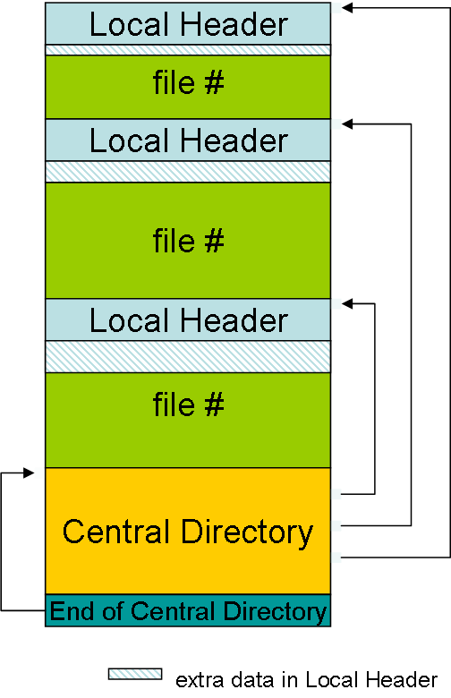
ZIP File Structure

Slide 6
Feature 1 : Creating a New Archive
You give it a name and the ability to add files that will be added to the archive
If none are specified, it will create a blank zip archive
List the contents of the archive before creation
Green message indicates success
Red message indicates failure (archive with same name present)

Slide 7
Feature 2 : Open Existing Archive
Open and view all the content of the archive
Pick a file and there will be a message if you selected a file that is not a zip archive

Slide 8
Feature 3 : Extract Contents of Archive
Dump the contents of a given archive but don’t place the contents in the main window

Slide 9
Key Logic 1 : Refreshing JFrame in real time
Check if the current element exists
If so, remove the current instance
Get a new, updated copy of the JTable and put it back in place of the old one
Update the “loaded archive” label (mostly redundant)
Redraw the current frame
Found in src/ZipWindow.java

Slide 10
Code
public void refresh_jframe(ContentsOfZip coz){ Container current_container = this.getContentPane(); if(this.exported_panel != null){ current_container.remove(this.exported_panel); } this.exported_panel = get_table_contents(coz.get_file_manifest(), coz.get_column_names()); this.add(this.exported_panel); current_container.invalidate(); current_container.revalidate(); current_container.repaint(); }

Slide 11
Key Logic 2 : Transporting Information
This was essentially a piece of code that translated the back end component of the dumped archive into information that could be used in the JTable object
Found in src/FileHandler.java
public Vector<String> info() throws IOException{ return new Vector<String>(Arrays.asList(this.get_path(), this.get_file_size(), this.get_mime_type(), this.get_last_modified())); }

