Slide 1

Model results for predicting customer buying behaviour
By: Jared Kipngetich

Slide 2
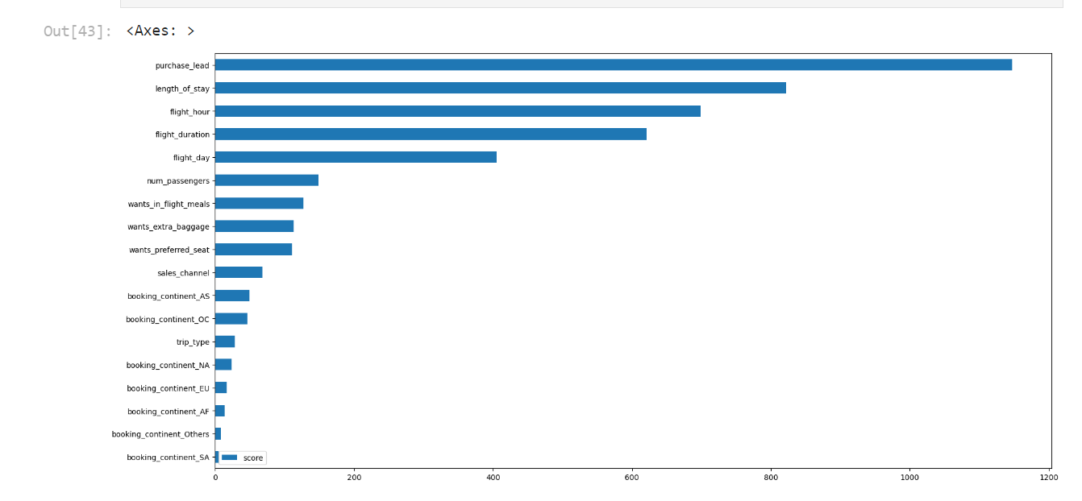
From our model, we have established that what influences the customers in completing their bookings are Purchase_led, that is the time gap between the order time and the flight. Another aspect of great influence is length_of_stay which is simply the amount of time the reveler will spend at the destination.
Of all things factors, the destination least influences customers in completing their booking.

