Slide 1


Outliers
Berkay Canogullari
Jared Mlekush

Slide 2
Outline
Dataset: Data consists of 8302 observations with 979 features consisting of miRNA data for total of 21 different cancer types.
Goal: Use Machine learning to analyze features and predict the stage of different types of cancer.

Slide 3
Techniques Applied
Process:
Data Exploration
Machine Learning Methods

Slide 4
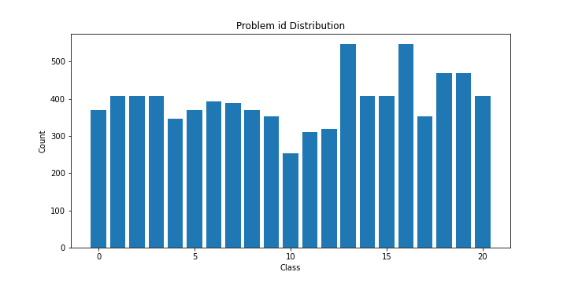
Techniques Applied
Exploratory Data Analysis (EDA): - Analyze target distribution - Analyze problem_id distribution - Checked class distribution/problem_id
EDA Conclusion: Because of target imbalance per problem_id - use stratified splitting on problem_id+class during cross validation for hyperparameter optimization and model performance check.

Slide 5
Techniques Applied
Machine Learning Methods: We used tree based ensemble methods Gradient boosting and Random Forest, as they provide the best performance on tabular data.
Since there are 21 different problems(cancer types), there should ideally be 21 different models. However, since tree based models separate feature space accordingly, we didn’t think it was necessary to create 21 different models and perform parameter optimization for each of them to save time and resources.
Used Optuna hyperparameter search framework for hyperparameter optimization. Utilizes Bayesian Optimization

Slide 6
Experimental Results
As mentioned, we used the Optuna framework for hyperparameter search on the LightGBM model. We tried to optimize the most important hyperparameters which included: max leaves, max depth, and number of estimators.
No hyperparam optimization accuracy: 0.72058
Hyperparameter optimized accuracy: 0.73774
Parameter: | Search Range: | Optimum Hyperparameters:
max_depth | Integer range 2-32 | max_depth = 12
max_leaves | Integer range 30-40 | max_leaves = 39
n_estimators | Integer range 10-150 step_size = 10 | n_estimators = 140

Slide 7
Lessons Learned
How to do stratification using two variables
How to use XGBoost and LightGBM libraries in Python
How to use Optuna framework

