Slide 1
The Formulation for Circuit Synthesis Using Python
By Jared Reichle

Slide 2
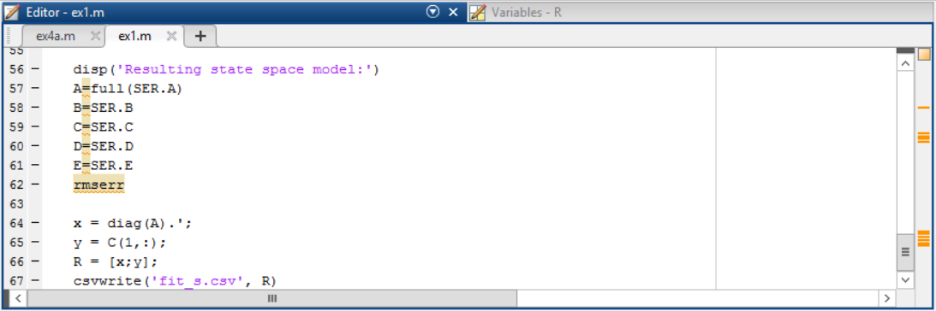
Matlab Poles & Residues

Slide 3
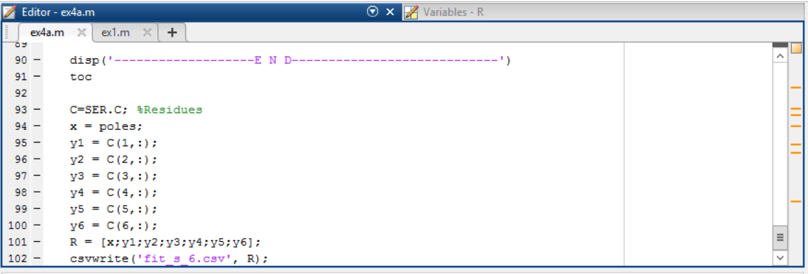
Matlab Poles & Residues

Slide 4
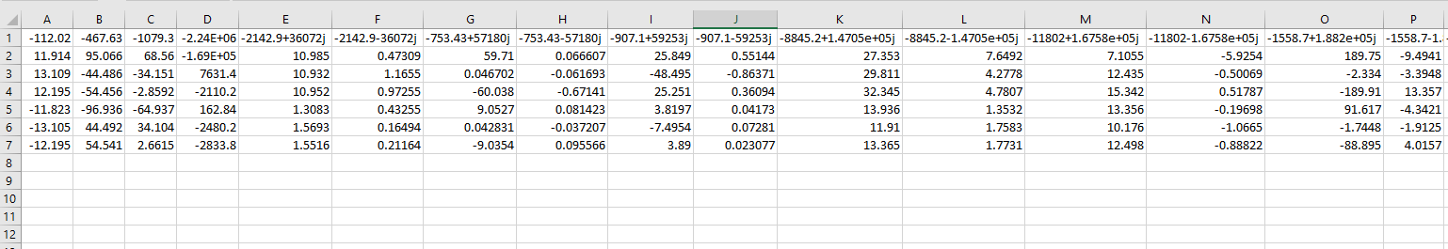
CSV Files

Slide 5
Python Flow-Chart
Start
For # Ports
Read .csv
For # points
For # ports
Calculate RL for real p/c
Init p/c arrays
Calculate RLRC for complex p/c
Extract p/c from file
Init Ra,Rb, L, and C
Write netlist

Slide 6
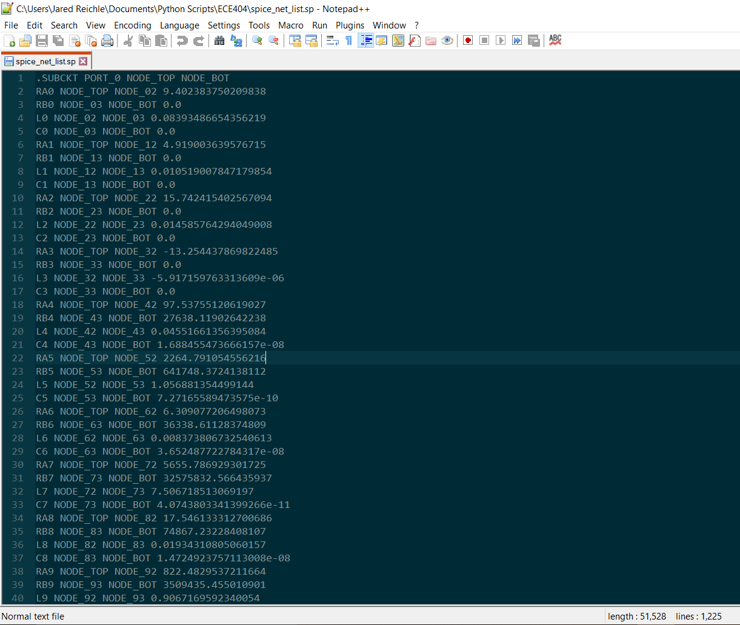
SPICE Net List

Slide 7
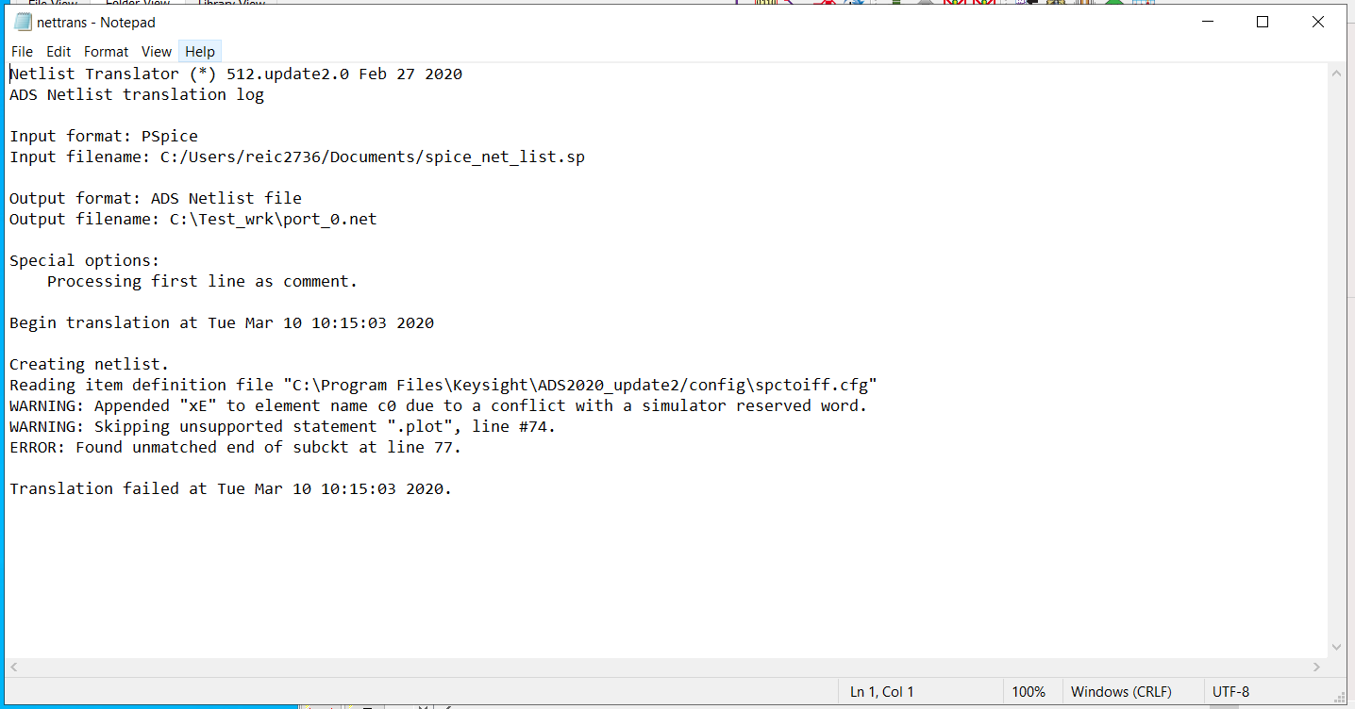
ADS Process

Slide 8
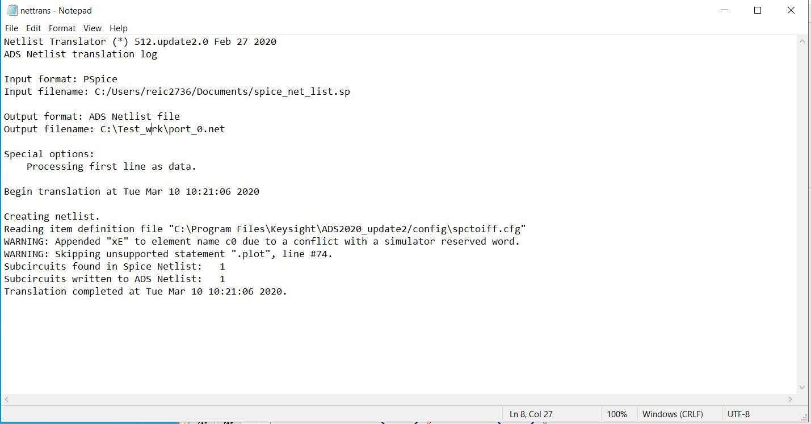
ADS Process

Slide 9
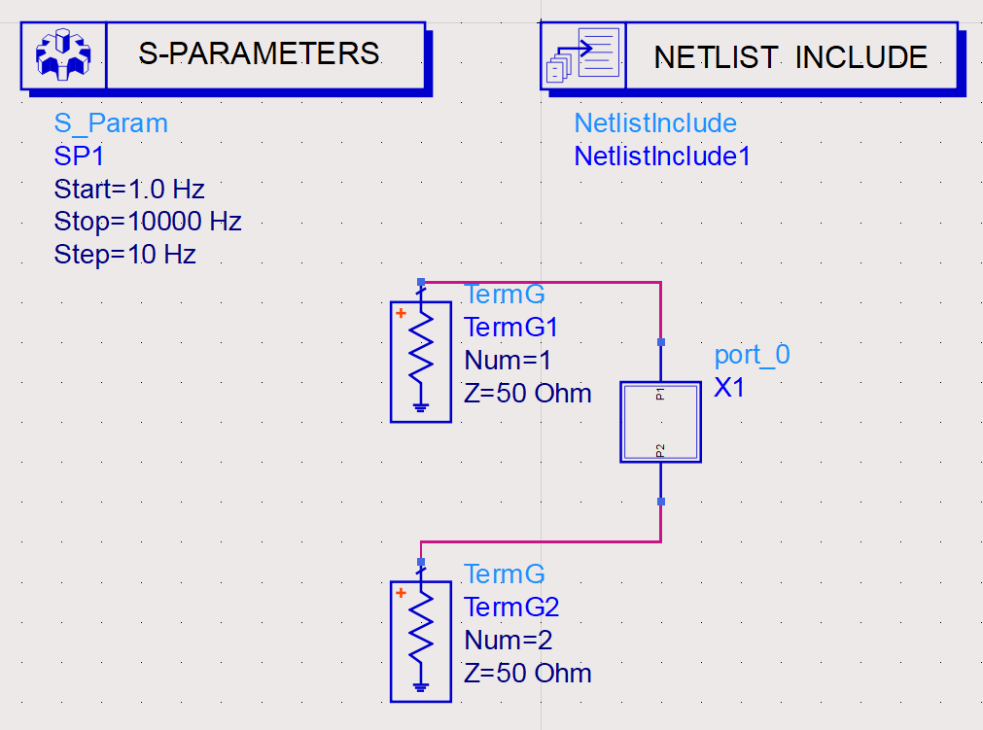
ADS Process

Slide 10
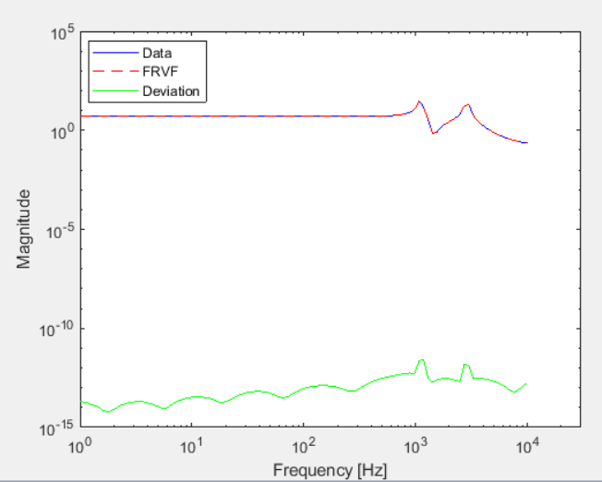
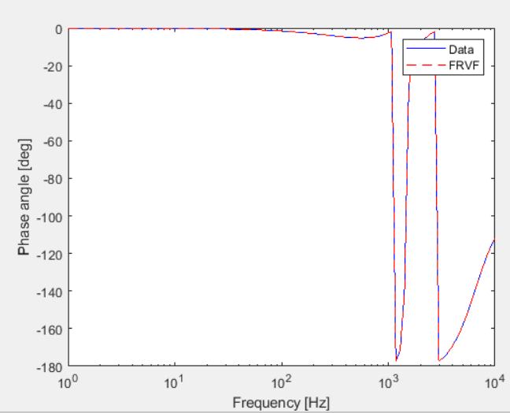
Matlab 1-port Magnitude/Phase

Slide 11
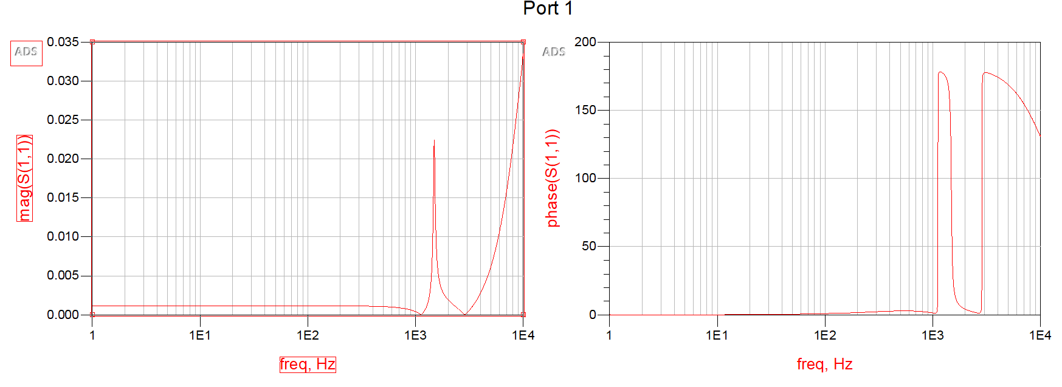
ADS 1-port Magnitude Phase

Slide 12
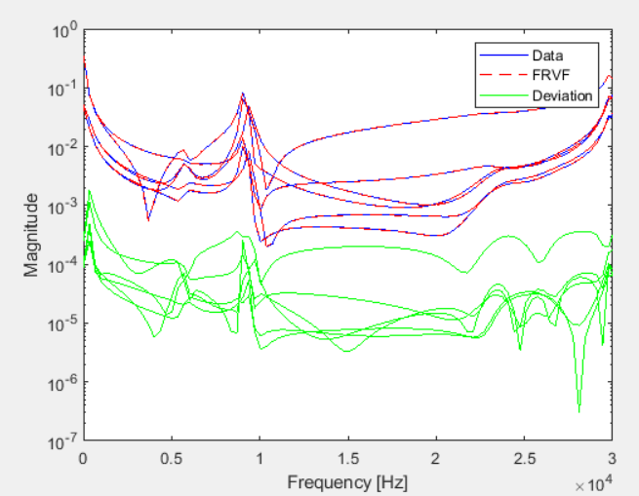
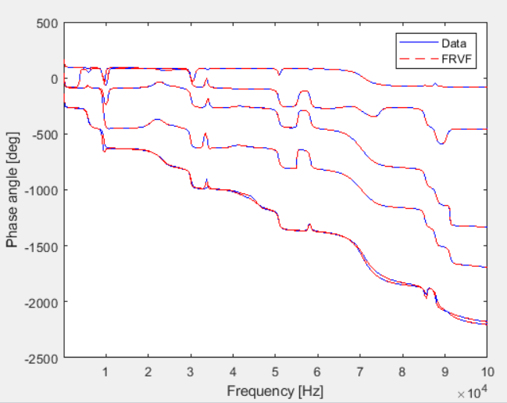
Matlab 6-port Magnitude/Phase

Slide 13
ADS 6-port Magnitude/Phase

Slide 14
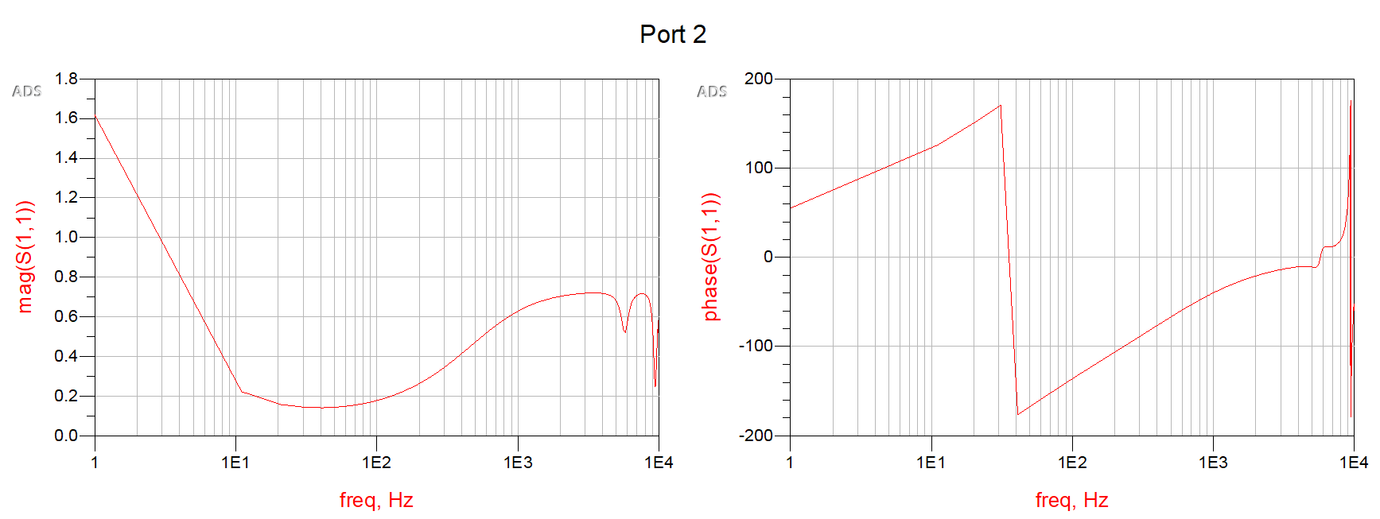
ADS 6-port Magnitude/Phase

Slide 15
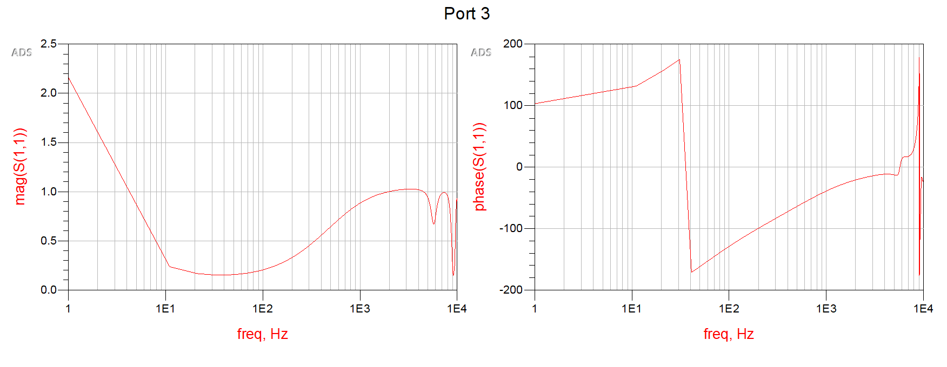
ADS 6-port Magnitude/Phase

Slide 16
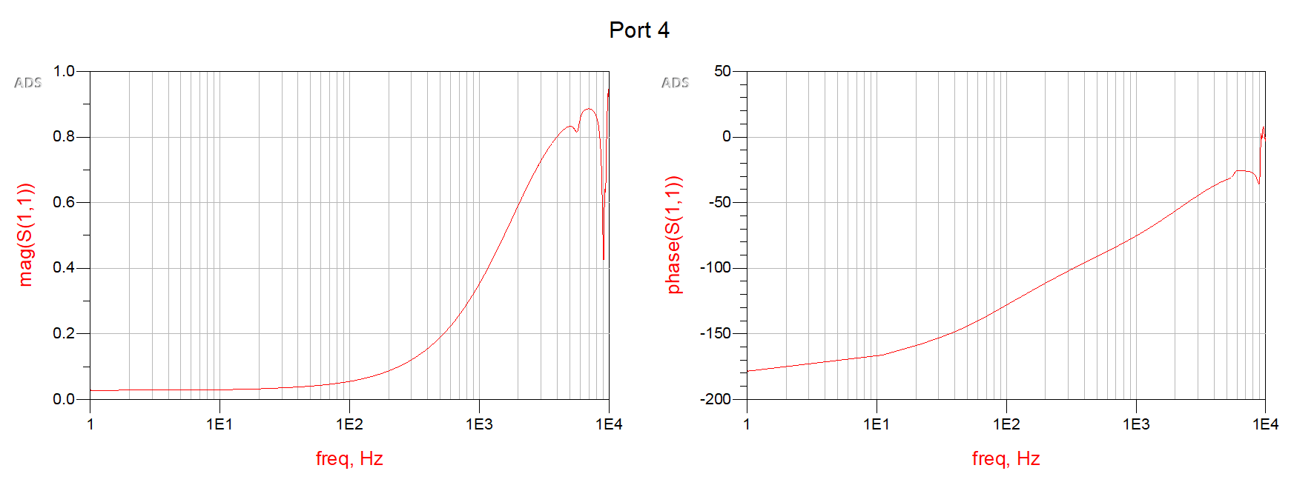
ADS 6-port Magnitude/Phase

Slide 17
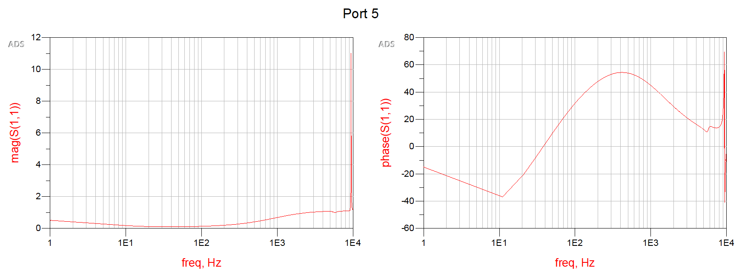
ADS 6-port Magnitude/Phase

Slide 18
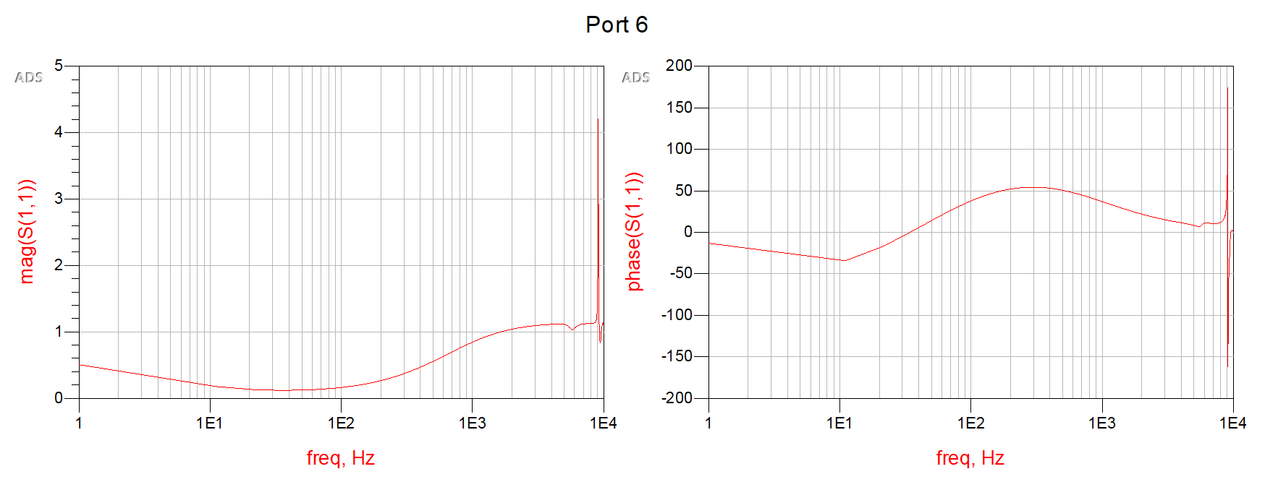
ADS 6-port Magnitude/Phase

Slide 19
References (IEEE)
[1] A. Zadehgol, "A semi-analytic and cellular approach to rational system characterization through equivalent circuits", Wiley IJNM, 2015. [Online]. https://doi.org/10.1002/jnm.2119
[2] V. Avula and A. Zadehgol, "A Novel Method for Equivalent Circuit Synthesis from Frequency Response of Multi-port Networks", EMC EUR, pp. 79-84, 2016. [Online]. Available: ://WOS:000392194100012.

Slide 20
Questions?

