Slide 1
Project 3
By Jared Reichle

Slide 2
Project 3 build
Project3.py
Import State Space Model (Vector fitted)
Enforce passivity by modifying SERD
Plot eig(real{Y}) before and after
Write results to a netlist
SERA.csv, SERC.csv, SERD.csv, SERE.csv
README.txt

Slide 3
Project deliverables
Eigenvalues.jpg - Eigenvalues mapped from the program
P3.sp - SPICE netlist generated from the state space model

Slide 4
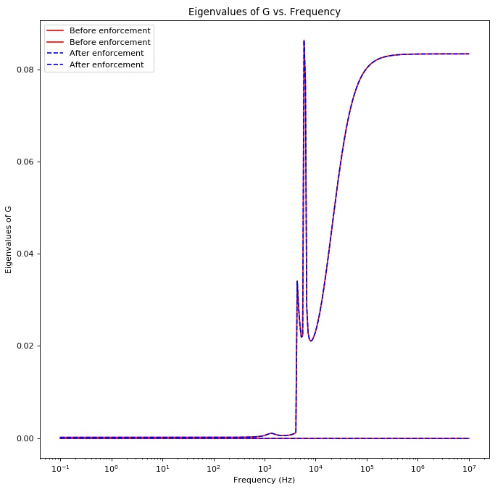
Eigenvalues

Slide 5
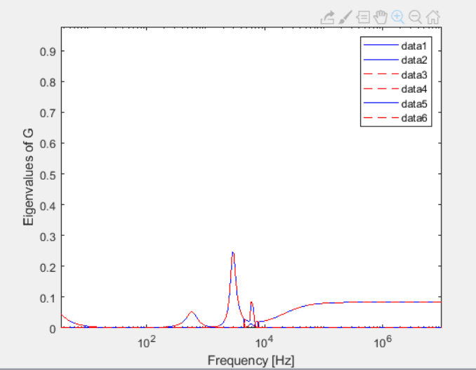
Eigenvalues from MATLAB

Slide 6
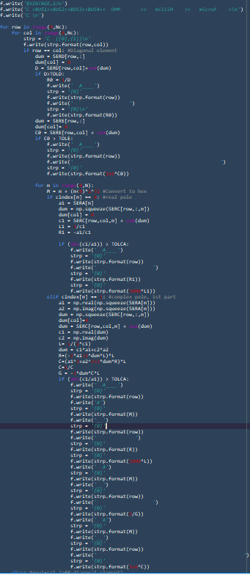
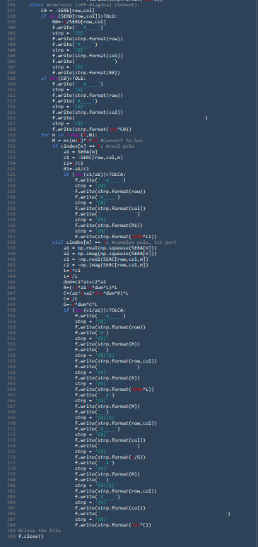
Netlist Generation

Slide 7
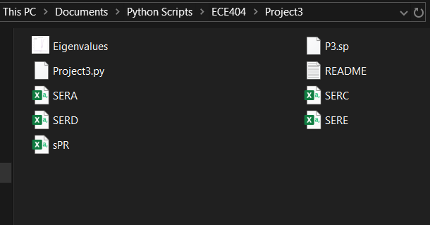
Netlist Generation

Slide 8
References (IEEE)
[1] Gustavsen, B. (2008). "Fast Passivity Enforcement for Pole-Residue Models by Perturbation of Residue Matrix Eigenvalues." Power Delivery, IEEE Transactions on 23(4): 2278-2285.
[2] Gustavsen, B. (2010). "Fast Passivity Enforcement for S-Parameter Models by Perturbation of Residue Matrix Eigenvalues." Advanced Packaging, IEEE Transactions on 33(1): 257-265.
[3] Gustavsen, B. (2020), https://www.sintef.no/projectweb/vectorfitting/

Slide 9
Questions?

