Slide 1
Stem Cells
By Jared Kettle

Slide 2
Overview
History
Implementation
Pros
Cons
Research published from 2018-2022
Pros vs. Cons Video
Summary
References

Slide 3
History or Background
Drs. Haeckel, Dantchakoff, Pappenheim, Ehrlich, Maximow founded the idea of stem cells In the 1882.
Later during WW2 William Bloom and Leon Jacobson researched the use of stem cells to cure blood cancer.
Now stem cells have been extensively researched for cures to many different diseases.
Notes:
The concept of a stem cell was first proposed by researchers working on embryonic development in the nineteenth century. They saw such cells as the starting point for biological processes. From the early twentieth century stem cells began to be seen as the source of different kinds of blood cells. Yet, blood stem cells could not be visualised in this period, so many doubted their existence. Knowledge advanced during the Second World War through the identification of a recovery factor in bone marrow which was thought to help regenerate the blood system. This was discovered by the haematologists William Bloom and Leon Jacobson as part of their research into the effects of radiation on the blood system which they carried out as part of the Manhattan Project to build the first atom bomb. It was this observation that laid the basis for the development of the BMT procedure for the treatment of blood cancer (leukaemia). BMTs opened the way to the identification and characterisation of stem cells within the bone marrow in the 1960s. In 1978 stem cells were also discovered to be present in human cord blood and three years later scientists cultivated the first embryonic stem cells from mice blastocysts.

Slide 4
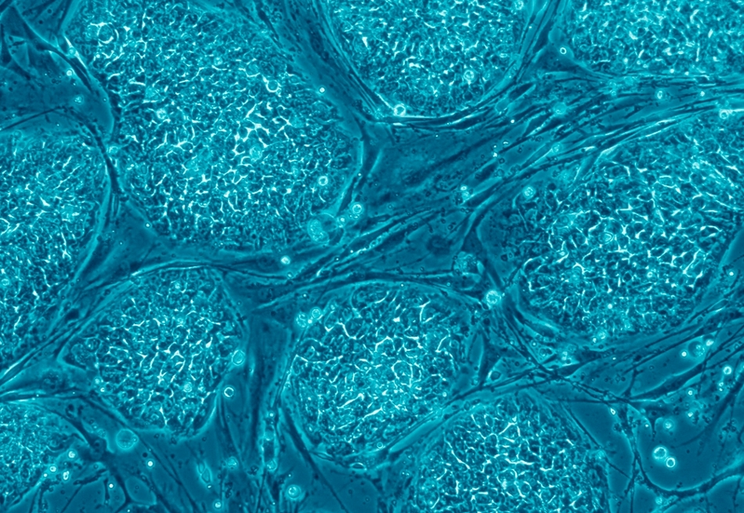
Image of stem cells
Notes:
This is an image of embryonic stem cells dyed blue to see under a microscope

Slide 5
Implimentation
Stem cells are being research for the use of regenerative medicine
They are being researched in curing neurological diseases such as Parkinson's and Alzheimer's
They are also being used to test the safety of new medicines
They are in a stage of research which makes them used in many different studies and tests
Notes:
Stem cells are currently used as research tools to understand the signals and mechanism of cell differentiation. This is useful not only for understanding the cause of disease, but also for the development of new therapies. The ability to generate large numbers of specialised cells from stem cells has also led to their use for testing the safety of new medicines, thereby reducing the need for animal testing. Cancer stem cells, for example, are used to screen potential anti-tumour drugs. Stem cells are also being explored for their properties to replace cells lost in degenerative diseases and for repairing cells in damaged tissues, a field known as regenerative medicine. Today more than 1,100 clinical studies, the overwhelming majority of them using adult stem cells, are being conducted to investigate the power of stem cell therapy. This includes treatments for retinal diseases, neurological conditions such as Parkinson's and Alzheimer's disease, heart disease such as post-ischaemic stroke, and type 1 diabetes.

Slide 6
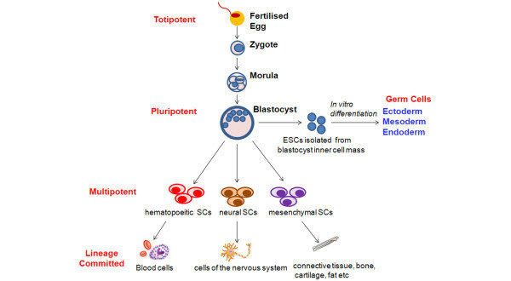
Evolution of stem cells
Notes:
This diagram represents how you get to a stem cell there are different types of stem cells that are produced to create all the different parts of your body there are different functions that these stem cells are programed to do but once they grow into adult cells most of them do not retain the ability to repair damaged cell such as the brain cells. So the idea is to get stem cells that are still in the growth stages and use them to cure different diseases by inserting those cells into diseased area of the patient to have them grow new cells that are not diseased. Or they can replace dead cells that can not be reproduce like brain cells.

Slide 7
Pros
The use of stem cells can cure many diseases
They will greatly improve the health system
They will help improve life quality
They can fix some birth defects
Would improve the area of medicine as well as the economy
Could lengthen the average lifespan
Notes:
Stem cell research can potentially help treat a range of medical problems. It could lead humanity closer to better treatment and possibly cure a number of diseases:
Parkinson’s Disease
Alzheimer’s Disease
Heart Diseases, Stroke and Diabetes (Type 1)
Birth Defects
Spinal Cord Injuries
Replace or Repair Damaged Organs
Reduced Risk of Transplantation (You could possibly get a copy of your own heart in a heart-transplantation in the future
Stem cells may play a major role in cancer
Better treatment of these diseases could also give significant social benefits for individuals and economic gains for society

Slide 8
Cons
One drawback is the ethicality of stem cells
The production of embryonic stem cells requires harvesting from a live embryo which kills it
And the research could lead to human cloning which is very unethical
Notes:
"We should not mess with human life."
"Humans should not be trying to play God"
Some argue that stem cell research in the far future can lead to knowledge on how to clone humans. It is hard to say whether this is true, but we have seen devastating consequences of other research-programs, even with good intentions, such as nuclear research.

Slide 9
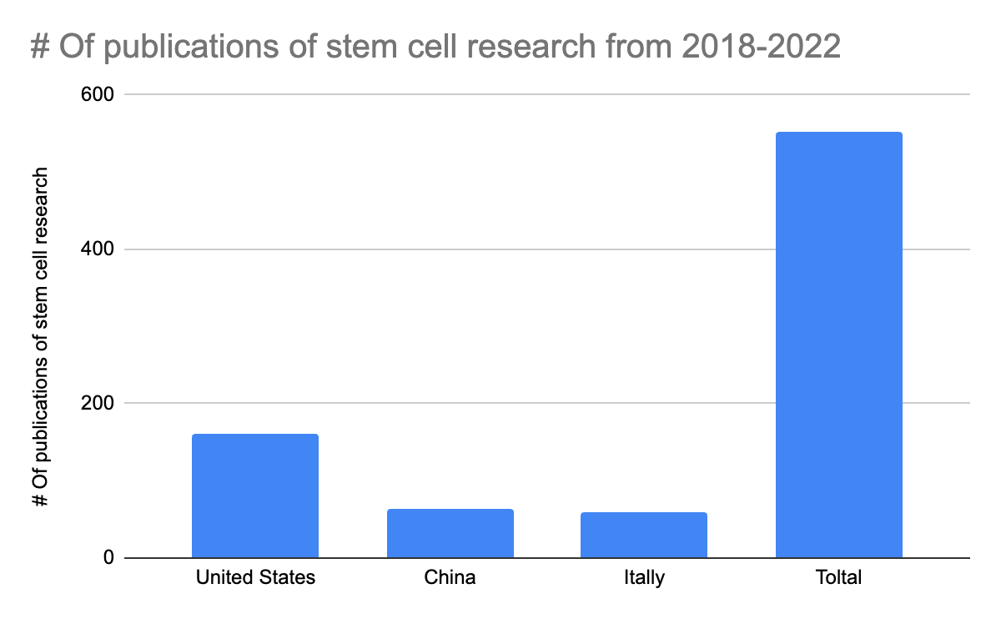
Research published from 2018-2022
Notes:
This graph shows the number of stem cell research publications were published from 2018-2022 This can help us to see where there is lots of research going on. And where we will expect more breakthroughs in the united states because there is more research being done there.

Slide 10

Pros vs. Cons Video

Slide 11
Summary
Stem cells can be implemented to help cure many diseases
Could boost medical field research
Could raise the expected lifespan
But some aspects of the use of stem cells are very unethical
Like harvesting of embryonic stem cells
Notes:
Stem cells can be used to change the practice of medicine for many un curable diseases such as parkinsons and alzheimers and would boost the economy. It also could help with birth defects and regenerative medicine. It has been tested for some cancers. But the use of stem cells is on the line of unethical because they could lead to human cloning and harvesting embryonic stem cells is very unethical due to the fact that it kills the embryo. So to sum up stem cells can be used to cure many many diseases and would aid many aspects of medicine but their research could be cut short due to many aspects of stem cell research being unethical.

Slide 12
References
Stem Cell Research By: Explorable
Stem cells By: what is biotechnology
Figure by ResearchGate

