Slide 1
Analysis of 2021 Parking and Camera Violations

Slide 2
Source
NYC Open Data - Open Parking and Camera Violations
https://data.cityofnewyork.us/City-Government/Open-Parking-and-Camera-Violations/nc67-uf89

Slide 3
What is the origin of the most significant amount of violations?

Slide 4
1st Limitation LICENSE TYPE
PAS 410932
COM 49069
OMT 15653
SRF 6079
MOT 3315
OMS 3070
999 1756
PAS Passenger
COM Commercial
OMT Medallion/Taxi
SRF City/Goverment
MOT Motorcycles
OMS Special Omnibus
999 Other/Unknown
Department of Motor Vehicles
Registration Class Codes

Slide 5
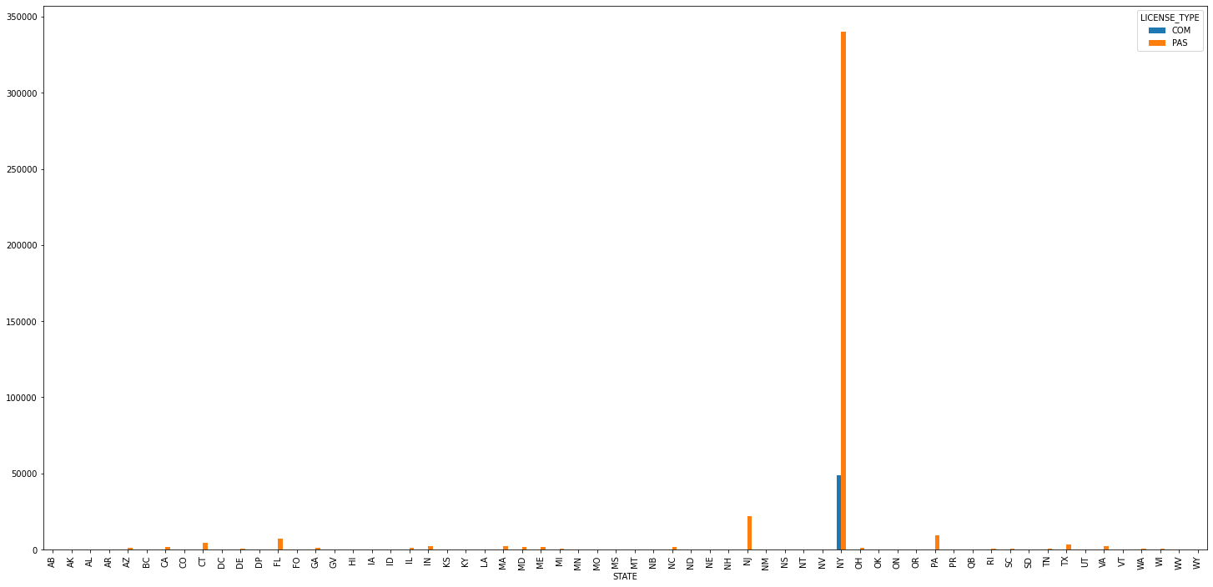
Sate by State Contribution
New York has the most

Slide 6
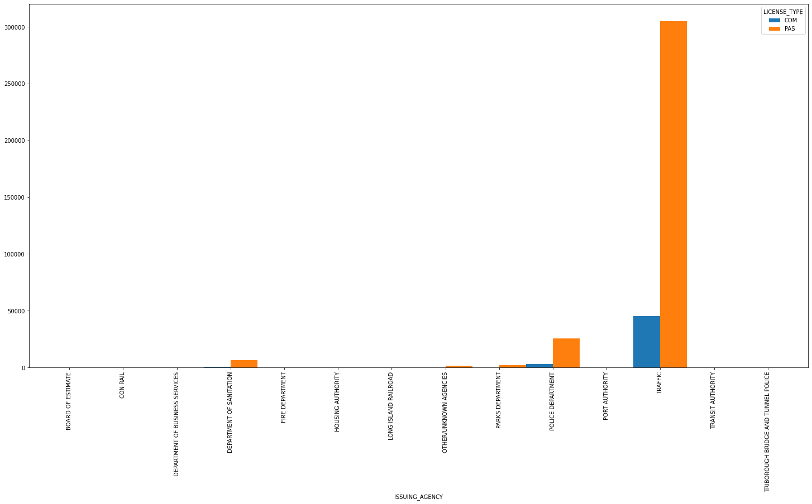
Who Gave Out the Most?
Traffic as in Traffic Police

Slide 7
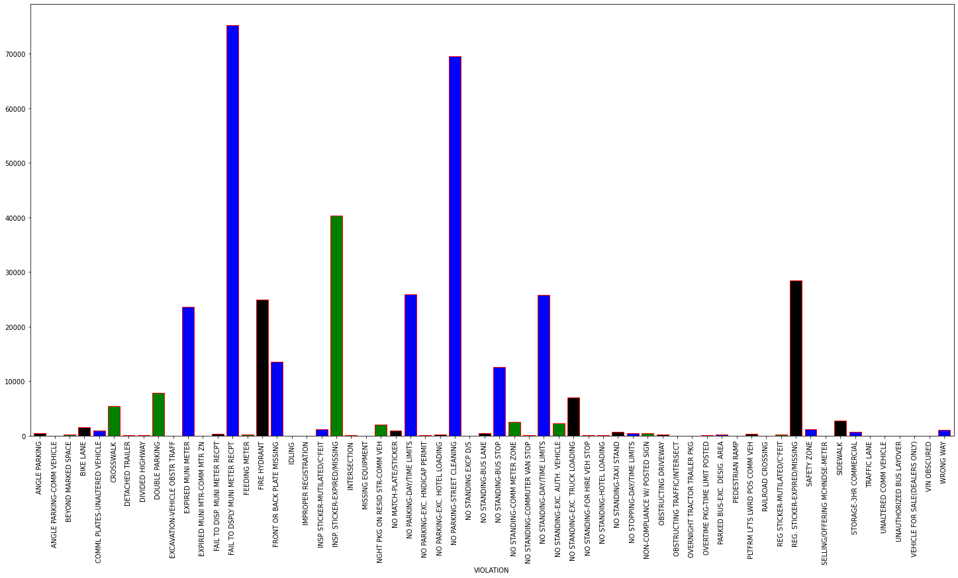
What Type of Violations Graph

Slide 8
Findings/Results
Fail to display Multi Meter receipt
No Parking – Street Cleaning
Inspection Sticker – Expired/Missing
Expired Multi Meter
Fire Hydrant
No Parking – Day/Night Limits
No Standing – Day/Night Limits
Registration Sticker – Expired/Missing

