Slide 1
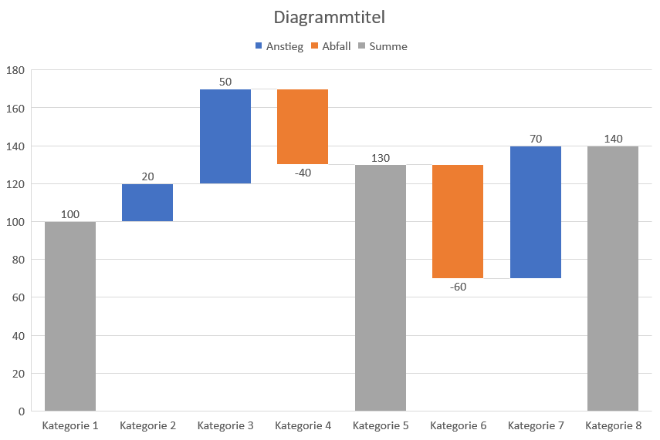
Notes:
Waterfall Chart

