Slide 1
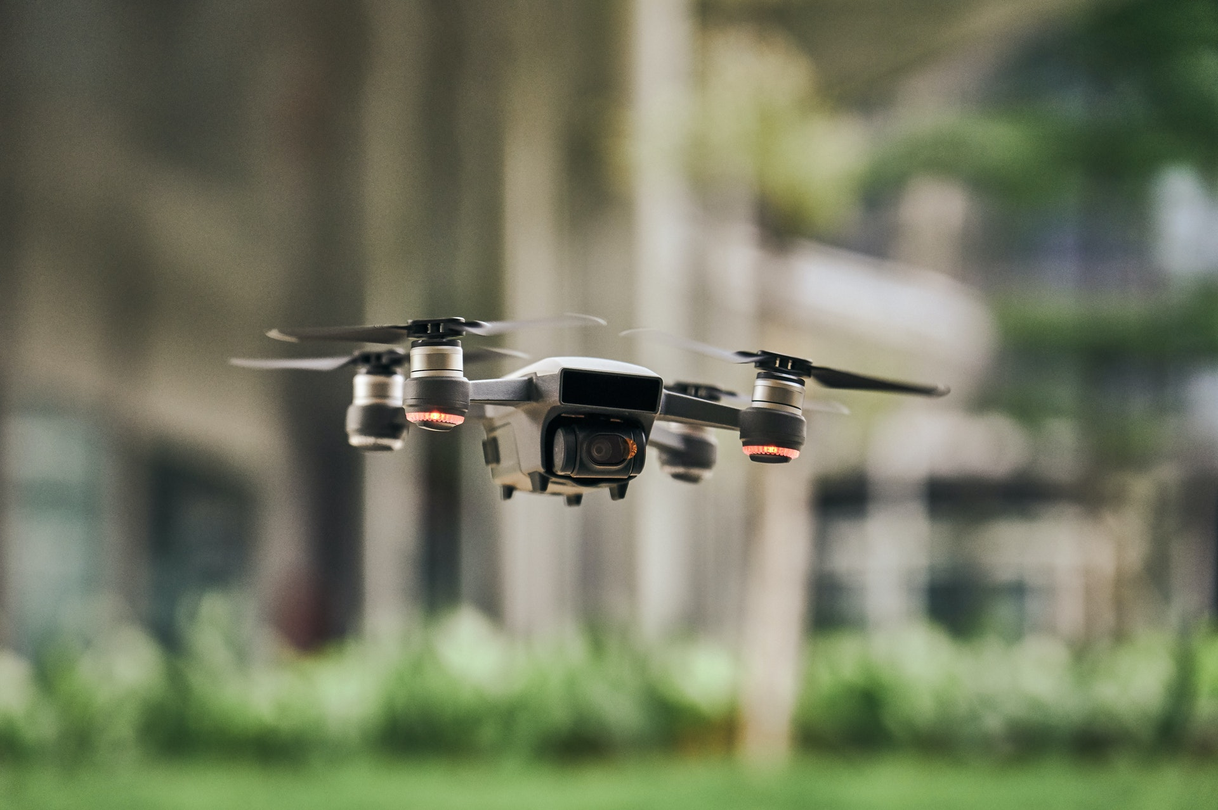
Using Decentralized Drone Swarms for Search and Rescue Missions
PRESENTED BY "TEMPORARY GROUP NAME"

Slide 2
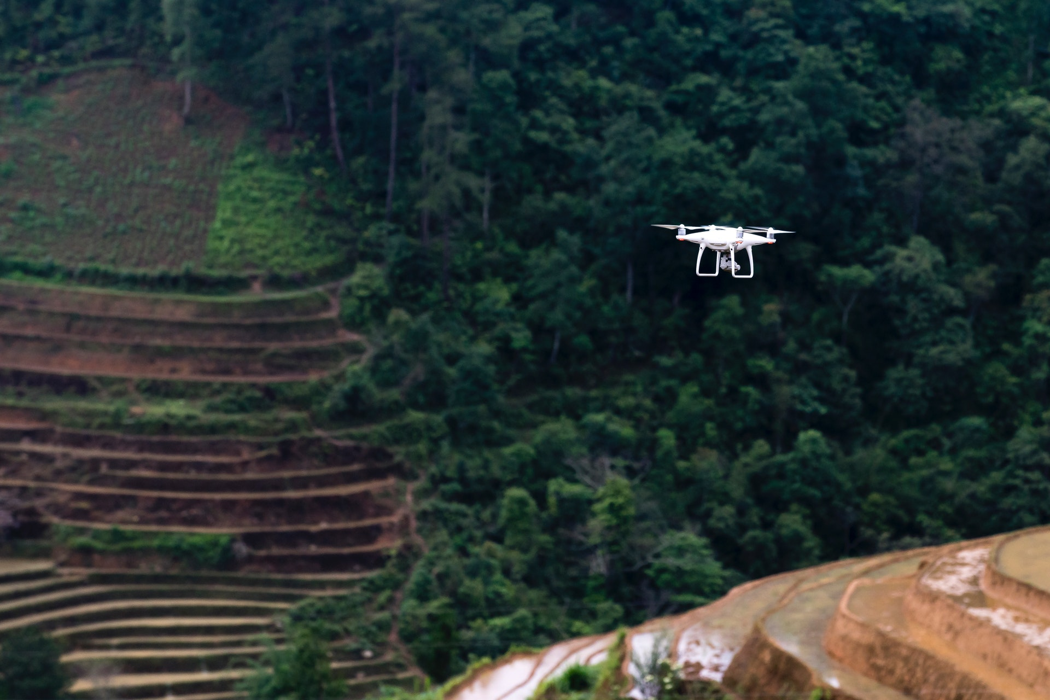

Introduction
Methodology
Data Collection
INTRODUCTION
Results
Conclusions

Slide 3

THE PROBLEM
Introduction
Search and Rescue is a life-saving process that can be shortened.
For missing aviators, the average time from last known position (LKP) to rescue is 31 hours.¹
Methodology
Data Collection
Results
A SOLUTION
  Employ a swarm of unmanned aerial vehicles (UAVs) to search the area
Conclusions
¹https://iflyamerica.org/safety-search-and-rescue.asp

Slide 4
PROJECT GOALS
Introduction
  Compare several search algorithms to find the best strategy for finding a missing target
      Vary search area size
      Vary number of drones used
      Constrainted by time
  Decentralized system
      No central control
Methodology
Data Collection
Results
Conclusions

Slide 5
Introduction
Methodology
Data Collection
METHODOLOGY
Results
Conclusions

Slide 6
SIMULATION ENVIRONMENT
Introduction
  Two dimensional grid
      Occupied by drones, obstacles, and the search target
Methodology
Data Collection
Results
Conclusions

Slide 7
EXPERIMENTAL DESIGN
Introduction
Created three algorithms:
    Random movement
        Drones move aimlessly
    RRT-inspired random search
        Drones choose random goals, move toward them
        Share information to avoid retreading
(third algorithm on next slide)
Methodology
Data Collection
Results
Conclusions

Slide 8
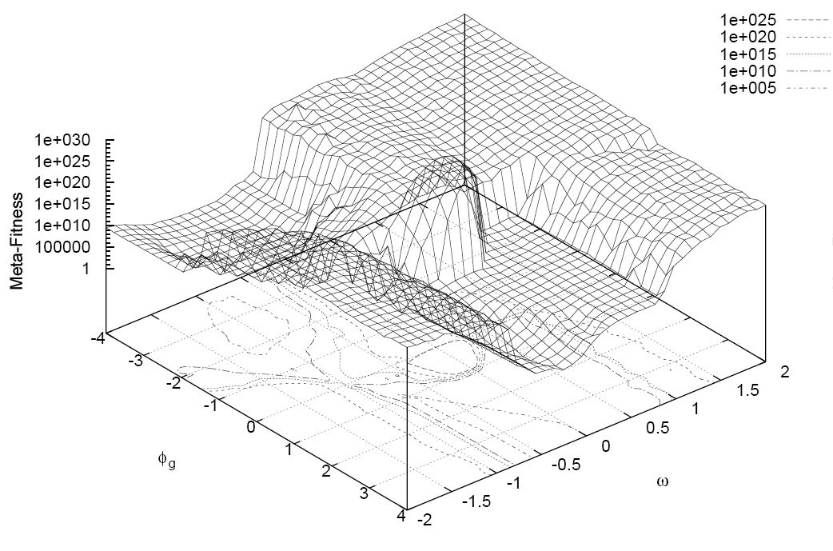
EXPERIMENTAL DESIGN (cont.)
Introduction
  Random search with probability density gradient
        Particle swarm-inspired
        Drones forced to move based on an ever-changing probability topology
              The more times an area is visited, the more that area will be avoided
Methodology
Data Collection
Results
Conclusions
https://en.wikipedia.org/wiki/Particle_swarm_optimization#/media/File:PSO_Meta-Fitness_Landscape_(12_benchmark_problems).JPG

Slide 9
PROBABILITY GRADIENT ALGORITHM
Introduction
Methodology
Data Collection
Results
Conclusions

Slide 10
Introduction
Methodology
Data Collection
DATA COLLECTION
Results
Conclusions

Slide 11
DATA COLLECTION
Introduction
GOAL: Find average # of iterations needed to find the target under the following conditions:
    Varying field size
        Field sizes: 20x20, 40x40, 60x60, 80x80, 100x100
        Number of drones: 5
    Increasing number of drones
        Number of drones: 2, 4, 8, 16, 18
        Field size: 40x40
Methodology
Data Collection
Results
Conclusions

Slide 12
Introduction
Methodology
Data Collection
RESULTS
Results
Conclusions

Slide 13
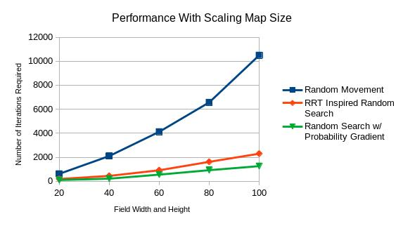
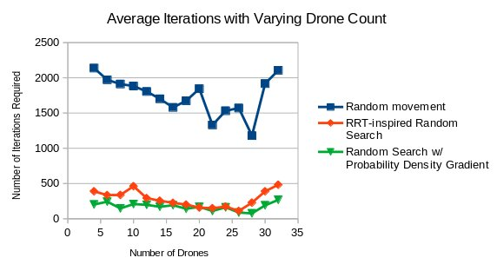
RESULTS
Introduction
Varying
map sizes:
Varying
drone count:
Methodology
Data Collection
Results
Conclusions

Slide 14
Introduction
Methodology
Data Collection
CONCLUSIONS
Results
Conclusions

Slide 15
CONCLUSIONS
Introduction
    Algorithm performance from worst to best:
        Random movement
        RRT-inspired random search
        Random search w/ probability density gradient
    Preventing retreading is important
    Number of iterations scale exponential with width and height of simulation field area
    Increasing number of drones improves performance until overcrowding occurs
Methodology
Data Collection
Results
Conclusions

Slide 16
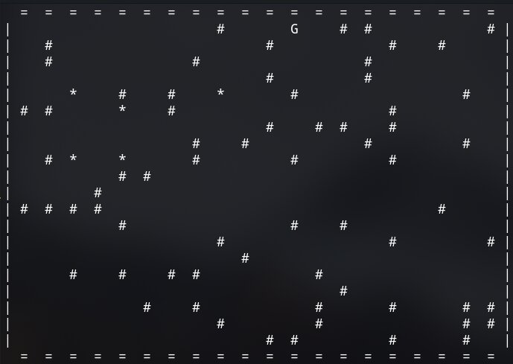
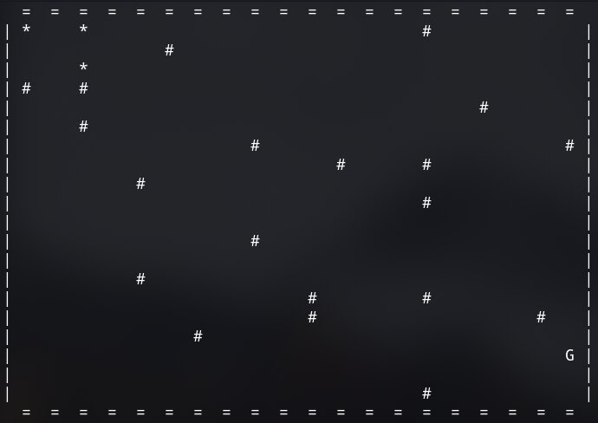
FUTURE WORK
Introduction
    Want to test more independent variables:
        Target moves also
        Density of obstacles
        Non-square field areas
Methodology
Data Collection
Results
Conclusions

Slide 17
Any questions?

