Slide 1

PROJECT
AiDeline

Slide 2
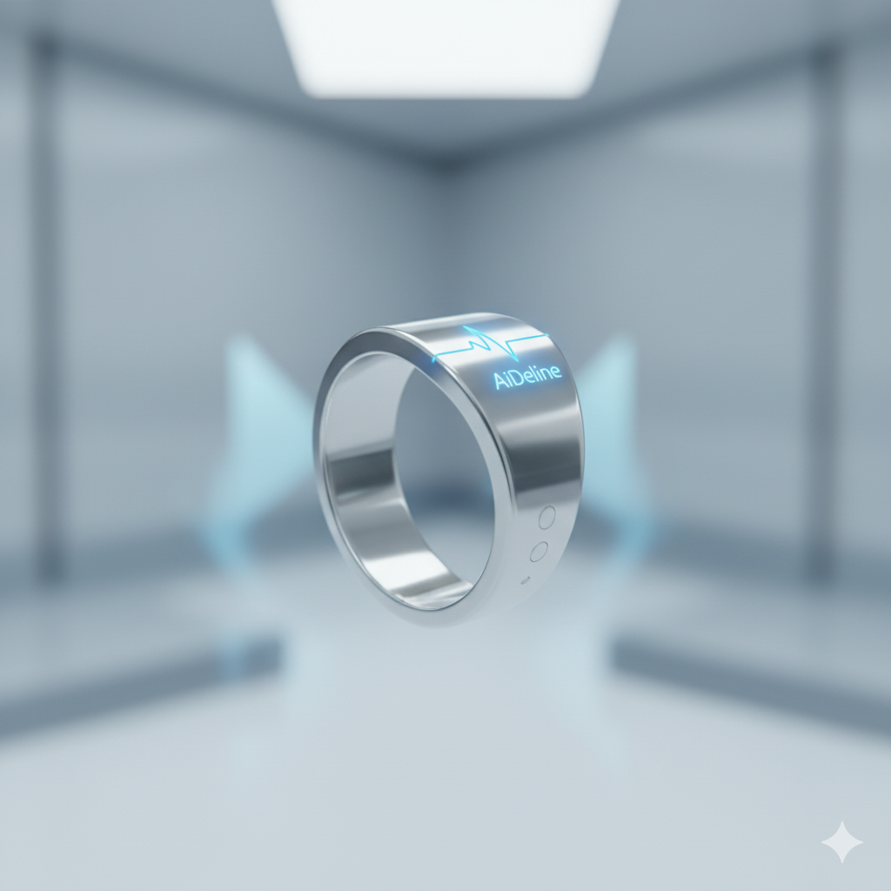
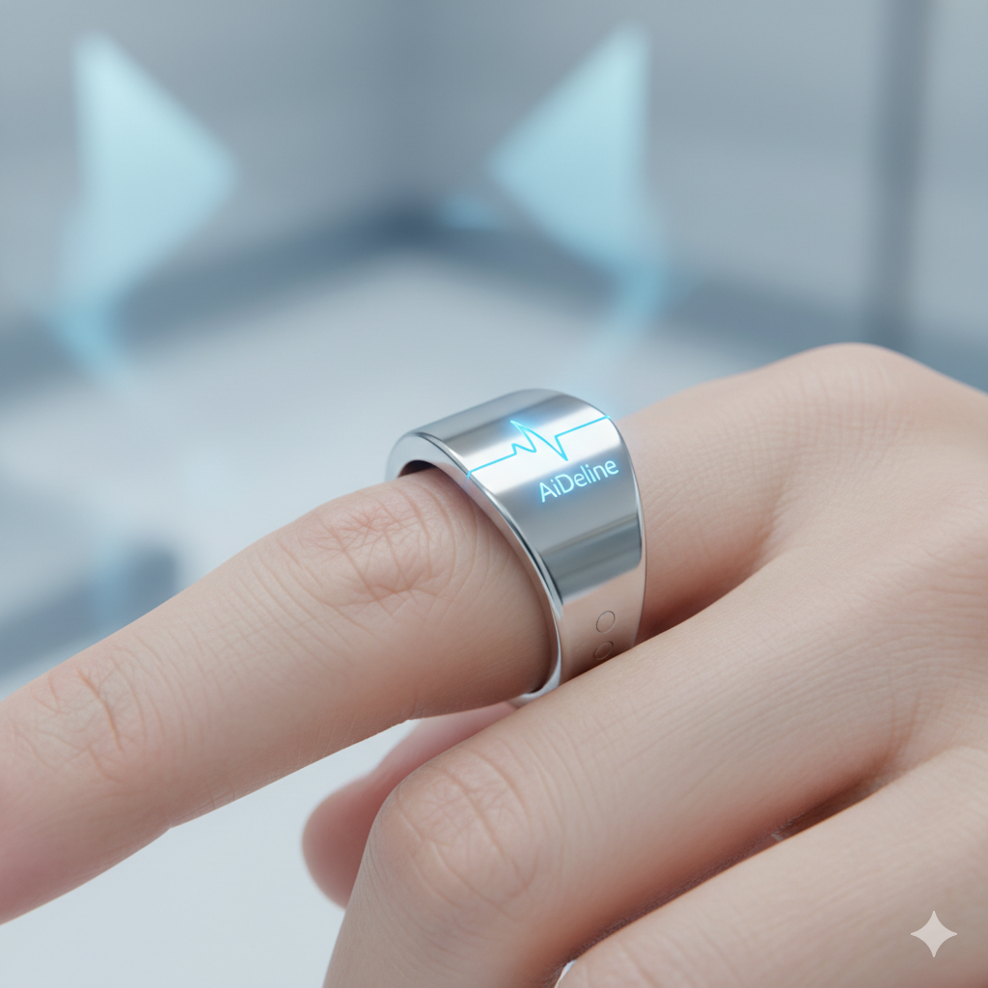

Slide 3
PROBLEM / NEED RECOGNITION
CONTIONOUS SUPERVISION
MEDICAL DEVICES X FASHION

Slide 4
PROBLEM / NEED RECOGNITION
CONTIONOUS SUPERVISION
MEDICAL DEVICES X FASHION

Slide 5
PROBLEM / NEED RECOGNITION
CONTIONOUS SUPERVISION
MEDICAL DEVICES X FASHION

Slide 6
PATIENTS NEED CONTIONOUS MONITORING
EXISTING DEVICES HAVE LIMITATIONS
INFORMATION SEARCH
NEW TECHNOLOGIES MAKE SMART RINGS A PROMISING SOLUTION
CHALLENGES REMAIN WITH REGULATIONS AND SAFETY
USERS WANT DEVICES THAT ARE STYLISH, AFFORDABLE, AND DISCREET

Slide 7
PATIENTS NEED CONTIONOUS MONITORING
EXISTING DEVICES HAVE LIMITATIONS
INFORMATION SEARCH
NEW TECHNOLOGIES MAKE SMART RINGS A PROMISING SOLUTION
CHALLENGES REMAIN WITH REGULATIONS AND SAFETY
USERS WANT DEVICES THAT ARE STYLISH, AFFORDABLE, AND DISCREET

Slide 8
PATIENTS NEED CONTIONOUS MONITORING
EXISTING DEVICES HAVE LIMITATIONS
INFORMATION SEARCH
NEW TECHNOLOGIES MAKE SMART RINGS A PROMISING SOLUTION
CHALLENGES REMAIN WITH REGULATIONS AND SAFETY
USERS WANT DEVICES THAT ARE STYLISH, AFFORDABLE, AND DISCREET

Slide 9
PATIENTS NEED CONTIONOUS MONITORING
EXISTING DEVICES HAVE LIMITATIONS
INFORMATION SEARCH
NEW TECHNOLOGIES MAKE SMART RINGS A PROMISING SOLUTION
CHALLENGES REMAIN WITH REGULATIONS AND SAFETY
USERS WANT DEVICES THAT ARE STYLISH, AFFORDABLE, AND DISCREET

Slide 10
PATIENTS NEED CONTIONOUS MONITORING
EXISTING DEVICES HAVE LIMITATIONS
INFORMATION SEARCH
NEW TECHNOLOGIES MAKE SMART RINGS A PROMISING SOLUTION
CHALLENGES REMAIN WITH REGULATIONS AND SAFETY
USERS WANT DEVICES THAT ARE STYLISH, AFFORDABLE, AND DISCREET

Slide 11
PATIENTS NEED CONTIONOUS MONITORING
EXISTING DEVICES HAVE LIMITATIONS
INFORMATION SEARCH
NEW TECHNOLOGIES MAKE SMART RINGS A PROMISING SOLUTION
CHALLENGES REMAIN WITH REGULATIONS AND SAFETY
USERS WANT DEVICES THAT ARE STYLISH, AFFORDABLE, AND DISCREET

Slide 12
PATIENTS NEED CONTIONOUS MONITORING
EXISTING DEVICES HAVE LIMITATIONS
INFORMATION SEARCH
NEW TECHNOLOGIES MAKE SMART RINGS A PROMISING SOLUTION
CHALLENGES REMAIN WITH REGULATIONS AND SAFETY
USERS WANT DEVICES THAT ARE STYLISH, AFFORDABLE, AND DISCREET

Slide 13
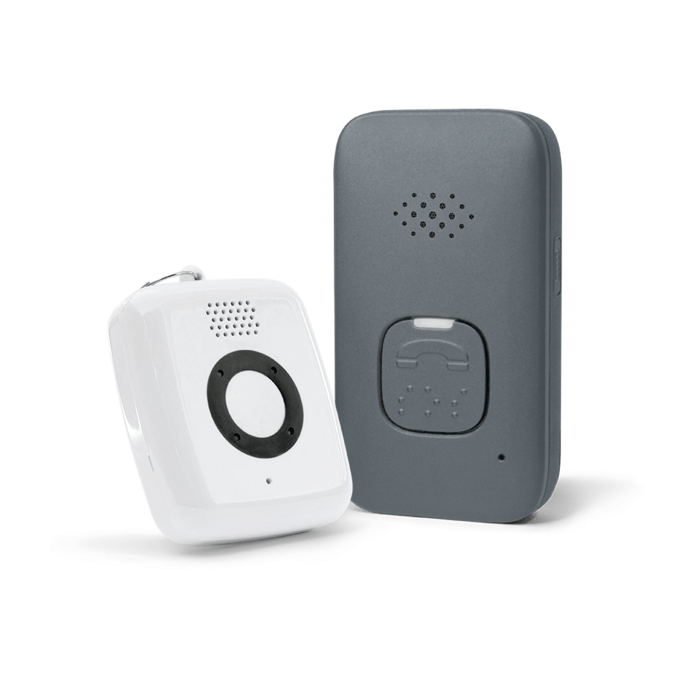
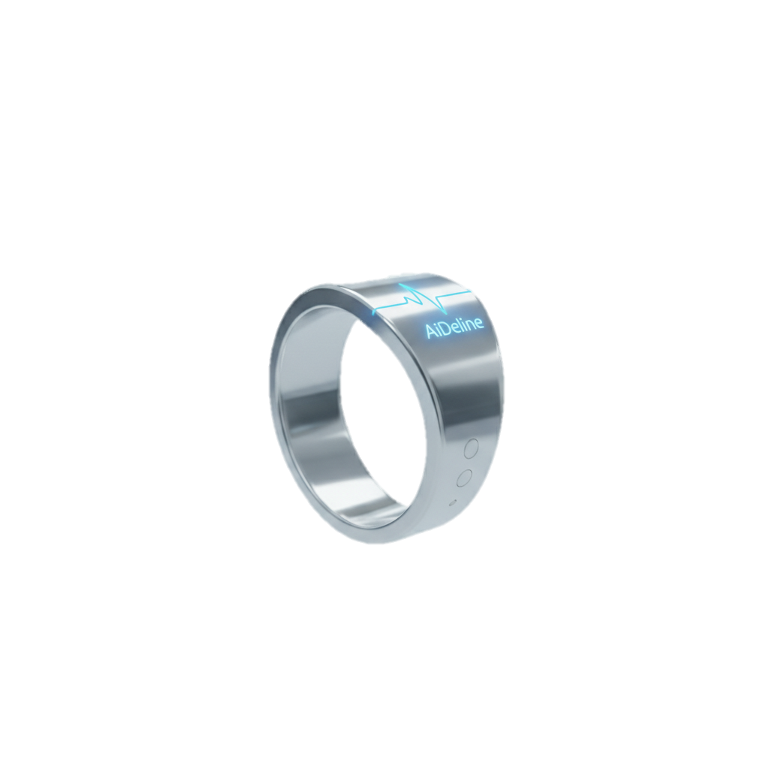
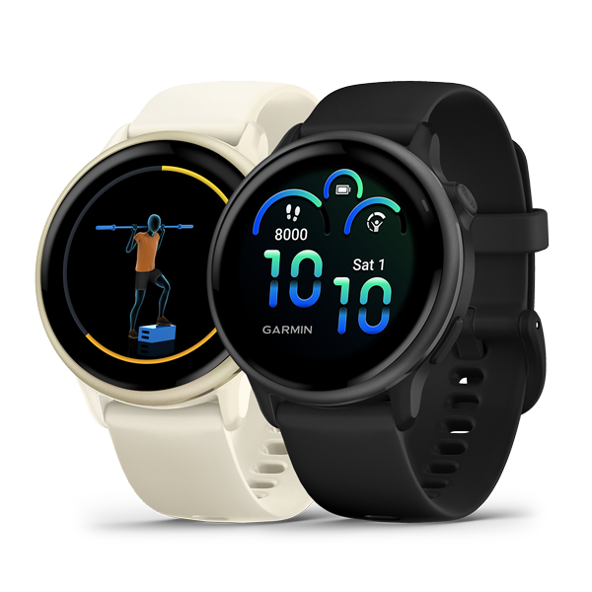
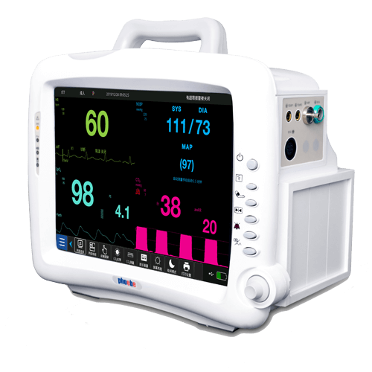
EVALUATION OF ALTERNATIVES
MEDICAL ALERT DEVICES
PORTABLE MEDICAL MONITORS
SMART RING
(AIDALINE)
SMARTWATCHES
Popular & multifunctional, but more lifestyle than medical; accuracy limited.
Highly accurate & FDA/CE-approved, but bulky and impractical for daily use.
are discreet, affordable, and accurate wearables that bridge the gap between consumer and clinical devices.
Reliable for emergencies, trusted by elderly, but no continuous monitoring.

Slide 14
EVALUATION OF ALTERNATIVES
SMARTWATCHES
Popular & multifunctional, but more lifestyle than medical; accuracy limited.
MEDICAL ALERT DEVICES
PORTABLE MEDICAL MONITORS
SMART RING
(AIDALINE)
Highly accurate & FDA/CE-approved, but bulky and impractical for daily use.
are discreet, affordable, and accurate wearables that bridge the gap between consumer and clinical devices.
Reliable for emergencies, trusted by elderly, but no continuous monitoring.

Slide 15
EVALUATION OF ALTERNATIVES
MEDICAL ALERT DEVICES
Reliable for emergencies, trusted by elderly, but no continuous monitoring.
PORTABLE MEDICAL MONITORS
SMART RING
(AIDALINE)
SMARTWATCHES
Popular & multifunctional, but more lifestyle than medical; accuracy limited.
Highly accurate & FDA/CE-approved, but bulky and impractical for daily use.
are discreet, affordable, and accurate wearables that bridge the gap between consumer and clinical devices.

Slide 16
EVALUATION OF ALTERNATIVES
PORTABLE MEDICAL MONITORS
Highly accurate & FDA/CE-approved, but bulky and impractical for daily use.
MEDICAL ALERT DEVICES
SMART RING
(AIDALINE)
SMARTWATCHES
Popular & multifunctional, but more lifestyle than medical; accuracy limited.
are discreet, affordable, and accurate wearables that bridge the gap between consumer and clinical devices.
Reliable for emergencies, trusted by elderly, but no continuous monitoring.

Slide 17
EVALUATION OF ALTERNATIVES
SMART RING
(AIDALINE)
are discreet, affordable, and accurate wearables that bridge the gap between consumer and clinical devices.
MEDICAL ALERT DEVICES
PORTABLE MEDICAL MONITORS
SMARTWATCHES
Popular & multifunctional, but more lifestyle than medical; accuracy limited.
Highly accurate & FDA/CE-approved, but bulky and impractical for daily use.
Reliable for emergencies, trusted by elderly, but no continuous monitoring.

Slide 18
EVALUATION OF ALTERNATIVES
MEDICAL ALERT DEVICES
PORTABLE MEDICAL MONITORS
SMART RING
(AIDALINE)
SMARTWATCHES
Popular & multifunctional, but more lifestyle than medical; accuracy limited.
Highly accurate & FDA/CE-approved, but bulky and impractical for daily use.
are discreet, affordable, and accurate wearables that bridge the gap between consumer and clinical devices.
Reliable for emergencies, trusted by elderly, but no continuous monitoring.

Slide 19
SELECTION STAGE
A
b
c
Popular & multifunctional, but more lifestyle than medical; accuracy limited.

Slide 20
SELECTION STAGE
A
b
c
Popular & multifunctional, but more lifestyle than medical; accuracy limited.

Slide 21
SELECTION STAGE
A
b
c
Popular & multifunctional, but more lifestyle than medical; accuracy limited.

Slide 22
SELECTION STAGE
A
b
c
Popular & multifunctional, but more lifestyle than medical; accuracy limited.

Slide 23
SELECTION STAGE
A
b
c
Popular & multifunctional, but more lifestyle than medical; accuracy limited.

Slide 24
SELECTION STAGE
A
6/10
ACCURACY (30%)
5/10
b
AFFORDABILITY (20%
6/10
COMFORT (20%)
7/10
MONITORING (20%)
c
8/10
USER-ACCEPTANCE (10%
6.5/10
WEIGHTED SCORE
Popular & multifunctional, but more lifestyle than medical; accuracy limited.

Slide 25
SELECTION STAGE
A
10/10
ACCURACY (30%)
4/10
b
AFFORDABILITY (20%
3/10
COMFORT (20%)
8/10
MONITORING (20%)
c
4/10
USER-ACCEPTANCE (10%
6.3/10
WEIGHTED SCORE
Popular & multifunctional, but more lifestyle than medical; accuracy limited.

Slide 26
SELECTION STAGE
A
8/10
ACCURACY (30%)
9/10
b
AFFORDABILITY (20%
9/10
COMFORT (20%)
9/10
MONITORING (20%)
c
9/10
USER-ACCEPTANCE (10%
8.8/10
WEIGHTED SCORE
Popular & multifunctional, but more lifestyle than medical; accuracy limited.

Slide 27
EVALUATION OF DECISION
MEETS NEEDS
SELECTION FIT
RISKS
VIABILITY

Slide 28
EVALUATION OF DECISION
✓
MEETS NEEDS
SELECTION FIT
RISKS
VIABILITY

Slide 29
EVALUATION OF DECISION
✓
✓
MEETS NEEDS
SELECTION FIT
RISKS
VIABILITY

Slide 30
EVALUATION OF DECISION
✓
✓
MEETS NEEDS
✓
SELECTION FIT
RISKS
VIABILITY

Slide 31
EVALUATION OF DECISION
✓
✓
MEETS NEEDS
✓
SELECTION FIT
✓
RISKS
VIABILITY

