Slide 1

FRM-Resumen
By: JARETH oLAZABAL

Slide 2
Foundations of Risk Managers

Slide 3
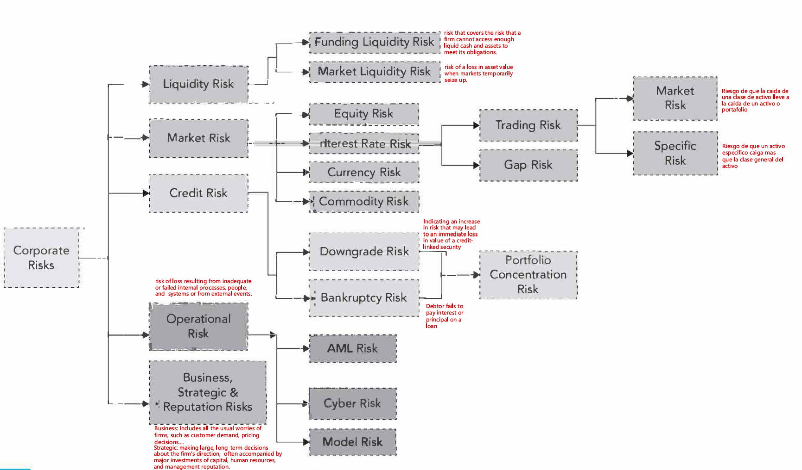
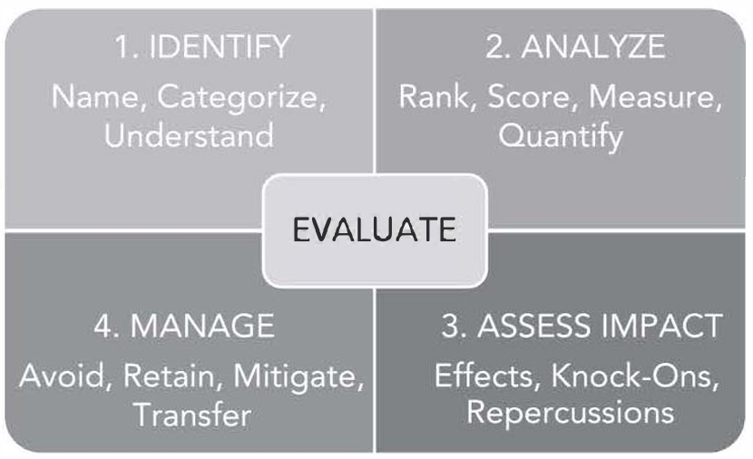
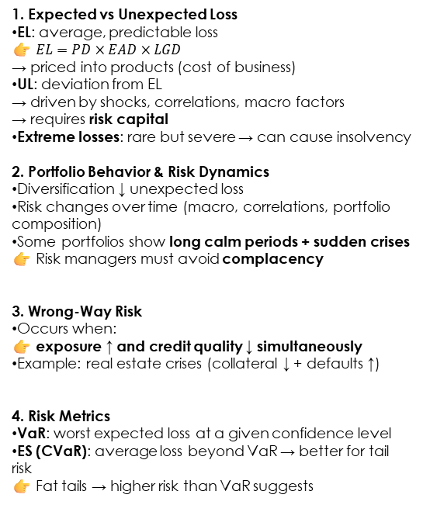
Building blocks of Risk Managment
TYPOLOGY OF RISKS AND RISK INTERACTIONS
IDENTIFYING RISK: KNOWNS AND UNKNOWNS
Known vs Unknown Risk (Rumsfeld + Knight)
Known risks (measurable): probabilities can be estimated → standard risk models apply.
Unknown risks:
Known unknowns: we know the risk exists but can’t measure it well.
Unknown unknowns: risks we don’t even foresee.
Risk vs Uncertainty (Knight / Keynes)
Risk: measurable uncertainty (probabilities known).
Uncertainty (Knightian): not measurable, probabilities unknown or unknowable.
Moonwalking bears: risks that are visible but ignored (e.g., overpriced markets).
Underwater icebergs: risks that are hard to detect (e.g., excessive leverage pre-2008).
Elephant in the room: risks everyone sees but no one wants to acknowledge.
Core Quantitative Risk Concepts and Dynamics
5. Risk Factor Decomposition
Break risk into drivers (PD, LGD, EAD)
Analyze interactions and correlations
Use data / ML to identify hidden patterns
👉 Key: understand what drives losses and how factors interact
6. Tail Risk & Structural Change
Rare extreme events (tail risk) → hard to detect
Use Extreme Value Theory (EVT) when data is scarce
Structural changes → invalidate historical data
👉 Financial systems are dynamic → past ≠ future
7. Human Behavior & Conflicts
Conflicts of interest can hide risk
Three lines of defense:
Business (owns risk)
Risk management (oversight)
Audit (independent control)
👉 Systems always have loopholes
9. RAROC (Core Decision Tool)
👉 RAROC = Risk-adjusted return / Economic capital
Adjusts return for EL
Risk measured by economic capital (UL)
👉 Decision rule: RAROC > cost of equity → value creation
1. Expected vs Unexpected Loss
EL: average, predictable loss 👉 $EL=PD×EAD×LGD$ → priced into products (cost of business)
UL: deviation from EL → driven by shocks, correlations, macro factors → requires risk capital
Extreme losses: rare but severe → can cause insolvency
2. Portfolio Behavior & Risk Dynamics
Diversification ↓ unexpected loss
Risk changes over time (macro, correlations, portfolio composition)
Some portfolios show long calm periods + sudden crises
👉 Risk managers must avoid complacency
3. Wrong-Way Risk
Occurs when: 👉 exposure ↑ and credit quality ↓ simultaneously
Example: real estate crises (collateral ↓ + defaults ↑)
4. Risk Metrics
VaR: worst expected loss at a given confidence level
ES (CVaR): average loss beyond VaR → better for tail risk
👉 Fat tails → higher risk than VaR suggests
10. ERM (Holistic Risk Management)
👉 Firm-wide integrated view of risk (no silos)
Risk is multi-dimensional → cannot rely on a single metric
Combines quantitative tools + judgment + scenarios
Links risk measurement → strategic decisions
👉 Key idea: Effective risk management = holistic view + action + strong risk culture
THE RISK MANAGEMENT PROCESS
Avoid: Do not take the risk → exit or avoid the activity entirely (e.g., don’t enter a risky market).
Retain: Keep (all or part of) the risk → only risks within risk appetite; can be full or partial retention via risk capital, self-insurance, captive insurance.
Mitigate: Reduce risk → lower probability or impact (hedging, controls, collateral, better processes).
Transfer: Shift risk to a third party → derivatives, insurance, structured products (pay a premium).

Slide 4
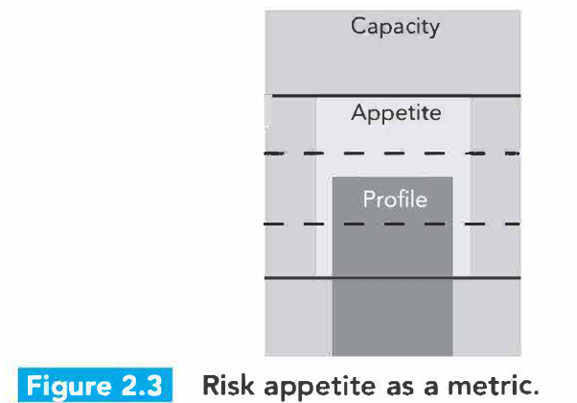
How Do Firms Manage Financial Risk?
1. Financial Risk Management Framework (From Appetite to Execution)
👉 Firms manage financial risk due to:
Need: ↑ volatility since 1970s
Opportunity: growth of derivatives & instruments
👉 Core process (end-to-end):
Define risk appetite (what risk to take)
Map risks (cash flows, exposures, timing)
Choose strategy:
Retain
Avoid
Mitigate
Transfer
Implement & monitor (limits, governance, tools)
Re-evaluate continuously
👉 Key principles:
Hedging ≠ always optimal (costs, investor perspective)
Goal = stabilize cash flows, avoid distress, enable planning
Instruments: forwards, futures, swaps, options
Natural hedging + derivatives = combined approach
👉 Risks of risk management:
Can create hidden/speculative exposure
Liquidity risk (e.g., margin calls)
Model risk, basis risk, governance failures
👉 Bottom line: Risk management is not just hedging → it’s aligning risk with strategy, capacity, and decision-making
Risk Appetite Framework (Capacity, Appetite, Profile & Governance)
👉 Definitions:
Capacity: maximum risk the firm can absorb
Appetite: risk the firm is willing to take (board-defined)
Profile: actual risk exposure
👉 Relation: Capacity > Appetite > Profile
👉 Process:
Senior management drafts risk appetite
Board reviews and approves
Translated into:
risk policies
limits (VaR, UL, stress tests)
business-level guidelines
Implemented in day-to-day decisions
Regularly monitored and updated
👉 Key Insight: No single metric → uses multiple measures across risks
👉 Objective: Keep risk profile within appetite and below capacity

Slide 5
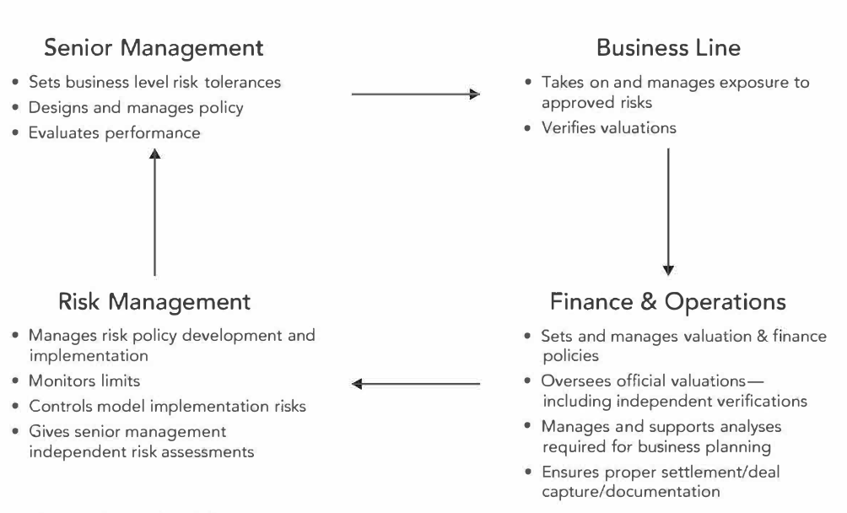
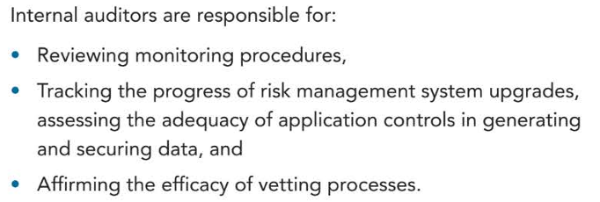
The Governance of Risk Management
Risk Appetite vs Capacity vs Tolerance Risk capacity: maximum risk the firm can absorb before threatening solvency Risk appetite: overall amount of risk the firm is willing to take Risk tolerance: acceptable range of variation around specific business objectives Current risk profile should remain within tolerance bands and below total capacity 👉 Goal: keep actual risk within tolerance and safely below capacity
1. Corporate Governance & Risk Governance Corporate governance: how a firm is directed, controlled, and supervised Risk governance: how risk-taking is defined, monitored, and overseen across the firm 👉 Risk governance = governance applied to risk-taking
2. Why Governance Became a Major Issue Corporate scandals and the 2007-2009 crisis exposed weak disclosure, poor oversight, and lack of accountability Boards and auditors often failed to understand the real risks being taken 👉 Main lesson: poor governance allows hidden risk to grow
3. Sarbanes-Oxley Act (SOX, 2002) U.S. law passed after Enron, WorldCom, and other scandals Strengthened executive accountability, internal controls, and disclosure requirements CEOs and CFOs must certify the accuracy of financial reports 👉 SOX = stronger transparency and management accountability
4. European Governance Reform (2000s) Europe relied more on governance codes and a “comply or explain” approach Focused on board structure, disclosure, and internal controls rather than one strict law like SOX 👉 Europe used principles-based governance reform
5. Basel I (1988) First Basel Accord Introduced minimum capital requirements based on risk-weighted assets Set the 8% capital standard 👉 Basel I = the first international bank capital framework
6. Basel II (2004/2006) Made capital regulation more risk-sensitive than Basel I Added the three-pillar structure: minimum capital supervisory review market discipline 👉 Basel II = more sophisticated risk-based banking regulation
7. Basel III (2010-2011 onward) Post-crisis reform designed to strengthen resilience Improved capital quality, added leverage ratio, LCR, NSFR, and countercyclical buffers Focused on both firm-level and systemic risk 👉 Basel III = stronger capital, liquidity, and systemic stability
8. BCBS Corporate Governance Principles (2010, revised 2015) Basel Committee guidance for banks on governance and risk oversight Emphasized board responsibility, CRO independence, risk committees, internal audit, and compensation 👉 Post-crisis governance became a core regulatory expectation
9. Glass-Steagall Act (1933) and Gramm-Leach-Bliley Act (1999) Glass-Steagall separated commercial and investment banking Gramm-Leach-Bliley largely removed that separation Allowed financial groups to combine banking, securities, and insurance activities 👉 U.S. banking moved from separation to universal banking
10. Dodd-Frank Act (2010) Major U.S. post-crisis reform Expanded oversight of systemic institutions, reformed derivatives markets, introduced resolution planning, and strengthened consumer protection 👉 Dodd-Frank = the main U.S. post-crisis financial reform
11. Volcker Rule (2013, effective 2015) Part of Dodd-Frank Restricted proprietary trading by banks and limited ties to hedge funds and private equity 👉 Volcker Rule = reduce speculative trading inside banks
12. Stress Testing: DFAST, CCAR, SREP, EBA (2010s) DFAST and CCAR in the U.S. test whether large banks can survive severe macro stress SREP and EBA stress tests play a similar role in Europe These frameworks are forward-looking and tied to capital and liquidity planning 👉 Stress testing = regulation focused on survivability, not just compliance
13. Role of the Board The board approves strategy, risk appetite, and major risk boundaries It must oversee management, ask hard questions, and ensure effective controls It should understand the risks taken, not just the profits reported 👉 Board oversight is central to effective risk governance
14. Risk Appetite Statement (RAS) and the CRO RAS defines the amount and type of risk the firm is willing to take It links strategy, capital, liquidity, compensation, and limits The CRO must be independent, have authority, and be able to escalate issues directly to the board 👉 RAS + independent CRO = core of practical risk governance
15. Incentives, Audit, and Final Governance Logic Bad compensation can encourage short-term risk-taking and hide long-term losses Post-crisis reforms pushed deferred bonuses, clawbacks, and risk-adjusted pay Internal audit must remain independent and verify that governance and controls truly work 👉 Effective risk governance = board oversight + strong CRO + clear limits + aligned incentives + independent audit

Slide 6
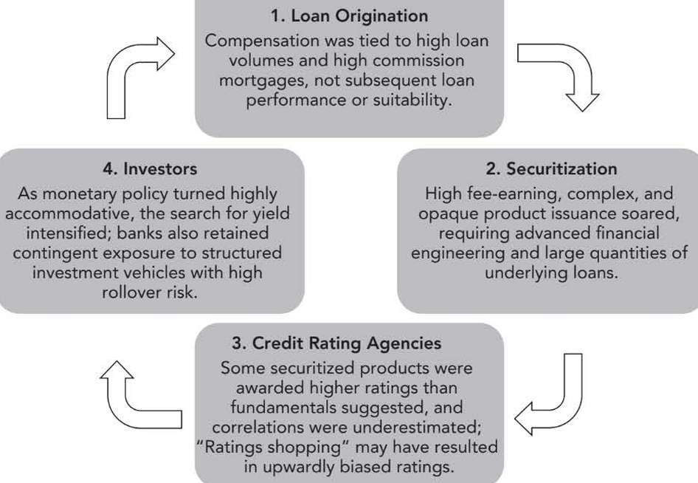
Credit Risk Transfer Mechanism
14. Post-Crisis Reform and Risk Retention U.S. regulators finalized risk retention rules in 2014 under Section 15G of the Securities Exchange Act Securitizers must retain at least 5% of the credit risk and cannot hedge it away This is meant to ensure they have “skin in the game” 👉 Post-crisis reform tries to reduce moral hazard by forcing originators to share the risk
15. Final Takeaway Credit risk transfer mechanisms are useful, necessary, and still relevant Some products survived well, especially CDS, ABS, and revived CLO markets The long-term value of these markets depends on transparency, liquidity, proper incentives, and strong risk management 👉 Key idea: credit risk transfer supports active credit management, but only if the structure, incentives, and oversight are sound
1. Credit Risk Transfer: Core Idea Banks’ main exposure is credit risk Traditionally, banks funded long-term illiquid loans with short-term liquid deposits Credit risk transfer mechanisms allowed banks to actively manage and redistribute credit exposure 👉 Main idea: credit risk no longer had to stay on the bank’s balance sheet
3. Why Credit Risk Transfer Can Be Useful Allows banks to reduce single-name and portfolio credit exposure Improves capital efficiency and funding flexibility Helps redistribute risk to a broader investor base Supports credit price discovery through market pricing 👉 Properly used, credit risk transfer improves risk management and market efficiency
4. Traditional Credit Protection Tools Before modern credit derivatives, banks used: insurance/financial guarantees netting margining/mark-to-market collateral termination clauses / put options These reduce exposure but do not fully isolate and redistribute credit risk 👉 Traditional tools protect against credit loss, but are less flexible than modern transfer mechanisms
5. Credit Derivatives and CDS Credit derivatives transfer credit risk without selling the underlying loan or bond CDS is the most common example: protection buyer pays a fee protection seller pays if a credit event occurs They allow fine-tuning of credit exposure and portfolio management 👉 CDS = credit risk transfer without transferring funding or client relationship
6. Securitization Mechanics Securitization pools loans/receivables and repackages them into securities A special purpose vehicle (SPV) buys the asset pool and issues tranches: senior junior equity/residual Cash flows from the asset pool are used to pay investors 👉 Securitization transforms illiquid credit assets into tradable securities
7. Buy-and-Hold vs Originate-to-Distribute (OTD) Buy-and-hold: originate loans and keep them on the balance sheet Originate-to-distribute: originate loans, pool them, and sell the risk through securitization OTD reduces direct credit, price, and liquidity risk for the originator 👉 OTD shifted banking from holding credit risk to distributing it
8. Benefits of the OTD Model Banks: more capital efficiency, funding access, lower short-term volatility Investors: more instruments and portfolio diversification Borrowers: more credit availability and lower borrowing costs 👉 In theory, OTD benefits banks, investors, and borrowers
9. What Went Wrong Before the Crisis The problem was not credit transfer itself, but how it was used Pre-crisis securitization created: misaligned incentives weak underwriting poor transparency excessive complexity overreliance on ratings poor stress testing and risk management 👉 Main failure: incentives and risk controls collapsed along the securitization chain
10. Moral Hazard in OTD When lenders do not keep the loan, they have weaker incentives to screen and monitor borrowers Loan origination became volume-driven rather than quality-driven 👉 OTD created moral hazard by weakening underwriting discipline
11. Banks Did Not Fully Transfer Risk Before the crisis, banks often claimed to distribute risk but actually retained or re-bought it They held exposures directly or indirectly through conduits, SIVs, and warehoused pipelines This created hidden leverage, liquidity risk, and concentration risk 👉 The crisis showed that “originate-to-distribute” often became “originate-and-retain-tail-risk”
12. Role of Ratings and Complexity Investors relied too heavily on rating agencies Some structured products received ratings that were too optimistic Complex products such as CDO-squared became too opaque to value properly 👉 Complexity often improved marketability, not risk management
13. Crisis Lessons for Securitization Key lessons: align incentives improve transparency strengthen underwriting stress test pipeline, liquidity, and concentration risks reduce blind reliance on ratings The issue was faulty execution, not the basic idea of credit risk transfer 👉 Securitization failed mainly because of poor governance and poor risk discipline
2. Main Credit Risk Transfer Instruments
CDS: transfers default risk through a protection contract
CDO: pools debt and splits it into risk tranches
CLO: CDO backed mainly by corporate loans
ABS: security backed by receivables like auto loans or credit cards
MBS: security backed by mortgage loans
ABCP: short-term paper backed by asset pools
👉 Credit derivatives transfer credit risk; securitization repackages it into tradable products

Slide 7
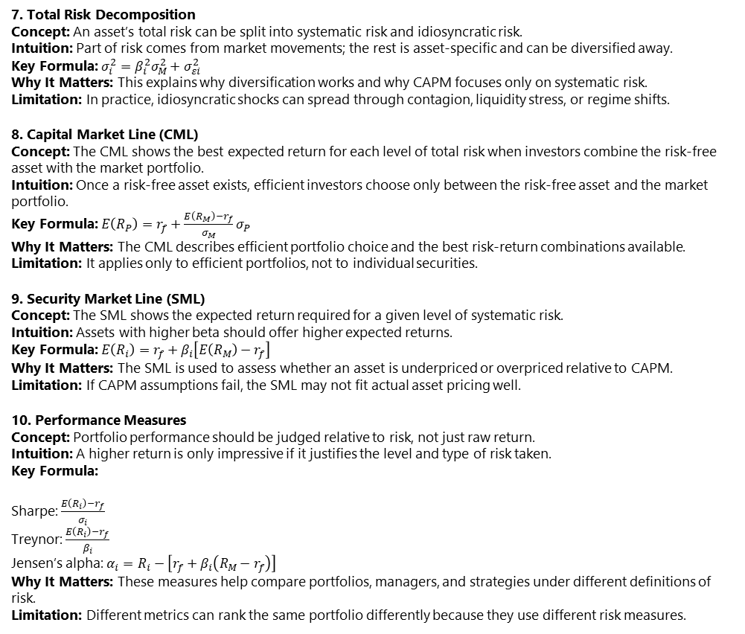
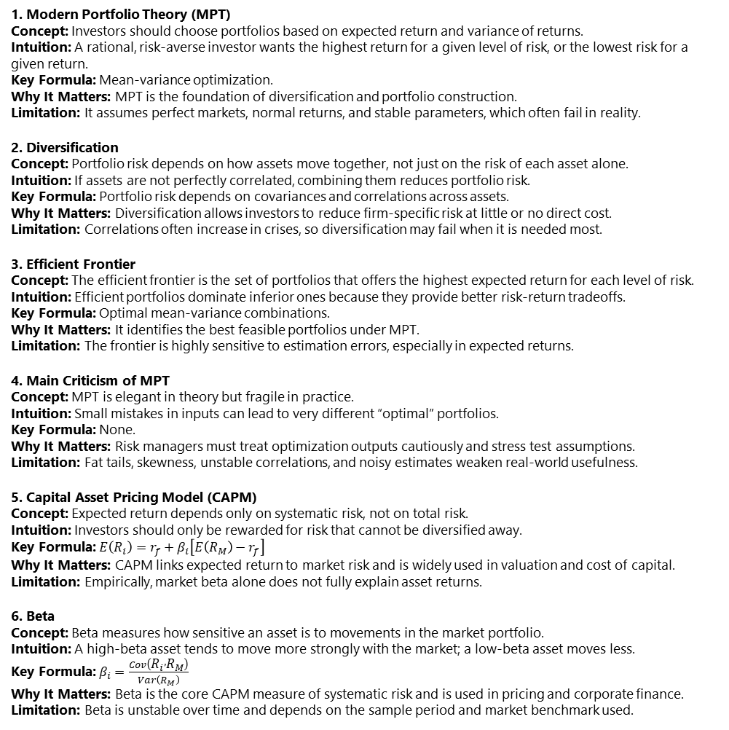
Modern Portfolio Theory and Capital Asset Pricing Model
1. Modern Portfolio Theory (MPT) Concept: Investors should choose portfolios based on expected return and variance of returns. Intuition: A rational, risk-averse investor wants the highest return for a given level of risk, or the lowest risk for a given return. Key Formula: Mean-variance optimization. Why It Matters: MPT is the foundation of diversification and portfolio construction. Limitation: It assumes perfect markets, normal returns, and stable parameters, which often fail in reality.
2. Diversification Concept: Portfolio risk depends on how assets move together, not just on the risk of each asset alone. Intuition: If assets are not perfectly correlated, combining them reduces portfolio risk. Key Formula: Portfolio risk depends on covariances and correlations across assets. Why It Matters: Diversification allows investors to reduce firm-specific risk at little or no direct cost. Limitation: Correlations often increase in crises, so diversification may fail when it is needed most.
3. Efficient Frontier Concept: The efficient frontier is the set of portfolios that offers the highest expected return for each level of risk. Intuition: Efficient portfolios dominate inferior ones because they provide better risk-return tradeoffs. Key Formula: Optimal mean-variance combinations. Why It Matters: It identifies the best feasible portfolios under MPT. Limitation: The frontier is highly sensitive to estimation errors, especially in expected returns.
4. Main Criticism of MPT Concept: MPT is elegant in theory but fragile in practice. Intuition: Small mistakes in inputs can lead to very different “optimal” portfolios. Key Formula: None. Why It Matters: Risk managers must treat optimization outputs cautiously and stress test assumptions. Limitation: Fat tails, skewness, unstable correlations, and noisy estimates weaken real-world usefulness.
5. Capital Asset Pricing Model (CAPM) Concept: Expected return depends only on systematic risk, not on total risk. Intuition: Investors should only be rewarded for risk that cannot be diversified away. Key Formula: $E\left(R_{i}\right)=r_{f}+β_{i}\left[E\left(R_{M}\right)−r_{f}\right]$ Why It Matters: CAPM links expected return to market risk and is widely used in valuation and cost of capital. Limitation: Empirically, market beta alone does not fully explain asset returns.
6. Beta Concept: Beta measures how sensitive an asset is to movements in the market portfolio. Intuition: A high-beta asset tends to move more strongly with the market; a low-beta asset moves less. Key Formula: $β_{i}=\frac{Cov\left(R_{i} , R_{M}\right)}{Var\left(R_{M}\right)}$ Why It Matters: Beta is the core CAPM measure of systematic risk and is used in pricing and corporate finance. Limitation: Beta is unstable over time and depends on the sample period and market benchmark used.
7. Total Risk Decomposition Concept: An asset’s total risk can be split into systematic risk and idiosyncratic risk. Intuition: Part of risk comes from market movements; the rest is asset-specific and can be diversified away. Key Formula: $σ_{i}^{2}=β_{i}^{2}σ_{M}^{2}+σ_{εi}^{2}$ Why It Matters: This explains why diversification works and why CAPM focuses only on systematic risk. Limitation: In practice, idiosyncratic shocks can spread through contagion, liquidity stress, or regime shifts.
8. Capital Market Line (CML) Concept: The CML shows the best expected return for each level of total risk when investors combine the risk-free asset with the market portfolio. Intuition: Once a risk-free asset exists, efficient investors choose only between the risk-free asset and the market portfolio. Key Formula: $E\left(R_{P}\right)=r_{f}+\frac{E\left(R_{M}\right)−r_{f}}{σ_{M}}σ_{P}$ Why It Matters: The CML describes efficient portfolio choice and the best risk-return combinations available. Limitation: It applies only to efficient portfolios, not to individual securities.
9. Security Market Line (SML) Concept: The SML shows the expected return required for a given level of systematic risk. Intuition: Assets with higher beta should offer higher expected returns. Key Formula: $E\left(R_{i}\right)=r_{f}+β_{i}\left[E\left(R_{M}\right)−r_{f}\right]$ Why It Matters: The SML is used to assess whether an asset is underpriced or overpriced relative to CAPM. Limitation: If CAPM assumptions fail, the SML may not fit actual asset pricing well.
10. Performance Measures Concept: Portfolio performance should be judged relative to risk, not just raw return. Intuition: A higher return is only impressive if it justifies the level and type of risk taken. Key Formula:
Sharpe: $\frac{E\left(R_{i}\right)−r_{f}}{σ_{i}}$ Treynor: $\frac{E\left(R_{i}\right)−r_{f}}{β_{i}}$ Jensen’s alpha: $α_{i}=R_{i}−\left[r_{f}+β_{i}\left(R_{M}−r_{f}\right)\right]$ Why It Matters: These measures help compare portfolios, managers, and strategies under different definitions of risk. Limitation: Different metrics can rank the same portfolio differently because they use different risk measures.

Slide 8
Principles for EffectiveData Aggregation and Risk Reporting
1. Data as a Risk Asset Topic: Role of data in risk management Core Idea: Effective risk analysis depends on sufficient, high-quality internal and external data. Key Requirements: Data must be organized, usable, and suitable for analytics, including ML/AI applications. Why It Matters: Poor data quality creates model risk and weak risk decisions. Common Failure: Fragmented, duplicated, outdated, or poorly stored data leads to “garbage in, garbage out.”
2. BCBS 239: Purpose and Scope Topic: Basel framework for risk data aggregation and reporting Core Idea: BCBS 239 was issued in 2013 to improve banks’ ability to aggregate and report risk across business lines, legal entities, and the group level. Key Requirements: The framework covers 14 principles across governance, infrastructure, data aggregation, reporting, and supervision. Why It Matters: Banks cannot manage enterprise-wide risk if they cannot reliably combine risk data. Common Failure: Banks underestimate the scale of IT redesign and fail to achieve full compliance.
3. Benefits of Effective RDARR Topic: Value of risk data aggregation and risk reporting Core Idea: Better data aggregation reduces uncertainty about accuracy, completeness, timeliness, and adaptability. Key Requirements: Firms need reliable data flows, usable analytics, and strong model validation. Why It Matters: Good RDARR improves tactical decisions, strategic decisions, and risk-adjusted returns. Common Failure: Management receives inaccurate or incomplete information and makes poor risk decisions.
4. Governance: Principle 1 Topic: Governance of risk data Core Idea: Risk data aggregation and reporting must be supported by strong governance. Key Requirements: Clear roles, responsibilities, incentives, oversight, and board involvement. Why It Matters: Data governance determines whether risk information is trusted at senior levels. Common Failure: No structured policy framework, weak escalation, and poor reporting to the board and senior management.
5. Data Architecture and IT Infrastructure: Principle 2 Topic: Architecture and infrastructure support Core Idea: Banks need integrated data architecture and IT systems that work in normal times and in stress. Key Requirements: Common data, common models, common assumptions, lifecycle controls, and integrated taxonomies. Why It Matters: Without integration, enterprise risk cannot be measured consistently. Common Failure: Legacy systems, inconsistent reference data, and weak controls after business changes.
6. Strong Data Aggregation Capability: Principles 3-6 Topic: Core aggregation requirements Core Idea: Risk data must be accurate, complete, timely, and adaptable. Key Requirements:
Principle 3: Accuracy and integrity
Principle 4: Completeness
Principle 5: Timeliness
Principle 6: Adaptability Why It Matters: Banks must be able to produce reliable risk data on demand, including in stress scenarios. Common Failure: Heavy manual processes, missing reconciliations, poor automation, weak data quality controls, and slow sourcing from subsidiaries.
7. Reporting Practices: Principles 7-11 Topic: Effective risk reporting Core Idea: Risk reports must be accurate, comprehensive, clear, frequent enough, and distributed properly. Key Requirements:
Principle 7: Accuracy
Principle 8: Comprehensiveness
Principle 9: Clarity and usefulness
Principle 10: Frequency
Principle 11: Distribution Why It Matters: Risk reports must help real decision-makers act quickly and correctly. Common Failure: Static reports, poor drill-down capability, bad audience targeting, unclear outputs, and weak confidentiality controls.
8. Model Risk and Data Quality Topic: Data in model risk management Core Idea: Data quality is especially important for input risk in models. Key Requirements: Model data must be appropriate, documented, and consistent with the model’s theory and methodology. Why It Matters: Even a good model fails if the underlying data are weak. Common Failure: Poor input data contaminate estimation, valuation, and hedging decisions.
9. Standardization and the Chief Data Officer Topic: Standardized enterprise data management Core Idea: BCBS 239 helped drive the rise of the Chief Data Officer role and broader data standardization. Key Requirements: Standardized identifiers, product data, accounting data, and consistent methodologies across departments. Why It Matters: Standardization makes the firm’s total risk profile visible and manageable. Common Failure: The same customer or exposure is not recognized across business lines because identifiers and standards are inconsistent.
10. Why Compliance Remains Difficult Topic: Implementation challenge Core Idea: Banks have made only limited progress because compliance is technically hard and highly institution-specific. Key Requirements: Ongoing investment, remediation, supervisory review, and cross-border cooperation under Principles 12-14. Why It Matters: BCBS 239 compliance is not a one-off project; it is a continuing transformation of data, systems, and governance. Common Failure: Firms improve reporting faster than aggregation, while governance and infrastructure remain weak.

Slide 9
Enterprise Risk Managementand Future Trends
1. Enterprise Risk Management (ERM) Concept: ERM is a firm-wide approach that manages the total portfolio of risks at the enterprise level rather than only within separate business or risk silos. Intuition: A risk may look small inside one unit but become dangerous when viewed across the whole firm. Key Elements: Enterprise risk appetite, enterprise-wide oversight, cross-risk analysis, and strategic integration. Why It Matters: ERM helps firms understand total exposure, prioritize major threats, and align risk with strategy. Common Failure: Firms manage risks only by business line and fail to see concentrations, interactions, or enterprise-wide threats.
2. Why Firms Need ERM Concept: ERM exists because silo-based risk management cannot fully capture diversification, concentrations, contagion, and cross-over risks. Intuition: Some risks cancel each other out, while others reinforce each other across the firm. Key Elements: Netting effects, diversification effects, concentration analysis, and cross-over risk identification. Why It Matters: ERM improves risk prioritization and helps firms focus on threats to survival and core functionality. Common Failure: Firms either overreact to local risks or underestimate risks that accumulate across the enterprise.
3. ERM vs Traditional Silo-Based Risk Management Concept: Traditional risk management treats risks separately by function or business line, while ERM integrates them. Intuition: Silo-based management sees “parts”; ERM sees the whole portfolio. Key Elements: Global risk committees, CRO oversight, common metrics, enterprise-wide risk transfer, and integrated capital/financing decisions. Why It Matters: ERM allows better comparison of risks, lower transfer costs, and more consistent decision-making. Common Failure: Different units use different metrics and make inconsistent risk decisions that conflict with enterprise goals.
4. Brief History of ERM Concept: ERM developed gradually as firms and regulators realized that risk had to be viewed more holistically. Intuition: As markets, derivatives, and global firms became more complex, isolated risk management stopped being enough. Key Elements: Financial liberalization in the 1970s, global risk divisions in the 1990s, CRO roles, VaR, operational risk tracking, and post-crisis expansion of ERM tools. Why It Matters: The 2007-2009 crisis showed the need for enterprise risk appetite, data aggregation, stress testing, and stronger risk culture. Common Failure: Firms adopt ERM structures formally but fail to change actual behavior, reporting, or decision-making.
5. Five Dimensions of ERM Concept: ERM works through five interacting dimensions: targets, structure, metrics, strategies, and culture. Intuition: ERM succeeds only when governance, measurement, action, and behavior all reinforce each other. Key Elements:
Targets: risk appetite and strategic goals
Structure: board, CRO, committees, reporting lines
Metrics: stress testing, VaR, risk mapping, total cost of risk
Strategies: avoid, retain, mitigate, transfer
Culture: tone at the top, accountability, risk literacy Why It Matters: These dimensions turn ERM from a vision into a practical operating framework. Common Failure: Firms strengthen one dimension, such as reporting or committees, but ignore culture or implementation.
6. Four Core Reasons Enterprise Risk Demands ERM Concept: ERM is needed because enterprise risks often emerge in ways that silo management cannot detect. Intuition: The biggest danger is often not one large visible risk, but many connected smaller ones. Key Elements:
Vertical vision: small local decisions can become firm-wide threats
Concentration risk: hidden exposure across customers, sectors, products, suppliers, or geographies
Beyond silos: diversification and cross-risk interactions
Retention decisions: self-insurance and captive insurance should be made at the enterprise level Why It Matters: ERM helps firms identify enterprise-scale threats early and allocate capital and protection more efficiently. Common Failure: Concentrations remain hidden until stress reveals them, as happened in crises and funding failures such as Northern Rock.
7. Risk Culture Concept: Risk culture is the set of values, behaviors, incentives, and norms that shape how people identify, discuss, and act on risk. Intuition: Risk culture determines whether the firm actually behaves in line with its stated risk appetite. Key Elements: Tone from the top, accountability, effective challenge, compensation, escalation, whistleblowing, risk literacy, and information flow. Why It Matters: A strong risk culture is one of the best tools for making ERM real across the firm. Common Failure: Firms state the right values, but local incentives, groupthink, or weak challenge drive different behavior in practice.
8. Scenario Analysis and Stress Testing Concept: Scenario analysis and stress testing are central ERM tools for understanding how extreme events affect the firm over time. Intuition: Instead of asking only “what is the average risk?”, firms ask “what happens if a severe scenario unfolds?” Key Elements: Historical scenarios, hypothetical scenarios, enterprise-wide stress tests, forward-looking narratives, and reverse stress testing. Why It Matters: These tools reveal cross-risk interactions, capital needs, warning indicators, and contingency actions better than summary metrics alone. Common Failure: Firms choose scenarios that are too mild, too narrow, or too influenced by the last crisis.
9. Post-Crisis Stress Testing and Strategic Use Concept: Post-crisis regulatory stress testing, especially CCAR and DFAST, pushed banks toward more dynamic and enterprise-wide ERM. Intuition: Banks must show not only that they can measure risk, but that they can survive severe macroeconomic stress. Key Elements: Multi-quarter macro scenarios, capital planning, projected losses, revenues, balance sheet impacts, and minimum capital ratios under stress. Why It Matters: Stress testing now influences risk appetite, capital plans, business planning, and strategic decisions. Common Failure: Many firms still treat stress testing mainly as a compliance exercise instead of using it in day-to-day planning.
10. ERM and Future Trends Concept: The future of ERM lies in more holistic thinking, more dynamic stress testing, stronger risk culture, and better use of data science and behavioral insights. Intuition: Risk management is moving from silo metrics toward integrated judgment supported by data, simulation, and human oversight. Key Elements: Multi-year dynamic scenarios, stochastic simulations, ambiguity awareness, machine learning, behavioral biases, and stronger links between ERM and strategy. Why It Matters: Future risk managers will need to connect numbers, business judgment, human behavior, and strategic planning. Common Failure: Firms adopt advanced tools without transparency, human review, or real integration into strategic decisions.

Slide 10
Learning from Financial Disasters
1. Case: U.S. Savings and Loan Crisis (1980s) Main Risk: Interest rate risk What Went Wrong: U.S. Savings and Loan associations, or S&Ls, funded long-term fixed-rate residential mortgages with short-term deposits. When short-term interest rates rose sharply, funding costs increased while mortgage income stayed fixed, destroying net interest margins. Key Lesson: Borrowing short and lending long without proper interest rate risk management can wipe out an entire industry.
2. Case: Lehman Brothers Bankruptcy (2008) Main Risk: Funding liquidity risk What Went Wrong: Lehman combined very high leverage with heavy use of short-term repo funding to finance illiquid long-term mortgage-related assets. Once confidence collapsed, counterparties demanded more collateral and funding disappeared. Key Lesson: A weak funding structure can turn asset problems into a fatal liquidity crisis.
3. Case: Continental Illinois Bank Failure (1984) Main Risk: Funding liquidity risk + credit concentration risk What Went Wrong: Continental Illinois suffered large credit losses from energy loans linked to Penn Square Bank and relied heavily on wholesale funding instead of stable retail deposits. Once investors lost confidence, funding dried up quickly. Key Lesson: Credit losses and weak funding can reinforce each other and trigger a bank collapse.
4. Case: Northern Rock Bank Run (2007) Main Risk: Funding liquidity risk + business model risk What Went Wrong: Northern Rock relied heavily on securitization and wholesale funding instead of customer deposits. When global funding markets froze, all of its major funding channels shut down at once. Key Lesson: A business model that depends too much on market funding is fragile in systemic stress.
5. Case: Metallgesellschaft Refining and Marketing, Inc. or MGRM Hedging Crisis (1993) Main Risk: Hedging strategy risk + liquidity risk What Went Wrong: MGRM hedged long-term fixed-price oil commitments with rolling short-term futures contracts. The strategy may have worked economically in the long run, but falling oil prices caused large margin calls and severe cash-flow stress, leading management to liquidate the hedge at a loss. Key Lesson: A hedge can fail if liquidity needs and management understanding are not aligned with the strategy.
6. Case: Victor Niederhoffer Hedge Fund Collapse (1997) Main Risk: Model risk What Went Wrong: The fund sold large quantities of deep out-of-the-money naked put options on the S&P 500, assuming that a very large one-day market drop was extremely unlikely. A sharp market decline triggered huge losses and margin calls. Key Lesson: Strategies that earn small steady profits can hide rare but catastrophic tail risk.
7. Case: Long-Term Capital Management or LTCM Collapse (1998) Main Risk: Model risk + liquidity risk + leverage risk What Went Wrong: LTCM used highly leveraged relative-value trades based on the assumption that spreads, correlations, and market behavior would eventually revert to normal. During crisis, spreads widened, liquidity vanished, and correlations broke down. Key Lesson: Models that work in normal markets can fail badly in stressed markets, especially under high leverage.
8. Case: JPMorgan Chase “London Whale” Losses (2012) Main Risk: Model risk + governance failure + operational risk What Went Wrong: JPMorgan’s Chief Investment Office built a massive synthetic credit derivatives position, repeatedly breached risk limits, changed valuation methods to hide losses, and adopted a flawed VaR model that artificially lowered measured risk. Key Lesson: Risk models become dangerous when governance is weak and managers manipulate metrics instead of reducing exposure.
9. Case: Barings Bank Collapse (1995) Main Risk: Rogue trading + misleading reporting What Went Wrong: Nick Leeson secretly built speculative positions while claiming to run an arbitrage strategy, and he was able to hide the losses because he controlled both front-office trading and back-office reporting. Key Lesson: Trading and reporting must be separated, and unusually large profits must be independently investigated.
10. Case: Orange County Bankruptcy (1994) Main Risk: Leverage risk + interest rate risk + structured product risk What Went Wrong: Orange County used repo borrowing to leverage investments in inverse floaters, which lose value when interest rates rise. When the Federal Reserve increased rates sharply, losses were magnified and funding pressure intensified. Key Lesson: Leverage and complex products can turn a rate bet into a major public-sector disaster.
11. Case: Sachsen Landesbank Subprime Exposure (2007) Main Risk: Hidden structured credit risk + off-balance-sheet risk What Went Wrong: Sachsen Landesbank supported off-balance-sheet vehicles loaded with highly rated U.S. mortgage-related securities. When subprime markets collapsed, the bank was forced to absorb losses it had not fully recognized as its own. Key Lesson: Off-balance-sheet structures and AAA ratings do not remove real economic risk.
12. Case: Volkswagen Emissions Scandal (2015) Main Risk: Reputation risk What Went Wrong: Volkswagen programmed diesel vehicles to pass regulatory emissions tests while emitting far more pollution in real driving conditions. The deception led to fines, lawsuits, and severe reputational damage. Key Lesson: Ethical misconduct can destroy firm value even if the original intent was to boost performance.
13. Case: Enron Bankruptcy (2001) Main Risk: Corporate governance failure + accounting fraud What Went Wrong: Enron used misleading accounting, abused special purpose vehicles, and hid losses while executives acted in their own interest. The board and auditors failed to provide effective oversight. Key Lesson: Weak governance, agency problems, and opaque accounting can destroy even admired firms.
14. Case: Cyber Risk in Financial Institutions Main Risk: Cyber risk + operational risk What Went Wrong: Banks face growing threats from hacking, fraud, identity theft, ATM attacks, and internal misuse of systems and customer information. Key Lesson: Cyber risk is now a core enterprise risk and requires constant investment, protection, and oversight.

Slide 11
Anatomy of the GreatFinancial Crisis of 2007-2009
7. Stage: Short-Term Wholesale Funding Vulnerability Core Problem: The system depended heavily on repo and ABCP funding. What Happened: Many institutions and SIVs funded long-term or illiquid assets with short-term instruments such as repos and asset-backed commercial paper. This worked only as long as investors kept rolling the funding. Why It Mattered: Once confidence fell, short-term funding disappeared almost overnight. Key Lesson: Heavy reliance on short-term wholesale funding creates extreme liquidity fragility.
8. Stage: Liquidity Crunch Core Problem: Falling collateral quality and uncertainty caused funding markets to freeze. What Happened: As doubts grew about mortgage-backed collateral, repo haircuts rose sharply and ABCP markets stopped functioning. SIVs could not refinance, hedge funds had to sell assets, and banks were forced to bring exposures back onto their balance sheets. Why It Mattered: A liquidity problem quickly became a solvency problem for highly leveraged institutions. Key Lesson: In a crisis, liquidity can vanish before losses are fully recognized.
9. Stage: Valuation Uncertainty and Transparency Failure Core Problem: Investors could not reliably value complex structured products or understand who held them. What Happened: Structured products were extremely difficult to price because of complex waterfalls, heterogeneous collateral pools, and model dependence. Many institutions lacked transparency about exposures, off-balance-sheet vehicles, and contingent commitments. Why It Mattered: Uncertainty about valuation destroyed trust between market participants and froze lending. Key Lesson: When transparency disappears, markets stop functioning even before all losses are known.
10. Stage: Peak of the Crisis in 2008 Core Problem: The financial system entered a full panic. What Happened: Lehman Brothers failed, Bear Stearns was absorbed, Fannie Mae and Freddie Mac were nationalized, AIG was rescued, and major investment banks converted to bank holding companies. In Europe, banks required massive state support and some sovereigns were later weakened by rescue costs. Why It Mattered: The crisis spread from subprime mortgages to the global banking system and then to the real economy. Key Lesson: A financial crisis becomes systemic when failures spread across institutions, markets, and countries.
11. Stage: Central Bank and Government Intervention Core Problem: Private markets could no longer provide enough liquidity or capital. What Happened: The Federal Reserve and other central banks created emergency liquidity facilities, supported money markets, financed purchases of high-quality assets, and governments recapitalized institutions through programs such as TARP. Why It Mattered: These actions helped prevent a complete collapse of the financial system. Key Lesson: In systemic crises, central banks become lenders of last resort and governments often become recapitalizers of last resort.
12. Stage: Systemic Risk in Action Core Problem: Problems in one market spread rapidly across the system. What Happened: Losses in subprime mortgages spread to ABS, CDOs, repo, ABCP, hedge funds, banks, interbank lending, and then to the broader economy. As trust collapsed, institutions hoarded cash, sold assets, and cut lending. Why It Mattered: The crisis showed how interconnected markets can amplify local shocks into global disasters. Key Lesson: Systemic risk is not just about losses, but about contagion, opacity, and interconnected funding dependence.
1. Stage: Pre-Crisis Build-Up Core Problem: Excess credit growth, housing bubble, leverage, and financial innovation outpaced risk management. What Happened: In the years before 2007, the U.S. experienced rapid credit expansion, rising house prices, and growing leverage throughout the financial system. Securitization increased the supply of credit assets but also increased complexity. Why It Mattered: The system became fragile before the crisis was even visible. Key Lesson: Financial crises usually begin with a long buildup of leverage, weak incentives, and hidden fragility.
2. Stage: Subprime Mortgage Boom Core Problem: Risky mortgages were expanded aggressively to weak borrowers. What Happened: Subprime lending rose from a small share of the mortgage market in 2001 to about 20% of originations by 2006. Many loans had teaser rates, low or zero down payments, weak documentation, or no verification of income and assets. Why It Mattered: Borrowers were highly vulnerable to rising rates and falling house prices. Key Lesson: Weak underwriting standards can create systemic problems when lending grows too quickly.
3. Stage: Originate-to-Distribute Model Core Problem: Loan originators no longer kept the credit risk. What Happened: Banks originated mortgages and sold them into securitizations, passing credit risk to investors. Because losses would be borne elsewhere, lenders had less incentive to screen borrowers carefully. Why It Mattered: The model weakened due diligence and encouraged volume over quality. Key Lesson: When originators do not retain risk, moral hazard becomes a major threat.
4. Stage: Securitization and Structured Products Core Problem: Risky mortgage pools were transformed into apparently safe securities. What Happened: Securitizers pooled subprime mortgages, split the cash flows into tranches, and sold senior tranches as highly rated securities such as CDOs and other ABS products. Why It Mattered: Investors believed they were buying safe yield, but the underlying collateral was much weaker than the ratings implied. Key Lesson: Financial engineering can repackage risk, but it cannot eliminate poor asset quality.
5. Stage: Rating Agency Failure Core Problem: Credit ratings overstated the safety of structured products. What Happened: Rating agencies used historical assumptions that did not reflect deteriorating loan quality, fraudulent documentation, and new risky mortgage features. They also relied heavily on issuer-provided data. Why It Mattered: Investors used ratings as a substitute for their own due diligence and underestimated risk. Key Lesson: Ratings are not a substitute for independent credit analysis.
6. Stage: Delinquencies Begin to Rise Core Problem: Subprime borrowers could no longer refinance or afford resets. What Happened: As housing prices fell and interest rates rose, many adjustable-rate subprime mortgages reset to much higher payments. Borrowers who expected to refinance could not do so, and delinquencies rose sharply. Why It Mattered: Mortgage defaults triggered losses, downgrades, and falling valuations across securitized products. Key Lesson: A fragile credit structure breaks quickly when refinancing assumptions fail.

Slide 12
GARP Code Conduct
1. Principle: Purpose of the GARP Code of Conduct What It Means: The Code sets ethical expectations for GARP members, FRM and ERP holders/candidates, board members, committee members, and staff. Key Duty: Support the advancement of the risk profession through high ethical standards, integrity, and proper disclosure. Red Flag: Treating ethics as only a legal compliance issue instead of a professional responsibility.
2. Principle: Ethics Goes Beyond Law What It Means: Ethical conduct is not just following the letter of rules and regulations, but also following their spirit. Key Duty: Consider ethical consequences even when no explicit rule has been broken. Red Flag: Using technically legal behavior to justify conduct that is misleading or unfair.
3. Principle: Professional Integrity and Ethical Conduct What It Means: GARP members must act with honesty, integrity, and competence in all professional activities. Key Duty: Avoid dishonesty, deception, and manipulative practices in measurement, assessment, and reporting. Red Flag: Creating distorted analyses or processes to gain business advantage at the expense of truthfulness.
4. Principle: Conflicts of Interest What It Means: Members must promote the interests of relevant stakeholders and fully disclose actual or potential conflicts. Key Duty: Disclose, manage, and avoid conflicts whenever possible. Red Flag: Providing risk advice while hiding incentives, biases, or conflicting loyalties.
5. Principle: Confidentiality What It Means: Confidential information must be protected from intentional or accidental disclosure. Key Duty: Safeguard employer, client, and work-related confidential information and never use it for personal benefit. Red Flag: Sharing confidential information without permission or using it for private gain.
6. Principle: Fundamental Responsibilities What It Means: Ethical responsibility cannot be delegated or outsourced. Key Duty: Maintain professional skill, continue improving expertise, understand client or employer needs, and avoid overstating certainty or precision. Red Flag: Claiming that someone else, a model, or a third party is responsible for ethical failures in your work.
7. Principle: Best Practices What It Means: GARP members should follow generally accepted risk management standards and consider the wider impact of their work. Key Duty: Apply best practices in supervised work and recognize that risk management affects colleagues, clients, markets, and the broader community. Red Flag: Ignoring accepted standards or treating risk management as isolated from wider consequences.
8. Principle: Communication and Disclosure What It Means: Communications must be clear, accurate, appropriate for the audience, and consistent with professional standards. Key Duty: Distinguish fact from opinion, avoid false statements, and communicate limits of knowledge or analysis. Red Flag: Misrepresenting analysis, hiding assumptions, or presenting opinion as fact.
9. Principle: Independence and Objectivity What It Means: Members must exercise independent judgment and avoid influences that impair objectivity. Key Duty: Do not offer, solicit, or accept gifts, benefits, or compensation that could compromise professional independence. Red Flag: Letting compensation, favors, or internal pressure influence risk decisions or reporting.
10. Principle: Compliance with Laws, Rules, and the Code What It Means: Members must comply with applicable laws, regulations, and the GARP Code itself. Key Duty: Avoid participating in or assisting violations, and apply the higher standard when local custom and professional ethics conflict. Red Flag: Hiding behind local practice or management orders to justify unethical or non-compliant conduct.
11. Principle: Proper Use of Risk Management Services What It Means: Members must take reasonable steps to ensure their work is not used for fraudulent, illegal, or improper purposes. Key Duty: Be alert to misuse of models, reports, recommendations, and risk processes. Red Flag: Knowing that a model, analysis, or recommendation is being used deceptively and doing nothing.
12. Principle: General Accepted Practices What It Means: Risk services must be performed diligently, objectively, and independently from interested parties. Key Duty: Collect, analyze, and distribute risk information with professional objectivity and disclose any departure from accepted practice. Red Flag: Producing biased analysis, weak diligence, or unsupported conclusions.
13. Principle: Applicability and Enforcement What It Means: Every GARP member is responsible for knowing and following the Code. Violations can lead to suspension, removal from membership roles, or loss of the right to use GARP designations such as FRM. Key Duty: Treat the Code as binding professional guidance, not as a symbolic statement. Red Flag: Assuming ethical breaches only matter if they trigger legal penalties.

Slide 13
Quantitative Analysis

Slide 14
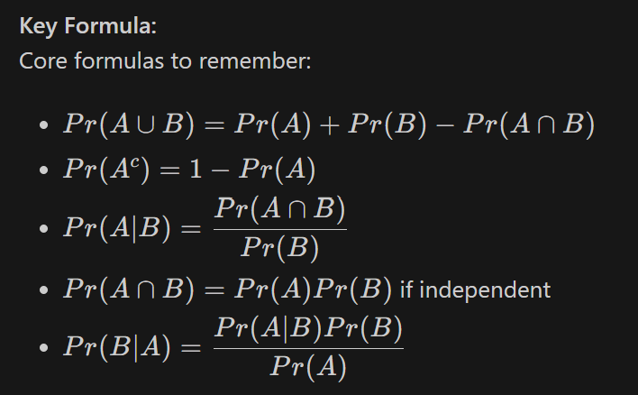
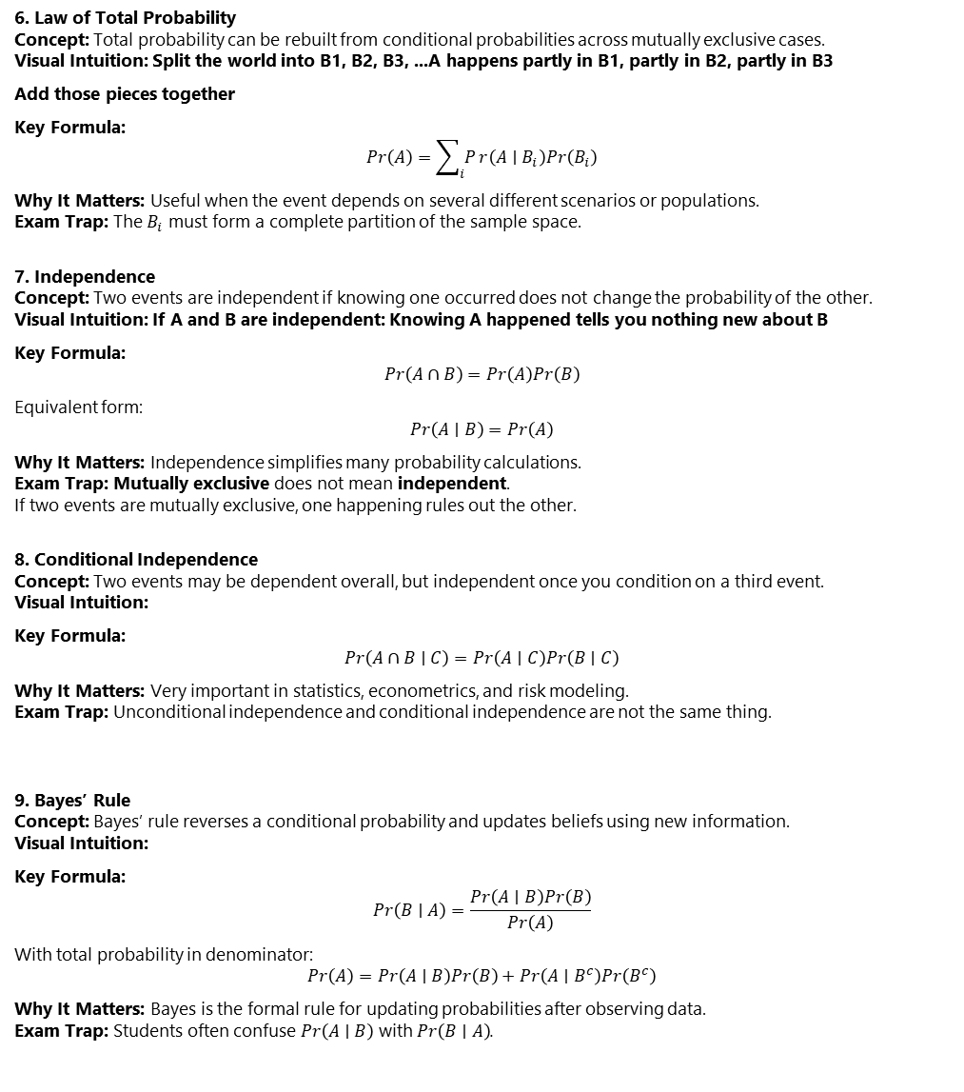
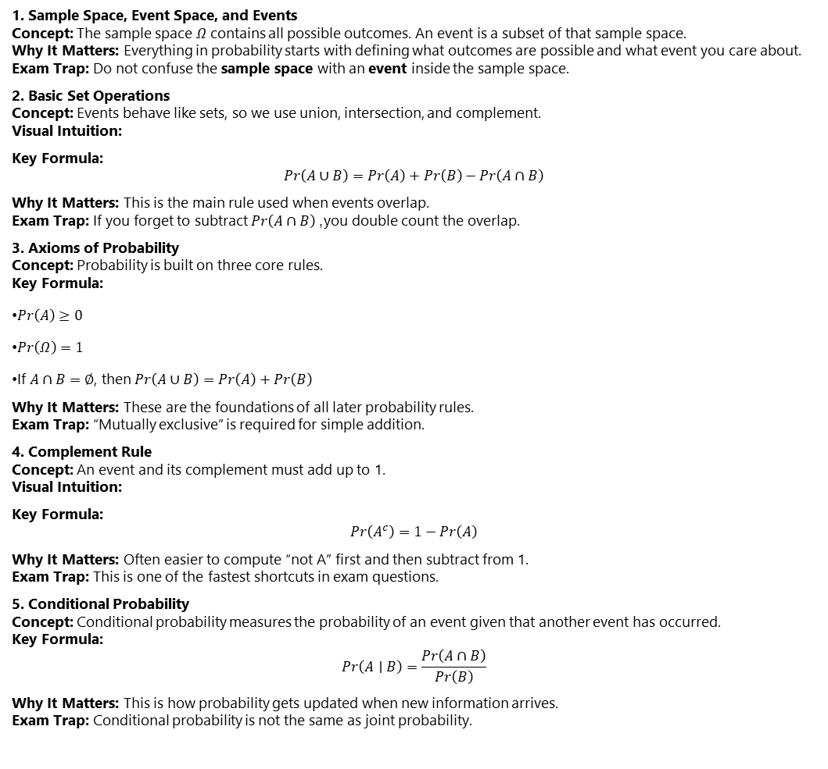
Fundamentals of Probability
6. Law of Total Probability Concept: Total probability can be rebuilt from conditional probabilities across mutually exclusive cases. Visual Intuition: Split the world into B1, B2, B3, ...A happens partly in B1, partly in B2, partly in B3
Add those pieces together
Key Formula: $$Pr\left(A\right)=\sum_{i}{P}r\left(A∣B_{i}\right)Pr\left(B_{i}\right)$$
Why It Matters: Useful when the event depends on several different scenarios or populations. Exam Trap: The $B_{i}$ must form a complete partition of the sample space.
7. Independence Concept: Two events are independent if knowing one occurred does not change the probability of the other. Visual Intuition: If A and B are independent: Knowing A happened tells you nothing new about B
Key Formula: $$Pr\left(A∩B\right)=Pr\left(A\right)Pr\left(B\right)$$
Equivalent form: $$Pr\left(A∣B\right)=Pr\left(A\right)$$
Why It Matters: Independence simplifies many probability calculations. Exam Trap: Mutually exclusive does not mean independent. If two events are mutually exclusive, one happening rules out the other.
8. Conditional Independence Concept: Two events may be dependent overall, but independent once you condition on a third event. Visual Intuition:
Key Formula: $$Pr\left(A∩B∣C\right)=Pr\left(A∣C\right)Pr\left(B∣C\right)$$
Why It Matters: Very important in statistics, econometrics, and risk modeling. Exam Trap: Unconditional independence and conditional independence are not the same thing.
9. Bayes’ Rule Concept: Bayes’ rule reverses a conditional probability and updates beliefs using new information. Visual Intuition:
Key Formula: $$Pr\left(B∣A\right)=\frac{Pr\left(A∣B\right)Pr\left(B\right)}{Pr\left(A\right)}$$
With total probability in denominator: $$Pr\left(A\right)=Pr\left(A∣B\right)Pr\left(B\right)+Pr\left(A∣B^{c}\right)Pr\left(B^{c}\right)$$
Why It Matters: Bayes is the formal rule for updating probabilities after observing data. Exam Trap: Students often confuse $Pr\left(A∣B\right)$ with $Pr\left(B∣A\right)$.
1. Sample Space, Event Space, and Events Concept: The sample space $Ω$ contains all possible outcomes. An event is a subset of that sample space. Why It Matters: Everything in probability starts with defining what outcomes are possible and what event you care about. Exam Trap: Do not confuse the sample space with an event inside the sample space.
2. Basic Set Operations Concept: Events behave like sets, so we use union, intersection, and complement. Visual Intuition:
Key Formula: $$Pr\left(A∪B\right)=Pr\left(A\right)+Pr\left(B\right)−Pr\left(A∩B\right)$$
Why It Matters: This is the main rule used when events overlap. Exam Trap: If you forget to subtract $Pr\left(A∩B\right)$, you double count the overlap.
3. Axioms of Probability Concept: Probability is built on three core rules. Key Formula:
$Pr\left(A\right)≥0$
$Pr\left(Ω\right)=1$
If $A∩B=∅$, then $Pr\left(A∪B\right)=Pr\left(A\right)+Pr\left(B\right)$
Why It Matters: These are the foundations of all later probability rules. Exam Trap: “Mutually exclusive” is required for simple addition.
4. Complement Rule Concept: An event and its complement must add up to 1. Visual Intuition:
Key Formula: $$Pr\left(A^{c}\right)=1−Pr\left(A\right)$$
Why It Matters: Often easier to compute “not A” first and then subtract from 1. Exam Trap: This is one of the fastest shortcuts in exam questions.
5. Conditional Probability Concept: Conditional probability measures the probability of an event given that another event has occurred. Key Formula: $$Pr\left(A∣B\right)=\frac{Pr\left(A∩B\right)}{Pr\left(B\right)}$$
Why It Matters: This is how probability gets updated when new information arrives. Exam Trap: Conditional probability is not the same as joint probability.

Slide 15
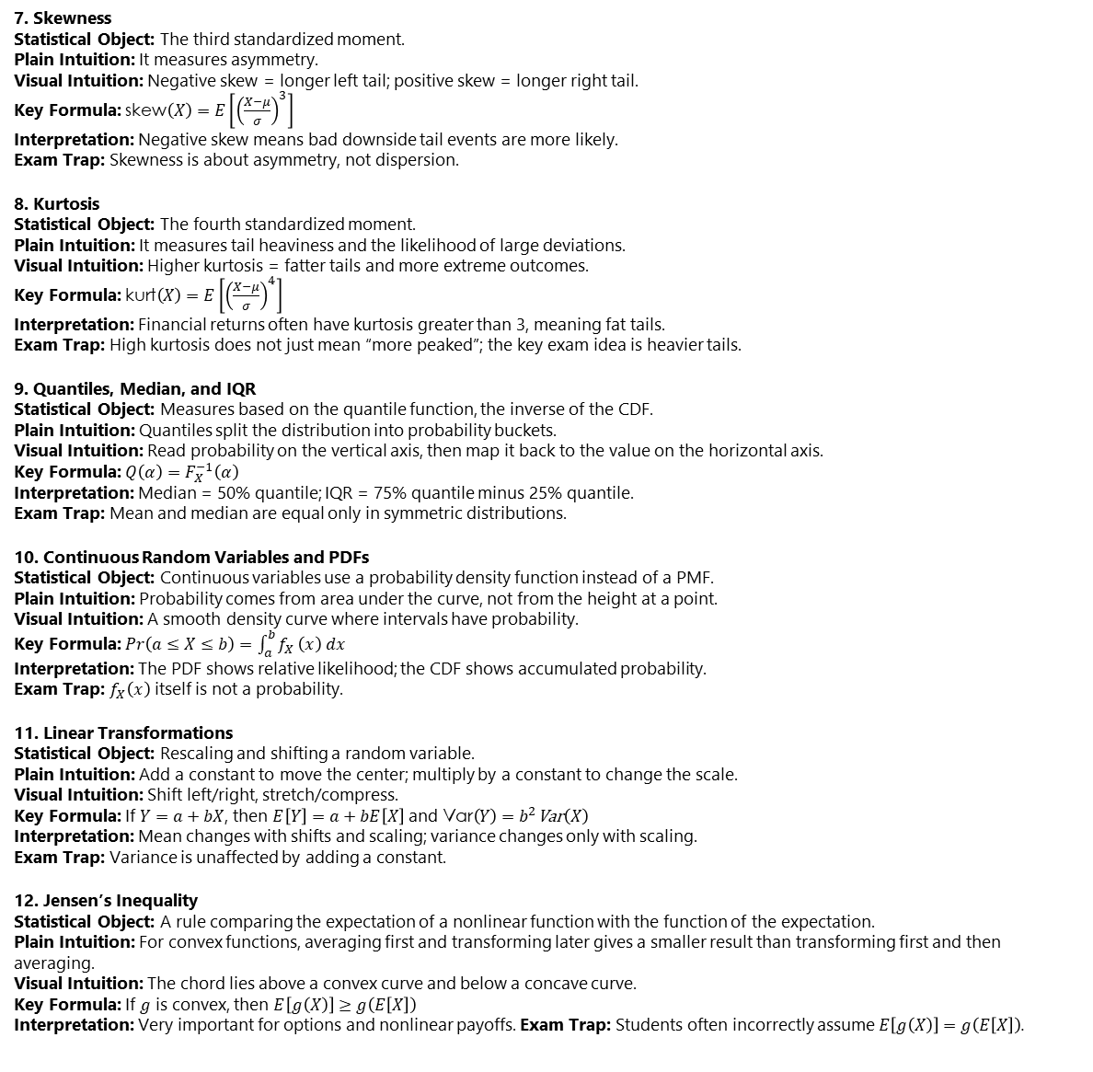

Random Variables
7. Skewness Statistical Object: The third standardized moment. Plain Intuition: It measures asymmetry. Visual Intuition: Negative skew = longer left tail; positive skew = longer right tail. Key Formula: $\text{skew}\left(X\right)=E\left[{\left(\frac{X−μ}{σ}\right)}^{3}\right]$ Interpretation: Negative skew means bad downside tail events are more likely. Exam Trap: Skewness is about asymmetry, not dispersion.
8. Kurtosis Statistical Object: The fourth standardized moment. Plain Intuition: It measures tail heaviness and the likelihood of large deviations. Visual Intuition: Higher kurtosis = fatter tails and more extreme outcomes. Key Formula: $\text{kurt}\left(X\right)=E\left[{\left(\frac{X−μ}{σ}\right)}^{4}\right]$ Interpretation: Financial returns often have kurtosis greater than 3, meaning fat tails. Exam Trap: High kurtosis does not just mean “more peaked”; the key exam idea is heavier tails.
9. Quantiles, Median, and IQR Statistical Object: Measures based on the quantile function, the inverse of the CDF. Plain Intuition: Quantiles split the distribution into probability buckets. Visual Intuition: Read probability on the vertical axis, then map it back to the value on the horizontal axis. Key Formula: $Q\left(α\right)=F_{X}^{−1}\left(α\right)$ Interpretation: Median = 50% quantile; IQR = 75% quantile minus 25% quantile. Exam Trap: Mean and median are equal only in symmetric distributions.
10. Continuous Random Variables and PDFs Statistical Object: Continuous variables use a probability density function instead of a PMF. Plain Intuition: Probability comes from area under the curve, not from the height at a point. Visual Intuition: A smooth density curve where intervals have probability. Key Formula: $Pr\left(a≤X≤b\right)=\int_{a}^{b}{f_{X}}\left(x\right) dx$ Interpretation: The PDF shows relative likelihood; the CDF shows accumulated probability. Exam Trap: $f_{X}\left(x\right)$ itself is not a probability.
11. Linear Transformations Statistical Object: Rescaling and shifting a random variable. Plain Intuition: Add a constant to move the center; multiply by a constant to change the scale. Visual Intuition: Shift left/right, stretch/compress. Key Formula: If $Y=a+bX$, then $E\left[Y\right]=a+bE\left[X\right]$ and $\text{Var}\left(Y\right)=b^{2}\text{Var}\left(X\right)$ Interpretation: Mean changes with shifts and scaling; variance changes only with scaling. Exam Trap: Variance is unaffected by adding a constant.
12. Jensen’s Inequality Statistical Object: A rule comparing the expectation of a nonlinear function with the function of the expectation. Plain Intuition: For convex functions, averaging first and transforming later gives a smaller result than transforming first and then averaging. Visual Intuition: The chord lies above a convex curve and below a concave curve. Key Formula: If $g$ is convex, then $E\left[g\left(X\right)\right]≥g\left(E\left[X\right]\right)$ Interpretation: Very important for options and nonlinear payoffs. Exam Trap: Students often incorrectly assume $E\left[g\left(X\right)\right]=g\left(E\left[X\right]\right)$.
1. Random Variable Statistical Object: A function that maps an outcome to a numerical value. Plain Intuition: It converts uncertainty into numbers. Visual Intuition: Outcome $ω→$ number $x$. Key Formula: $x=X\left(ω\right)$ Interpretation: $X$ is the random variable; $x$ is one realized value. Exam Trap: Do not confuse the random variable with its realization.
2. Discrete vs Continuous Random Variables Statistical Object: Two main classes of random variables. Plain Intuition: Discrete variables jump across distinct values; continuous variables can take any value in an interval. Visual Intuition: Discrete = bars; continuous = smooth curve. Key Formula: None. Interpretation: Defaults and dice are usually discrete; returns and yields are usually modeled as continuous. Exam Trap: A continuous variable has probability 0 at any single point.
3. Probability Mass Function (PMF) Statistical Object: A function giving the probability of each value for a discrete random variable. Plain Intuition: It tells you the chance of each exact outcome. Visual Intuition: A bar chart over possible values. Key Formula: $f_{X}\left(x\right)=Pr\left(X=x\right)$ Interpretation: Use PMF for exact probabilities in discrete settings. Exam Trap: PMF is not used for continuous random variables.
4. Cumulative Distribution Function (CDF) Statistical Object: A function giving the probability that $X$ is less than or equal to $x$. Plain Intuition: It accumulates probability from left to right. Visual Intuition: An increasing staircase or smooth S-shaped curve. Key Formula: $F_{X}\left(x\right)=Pr\left(X≤x\right)$ Interpretation: The CDF tells you how much probability has already accumulated up to $x$. Exam Trap: CDF is cumulative probability, not point probability.
5. Expectation Statistical Object: The probability-weighted average of a random variable. Plain Intuition: It is the long-run average outcome. Visual Intuition: A balancing point of the distribution. Key Formula: $E\left[X\right]=\sum{x} Pr\left(X=x\right)$ for discrete variables, and $E\left[X\right]=\int{x}f_{X}\left(x\right) dx$ for continuous variables. Interpretation: Expected value summarizes the central level of the distribution. Exam Trap: In general, $E\left[g\left(X\right)\right]≠g\left(E\left[X\right]\right)$ for nonlinear functions.
6. Moments Statistical Object: Expected values of functions of a random variable used to summarize its shape. Plain Intuition: Moments describe center, spread, asymmetry, and tail heaviness. Visual Intuition: Mean shifts location; variance widens or narrows; skew tilts; kurtosis fattens tails. Key Formula: $μ=E\left[X\right]$, $σ^{2}=E\left[\left(X−μ{\left.)\right.}^{2}\right]\right.$ Interpretation: Moments are the main summary tools in finance and risk management. Exam Trap: Variance is in squared units; standard deviation is usually easier to interpret.

Slide 16
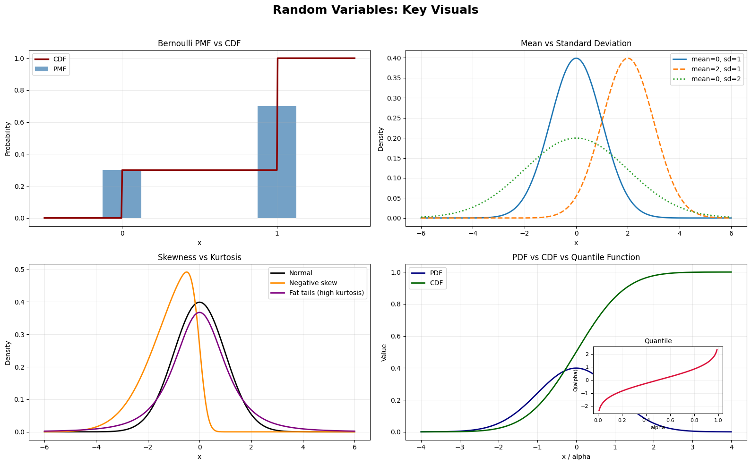

Slide 17
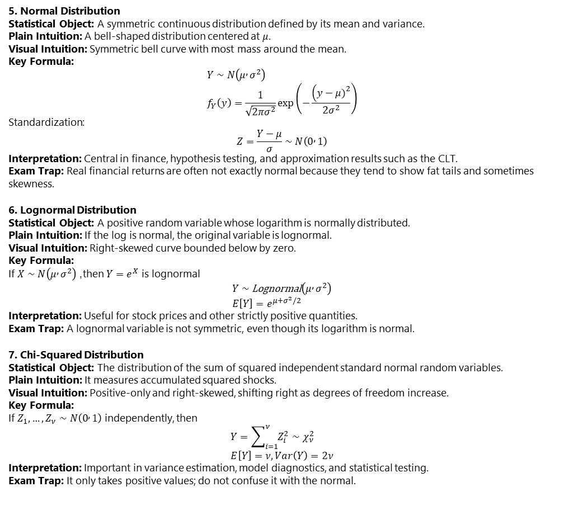
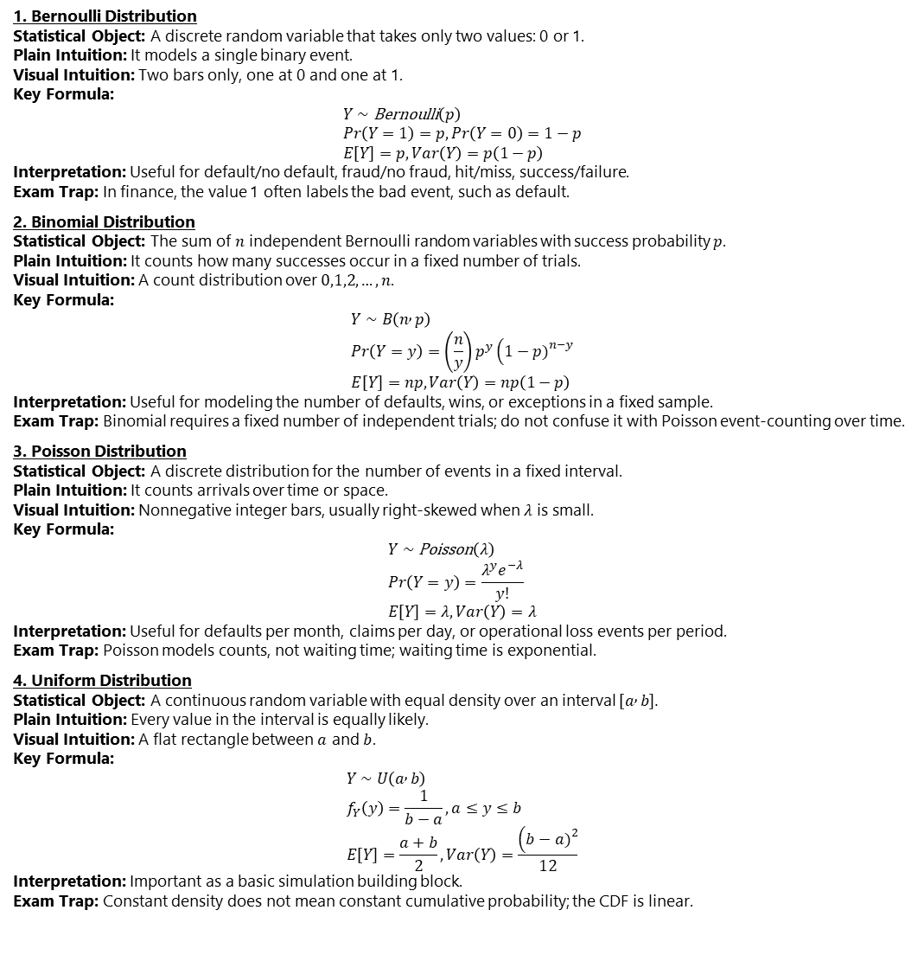
Common Univariate Random Variables
5. Normal Distribution Statistical Object: A symmetric continuous distribution defined by its mean and variance. Plain Intuition: A bell-shaped distribution centered at $μ$. Visual Intuition: Symmetric bell curve with most mass around the mean. Key Formula: $$Y∼N\left(μ , σ^{2}\right) \\ f_{Y}\left(y\right)=\frac{1}{\sqrt{2πσ^{2}}}\exp\left(−\frac{\left(y−μ{\left.)\right.}^{2}\right.}{2σ^{2}}\right)$$ Standardization: $$Z=\frac{Y−μ}{σ}∼N\left(0 , 1\right)$$ Interpretation: Central in finance, hypothesis testing, and approximation results such as the CLT. Exam Trap: Real financial returns are often not exactly normal because they tend to show fat tails and sometimes skewness.
6. Lognormal Distribution Statistical Object: A positive random variable whose logarithm is normally distributed. Plain Intuition: If the log is normal, the original variable is lognormal. Visual Intuition: Right-skewed curve bounded below by zero. Key Formula: If $X∼N\left(μ , σ^{2}\right)$, then $Y=e^{X}$ is lognormal $$Y∼\text{Lognormal}\left(μ , σ^{2}\right) \\ E\left[Y\right]=e^{μ+σ^{2}/2}$$ Interpretation: Useful for stock prices and other strictly positive quantities. Exam Trap: A lognormal variable is not symmetric, even though its logarithm is normal.
7. Chi-Squared Distribution Statistical Object: The distribution of the sum of squared independent standard normal random variables. Plain Intuition: It measures accumulated squared shocks. Visual Intuition: Positive-only and right-skewed, shifting right as degrees of freedom increase. Key Formula: If $Z_{1},…,Z_{ν}∼N\left(0 , 1\right)$ independently, then $$Y=\sum_{i=1}^{ν}{Z_{i}^{2}}∼χ_{ν}^{2} \\ E\left[Y\right]=ν, Var\left(Y\right)=2ν$$ Interpretation: Important in variance estimation, model diagnostics, and statistical testing. Exam Trap: It only takes positive values; do not confuse it with the normal.
1. Bernoulli Distribution Statistical Object: A discrete random variable that takes only two values: 0 or 1. Plain Intuition: It models a single binary event. Visual Intuition: Two bars only, one at 0 and one at 1. Key Formula: $$Y∼\text{Bernoulli}\left(p\right) \\ Pr\left(Y=1\right)=p, Pr\left(Y=0\right)=1−p \\ E\left[Y\right]=p, Var\left(Y\right)=p\left(1−p\right)$$ Interpretation: Useful for default/no default, fraud/no fraud, hit/miss, success/failure. Exam Trap: In finance, the value 1 often labels the bad event, such as default.
2. Binomial Distribution Statistical Object: The sum of $n$ independent Bernoulli random variables with success probability $p$. Plain Intuition: It counts how many successes occur in a fixed number of trials. Visual Intuition: A count distribution over $0,1,2,…,n$. Key Formula: $$Y∼B\left(n , p\right) \\ Pr\left(Y=y\right)=\left(\frac{n}{y}\right)p^{y}\left(1−p{\left.)\right.}^{n−y}\right. \\ E\left[Y\right]=np, Var\left(Y\right)=np\left(1−p\right)$$ Interpretation: Useful for modeling the number of defaults, wins, or exceptions in a fixed sample. Exam Trap: Binomial requires a fixed number of independent trials; do not confuse it with Poisson event-counting over time.
3. Poisson Distribution Statistical Object: A discrete distribution for the number of events in a fixed interval. Plain Intuition: It counts arrivals over time or space. Visual Intuition: Nonnegative integer bars, usually right-skewed when $λ$ is small. Key Formula: $$Y∼\text{Poisson}\left(λ\right) \\ Pr\left(Y=y\right)=\frac{λ^{y}e^{−λ}}{y!} \\ E\left[Y\right]=λ, Var\left(Y\right)=λ$$ Interpretation: Useful for defaults per month, claims per day, or operational loss events per period. Exam Trap: Poisson models counts, not waiting time; waiting time is exponential.
4. Uniform Distribution Statistical Object: A continuous random variable with equal density over an interval $\left[a , b\right]$. Plain Intuition: Every value in the interval is equally likely. Visual Intuition: A flat rectangle between $a$ and $b$. Key Formula: $$Y∼U\left(a , b\right) \\ f_{Y}\left(y\right)=\frac{1}{b−a}, a≤y≤b \\ E\left[Y\right]=\frac{a+b}{2}, Var\left(Y\right)=\frac{\left(b−a{\left.)\right.}^{2}\right.}{12}$$ Interpretation: Important as a basic simulation building block. Exam Trap: Constant density does not mean constant cumulative probability; the CDF is linear.

Slide 18
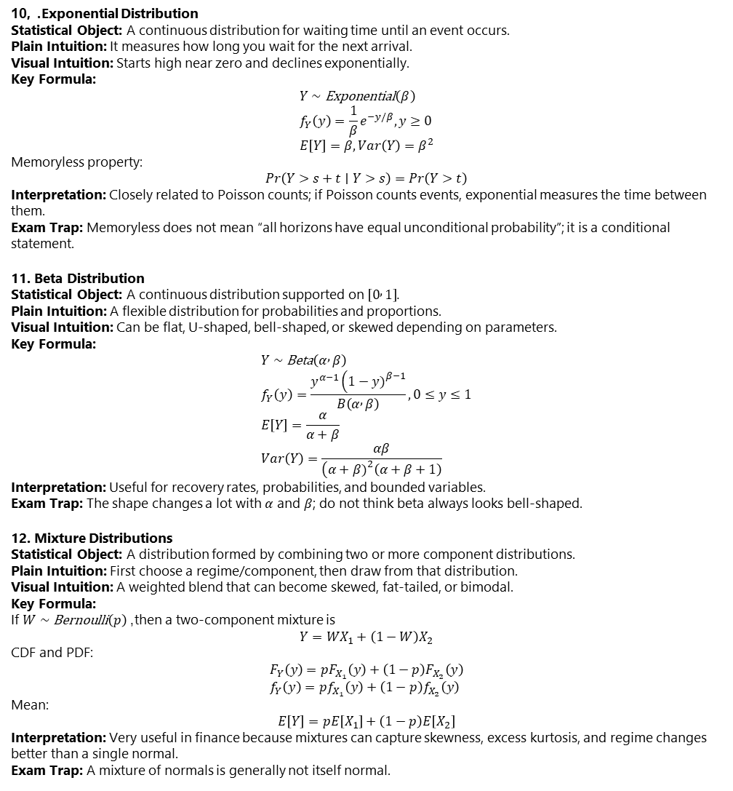
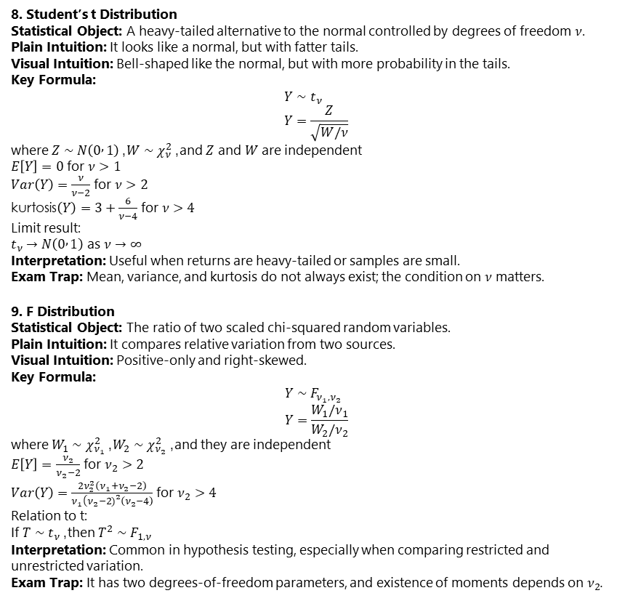
Common Univariate Random Variables
10, . Exponential Distribution Statistical Object: A continuous distribution for waiting time until an event occurs. Plain Intuition: It measures how long you wait for the next arrival. Visual Intuition: Starts high near zero and declines exponentially. Key Formula: $$Y∼\text{Exponential}\left(β\right) \\ f_{Y}\left(y\right)=\frac{1}{β}e^{−y/β}, y≥0 \\ E\left[Y\right]=β, Var\left(Y\right)=β^{2}$$ Memoryless property: $$Pr\left(Y>s+t∣Y>s\right)=Pr\left(Y>t\right)$$ Interpretation: Closely related to Poisson counts; if Poisson counts events, exponential measures the time between them. Exam Trap: Memoryless does not mean “all horizons have equal unconditional probability”; it is a conditional statement.
11. Beta Distribution Statistical Object: A continuous distribution supported on $\left[0 , 1\right]$. Plain Intuition: A flexible distribution for probabilities and proportions. Visual Intuition: Can be flat, U-shaped, bell-shaped, or skewed depending on parameters. Key Formula: $$Y∼\text{Beta}\left(α , β\right) \\ f_{Y}\left(y\right)=\frac{y^{α−1}\left(1−y{\left.)\right.}^{β−1}\right.}{B\left(α , β\right)}, 0≤y≤1 \\ E\left[Y\right]=\frac{α}{α+β} \\ Var\left(Y\right)=\frac{αβ}{\left(α+β{\left.)\right.}^{2}\left(α+β+1\right)\right.}$$ Interpretation: Useful for recovery rates, probabilities, and bounded variables. Exam Trap: The shape changes a lot with $α$ and $β$; do not think beta always looks bell-shaped.
12. Mixture Distributions Statistical Object: A distribution formed by combining two or more component distributions. Plain Intuition: First choose a regime/component, then draw from that distribution. Visual Intuition: A weighted blend that can become skewed, fat-tailed, or bimodal. Key Formula: If $W∼\text{Bernoulli}\left(p\right)$, then a two-component mixture is $$Y=WX_{1}+\left(1−W\right)X_{2}$$ CDF and PDF: $$F_{Y}\left(y\right)=pF_{X_{1}}\left(y\right)+\left(1−p\right)F_{X_{2}}\left(y\right) \\ f_{Y}\left(y\right)=pf_{X_{1}}\left(y\right)+\left(1−p\right)f_{X_{2}}\left(y\right)$$ Mean: $$E\left[Y\right]=pE\left[X_{1}\right]+\left(1−p\right)E\left[X_{2}\right]$$ Interpretation: Very useful in finance because mixtures can capture skewness, excess kurtosis, and regime changes better than a single normal. Exam Trap: A mixture of normals is generally not itself normal.
8. Student’s t Distribution Statistical Object: A heavy-tailed alternative to the normal controlled by degrees of freedom $ν$. Plain Intuition: It looks like a normal, but with fatter tails. Visual Intuition: Bell-shaped like the normal, but with more probability in the tails. Key Formula: $$Y∼t_{ν} \\ Y=\frac{Z}{\sqrt{W/ν}}$$ where $Z∼N\left(0 , 1\right)$, $W∼χ_{ν}^{2}$, and $Z$ and $W$ are independent $E\left[Y\right]=0$ for $ν>1$ $Var\left(Y\right)=\frac{ν}{ν−2}$ for $ν>2$ $\text{kurtosis}\left(Y\right)=3+\frac{6}{ν−4}$ for $ν>4$ Limit result: $t_{ν}→N\left(0 , 1\right)$ as $ν→∞$ Interpretation: Useful when returns are heavy-tailed or samples are small. Exam Trap: Mean, variance, and kurtosis do not always exist; the condition on $ν$ matters.
9. F Distribution Statistical Object: The ratio of two scaled chi-squared random variables. Plain Intuition: It compares relative variation from two sources. Visual Intuition: Positive-only and right-skewed. Key Formula: $$Y∼F_{ν_{1},ν_{2}} \\ Y=\frac{W_{1}/ν_{1}}{W_{2}/ν_{2}}$$ where $W_{1}∼χ_{ν_{1}}^{2}$, $W_{2}∼χ_{ν_{2}}^{2}$, and they are independent $E\left[Y\right]=\frac{ν_{2}}{ν_{2}−2}$ for $ν_{2}>2$ $Var\left(Y\right)=\frac{2ν_{2}^{2}\left(ν_{1}+ν_{2}−2\right)}{ν_{1}\left(ν_{2}−2{\left.)\right.}^{2}\left(ν_{2}−4\right)\right.}$ for $ν_{2}>4$ Relation to t: If $T∼t_{ν}$, then $T^{2}∼F_{1,ν}$ Interpretation: Common in hypothesis testing, especially when comparing restricted and unrestricted variation. Exam Trap: It has two degrees-of-freedom parameters, and existence of moments depends on $ν_{2}$.

Slide 19
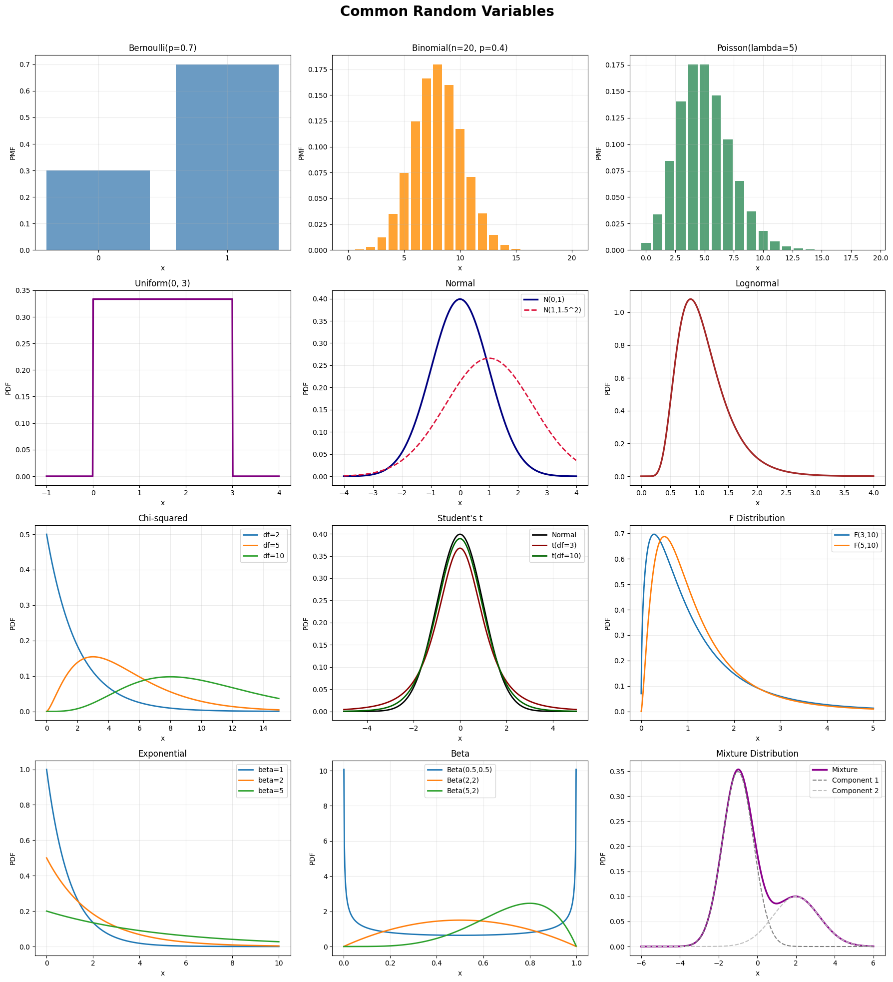

Slide 20
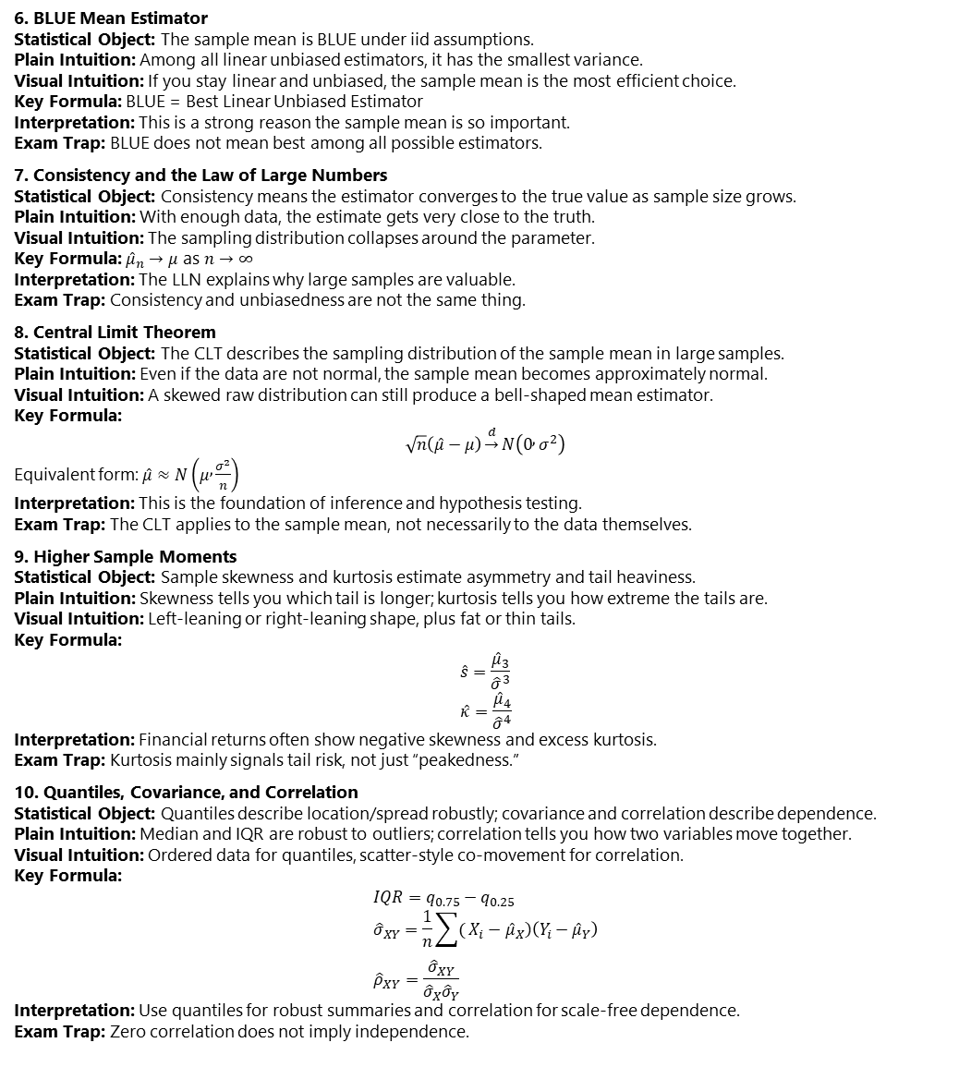
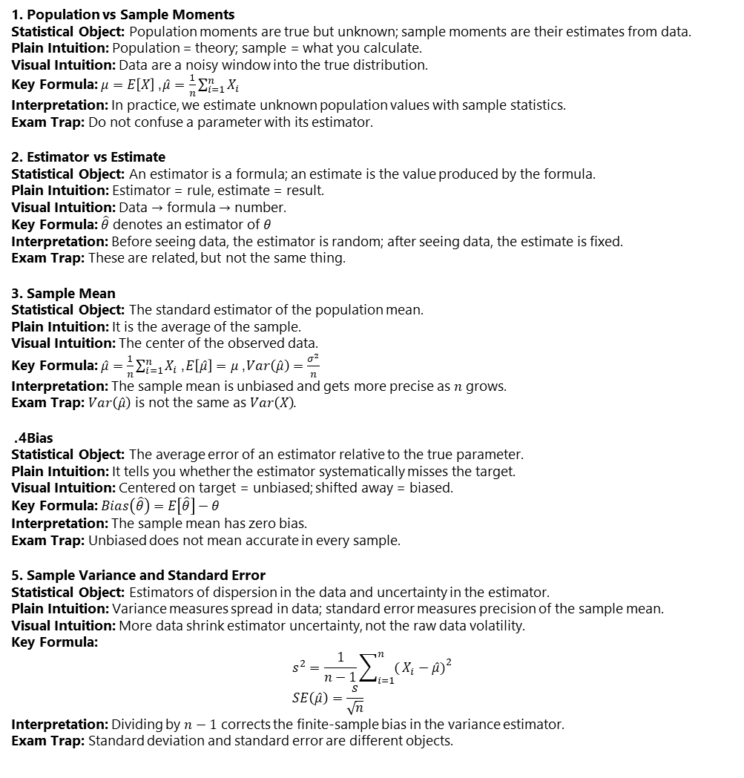
Sample Moments
6. BLUE Mean Estimator Statistical Object: The sample mean is BLUE under iid assumptions. Plain Intuition: Among all linear unbiased estimators, it has the smallest variance. Visual Intuition: If you stay linear and unbiased, the sample mean is the most efficient choice. Key Formula: BLUE = Best Linear Unbiased Estimator Interpretation: This is a strong reason the sample mean is so important. Exam Trap: BLUE does not mean best among all possible estimators.
7. Consistency and the Law of Large Numbers Statistical Object: Consistency means the estimator converges to the true value as sample size grows. Plain Intuition: With enough data, the estimate gets very close to the truth. Visual Intuition: The sampling distribution collapses around the parameter. Key Formula: ${\hat{μ}}_{n}→μ$ as $n→∞$ Interpretation: The LLN explains why large samples are valuable. Exam Trap: Consistency and unbiasedness are not the same thing.
8. Central Limit Theorem Statistical Object: The CLT describes the sampling distribution of the sample mean in large samples. Plain Intuition: Even if the data are not normal, the sample mean becomes approximately normal. Visual Intuition: A skewed raw distribution can still produce a bell-shaped mean estimator. Key Formula: $$\sqrt{n}\left(\hat{μ}−μ\right)\underset{→}{d}N\left(0 , σ^{2}\right)$$ Equivalent form: $\hat{μ}≈N\left(μ , \frac{σ^{2}}{n}\right)$ Interpretation: This is the foundation of inference and hypothesis testing. Exam Trap: The CLT applies to the sample mean, not necessarily to the data themselves.
9. Higher Sample Moments Statistical Object: Sample skewness and kurtosis estimate asymmetry and tail heaviness. Plain Intuition: Skewness tells you which tail is longer; kurtosis tells you how extreme the tails are. Visual Intuition: Left-leaning or right-leaning shape, plus fat or thin tails. Key Formula: $$\hat{s}=\frac{{\hat{μ}}_{3}}{{\hat{σ}}^{3}} \\ \hat{κ}=\frac{{\hat{μ}}_{4}}{{\hat{σ}}^{4}}$$ Interpretation: Financial returns often show negative skewness and excess kurtosis. Exam Trap: Kurtosis mainly signals tail risk, not just “peakedness.”
10. Quantiles, Covariance, and Correlation Statistical Object: Quantiles describe location/spread robustly; covariance and correlation describe dependence. Plain Intuition: Median and IQR are robust to outliers; correlation tells you how two variables move together. Visual Intuition: Ordered data for quantiles, scatter-style co-movement for correlation. Key Formula: $$IQR=q_{0.75}−q_{0.25} \\ {\hat{σ}}_{XY}=\frac{1}{n}\sum{(}\left.X_{i}−{\hat{μ}}_{X}\right)\left(Y_{i}−{\hat{μ}}_{Y}\right) \\ {\hat{ρ}}_{XY}=\frac{{\hat{σ}}_{XY}}{{\hat{σ}}_{X}{\hat{σ}}_{Y}}$$ Interpretation: Use quantiles for robust summaries and correlation for scale-free dependence. Exam Trap: Zero correlation does not imply independence.
1. Population vs Sample Moments Statistical Object: Population moments are true but unknown; sample moments are their estimates from data. Plain Intuition: Population = theory; sample = what you calculate. Visual Intuition: Data are a noisy window into the true distribution. Key Formula: $μ=E\left[X\right]$, $\hat{μ}=\frac{1}{n}\sum_{i=1}^{n}{X_{i}}$ Interpretation: In practice, we estimate unknown population values with sample statistics. Exam Trap: Do not confuse a parameter with its estimator.
2. Estimator vs Estimate Statistical Object: An estimator is a formula; an estimate is the value produced by the formula. Plain Intuition: Estimator = rule, estimate = result. Visual Intuition: Data $→$ formula $→$ number. Key Formula: $\hat{θ}$ denotes an estimator of $θ$ Interpretation: Before seeing data, the estimator is random; after seeing data, the estimate is fixed. Exam Trap: These are related, but not the same thing.
3. Sample Mean Statistical Object: The standard estimator of the population mean. Plain Intuition: It is the average of the sample. Visual Intuition: The center of the observed data. Key Formula: $\hat{μ}=\frac{1}{n}\sum_{i=1}^{n}{X_{i}}$, $E\left[\hat{μ}\right]=μ$, $Var\left(\hat{μ}\right)=\frac{σ^{2}}{n}$ Interpretation: The sample mean is unbiased and gets more precise as $n$ grows. Exam Trap: $Var\left(\hat{μ}\right)$ is not the same as $Var\left(X\right)$.
4. Bias Statistical Object: The average error of an estimator relative to the true parameter. Plain Intuition: It tells you whether the estimator systematically misses the target. Visual Intuition: Centered on target = unbiased; shifted away = biased. Key Formula: $Bias\left(\hat{θ}\right)=E\left[\hat{θ}\right]−θ$ Interpretation: The sample mean has zero bias. Exam Trap: Unbiased does not mean accurate in every sample.
5. Sample Variance and Standard Error Statistical Object: Estimators of dispersion in the data and uncertainty in the estimator. Plain Intuition: Variance measures spread in data; standard error measures precision of the sample mean. Visual Intuition: More data shrink estimator uncertainty, not the raw data volatility. Key Formula: $$s^{2}=\frac{1}{n−1}\sum_{i=1}^{n}{(}\left.X_{i}−\hat{μ}{\left.)\right.}^{2}\right. \\ SE\left(\hat{μ}\right)=\frac{s}{\sqrt{n}}$$ Interpretation: Dividing by $n−1$ corrects the finite-sample bias in the variance estimator. Exam Trap: Standard deviation and standard error are different objects.

Slide 21
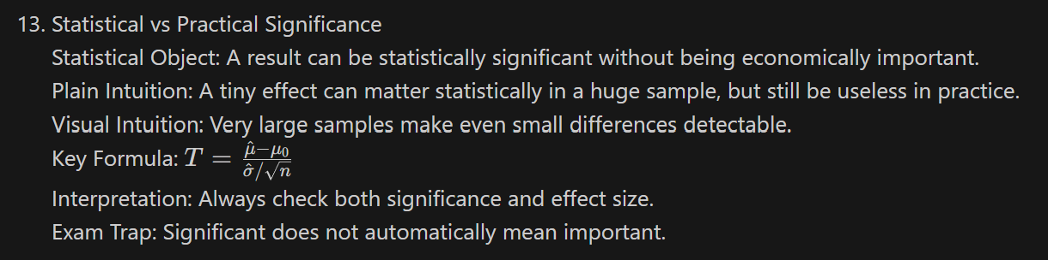
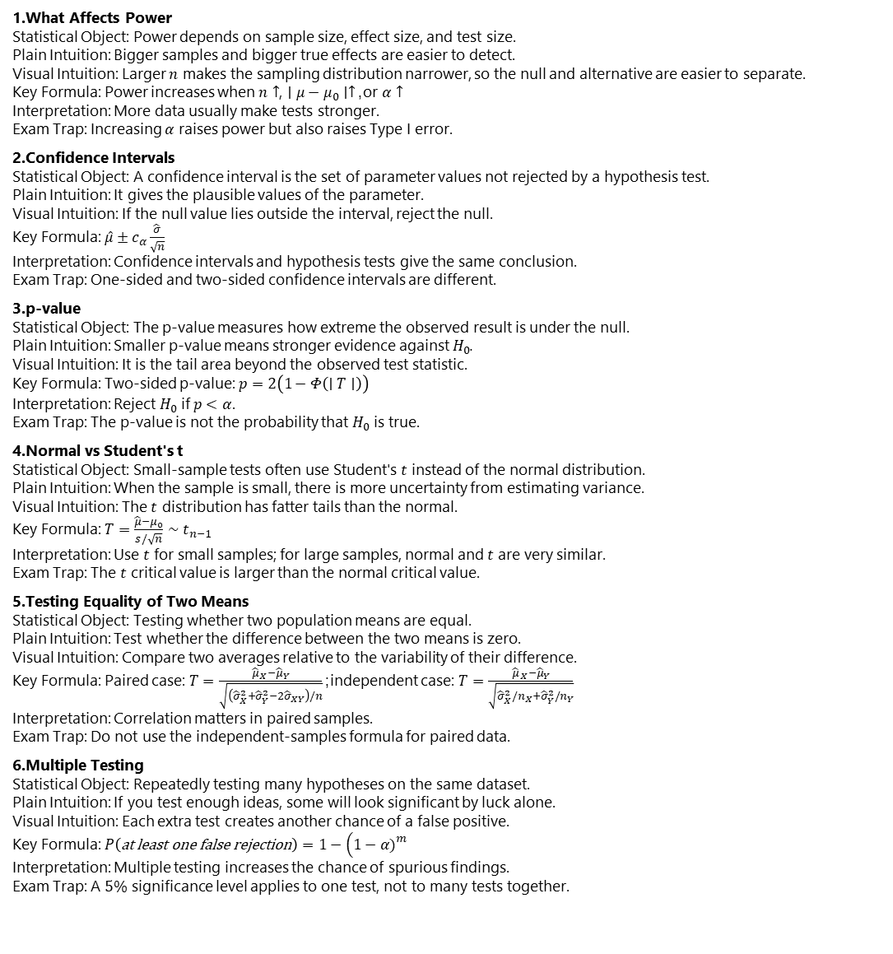

Hypotjesis testing
What Affects Power Statistical Object: Power depends on sample size, effect size, and test size. Plain Intuition: Bigger samples and bigger true effects are easier to detect. Visual Intuition: Larger $n$ makes the sampling distribution narrower, so the null and alternative are easier to separate. Key Formula: Power increases when $n↑$, $∣μ−μ_{0}∣↑$, or $α↑$ Interpretation: More data usually make tests stronger. Exam Trap: Increasing $α$ raises power but also raises Type I error.
Confidence Intervals Statistical Object: A confidence interval is the set of parameter values not rejected by a hypothesis test. Plain Intuition: It gives the plausible values of the parameter. Visual Intuition: If the null value lies outside the interval, reject the null. Key Formula: $\hat{μ}±c_{α}\frac{\hat{σ}}{\sqrt{n}}$ Interpretation: Confidence intervals and hypothesis tests give the same conclusion. Exam Trap: One-sided and two-sided confidence intervals are different.
p-value Statistical Object: The p-value measures how extreme the observed result is under the null. Plain Intuition: Smaller p-value means stronger evidence against $H_{0}$. Visual Intuition: It is the tail area beyond the observed test statistic. Key Formula: Two-sided p-value: $p=2\left(1−Φ\left(∣T∣\right)\right)$ Interpretation: Reject $H_{0}$ if $p<α$. Exam Trap: The p-value is not the probability that $H_{0}$ is true.
Normal vs Student's t Statistical Object: Small-sample tests often use Student's $t$ instead of the normal distribution. Plain Intuition: When the sample is small, there is more uncertainty from estimating variance. Visual Intuition: The $t$ distribution has fatter tails than the normal. Key Formula: $T=\frac{\hat{μ}−μ_{0}}{s/\sqrt{n}}∼t_{n−1}$ Interpretation: Use $t$ for small samples; for large samples, normal and $t$ are very similar. Exam Trap: The $t$ critical value is larger than the normal critical value.
Testing Equality of Two Means Statistical Object: Testing whether two population means are equal. Plain Intuition: Test whether the difference between the two means is zero. Visual Intuition: Compare two averages relative to the variability of their difference. Key Formula: Paired case: $T=\frac{{\hat{μ}}_{X}−{\hat{μ}}_{Y}}{\sqrt{\left({\hat{σ}}_{X}^{2}+{\hat{σ}}_{Y}^{2}−2{\hat{σ}}_{XY}\right)/n}}$; independent case: $T=\frac{{\hat{μ}}_{X}−{\hat{μ}}_{Y}}{\sqrt{{\hat{σ}}_{X}^{2}/n_{X}+{\hat{σ}}_{Y}^{2}/n_{Y}}}$ Interpretation: Correlation matters in paired samples. Exam Trap: Do not use the independent-samples formula for paired data.
Multiple Testing Statistical Object: Repeatedly testing many hypotheses on the same dataset. Plain Intuition: If you test enough ideas, some will look significant by luck alone. Visual Intuition: Each extra test creates another chance of a false positive. Key Formula: $P\left(\text{at} \text{least} \text{one} \text{false} \text{rejection}\right)=1−\left(1−α{\left.)\right.}^{m}\right.$ Interpretation: Multiple testing increases the chance of spurious findings. Exam Trap: A $5\%$ significance level applies to one test, not to many tests together.
Null vs Alternative Hypothesis Statistical Object: The null hypothesis $H_{0}$ is the benchmark claim; the alternative $H_{1}$ is what we support if the data contradict $H_{0}$. Plain Intuition: $H_{0}$ = default assumption; $H_{1}$ = competing claim. Visual Intuition: Start from a distribution centered at the null value and see whether the sample result falls too far away. Key Formula: $H_{0}:μ=μ_{0}$, $H_{1}:μ≠μ_{0}$ or $H_{1}:μ>μ_{0}$ or $H_{1}:μ<μ_{0}$ Interpretation: Hypothesis testing asks whether the sample is consistent with the null. Exam Trap: Failing to reject $H_{0}$ does not mean $H_{0}$ is true.
One-Sided vs Two-Sided Test Statistical Object: The alternative can be directional or non-directional. Plain Intuition: Two-sided tests ask whether something is different; one-sided tests ask whether it is specifically bigger or smaller. Visual Intuition: Two-sided = both tails matter; one-sided = only one tail matters. Key Formula: Two-sided: $H_{1}:μ≠μ_{0}$; upper-tailed: $H_{1}:μ>μ_{0}$; lower-tailed: $H_{1}:μ<μ_{0}$ Interpretation: One-sided tests are more powerful in one direction. Exam Trap: Do not use a one-sided test unless the question is truly directional.
Test Statistic Statistical Object: The test statistic standardizes the distance between the estimate and the null value. Plain Intuition: It tells you how many standard errors the estimate is from the null. Visual Intuition: The farther from zero, the more unusual the sample is under $H_{0}$. Key Formula: $T=\frac{\hat{μ}−μ_{0}}{\hat{σ}/\sqrt{n}}$ Interpretation: Large absolute values of $T$ provide evidence against the null. Exam Trap: Use the standard error, not the standard deviation alone.
Type I Error and Size Statistical Object: A Type I error is rejecting a true null hypothesis. Plain Intuition: It is a false alarm. Visual Intuition: It is the rejection area under the null distribution. Key Formula: $P\left(\text{Type} \text{I} \text{Error}\right)=α$ Interpretation: The size $α$ is chosen before the test, usually $10\%$, $5\%$, or $1\%$. Exam Trap: $α$ is not the probability that the null is true.
Critical Value and Decision Rule Statistical Object: The critical value determines the rejection region. Plain Intuition: It is the cutoff beyond which the result is too extreme under the null. Visual Intuition: If the test statistic crosses the cutoff, reject $H_{0}$. Key Formula: Two-sided: reject if $∣T∣>c_{α}$ Interpretation: The decision depends on the test statistic, test size, and whether the test is one-sided or two-sided. Exam Trap: One-sided and two-sided tests do not use the same critical values.
Type II Error and Power Statistical Object: A Type II error is failing to reject a false null; power is the probability of correctly rejecting it. Plain Intuition: Type II = missed detection; power = ability to detect a real effect. Visual Intuition: The less overlap between the null and alternative distributions, the higher the power. Key Formula: $P\left(\text{Type} \text{II} \text{Error}\right)=β$, Power $=1−β$ Interpretation: A good test has low $β$ and high power. Exam Trap: Power is not fixed in advance like $α$.

Slide 22
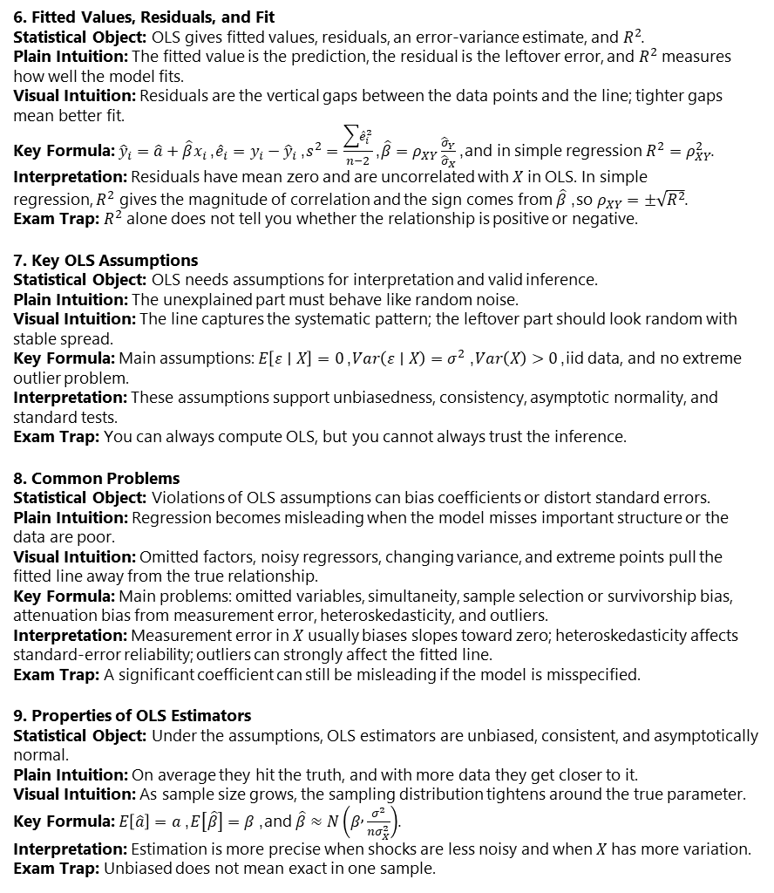
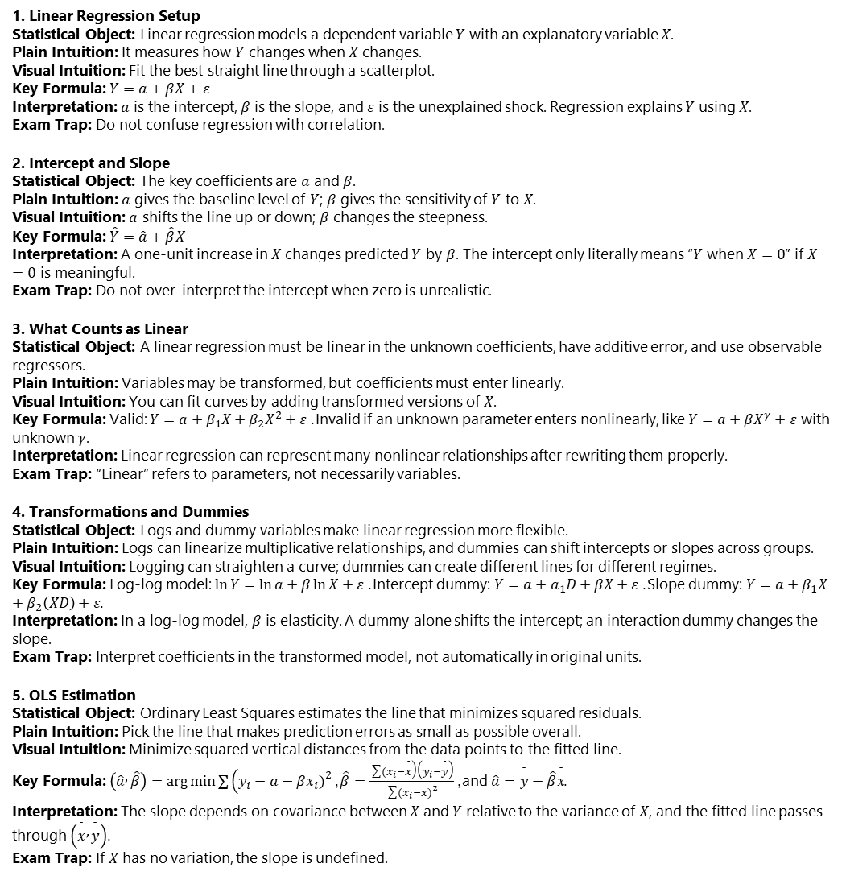
Linear Regression
1. Linear Regression Setup Statistical Object: Linear regression models a dependent variable $Y$ with an explanatory variable $X$. Plain Intuition: It measures how $Y$ changes when $X$ changes. Visual Intuition: Fit the best straight line through a scatterplot. Key Formula: $Y=a+βX+ε$ Interpretation: $a$ is the intercept, $β$ is the slope, and $ε$ is the unexplained shock. Regression explains $Y$ using $X$. Exam Trap: Do not confuse regression with correlation.
2. Intercept and Slope Statistical Object: The key coefficients are $a$ and $β$. Plain Intuition: $a$ gives the baseline level of $Y$; $β$ gives the sensitivity of $Y$ to $X$. Visual Intuition: $a$ shifts the line up or down; $β$ changes the steepness. Key Formula: $\hat{Y}=\hat{a}+\hat{β}X$ Interpretation: A one-unit increase in $X$ changes predicted $Y$ by $β$. The intercept only literally means “$Y$ when $X=0$” if $X=0$ is meaningful. Exam Trap: Do not over-interpret the intercept when zero is unrealistic.
3. What Counts as Linear Statistical Object: A linear regression must be linear in the unknown coefficients, have additive error, and use observable regressors. Plain Intuition: Variables may be transformed, but coefficients must enter linearly. Visual Intuition: You can fit curves by adding transformed versions of $X$. Key Formula: Valid: $Y=a+β_{1}X+β_{2}X^{2}+ε$. Invalid if an unknown parameter enters nonlinearly, like $Y=a+βX^{γ}+ε$ with unknown $γ$. Interpretation: Linear regression can represent many nonlinear relationships after rewriting them properly. Exam Trap: “Linear” refers to parameters, not necessarily variables.
4. Transformations and Dummies Statistical Object: Logs and dummy variables make linear regression more flexible. Plain Intuition: Logs can linearize multiplicative relationships, and dummies can shift intercepts or slopes across groups. Visual Intuition: Logging can straighten a curve; dummies can create different lines for different regimes. Key Formula: Log-log model: $\ln{Y}=\ln{a}+β\ln{X}+ε$. Intercept dummy: $Y=a+a_{1}D+βX+ε$. Slope dummy: $Y=a+β_{1}X+β_{2}\left(XD\right)+ε$. Interpretation: In a log-log model, $β$ is elasticity. A dummy alone shifts the intercept; an interaction dummy changes the slope. Exam Trap: Interpret coefficients in the transformed model, not automatically in original units.
5. OLS Estimation Statistical Object: Ordinary Least Squares estimates the line that minimizes squared residuals. Plain Intuition: Pick the line that makes prediction errors as small as possible overall. Visual Intuition: Minimize squared vertical distances from the data points to the fitted line. Key Formula: $\left(\hat{a} , \hat{β}\right)=\arg{min}{∑}\left(y_{i}−a−βx_{i}{\left.)\right.}^{2}\right.$, $\hat{β}=\frac{\sum{(}\left.x_{i}−\overset{ˉ}{x}\right)\left(y_{i}−\overset{ˉ}{y}\right)}{\sum{(}\left.x_{i}−\overset{ˉ}{x}{\left.)\right.}^{2}\right.}$, and $\hat{a}=\overset{ˉ}{y}−\hat{β}\overset{ˉ}{x}$. Interpretation: The slope depends on covariance between $X$ and $Y$ relative to the variance of $X$, and the fitted line passes through $\left(\overset{ˉ}{x} , \overset{ˉ}{y}\right)$. Exam Trap: If $X$ has no variation, the slope is undefined.
6. Fitted Values, Residuals, and Fit Statistical Object: OLS gives fitted values, residuals, an error-variance estimate, and $R^{2}$. Plain Intuition: The fitted value is the prediction, the residual is the leftover error, and $R^{2}$ measures how well the model fits. Visual Intuition: Residuals are the vertical gaps between the data points and the line; tighter gaps mean better fit. Key Formula: ${\hat{y}}_{i}=\hat{a}+\hat{β}x_{i}$, ${\hat{e}}_{i}=y_{i}−{\hat{y}}_{i}$, $s^{2}=\frac{\sum{{\hat{e}}_{i}^{2}}}{n−2}$, $\hat{β}=ρ_{XY}\frac{{\hat{σ}}_{Y}}{{\hat{σ}}_{X}}$, and in simple regression $R^{2}=ρ_{XY}^{2}$. Interpretation: Residuals have mean zero and are uncorrelated with $X$ in OLS. In simple regression, $R^{2}$ gives the magnitude of correlation and the sign comes from $\hat{β}$, so $ρ_{XY}=±\sqrt{R^{2}}$. Exam Trap: $R^{2}$ alone does not tell you whether the relationship is positive or negative.
7. Key OLS Assumptions Statistical Object: OLS needs assumptions for interpretation and valid inference. Plain Intuition: The unexplained part must behave like random noise. Visual Intuition: The line captures the systematic pattern; the leftover part should look random with stable spread. Key Formula: Main assumptions: $E\left[ε∣X\right]=0$, $Var\left(ε∣X\right)=σ^{2}$, $Var\left(X\right)>0$, iid data, and no extreme outlier problem. Interpretation: These assumptions support unbiasedness, consistency, asymptotic normality, and standard tests. Exam Trap: You can always compute OLS, but you cannot always trust the inference.
8. Common Problems Statistical Object: Violations of OLS assumptions can bias coefficients or distort standard errors. Plain Intuition: Regression becomes misleading when the model misses important structure or the data are poor. Visual Intuition: Omitted factors, noisy regressors, changing variance, and extreme points pull the fitted line away from the true relationship. Key Formula: Main problems: omitted variables, simultaneity, sample selection or survivorship bias, attenuation bias from measurement error, heteroskedasticity, and outliers. Interpretation: Measurement error in $X$ usually biases slopes toward zero; heteroskedasticity affects standard-error reliability; outliers can strongly affect the fitted line. Exam Trap: A significant coefficient can still be misleading if the model is misspecified.
9. Properties of OLS Estimators Statistical Object: Under the assumptions, OLS estimators are unbiased, consistent, and asymptotically normal. Plain Intuition: On average they hit the truth, and with more data they get closer to it. Visual Intuition: As sample size grows, the sampling distribution tightens around the true parameter. Key Formula: $E\left[\hat{a}\right]=a$, $E\left[\hat{β}\right]=β$, and $\hat{β}≈N\left(β , \frac{σ^{2}}{nσ_{X}^{2}}\right)$. Interpretation: Estimation is more precise when shocks are less noisy and when $X$ has more variation. Exam Trap: Unbiased does not mean exact in one sample.

Slide 23
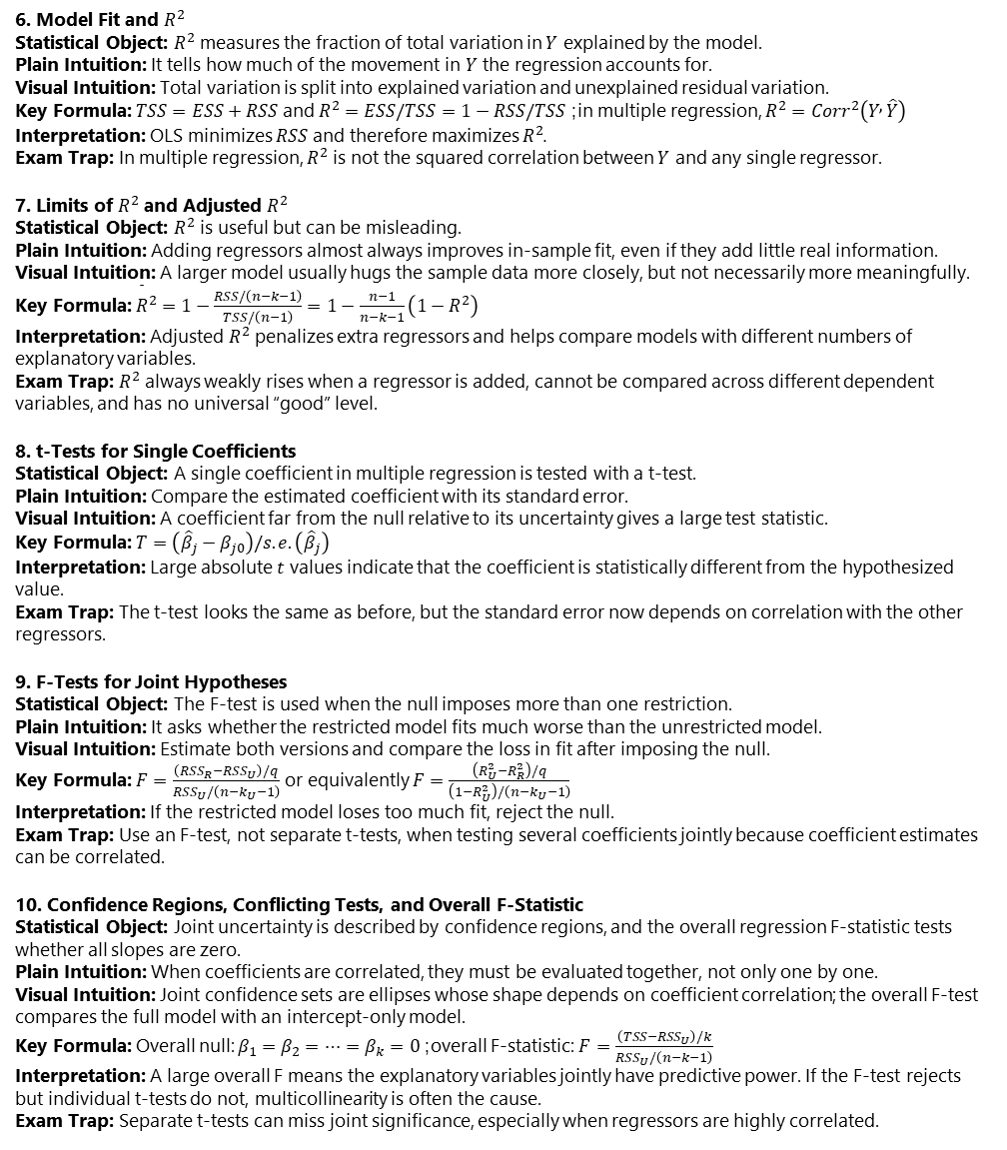
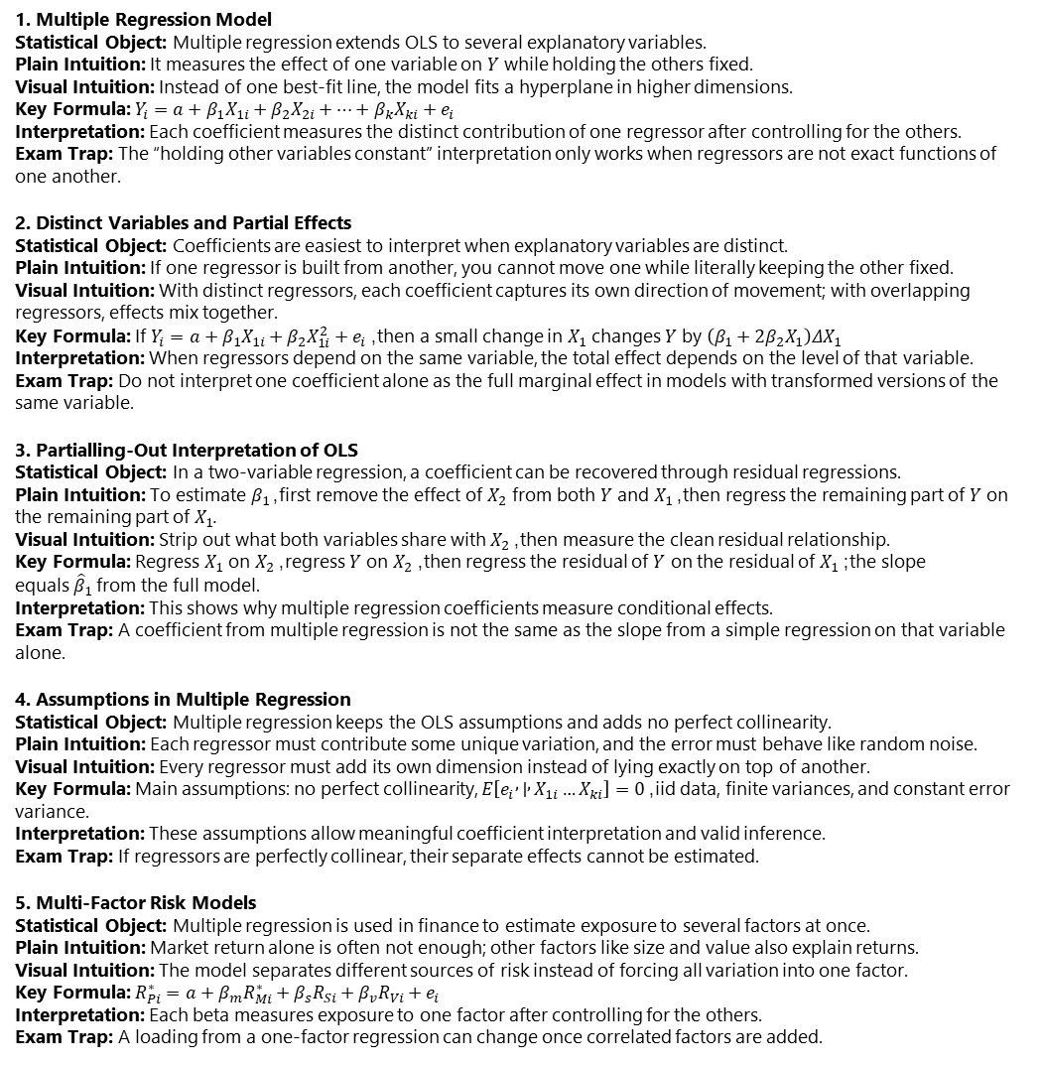
Reg. with multiple variables
6. Model Fit and $R^{2}$ Statistical Object: $R^{2}$ measures the fraction of total variation in $Y$ explained by the model. Plain Intuition: It tells how much of the movement in $Y$ the regression accounts for. Visual Intuition: Total variation is split into explained variation and unexplained residual variation. Key Formula: $TSS=ESS+RSS$ and $R^{2}=ESS/TSS=1−RSS/TSS$; in multiple regression, $R^{2}=Corr^{2}\left(Y , \hat{Y}\right)$ Interpretation: OLS minimizes $RSS$ and therefore maximizes $R^{2}$. Exam Trap: In multiple regression, $R^{2}$ is not the squared correlation between $Y$ and any single regressor.
7. Limits of $R^{2}$ and Adjusted $R^{2}$ Statistical Object: $R^{2}$ is useful but can be misleading. Plain Intuition: Adding regressors almost always improves in-sample fit, even if they add little real information. Visual Intuition: A larger model usually hugs the sample data more closely, but not necessarily more meaningfully. Key Formula: ${\overset{ˉ}{R}}^{2}=1−\frac{RSS/\left(n−k−1\right)}{TSS/\left(n−1\right)}=1−\frac{n−1}{n−k−1}\left(1−R^{2}\right)$ Interpretation: Adjusted $R^{2}$ penalizes extra regressors and helps compare models with different numbers of explanatory variables. Exam Trap: $R^{2}$ always weakly rises when a regressor is added, cannot be compared across different dependent variables, and has no universal “good” level.
8. t-Tests for Single Coefficients Statistical Object: A single coefficient in multiple regression is tested with a t-test. Plain Intuition: Compare the estimated coefficient with its standard error. Visual Intuition: A coefficient far from the null relative to its uncertainty gives a large test statistic. Key Formula: $T=\left({\hat{β}}_{j}−β_{j0}\right)/s.e.\left({\hat{β}}_{j}\right)$ Interpretation: Large absolute $t$ values indicate that the coefficient is statistically different from the hypothesized value. Exam Trap: The t-test looks the same as before, but the standard error now depends on correlation with the other regressors.
9. F-Tests for Joint Hypotheses Statistical Object: The F-test is used when the null imposes more than one restriction. Plain Intuition: It asks whether the restricted model fits much worse than the unrestricted model. Visual Intuition: Estimate both versions and compare the loss in fit after imposing the null. Key Formula: $F=\frac{\left(RSS_{R}−RSS_{U}\right)/q}{RSS_{U}/\left(n−k_{U}−1\right)}$ or equivalently $F=\frac{\left(R_{U}^{2}−R_{R}^{2}\right)/q}{\left(1−R_{U}^{2}\right)/\left(n−k_{U}−1\right)}$ Interpretation: If the restricted model loses too much fit, reject the null. Exam Trap: Use an F-test, not separate t-tests, when testing several coefficients jointly because coefficient estimates can be correlated.
10. Confidence Regions, Conflicting Tests, and Overall F-Statistic Statistical Object: Joint uncertainty is described by confidence regions, and the overall regression F-statistic tests whether all slopes are zero. Plain Intuition: When coefficients are correlated, they must be evaluated together, not only one by one. Visual Intuition: Joint confidence sets are ellipses whose shape depends on coefficient correlation; the overall F-test compares the full model with an intercept-only model. Key Formula: Overall null: $β_{1}=β_{2}=⋯=β_{k}=0$; overall F-statistic: $F=\frac{\left(TSS−RSS_{U}\right)/k}{RSS_{U}/\left(n−k−1\right)}$ Interpretation: A large overall F means the explanatory variables jointly have predictive power. If the F-test rejects but individual t-tests do not, multicollinearity is often the cause. Exam Trap: Separate t-tests can miss joint significance, especially when regressors are highly correlated.
1. Multiple Regression Model Statistical Object: Multiple regression extends OLS to several explanatory variables. Plain Intuition: It measures the effect of one variable on $Y$ while holding the others fixed. Visual Intuition: Instead of one best-fit line, the model fits a hyperplane in higher dimensions. Key Formula: $Y_{i}=a+β_{1}X_{1i}+β_{2}X_{2i}+⋯+β_{k}X_{ki}+e_{i}$ Interpretation: Each coefficient measures the distinct contribution of one regressor after controlling for the others. Exam Trap: The “holding other variables constant” interpretation only works when regressors are not exact functions of one another.
2. Distinct Variables and Partial Effects Statistical Object: Coefficients are easiest to interpret when explanatory variables are distinct. Plain Intuition: If one regressor is built from another, you cannot move one while literally keeping the other fixed. Visual Intuition: With distinct regressors, each coefficient captures its own direction of movement; with overlapping regressors, effects mix together. Key Formula: If $Y_{i}=a+β_{1}X_{1i}+β_{2}X_{1i}^{2}+e_{i}$, then a small change in $X_{1}$ changes $Y$ by $\left(β_{1}+2β_{2}X_{1}\right)ΔX_{1}$ Interpretation: When regressors depend on the same variable, the total effect depends on the level of that variable. Exam Trap: Do not interpret one coefficient alone as the full marginal effect in models with transformed versions of the same variable.
3. Partialling-Out Interpretation of OLS Statistical Object: In a two-variable regression, a coefficient can be recovered through residual regressions. Plain Intuition: To estimate $β_{1}$, first remove the effect of $X_{2}$ from both $Y$ and $X_{1}$, then regress the remaining part of $Y$ on the remaining part of $X_{1}$. Visual Intuition: Strip out what both variables share with $X_{2}$, then measure the clean residual relationship. Key Formula: Regress $X_{1}$ on $X_{2}$, regress $Y$ on $X_{2}$, then regress the residual of $Y$ on the residual of $X_{1}$; the slope equals ${\hat{β}}_{1}$ from the full model. Interpretation: This shows why multiple regression coefficients measure conditional effects. Exam Trap: A coefficient from multiple regression is not the same as the slope from a simple regression on that variable alone.
4. Assumptions in Multiple Regression Statistical Object: Multiple regression keeps the OLS assumptions and adds no perfect collinearity. Plain Intuition: Each regressor must contribute some unique variation, and the error must behave like random noise. Visual Intuition: Every regressor must add its own dimension instead of lying exactly on top of another. Key Formula: Main assumptions: no perfect collinearity, $E\left[e_{i} , ∣ , X_{1i}…X_{ki}\right]=0$, iid data, finite variances, and constant error variance. Interpretation: These assumptions allow meaningful coefficient interpretation and valid inference. Exam Trap: If regressors are perfectly collinear, their separate effects cannot be estimated.
5. Multi-Factor Risk Models Statistical Object: Multiple regression is used in finance to estimate exposure to several factors at once. Plain Intuition: Market return alone is often not enough; other factors like size and value also explain returns. Visual Intuition: The model separates different sources of risk instead of forcing all variation into one factor. Key Formula: $R_{Pi}^{∗}=a+β_{m}R_{Mi}^{∗}+β_{s}R_{Si}+β_{v}R_{Vi}+e_{i}$ Interpretation: Each beta measures exposure to one factor after controlling for the others. Exam Trap: A loading from a one-factor regression can change once correlated factors are added.

Slide 24
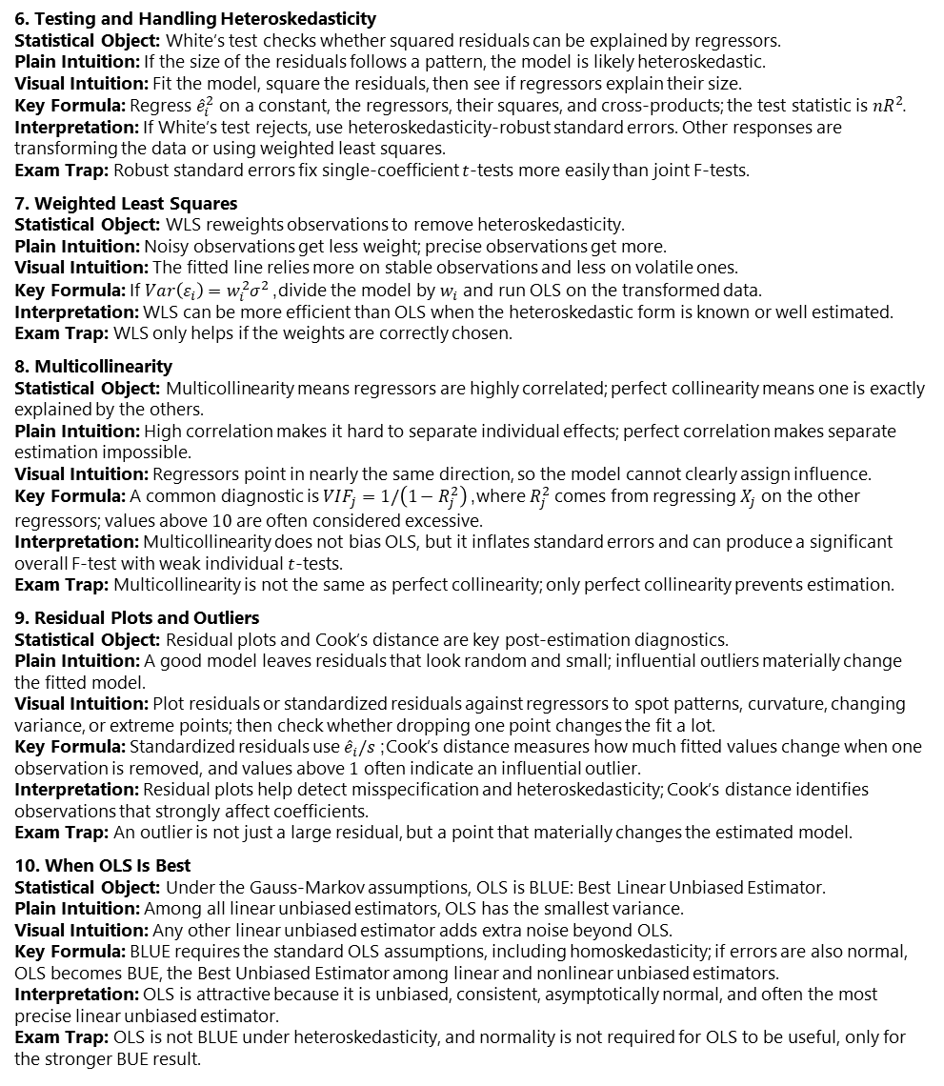
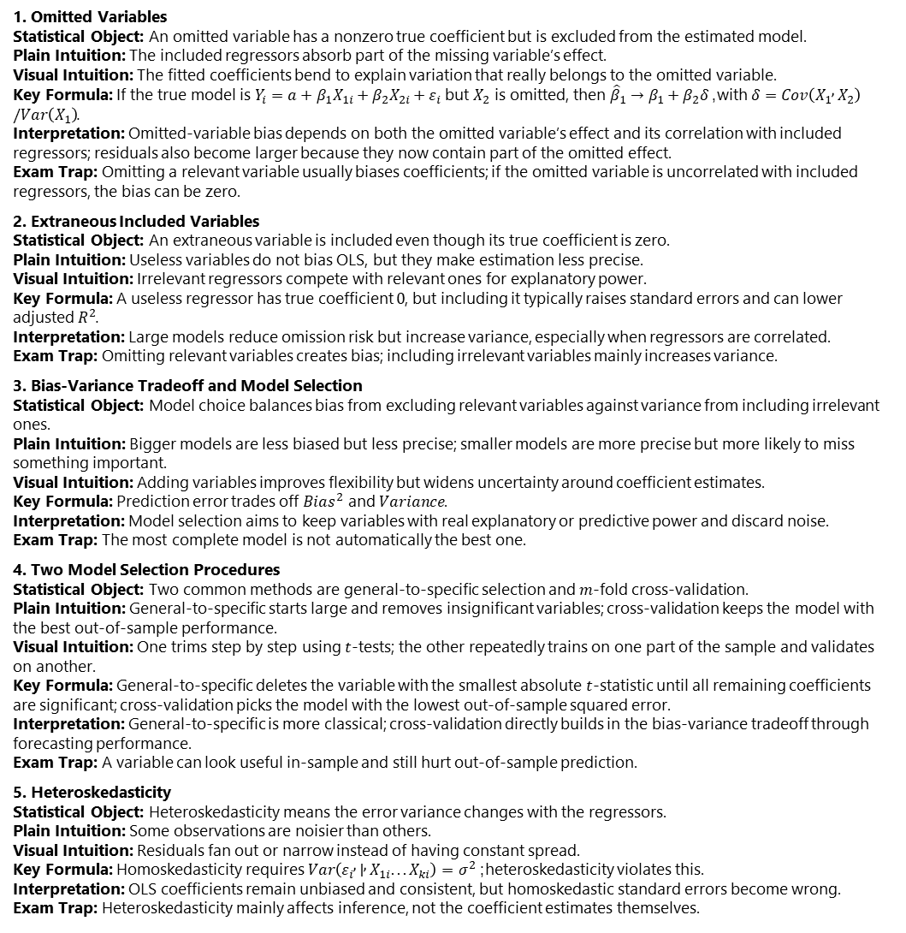
Regression Diagnostics
6. Testing and Handling Heteroskedasticity Statistical Object: White’s test checks whether squared residuals can be explained by regressors. Plain Intuition: If the size of the residuals follows a pattern, the model is likely heteroskedastic. Visual Intuition: Fit the model, square the residuals, then see if regressors explain their size. Key Formula: Regress ${\hat{e}}_{i}^{2}$ on a constant, the regressors, their squares, and cross-products; the test statistic is $nR^{2}$. Interpretation: If White’s test rejects, use heteroskedasticity-robust standard errors. Other responses are transforming the data or using weighted least squares. Exam Trap: Robust standard errors fix single-coefficient $t$-tests more easily than joint F-tests.
7. Weighted Least Squares Statistical Object: WLS reweights observations to remove heteroskedasticity. Plain Intuition: Noisy observations get less weight; precise observations get more. Visual Intuition: The fitted line relies more on stable observations and less on volatile ones. Key Formula: If $Var\left(ε_{i}\right)=w_{i}^{2}σ^{2}$, divide the model by $w_{i}$ and run OLS on the transformed data. Interpretation: WLS can be more efficient than OLS when the heteroskedastic form is known or well estimated. Exam Trap: WLS only helps if the weights are correctly chosen.
8. Multicollinearity Statistical Object: Multicollinearity means regressors are highly correlated; perfect collinearity means one is exactly explained by the others. Plain Intuition: High correlation makes it hard to separate individual effects; perfect correlation makes separate estimation impossible. Visual Intuition: Regressors point in nearly the same direction, so the model cannot clearly assign influence. Key Formula: A common diagnostic is $VIF_{j}=1/\left(1−R_{j}^{2}\right)$, where $R_{j}^{2}$ comes from regressing $X_{j}$ on the other regressors; values above $10$ are often considered excessive. Interpretation: Multicollinearity does not bias OLS, but it inflates standard errors and can produce a significant overall F-test with weak individual $t$-tests. Exam Trap: Multicollinearity is not the same as perfect collinearity; only perfect collinearity prevents estimation.
9. Residual Plots and Outliers Statistical Object: Residual plots and Cook’s distance are key post-estimation diagnostics. Plain Intuition: A good model leaves residuals that look random and small; influential outliers materially change the fitted model. Visual Intuition: Plot residuals or standardized residuals against regressors to spot patterns, curvature, changing variance, or extreme points; then check whether dropping one point changes the fit a lot. Key Formula: Standardized residuals use ${\hat{e}}_{i}/s$; Cook’s distance measures how much fitted values change when one observation is removed, and values above $1$ often indicate an influential outlier. Interpretation: Residual plots help detect misspecification and heteroskedasticity; Cook’s distance identifies observations that strongly affect coefficients. Exam Trap: An outlier is not just a large residual, but a point that materially changes the estimated model.
10. When OLS Is Best Statistical Object: Under the Gauss-Markov assumptions, OLS is BLUE: Best Linear Unbiased Estimator. Plain Intuition: Among all linear unbiased estimators, OLS has the smallest variance. Visual Intuition: Any other linear unbiased estimator adds extra noise beyond OLS. Key Formula: BLUE requires the standard OLS assumptions, including homoskedasticity; if errors are also normal, OLS becomes BUE, the Best Unbiased Estimator among linear and nonlinear unbiased estimators. Interpretation: OLS is attractive because it is unbiased, consistent, asymptotically normal, and often the most precise linear unbiased estimator. Exam Trap: OLS is not BLUE under heteroskedasticity, and normality is not required for OLS to be useful, only for the stronger BUE result.
1. Omitted Variables Statistical Object: An omitted variable has a nonzero true coefficient but is excluded from the estimated model. Plain Intuition: The included regressors absorb part of the missing variable’s effect. Visual Intuition: The fitted coefficients bend to explain variation that really belongs to the omitted variable. Key Formula: If the true model is $Y_{i}=a+β_{1}X_{1i}+β_{2}X_{2i}+ε_{i}$ but $X_{2}$ is omitted, then ${\hat{β}}_{1}→β_{1}+β_{2}δ$, with $δ=Cov\left(X_{1} , X_{2}\right)/Var\left(X_{1}\right)$. Interpretation: Omitted-variable bias depends on both the omitted variable’s effect and its correlation with included regressors; residuals also become larger because they now contain part of the omitted effect. Exam Trap: Omitting a relevant variable usually biases coefficients; if the omitted variable is uncorrelated with included regressors, the bias can be zero.
2. Extraneous Included Variables Statistical Object: An extraneous variable is included even though its true coefficient is zero. Plain Intuition: Useless variables do not bias OLS, but they make estimation less precise. Visual Intuition: Irrelevant regressors compete with relevant ones for explanatory power. Key Formula: A useless regressor has true coefficient $0$, but including it typically raises standard errors and can lower adjusted $R^{2}$. Interpretation: Large models reduce omission risk but increase variance, especially when regressors are correlated. Exam Trap: Omitting relevant variables creates bias; including irrelevant variables mainly increases variance.
3. Bias-Variance Tradeoff and Model Selection Statistical Object: Model choice balances bias from excluding relevant variables against variance from including irrelevant ones. Plain Intuition: Bigger models are less biased but less precise; smaller models are more precise but more likely to miss something important. Visual Intuition: Adding variables improves flexibility but widens uncertainty around coefficient estimates. Key Formula: Prediction error trades off $Bias^{2}$ and $Variance$. Interpretation: Model selection aims to keep variables with real explanatory or predictive power and discard noise. Exam Trap: The most complete model is not automatically the best one.
4. Two Model Selection Procedures Statistical Object: Two common methods are general-to-specific selection and $m$-fold cross-validation. Plain Intuition: General-to-specific starts large and removes insignificant variables; cross-validation keeps the model with the best out-of-sample performance. Visual Intuition: One trims step by step using $t$-tests; the other repeatedly trains on one part of the sample and validates on another. Key Formula: General-to-specific deletes the variable with the smallest absolute $t$-statistic until all remaining coefficients are significant; cross-validation picks the model with the lowest out-of-sample squared error. Interpretation: General-to-specific is more classical; cross-validation directly builds in the bias-variance tradeoff through forecasting performance. Exam Trap: A variable can look useful in-sample and still hurt out-of-sample prediction.
5. Heteroskedasticity Statistical Object: Heteroskedasticity means the error variance changes with the regressors. Plain Intuition: Some observations are noisier than others. Visual Intuition: Residuals fan out or narrow instead of having constant spread. Key Formula: Homoskedasticity requires $Var\left(ε_{i} , ∣ , X_{1i}...X_{ki}\right)=σ^{2}$; heteroskedasticity violates this. Interpretation: OLS coefficients remain unbiased and consistent, but homoskedastic standard errors become wrong. Exam Trap: Heteroskedasticity mainly affects inference, not the coefficient estimates themselves.

Slide 25
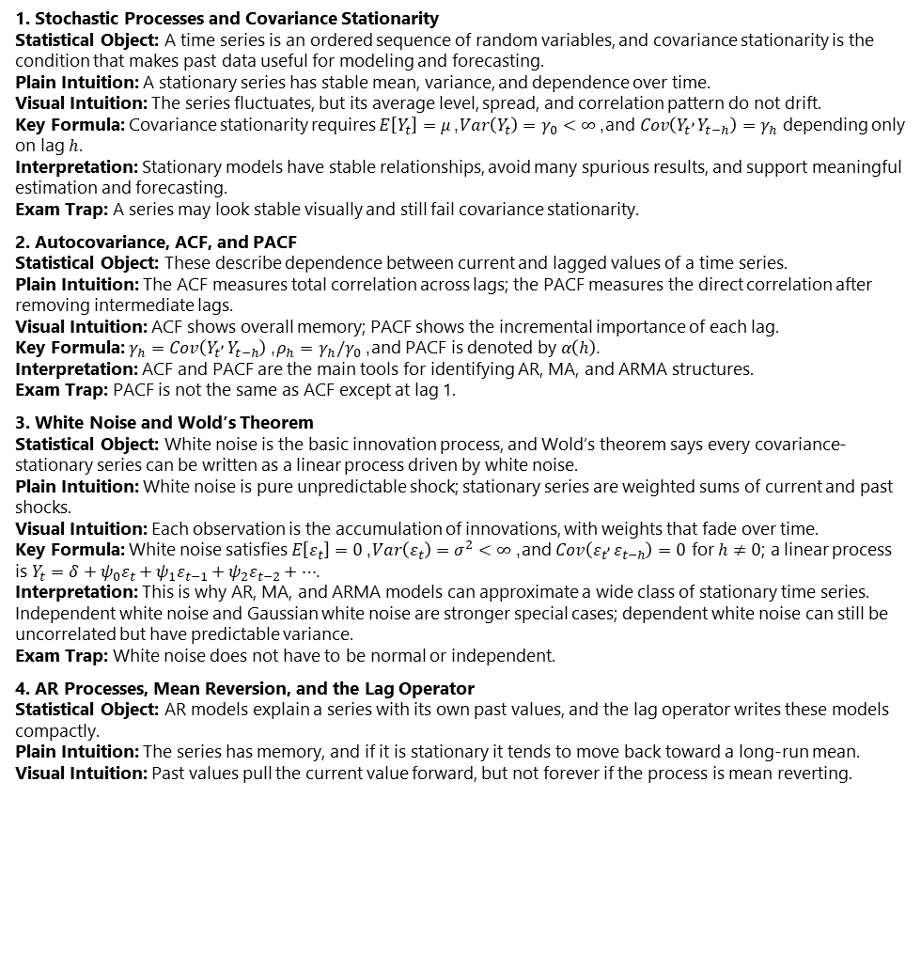
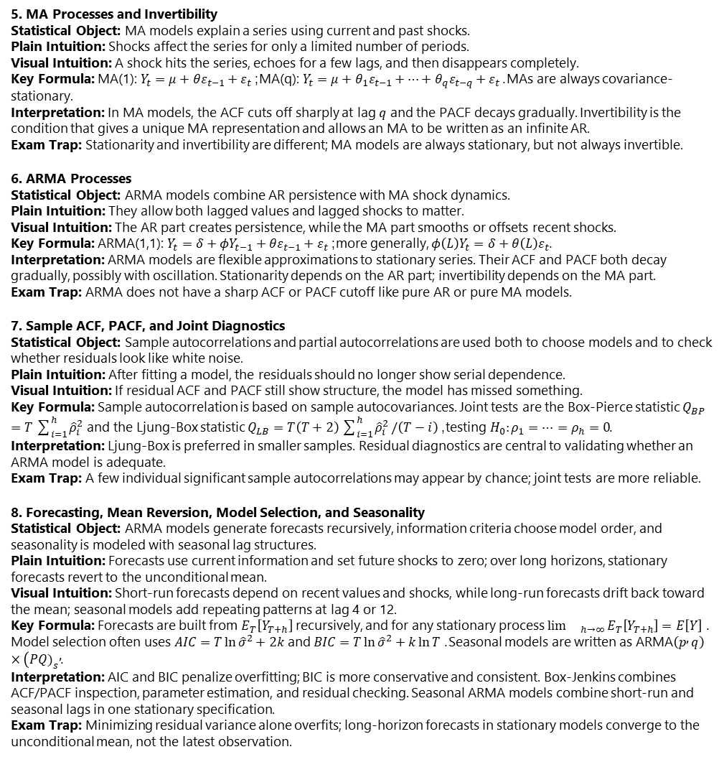
Stationary time series
5. MA Processes and Invertibility Statistical Object: MA models explain a series using current and past shocks. Plain Intuition: Shocks affect the series for only a limited number of periods. Visual Intuition: A shock hits the series, echoes for a few lags, and then disappears completely. Key Formula: MA(1): $Y_{t}=μ+θε_{t−1}+ε_{t}$; MA(q): $Y_{t}=μ+θ_{1}ε_{t−1}+⋯+θ_{q}ε_{t−q}+ε_{t}$. MAs are always covariance-stationary. Interpretation: In MA models, the ACF cuts off sharply at lag $q$ and the PACF decays gradually. Invertibility is the condition that gives a unique MA representation and allows an MA to be written as an infinite AR. Exam Trap: Stationarity and invertibility are different; MA models are always stationary, but not always invertible.
6. ARMA Processes Statistical Object: ARMA models combine AR persistence with MA shock dynamics. Plain Intuition: They allow both lagged values and lagged shocks to matter. Visual Intuition: The AR part creates persistence, while the MA part smooths or offsets recent shocks. Key Formula: ARMA(1,1): $Y_{t}=δ+φY_{t−1}+θε_{t−1}+ε_{t}$; more generally, $φ\left(L\right)Y_{t}=δ+θ\left(L\right)ε_{t}$. Interpretation: ARMA models are flexible approximations to stationary series. Their ACF and PACF both decay gradually, possibly with oscillation. Stationarity depends on the AR part; invertibility depends on the MA part. Exam Trap: ARMA does not have a sharp ACF or PACF cutoff like pure AR or pure MA models.
7. Sample ACF, PACF, and Joint Diagnostics Statistical Object: Sample autocorrelations and partial autocorrelations are used both to choose models and to check whether residuals look like white noise. Plain Intuition: After fitting a model, the residuals should no longer show serial dependence. Visual Intuition: If residual ACF and PACF still show structure, the model has missed something. Key Formula: Sample autocorrelation is based on sample autocovariances. Joint tests are the Box-Pierce statistic $Q_{BP}=T\sum_{i=1}^{h}{{\hat{ρ}}_{i}^{2}}$ and the Ljung-Box statistic $Q_{LB}=T\left(T+2\right)\sum_{i=1}^{h}{{\hat{ρ}}_{i}^{2}}/\left(T−i\right)$, testing $H_{0}:ρ_{1}=⋯=ρ_{h}=0$. Interpretation: Ljung-Box is preferred in smaller samples. Residual diagnostics are central to validating whether an ARMA model is adequate. Exam Trap: A few individual significant sample autocorrelations may appear by chance; joint tests are more reliable.
8. Forecasting, Mean Reversion, Model Selection, and Seasonality Statistical Object: ARMA models generate forecasts recursively, information criteria choose model order, and seasonality is modeled with seasonal lag structures. Plain Intuition: Forecasts use current information and set future shocks to zero; over long horizons, stationary forecasts revert to the unconditional mean. Visual Intuition: Short-run forecasts depend on recent values and shocks, while long-run forecasts drift back toward the mean; seasonal models add repeating patterns at lag 4 or 12. Key Formula: Forecasts are built from $E_{T}\left[Y_{T+h}\right]$ recursively, and for any stationary process ${\lim{}}_{h→∞}E_{T}\left[Y_{T+h}\right]=E\left[Y\right]$. Model selection often uses $AIC=T\ln{{\hat{σ}}^{2}}+2k$ and $BIC=T\ln{{\hat{σ}}^{2}}+k\ln{T}$. Seasonal models are written as ARMA$\left(p , q\right)×(PQ{\left.)\right.}_{s},$. Interpretation: AIC and BIC penalize overfitting; BIC is more conservative and consistent. Box-Jenkins combines ACF/PACF inspection, parameter estimation, and residual checking. Seasonal ARMA models combine short-run and seasonal lags in one stationary specification. Exam Trap: Minimizing residual variance alone overfits; long-horizon forecasts in stationary models converge to the unconditional mean, not the latest observation.
1. Stochastic Processes and Covariance Stationarity Statistical Object: A time series is an ordered sequence of random variables, and covariance stationarity is the condition that makes past data useful for modeling and forecasting. Plain Intuition: A stationary series has stable mean, variance, and dependence over time. Visual Intuition: The series fluctuates, but its average level, spread, and correlation pattern do not drift. Key Formula: Covariance stationarity requires $E\left[Y_{t}\right]=μ$, $Var\left(Y_{t}\right)=γ_{0}<∞$, and $Cov\left(Y_{t} , Y_{t−h}\right)=γ_{h}$ depending only on lag $h$. Interpretation: Stationary models have stable relationships, avoid many spurious results, and support meaningful estimation and forecasting. Exam Trap: A series may look stable visually and still fail covariance stationarity.
2. Autocovariance, ACF, and PACF Statistical Object: These describe dependence between current and lagged values of a time series. Plain Intuition: The ACF measures total correlation across lags; the PACF measures the direct correlation after removing intermediate lags. Visual Intuition: ACF shows overall memory; PACF shows the incremental importance of each lag. Key Formula: $γ_{h}=Cov\left(Y_{t} , Y_{t−h}\right)$, $ρ_{h}=γ_{h}/γ_{0}$, and PACF is denoted by $α\left(h\right)$. Interpretation: ACF and PACF are the main tools for identifying AR, MA, and ARMA structures. Exam Trap: PACF is not the same as ACF except at lag 1.
3. White Noise and Wold’s Theorem Statistical Object: White noise is the basic innovation process, and Wold’s theorem says every covariance-stationary series can be written as a linear process driven by white noise. Plain Intuition: White noise is pure unpredictable shock; stationary series are weighted sums of current and past shocks. Visual Intuition: Each observation is the accumulation of innovations, with weights that fade over time. Key Formula: White noise satisfies $E\left[ε_{t}\right]=0$, $Var\left(ε_{t}\right)=σ^{2}<∞$, and $Cov\left(ε_{t} , ε_{t−h}\right)=0$ for $h≠0$; a linear process is $Y_{t}=δ+ψ_{0}ε_{t}+ψ_{1}ε_{t−1}+ψ_{2}ε_{t−2}+⋯$. Interpretation: This is why AR, MA, and ARMA models can approximate a wide class of stationary time series. Independent white noise and Gaussian white noise are stronger special cases; dependent white noise can still be uncorrelated but have predictable variance. Exam Trap: White noise does not have to be normal or independent.
4. AR Processes, Mean Reversion, and the Lag Operator Statistical Object: AR models explain a series with its own past values, and the lag operator writes these models compactly. Plain Intuition: The series has memory, and if it is stationary it tends to move back toward a long-run mean. Visual Intuition: Past values pull the current value forward, but not forever if the process is mean reverting. Key Formula: AR(1): $Y_{t}=δ+φY_{t−1}+ε_{t}$, stationary if $∣φ∣<1$, with mean $μ=δ/\left(1−φ\right)$, variance $γ_{0}=σ^{2}/\left(1−φ^{2}\right)$, and ACF $ρ\left(h\right)=φ^{∣h∣}$. The lag operator satisfies $LY_{t}=Y_{t−1}$ and lets us write $\left(1−φL\right)Y_{t}=δ+ε_{t}$. AR(p): $Y_{t}=δ+φ_{1}Y_{t−1}+⋯+φ_{p}Y_{t−p}+ε_{t}$. Interpretation: In AR models, the ACF decays gradually and the PACF cuts off at lag $p$. Long-horizon forecasts converge to the long-run mean. Stationarity in higher-order ARs is determined by the characteristic roots being outside the unit circle. Exam Trap: Stationarity is not just “small coefficients”; it is a root condition.

Slide 26
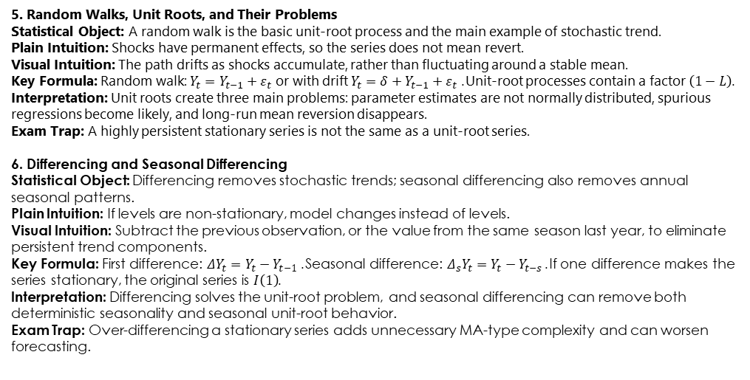
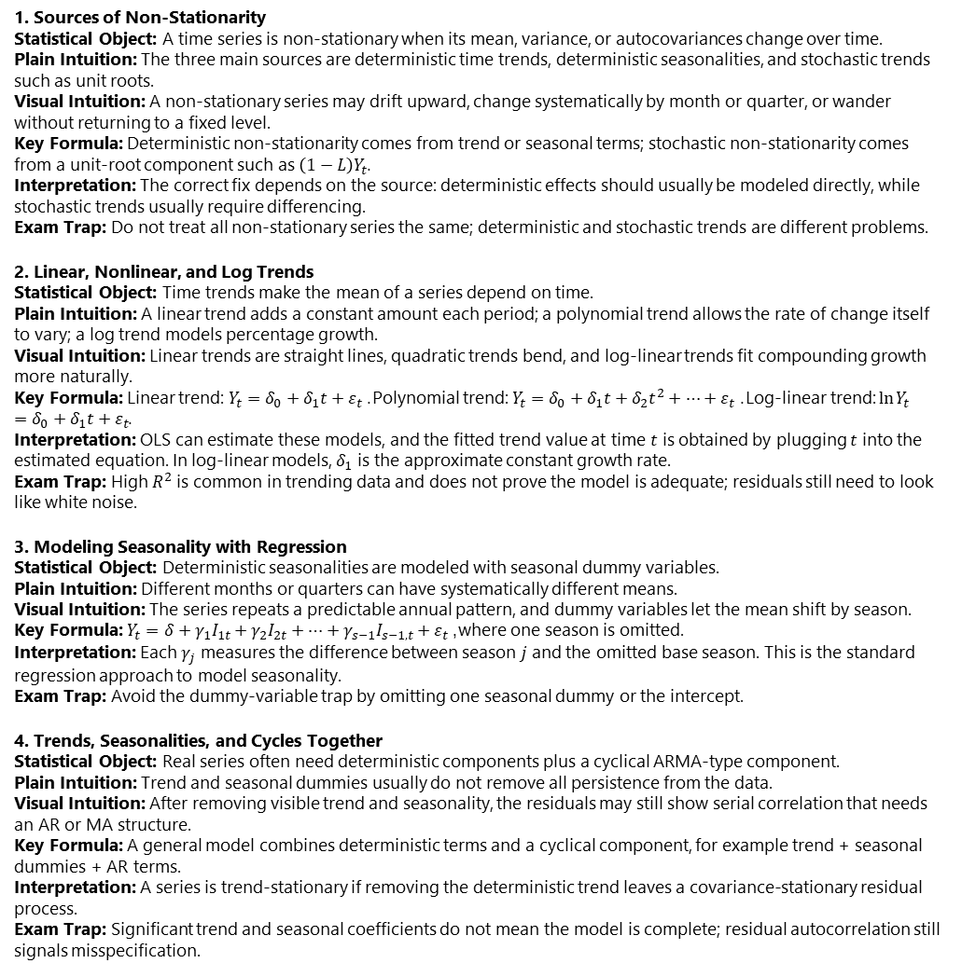
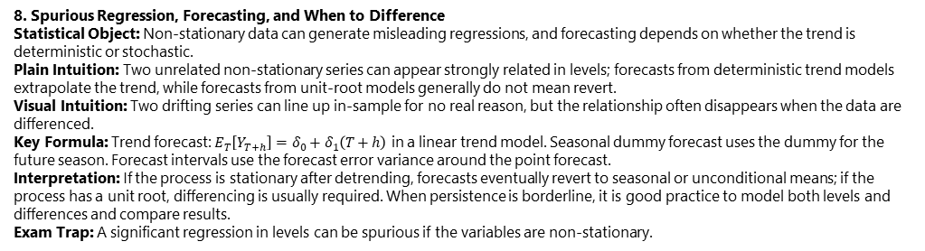
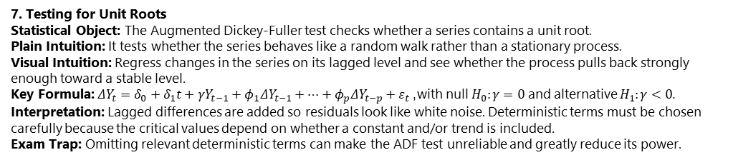
Non-Stationary Time Series
5. Random Walks, Unit Roots, and Their Problems Statistical Object: A random walk is the basic unit-root process and the main example of stochastic trend. Plain Intuition: Shocks have permanent effects, so the series does not mean revert. Visual Intuition: The path drifts as shocks accumulate, rather than fluctuating around a stable mean. Key Formula: Random walk: $Y_{t}=Y_{t−1}+ε_{t}$ or with drift $Y_{t}=δ+Y_{t−1}+ε_{t}$. Unit-root processes contain a factor $\left(1−L\right)$. Interpretation: Unit roots create three main problems: parameter estimates are not normally distributed, spurious regressions become likely, and long-run mean reversion disappears. Exam Trap: A highly persistent stationary series is not the same as a unit-root series.
6. Differencing and Seasonal Differencing Statistical Object: Differencing removes stochastic trends; seasonal differencing also removes annual seasonal patterns. Plain Intuition: If levels are non-stationary, model changes instead of levels. Visual Intuition: Subtract the previous observation, or the value from the same season last year, to eliminate persistent trend components. Key Formula: First difference: $ΔY_{t}=Y_{t}−Y_{t−1}$. Seasonal difference: $Δ_{s}Y_{t}=Y_{t}−Y_{t−s}$. If one difference makes the series stationary, the original series is $I\left(1\right)$. Interpretation: Differencing solves the unit-root problem, and seasonal differencing can remove both deterministic seasonality and seasonal unit-root behavior. Exam Trap: Over-differencing a stationary series adds unnecessary MA-type complexity and can worsen forecasting.
1. Sources of Non-Stationarity Statistical Object: A time series is non-stationary when its mean, variance, or autocovariances change over time. Plain Intuition: The three main sources are deterministic time trends, deterministic seasonalities, and stochastic trends such as unit roots. Visual Intuition: A non-stationary series may drift upward, change systematically by month or quarter, or wander without returning to a fixed level. Key Formula: Deterministic non-stationarity comes from trend or seasonal terms; stochastic non-stationarity comes from a unit-root component such as $\left(1−L\right)Y_{t}$. Interpretation: The correct fix depends on the source: deterministic effects should usually be modeled directly, while stochastic trends usually require differencing. Exam Trap: Do not treat all non-stationary series the same; deterministic and stochastic trends are different problems.
2. Linear, Nonlinear, and Log Trends Statistical Object: Time trends make the mean of a series depend on time. Plain Intuition: A linear trend adds a constant amount each period; a polynomial trend allows the rate of change itself to vary; a log trend models percentage growth. Visual Intuition: Linear trends are straight lines, quadratic trends bend, and log-linear trends fit compounding growth more naturally. Key Formula: Linear trend: $Y_{t}=δ_{0}+δ_{1}t+ε_{t}$. Polynomial trend: $Y_{t}=δ_{0}+δ_{1}t+δ_{2}t^{2}+⋯+ε_{t}$. Log-linear trend: $\ln{Y_{t}}=δ_{0}+δ_{1}t+ε_{t}$. Interpretation: OLS can estimate these models, and the fitted trend value at time $t$ is obtained by plugging $t$ into the estimated equation. In log-linear models, $δ_{1}$ is the approximate constant growth rate. Exam Trap: High $R^{2}$ is common in trending data and does not prove the model is adequate; residuals still need to look like white noise.
3. Modeling Seasonality with Regression Statistical Object: Deterministic seasonalities are modeled with seasonal dummy variables. Plain Intuition: Different months or quarters can have systematically different means. Visual Intuition: The series repeats a predictable annual pattern, and dummy variables let the mean shift by season. Key Formula: $Y_{t}=δ+γ_{1}I_{1t}+γ_{2}I_{2t}+⋯+γ_{s−1}I_{s−1,t}+ε_{t}$, where one season is omitted. Interpretation: Each $γ_{j}$ measures the difference between season $j$ and the omitted base season. This is the standard regression approach to model seasonality. Exam Trap: Avoid the dummy-variable trap by omitting one seasonal dummy or the intercept.
4. Trends, Seasonalities, and Cycles Together Statistical Object: Real series often need deterministic components plus a cyclical ARMA-type component. Plain Intuition: Trend and seasonal dummies usually do not remove all persistence from the data. Visual Intuition: After removing visible trend and seasonality, the residuals may still show serial correlation that needs an AR or MA structure. Key Formula: A general model combines deterministic terms and a cyclical component, for example trend + seasonal dummies + AR terms. Interpretation: A series is trend-stationary if removing the deterministic trend leaves a covariance-stationary residual process. Exam Trap: Significant trend and seasonal coefficients do not mean the model is complete; residual autocorrelation still signals misspecification.
7. Testing for Unit Roots Statistical Object: The Augmented Dickey-Fuller test checks whether a series contains a unit root. Plain Intuition: It tests whether the series behaves like a random walk rather than a stationary process. Visual Intuition: Regress changes in the series on its lagged level and see whether the process pulls back strongly enough toward a stable level. Key Formula: $ΔY_{t}=δ_{0}+δ_{1}t+γY_{t−1}+φ_{1}ΔY_{t−1}+⋯+φ_{p}ΔY_{t−p}+ε_{t}$, with null $H_{0}:γ=0$ and alternative $H_{1}:γ<0$. Interpretation: Lagged differences are added so residuals look like white noise. Deterministic terms must be chosen carefully because the critical values depend on whether a constant and/or trend is included. Exam Trap: Omitting relevant deterministic terms can make the ADF test unreliable and greatly reduce its power.
8. Spurious Regression, Forecasting, and When to Difference Statistical Object: Non-stationary data can generate misleading regressions, and forecasting depends on whether the trend is deterministic or stochastic. Plain Intuition: Two unrelated non-stationary series can appear strongly related in levels; forecasts from deterministic trend models extrapolate the trend, while forecasts from unit-root models generally do not mean revert. Visual Intuition: Two drifting series can line up in-sample for no real reason, but the relationship often disappears when the data are differenced. Key Formula: Trend forecast: $E_{T}\left[Y_{T+h}\right]=δ_{0}+δ_{1}\left(T+h\right)$ in a linear trend model. Seasonal dummy forecast uses the dummy for the future season. Forecast intervals use the forecast error variance around the point forecast. Interpretation: If the process is stationary after detrending, forecasts eventually revert to seasonal or unconditional means; if the process has a unit root, differencing is usually required. When persistence is borderline, it is good practice to model both levels and differences and compare results. Exam Trap: A significant regression in levels can be spurious if the variables are non-stationary.

Slide 27
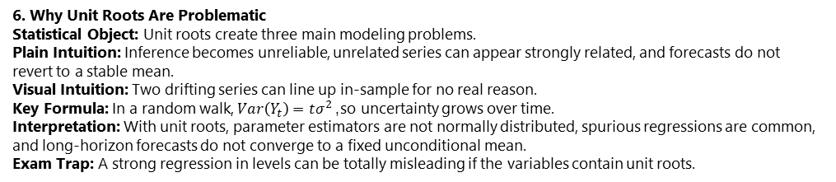
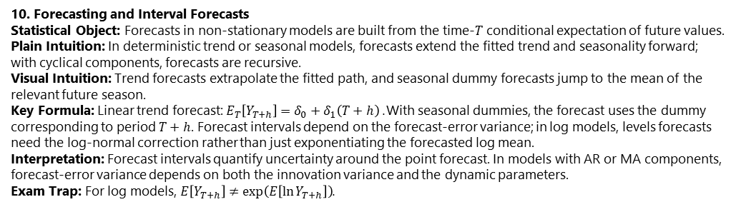
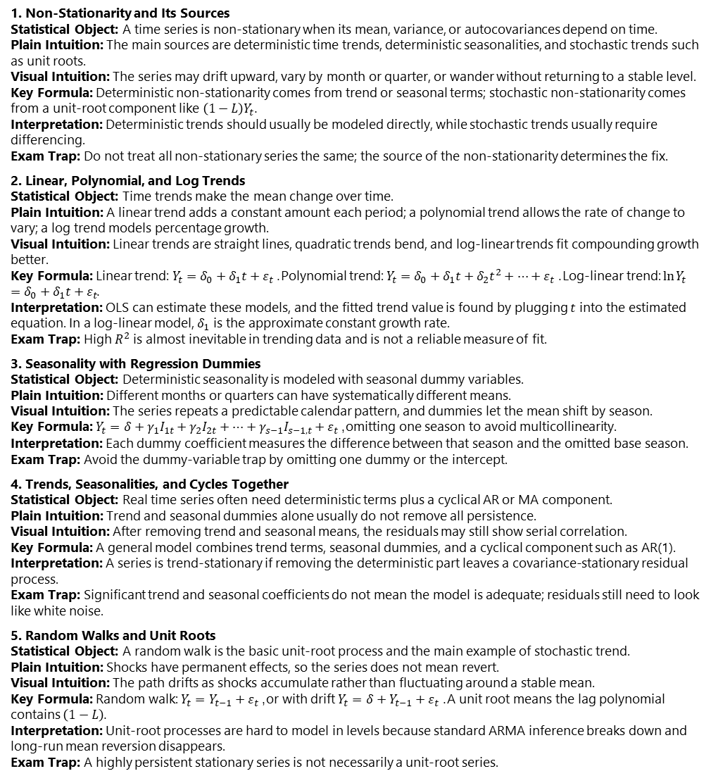
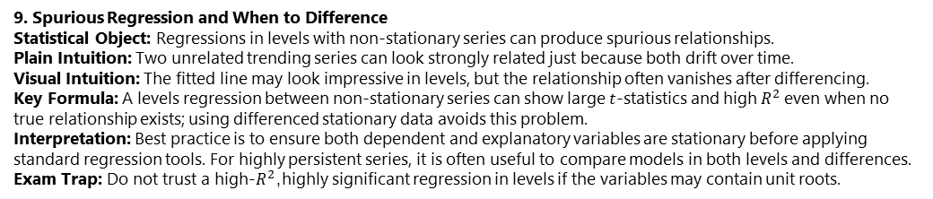
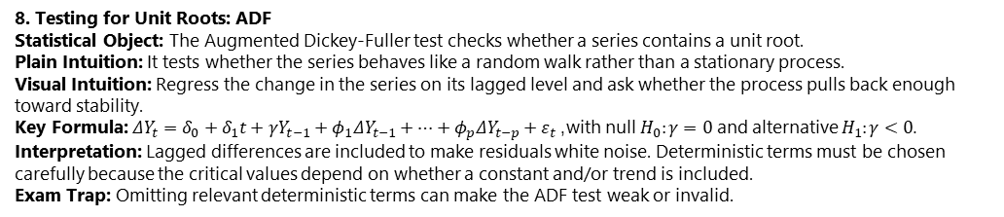
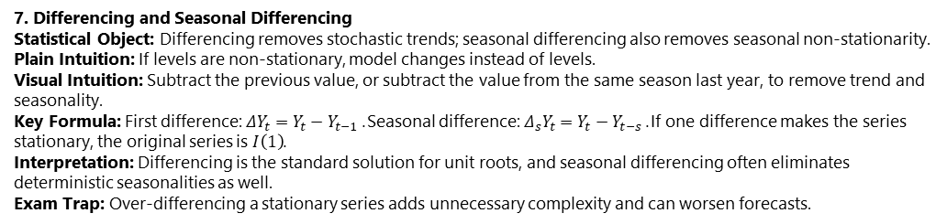
Non-Stationary Time Series
6. Why Unit Roots Are Problematic Statistical Object: Unit roots create three main modeling problems. Plain Intuition: Inference becomes unreliable, unrelated series can appear strongly related, and forecasts do not revert to a stable mean. Visual Intuition: Two drifting series can line up in-sample for no real reason. Key Formula: In a random walk, $Var\left(Y_{t}\right)=tσ^{2}$, so uncertainty grows over time. Interpretation: With unit roots, parameter estimators are not normally distributed, spurious regressions are common, and long-horizon forecasts do not converge to a fixed unconditional mean. Exam Trap: A strong regression in levels can be totally misleading if the variables contain unit roots.
1. Non-Stationarity and Its Sources Statistical Object: A time series is non-stationary when its mean, variance, or autocovariances depend on time. Plain Intuition: The main sources are deterministic time trends, deterministic seasonalities, and stochastic trends such as unit roots. Visual Intuition: The series may drift upward, vary by month or quarter, or wander without returning to a stable level. Key Formula: Deterministic non-stationarity comes from trend or seasonal terms; stochastic non-stationarity comes from a unit-root component like $\left(1−L\right)Y_{t}$. Interpretation: Deterministic trends should usually be modeled directly, while stochastic trends usually require differencing. Exam Trap: Do not treat all non-stationary series the same; the source of the non-stationarity determines the fix.
2. Linear, Polynomial, and Log Trends Statistical Object: Time trends make the mean change over time. Plain Intuition: A linear trend adds a constant amount each period; a polynomial trend allows the rate of change to vary; a log trend models percentage growth. Visual Intuition: Linear trends are straight lines, quadratic trends bend, and log-linear trends fit compounding growth better. Key Formula: Linear trend: $Y_{t}=δ_{0}+δ_{1}t+ε_{t}$. Polynomial trend: $Y_{t}=δ_{0}+δ_{1}t+δ_{2}t^{2}+⋯+ε_{t}$. Log-linear trend: $\ln{Y_{t}}=δ_{0}+δ_{1}t+ε_{t}$. Interpretation: OLS can estimate these models, and the fitted trend value is found by plugging $t$ into the estimated equation. In a log-linear model, $δ_{1}$ is the approximate constant growth rate. Exam Trap: High $R^{2}$ is almost inevitable in trending data and is not a reliable measure of fit.
3. Seasonality with Regression Dummies Statistical Object: Deterministic seasonality is modeled with seasonal dummy variables. Plain Intuition: Different months or quarters can have systematically different means. Visual Intuition: The series repeats a predictable calendar pattern, and dummies let the mean shift by season. Key Formula: $Y_{t}=δ+γ_{1}I_{1t}+γ_{2}I_{2t}+⋯+γ_{s−1}I_{s−1,t}+ε_{t}$, omitting one season to avoid multicollinearity. Interpretation: Each dummy coefficient measures the difference between that season and the omitted base season. Exam Trap: Avoid the dummy-variable trap by omitting one dummy or the intercept.
4. Trends, Seasonalities, and Cycles Together Statistical Object: Real time series often need deterministic terms plus a cyclical AR or MA component. Plain Intuition: Trend and seasonal dummies alone usually do not remove all persistence. Visual Intuition: After removing trend and seasonal means, the residuals may still show serial correlation. Key Formula: A general model combines trend terms, seasonal dummies, and a cyclical component such as AR(1). Interpretation: A series is trend-stationary if removing the deterministic part leaves a covariance-stationary residual process. Exam Trap: Significant trend and seasonal coefficients do not mean the model is adequate; residuals still need to look like white noise.
5. Random Walks and Unit Roots Statistical Object: A random walk is the basic unit-root process and the main example of stochastic trend. Plain Intuition: Shocks have permanent effects, so the series does not mean revert. Visual Intuition: The path drifts as shocks accumulate rather than fluctuating around a stable mean. Key Formula: Random walk: $Y_{t}=Y_{t−1}+ε_{t}$, or with drift $Y_{t}=δ+Y_{t−1}+ε_{t}$. A unit root means the lag polynomial contains $\left(1−L\right)$. Interpretation: Unit-root processes are hard to model in levels because standard ARMA inference breaks down and long-run mean reversion disappears. Exam Trap: A highly persistent stationary series is not necessarily a unit-root series.
7. Differencing and Seasonal Differencing Statistical Object: Differencing removes stochastic trends; seasonal differencing also removes seasonal non-stationarity. Plain Intuition: If levels are non-stationary, model changes instead of levels. Visual Intuition: Subtract the previous value, or subtract the value from the same season last year, to remove trend and seasonality. Key Formula: First difference: $ΔY_{t}=Y_{t}−Y_{t−1}$. Seasonal difference: $Δ_{s}Y_{t}=Y_{t}−Y_{t−s}$. If one difference makes the series stationary, the original series is $I\left(1\right)$. Interpretation: Differencing is the standard solution for unit roots, and seasonal differencing often eliminates deterministic seasonalities as well. Exam Trap: Over-differencing a stationary series adds unnecessary complexity and can worsen forecasts.
8. Testing for Unit Roots: ADF Statistical Object: The Augmented Dickey-Fuller test checks whether a series contains a unit root. Plain Intuition: It tests whether the series behaves like a random walk rather than a stationary process. Visual Intuition: Regress the change in the series on its lagged level and ask whether the process pulls back enough toward stability. Key Formula: $ΔY_{t}=δ_{0}+δ_{1}t+γY_{t−1}+φ_{1}ΔY_{t−1}+⋯+φ_{p}ΔY_{t−p}+ε_{t}$, with null $H_{0}:γ=0$ and alternative $H_{1}:γ<0$. Interpretation: Lagged differences are included to make residuals white noise. Deterministic terms must be chosen carefully because the critical values depend on whether a constant and/or trend is included. Exam Trap: Omitting relevant deterministic terms can make the ADF test weak or invalid.
9. Spurious Regression and When to Difference Statistical Object: Regressions in levels with non-stationary series can produce spurious relationships. Plain Intuition: Two unrelated trending series can look strongly related just because both drift over time. Visual Intuition: The fitted line may look impressive in levels, but the relationship often vanishes after differencing. Key Formula: A levels regression between non-stationary series can show large $t$-statistics and high $R^{2}$ even when no true relationship exists; using differenced stationary data avoids this problem. Interpretation: Best practice is to ensure both dependent and explanatory variables are stationary before applying standard regression tools. For highly persistent series, it is often useful to compare models in both levels and differences. Exam Trap: Do not trust a high-$R^{2}$, highly significant regression in levels if the variables may contain unit roots.
10. Forecasting and Interval Forecasts Statistical Object: Forecasts in non-stationary models are built from the time-$T$ conditional expectation of future values. Plain Intuition: In deterministic trend or seasonal models, forecasts extend the fitted trend and seasonality forward; with cyclical components, forecasts are recursive. Visual Intuition: Trend forecasts extrapolate the fitted path, and seasonal dummy forecasts jump to the mean of the relevant future season. Key Formula: Linear trend forecast: $E_{T}\left[Y_{T+h}\right]=δ_{0}+δ_{1}\left(T+h\right)$. With seasonal dummies, the forecast uses the dummy corresponding to period $T+h$. Forecast intervals depend on the forecast-error variance; in log models, levels forecasts need the log-normal correction rather than just exponentiating the forecasted log mean. Interpretation: Forecast intervals quantify uncertainty around the point forecast. In models with AR or MA components, forecast-error variance depends on both the innovation variance and the dynamic parameters. Exam Trap: For log models, $E\left[Y_{T+h}\right]≠exp⁡\left(E\left[\ln{Y_{T+h}}\right]\right)$.

Slide 28
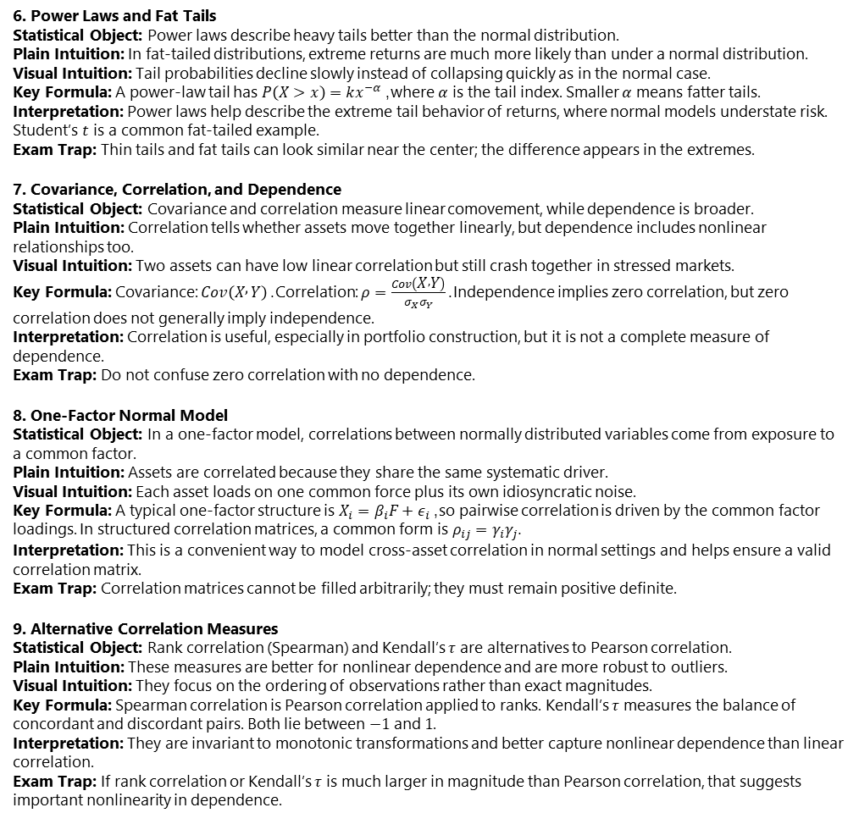
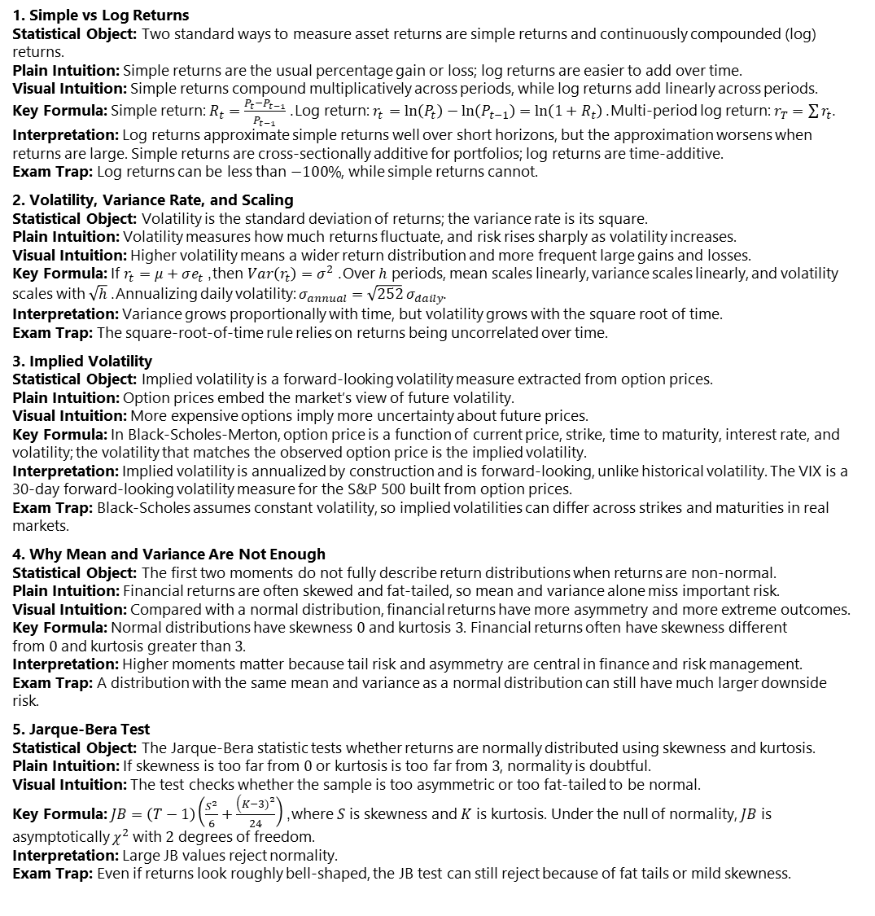
Measuring Returns, Volatility, and Correlation
1. Simple vs Log Returns Statistical Object: Two standard ways to measure asset returns are simple returns and continuously compounded (log) returns. Plain Intuition: Simple returns are the usual percentage gain or loss; log returns are easier to add over time. Visual Intuition: Simple returns compound multiplicatively across periods, while log returns add linearly across periods. Key Formula: Simple return: $R_{t}=\frac{P_{t}−P_{t−1}}{P_{t−1}}$. Log return: $r_{t}=ln⁡\left(P_{t}\right)−ln⁡\left(P_{t−1}\right)=ln⁡\left(1+R_{t}\right)$. Multi-period log return: $r_{T}=\sum{r_{t}}$. Interpretation: Log returns approximate simple returns well over short horizons, but the approximation worsens when returns are large. Simple returns are cross-sectionally additive for portfolios; log returns are time-additive. Exam Trap: Log returns can be less than $−100\%$, while simple returns cannot.
2. Volatility, Variance Rate, and Scaling Statistical Object: Volatility is the standard deviation of returns; the variance rate is its square. Plain Intuition: Volatility measures how much returns fluctuate, and risk rises sharply as volatility increases. Visual Intuition: Higher volatility means a wider return distribution and more frequent large gains and losses. Key Formula: If $r_{t}=μ+σe_{t}$, then $Var\left(r_{t}\right)=σ^{2}$. Over $h$ periods, mean scales linearly, variance scales linearly, and volatility scales with $\sqrt{h}$. Annualizing daily volatility: $σ_{annual}=\sqrt{252} σ_{daily}$. Interpretation: Variance grows proportionally with time, but volatility grows with the square root of time. Exam Trap: The square-root-of-time rule relies on returns being uncorrelated over time.
3. Implied Volatility Statistical Object: Implied volatility is a forward-looking volatility measure extracted from option prices. Plain Intuition: Option prices embed the market’s view of future volatility. Visual Intuition: More expensive options imply more uncertainty about future prices. Key Formula: In Black-Scholes-Merton, option price is a function of current price, strike, time to maturity, interest rate, and volatility; the volatility that matches the observed option price is the implied volatility. Interpretation: Implied volatility is annualized by construction and is forward-looking, unlike historical volatility. The VIX is a 30-day forward-looking volatility measure for the S&P 500 built from option prices. Exam Trap: Black-Scholes assumes constant volatility, so implied volatilities can differ across strikes and maturities in real markets.
4. Why Mean and Variance Are Not Enough Statistical Object: The first two moments do not fully describe return distributions when returns are non-normal. Plain Intuition: Financial returns are often skewed and fat-tailed, so mean and variance alone miss important risk. Visual Intuition: Compared with a normal distribution, financial returns have more asymmetry and more extreme outcomes. Key Formula: Normal distributions have skewness $0$ and kurtosis $3$. Financial returns often have skewness different from $0$ and kurtosis greater than $3$. Interpretation: Higher moments matter because tail risk and asymmetry are central in finance and risk management. Exam Trap: A distribution with the same mean and variance as a normal distribution can still have much larger downside risk.
5. Jarque-Bera Test Statistical Object: The Jarque-Bera statistic tests whether returns are normally distributed using skewness and kurtosis. Plain Intuition: If skewness is too far from $0$ or kurtosis is too far from $3$, normality is doubtful. Visual Intuition: The test checks whether the sample is too asymmetric or too fat-tailed to be normal. Key Formula: $JB=\left(T−1\right)\left(\frac{S^{2}}{6}+\frac{\left(K−3{\left.)\right.}^{2}\right.}{24}\right)$, where $S$ is skewness and $K$ is kurtosis. Under the null of normality, $JB$ is asymptotically $χ^{2}$ with $2$ degrees of freedom. Interpretation: Large JB values reject normality. Exam Trap: Even if returns look roughly bell-shaped, the JB test can still reject because of fat tails or mild skewness.
6. Power Laws and Fat Tails Statistical Object: Power laws describe heavy tails better than the normal distribution. Plain Intuition: In fat-tailed distributions, extreme returns are much more likely than under a normal distribution. Visual Intuition: Tail probabilities decline slowly instead of collapsing quickly as in the normal case. Key Formula: A power-law tail has $P\left(X>x\right)=kx^{−α}$, where $α$ is the tail index. Smaller $α$ means fatter tails. Interpretation: Power laws help describe the extreme tail behavior of returns, where normal models understate risk. Student’s $t$ is a common fat-tailed example. Exam Trap: Thin tails and fat tails can look similar near the center; the difference appears in the extremes.
7. Covariance, Correlation, and Dependence Statistical Object: Covariance and correlation measure linear comovement, while dependence is broader. Plain Intuition: Correlation tells whether assets move together linearly, but dependence includes nonlinear relationships too. Visual Intuition: Two assets can have low linear correlation but still crash together in stressed markets. Key Formula: Covariance: $Cov\left(X , Y\right)$. Correlation: $ρ=\frac{Cov\left(X , Y\right)}{σ_{X}σ_{Y}}$. Independence implies zero correlation, but zero correlation does not generally imply independence. Interpretation: Correlation is useful, especially in portfolio construction, but it is not a complete measure of dependence. Exam Trap: Do not confuse zero correlation with no dependence.
8. One-Factor Normal Model Statistical Object: In a one-factor model, correlations between normally distributed variables come from exposure to a common factor. Plain Intuition: Assets are correlated because they share the same systematic driver. Visual Intuition: Each asset loads on one common force plus its own idiosyncratic noise. Key Formula: A typical one-factor structure is $X_{i}=β_{i}F+ε_{i}$, so pairwise correlation is driven by the common factor loadings. In structured correlation matrices, a common form is $ρ_{ij}=γ_{i}γ_{j}$. Interpretation: This is a convenient way to model cross-asset correlation in normal settings and helps ensure a valid correlation matrix. Exam Trap: Correlation matrices cannot be filled arbitrarily; they must remain positive definite.
9. Alternative Correlation Measures Statistical Object: Rank correlation (Spearman) and Kendall’s $τ$ are alternatives to Pearson correlation. Plain Intuition: These measures are better for nonlinear dependence and are more robust to outliers. Visual Intuition: They focus on the ordering of observations rather than exact magnitudes. Key Formula: Spearman correlation is Pearson correlation applied to ranks. Kendall’s $τ$ measures the balance of concordant and discordant pairs. Both lie between $−1$ and $1$. Interpretation: They are invariant to monotonic transformations and better capture nonlinear dependence than linear correlation. Exam Trap: If rank correlation or Kendall’s $τ$ is much larger in magnitude than Pearson correlation, that suggests important nonlinearity in dependence.

Slide 29
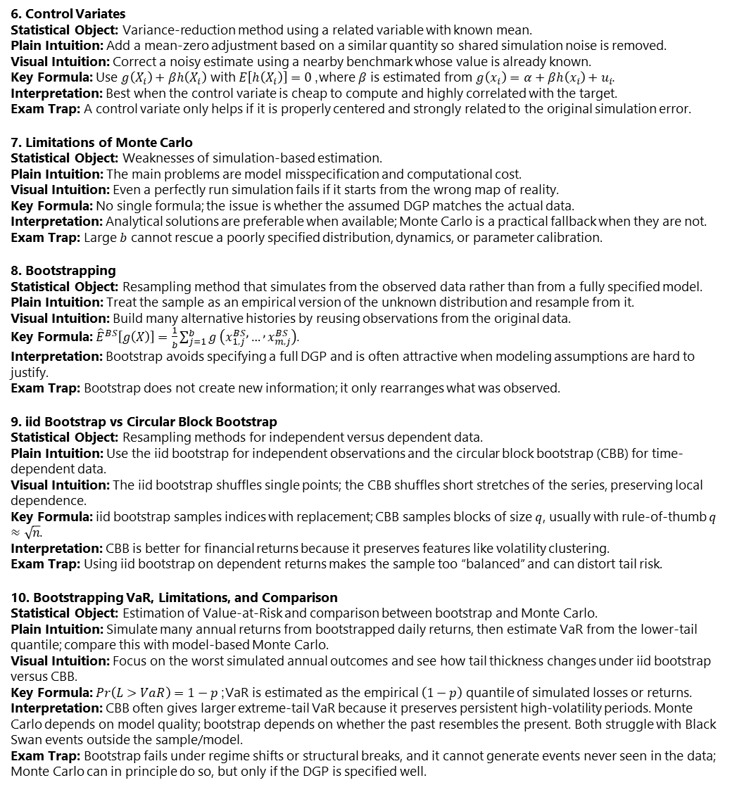
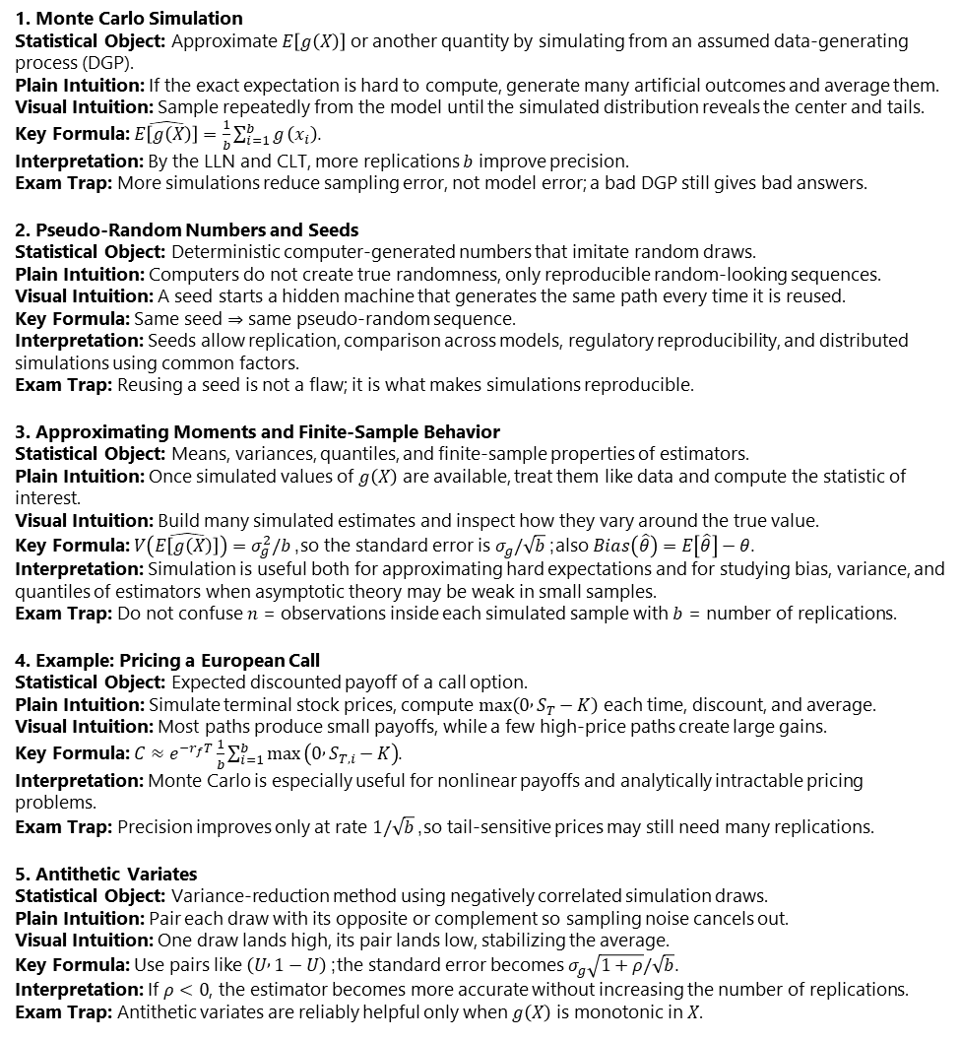
Simulation and Bootstrapping
6. Control Variates Statistical Object: Variance-reduction method using a related variable with known mean. Plain Intuition: Add a mean-zero adjustment based on a similar quantity so shared simulation noise is removed. Visual Intuition: Correct a noisy estimate using a nearby benchmark whose value is already known. Key Formula: Use $g\left(X_{i}\right)+βh\left(X_{i}\right)$ with $E\left[h\left(X_{i}\right)\right]=0$, where $β$ is estimated from $g\left(x_{i}\right)=α+βh\left(x_{i}\right)+u_{i}$. Interpretation: Best when the control variate is cheap to compute and highly correlated with the target. Exam Trap: A control variate only helps if it is properly centered and strongly related to the original simulation error.
7. Limitations of Monte Carlo Statistical Object: Weaknesses of simulation-based estimation. Plain Intuition: The main problems are model misspecification and computational cost. Visual Intuition: Even a perfectly run simulation fails if it starts from the wrong map of reality. Key Formula: No single formula; the issue is whether the assumed DGP matches the actual data. Interpretation: Analytical solutions are preferable when available; Monte Carlo is a practical fallback when they are not. Exam Trap: Large $b$ cannot rescue a poorly specified distribution, dynamics, or parameter calibration.
8. Bootstrapping Statistical Object: Resampling method that simulates from the observed data rather than from a fully specified model. Plain Intuition: Treat the sample as an empirical version of the unknown distribution and resample from it. Visual Intuition: Build many alternative histories by reusing observations from the original data. Key Formula: ${\hat{E}}^{BS}\left[g\left(X\right)\right]=\frac{1}{b}\sum_{j=1}^{b}{g}\left(x_{1,j}^{BS} , … , x_{m,j}^{BS}\right)$. Interpretation: Bootstrap avoids specifying a full DGP and is often attractive when modeling assumptions are hard to justify. Exam Trap: Bootstrap does not create new information; it only rearranges what was observed.
9. iid Bootstrap vs Circular Block Bootstrap Statistical Object: Resampling methods for independent versus dependent data. Plain Intuition: Use the iid bootstrap for independent observations and the circular block bootstrap (CBB) for time-dependent data. Visual Intuition: The iid bootstrap shuffles single points; the CBB shuffles short stretches of the series, preserving local dependence. Key Formula: iid bootstrap samples indices with replacement; CBB samples blocks of size $q$, usually with rule-of-thumb $q≈\sqrt{n}$. Interpretation: CBB is better for financial returns because it preserves features like volatility clustering. Exam Trap: Using iid bootstrap on dependent returns makes the sample too “balanced” and can distort tail risk.
10. Bootstrapping VaR, Limitations, and Comparison Statistical Object: Estimation of Value-at-Risk and comparison between bootstrap and Monte Carlo. Plain Intuition: Simulate many annual returns from bootstrapped daily returns, then estimate VaR from the lower-tail quantile; compare this with model-based Monte Carlo. Visual Intuition: Focus on the worst simulated annual outcomes and see how tail thickness changes under iid bootstrap versus CBB. Key Formula: $Pr\left(L>VaR\right)=1−p$; VaR is estimated as the empirical $\left(1−p\right)$ quantile of simulated losses or returns. Interpretation: CBB often gives larger extreme-tail VaR because it preserves persistent high-volatility periods. Monte Carlo depends on model quality; bootstrap depends on whether the past resembles the present. Both struggle with Black Swan events outside the sample/model. Exam Trap: Bootstrap fails under regime shifts or structural breaks, and it cannot generate events never seen in the data; Monte Carlo can in principle do so, but only if the DGP is specified well.
1. Monte Carlo Simulation Statistical Object: Approximate $E\left[g\left(X\right)\right]$ or another quantity by simulating from an assumed data-generating process (DGP). Plain Intuition: If the exact expectation is hard to compute, generate many artificial outcomes and average them. Visual Intuition: Sample repeatedly from the model until the simulated distribution reveals the center and tails. Key Formula: $\hat{E\left[g\left(X\right)\right]}=\frac{1}{b}\sum_{i=1}^{b}{g}\left(x_{i}\right)$. Interpretation: By the LLN and CLT, more replications $b$ improve precision. Exam Trap: More simulations reduce sampling error, not model error; a bad DGP still gives bad answers.
2. Pseudo-Random Numbers and Seeds Statistical Object: Deterministic computer-generated numbers that imitate random draws. Plain Intuition: Computers do not create true randomness, only reproducible random-looking sequences. Visual Intuition: A seed starts a hidden machine that generates the same path every time it is reused. Key Formula: Same seed $⇒$ same pseudo-random sequence. Interpretation: Seeds allow replication, comparison across models, regulatory reproducibility, and distributed simulations using common factors. Exam Trap: Reusing a seed is not a flaw; it is what makes simulations reproducible.
3. Approximating Moments and Finite-Sample Behavior Statistical Object: Means, variances, quantiles, and finite-sample properties of estimators. Plain Intuition: Once simulated values of $g\left(X\right)$ are available, treat them like data and compute the statistic of interest. Visual Intuition: Build many simulated estimates and inspect how they vary around the true value. Key Formula: $V\left(\hat{E\left[g\left(X\right)\right]}\right)=σ_{g}^{2}/b$, so the standard error is $σ_{g}/\sqrt{b}$; also $Bias\left(\hat{θ}\right)=E\left[\hat{θ}\right]−θ$. Interpretation: Simulation is useful both for approximating hard expectations and for studying bias, variance, and quantiles of estimators when asymptotic theory may be weak in small samples. Exam Trap: Do not confuse $n$ = observations inside each simulated sample with $b$ = number of replications.
4. Example: Pricing a European Call Statistical Object: Expected discounted payoff of a call option. Plain Intuition: Simulate terminal stock prices, compute $max⁡\left(0 , S_{T}−K\right)$ each time, discount, and average. Visual Intuition: Most paths produce small payoffs, while a few high-price paths create large gains. Key Formula: $C≈e^{−r_{f}T}\frac{1}{b}\sum_{i=1}^{b}{max}⁡\left(0 , S_{T,i}−K\right)$. Interpretation: Monte Carlo is especially useful for nonlinear payoffs and analytically intractable pricing problems. Exam Trap: Precision improves only at rate $1/\sqrt{b}$, so tail-sensitive prices may still need many replications.
5. Antithetic Variates Statistical Object: Variance-reduction method using negatively correlated simulation draws. Plain Intuition: Pair each draw with its opposite or complement so sampling noise cancels out. Visual Intuition: One draw lands high, its pair lands low, stabilizing the average. Key Formula: Use pairs like $\left(U , 1−U\right)$; the standard error becomes $σ_{g}\sqrt{1+ρ}/\sqrt{b}$. Interpretation: If $ρ<0$, the estimator becomes more accurate without increasing the number of replications. Exam Trap: Antithetic variates are reliably helpful only when $g\left(X\right)$ is monotonic in $X$.

Slide 30
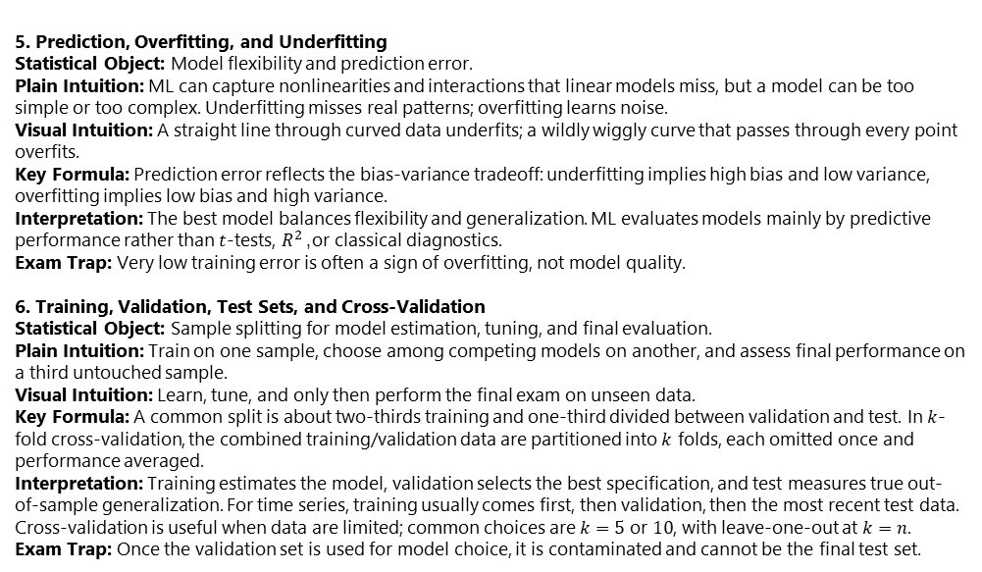
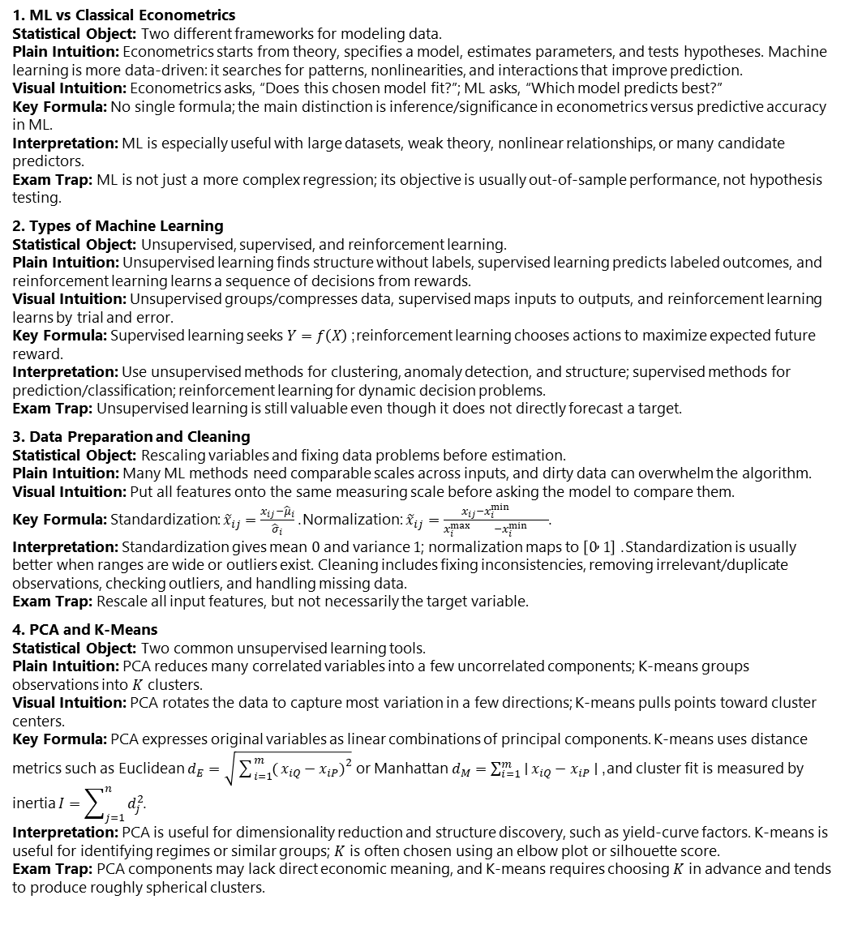
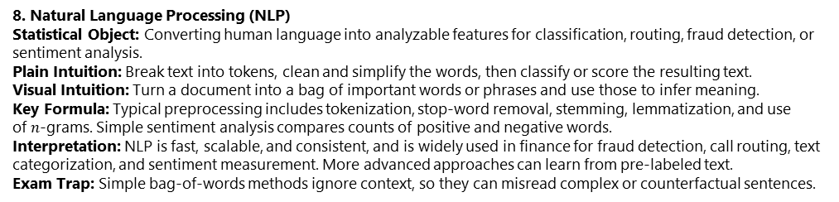
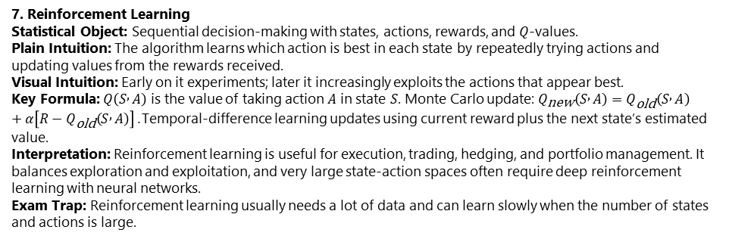
Machine Learning Methods
5. Prediction, Overfitting, and Underfitting Statistical Object: Model flexibility and prediction error. Plain Intuition: ML can capture nonlinearities and interactions that linear models miss, but a model can be too simple or too complex. Underfitting misses real patterns; overfitting learns noise. Visual Intuition: A straight line through curved data underfits; a wildly wiggly curve that passes through every point overfits. Key Formula: Prediction error reflects the bias-variance tradeoff: underfitting implies high bias and low variance, overfitting implies low bias and high variance. Interpretation: The best model balances flexibility and generalization. ML evaluates models mainly by predictive performance rather than $t$-tests, $R^{2}$, or classical diagnostics. Exam Trap: Very low training error is often a sign of overfitting, not model quality.
6. Training, Validation, Test Sets, and Cross-Validation Statistical Object: Sample splitting for model estimation, tuning, and final evaluation. Plain Intuition: Train on one sample, choose among competing models on another, and assess final performance on a third untouched sample. Visual Intuition: Learn, tune, and only then perform the final exam on unseen data. Key Formula: A common split is about two-thirds training and one-third divided between validation and test. In $k$-fold cross-validation, the combined training/validation data are partitioned into $k$ folds, each omitted once and performance averaged. Interpretation: Training estimates the model, validation selects the best specification, and test measures true out-of-sample generalization. For time series, training usually comes first, then validation, then the most recent test data. Cross-validation is useful when data are limited; common choices are $k=5$ or $10$, with leave-one-out at $k=n$. Exam Trap: Once the validation set is used for model choice, it is contaminated and cannot be the final test set.
1. ML vs Classical Econometrics Statistical Object: Two different frameworks for modeling data. Plain Intuition: Econometrics starts from theory, specifies a model, estimates parameters, and tests hypotheses. Machine learning is more data-driven: it searches for patterns, nonlinearities, and interactions that improve prediction. Visual Intuition: Econometrics asks, “Does this chosen model fit?”; ML asks, “Which model predicts best?” Key Formula: No single formula; the main distinction is inference/significance in econometrics versus predictive accuracy in ML. Interpretation: ML is especially useful with large datasets, weak theory, nonlinear relationships, or many candidate predictors. Exam Trap: ML is not just a more complex regression; its objective is usually out-of-sample performance, not hypothesis testing.
2. Types of Machine Learning Statistical Object: Unsupervised, supervised, and reinforcement learning. Plain Intuition: Unsupervised learning finds structure without labels, supervised learning predicts labeled outcomes, and reinforcement learning learns a sequence of decisions from rewards. Visual Intuition: Unsupervised groups/compresses data, supervised maps inputs to outputs, and reinforcement learning learns by trial and error. Key Formula: Supervised learning seeks $Y=f\left(X\right)$; reinforcement learning chooses actions to maximize expected future reward. Interpretation: Use unsupervised methods for clustering, anomaly detection, and structure; supervised methods for prediction/classification; reinforcement learning for dynamic decision problems. Exam Trap: Unsupervised learning is still valuable even though it does not directly forecast a target.
3. Data Preparation and Cleaning Statistical Object: Rescaling variables and fixing data problems before estimation. Plain Intuition: Many ML methods need comparable scales across inputs, and dirty data can overwhelm the algorithm. Visual Intuition: Put all features onto the same measuring scale before asking the model to compare them. Key Formula: Standardization: ${\tilde{x}}_{ij}=\frac{x_{ij}−{\hat{μ}}_{i}}{{\hat{σ}}_{i}}$. Normalization: ${\tilde{x}}_{ij}=\frac{x_{ij}−x_{i}^{min{}}}{x_{i}^{max{}}−x_{i}^{min{}}}$. Interpretation: Standardization gives mean $0$ and variance $1$; normalization maps to $\left[0 , 1\right]$. Standardization is usually better when ranges are wide or outliers exist. Cleaning includes fixing inconsistencies, removing irrelevant/duplicate observations, checking outliers, and handling missing data. Exam Trap: Rescale all input features, but not necessarily the target variable.
4. PCA and K-Means Statistical Object: Two common unsupervised learning tools. Plain Intuition: PCA reduces many correlated variables into a few uncorrelated components; K-means groups observations into $K$ clusters. Visual Intuition: PCA rotates the data to capture most variation in a few directions; K-means pulls points toward cluster centers. Key Formula: PCA expresses original variables as linear combinations of principal components. K-means uses distance metrics such as Euclidean $d_{E}=\sqrt{\sum_{i=1}^{m}{(}\left.x_{iQ}−x_{iP}{\left.)\right.}^{2}\right.}$ or Manhattan $d_{M}=\sum_{i=1}^{m}{∣}x_{iQ}−x_{iP}∣$, and cluster fit is measured by inertia $I=\sum_{j=1}^{n}{d_{j}^{2}}$. Interpretation: PCA is useful for dimensionality reduction and structure discovery, such as yield-curve factors. K-means is useful for identifying regimes or similar groups; $K$ is often chosen using an elbow plot or silhouette score. Exam Trap: PCA components may lack direct economic meaning, and K-means requires choosing $K$ in advance and tends to produce roughly spherical clusters.
7. Reinforcement Learning Statistical Object: Sequential decision-making with states, actions, rewards, and $Q$-values. Plain Intuition: The algorithm learns which action is best in each state by repeatedly trying actions and updating values from the rewards received. Visual Intuition: Early on it experiments; later it increasingly exploits the actions that appear best. Key Formula: $Q\left(S , A\right)$ is the value of taking action $A$ in state $S$. Monte Carlo update: $Q_{\text{new}}\left(S , A\right)=Q_{\text{old}}\left(S , A\right)+α\left[R−Q_{\text{old}}\left(S , A\right)\right]$. Temporal-difference learning updates using current reward plus the next state’s estimated value. Interpretation: Reinforcement learning is useful for execution, trading, hedging, and portfolio management. It balances exploration and exploitation, and very large state-action spaces often require deep reinforcement learning with neural networks. Exam Trap: Reinforcement learning usually needs a lot of data and can learn slowly when the number of states and actions is large.
8. Natural Language Processing (NLP) Statistical Object: Converting human language into analyzable features for classification, routing, fraud detection, or sentiment analysis. Plain Intuition: Break text into tokens, clean and simplify the words, then classify or score the resulting text. Visual Intuition: Turn a document into a bag of important words or phrases and use those to infer meaning. Key Formula: Typical preprocessing includes tokenization, stop-word removal, stemming, lemmatization, and use of $n$-grams. Simple sentiment analysis compares counts of positive and negative words. Interpretation: NLP is fast, scalable, and consistent, and is widely used in finance for fraud detection, call routing, text categorization, and sentiment measurement. More advanced approaches can learn from pre-labeled text. Exam Trap: Simple bag-of-words methods ignore context, so they can misread complex or counterfactual sentences.

Slide 31
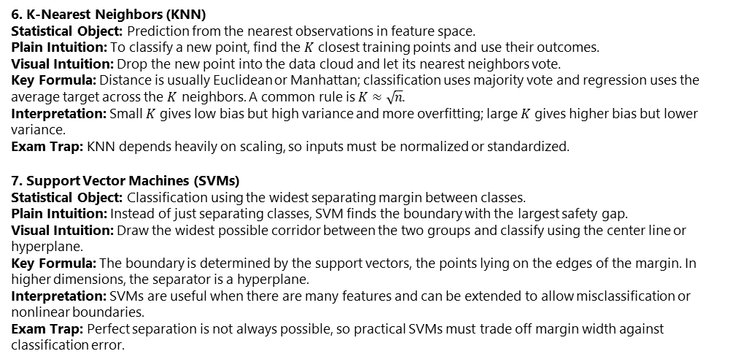


Machine Learning and Predictions:
1. Categorical Variables and Encoding Statistical Object: Converting qualitative information into numerical inputs. Plain Intuition: Unordered categories must be represented with separate dummy variables; ordered categories can use integer coding. Visual Intuition: For unordered categories, each category gets its own on/off switch. Key Formula: One-hot encoding uses one dummy per category; ordinal encoding uses values like $0,1,2$ only when order is meaningful. Interpretation: One-hot encoding avoids imposing a false ranking across categories. Exam Trap: Never code unordered categories as $0,1,2,…$ because that creates artificial order and distance.
2. Regularization: Ridge, LASSO, and Elastic Net Statistical Object: Linear prediction with penalties that shrink coefficients. Plain Intuition: When there are many correlated features, OLS can produce unstable, offsetting coefficients; regularization keeps the model smaller and more robust. Visual Intuition: Pull large coefficients back toward zero so the model becomes smoother and less fragile. Key Formula: Ridge minimizes RSS $+λ\sum{β_{i}^{2}}$; LASSO minimizes RSS $+λ\sum{∣}β_{i}∣$; Elastic Net combines both penalties. Interpretation: Ridge shrinks coefficients but usually keeps all variables; LASSO can set some coefficients exactly to zero and acts as feature selection; Elastic Net mixes both effects. The tuning parameter $λ$ is a hyperparameter chosen using training/validation/test splits. Exam Trap: Ridge and LASSO are not the same: Ridge shrinks, LASSO can eliminate features.
3. Logistic Regression Statistical Object: Predicting a binary outcome as a probability. Plain Intuition: For yes/no problems, linear regression is inappropriate because predicted probabilities can fall outside $\left[0 , 1\right]$; logistic regression maps a linear score into that range. Visual Intuition: A straight-line score is passed through an S-shaped sigmoid curve. Key Formula: $p_{j}=\frac{1}{1+e^{−\left(α+β_{1}X_{1j}+⋯+β_{m}X_{mj}\right)}}$. Predict class $1$ if $p_{j}>Z$, else $0$. Parameters are estimated by maximum likelihood, not OLS. Interpretation: Coefficient signs still show direction, but magnitudes are not interpreted like OLS because of the nonlinear transformation. The threshold $Z$ depends on the relative costs of false positives and false negatives. Regularization can also be applied to logistic regression. Exam Trap: The cutoff is not automatically $0.5$; it should reflect the decision problem.
4. Model Evaluation for Prediction and Classification Statistical Object: Measuring out-of-sample predictive performance. Plain Intuition: Continuous targets are evaluated with forecast errors; binary targets are evaluated with confusion-matrix metrics. Visual Intuition: For classification, place predictions into a $2×2$ table of right and wrong decisions. Key Formula: Continuous case: $MSFE=\frac{1}{n_{test}}\sum{(}\left.y_{i}−{\hat{y}}_{i}{\left.)\right.}^{2}\right.$. Binary case: Accuracy $=\frac{TP+TN}{TP+TN+FP+FN}$, Precision $=\frac{TP}{TP+FP}$, Recall $=\frac{TP}{TP+FN}$. ROC curves vary the threshold $Z$, and AUC summarizes overall classification quality. Interpretation: Different metrics reward different behavior. Precision, recall, and AUC are often more informative than accuracy when class frequencies or error costs differ. Exam Trap: High accuracy alone can be misleading if the important class is predicted poorly.
Exam Trap: Bagging builds models independently; boosting builds them sequentially to correct earlier errors.
6. K-Nearest Neighbors (KNN) Statistical Object: Prediction from the nearest observations in feature space. Plain Intuition: To classify a new point, find the $K$ closest training points and use their outcomes. Visual Intuition: Drop the new point into the data cloud and let its nearest neighbors vote. Key Formula: Distance is usually Euclidean or Manhattan; classification uses majority vote and regression uses the average target across the $K$ neighbors. A common rule is $K≈\sqrt{n}$. Interpretation: Small $K$ gives low bias but high variance and more overfitting; large $K$ gives higher bias but lower variance. Exam Trap: KNN depends heavily on scaling, so inputs must be normalized or standardized.
7. Support Vector Machines (SVMs) Statistical Object: Classification using the widest separating margin between classes. Plain Intuition: Instead of just separating classes, SVM finds the boundary with the largest safety gap. Visual Intuition: Draw the widest possible corridor between the two groups and classify using the center line or hyperplane. Key Formula: The boundary is determined by the support vectors, the points lying on the edges of the margin. In higher dimensions, the separator is a hyperplane. Interpretation: SVMs are useful when there are many features and can be extended to allow misclassification or nonlinear boundaries. Exam Trap: Perfect separation is not always possible, so practical SVMs must trade off margin width against classification error.
8. Neural Networks and Comparison with Logistic Regression Statistical Object: Flexible nonlinear prediction through layers of weighted nodes. Plain Intuition: Inputs feed into hidden units, activation functions create nonlinear transformations, and the final output gives a prediction or classification. Visual Intuition: Data pass through successive layers that learn increasingly complex patterns. Key Formula: Hidden units take forms like $H=φ\left(w_{1}X_{1}+⋯+w_{m}X_{m}+b\right)$, and outputs are computed similarly from hidden-layer values. Weights and biases are estimated numerically using gradient descent; the learning rate controls step size. Interpretation: Without nonlinear activation functions, a neural network reduces to a linear model. Large networks are flexible but prone to overfitting, so validation data are used to stop training. Compared with logistic regression, neural networks are less interpretable but can capture richer nonlinear structure. Confusion matrices show that one model may do better on precision while the other does better on recall, so the preferred model depends on the cost of each type of error. Exam Trap: No single metric determines the better classifier; accuracy, precision, and recall can point in different directions.

Slide 32
Financial Products and Markets

Slide 33

Bancos:
1. Commercial vs Investment Banking Financial Object: The two main banking functions. Plain Intuition: Commercial banking takes deposits and makes loans, while investment banking raises capital, advises firms, and intermediates securities trading. Retail banking serves individuals and small firms; wholesale banking serves large corporations with larger transactions, lower unit costs, and lower spreads. Visual Intuition: Commercial banking = balance-sheet intermediation; investment banking = capital markets and advisory services. Key Formula: No formula; the key distinction is deposits/loans versus underwriting/advisory/trading. Interpretation: Some countries separate the two more strictly, especially to prevent deposit-funded risk taking. Exam Trap: Wholesale banking is part of commercial banking, not the same as investment banking.
2. Main Risks Faced by Banks Financial Object: Market risk, credit risk, and operational risk. Plain Intuition: Banks can lose money because market prices move, borrowers or counterparties default, or systems/people/processes fail. Visual Intuition: Trading exposures, lending exposures, and business-process failures. Key Formula: Net interest margin = loan rate minus funding cost. Interpretation: Market risk mainly comes from trading and market-making; credit risk from loans and derivatives counterparties; operational risk includes fraud, cyber risk, legal/compliance failures, process errors, and system disruptions. Exam Trap: Operational risk is a broad residual category, not just back-office mistakes.
3. Credit Losses, Capital, and Regulation Financial Object: How banks absorb expected and unexpected losses. Plain Intuition: Expected losses are built into pricing and accounting adjustments, while capital is held for unexpected losses. Equity absorbs losses while the bank survives; debt capital absorbs losses after failure. Visual Intuition: Margins cover normal losses; capital covers stress losses. Key Formula: Required Capital = $max⁡\left(I , MC 0.725×SMC\right)$. Interpretation: Regulatory capital is the minimum required by regulators; economic capital is the bank’s own estimate. Basel I set common capital rules, Basel II added operational risk and improved credit risk treatment, and Basel III raised equity and tightened standards after the crisis. Exam Trap: Capital is mainly for unexpected losses, not expected losses.
4. Trading Book, Banking Book, and Liquidity Financial Object: Regulatory treatment of positions and funding risk. Plain Intuition: Trading book items are held for trading and mainly attract market risk capital; banking book items are generally held to maturity and mainly attract credit risk capital. Separately, a bank can fail if short-term funding disappears before long-term assets mature. Visual Intuition: Dealer inventory versus hold-to-collect assets; short-term funding supporting long-term loans. Key Formula: No single formula; key Basel III tools are the Liquidity Coverage Ratio and Net Stable Funding Ratio. Interpretation: The Liquidity Coverage Ratio protects against a 30-day stress scenario, while the Net Stable Funding Ratio limits maturity mismatch. Exam Trap: A bank can be solvent but still fail because of liquidity problems.
5. Deposit Insurance and Moral Hazard Financial Object: Protection for depositors and the incentives it creates. Plain Intuition: Deposit insurance supports confidence in banks, but it can also encourage banks to take more risk because depositors stop monitoring them. Visual Intuition: Depositors feel safe, so market discipline weakens. Key Formula: No formula; the key concept is moral hazard. Interpretation: Risk-based insurance premiums and risk-sensitive capital requirements reduce this problem. Exam Trap: Deposit insurance improves stability, but by itself it can worsen risk-taking incentives.
6. Investment Banking: Underwriting, IPOs, and Advice Financial Object: Raising capital and advising firms on strategic transactions. Plain Intuition: Investment banks help firms issue securities, price IPOs, and advise on mergers, acquisitions, divestitures, and restructurings. Public offerings can be done on a best-efforts basis or a firm-commitment basis. Visual Intuition: The bank stands between issuers and investors, helping price and distribute securities. Key Formula: In a firm commitment, bank profit depends on resale price minus purchase price. Interpretation: Best efforts is safer for the bank; firm commitment is safer for the issuer. IPO pricing is difficult because no market price exists yet, and Dutch auctions try to let the market set the issue price. Exam Trap: IPO underpricing can still occur even with auction-based issuance.
7. Trading, Conflicts of Interest, and Chinese Walls Financial Object: Market-making activity and internal incentive conflicts. Plain Intuition: Banks provide clients with trading and brokerage services, but different divisions may have conflicting incentives, such as research, lending, underwriting, and advisory teams influencing each other. Visual Intuition: One bank, many businesses, overlapping interests. Key Formula: No formula; the key mechanism is information barriers. Interpretation: Chinese walls are internal rules that limit information sharing to reduce conflicts of interest. These matter because fines and reputational damage can be large. Exam Trap: Conflicts of interest are one reason regulators have historically separated commercial and investment banking.
8. Originate-to-Distribute and Securitization Financial Object: Moving loans off the balance sheet and redistributing risk. Plain Intuition: Instead of keeping loans, banks can originate them, package them into securities, and sell the risk to investors. Visual Intuition: Loans flow into an SPV, which creates tranches with different exposures to loss. Key Formula: Equity tranche bears first losses, mezzanine bears the next layer, and senior tranche bears losses only after subordinate tranches are wiped out. Interpretation: This model frees balance-sheet capacity and generates fees, but it contributed to the 2007-2008 crisis because weak loans were still securitized and even re-securitized. Exam Trap: Securitization transfers risk; it does not eliminate it.

Slide 34


Insurance Companies and Pension plans
5. Longevity, Mortality, and Investment Risk Financial Object: Key risks on life insurers’ liabilities and assets. Plain Intuition: Longevity risk means people live longer than expected; mortality risk means they die sooner. Life insurance benefits from longevity, while annuities and defined benefit pensions are hurt by it. Visual Intuition: Longer lives delay death benefits but increase the length of annuity and pension payments. Key Formula: A simple longevity derivative payoff can be $\left(\text{fixed} \text{mortality} \text{rate}−\text{realized} \text{mortality} \text{rate}\right)×\text{principal}$. Interpretation: Life insurers partly offset mortality and longevity exposures across products, but residual risk remains and can be hedged with longevity derivatives. On the asset side, insurers often invest in long-term corporate bonds, which introduce interest rate, market, and credit risk. Exam Trap: Longevity risk is favorable for whole life insurance but unfavorable for annuities and pension obligations.
6. Pension Plans Financial Object: Retirement arrangements funded by employee and employer contributions. Plain Intuition: Defined contribution plans depend on how invested assets perform; defined benefit plans promise pensions based on a formula, so the employer bears funding and investment risk. Visual Intuition: Defined contribution gives the employee an investment pot; defined benefit gives the employee a promised retirement stream. Key Formula: A typical defined benefit pension can be average final salary $×$ years of service $×$ accrual rate. Interpretation: Defined benefit obligations are long-dated and highly sensitive to the discount rate, often based on AA bond yields. Because pension assets are often invested heavily in equities rather than fully matched in bonds, poor equity performance or rising life expectancy can create large deficits. These deficits reduce shareholder equity and may ultimately shift costs to guaranty entities or younger generations, which is why risk sharing is often discussed. Exam Trap: Defined benefit plans are much riskier for employers than defined contribution plans because promised benefits are fixed while asset performance is uncertain.
7. Property and Casualty Insurance and CAT Bonds Financial Object: Short-term insurance against property damage, liability, and catastrophic events. Plain Intuition: Property-casualty policies are usually one-year contracts repriced annually. Some risks, like auto insurance, involve many largely independent claims and are predictable from experience; catastrophe risks, like hurricanes, can create many correlated claims at once. Visual Intuition: Ordinary claims average out across many policyholders, while catastrophe losses hit many insureds simultaneously. Key Formula: Loss ratio = payouts / premiums. Expense ratio = expenses / premiums. Combined ratio = loss ratio + expense ratio. Operating ratio adjusts the combined ratio for investment income. Interpretation: Catastrophe risk is much harder to diversify, so insurers often transfer it through reinsurance or CAT bonds, where investors receive high yields in exchange for losing interest or principal if specified catastrophe losses occur. CAT bonds are attractive because their risk is often weakly correlated with traditional financial assets. Exam Trap: A low loss ratio alone does not guarantee profitability; expenses and investment income also matter.
8. Health Insurance, Moral Hazard, Adverse Selection, and Regulation Financial Object: Insurance-market frictions and the solvency framework for insurers. Plain Intuition: Health insurance covers medical costs, but unlike property-casualty insurance, premiums usually cannot rise just because a policyholder unexpectedly becomes ill. Insurance markets also face moral hazard and adverse selection. Visual Intuition: Insurance can change behavior after purchase and attract high-risk buyers before purchase. Key Formula: Under Solvency II, insurers must satisfy both a Minimum Capital Requirement (MCR) and a Solvency Capital Requirement (SCR), with MCR usually 25% to 45% of SCR. Interpretation: Moral hazard means insured parties behave differently because they are protected; adverse selection means higher-risk people are more likely to buy insurance if premiums are not risk-sensitive. Deductibles, co-insurance, and claim limits reduce moral hazard. Solvency II in Europe imposes capital for investment risk, underwriting risk, and operational risk, while U.S. insurance regulation is state-based and policyholder protection is handled after insolvency rather than through a permanent pre-funded federal pool like bank deposit insurance. Exam Trap: Moral hazard and adverse selection are different: moral hazard concerns behavior after insurance is purchased, while adverse selection concerns who chooses to buy it before pricing fully reflects risk.
1. Insurance, Life Insurance, and Pension Basics Financial Object: Contracts that exchange regular contributions or premiums for protection or future income. Plain Intuition: Insurance protects against adverse events: most years no claim occurs, but if the insured event happens the insurer makes a large payout. Life insurance and pensions are closely related because both convert contributions into future benefits tied to life events. Visual Intuition: Many small premium inflows fund occasional large insurance claims or long retirement payments. Key Formula: No single formula; the structure is premiums/contributions today for contingent or deferred payouts later. Interpretation: Life insurance and property-casualty insurance are the two main insurance categories. Pension plans are similar to annuities because they provide retirement income for life. Exam Trap: Life insurance and pensions are long-horizon mortality-based products; property-casualty insurance is usually short-term and renewed frequently.
2. Mortality Tables and Life Expectancy Financial Object: Probabilities of death and survival used by actuaries to price life insurance and value pensions. Plain Intuition: Mortality tables show the chance of dying within a year and the cumulative chance of surviving to later ages. Visual Intuition: A survival curve declines gradually with age as yearly death probabilities increase. Key Formula: Survival to year $n+1$ = survival to year $n×\left(1−q_{n}\right)$, where $q_{n}$ is the one-year death probability. Life expectancy is the probability-weighted average remaining lifetime. Interpretation: These tables determine expected payouts, premiums, annuity values, and pension obligations. Exam Trap: The probability of death within a year is conditional on being alive at the start of that year.
3. Whole Life Insurance Financial Object: Insurance covering the policyholder’s entire life. Plain Intuition: Premiums are paid until death, and the insurer definitely pays the face value at death; only the timing is uncertain. Visual Intuition: Expected cash surpluses occur early in life and expected deficits later, so early surpluses must be invested to finance later payouts. Key Formula: Expected payout in a year = face value $×$ probability of death in that year. Interpretation: Whole life policies rely heavily on investment income. Variants include variable life, where policyholders choose investments, and universal life, where premiums can be reduced without lapse; variable-universal combines both features. Tax advantages often arise because investment income grows inside the contract. Exam Trap: Whole life is not like term insurance because the insurer is certain to pay eventually.
4. Term Insurance, Endowment Insurance, Group Life, and Annuities Financial Object: Other major life-insurance-type contracts. Plain Intuition: Term insurance pays only if death occurs during a fixed period; endowment insurance always pays either at death during the term or at maturity; group life covers many employees together; annuities reverse life insurance by converting a lump sum into lifetime payments. Visual Intuition: Term insurance protects against dying too early; annuities protect against living too long. Key Formula: Breakeven premium = present value of expected payouts divided by present value of expected premiums. Interpretation: Group insurance avoids extensive individual underwriting because risks are pooled. Deferred annuities start later and may contain guarantees or investment-linked features. Exam Trap: Life insurance and annuities have opposite exposure to mortality: early death hurts life insurers but helps annuity writers.

Slide 35


Fund Managment
6. Hedge Funds and Incentive Fees Financial Object: Less-regulated funds using flexible strategies and performance-based compensation. Plain Intuition: Hedge funds often impose lockups, use leverage, disclose less, and charge both management and incentive fees. The classic fee structure is “2 and 20.” Visual Intuition: Managers earn a steady fee plus a call-option-like payoff on profits. Key Formula: Incentive fee under 2 and 20 is $0.2×max⁡\left(R , A−0.02A0\right)$, where $A$ is beginning assets and $R$ is gross return. Interpretation: Incentive fees give managers upside without comparable downside, so they may encourage excessive risk-taking. Investors therefore often require protections such as hurdle rates, high-water marks, proportional adjustment clauses, and clawbacks. Prime brokers provide financing, execution, shorting, collateral management, and risk control, but can also force deleveraging if conditions deteriorate. Exam Trap: A hedge fund manager can benefit from taking more risk even when investor expected return does not improve.
7. Hedge Fund Strategies Financial Object: Major hedge fund trading styles. Plain Intuition: Hedge funds pursue many strategies depending on mispricing, macro views, event outcomes, or model-based relative value trades. Visual Intuition: Some strategies bet on spreads converging, some on corporate events, some on macroeconomic imbalances, and some on trends. Key Formula: No universal formula; each strategy depends on identifying pricing discrepancies or directional opportunities. Interpretation: Long-short equity buys undervalued stocks and shorts overvalued ones. Dedicated short focuses on overpriced stocks and tends to do poorly in bull markets. Distressed debt targets troubled issuers and restructurings. Merger arbitrage trades on announced deals. Convertible arbitrage values convertible bonds and hedges embedded risks. Fixed-income arbitrage exploits relative mispricing among bonds, often with leverage. Emerging markets strategies trade securities in developing economies. Global macro uses macroeconomic views on rates, FX, and other variables. Managed futures use models and back-testing to trade futures markets. Exam Trap: “Arbitrage” hedge fund strategies are rarely riskless; they often involve leverage, model risk, liquidity risk, and event risk.
8. Performance and Measurement Biases Financial Object: Assessing whether active fund management adds value. Plain Intuition: Research shows actively managed mutual funds do not beat the market on average after fees, and past outperformance rarely persists. Hedge fund performance is harder to evaluate because reporting is incomplete and biased. Visual Intuition: Strong historical performance may reflect luck, selection, or missing bad outcomes rather than persistent skill. Key Formula: No single formula; the main issues are average abnormal performance, persistence, and reporting bias. Interpretation: Mutual fund evidence supports passive investing because index funds charge lower fees and often outperform active funds after expenses. Hedge fund databases suffer from self-reporting, survivorship, and selection biases because poorly performing or closed funds are less likely to report. Hedge funds may outperform in bear markets and underperform in bull markets, which partly explains mixed evidence relative to broad equity indexes like the S&P 500. Exam Trap: Do not interpret reported hedge fund average returns at face value; measurement biases can overstate true performance.
5. Undesirable Trading Behavior in Mutual Funds Financial Object: Trading abuses and conflicts in fund management. Plain Intuition: Some trading behaviors exploit stale pricing, privileged timing, or knowledge of pending trades at the expense of other investors. Visual Intuition: Traders or brokers use information others do not have to obtain an unfair advantage. Key Formula: No formula; the issue is unfair execution or informational advantage. Interpretation: Late trading means placing or changing trades after 4 p.m. but receiving the 4 p.m. price, which is illegal. Market timing exploits stale prices and is not necessarily illegal, but can harm other investors. Front running means trading ahead of known large fund orders and is illegal. Directed brokerage means routing trades to brokers in exchange for distribution support and is frowned upon by regulators. Exam Trap: Market timing is not the same as late trading; the former exploits stale prices, the latter violates the pricing cutoff.
1. Mutual Funds, ETFs, and Hedge Funds Financial Object: Pooled investment vehicles managed on behalf of investors. Plain Intuition: Fund managers pool money, invest according to stated objectives, and offer investors expertise, lower transaction costs, and diversification. Mutual funds and ETFs mainly serve retail investors; hedge funds mainly serve wealthy individuals and institutions. Visual Intuition: Many investors place money into one large portfolio managed by a professional. Key Formula: No single formula; the key distinction is structure, regulation, liquidity, and investor base. Interpretation: Mutual funds and ETFs are more regulated and transparent; hedge funds are less regulated, use wider strategies, and usually require large minimum investments. Exam Trap: Hedge funds are not just “riskier mutual funds”; they differ in lockups, leverage, fees, disclosure, and regulation.
2. Open-End Mutual Funds and NAV Financial Object: Mutual funds whose shares expand and contract with investor demand. Plain Intuition: Investors buy from and redeem shares with the fund itself, so the number of shares changes over time. All trades occur at the end-of-day net asset value. Visual Intuition: Cash enters or leaves the fund, and the fund creates or cancels shares accordingly. Key Formula: $\text{NAV}=\frac{\text{value} \text{of} \text{fund} \text{assets}}{\text{number} \text{of} \text{fund} \text{shares}}$. Interpretation: Assets are valued at 4 p.m., and all orders placed before then transact at that 4 p.m. NAV. Open-end funds include money market, bond, equity, and hybrid funds. Equity funds may be actively managed or passive index funds. Exam Trap: An investor placing an order in the morning does not lock in the morning price; the trade occurs at the next 4 p.m. NAV.
3. Index Funds, Tracking Error, Fees, and Closed-End Funds Financial Object: Passive funds, fee structures, and closed-end mutual funds. Plain Intuition: Index funds try to replicate a benchmark rather than beat it; closed-end funds have a fixed number of shares and trade like ordinary stocks. Visual Intuition: Index funds shadow an index; closed-end funds have a market price that can differ from underlying asset value. Key Formula: Tracking error can be measured by the root-mean-square difference between fund returns and index returns. Interpretation: Index funds usually charge much lower fees than active funds and have grown rapidly because active funds do not outperform the market on average after fees. Closed-end funds often trade below NAV, partly because management fees reduce the present value to investors. Unlike open-end funds, closed-end funds can be traded intraday and shorted, and they do not need liquidity for redemptions. Exam Trap: Closed-end funds do not trade at NAV like open-end funds; their price is determined by supply and demand.
4. Exchange-Traded Funds (ETFs) Financial Object: Funds combining features of open-end and closed-end structures. Plain Intuition: ETFs trade on exchanges like stocks, but authorized institutional investors can create or redeem shares by exchanging baskets of underlying securities, which keeps price close to NAV. Visual Intuition: If ETF price drifts away from NAV, institutions arbitrage the gap by swapping ETF shares for the underlying portfolio or vice versa. Key Formula: No single formula beyond the NAV concept; the key mechanism is creation/redemption arbitrage. Interpretation: ETFs can be traded intraday, shorted, and do not require large liquidity buffers for retail redemptions, yet unlike closed-end funds they usually do not trade at persistent discounts or premiums to NAV. Some are passive and some are active, though active ETFs must disclose holdings more frequently. Exam Trap: ETFs are not the same as index mutual funds; both may track indexes, but ETF shares trade continuously on exchanges.

Slide 36


Introduction to Derivatives
5. Options Financial Object: Contracts giving the right, but not the obligation, to buy or sell an asset at a fixed price. Plain Intuition: A call gives the right to buy; a put gives the right to sell. The buyer pays a premium for this flexibility. Visual Intuition: Options protect against bad outcomes while allowing favorable outcomes to be retained. Key Formula: Long call payoff = $max⁡\left(S_{T} , −K0\right)$. Short call payoff = $−max⁡\left(S_{T} , −K0\right)$. Long put payoff = $max⁡\left(K , −S_{T}0\right)$. Short put payoff = $−max⁡\left(K , −S_{T}0\right)$. Interpretation: European options can be exercised only at expiration; American options can be exercised at any time up to expiration. Options are non-linear derivatives, so their values depend on the underlying in a non-linear way and are also sensitive to volatility. Exam Trap: Entering an option requires paying a premium, unlike entering a forward.
6. Hedgers Financial Object: Traders who use derivatives to reduce existing risk exposures. Plain Intuition: Hedgers use forwards, futures, or options to protect themselves against adverse price moves in something they already care about, such as FX, interest rates, or commodities. Visual Intuition: A hedge offsets a risky exposure with a derivative position that gains when the original exposure loses. Key Formula: A forward locks in a future price; an option provides one-sided protection with payoff such as $max⁡\left(S_{T} , −K0\right)$ or $max⁡\left(K , −S_{T}0\right)$. Interpretation: A firm that must pay euros in the future can buy euros forward or buy a call option on euros. The forward gives certainty at no premium, while the option costs money but preserves upside if exchange rates move favorably. Exam Trap: A forward removes upside and downside, while an option protects downside but keeps upside, at the cost of a premium.
7. Speculators Financial Object: Traders who use derivatives to bet on future market movements without an offsetting exposure. Plain Intuition: Derivatives allow speculators to take large positions with relatively small upfront cash, creating leverage. Visual Intuition: A small premium can control a much larger notional exposure. Key Formula: Option payoff magnifies gains when the trade is right but can lose the entire premium when wrong. Interpretation: Compared with buying the underlying asset, buying options can create much larger percentage gains if prices move favorably, but also total loss of the premium if they do not. Derivatives therefore make speculation highly attractive but highly risky. Exam Trap: Leverage increases both potential reward and potential loss; options can expire worthless even when the underlying did not move much.
8. Arbitrageurs and Derivatives Risks Financial Object: Riskless pricing opportunities and dangers created by derivatives use. Plain Intuition: Arbitrageurs exploit inconsistent prices across markets to lock in profits. At the same time, derivatives can create major risks when used for hidden or excessive speculation. Visual Intuition: Arbitrage links markets together; poor controls let traders hide increasingly dangerous positions. Key Formula: Example arbitrage profit = forward sale proceeds minus borrowing repayment when the forward price is too high relative to spot and financing cost. Interpretation: Arbitrage helps enforce pricing consistency. But derivatives can lead to catastrophic losses when traders exceed mandates, hide positions, or double down after losses. Famous cases include Barings, Societe Generale, UBS, and Allied Irish Bank. Exam Trap: Derivatives themselves are not inherently dangerous; the main danger often comes from leverage, opacity, and weak risk controls.
1. What Derivatives Are and Why They Matter Financial Object: Contracts whose values depend on one or more underlying variables. Plain Intuition: A derivative gets its value from something else, such as a stock price, exchange rate, interest rate, commodity price, temperature, or even insurance losses. Visual Intuition: The derivative is a layer on top of an underlying asset or variable; when the underlying moves, the derivative’s value moves too. Key Formula: No single formula; the essential idea is that derivative value is a function of the underlying and often of other variables such as interest rates and volatility. Interpretation: Derivatives can be linear, like forwards, where payoff changes proportionally with the underlying, or non-linear, like options, where payoff changes asymmetrically. They are used for hedging, speculation, structuring securities, employee compensation, real options, mortgages, and many other applications. Exam Trap: Derivatives are not always based on financial assets; almost any observable variable can be an underlying.
2. Exchange-Traded vs Over-the-Counter Markets Financial Object: The two main ways derivatives are traded. Plain Intuition: Exchange-traded derivatives are standardized contracts traded on organized exchanges, while OTC derivatives are privately negotiated contracts tailored to users’ needs. Visual Intuition: Exchange markets are standardized and centralized; OTC markets are flexible and customized. Key Formula: No formula; the core contrast is standardization versus customization. Interpretation: Exchange-traded markets provide standard contracts and mechanisms that reduce default risk. OTC markets allow customization and are used by end users and dealers, with dealers often hedging risk in interdealer markets. Post-2008 reforms increased OTC transparency through trading platforms, central clearing for standardized trades, and trade reporting. Exam Trap: OTC markets are not necessarily informal or small; they are very large and often dealer-driven.
3. Forward Contracts Financial Object: OTC agreements to buy or sell an asset at a specified future date for a predetermined price. Plain Intuition: A forward locks in the price today for a transaction that will happen later. One side agrees to buy, the other to sell. Visual Intuition: The long benefits if the future spot price rises above the delivery price; the short benefits if it falls below it. Key Formula: Long forward payoff = $S_{T}−K$. Short forward payoff = $K−S_{T}$. Interpretation: Forwards are linear derivatives because payoff depends linearly on the underlying price at maturity. They are widely used to hedge foreign exchange and interest rate exposures. Exam Trap: A forward contract has no upfront cost, but it still creates gain/loss exposure at maturity.
4. Futures Contracts Financial Object: Exchange-traded contracts with payoffs similar to forwards. Plain Intuition: A futures contract works like a forward, but it is standardized and traded on an exchange with much lower credit risk. Visual Intuition: Same directional exposure as a forward, but with exchange infrastructure standing behind the contract. Key Formula: Payoff pattern is similar to a forward: long gains when the underlying rises, short gains when it falls. Interpretation: Futures trade on many underlyings such as commodities, stock indices, energy, real estate, weather, and cryptocurrencies. Exchanges define the asset and maturity dates and organize trading to minimize default risk. Exam Trap: Futures and forwards have similar payoffs, but they are not the same instrument because trading venue, standardization, and credit-risk mechanics differ.

Slide 37

Exchange and OTC Markets
5. Margin Accounts in Other Contexts Financial Object: Margining outside the core CCP-member relationship. Plain Intuition: Margin accounts are also used between brokers and retail clients, in short sales, stock purchases on margin, and short option positions. Visual Intuition: Borrowed or risky positions are backed by collateral that is adjusted as market prices move. Key Formula: For buying stock on margin, account equity = value of shares minus amount borrowed. Margin percentage = account equity / value of shares. Interpretation: Maintenance margin sets a lower limit; if the account falls below it, the trader must add funds or the broker closes the position. Short option sellers also post margin because they can face future obligations; long option buyers generally do not because they pay the premium upfront and have no further liability. Exam Trap: Long option positions usually require no margin, but short option positions do.
6. OTC Markets and Their Main Uses Financial Object: Customized bilateral or centrally cleared derivatives markets. Plain Intuition: OTC markets let participants tailor contracts to their needs rather than use standardized exchange contracts. Visual Intuition: End users request custom risk transfers from dealers, who then hedge in interdealer markets. Key Formula: No single formula; the main distinction is customization rather than standardization. Interpretation: OTC markets are especially important for interest rate and foreign exchange derivatives. Their notional amounts are huge, but actual market values are much smaller than notionals. OTC markets are attractive because they fit precise corporate, institutional, or structured risk-management needs. Exam Trap: Notional principal is not the same as market value or credit exposure.
7. Risks in OTC Markets and How They Are Mitigated Financial Object: Counterparty credit risk in customized derivative contracts. Plain Intuition: In OTC markets, one side may default when the contract has positive value to the other side. Visual Intuition: A derivative can become an asset to one party and a liability to the other; if the liability side defaults, the asset side loses value. Key Formula: Credit exposure to a trader is approximately $max⁡\left(V , 0\right)$, where $V$ is the value of the derivative to that trader. Interpretation: Credit risk is mitigated by enforceable bilateral netting, collateralization through a credit support annex, use of CCPs for standardized trades, and historically through structures such as DPCs or credit default swap protection. Exam Trap: OTC credit exposure depends on the current positive value of the trade, not on the full notional principal.
8. Collateralization, SPVs, and Other OTC Credit-Risk Tools Financial Object: Additional methods for reducing OTC credit and structural risk. Plain Intuition: Collateralization makes the losing side post assets when the net value of trades moves against it, similar in spirit to exchange margining. SPVs isolate risks legally from their sponsor. Visual Intuition: Collateral follows mark-to-market changes; SPVs ring-fence assets and liabilities from the parent company. Key Formula: Net collateral posted is based on the current net mark-to-market of covered trades, subject to thresholds and minimum transfer amounts. Interpretation: Collateralization resembles margining but is governed by bilateral agreements rather than exchange rules. SPVs are used to securitize portfolios and keep credit risk legally separate from the sponsoring firm. DPCs historically tried to create AAA-rated counterparties, but became less important as collateralization increased. Credit default swaps were also used to transfer credit risk, though the crisis showed that protection sellers themselves can fail. Exam Trap: Collateral reduces but does not necessarily eliminate exposure, especially if thresholds, transfer lags, or legal problems exist.
1. Why Exchanges Matter and How They Reduce Counterparty Risk Financial Object: Organized markets where standardized derivatives trade and where a central counterparty stands between traders. Plain Intuition: Early exchanges mainly provided a meeting place and standard contracts, but modern exchanges reduce counterparty risk by inserting a CCP between buyers and sellers. Visual Intuition: Instead of Trader A facing Trader B directly, both face the CCP. Key Formula: No single pricing formula; the key mechanism is novation, where the CCP becomes the buyer to every seller and the seller to every buyer. Interpretation: This means members do not need to worry about the creditworthiness of whoever they originally traded with, and positions are easier to close out because traders can offset with any other member. Exam Trap: The CCP does not eliminate risk; it centralizes and manages it.
2. Netting Financial Object: Offsetting long and short positions to reduce exposures. Plain Intuition: If positions move in opposite directions, they can cancel partially or fully, so fewer payments and less credit exposure remain. Visual Intuition: Multiple contracts collapse into one smaller net position. Key Formula: Net exposure = long positions minus short positions in the same contract or across covered contracts. Interpretation: Netting reduces the amount of corn, cash, or other assets that would otherwise have to be exchanged and lowers counterparty exposure. In OTC markets, master agreements make all covered trades between two parties behave like one net transaction after default. Exam Trap: Netting only works where contracts are sufficiently compatible and the legal agreement is enforceable.
3. Variation Margin and Daily Settlement Financial Object: Daily transfers that reflect gains and losses on exchange-traded positions. Plain Intuition: Futures are settled every day, not only at maturity. Losers pay the CCP and winners receive funds. Visual Intuition: Each trading day resets the economic value of the position. Key Formula: Variation margin = contract size × daily futures price change × number of contracts. Interpretation: If futures prices rise, short positions pay and long positions receive; if prices fall, the reverse occurs. This process greatly reduces credit exposure because losses are realized immediately rather than accumulating to maturity. Exam Trap: Futures are not only settled at the end; daily settlement is a core feature.
4. Initial Margin and Default Fund Contributions Financial Object: Financial buffers protecting the CCP against member default. Plain Intuition: Initial margin covers possible losses between the last settlement and the time a defaulting position can be closed. Default fund contributions are an additional shared safety net. Visual Intuition: Initial margin is the first cushion, default fund the next cushion, and CCP equity the final buffer. Key Formula: Initial margin is set by the exchange based largely on price volatility; total protection = defaulter’s variation margin shortfall + initial margin + default fund, then other layers. Interpretation: Initial margin can be posted in cash or eligible securities subject to haircuts. Default fund contributions cover losses that exceed the defaulter’s own margin. Exam Trap: Initial margin is not the same as variation margin; one is a buffer against future losses, the other settles realized daily losses.

Slide 38
Central Clearing
5. Standard vs Non-Standard Transactions Financial Object: The distinction between derivatives eligible for CCP clearing and those that remain bilaterally cleared. Plain Intuition: A derivative can be centrally cleared only if it is standardized enough, liquid enough, and modelable enough for the CCP to manage safely. Visual Intuition: Plain vanilla swaps fit inside the clearing system; exotic customized trades often stay outside it. Key Formula: No single formula; eligibility depends on legal standardization, accepted valuation models, trading activity, and sufficient historical data for margin calibration. Interpretation: Standard products currently include major interest rate swaps and CDS indices. Non-standard or exotic derivatives are generally uncleared. Regulators worried dealers would slightly customize standard products just to avoid clearing, so uncleared derivatives were made subject to margin rules as well. For uncleared trades, initial margin is usually held by a third party rather than exchanged directly between counterparties. Exam Trap: “Uncleared” does not mean unregulated; non-centrally cleared derivatives are still subject to significant margin requirements.
6. Central Clearing vs Bilateral Clearing and Netting Financial Object: The effect of central clearing on exposures and netting. Plain Intuition: CCPs can increase netting by allowing members to offset trades with many counterparties through one hub, but sometimes they can also reduce netting if trades are split across CCPs or between cleared and uncleared markets. Visual Intuition: A web of bilateral exposures can collapse into smaller net exposures to one CCP. Key Formula: System-wide credit exposure may fall when many bilateral positive and negative positions are netted multilaterally through a CCP. Interpretation: Central clearing often improves netting and reduces initial margin needs relative to fragmented bilateral relationships. But netting gains are not guaranteed. Trades at different CCPs usually cannot be netted against each other, and cleared standard trades cannot be netted against uncleared non-standard trades the way bilateral portfolios sometimes can. Exam Trap: Central clearing usually increases netting, but not always.
7. Advantages of Central Clearing Financial Object: Benefits of using CCPs in OTC markets. Plain Intuition: CCPs make it easier to exit trades, mutualize losses, centralize operational processes, and potentially improve market liquidity and standardization. Visual Intuition: One shared infrastructure replaces many separate bilateral risk-management systems. Key Formula: No single formula; the benefits come from easier close-out, shared default management, and centralized risk controls. Interpretation: A cleared trade can be offset more easily than a bilaterally cleared trade because the member only needs the CCP to recognize the offset. CCPs also mutualize losses among members, which regulators like because it reduces contagion from one firm’s failure. Centralizing margining, netting, settlement, and default management can improve efficiency and support standard documentation. Exam Trap: Loss mutualization reduces concentrated bilateral exposure, but it also means members share losses from defaults they did not directly cause.
8. Disadvantages and Risks of CCPs Financial Object: The dangers created by concentrating clearing activity in systemically important institutions. Plain Intuition: CCPs reduce some risks but create others, including moral hazard, adverse selection, procyclicality, model risk, liquidity risk, operational risk, and concentration risk. Visual Intuition: The financial system becomes safer in some dimensions but more dependent on a few central nodes. Key Formula: No single formula; the key issue is that losses can move through the CCP default waterfall and stress can increase margin requirements when liquidity is already scarce. Interpretation: Moral hazard arises because traders worry less about counterparties when the CCP stands in the middle. Adverse selection arises if dealers prefer to clear risky trades through the CCP while keeping safer ones bilateral. CCPs are also procyclical because they may raise margin and default fund requirements during stressed markets, worsening liquidity shortages. Members may not fully understand the risks they inherit through shared default resources. Additional risks include fraud, cyber failure, litigation, investment losses on margin cash, model risk in valuing illiquid OTC products, and liquidity risk from investing large margin balances. Exam Trap: Replacing too-big-to-fail banks with too-big-to-fail CCPs does not remove systemic risk; it changes its form and location.
9. Risks to Members vs Non-Members Financial Object: How central clearing affects clearing members and clients that are not members. Plain Intuition: Members face direct CCP risk through margin, default fund contributions, and loss-sharing; non-members face CCP risk indirectly through their clearing members. Visual Intuition: Members stand inside the clearing system; non-members stand outside and access it through a member. Key Formula: Non-members post initial and variation margin to their clearing member, much like retail clients of brokers in exchange-traded markets. Interpretation: Clearing members risk default fund contributions, possible variation-margin gains being at risk, and uncertainty about exposures created by other members’ portfolios. Non-members are exposed to the solvency and operational strength of their clearing member as well as to the CCP structure behind it. They benefit from the safety of central clearing but do not interact directly with the CCP. Exam Trap: Non-members do not avoid clearing risk; they bear it indirectly through the clearing member relationship.
1. What a CCP Is and How It Works Financial Object: A central counterparty (CCP) that becomes the buyer to every seller and the seller to every buyer. Plain Intuition: Instead of market participants facing each other directly, they face the CCP, which manages margin, netting, settlement, and default resolution. Visual Intuition: Many bilateral exposures are replaced by a hub-and-spoke structure centered on the CCP. Key Formula: No single pricing formula; the key mechanism is novation plus margining and default-fund protection. Interpretation: CCPs have long been used successfully in exchange-traded derivatives and now clear many OTC products as well. Their matched books mean they normally take no market risk except when a member defaults and positions must be closed out. Exam Trap: A CCP does not eliminate counterparty risk; it transforms and concentrates it.
2. How CCPs Control Credit Risk Financial Object: The risk controls used by CCPs to survive member defaults. Plain Intuition: CCPs protect themselves through netting, variation margin, initial margin, and default fund contributions. Visual Intuition: Daily losses are settled immediately, future potential losses are buffered by initial margin, and extreme losses are absorbed by a shared default waterfall. Key Formula: Initial margin is typically set so the CCP is about 99% confident losses over the close-out period, often five days for cleared OTC trades, will be covered. Interpretation: Variation margin reflects daily changes in portfolio value. Initial margin covers losses between the last margin call and the close-out of a defaulting member’s positions. If that is insufficient, the defaulter’s default fund contribution is used, then the contributions of other members, and only then CCP equity is at risk. Exam Trap: Variation margin covers realized mark-to-market losses; initial margin covers potential future losses during close-out.
3. OTC CCPs vs Exchange CCPs Financial Object: Central clearing in OTC markets compared with exchange-traded markets. Plain Intuition: OTC CCPs operate similarly to exchange CCPs, but the products they clear are longer-dated, less liquid, and more model-dependent. Visual Intuition: Exchange products are short-dated and standardized; OTC products are larger, longer, and trade less frequently. Key Formula: OTC initial margin often targets a 99% loss coverage over a close-out horizon, but models are needed because prices are less directly observable. Interpretation: Most exchange-traded contracts last only months, whereas OTC contracts may last ten years or more. Because OTC products trade less actively, CCPs rely more heavily on models for valuation, variation margin, and initial margin. Large OTC CCPs such as SwapClear, ClearPort, and ICE Clear Credit are systemically important and effectively treated as too big to fail. Exam Trap: OTC CCPs are not just larger versions of exchange CCPs; model risk and liquidity risk are much more important.
4. Regulation After the 2007-2008 Crisis Financial Object: Post-crisis reforms of the OTC derivatives market. Plain Intuition: Regulators wanted to reduce systemic risk and increase transparency in OTC markets, especially for standardized products. Visual Intuition: The old opaque dealer network was pushed toward centrally cleared, electronically traded, and reported transactions. Key Formula: Standardized OTC derivatives should be centrally cleared and, where appropriate, traded on platforms; uncleared trades face higher capital and margin requirements. Interpretation: G-20 reforms led to three main rules: standardized OTC derivatives should be cleared through CCPs, standardized trades should move to electronic platforms, and all trades should be reported to trade repositories. These changes greatly increased central clearing for products such as plain vanilla interest rate swaps and CDS indices. Uncleared trades were also made more expensive through initial and variation margin requirements. Exam Trap: Not all OTC derivatives must be centrally cleared; the rules mainly target standardized products and major financial counterparties.

Slide 39
Future Markets
5. Futures Price Patterns Financial Object: The term structure of futures prices across maturities. Plain Intuition: Futures prices can rise with maturity in a normal market or fall with maturity in an inverted market. Visual Intuition: The futures curve can slope upward, downward, or change shape across maturities. Key Formula: No single formula here; the chapter just distinguishes normal and inverted patterns. Interpretation: Gold futures often show a normal market, while crude oil may sometimes show an inverted market. The same asset can exhibit different futures curve shapes at different times. Exam Trap: There is no universal rule that futures prices always rise with maturity.
6. Market Participants and Order Types Financial Object: The main actors in futures markets and the instructions they use to trade. Plain Intuition: Brokers and futures commission merchants handle customer orders, while locals trade for their own accounts. Different orders control execution price, timing, and risk management. Visual Intuition: Traders choose not only direction, but also how aggressively or selectively to enter and exit the market. Key Formula: No single formula; the key distinctions are among order types and trader roles. Interpretation: Traders may be scalpers, day traders, or position traders. Common order types include market orders, limit orders, stop-loss orders, stop-limit orders, market-if-touched orders, discretionary orders, fill-or-kill orders, day orders, and good-till-cancelled orders. Exam Trap: A stop-loss order becomes a market order once the stop is reached; a stop-limit order becomes a limit order.
7. Marking to Market and Hedge Accounting Financial Object: The accounting treatment of futures gains and losses. Plain Intuition: Futures gains and losses are normally recognized as they occur because contracts are settled daily, but hedge accounting can defer recognition so it matches the hedged item. Visual Intuition: Without hedge accounting, earnings move as futures are marked to market each period; with hedge accounting, those effects are aligned with the exposure being hedged. Key Formula: Mark-to-market profit or loss each period = change in futures price × contract size × number of contracts. Interpretation: Daily settlement means profits and losses are realized continuously. This can increase reported earnings volatility unless the futures qualify for hedge accounting under accounting rules such as ASC 815 or IFRS 9. Hedge accounting is allowed only when strict documentation and effectiveness requirements are satisfied. Exam Trap: A hedge for economic purposes is not automatically a hedge for accounting purposes.
8. Futures vs Forward Contracts Financial Object: Comparison between exchange-traded futures and OTC forwards. Plain Intuition: Both lock in a future transaction price, but futures are standardized, exchange-traded, and settled daily, while forwards are customized OTC contracts usually settled at maturity. Visual Intuition: Futures are liquid and easy to offset; forwards are tailored but less flexible to unwind. Key Formula: Futures and forwards have similar directional exposure, but futures are marked to market daily while forwards are not. Interpretation: Futures cover a wide range of underlyings and are usually closed out before delivery. Forwards are especially common in FX and interest rates, often involve actual delivery, and are harder to close out because the original counterparty must agree. Futures specify a delivery period; forwards usually specify a single delivery date. Exam Trap: Futures and forwards may look similar economically, but their settlement, liquidity, customization, and credit-risk characteristics are materially different.
1. What Futures Contracts Are and How Exchanges Organize Them Financial Object: Exchange-traded agreements to buy or sell an asset at a future time for a specified price. Plain Intuition: Futures are standardized forwards traded on exchanges, with the exchange CCP standing between traders and managing credit risk through margining and clearing. Visual Intuition: Many traders enter and exit standardized contracts through one organized exchange rather than negotiating directly with each other. Key Formula: No single pricing formula here; the key institutional features are standardization, daily settlement, CCP clearing, and easy close-out. Interpretation: Futures exchanges define contracts, require margin, settle gains and losses daily, and make it easy to offset positions before delivery. Open interest is the number of outstanding net long or net short contracts, while trading volume is the number of contracts traded during a day. Exam Trap: Open interest is not the same as trading volume; volume can exceed open interest when positions are frequently opened and closed.
2. Contract Specifications Financial Object: The detailed terms defined by the exchange for each futures contract. Plain Intuition: The exchange must specify exactly what is being traded, how much of it, where and when it can be delivered, and how price is quoted. Visual Intuition: Every futures contract is a template with fixed rules on asset, size, location, timing, and trading conditions. Key Formula: Minimum contract value movement = minimum quoted price movement × contract size. Interpretation: Specifications include the underlying asset, contract size, delivery location, delivery period, quotation convention, minimum tick size, daily price limits, and position limits. For commodities, the exchange may also define acceptable grades and price adjustments across grades. Usually, when choices exist, the short side chooses quality, location, or delivery date. Exam Trap: For commodity contracts, the exact grade and delivery terms matter; they are not minor details.
3. Convergence of Futures and Spot Prices Financial Object: The relationship between futures prices and spot prices as delivery approaches. Plain Intuition: As the delivery period gets close, the futures price must converge to the spot price or arbitrage opportunities will arise. Visual Intuition: Two price paths, one for spot and one for futures, move together and meet near delivery. Key Formula: If futures are above spot during delivery, traders can short futures, buy spot, and deliver; if futures are below spot, traders can buy futures and wait for delivery. Interpretation: Arbitrage enforces convergence. A futures price meaningfully above or below spot during the delivery period cannot persist because traders would exploit the difference. Exam Trap: Convergence happens because delivery links the contracts economically; it is not just an empirical pattern.
4. Delivery Process vs Cash Settlement Financial Object: How futures contracts are finally settled. Plain Intuition: Most futures are closed out before delivery, but the delivery process remains crucial because it ties futures prices to spot prices. Some contracts instead settle in cash. Visual Intuition: In physical delivery, the short issues notice and the long must accept; in cash settlement, final value is transferred without delivering the asset. Key Formula: Final settlement for cash-settled contracts is based on a specified final index or reference price. Interpretation: Delivery begins when the short issues a notice of intention to deliver. The exchange allocates the notice to a long, and the short usually chooses the permitted delivery date, location, and sometimes grade. Cash settlement is common for stock index, weather, real estate, and some interest rate futures where physical delivery would be costly or impractical. Exam Trap: Even if almost all contracts are closed out before delivery, the delivery process still matters because it anchors pricing.

Slide 40


Using Futures for hedging
5. Tailing the Hedge Financial Object: Adjusting the hedge ratio when futures, rather than forwards, are used. Plain Intuition: Because futures are settled daily, a hedge with futures is really a sequence of short-term hedges, so the theoretically correct hedge uses returns and current values rather than just price changes over the full hedge horizon. Visual Intuition: The hedge should be slightly “tailed” over time because daily settlement changes the economics. Key Formula: $h^{∗}=ρ\frac{σ_{s}}{σ_{F}}$ using daily return volatilities, and $N^{∗}=h^{∗}\frac{V_{A}}{V_{F}}$. Interpretation: In practice, analysts usually simplify by assuming $V_{A}/V_{F}$ stays near its initial value and by ignoring small discounting adjustments. Exam Trap: Tailing the hedge matters for futures because of daily settlement; the simpler hedge-ratio formula is exact for forwards.
6. Hedging Equity Portfolios and Managing Beta Financial Object: Using stock index futures to reduce, eliminate, or change market exposure. Plain Intuition: If a portfolio is well diversified, index futures can hedge its systematic risk or adjust its beta to a desired level. Visual Intuition: Short index futures lower market exposure; long index futures increase it. Key Formula: Full hedge contracts: $N^{∗}=β\frac{V_{A}}{V_{F}}$. To change beta from $β$ to $β^{∗}$, use $\left(β−β^{∗}\right)\frac{V_{A}}{V_{F}}$ contracts short if reducing beta, or $\left(β^{∗}−β\right)\frac{V_{A}}{V_{F}}$ contracts long if increasing beta. Interpretation: A portfolio with beta 1.25 can be hedged to beta 0 by shorting enough futures, or partially hedged to any target beta. The result is to keep stock-selection exposure while adjusting or eliminating market exposure. Exam Trap: Index futures hedge systematic market risk, not firm-specific risk.
7. Long-Term Hedges and Stack-and-Roll Financial Object: Creating long-horizon hedges using a sequence of short-term futures contracts. Plain Intuition: If no sufficiently liquid long-dated futures exist, hedge with short-dated futures and repeatedly roll the hedge forward as contracts near maturity. Visual Intuition: Build one long hedge by stacking a series of shorter hedges. Key Formula: No new core formula; the outcome depends on gains and losses from each successive futures position rolled through time. Interpretation: A stack-and-roll strategy can approximate a long-term hedge, but it creates extra uncertainty because each roll exposes the hedger to new basis and term-structure risk. Exam Trap: A stack-and-roll hedge is not equivalent to a single long-dated futures hedge; roll risk is real.
8. Cash Flow Risk in Futures Hedging Financial Object: The liquidity impact of daily settlement on hedging programs. Plain Intuition: Even if a futures hedge works economically, variation margin can create short-term cash outflows before the underlying exposure produces offsetting gains. Visual Intuition: The hedge may be right in the long run but still create immediate funding stress. Key Formula: No single formula; the issue is the mismatch between daily futures cash flows and the later cash flows from the underlying exposure. Interpretation: Hedgers must be able to finance interim margin calls. The Metallgesellschaft episode is a classic example: the long-run hedge logic may have been defensible, but the short-run liquidity pressure from losses on rolled futures positions made the strategy unsustainable. Exam Trap: A hedge can fail because of liquidity and cash-flow pressure even when its long-run economics appear sound.
1. Long and Short Hedges Financial Object: Using futures positions to reduce exposure to future price movements. Plain Intuition: Use a short hedge when you will sell an asset later; use a long hedge when you will buy an asset later. Visual Intuition: A short futures position offsets falling sale prices; a long futures position offsets rising purchase prices. Key Formula: Short hedge locks in approximately the initial futures price for a future sale; long hedge locks in approximately the initial futures price for a future purchase. Interpretation: A producer receiving oil later can short oil futures; a company needing copper later can go long copper futures. In idealized examples, gains or losses on the futures position offset the opposite movement in the spot price. Exam Trap: A short hedge is for future sales or future receipts of the asset, not for future purchases.
2. Why Hedge and Why Some Firms Do Not Financial Object: The economic rationale for hedging and the arguments against it. Plain Intuition: Hedging reduces the variability of profits, but it does not necessarily increase expected profits. Some argue shareholders can diversify or hedge for themselves. Visual Intuition: Hedging smooths outcomes rather than maximizing them. Key Formula: No single formula; the main issue is reduced profit volatility, not necessarily higher expected return. Interpretation: Hedging can make earnings more stable and firms more attractive to investors. But shareholders may prefer firms not to hedge if they can diversify on their own. Also, firms may already have offsetting exposures, so hedging one side in isolation can increase risk rather than reduce it. Exam Trap: The purpose of hedging is risk reduction, not guaranteed profit improvement.
3. Basis and Basis Risk Financial Object: The difference between the spot price of the hedged asset and the futures price used in the hedge. Plain Intuition: Futures hedges are rarely perfect because the futures price and the spot price at hedge close-out are usually not exactly equal. Visual Intuition: The hedge locks in the initial futures price plus whatever basis exists when the hedge is lifted. Key Formula: Basis = Spot price of hedged asset − Futures price. Net price under either a short or long hedge = initial futures price + basis at hedge close-out. Interpretation: The uncertainty in hedge performance comes from uncertainty in the future basis. Basis risk is especially important when the hedge is closed before delivery or when the asset being hedged differs from the asset underlying the futures contract. Exam Trap: Hedgers usually lock in the futures price plus the final basis, not the current spot price.
4. Cross Hedging, Hedge Ratio, and Hedge Effectiveness Financial Object: Hedging one asset with futures on a different but related asset. Plain Intuition: When no perfect futures contract exists, use a related contract and choose the hedge ratio that minimizes risk. Visual Intuition: Match the hedge to the exposure as closely as possible, even when the two price series are not identical. Key Formula: Optimal hedge ratio: $h^{∗}=ρ\frac{σ_{S}}{σ_{F}}$. Optimal number of contracts: $N^{∗}=h^{∗}\frac{Q_{A}}{Q_{F}}$. Hedge effectiveness is approximately $R^{2}=ρ^{2}$. Interpretation: The hedge ratio depends on the correlation between spot and futures price changes and on their relative volatility. A higher correlation implies a more effective hedge. Exam Trap: The optimal hedge ratio is not always 1; it depends on correlation and volatility.

Slide 41

Foreign Exchange Markets
Multi-Currency Hedging with Options Financial Object: Basket options and Asian options. Plain Intuition: Multinationals face many currency exposures that are not perfectly correlated, so hedging the portfolio can be cheaper than hedging each currency separately. Options are attractive because they protect against adverse moves while preserving upside from favorable moves. Visual Intuition: A basket option hedges a whole FX portfolio; an Asian option hedges average exchange rates over time instead of one single date. Key Formula: No single closed-form formula is required here; the key idea is portfolio diversification across currencies and averaging across time. Interpretation: Basket and Asian structures usually lower hedging cost relative to many separate vanilla options. Exam Trap: A basket hedge is not the same as separate single-currency hedges; correlation across currencies reduces total risk.
What Determines Exchange Rates Financial Object: Supply and demand for currencies driven by trade flows, inflation, and monetary policy. Plain Intuition: More demand for a country’s goods tends to raise demand for its currency. Higher inflation tends to weaken a currency. Faster money-supply growth also tends to weaken a currency. Visual Intuition: Export demand supports a currency; high inflation erodes purchasing power; loose monetary policy raises currency supply. Key Formula: No single exact formula determines spot rates; they reflect many interacting forces. Interpretation: Exchange rates respond to macroeconomic fundamentals, but prediction is still highly uncertain. Exam Trap: Do not treat any one variable as mechanically determining FX; most results are approximate except arbitrage-based parity relations.
Appreciation, Depreciation, and Purchasing Power Parity Financial Object: PPP links inflation differentials to long-run currency movements. Plain Intuition: If domestic inflation exceeds foreign inflation, the domestic currency should depreciate over time so that goods cost roughly the same across countries. Visual Intuition: A country with faster-rising prices needs a weaker currency to preserve relative purchasing power. Key Formula: Approximate PPP: percentage change in domestic spot rate = foreign inflation rate - domestic inflation rate. Interpretation: If domestic inflation is higher, the domestic spot rate tends to weaken; if foreign inflation is higher, the domestic spot rate tends to strengthen. Exam Trap: PPP is a long-run approximation, not a precise short-run pricing rule.
Nominal vs Real Interest Rates Financial Object: Real interest rates adjust nominal rates for inflation. Plain Intuition: A nominal return can look high, but if prices also rise, the true increase in purchasing power may be small or even negative. Visual Intuition: Earning 4% in a country with 3% inflation gives only about 1% real growth in purchasing power. Key Formula:
$1+R_{real}=\frac{1+R_{nom}}{1+π}$
Approximation:
$R_{real}≈R_{nom}−π$
Interpretation: Real rates matter for actual economic gain; nominal rates matter for market quotations and parity formulas. Exam Trap: Negative nominal rates are possible; storage costs prevent simple arbitrage through holding cash.
Covered and Uncovered Interest Parity Financial Object: Covered interest parity (CIP) links spot rates, forward rates, and interest rates by no-arbitrage; uncovered interest parity (UIP) links expected spot changes to interest-rate differentials. Plain Intuition: Under CIP, investing domestically or converting currency and investing abroad with a forward hedge must give the same risk-free result. Under UIP, higher-yield currencies are expected to depreciate enough to offset the yield advantage, but this is much less reliable. Visual Intuition: CIP is an arbitrage identity with a hedge; UIP is an equilibrium expectation without a hedge. Key Formula: For XXXYYY,
$F=S\frac{\left(1+R_{YYY}{\left.)\right.}^{T}\right.}{\left(1+R_{XXX}{\left.)\right.}^{T}\right.}$
Approximation for forward points:
$\frac{F−S}{S}≈\left(R_{YYY}−R_{XXX}\right)T$
Interpretation: If the interest rate on XXX is higher than on YYY, XXX is weaker in the forward market than in the spot market. If both CIP and UIP held exactly, the forward rate would equal the expected future spot rate. Exam Trap: CIP is based on arbitrage and generally holds much better than UIP; do not assume forward rates are always unbiased forecasts of future spot rates.
Quotes and Bid-Ask Financial Object: Spot, forward, and futures FX quotes with base currency and quote currency. Plain Intuition: In XXXYYY, the quote tells how many units of YYY are needed to buy 1 unit of XXX. The bid is the dealer’s buying price; the ask is the dealer’s selling price. Visual Intuition: If EURUSD = 1.2345, one euro costs 1.2345 dollars. Bid-ask spread = ask minus bid. Key Formula: Bid-ask spread = ask - bid. Interpretation: Spot spreads are usually very small for large trades; forward spreads can differ because forward points also have bid and ask quotes. Exam Trap: Do not confuse base and quote currency; appreciation/depreciation depends on how the pair is quoted.
Forward Quotes, Points, Outrights, and Swaps Financial Object: Forward FX rates may be quoted as outright rates or as points relative to spot. Plain Intuition: Forward points adjust the spot rate up or down depending on the interest-rate differential between the two currencies. An outright is one future exchange; an FX swap is a spot exchange plus a reverse forward exchange. Visual Intuition: Buy foreign currency today, agree to sell it later: that is effectively foreign funding using domestic borrowing. Key Formula: Forward rate = spot rate plus/minus forward points. Interpretation: If the foreign currency is stronger in the forward market, the forward exceeds spot; if weaker, the forward is below spot. Exam Trap: When forward points are quoted with omitted minus signs, traders still know to subtract them if adding would imply an impossible narrowing of the forward spread.
Futures Quotes Financial Object: Exchange-traded FX futures. Plain Intuition: Futures are standardized versions of forwards traded on exchanges; they are often quoted with USD as the quote currency. Visual Intuition: If USDCAD = 1.3000, the equivalent CAD futures quote in USD per CAD is 1 / 1.3000 = 0.7692. Key Formula: Futures quote in inverse convention = 1 / spot or forward quote, when the exchange uses the opposite convention. Interpretation: Same economics as forwards, but standardized contract sizes, dates, and exchange trading. Exam Trap: A futures quote may look inverted relative to the OTC spot convention.
Transaction, Translation, and Economic Risk Financial Object: Three main corporate FX exposures. Plain Intuition: Transaction risk comes from receivables/payables; translation risk comes from converting foreign assets, liabilities, or earnings into domestic reporting currency; economic risk comes from the long-run effect of FX moves on competitiveness and future cash flows. Visual Intuition: Paying suppliers in foreign currency creates transaction risk; holding a foreign factory creates translation risk; facing cheaper foreign competitors creates economic risk. Key Formula: FX gain/loss = foreign-currency amount × change in exchange rate. Interpretation: Transaction risk affects cash flows directly, translation risk mainly affects reported earnings, and economic risk affects firm value more broadly. Exam Trap: Translation risk is not the same as transaction risk; hedging translation exposure can reduce accounting volatility while increasing actual cash-flow exposure.
How to Hedge FX Risks Financial Object: Forward contracts, FX swaps, and matching foreign assets with foreign liabilities. Plain Intuition: Transaction risk is usually hedged with forwards. Translation risk is often better managed by financing foreign assets with debt in the same currency. Economic risk is harder to hedge and often enters strategic decisions. Visual Intuition: A GBP asset financed with GBP debt creates a natural hedge because FX gains on the asset are offset by FX losses on the liability. Key Formula: Natural hedge: foreign asset exposure - foreign liability exposure. Interpretation: The best hedge depends on whether the exposure is accounting-based, cash-flow-based, or strategic. Exam Trap: Hedging translation exposure at multiple future dates can over-hedge because the same value change may be counted more than once.

Slide 42
Pricing Financial Forwards and futures
Known income: Value of long forward = S - I - K / (1 + R)^T
Known yield: Value of long forward = S / (1 + Q)^T - K / (1 + R)^T Interpretation: Income received before maturity lowers the net asset cost in valuation. Exam Trap: For valuation, use remaining life of the contract and remaining income only.
Forward vs Futures Prices Financial Object: Relationship between forward and futures prices for the same underlying and maturity. Plain Intuition: They are usually very close, but not always identical because futures are settled daily while forwards settle only at maturity. Visual Intuition: Daily settlement lets gains and losses be reinvested sooner or financed sooner, so correlation with interest rates matters. Key Formula: No core closed-form adjustment is emphasized; the main rule is directional. If asset returns are positively correlated with interest rates, futures price tends to be slightly above forward price. If negatively correlated, futures price tends to be slightly below forward price. Interpretation: In most markets the difference is small enough to ignore. Exam Trap: The price may be similar, but the profit timing is different; futures gains/losses are realized daily.
Exchange Rates as an Application Financial Object: Foreign exchange forwards fit the known-yield framework. Plain Intuition: From the domestic investor’s perspective, foreign currency is an asset that earns the foreign risk-free rate as a yield. Visual Intuition: Holding foreign currency gives foreign interest income, so FX forward pricing is just a special case of forward pricing with yield. Key Formula: F = S[(1 + R_dom)^T / (1 + R_for)^T] Interpretation: This is covered interest parity expressed as an asset-pricing result. Exam Trap: Domestic and foreign rates must be assigned consistently with the quote convention.
Stock Index Futures Financial Object: Stock index futures price an index treated as an asset that pays dividend yield. Plain Intuition: Since the underlying stock portfolio pays dividends, the futures price depends on financing cost minus dividend yield. Visual Intuition: Buy the stock portfolio, receive dividends, finance the purchase, and compare with the index futures price. Key Formula: F = S[(1 + R)^T / (1 + Q)^T] where Q is the dividend yield of the index. Interpretation: Higher rates raise index futures prices; higher dividend yield lowers them. Exam Trap: Standard price indices usually exclude reinvested dividends, so dividend yield must still be accounted for separately.
Index Arbitrage and Limits Financial Object: Arbitrage between stock index futures and the underlying stock portfolio. Plain Intuition: If futures are overpriced, buy the stock basket and short futures; if underpriced, short the basket and buy futures. Visual Intuition: Program trading executes many stock trades plus the futures trade at once to lock in mispricing. Key Formula: Compare market futures price with theoretical value from the index pricing formula. Interpretation: Index arbitrage usually keeps futures close to fair value. Exam Trap: The no-arbitrage relation only works if the index corresponds to a tradable portfolio; some indices, especially when converted across currencies, may not be perfectly tradable.
Financial Asset and Short Selling Financial Object: Financial assets are claims-based investment assets such as stocks, bonds, and currencies; short selling means selling an asset you do not own and buying it back later. Plain Intuition: A short position profits if the asset price falls and loses if it rises. If the asset pays dividends while shorted, the short seller must pay them. Visual Intuition: Short at 50, pay dividend 2, cover at 30: profit = 50 - 30 - 2 = 18 per share. Key Formula: Short-sale profit = initial sale price - repurchase price - income paid on asset. Interpretation: Long and short cash flows are mirror images. Exam Trap: Do not forget dividends or borrowing fees when computing short-sale profit.
Forward Pricing for Assets with No Income Financial Object: Forward price of an asset that pays no income, such as a non-dividend-paying stock or zero-coupon bond. Plain Intuition: If you can buy the asset today and finance it at the risk-free rate, the fair forward price is the spot price carried forward at that rate. Visual Intuition: Buy spot now, hold until maturity, and deliver into the forward; no-arbitrage forces this to match the forward price. Key Formula: F = S(1 + R)^T Interpretation: If forward is too high, buy spot and short forward. If forward is too low, short spot and go long forward. Exam Trap: This is the forward price, not the value of an existing forward contract.
Forward Pricing with Known Cash Income Financial Object: Forward price when the asset pays known fixed cash flows during the contract life, such as bond coupons or declared dividends. Plain Intuition: Since the holder of the asset receives those cash flows before maturity, they reduce the net cost of carrying the asset. Visual Intuition: Start from spot price, subtract the present value of income received before maturity, then compound the remainder forward. Key Formula: F = (S - I)(1 + R)^T Here, I = present value of known income during the contract life. Interpretation: Known income lowers the forward price relative to the no-income case. Exam Trap: Use the present value of the income, not the raw income amount.
Forward Pricing with Known Yield Financial Object: Forward price when the asset provides income as a known yield percentage, such as stock indices with dividend yield or currencies with foreign interest yield. Plain Intuition: The yield acts like a benefit of holding the asset, so it reduces the forward price relative to pure financing cost. Visual Intuition: Financing pushes the forward price up; yield pulls it down. Key Formula: F = S[(1 + R)^T / (1 + Q)^T] Interpretation: If R > Q, forward exceeds spot; if Q > R, forward can be below spot. Exam Trap: Known yield is not the same as known cash income; use the right formula.
Forward Price vs Forward Contract Value Financial Object: The forward price is the delivery price for a new contract; the value is the gain or loss on an existing contract. Plain Intuition: A newly entered forward has value approximately zero. Later, if market conditions change, the contract can become positive or negative in value. Visual Intuition: The contract keeps the old delivery price K, while the market now implies a new fair forward price F. The difference creates value. Key Formula: Value of long forward = (F - K) / (1 + R)^T Value of short forward = (K - F) / (1 + R)^T Interpretation: A long forward gains when the current forward price rises above the original delivery price. Exam Trap: Do not say the value of a forward equals its forward price; they are different concepts.
Value of a Forward on Financial Assets Financial Object: Valuation of existing forward contracts on assets with no income, known income, or known yield. Plain Intuition: Compute the current theoretical forward price first, then compare it with the contract delivery price. Visual Intuition: Existing forward value = current fair delivery value minus locked-in delivery price, discounted to today. Key Formula: No income: Value of long forward = S - K / (1 + R)^T

Slide 43


Commodity Forwards and Futures
5. Lease Rate Financial Object: The lease rate is the cost of borrowing an investment commodity such as gold. Plain Intuition: It works like an income yield on the commodity. Visual Intuition: A dealer can borrow gold, sell it spot, and use a forward to replace it later. Key Formula:
$$F=S{\left(\frac{1+R}{1+e}\right)}^{T}$$
Interpretation: A higher lease rate lowers the forward price. Exam Trap: Lease rate is not the same as convenience yield.
6. Convenience Yield Financial Object: Convenience yield is the benefit of physically holding a consumption commodity. Plain Intuition: Inventory protects against shortages, delays, and production disruptions. Visual Intuition: A refinery may keep oil in storage even if selling spot seems attractive because immediate access has value. Key Formula:
$$F=\left(S+U\right){\left(\frac{1+R}{1+Y}\right)}^{T}$$
Interpretation: Higher convenience yield lowers futures prices. Exam Trap: Convenience yield is implied, not directly observed.
7. Cost of Carry Financial Object: Cost of carry is the net cost of holding a commodity until maturity. Plain Intuition: It mainly includes financing and storage, offset by convenience yield. Visual Intuition: Buy today, finance and store the commodity, then compare with the futures price. Key Formula:
$$F=Se^{\left(C−Y\right)T}$$
Interpretation: Higher carry raises futures prices; higher convenience yield lowers them. Exam Trap: For commodities, cost of carry is more than just interest.
8. Expected Future Spot, Backwardation, and Contango Financial Object: Futures prices may differ from expected future spot prices because of systematic risk. Plain Intuition: If the asset has positive market risk, investors require compensation, so futures can be below expected future spot. Visual Intuition: A futures position plus risk-free investment creates synthetic future exposure, so CAPM logic applies. Key Formula:
$$E\left(S_{T}\right)=F{\left(\frac{1+X}{1+R}\right)}^{T}$$
$$\text{Normal} \text{Backwardation}\text{: }F<E\left(S_{T}\right), \text{Contango}\text{: }F>E\left(S_{T}\right)$$
Interpretation: Positive systematic risk usually implies ( E(S_T) > F ); negative systematic risk implies ( E(S_T) < F ). Exam Trap: Backwardation and contango may be defined relative to expected future spot or current spot, so read the wording carefully.
1. Why Commodities Are Different Financial Object: Commodity forwards price assets usually held for consumption, not pure investment. Plain Intuition: Commodities differ from financial assets because storage, transport, location, and physical use matter. Visual Intuition: Holding oil or corn is valuable because firms may need immediate inventory, not just price exposure. Key Formula:
$$F≤\left(S+U\right)\left(1+R{\left.)\right.}^{T}\right.$$
Interpretation: For consumption commodities, arbitrage often gives only an upper bound. Exam Trap: Do not price them exactly like stocks or bonds.
2. Agricultural Commodities Financial Object: Agricultural futures price crops and livestock such as corn, wheat, soybeans, cattle, and hogs. Plain Intuition: These commodities are seasonal, costly to store, and sensitive to weather and harvest conditions. Visual Intuition: Prices are often low at harvest and higher later because storage is needed. Key Formula:
$$F≤\left(S+U\right)\left(1+R{\left.)\right.}^{T}\right.$$
Interpretation: Futures reflect seasonality, storage cost, expected harvest quality, and trade conditions. Exam Trap: Agricultural futures may show both normal and inverted seasonal patterns.
3. Metals Financial Object: Metal futures price assets such as gold, silver, copper, and aluminum. Plain Intuition: Some metals, especially gold and silver, are partly investment assets, so pricing is closer to financial forwards. Visual Intuition: If storage is cheap, holding a futures contract can be close to holding the physical metal. Key Formula:
$$F=S\left(1+R{\left.)\right.}^{T}\right.$$
when storage costs and lease rate are ignored. Interpretation: Investment metals behave more like financial assets than most other commodities. Exam Trap: Do not treat gold the same as industrial metals like copper.
4. Energy and Weather Financial Object: Energy futures and weather derivatives price oil, natural gas, electricity, and temperature-linked risk. Plain Intuition: Energy prices depend heavily on seasonality, storage constraints, and regional demand; weather contracts hedge temperature risk. Visual Intuition: Natural gas demand rises in winter and electricity can spike because it is hard to store. Key Formula:
$$\text{HDD}=max⁡\left(0 , 65−A\right), \text{CDD}=max⁡\left(0 , A−65\right)$$
Interpretation: Weather derivatives are important for firms exposed to heating and cooling demand. Exam Trap: Weather derivatives depend on an index, not delivery of a physical commodity.

Slide 44


Option Markets
6. Maturity, Strikes, Dividends, and Splits Financial Object: Listed options follow standard maturity cycles and strike intervals, with adjustments for stock splits and stock dividends. Plain Intuition: Exchanges list strikes near the current stock price and add more strikes as the stock moves. Visual Intuition: After a split or stock dividend, strike and contract size adjust so the economic position stays unchanged. Key Formula: For a $5$-for-$1$ split, $K_{\text{new}}=K_{\text{old}}/5$; for a $10\%$ stock dividend, $K_{\text{new}}=\left(10/11\right)K_{\text{old}}$. Interpretation: Stock splits and stock dividends change option terms; ordinary cash dividends usually do not. Exam Trap: Cash dividends usually do not trigger adjustments, but stock splits and stock dividends do.
7. Index, ETP, and Non-Standard Options Financial Object: Exchanges also trade options on stock indices, ETFs and other ETPs, plus customized products such as FLEX, Asian, and cliquet options. Plain Intuition: Index options are often European and cash-settled, while ETP options behave more like stock options. Visual Intuition: An index option settles on an index value instead of delivering the underlying stocks. Key Formula: Example Asian call payoff $=max⁡\left(\overset{ˉ}{S} , −K0\right)$. Interpretation: Non-standard contracts allow more tailored payoffs, strikes, and maturities. Exam Trap: Do not assume all exchange-traded options are standard vanilla contracts with physical settlement.
8. Trading, Clearing, and Limits Financial Object: Options trade electronically through brokers, with market makers supplying liquidity and the OCC handling clearing. Plain Intuition: Positions can be closed by taking an offsetting trade, just like futures. Visual Intuition: Open interest counts outstanding contracts, while position and exercise limits prevent market concentration. Key Formula: Open interest $=$ number of outstanding contracts. Interpretation: Long calls and short puts count on one side of the market; short calls and long puts on the other. Exam Trap: Do not confuse open interest with trading volume.
9. Margin Requirements Financial Object: Option buyers usually pay the premium in full, while option sellers must post margin because they may face future liabilities. Plain Intuition: A long option has limited downside, but a short option can generate large losses. Visual Intuition: A covered call requires no margin because the underlying asset is already owned and available for delivery. Key Formula: Short call margin $=\text{Premium}+max⁡\left(0.20 , S_{0}−\text{OTM} \text{amount}0.10S_{0}\right)$; Short put margin $=\text{Premium}+max⁡\left(0.20 , S_{0}−\text{OTM} \text{amount}0.10K\right)$. Interpretation: Margin is recalculated daily using current market values; for index options, $20\%$ is typically replaced by $15\%$. Exam Trap: Fully paid long options generally do not require margin; short options usually do.
10. OTC Options, Warrants, Convertibles, and Employee Stock Options Financial Object: OTC options are customized contracts, while warrants, convertibles, and employee stock options are issuer-created option-like instruments. Plain Intuition: OTC options allow tailored strike, maturity, and exercise rules; warrants and convertibles embed equity upside; employee stock options are compensation tools with restrictions. Visual Intuition: Warrants and convertibles can lead to new share issuance, while employee stock options usually cannot be sold and may be forfeited. Key Formula: Conversion price $=\frac{\text{Bond} \text{Par} \text{Value}}{\text{Conversion} \text{Ratio}}$. Interpretation: Employee stock options are often exercised earlier than exchange-traded options because they are non-transferable and subject to vesting and forfeiture. Exam Trap: Do not treat employee stock options like exchange-traded options; vesting, forfeiture, and non-transferability matter.
1. Calls, Puts, and Style Financial Object: Options give the holder the right, but not the obligation, to buy or sell an asset at a fixed strike price. Plain Intuition: A call gives the right to buy and a put gives the right to sell; European options are exercised only at expiration, while American options can be exercised any time up to expiration. Visual Intuition: Unlike forwards, options require an upfront premium and are exercised only when favorable. Key Formula: Call payoff $=max⁡\left(S_{T} , −K0\right)$, Put payoff $=max⁡\left(K , −S_{T}0\right)$. Interpretation: Buyers get asymmetric exposure with limited downside and favorable upside. Exam Trap: A forward is an obligation; an option is a right purchased with a premium.
2. Moneyness Financial Object: Moneyness classifies options as in-the-money, at-the-money, or out-of-the-money. Plain Intuition: It depends on whether immediate exercise would create a positive, zero, or negative payoff. Visual Intuition: A call is valuable when the asset price is above the strike; a put is valuable when the asset price is below the strike. Key Formula: Call intrinsic value $=max⁡\left(S_{0} , −K0\right)$, Put intrinsic value $=max⁡\left(K , −S_{0}0\right)$. Interpretation: Calls are ITM when $S_{0}>K$; puts are ITM when $S_{0}<K$. Exam Trap: Moneyness is about exercise value, not profit after premium.
3. Profit and Loss Financial Object: Option profit equals payoff minus premium for buyers, and premium minus payoff for sellers. Plain Intuition: An option may be exercised and still produce a net loss if the payoff does not cover the premium. Visual Intuition: Buyer profit diagrams are convex; seller profit diagrams are the mirror image. Key Formula: Long call $=max⁡\left(S_{T} , −K0\right)−c$, Short call $=c−max⁡\left(S_{T} , −K0\right)$, Long put $=max⁡\left(K , −S_{T}0\right)−p$, Short put $=p−max⁡\left(K , −S_{T}0\right)$. Interpretation: Buyers lose at most the premium; sellers gain at most the premium. Exam Trap: Do not confuse payoff with profit.
4. The Four Basic Positions Financial Object: The core option positions are long call, short call, long put, and short put. Plain Intuition: These four positions are the building blocks of all option strategies. Visual Intuition: Long call benefits from upside, long put from downside, and the short positions take the opposite side. Key Formula: Long call payoff $=max⁡\left(S_{T} , −K0\right)$, Short call payoff $=−max⁡\left(S_{T} , −K0\right)$, Long put payoff $=max⁡\left(K , −S_{T}0\right)$, Short put payoff $=−max⁡\left(K , −S_{T}0\right)$. Interpretation: Options are zero-sum at the payoff level. Exam Trap: Writing an option means selling it.
5. Exchange-Traded Stock Options Financial Object: Exchange-traded stock options are standardized contracts, usually American-style, typically written on 100 shares. Plain Intuition: Standardization improves liquidity, trading efficiency, and clearing. Visual Intuition: In-the-money options are usually exercised automatically at maturity, and short positions may be assigned randomly through the OCC. Key Formula: One contract $=100$ shares. Interpretation: Options are organized by class and series according to underlying, strike, and maturity. Exam Trap: Do not assume all exchange-traded options are European; many stock options are American.

Slide 45


Properties of options
6. Put Options and Early Exercise Financial Object: American puts can be exercised early, even when the stock pays no dividends. Plain Intuition: A put holder receives the strike upon exercise, so early exercise may be attractive because the cash can be invested immediately. Visual Intuition: Deep in-the-money puts are prime candidates for early exercise when the stock price is very low. Key Formula: European put lower bound: $p_{E}≥max⁡\left(P , V\left(K\right)−S0\right)$; American put lower bound: $p_{A}≥max⁡\left(K , −S0\right)$. Interpretation: Early exercise is more attractive for puts when interest rates are high and the stock price is low. Exam Trap: Unlike calls on non-dividend stocks, American puts may rationally be exercised before maturity.
7. Put Option Bounds and Dividend Effects Financial Object: Put option bounds differ from call bounds and are affected differently by dividends. Plain Intuition: Dividends make early exercise of puts less attractive because exercising means giving up ownership of the stock and its dividends. Visual Intuition: The more dividends expected, the more valuable it may be to keep the stock-linked position alive. Key Formula: European put with dividends: $p_{E}≥max⁡\left(P , V\left(K\right)+PV\left(\text{Divs}\right)−S0\right)$. European put upper bound: $p_{E}≤PV\left(K\right)$. American put upper bound: $p_{A}≤K$. Interpretation: Put exercise becomes less attractive when stock price rises, interest rate falls, time to maturity rises, or dividends increase. Exam Trap: Dividends increase the lower bound for puts, but reduce the attractiveness of early exercise.
8. Put-Call Parity for European Options Financial Object: Put-call parity links the values of European calls and puts with the same strike and maturity. Plain Intuition: Two portfolios with identical payoffs at maturity must have the same value today. Visual Intuition: A call plus discounted strike and dividends replicates a put plus stock. Key Formula: $c_{E}+PV\left(K\right)+PV\left(\text{Divs}\right)=p_{E}+S$. Without dividends: $c_{E}+PV\left(K\right)=p_{E}+S$. Interpretation: If parity fails, arbitrage is possible by buying the cheap side and selling the expensive side. Exam Trap: Put-call parity is exact for European options, not for American options.
9. Put-Call Parity with Forward Prices Financial Object: Put-call parity can be generalized to options on other assets by using forward prices. Plain Intuition: Using forwards avoids having to model dividends or income directly. Visual Intuition: A put plus a forward plus discounted forward price can replicate a call plus discounted strike. Key Formula: $c_{E}+PV\left(K\right)=p_{E}+PV\left(F\right)$. Hence $c_{E}≥PV\left(F\right)−PV\left(K\right)$ and $p_{E}≥PV\left(K\right)−PV\left(F\right)$. Interpretation: This version is useful for options on currencies, indices, commodities, and other assets where forward prices are observable. Exam Trap: When the underlying is not a simple stock, use the forward-price form of parity instead of forcing the stock-dividend version.
1. Drivers of Option Value Financial Object: An option’s price depends on the underlying stock and contract terms. Plain Intuition: Option value rises or falls with the stock price, strike, interest rate, volatility, time to maturity, and dividends. Visual Intuition: A call becomes more attractive when upside potential rises; a put becomes more attractive when downside protection becomes more valuable. Key Formula: Main factors: stock price $S$, strike $K$, risk-free rate $r$, volatility $σ$, maturity $T$, and dividends. Interpretation: These are the six core inputs behind all option pricing models. Exam Trap: Expected stock return is not one of the pricing inputs.
2. Call Options on Non-Dividend Stocks Financial Object: An American call on a non-dividend-paying stock should not be exercised early. Plain Intuition: Early exercise destroys optionality and forces early payment of the strike, which is inefficient when interest rates are positive. Visual Intuition: By waiting, the holder keeps downside protection if the stock falls below the strike and also delays paying $K$. Key Formula: Call lower bound: $c≥max⁡\left(S , −PV\left(K\right)0\right)$. Interpretation: The call must be worth at least intrinsic-like discounted value, and usually more because of time value. Exam Trap: For a non-dividend stock, selling the call is better than exercising early if the investor wants to exit.
3. Call Option Bounds Financial Object: Call prices have model-free lower and upper bounds. Plain Intuition: A call cannot be worth less than its no-arbitrage lower bound or more than the stock itself. Visual Intuition: The stock is the most a call could ever replicate, because the call only gives upside participation. Key Formula: Lower bound: $c≥max⁡\left(S , −PV\left(K\right)0\right)$, Upper bound: $c≤S$. Interpretation: These bounds apply to European calls and also to American calls on non-dividend-paying stocks. Exam Trap: Do not replace $PV\left(K\right)$ with $K$ in the lower bound for European calls.
4. Impact of Dividends on Calls Financial Object: Dividends can make early exercise of an American call rational. Plain Intuition: A stockholder receives dividends, but a call holder does not, so exercising just before an ex-dividend date may be optimal. Visual Intuition: If the dividend is large enough, owning the stock becomes better than keeping the option alive. Key Formula: European call lower bound with dividends: $c_{E}≥max⁡\left(S , −PV\left(K\right)−PV\left(\text{Divs}\right)0\right)$. Interpretation: Dividends reduce call value because they lower future stock prices. Exam Trap: With dividends, the bound above is for European calls; the American call may be worth more because early exercise is possible.
5. Employee Stock Options Financial Object: Employee stock options are often exercised early even on non-dividend-paying stocks. Plain Intuition: This is not necessarily irrational because employees usually cannot sell the option itself. Visual Intuition: If the employee wants cash but cannot trade the option, exercising is the only way to realize value. Key Formula: Exchange-traded logic says early exercise is suboptimal, but non-transferability changes that conclusion. Interpretation: Restrictions such as non-transferability and forfeiture explain earlier exercise behavior. Exam Trap: Do not apply exchange-traded option logic mechanically to employee stock options.

Slide 46


Trading Strategies
6. Box Spread Financial Object: A box spread combines a bull spread and a bear spread with the same strikes and maturity. Plain Intuition: It creates a risk-free payoff at maturity. Visual Intuition: No matter where the asset ends up, the portfolio pays the same fixed amount. Key Formula: Payoff is always $K_{2}−K_{1}$, so fair cost is $PV\left(K_{2}−K_{1}\right)$. Interpretation: If mispriced, it creates arbitrage versus the risk-free rate. Exam Trap: Exact fixed payoff requires European options; American options can be exercised early.
7. Butterfly Spread Financial Object: A butterfly spread uses three strikes, typically one long low-strike call, two short middle-strike calls, and one long high-strike call. Plain Intuition: The trader expects little movement and wants price to end near the middle strike. Visual Intuition: The payoff looks like a tent, peaking at the middle strike and falling to zero on both sides. Key Formula: Long calls at $K_{1}$ and $K_{3}$, short two calls at $K_{2}=\frac{K_{1}+K_{3}}{2}$. Interpretation: Profits from low volatility or little movement around $K_{2}$. Exam Trap: This is not a directional strategy; it is a range/low-volatility strategy.
8. Calendar Spread Financial Object: A calendar spread uses two options with the same strike but different maturities. Plain Intuition: The trader buys the longer-dated option and sells the shorter-dated option. Visual Intuition: The strategy benefits if the asset is near the strike when the short option expires. Key Formula: Calendar spread cost with calls is $c^{∗}−c$, where $T^{∗}>T$. Interpretation: It is a time-spread strategy, often used when near-term movement is expected to be limited. Exam Trap: Unlike vertical spreads, the strike is the same and maturities differ.
9. Straddle Financial Object: A straddle is a long call plus a long put with the same strike and maturity. Plain Intuition: The trader expects a big move but does not know the direction. Visual Intuition: The payoff is V-shaped: large gains if price moves far up or down. Key Formula: Payoff: $max⁡\left(S_{T} , −K0\right)+max⁡\left(K , −S_{T}0\right)=∣S_{T}−K∣$. Interpretation: Long volatility strategy; expensive because two options are purchased. Exam Trap: A big move is not enough for profit unless it exceeds the total premium paid.
10. Strangle and Manufacturing Payoffs Financial Object: A strangle is like a straddle but uses different strikes; more generally, combinations of options can approximate almost any continuous payoff. Plain Intuition: A strangle is cheaper than a straddle, but it needs a larger move to make money. Butterfly-type building blocks can be stacked to manufacture custom payoffs. Visual Intuition: The strangle is a wider V-shape; payoff engineering is like combining many small spikes into a desired shape. Key Formula: Long put at $K_{1}$ and long call at $K_{2}$ with $K_{1}<K_{2}$. Payoff: $K_{1}−S_{T}$ if $S_{T}<K_{1}$, $0$ if $K_{1}≤S_{T}≤K_{2}$, and $S_{T}−K_{2}$ if $S_{T}>K_{2}$. Interpretation: Strangle = cheaper long-volatility trade; payoff manufacturing = options can replicate many target payoff shapes. Exam Trap: A strangle costs less than a straddle, but the break-even move must be larger.
1. Protective Put Financial Object: A protective put is a long asset plus a long put. Plain Intuition: The investor wants upside exposure but buys downside insurance. Visual Intuition: You keep gains if the asset rises, but the put sets a floor if price falls. Key Formula: By put-call parity, $p+S=c+PV\left(K\right)$. Payoff at maturity: $max⁡\left(S_{T} , K\right)$. Interpretation: Bullish strategy with limited downside. Exam Trap: It is insurance, not a free lunch; the put premium reduces total return.
2. Covered Call Financial Object: A covered call is a long asset plus a short call. Plain Intuition: The investor earns option premium in exchange for giving up some upside. Visual Intuition: You keep the asset unless price rises too much, in which case gains are capped. Key Formula: $S−c=PV\left(K\right)−p$. Payoff at maturity: $min⁡\left(S_{T} , K\right)$. Interpretation: Mildly bullish to neutral strategy that monetizes limited upside. Exam Trap: Upside is capped, but downside from holding the asset remains.
3. Principal Protected Note Financial Object: A PPN combines a zero-coupon bond with a call option on a risky portfolio. Plain Intuition: Most of the money buys principal protection; the rest buys upside participation. Visual Intuition: At maturity, the bond returns principal and the call adds gains if the underlying performs well. Key Formula: $\text{PPN}=\text{Zero}\text{−}\text{Coupon} \text{Bond}+\text{Call}$. Full participation requires call cost $≤$ funds left after buying the bond. Interpretation: Investors trade away current income and some flexibility to obtain capital protection plus upside. Exam Trap: Full participation is only possible if the underlying portfolio provides enough income or volatility is low enough.
4. Bull Spread Financial Object: A bull spread uses two calls or two puts with different strikes. Plain Intuition: The trader expects the asset price to rise, but not by too much. Visual Intuition: Profit rises with the asset price up to a cap, then flattens. Key Formula: With calls: long call at $K_{1}$, short call at $K_{2}$, with $K_{2}>K_{1}$. Payoff: $0$ if $S_{T}≤K_{1}$, $S_{T}−K_{1}$ if $K_{1}<S_{T}≤K_{2}$, and $K_{2}−K_{1}$ if $S_{T}>K_{2}$. Interpretation: Cheaper than a naked long call because upside above $K_{2}$ is surrendered. Exam Trap: Bull spread means buy low strike, sell high strike.
5. Bear Spread Financial Object: A bear spread uses two puts or two calls with different strikes. Plain Intuition: The trader expects the asset price to fall, but not collapse far beyond the lower strike. Visual Intuition: Profit is highest when the asset falls below the lower region and is capped. Key Formula: With puts: long put at $K_{2}$, short put at $K_{1}$, with $K_{2}>K_{1}$. Payoff: $K_{2}−K_{1}$ if $S_{T}≤K_{1}$, $K_{2}−S_{T}$ if $K_{1}<S_{T}≤K_{2}$, and $0$ if $S_{T}>K_{2}$. Interpretation: Defined-risk bearish strategy. Exam Trap: Bear spread means buy high strike, sell low strike.

Slide 47


Slide 48






Exotic Options
6. Binary and Barrier Options Financial Object: Binary options pay a discontinuous amount; barrier options depend on whether a barrier is hit during the option’s life. Plain Intuition: Binary options are all-or-nothing; barrier options switch on or off if price touches a level. Visual Intuition: A binary jumps abruptly at the strike; a barrier option can suddenly vanish or come alive when the barrier is crossed. Key Formula: Cash-or-nothing call payoff $=Q$ if $S_{T}>K$, else $0$; asset-or-nothing call payoff $=S_{T}$ if $S_{T}>K$, else $0$. Barrier types: down-and-out, down-and-in, up-and-out, up-and-in. Interpretation: Barrier options are cheaper than comparable vanilla options because the barrier condition reduces expected payoff. Exam Trap: Barrier and binary payoffs are discontinuous, which makes hedging and manipulation risk more important.
1. Plain Vanilla vs Exotic Financial Object: Plain vanilla options are standard European or American options; exotic options have non-standard exercise rules, triggers, underlyings, or payoff structures. Plain Intuition: Exotics are custom-built to match specific hedging, trading, tax, regulatory, or leverage needs. Visual Intuition: A vanilla option depends mainly on final price and strike; an exotic may also depend on averages, barriers, volatility, multiple assets, or another option. Key Formula: Vanilla call payoff $=max⁡\left(S_{T} , −K0\right)$, while an exotic payoff may depend on $S_{T}$, $S_{max{}}$, $S_{min{}}$, $S_{\text{avg}}$, volatility, or several assets. Interpretation: Exotics are usually OTC and carry wider bid-offer spreads. Exam Trap: “Exotic” does not mean complicated pricing only; it means non-standard contract features.
2. Why Exotics Exist Financial Object: Exotics are created to improve hedging efficiency or express more precise market views. Plain Intuition: A firm often does not want a generic call or put; it wants a payoff tied to the exact risk it faces. Visual Intuition: If exposure depends on an average exchange rate, a barrier event, or volatility itself, an exotic may hedge much better than vanilla options. Key Formula: No single formula; the key idea is payoff customization. Interpretation: Exotics can reduce cost, target a precise scenario, or embed leverage. Exam Trap: Firms do not use exotics only for speculation; many are designed for cheaper or more accurate hedging.
3. Zero-Cost Products and Futures-Style Options Financial Object: Any derivative can be converted into a zero-cost product by deferring the premium payment to maturity. Plain Intuition: Instead of paying premium today, the buyer agrees to pay an accumulated amount later. Visual Intuition: The derivative is bundled with financing so no cash is paid upfront. Key Formula: If premium is $f$, deferred payment at maturity is $f\left(1+R{\left.)\right.}^{T}\right.$; zero-cost call payoff becomes $max⁡\left(S_{T} , −K−A−A\right)$ with $A=c\left(1+R{\left.)\right.}^{T}\right.$. Interpretation: Futures-style options are a marked-to-market version of this idea. Exam Trap: “Zero cost” means no upfront premium, not zero economic cost.
4. Non-Standard American and Forward Start Options Financial Object: Standard American options can be modified into Bermudan, lockout-period, or changing-strike options; forward start options begin in the future. Plain Intuition: Exercise rights can be restricted to certain dates, delayed, or made to depend on later conditions. Visual Intuition: A Bermudan is between European and American; a forward start option is like buying tomorrow’s at-the-money option today. Key Formula: Forward start options are usually specified to start at future time $t_{1}$ with strike set near spot at $t_{1}$. Interpretation: These products are useful in employee compensation, callable bonds, and structured products. Exam Trap: A forward start option does not begin now; its strike is typically determined later.
5. Gap, Chooser, Cliquet, and Compound Options Financial Object: These exotics modify the timing or definition of the payoff trigger. Plain Intuition: A gap option uses one price to trigger the payoff and another to calculate it; a chooser lets the holder decide later whether the option is a call or put; a cliquet is a series of forward starts; a compound option is an option on an option. Visual Intuition: These options separate decision points from final payoff in ways vanilla options do not. Key Formula: Gap call payoff $=S_{T}−K_{1}$ if $S_{T}>K_{2}$, else $0$; gap put payoff $=K_{1}−S_{T}$ if $S_{T}≤K_{2}$, else $0$. Chooser value at decision time $=max⁡\left(c , p\right)$. Interpretation: Compound options provide extra leverage; chooser options are valuable when direction is uncertain but volatility is expected. Exam Trap: Gap option payoffs can be negative if trigger and payoff strikes differ enough.
7. Asian and Lookback Options Financial Object: Asian options depend on an average price; lookback options depend on the maximum or minimum price over the option’s life. Plain Intuition: Asians smooth price noise; lookbacks give the holder a “best observed price” feature. Visual Intuition: An Asian reduces the impact of one extreme day; a lookback rewards hindsight. Key Formula: Average price call $=max⁡\left(S_{\text{avg}} , −K0\right)$, average strike call $=max⁡\left(S_{T} , −S_{\text{avg}}0\right)$, fixed lookback call $=max⁡\left(S_{max{}} , −K0\right)$, floating lookback call $=S_{T}−S_{min{}}$. Interpretation: Asian options are usually cheaper than vanilla options; lookbacks are usually more expensive. Exam Trap: Asian options hedge average exposure; lookbacks are path-dependent and become more valuable as observation frequency rises.
8. Exchange and Basket Options Financial Object: Exchange options allow one asset to be exchanged for another; basket options are written on a portfolio of assets. Plain Intuition: These are useful when the true risk is relative value or aggregate portfolio value, not a single asset price. Visual Intuition: An exchange option is like the right to swap the weaker asset for the stronger one; a basket option is one option on the whole package. Key Formula: Stylized exchange payoff $=max⁡\left(S_{1,T} , −S_{2,T}0\right)$; basket call payoff $=\max{ \text{⁣}}\left(\sum_{i}{w_{i}} , S_{i,T}−K0\right)$. Interpretation: Basket option value depends heavily on correlation among the underlying assets. Exam Trap: Higher correlation raises basket option value because diversification is weaker.
9. Volatility and Variance Swaps Financial Object: These swaps depend on realized volatility or realized variance rather than directly on asset price. Plain Intuition: They isolate pure volatility exposure, unlike vanilla options which depend on both price and volatility. Visual Intuition: The trader is betting on how turbulent the market will be, not on direction. Key Formula: Pay-fixed volatility swap payoff $=L_{\text{vol}}\left(σ−σ_{K}\right)$; pay-fixed variance swap payoff $=L_{\text{var}}\left(V−V_{K}\right)$. Interpretation: Variance swaps are more sensitive to large volatility outcomes because variance squares volatility. Exam Trap: A volatility swap is linear in volatility; a variance swap is linear in variance, not volatility.
10. Financial Object: Static replication hedges an exotic by constructing a portfolio of vanilla options that matches its value on a boundary. Plain Intuition: If two portfolios match on the relevant boundary, they must match inside it under no-arbitrage. Visual Intuition: Instead of dynamically re-hedging every move, the trader builds a portfolio of vanilla options and leaves it unchanged until the boundary is reached. Key Formula: For boundary points $j=1,…,N$, choose weights $a_{i}$ so that $c_{j}+\sum_{i=1}^{N}{a_{i}}f_{ij}=0$. Interpretation: This is especially useful for difficult-to-hedge exotics such as barrier options. Exam Trap: Static replication is approximate in practice; quality improves as the boundary is matched more finely.

Slide 49


Slide 50


Properties of Interest Rates
6. Bond Price, Yield, and Par Yield Financial Object: A bond’s value is the present value of coupons plus principal. Plain Intuition: Bond price rises when coupon is high relative to market rates and falls when market discount rates rise. Visual Intuition: A bond is just a package of future cash flows, each discounted separately. Key Formula: Bond price is $B=\sum{\frac{CF_{t}}{\left(1+y/m{\left.)\right.}^{mt}\right.}}$ when using yield, while theoretical price uses spot rates cash-flow by cash-flow. Par yield satisfies $c=\frac{\left(100−100d\right)m}{A}$. Interpretation: Yield is the single discount rate that matches price; par yield is the coupon rate that makes price equal par. Exam Trap: Bond yield is not the same thing as zero rates; yield is one summary rate, while zero rates are maturity-specific.
7. Duration Financial Object: Duration measures bond price sensitivity to changes in yield. Plain Intuition: The longer the weighted average time to receive cash flows, the more sensitive the bond is to interest-rate changes. Visual Intuition: Long-duration bonds move more when yields move. Key Formula: Approximate bond price change is $ΔB=−DBΔy$, and modified duration is $\text{ModDur}=\frac{\text{Macaulay} \text{Duration}}{1+y/m}$. Interpretation: Macaulay duration is a weighted average maturity measure; modified duration translates that into price sensitivity. Exam Trap: Duration works best for small, parallel shifts in the yield curve.
8. Convexity Financial Object: Convexity improves the duration approximation by capturing curvature in the price-yield relationship. Plain Intuition: Bond prices do not move in a straight line with yields; convexity corrects for that. Visual Intuition: Duration gives the tangent line, convexity bends the estimate toward the true curve. Key Formula: $ΔB=−DBΔy+\frac{1}{2}CB\left(Δy{\left.)\right.}^{2}\right.$. Interpretation: Adding convexity improves accuracy, especially for larger yield changes. Exam Trap: Duration alone becomes unreliable for large yield moves or non-parallel shifts in the term structure.
9. Forward Rates and FRAs Financial Object: Forward rates are future interest rates implied by today’s spot rates; FRAs are contracts that lock in those future rates. Plain Intuition: If you know spot rates for different maturities, you can infer the market’s implied rate for the period in between. Visual Intuition: Invest to $T_{2}$ directly, or invest to $T_{1}$ and then roll over from $T_{1}$ to $T_{2}$; no-arbitrage makes the two paths consistent. Key Formula: With continuous compounding, forward rate is $F=\frac{R_{2}T_{2}−R_{1}T_{1}}{T_{2}−T_{1}}$; FRA payoff for receiving floating and paying fixed is $\frac{\left(R−R_{K}\right)TL}{1+RT}$. Interpretation: FRAs and swaps are built on the idea of exchanging a fixed rate for a future floating rate. Exam Trap: FRA settlement is usually at the beginning of the interest period, so the payoff is discounted.
10. Bootstrap and Term Structure Theories Financial Object: The bootstrap method extracts zero rates from market prices of coupon bonds, and term structure theories explain why rates vary by maturity. Plain Intuition: First infer short zero rates, then solve progressively for longer ones; afterward, explain the shape of the yield curve using expectations and liquidity effects. Visual Intuition: Bootstrapping peels the curve one maturity at a time, while term structure theories explain whether the curve slopes up or down. Key Formula: Bootstrap uses known earlier spot rates to solve the unknown later spot rate from a bond-pricing equation; under expectations theory, forward rates reflect expected future spot rates. Interpretation: Market segmentation is too rigid, expectations theory is incomplete, and liquidity preference explains why upward-sloping curves are more common: forward rates tend to exceed expected future spot rates. Exam Trap: Do not assume forward rates are unbiased forecasts of future spot rates; liquidity preference says they usually overstate them.
1. Types of Interest Rates Financial Object: Interest rates differ by credit risk, liquidity, maturity, and collateral. Plain Intuition: Safer and more liquid borrowing costs less; riskier or less liquid borrowing costs more. Visual Intuition: Treasury rates are near the bottom, unsecured bank borrowing is higher, and stressed credit-sensitive rates rise the most. Key Formula: $1$ basis point $=0.01\%$, so $2\%=200$ bps. Interpretation: Treasury rates are often treated as close to risk-free; repo-based rates are also very low risk because lending is secured by collateral. Exam Trap: “Risk-free” does not mean literally zero risk in all situations; it usually means negligible default risk for developed sovereign debt in its own currency.
2. Treasury, LIBOR, SOFR, and Repo Rates Financial Object: Treasury rates, LIBOR, SOFR, and repo rates are key benchmarks in interest-rate markets. Plain Intuition: LIBOR was a forward-looking unsecured bank borrowing benchmark; SOFR is a backward-looking overnight secured benchmark based on repo transactions. Visual Intuition: LIBOR asked, “At what rate can banks borrow?” while SOFR asks, “At what secured overnight rate did actual transactions occur?” Key Formula: Over a period of $D$ days, compounded overnight RFR is $R=\left[\prod_{i=1}^{n}{(}\left.1+r_{i}d_{i}/360\right)−1\right]×360/D$. Interpretation: SOFR, SONIA, SARON, ESTER, and TONAR replaced LIBOR because they are transaction-based and harder to manipulate. Exam Trap: LIBOR is forward-looking and credit-sensitive; RFRs like SOFR are backward-looking and nearly risk-free.
3. Compounding Frequency Financial Object: The compounding frequency determines how often interest earns interest. Plain Intuition: The more frequently interest is compounded, the higher the future value for the same quoted annual rate. Visual Intuition: Annual, semiannual, quarterly, and daily compounding all start from the same quoted rate but end at different values. Key Formula: Future value is $A\left(1+R/m{\left.)\right.}^{mT}\right.$. Interpretation: A borrower prefers lower compounding frequency; an investor prefers higher compounding frequency. Exam Trap: You cannot compare quoted rates directly unless they use the same compounding convention.
4. Equivalent Rates and Continuous Compounding Financial Object: The same economic interest rate can be expressed with different compounding conventions. Plain Intuition: Annual, quarterly, and continuous rates are just different ways of measuring the same growth process. Visual Intuition: Converting rates is like changing units from kilograms to pounds. Key Formula: Equivalent periodic rates satisfy $\left(1+R_{1}/m_{1}{\left.)\right.}^{m_{1}}=\left(1+R_{2}/m_{2}{\left.)\right.}^{m_{2}}\right.\right.$, and with continuous compounding $FV=Ae^{RT}$. Interpretation: Continuous compounding simplifies many derivative formulas and is heavily used in pricing models. Exam Trap: Continuous rates are usually slightly lower than equivalent periodically compounded rates.
5. Zero Rates and Discounting Financial Object: A zero rate, or spot rate, is the interest rate for a single cash flow received at a future maturity. Plain Intuition: To value any future cash flow, discount it using the spot rate matching its maturity. Visual Intuition: Each future payment has its own discount factor depending on when it arrives. Key Formula: Present value is $A\left(1+R/m{\left.)\right.}^{−mT}\right.$ or $Ae^{−RT}$ under continuous compounding. Interpretation: Zero rates are the building blocks for valuing bonds, FRAs, swaps, and many derivatives. Exam Trap: Do not discount all bond cash flows at one single spot rate; each cash flow should use its own maturity-specific rate.

Slide 51
Corporate Bonds
6. Special Features of High-Yield Bonds Financial Object: High-yield bonds often include unusual payment features. Plain Intuition: These structures give the issuer flexibility when cash is tight. Visual Intuition: Instead of paying standard coupons from day one, the bond may defer coupons, step them up, or even pay with additional bonds. Key Formula: Common forms: deferred-coupon, step-up, payment-in-kind (PIK), and extendable reset bonds. Interpretation: These features increase issuer flexibility but usually raise investor risk. Exam Trap: PIK bonds may satisfy interest obligations without cash payment, but that does not make them safer.
7. Bond Risk: Default Risk, Credit Spread Risk, and Event Risk Financial Object: Corporate bondholders face both default risk and credit spread risk. Plain Intuition: Default risk is the chance the issuer misses payments; credit spread risk is the chance the market demands a higher spread even if no default occurs. Visual Intuition: A bond can lose value either because the issuer weakens or because the market becomes more risk-averse. Key Formula: Spread duration is the approximate percentage bond price change for a 100 bp change in credit spread. Interpretation: Event risk often comes from leverage-increasing events such as LBOs, share buybacks, or acquisitions. Exam Trap: A bond can fall sharply in price without default if spreads widen.
8. Bond Classification Financial Object: Bonds are classified by issuer, maturity, interest-rate structure, and collateral. Plain Intuition: These features determine both the bond’s promised payments and its position in distress. Visual Intuition: A zero-coupon bond gives all return at maturity, a floating-rate bond resets with market rates, and secured bonds stand ahead of unsecured ones in bankruptcy. Key Formula: Zero-coupon bond return example: if price is 80 and par is 100, annualized return is (100/80)^(1/5) - 1. Interpretation: Secured bonds are generally safer than debentures; subordinated debentures are riskier than senior debentures. Exam Trap: Zero-coupon bonds eliminate reinvestment risk, unlike coupon bonds.
9. Debt Retirement Before Maturity Financial Object: Corporate bonds may be retired early through call provisions, sinking funds, tenders, or asset sales. Plain Intuition: Issuers refinance early when rates fall or when old covenants become too restrictive. Visual Intuition: A callable bond lets the issuer take the bond back; a sinking fund retires bonds gradually over time. Key Formula: A make-whole call usually sets call price as the present value of remaining cash flows discounted at Treasury + spread. Interpretation: Early retirement helps issuers but can hurt bondholders by forcing reinvestment at lower rates. Exam Trap: Make-whole calls are usually less harmful to bondholders than standard callable bonds.
10. Default Rate, Recovery Rate, and Expected Return Financial Object: Bond performance depends on default probability, recovery, and compensation for bearing credit risk. Plain Intuition: Investors do not usually lose everything in default, because some recovery is often made. Visual Intuition: Expected bond return equals safe return plus spread minus expected credit losses. Key Formula: Expected loss rate = Probability of default × (1 - Recovery rate); Expected return = Risk-free rate + Credit spread - Expected loss rate. Interpretation: Credit spreads are usually larger than expected losses because investors also require compensation for systematic credit risk. Exam Trap: Do not confuse issuer default rate with dollar default rate, and do not assume credit spread equals expected loss.
1. Bond Basics and Yield Behavior Financial Object: A corporate bond is a debt instrument through which a corporation borrows from investors and promises coupon and principal payments. Plain Intuition: Riskier bonds must offer higher coupons or yields to attract investors. Visual Intuition: A bond’s yield is roughly a risk-free rate plus a credit spread; if price rises, yield falls, and if price falls, yield rises. Key Formula: Yield = Risk-free rate + Credit spread. Interpretation: Bond prices move with changes in interest rates, credit quality, and liquidity. Exam Trap: Coupon rate is fixed in the contract; yield changes with the market price.
2. Bond Issuance Financial Object: Corporate bonds are issued either through private placements or public offerings. Plain Intuition: Private placements are faster and cheaper to arrange, but usually require paying a higher interest rate; public issues are broader, rated, and underwritten by investment banks. Visual Intuition: Private placement means selling to a few big institutions; public issue means the underwriter buys from the firm and resells to the market. Key Formula: No core pricing formula; the tradeoff is lower issuance cost vs higher borrowing rate. Interpretation: Issuers choose between flexibility and lower ongoing financing cost. Exam Trap: Private placements usually avoid registration and ratings, but they do not usually give the issuer a lower interest rate.
3. Bond Trading and Clean vs Dirty Price Financial Object: Public corporate bonds trade mainly over the counter through dealers rather than on exchanges. Plain Intuition: Dealers make markets by quoting bid and ask prices and holding inventory. Visual Intuition: The quoted bond price is the clean price; the actual amount paid is the dirty price, which includes accrued interest. Key Formula: Dirty price = Clean price + Accrued interest. Interpretation: Liquidity matters: less liquid bonds require higher yields and wider bid-ask spreads. Exam Trap: The price you see quoted is often not the full cash price paid in settlement.
4. Bond Indenture and Trustee Financial Object: A bond indenture is the legal contract governing the bond issue. Plain Intuition: It specifies payments, maturity, investor protections, and restrictions on the issuer. Visual Intuition: The indenture is the rulebook; the trustee is the referee acting for bondholders. Key Formula: No formula; key elements are negative covenants, positive covenants, and financial covenants. Interpretation: Riskier issuers tend to have stricter covenants. Exam Trap: The trustee represents bondholders, but only within the duties explicitly stated in the indenture.
5. Credit Ratings and High-Yield Bonds Financial Object: Ratings agencies classify bonds by credit quality, separating investment-grade from high-yield bonds. Plain Intuition: High-yield bonds are below investment grade and compensate investors with higher yields. Visual Intuition: A bond can start risky, become risky later as a fallen angel, or become risky because leverage rises. Key Formula: Investment grade is generally Baa3/BBB- or above; below that is high-yield. Interpretation: High-yield issuers include young firms, fallen angels, and highly leveraged companies. Exam Trap: High-yield does not always mean distressed; some are simply young or fast-growing firms.

Slide 52


Mort.and Mortagages Backed Securities
6. Agency MBS, Pass-Throughs, Specific Pools, and TBAs Financial Object: Agency MBS are created mainly by GNMA, FNMA, and FHLMC and often trade as pass-throughs, specified pools, or TBAs. Plain Intuition: Pass-throughs give investors their share of mortgage cash flows net of servicing and guarantee fees. Visual Intuition: In a specified pool trade, the exact pool is known; in a TBA trade, only issuer, maturity, coupon, par amount, price, and settlement month are agreed initially. Key Formula: A TBA contract specifies issuer, original maturity, coupon, price per $100$ par, par amount, and settlement month. Interpretation: The TBA market is highly liquid and effectively a forward market for agency MBS. Exam Trap: In a TBA, the seller usually has a cheapest-to-deliver option within delivery rules.
7. Dollar Rolls and Trading Mechanics Financial Object: A dollar roll is the sale of a TBA for one month and the purchase of a similar TBA for a later month. Plain Intuition: It resembles a repo, but the collateral delivered later may not be the same pool, and the initiator gives up one month of cash flow. Visual Intuition: Sell now, buy similar collateral back next month, and compare sale proceeds with repurchase cost and foregone cash flow. Key Formula: Dollar roll value $=A−B+C−D$, where $A$ is first sale price including accrued interest, $B$ repurchase price including accrued interest, $C$ interest earned on sale proceeds, and $D$ coupon plus principal forgone during the roll month. Interpretation: A positive roll value benefits the initiator of the roll. Exam Trap: A dollar roll is not identical to a repo because collateral can change and no explicit repo interest is added to the repurchase price.
8. CMOs, IOs, POs, and Non-Agency MBS Financial Object: Mortgage cash flows can be reallocated into tranches such as CMOs, IOs, and POs. Plain Intuition: CMOs redistribute prepayment risk across tranches; IOs receive only interest cash flows and POs receive only principal cash flows. Visual Intuition: Early tranches absorb prepayments first, while later tranches are protected; IOs like slow prepayment and POs like fast prepayment. Key Formula: IO value falls when prepayments rise; PO value rises when prepayments rise. Interpretation: CMOs and stripped MBS let investors choose specific prepayment exposure. Exam Trap: Non-agency MBS add significant default risk, unlike agency MBS where default risk is largely guaranteed away.
9. Prepayment Option and Prepayment Modeling Financial Object: The borrower’s prepayment option is the key embedded option in a mortgage. Plain Intuition: Borrowers prepay because of refinancing, turnover, defaults, and curtailments. Visual Intuition: When rates fall, borrowers refinance; when homes are sold, mortgages are repaid; when conditions worsen, defaults matter; when balances are small, partial prepayments become more common. Key Formula: A simple refinancing incentive is $I=WAC−R$, where $R$ is the current mortgage rate available; a stylized annualized prepayment function may be $\frac{1}{a+be^{−cI}}$. Interpretation: Prepayment depends not only on current rates but also on loan size, housing prices, borrower characteristics, seasoning, and burnout. Exam Trap: Prepayment is path-dependent; old pools may refinance less than expected because the most refinance-prone borrowers have already exited.
10. Valuing MBS with Monte Carlo and OAS Financial Object: MBS valuation requires simulating interest rates, prepayments, and resulting cash flows. Plain Intuition: Because prepayments depend on uncertain future interest-rate paths and borrower behavior, valuation is path-dependent and usually done with Monte Carlo simulation. Visual Intuition: Simulate many rate paths, generate mortgage cash flows under each path, discount them, and average the results. Key Formula: $OAS=\text{Expected} \text{MBS} \text{return}−\text{Treasury} \text{return}$, with OAS found by adjusting discount rates until simulated price matches market price. Interpretation: OAS is used to compare relative value across MBS after adjusting for embedded prepayment options. Exam Trap: A high OAS is only meaningful if the prepayment model is credible; bad assumptions can make an MBS look artificially cheap.
1. Residential Mortgage Types Financial Object: Residential mortgages finance homes and are usually fixed-rate mortgages or adjustable-rate mortgages (ARMs). Plain Intuition: Fixed-rate mortgages keep the borrower’s rate constant, while ARMs reset with an index after an initial fixed period. Visual Intuition: A fixed-rate mortgage gives payment stability to the borrower; an ARM shifts more interest-rate risk to the borrower and less to the lender. Key Formula: ARM coupon is typically tied to an index such as a Treasury rate or cost-of-funds index plus a spread. Interpretation: ARMs usually start with lower rates than comparable fixed-rate mortgages because borrowers bear more rate risk. Exam Trap: In U.S. fixed-rate mortgages, the borrower usually has a valuable prepayment option with little or no penalty.
2. Fixed-Rate Mortgage Payments and Amortization Financial Object: A fixed-rate mortgage is an amortizing loan with equal monthly payments containing both interest and principal. Plain Intuition: Early payments are mostly interest; later payments are mostly principal. Visual Intuition: The outstanding balance falls slowly at first and faster near the end. Key Formula: Monthly payment satisfies $A=\frac{X}{R/12}\left(1−\frac{1}{\left(1+R/12{\left.)\right.}^{12T}\right.}\right)$, where $A$ is loan amount, $X$ monthly payment, $R$ annual mortgage rate with monthly compounding, and $T$ years. Interpretation: The payment is chosen so the mortgage is fully amortized by maturity. Exam Trap: Mortgage-rate quotes may require conversion to monthly compounding before computing payments.
3. Principal and Interest Components Financial Object: Each monthly payment can be split into interest and scheduled principal repayment. Plain Intuition: Interest each month is computed on the outstanding balance; the rest of the payment reduces principal. Visual Intuition: As balance declines, interest falls and principal repayment rises. Key Formula: Monthly interest $=\left(R/12\right)×\text{outstanding} \text{balance}$, monthly principal $=X−\text{interest}$. Interpretation: An amortization table tracks how the balance declines over time. Exam Trap: These calculations describe contractual amortization only; actual mortgage value also depends on discount rates and prepayments.
4. Mortgage Pools and Securitization Financial Object: Mortgage-backed securities are created by pooling mortgages and passing the cash flows to investors. Plain Intuition: Banks originate mortgages, sell them into pools, and securities are created from those pools so banks can recycle capital into new lending. Visual Intuition: Many individual mortgages are bundled into one investment vehicle. Key Formula: Pool weights are $w_{i}=\frac{P_{i}}{\sum_{j=1}^{n}{P_{j}}}$, where $P_{i}$ is outstanding principal of mortgage $i$. Interpretation: Securitization transfers mortgage cash-flow risk from lenders to capital-market investors. Exam Trap: Agency MBS investors are protected against default by the agency guarantee, but not against prepayment risk.
5. Mortgage Pool Statistics: WAC, WAM, SMM, and CPR Financial Object: Mortgage pools are summarized by weighted averages and prepayment measures. Plain Intuition: WAC tells you the average coupon, WAM the average maturity, SMM the monthly prepayment rate, and CPR the annualized prepayment rate. Visual Intuition: These measures summarize how fast the pool pays interest, amortizes, and prepays. Key Formula: $WAC=\sum_{i=1}^{n}{w_{i}}c_{i}$, $WAM=\sum_{i=1}^{n}{w_{i}}L_{i}$, and $CPR=1−\left(1−SMM{\left.)\right.}^{12}\right.$. Interpretation: Higher SMM or CPR means faster return of principal and more reinvestment risk. Exam Trap: SMM excludes scheduled principal repayments; it measures only unscheduled prepayments.

Slide 53


Interest Rate Futures
6. Conversion Factor Financial Object: Factor que ajusta bonos distintos para hacerlos comparables en la entrega. Plain Intuition: Convierte cada bono entregable en el equivalente a un bono “estándar” con yield del 6% y capitalización semestral. Visual Intuition: Si un bono tiene $f>1$, el short recibe más por entregarlo; si $f<1$, recibe menos. Key Formula: $f=\text{clean} \text{price} \text{per}\text{ \$}\text{1 }\text{principal} \text{assuming} y=6\% \text{with} \text{semiannual} \text{compounding}$ Interpretation: Para Treasury bond/note futures largos, primero se calcula el tiempo a vencimiento desde el primer día del mes de entrega, se redondea hacia abajo y luego se valora al 6%. Exam Trap: El redondeo depende del contrato: en algunos se redondea al mes, en otros al trimestre.
7. Cheapest-to-Deliver (CTD) Financial Object: Bono cuya entrega minimiza el costo para el short. Plain Intuition: El short elige el bono que le sale más barato comprar en cash y entregar contra el futuro. Visual Intuition: Comparas lo que cuesta el bono en el mercado con lo que el futuro “te reconoce” por él. Key Formula: $\text{Cost} \text{of} \text{Delivery}=\left(Q+A\right)−\left(Sf+A\right)=Q−Sf$ Interpretation: El CTD es el bono con menor $Q−Sf$. Si los yields son mayores a 6%, suelen favorecerse bonos de bajo cupón y largo plazo; si son menores a 6%, bonos de alto cupón y corto plazo. Exam Trap: El accrued interest se cancela al comparar costo de entrega, por eso basta con mirar $Q−Sf$.
8. Yield Curve Effects and Wild Card Play Financial Object: Efecto de la forma de la curva sobre la decisión de entrega. Plain Intuition: La pendiente de la curva altera qué bono es relativamente más atractivo para entregar. Visual Intuition: Curva ascendente favorece bonos largos; curva invertida favorece bonos cortos. Key Formula: No hay una sola fórmula; la lógica central es cómo cambia $Q−Sf$ con cupón, madurez y yields relativos al 6%. Interpretation: El short también tiene la opción de decidir el día exacto de entrega dentro del mes y puede beneficiarse con movimientos de precio después del cierre del futures settlement. Exam Trap: La “wild card play” es una ventaja del short, no del long.
9. Theoretical Futures Price Financial Object: Precio justo de un Treasury bond futures si se conoce el bono a entregar y el momento de entrega. Plain Intuition: Es un caso de carry pricing para un activo con ingresos conocidos (los cupones). Visual Intuition: Tomas el dirty spot price, restas el valor presente de cupones recibidos antes de delivery y capitalizas hasta entrega. Key Formula: $F=\left(S−I\right)e^{RT}$ o $F=\left(S−I\right)e^{rT}$, según convención de capitalización Interpretation: Aquí $S$ debe ser el dirty cash price y el resultado inicial es un dirty futures price; luego se resta accrued interest al delivery para llegar al clean futures price, y finalmente se divide entre $f$. Exam Trap: El quoted futures price no sale directo de la fórmula; antes debes pasar por dirty price, accrued interest y conversion factor.
10. SOFR Futures, Zero Curves, and Duration Hedging Financial Object: Futuros de corto plazo para cubrir tasas y construir curvas; hedge ratio basado en duration para cubrir riesgo de tasa. Plain Intuition: Los SOFR futures fijan aproximadamente una tasa futura de fondeo; los bond futures permiten cubrir sensibilidad a movimientos de la curva. Visual Intuition: Si temes subidas de tasas sobre un préstamo futuro, haces short futures; si tu portafolio pierde con alzas de tasas, también necesitas una cobertura corta en muchos casos. Key Formula: $\text{SOFR} \text{rate}=100−\text{futures} \text{price}$, $R_{2}=\frac{F\left(T_{2}−T_{1}\right)+R_{1}T_{1}}{T_{2}}$, $N^{∗}=−\frac{EV}{EF}$, $ΔP≈−BDΔy$ Interpretation: Los SOFR futures sirven para hedging de tasas cortas y para extraer forwards/zeros; en duration hedging, $EV$ es el cambio en el valor de la posición por 1 bp y $EF$ el de un futures contract por 1 bp. Exam Trap: El hedge por duration solo funciona bien para pequeños shifts paralelos, asume alta correlación entre exposición y contrato, y en bond futures además supone conocer el CTD correctamente.
1. Day Count Conventions Financial Object: Reglas para calcular intereses devengados según el tipo de instrumento. Plain Intuition: No todos los mercados cuentan los días igual; eso cambia el interés acumulado y el precio. Visual Intuition: Es la fracción del cupón ya “ganada” entre el último pago y la fecha actual. Key Formula: $\text{Accrued} \text{Interest}=\frac{\text{days} \text{in} \text{accrual} \text{period}}{\text{days} \text{in} \text{reference} \text{period}}×\text{coupon} \text{payment}$ Interpretation: En bonos del Tesoro USA se usa actual/actual; en bonos corporativos USA, 30/360; en T-bills USA, actual/360. Exam Trap: No confundas el numerador y denominador de $X/Y$: en bonos el denominador es el período entre cupones; en money markets suele ser el año.
2. Actual/Actual vs 30/360 Financial Object: Convenciones más comunes en bonos. Plain Intuition: Actual/actual usa días calendario reales; 30/360 finge que todos los meses tienen 30 días. Visual Intuition: Dos bonos idénticos pueden acumular intereses ligeramente distintos solo por la convención usada. Key Formula: ${\text{AI}}_{A/A}=\frac{\text{actual} \text{days} \text{since} \text{last} \text{coupon}}{\text{actual} \text{days} \text{between} \text{coupons}}×C$, ${\text{AI}}_{30/360}=\frac{\text{30}\text{/}\text{360 }\text{days} \text{since} \text{last} \text{coupon}}{180}×C$ Interpretation: El 30/360 simplifica cálculos, pero genera rarezas como “3 días” entre 28 de febrero y 1 de marzo. Exam Trap: En FRM suelen preguntarte qué convención corresponde a cada mercado, no solo calcular.
3. Treasury Bill Discount Quotes Financial Object: Cotización de T-bills en tasa de descuento, no en precio directo. Plain Intuition: El mercado quotea cuánto descuento se aplica al valor final, no cuánto rinde sobre el monto invertido. Visual Intuition: Compras hoy por debajo de 100 y recibes 100 al vencimiento. Key Formula: $C=100−\frac{n}{360}Q$, $Q=\frac{360\left(100−C\right)}{n}$ Interpretation: Si sube el quote de descuento, baja el precio; por eso el bid quote puede ser mayor que el ask quote. Exam Trap: No interpretes $Q$ como yield tradicional; es una tasa sobre el valor final del bill.
4. Clean Price vs Dirty Price Financial Object: Dos maneras de expresar el precio de un Treasury bond. Plain Intuition: El clean price es el quote de mercado; el dirty price es lo que realmente se paga. Visual Intuition: El comprador paga el precio cotizado más el interés acumulado desde el último cupón. Key Formula: $\text{Dirty} \text{Price}=\text{Clean} \text{Price}+\text{Accrued} \text{Interest}$ Interpretation: En bonos del Tesoro USA el accrued interest se calcula con actual/actual. Exam Trap: El examen suele darte clean price y pedir cash price; no olvides sumar accrued interest.
5. Treasury Bond Futures and Deliverables Financial Object: Futuros sobre Treasury notes/bonds con canasta entregable. Plain Intuition: El short no entrega un bono único fijo; puede elegir cuál bono entregar y cuándo durante el mes. Visual Intuition: El contrato es como una “opción de entrega” a favor del short dentro de un conjunto elegible. Key Formula: $\text{Invoice} \text{Price}=Sf+A$ Interpretation: $S$ es el settlement futures price, $f$ el conversion factor y $A$ el accrued interest del bono entregado. Exam Trap: Esa flexibilidad beneficia al short, así que tiende a reducir el precio del futuro respecto a un caso sin opciones de entrega.

Slide 54


SWAPS
6. Transforming Liabilities and Assets Financial Object: Uso del swap para convertir deuda o inversión de fija a flotante, o viceversa. Plain Intuition: El swap no crea financiamiento nuevo; reconfigura los cash flows del financiamiento o inversión ya existente. Visual Intuition: Deuda fija + swap pay floating/receive fixed = deuda flotante; inversión fija + swap receive floating/pay fixed = inversión flotante. Key Formula: $\text{Net} \text{Cost}=\text{Original} \text{Financing} \text{Cost}+\text{Swap} \text{Outflow}−\text{Swap} \text{Inflow}$ Interpretation: El swap “transforma” la naturaleza económica del activo o pasivo sin tocar el contrato original de préstamo o inversión. Exam Trap: No olvides sumar los tres bloques de flujos: instrumento original, pierna recibida del swap y pierna pagada del swap.
7. Comparative Advantage Argument Financial Object: Explicación clásica de por qué dos firmas con distinta calidad crediticia harían swaps. Plain Intuition: Cada empresa se financia donde tiene ventaja relativa y luego usa un swap para obtener la exposición deseada. Visual Intuition: Si A tiene más ventaja en fijo y B menos desventaja en flotante, pueden repartirse un beneficio total aparente. Key Formula: $\text{Total} \text{Gain}=\left(\text{fixed} \text{spread} \text{difference}\right)−\left(\text{floating} \text{spread} \text{difference}\right)$ Interpretation: El beneficio conjunto aparece por la diferencia entre spreads relativos en ambos mercados. Exam Trap: La crítica central es que esto puede ser parcialmente ilusorio: el spread sobre tasa flotante puede cambiar si cambia la calidad crediticia, así que el “ahorro” no siempre está asegurado.
8. Discounting and Risk-Free Curve Financial Object: Curva usada para valorar swaps plain vanilla. Plain Intuition: Hoy se descuenta con tasas OIS porque son la mejor aproximación práctica a la tasa libre de riesgo para derivados colateralizados. Visual Intuition: Los OIS cortos dan directamente cero rates cortas; los OIS largos entregan par yields que se bootstrapean para obtener zeros. Key Formula: $PV=\sum_{i}{\frac{CF_{i}}{\left(1+r_{i}{\left.)\right.}^{t_{i}}\right.}}$ Interpretation: La valuación del swap depende críticamente de la curva de descuento; no se usan Treasury yields como proxy directo cuando resultan demasiado bajos. Exam Trap: En FRM suelen pedir la lógica: OIS rates $→$ par yields/zero rates $→$ discount factors.
9. Valuation of an Interest Rate Swap Financial Object: Valor del swap como diferencia entre una pierna fija y una pierna flotante, o como combinación de dos bonos / una serie de FRAs. Plain Intuition: Un swap viejo vale distinto de cero si su tasa fija contractual difiere del swap rate actual de mercado. Visual Intuition: Recibir fijo al 4% cuando el mercado nuevo paga solo 2.96% tiene valor positivo. Key Formula: $V_{\text{swap}}=V_{\text{fixed} \text{leg}}−V_{\text{floating} \text{leg}}$ Interpretation: También puede verse como: swap antiguo + swap nuevo opuesto a tasa de mercado = flujo fijo neto conocido; o como suma de FRAs valuadas con forwards implícitos. Exam Trap: Si te piden valoración “from two bond positions”, piensa en pierna fija como bono fijo y pierna flotante como bono flotante; si te piden “from FRAs”, descompón período por período.
10. Currency Swaps, Other Swaps, and Credit Risk Financial Object: Swaps donde se intercambian flujos en distintas monedas, commodities, equity, volatility, CDS u otras estructuras exóticas. Plain Intuition: En currency swaps sí suele intercambiarse principal al inicio y al final; en otros swaps, la lógica sigue siendo intercambiar una exposición por otra. Visual Intuition: Una firma puede convertir deuda en USD a deuda en EUR intercambiando principal e intereses; un CDS intercambia primas por protección contra default. Key Formula: $V_{\text{currency} \text{swap} \text{in} \text{X}}=PV\left(\text{leg} \text{in} \text{X}\right)−S_{0}×PV\left(\text{leg} \text{in} \text{Y}\right)$ Interpretation: Un currency swap puede valorarse como dos bonos en monedas distintas o como una serie de flujos convertidos con forwards FX; ambos métodos deben dar el mismo resultado. El riesgo de crédito surge cuando la contraparte defaulta mientras el swap tiene valor positivo para ti. Exam Trap: No olvides que en currency swaps el principal normalmente sí se intercambia, y que el crédito relevante es el valor neto del portafolio de swaps, no de cada transacción aislada.
1. Swap Structure Financial Object: Contrato OTC para intercambiar flujos futuros según una regla predefinida. Plain Intuition: Un swap es como una serie de forwards: en vez de un solo intercambio futuro, hay varios. Visual Intuition: En cada fecha una parte paga una “pierna” y recibe otra; normalmente solo se netea la diferencia. Key Formula: ${\text{Net} \text{Cash} \text{Flow}}_{t}={\text{Cash} \text{Flow} \text{Received}}_{t}−{\text{Cash} \text{Flow} \text{Paid}}_{t}$ Interpretation: El swap suele iniciarse con valor cercano a cero, aunque cada flujo individual futuro puede tener valor positivo o negativo. Exam Trap: No confundas “valor inicial cercano a cero” con “cada pago futuro vale cero”; eso es falso.
2. Plain Vanilla Interest Rate Swap Financial Object: Intercambio de tasa fija por tasa flotante sobre un principal nocional. Plain Intuition: Una parte paga fijo y recibe flotante; la otra hace lo opuesto. El principal no se intercambia. Visual Intuition: Sobre un nocional de USD 100 millones, una parte paga por ejemplo 3% fijo y recibe SOFR trimestral. Key Formula: $\text{Fixed} \text{Leg} \text{Payment}=N×K×Δ, \text{Floating} \text{Leg} \text{Payment}=N×L×Δ$ Interpretation: $N$ es el notional, $K$ la tasa fija, $L$ la tasa flotante observada para el período y $Δ$ la fracción de año. Exam Trap: En interest rate swaps el notional normalmente no se entrega; solo sirve para calcular intereses.
3. OIS and Floating Leg Timing Financial Object: Overnight Indexed Swap, donde la pierna flotante se basa en tasas overnight realizadas. Plain Intuition: A diferencia de Libor, la tasa OIS del período no se conoce al inicio sino al final, porque se construye con overnight rates realizados. Visual Intuition: En un OIS de 3 meses, cada día se compone SOFR; al final se obtiene una tasa efectiva del período y recién ahí se liquida. Key Formula: $\text{Floating} \text{Payment}=N×R_{\text{OIS}\text{, }\text{realized}}×Δ$ Interpretation: Los OIS cortos suelen tener un solo pago al vencimiento; los de más de un año suelen pagarse trimestralmente. Exam Trap: No trates la tasa OIS como una tasa fijada al inicio del período; eso era la lógica Libor.
4. Day Counts, Holidays, and Confirmations Financial Object: Reglas operativas que determinan cuánto se paga y en qué fecha exacta. Plain Intuition: El flujo real depende no solo de la tasa, sino también de la convención de días y del calendario hábil. Visual Intuition: Un mismo 3% fijo puede generar flujos distintos si usas actual/365 o 30/360; además, si la fecha cae feriado, se mueve. Key Formula: $\text{Cash} \text{Flow}=N×r×\frac{\text{days} \text{in} \text{period}}{\text{day}\text{−}\text{count} \text{base}}$ Interpretation: La confirmación especifica fechas, day count, holiday calendar y business day convention, y evita ambigüedades operativas. Exam Trap: En swaps, fixed y floating pueden usar bases distintas, así que no siempre son directamente comparables.
5. Dealers, Quotes, and Swap Rate Financial Object: Mercado intermediado donde bancos cotizan bid/ask para entrar al swap. Plain Intuition: El dealer compra un tipo de exposición a una tasa y vende la contraria, capturando el spread. Visual Intuition: Si el banco cotiza 2.95%-2.97% para 2 años, paga fijo a 2.95% si toma el lado bid y recibe fijo a 2.97% si toma el lado ask. Key Formula: $\text{Swap} \text{Rate}=\frac{\text{Bid}+\text{Ask}}{2}$ Interpretation: El swap rate es la tasa fija mid-market que hace que un swap nuevo tenga valor aproximadamente cero. Exam Trap: Si una empresa quiere recibir fijo, normalmente toma el bid; si quiere pagar fijo, toma el ask.

Slide 55
Valuation and Risk Models

Slide 56


Measures of Financial Risks
6. VaR Financial Object: Pérdida máxima no esperada de superar durante un horizonte dado con cierto nivel de confianza. Plain Intuition: El VaR responde: “¿cuánto puedo perder como máximo en condiciones normales con $X\%$ de confianza?” Visual Intuition: Es el percentil de la distribución de pérdidas que deja una cola de probabilidad $\left(1−X\right)$. Key Formula: ${\text{VaR}}_{X\%}=\text{percentil} X \text{de} \text{la} \text{distribuci}\overset{ˊ}{\text{o}}\text{n} \text{de} \text{p}\overset{ˊ}{\text{e}}\text{rdidas}$ Interpretation: Un VaR de USD 10 millones a 10 días y 99% significa que hay 1% de probabilidad de perder más de USD 10 millones en 10 días. Exam Trap: VaR depende del horizonte y del nivel de confianza; no tiene sentido citarlo sin ambos.
7. VaR Limitations Financial Object: Debilidades conceptuales de VaR como medida de riesgo extremo. Plain Intuition: VaR dice dónde empieza la cola, pero no qué tan mala puede ser una pérdida dentro de esa cola. Visual Intuition: Dos inversiones pueden tener el mismo VaR y riesgos extremos muy distintos. Key Formula: No resume la severidad más allá del percentil: $\text{VaR}$ no incorpora directamente pérdidas mayores que el umbral. Interpretation: Es útil por simplicidad, pero puede ocultar riesgo catastrófico. Exam Trap: VaR no distingue entre “la pérdida apenas supera el umbral” y “la pérdida puede explotar muchísimo”.
8. Expected Shortfall (ES) Financial Object: Pérdida esperada condicionada a estar en la cola peor que el VaR. Plain Intuition: ES responde: “si ya caí en el peor 1% o 2.5%, ¿cuánto espero perder en promedio?” Visual Intuition: Mientras VaR mira un punto de corte, ES mira el promedio de toda la cola. Key Formula: $\text{ES}=E\left[\text{Loss}∣\text{Loss}>\text{VaR}\right]$ Interpretation: ES siempre es mayor que VaR y captura mejor el riesgo extremo. Exam Trap: No confundas ES con otro percentil; es un promedio condicional, no un punto de la distribución.
9. Coherent Risk Measures Financial Object: Criterios teóricos que una buena medida de riesgo debería satisfacer. Plain Intuition: Una medida de riesgo debe respetar dominancia, efecto del cash, escala y beneficios de diversificación. Visual Intuition: Si agregas efectivo, el riesgo baja; si duplicas la posición, el riesgo se duplica; si diversificas, el riesgo no debería subir. Key Formula: Propiedades: monotonicity, translation invariance, homogeneity, subadditivity. Interpretation: Una medida coherente se comporta de forma consistente con intuición económica y manejo prudente del riesgo. Exam Trap: Subadditivity es la propiedad clave que conecta coherencia con diversificación.
10. Why VaR Is Not Coherent Financial Object: Falla principal de VaR frente a las medidas coherentes. Plain Intuition: VaR puede castigar la diversificación en vez de premiarla. Visual Intuition: Dos posiciones separadas pueden tener VaR bajo, pero al combinarlas el VaR puede saltar mucho más que la suma intuitiva esperada. Key Formula: Puede violar $ρ\left(A+B\right)≤ρ\left(A\right)+ρ\left(B\right)$ Interpretation: VaR cumple monotonicity, translation invariance y homogeneity, pero no siempre subadditivity; ES sí cumple las cuatro. Exam Trap: No digas que VaR “nunca” es subaditivo; falla solo en ciertos casos, típicamente con distribuciones discretas o no normales.
11. Weighting and Spectral Measures Financial Object: Visión general de medidas de riesgo como ponderaciones sobre percentiles de pérdidas. Plain Intuition: Toda medida de riesgo puede verse como cuánto peso le asigna a distintas partes de la cola. Visual Intuition: VaR pone todo el peso en un solo percentil; ES da peso uniforme a toda la cola; spectral measures dan más peso a pérdidas cada vez peores. Key Formula: Para medidas coherentes, $w\left(p_{1}\right)≥w\left(p_{2}\right)$ cuando $p_{1}>p_{2}$; ejemplo espectral: $w\left(p\right)∝e^{−\left(1−p\right)/γ}$ Interpretation: Cuanto menor es $γ$, mayor es la aversión al riesgo y más peso reciben los peores percentiles. Exam Trap: La intuición importante no es memorizar la forma exacta, sino que una medida coherente debe asignar pesos no decrecientes a percentiles más extremos.
1. Mean-Variance Framework Financial Object: Relación básica entre retorno esperado y riesgo medido por volatilidad. Plain Intuition: Invertir implica intercambiar más retorno esperado por más riesgo. Visual Intuition: Cada activo o portafolio se ubica como un punto en el plano “media-retorno vs desviación estándar”. Key Formula: $μ=E\left(R\right)$, $σ=\sqrt{E\left(R^{2}\right)−\left[E\left(R\right){\left.]\right.}^{2}\right.}$ Interpretation: La media es el retorno promedio; la desviación estándar mide qué tanto fluctúa alrededor de ese promedio. Exam Trap: “Expected return” no significa el retorno que ocurrirá, sino el promedio estadístico.
2. Combining Investments Financial Object: Cálculo del retorno y riesgo de un portafolio con varios activos. Plain Intuition: El retorno del portafolio es un promedio ponderado, pero el riesgo depende además de las correlaciones. Visual Intuition: Dos activos riesgosos pueden combinarse para producir un portafolio con menos riesgo que cada activo por separado. Key Formula: $μ_{p}=\sum_{i=1}^{n}{w_{i}}μ_{i}$, Interpretation: La diversificación funciona porque $ρ_{ij}<1$ reduce la volatilidad conjunta. Exam Trap: La desviación estándar del portafolio no es el promedio ponderado de las volatilidades.
3. Efficient Frontier Financial Object: Conjunto de portafolios que ofrecen el mayor retorno para cada nivel de riesgo. Plain Intuition: Un portafolio es eficiente si no existe otro con mayor retorno y menor volatilidad al mismo tiempo. Visual Intuition: Es la frontera superior-izquierda del conjunto de combinaciones posibles. Key Formula: No hay una sola fórmula; surge de optimizar $μ_{p}$ para cada nivel de $σ_{p}$ o minimizar $σ_{p}$ para cada $μ_{p}$. Interpretation: Los portafolios por debajo o a la derecha de la frontera están dominados. Exam Trap: La frontera eficiente no contiene todos los portafolios posibles, solo los no dominados.
4. Risk-Free Asset and Capital Allocation Financial Object: Efecto de combinar activos riesgosos con un activo libre de riesgo. Plain Intuition: Si puedes mezclar el portafolio eficiente con un activo libre de riesgo, mejoras la relación riesgo-retorno. Visual Intuition: Una línea recta desde $R_{F}$ tangente a la frontera eficiente domina a muchas otras combinaciones. Key Formula: $μ_{p}=wμ_{M}+\left(1−w\right)R_{F}$, $σ_{p}=wσ_{M}$ Interpretation: El portafolio tangente se vuelve el mejor portafolio riesgoso para combinar con el activo libre de riesgo. Exam Trap: Esto depende de supuestos fuertes: misma información para todos, solo importa media-varianza, y todos pueden prestar o endeudarse a $R_{F}$.
5. Normal Distribution vs Actual Returns Financial Object: Comparación entre el modelo normal y la distribución real de retornos financieros. Plain Intuition: La normal subestima eventos extremos; los retornos reales suelen tener colas gordas. Visual Intuition: La distribución real es más picuda en el centro y más pesada en las colas que la normal. Key Formula: $f\left(x\right)=\frac{1}{σ\sqrt{2π}}e^{−\left(x−μ{\left.)\right.}^{2}/\left(2σ^{2}\right)\right.}$, $z=\frac{x−μ}{σ}$ Interpretation: Movimientos de 3, 4, 5 o 6 desviaciones estándar ocurren mucho más seguido de lo que predice una normal. Exam Trap: Usar media y desviación estándar no implica que la distribución sea realmente normal

Slide 57


Calc. and applying VaR
6. Term Structures as Risk Factors Financial Object: Factores de riesgo definidos por toda una curva, como tasas, spreads o volatilidades implícitas. Plain Intuition: No basta un solo número; necesitas varios nodos de la curva y luego interpolar. Visual Intuition: Si conoces la tasa a 6 meses y 1 año, estimas la de 9 meses por interpolación lineal. Key Formula: $\text{intermediate} \text{point}=\text{linear} \text{interpolation} \text{between} \text{nodes}$ Interpretation: En simulación histórica, si dos nodos cambian, los puntos intermedios cambian en proporción. Exam Trap: Las curvas suelen asumirse horizontales fuera del rango de nodos extremos.
7. Stressed VaR and Stressed ES Financial Object: Versiones de VaR y ES calculadas con datos de un período históricamente estresado. Plain Intuition: En vez de usar una ventana reciente “normal”, usas un año pasado parecido a una crisis relevante para el portafolio actual. Visual Intuition: Si tu portafolio sufriría en una crisis tipo 2008, generas escenarios usando cambios observados en ese período. Key Formula: Mismo procedimiento que historical simulation, pero con datos de una ventana estresada. Interpretation: La lógica es estimar pérdidas bajo condiciones severas y no solo bajo mercados normales. Exam Trap: No cambia el método, cambia la muestra histórica usada para crear escenarios.
8. Delta-Normal Model Financial Object: Método paramétrico que aproxima el cambio del portafolio linealmente y asume normalidad. Plain Intuition: Si el portafolio es lineal y los factores son normales, entonces el cambio del portafolio también es normal. Visual Intuition: Con deltas, medias, volatilidades y correlaciones de factores, construyes la volatilidad del portafolio y de ahí el VaR. Key Formula: $ΔP=\sum_{i}{a_{i}}x_{i}$, $μ_{P}=\sum_{i}{a_{i}}μ_{i}$, Interpretation: Luego, si $ΔP$ es normal, $\text{VaR}=μ_{P}+σ_{P}U$ y ES sale de la fórmula normal cerrada. Exam Trap: Si se asume media cero, el VaR se simplifica, pero no olvides que eso es una aproximación de corto plazo.
9. Delta-Normal for Derivatives and Its Limits Financial Object: Uso del delta-normal en portafolios con opciones y otros productos no lineales. Plain Intuition: Puede usarse, pero pierde precisión cuando la curvatura importa mucho. Visual Intuition: En opciones at-the-money la gamma es alta, así que una recta local describe mal el cambio real del precio. Key Formula: Error de linealización aumenta con $γ$ porque $ΔP≈δΔS+\frac{1}{2}γ\left(ΔS{\left.)\right.}^{2}\right.$ Interpretation: El modelo funciona mejor para opciones deep in-the-money o posiciones casi lineales; peor para posiciones con fuerte convexidad como butterflies. Exam Trap: Para una call larga, el delta-normal tiende a sobrestimar VaR y ES; para una call corta, tiende a subestimarlos.
10. Monte Carlo Simulation Financial Object: Método que genera escenarios aleatorios a partir de distribuciones asumidas para los factores de riesgo. Plain Intuition: En vez de copiar la historia, inventas muchos futuros posibles muestreando de un modelo estadístico. Visual Intuition: Simulas cambios conjuntos de factores, revalúas el portafolio miles de veces y obtienes la distribución de pérdidas. Key Formula: Repetir: samplear $Δx$, construir factores futuros, revaluar, calcular $\text{Loss}=V_{0}−V_{T}$ Interpretation: Es flexible, sirve para portafolios lineales y no lineales, y permite usar distribuciones no normales. Exam Trap: Su gran debilidad es el costo computacional, especialmente con full revaluation.
11. Correlation Breakdown and Worst-Case Analysis Financial Object: Riesgo de que las correlaciones cambien en estrés y análisis de resultados extremos repetidos. Plain Intuition: En crisis, los activos tienden a moverse más juntos, por lo que la diversificación se reduce justo cuando más la necesitas. Visual Intuition: Lo que parecía una cartera diversificada en tiempos normales puede comportarse casi como una sola posición en estrés. Key Formula: No hay una fórmula única; la idea clave es que $ρ$ en estrés puede ser mucho mayor que $ρ$ en tiempos normales. Interpretation: VaR y ES deben usar correlaciones coherentes con escenarios extremos; worst-case analysis estudia el peor resultado dentro de muchas repeticiones, pero suele ser demasiado pesimista para reemplazar VaR o ES. Exam Trap: “Todas las correlaciones van a uno” es una exageración, pero captura la intuición de correlation breakdown.
1. Linear vs Non-Linear Portfolios Financial Object: Diferencia entre portafolios cuyo valor cambia linealmente con los factores de riesgo y los que no. Plain Intuition: Acciones y forwards son casi lineales; opciones y estrategias con opciones suelen ser no lineales. Visual Intuition: En un portafolio lineal, si el factor sube el doble, el valor cambia el doble; en uno no lineal, la relación se curva. Key Formula: $ΔP=\sum_{i}{δ_{i}}ΔS_{i}$, $ΔP=\sum_{i}{q_{i}}Δr_{i}$ Interpretation: Para acciones, bonos simples o forwards, delta describe bien el cambio; para opciones, solo sirve localmente. Exam Trap: No todo derivado es no lineal: un forward sí es lineal; una call no.
2. Historical Simulation Financial Object: Método no paramétrico para calcular VaR y ES usando cambios históricos reales en los factores de riesgo. Plain Intuition: Se asume que mañana podría parecerse a cualquiera de los días observados en el pasado. Visual Intuition: Tomas cada día histórico como un escenario posible, revalúas el portafolio y generas una distribución de pérdidas. Key Formula: $\text{VaR}\left(T , X\right)=\sqrt{T} \text{VaR}\left(1 , X\right)$, $\text{ES}\left(T , X\right)=\sqrt{T} \text{ES}\left(1 , X\right)$ Interpretation: Normalmente se calcula a 1 día y luego se escala a $T$ días con la regla de raíz de tiempo. Exam Trap: Esa regla supone cambios diarios independientes y aproximadamente normales con media cero.
3. Building Historical Scenarios Financial Object: Construcción práctica de escenarios a partir de datos pasados de risk factors. Plain Intuition: Para cada día histórico copias el patrón de cambio de todos los factores al día de hoy. Visual Intuition: Si una acción subió 4% en cierto día histórico, en un escenario asumes que mañana sube 4%; si una tasa subió 2 bps, mañana sube 2 bps. Key Formula: Para factores proporcionales: $S_{t+1}^{\left(k\right)}=S_{t}\left(1+\frac{ΔS_{k}}{S_{k}}\right)$; para factores absolutos: $R_{t+1}^{\left(k\right)}=R_{t}+ΔR_{k}$ Interpretation: Acciones y FX suelen moverse por cambios porcentuales; tasas y spreads, por cambios absolutos. Exam Trap: No mezcles cambios proporcionales con cambios absolutos; esa distinción es central.
4. From Scenarios to VaR and ES Financial Object: Obtención de la distribución de pérdidas revaluando el portafolio en cada escenario. Plain Intuition: Revalúas, calculas pérdidas, ordenas de peor a mejor y lees VaR y ES en la cola. Visual Intuition: La peor pérdida queda arriba de la lista; el VaR al 99% es la pérdida que marca el 1% peor de escenarios. Key Formula: $\text{Loss}=V_{0}−V^{\left(k\right)}$, $\text{ES}=\text{average} \text{of} \text{losses} \text{worse} \text{than} \text{VaR}$ Interpretation: Con 500 escenarios, el VaR al 99% suele ser la quinta peor pérdida porque $5/500=1\%$. Exam Trap: Las ganancias se registran como pérdidas negativas para construir la loss distribution.
5. Full Revaluation vs Delta-Gamma Approximation Financial Object: Formas de acelerar la valoración del portafolio bajo cada escenario. Plain Intuition: Revalorar todo exacto es lento; usar sensibilidades es más rápido. Visual Intuition: Delta da la pendiente local; gamma corrige la curvatura. Key Formula: $ΔP=δΔS$, $ΔP≈δΔS+\frac{1}{2}γ\left(ΔS{\left.)\right.}^{2}\right.$ Interpretation: Delta es exacto para portafolios lineales; para no lineales, agregar gamma mejora mucho la aproximación. Exam Trap: Si el portafolio depende de varios factores, puede haber cross-gammas; no siempre basta con sumar gammas simples.

Slide 58


Measuring and Monitoring Volatility
6. Limits of the Simple Historical Estimate Financial Object: Problemas de usar una ventana fija simple para estimar volatilidad actual. Plain Intuition: Si usas demasiados días, mezclas información vieja; si usas muy pocos, el estimador se vuelve ruidoso. Visual Intuition: Un gran retorno ocurrido hace 25 días afecta fuerte la estimación hasta que sale de la ventana, produciendo saltos artificiales. Key Formula: $\text{SE}\left(\hat{σ}\right)≈\frac{\hat{σ}}{\sqrt{2\left(m−1\right)}}$ Interpretation: Existe un trade-off entre relevancia temporal y precisión estadística. Exam Trap: El problema no es solo el tamaño de muestra; también importa que la volatilidad no sea estable en el tiempo.
7. EWMA / Exponential Smoothing Financial Object: Método para monitorear volatilidad dando más peso a retornos recientes. Plain Intuition: La volatilidad de ayer importa mucho, pero el último shock también actualiza la estimación. Visual Intuition: Los retornos más recientes pesan más; los de hace mucho pesan cada vez menos de forma exponencial. Key Formula: $σ_{n}^{2}=\left(1−λ\right)r_{n−1}^{2}+λσ_{n−1}^{2}$ Interpretation: Si $λ$ es alto, el modelo responde lento; si es bajo, reacciona demasiado a datos nuevos. RiskMetrics popularizó $λ=0.94$. Exam Trap: En EWMA se actualiza la varianza, no directamente la volatilidad.
8. Choosing $λ$ and Weighted Historical Simulation Financial Object: Determinación del parámetro de persistencia y uso de pesos también en simulación histórica. Plain Intuition: El mejor $λ$ balancea estabilidad con capacidad de reacción a nueva información. Visual Intuition: En historical simulation ponderada, los escenarios recientes reciben más peso y pueden empujar VaR y ES más arriba si el mercado se ha tensionado. Key Formula: ${\text{weight}}_{k}∝λ^{k}$ Interpretation: Para volatilidad, suelen funcionar valores como 0.94; para ponderar escenarios históricos, suelen usarse $λ$ más altos, cercanos a 0.99. Exam Trap: No uses ponderación exponencial en stressed historical simulation regulatoria; ahí no hay motivo para privilegiar días más recientes dentro del período de estrés.
9. GARCH(1,1) and Mean Reversion Financial Object: Modelo más general que EWMA para monitorear varianza con reversión a la media. Plain Intuition: La volatilidad de hoy depende del último shock, de la volatilidad previa y de un nivel de largo plazo al que tiende a volver. Visual Intuition: Si la volatilidad está muy alta, GARCH la “jala” hacia abajo; si está muy baja, la “jala” hacia arriba. Key Formula: $σ_{n}^{2}=ω+αr_{n−1}^{2}+βσ_{n−1}^{2}$, $V_{L}=\frac{ω}{1−α−β}$ Interpretation: EWMA es un caso especial de GARCH(1,1) sin reversión a la media. GARCH incorpora persistencia y mean reversion. Exam Trap: Mean reversion puede tener sentido para volatilidad o tasas, pero no para precios de activos transables, porque eso implicaría oportunidades de arbitraje previsibles.
10. Long-Horizon Volatility Financial Object: Estimación de volatilidad para horizontes mayores a un día. Plain Intuition: La regla de raíz de tiempo sirve con volatilidad constante, pero puede fallar si hay mean reversion. Visual Intuition: Si hoy la volatilidad está muy alta, no necesariamente seguirá así por 25 días; por eso $\sqrt{T}$ puede exagerar el riesgo. Key Formula: Si es constante: $σ_{T}=\sqrt{T} σ_{1}$; en GARCH: $σ_{t+k}^{2}=V_{L}+\left(α+β{\left.)\right.}^{k}\left(σ_{t}^{2}−V_{L}\right)\right.$ Interpretation: Con GARCH se puede estimar la varianza promedio futura y usarla para un VaR o ES a varios días más realista. Exam Trap: La regla $\sqrt{T}$ es exacta solo bajo supuestos restrictivos; en presencia de mean reversion es una aproximación.
11. Implied Volatility Financial Object: Volatilidad implícita en precios de opciones. Plain Intuition: A diferencia de EWMA o GARCH, la volatilidad implícita mira hacia adelante, no hacia atrás. Visual Intuition: El mercado de opciones “revela” qué volatilidad espera el mercado para el futuro. Key Formula: $σ_{\text{daily}}=\frac{σ_{\text{annual}}}{\sqrt{252}}$ Interpretation: La implied volatility suele predecir mejor la volatilidad realizada que las medidas puramente históricas. El VIX es el ejemplo clásico. Exam Trap: La implied vol de una opción a un mes refleja volatilidad esperada promedio para ese horizonte, no la volatilidad spot exacta de mañana.
12. Monitoring Correlation Financial Object: Seguimiento dinámico de covarianzas y correlaciones junto con volatilidades. Plain Intuition: Para VaR delta-normal no basta con saber volatilidades; también necesitas cómo se mueven juntas las variables. Visual Intuition: Igual que con volatilidad, actualizas la covarianza usando más peso en observaciones recientes. Key Formula: ${\text{cov}}_{n}=λ {\text{cov}}_{n−1}+\left(1−λ\right)x_{n−1}y_{n−1}$, $ρ_{n}=\frac{{\text{cov}}_{n}}{σ_{x,n}σ_{y,n}}$ Interpretation: Para consistencia, si usas EWMA en varianzas, debes usar el mismo $λ$ en covarianzas. Exam Trap: Extender GARCH a muchas covarianzas es bastante más complejo que actualizar una sola volatilidad.
1. Why Volatility Matters Financial Object: La volatilidad como variable clave para medir riesgo de mercado. Plain Intuition: Si la volatilidad cambia con el tiempo, asumirla constante subestima o sobreestima el riesgo real. Visual Intuition: En períodos tranquilos los retornos diarios son pequeños; en estrés aparecen movimientos mucho más grandes. Key Formula: $σ=\text{desviaci}\overset{ˊ}{\text{o}}\text{n} \text{est}\overset{ˊ}{\text{a}}\text{ndar} \text{diaria} \text{de} \text{los} \text{retornos}$ Interpretation: VaR y ES dependen mucho de las colas de la distribución, por eso modelar bien la volatilidad es central. Exam Trap: El problema no es solo que los retornos no sean normales; muchas veces la “no normalidad” viene de volatilidad cambiante.
2. Sources of Non-Normality Financial Object: Formas en que los retornos se desvían de la normalidad. Plain Intuition: Una distribución puede diferir de la normal por colas gordas, asimetría o parámetros que cambian en el tiempo. Visual Intuition: Si a veces el mercado está calmado y a veces agitado, juntar ambos regímenes produce una distribución más extrema que una normal simple. Key Formula: Mezcla: $f\left(x\right)=0.5 φ\left(x ; 0 ; σ_{1}\right)+0.5 φ\left(x ; 0 ; σ_{2}\right)$ Interpretation: Volatilidad estocástica genera colas gordas; media y volatilidad estocásticas juntas pueden generar skewness. Exam Trap: No toda fat tail implica una distribución exótica; puede surgir solo por mezclar normales con distinta volatilidad.
3. Unconditional vs Conditional Normality Financial Object: Diferencia entre normalidad incondicional y normalidad condicional. Plain Intuition: Los retornos pueden ser normales dado el nivel actual de volatilidad, aunque al juntar todos los días no parezcan normales. Visual Intuition: Cada día tiene su propia campana normal, pero unas son angostas y otras anchas; al mezclarlas aparece una distribución fat-tailed. Key Formula: $r_{t}∣σ_{t}∼N\left(0 , σ_{t}^{2}\right)$ Interpretation: Lo que observamos en los datos históricos es la distribución incondicional, que puede tener colas gordas aunque cada día individual sea normal condicionalmente. Exam Trap: “Condicionalmente normal” no significa “normal con desviación estándar constante”.
4. Slow Changes vs Regime Switching Financial Object: Formas en que la volatilidad evoluciona a través del tiempo. Plain Intuition: A veces la volatilidad cambia gradualmente; otras veces salta bruscamente de un régimen a otro. Visual Intuition: Mercados nerviosos suelen seguir nerviosos un tiempo; pero una intervención o shock puede llevar de 1% diario a 3% diario casi de golpe. Key Formula: No hay una fórmula única; la idea clave es persistencia o cambio de régimen. Interpretation: EWMA y GARCH funcionan mejor cuando la volatilidad cambia lentamente; los saltos de régimen son más difíciles de anticipar. Exam Trap: Regime switching rompe la intuición de que “grandes cambios siguen a grandes cambios” de forma suave.
5. Measuring Historical Volatility Financial Object: Estimación de volatilidad diaria a partir de retornos pasados. Plain Intuition: En risk management, volatilidad es la desviación estándar del retorno diario. Visual Intuition: Tomas varios retornos diarios, los elevas al cuadrado, los promedias y sacas raíz cuadrada. Key Formula: $r_{i}=\frac{S_{i}−S_{i−1}}{S_{i−1}}$, $σ_{n}^{2}=\frac{1}{m}\sum_{i=1}^{m}{r_{n−i}^{2}}$ Interpretation: La varianza diaria es el promedio de los retornos diarios al cuadrado, asumiendo media cercana a cero. Exam Trap: En gestión de riesgos de corto plazo suele asumirse $\overset{ˉ}{r}≈0$; no es una identidad exacta, sino una aproximación práctica.

Slide 59


External and Credit Ratings
6. Recovery Rate and Expected Loss Financial Object: Pérdida esperada de un préstamo o bono una vez considerado default y recuperación. Plain Intuition: No basta con saber si defaulta; también importa cuánto se recupera después. Visual Intuition: Dos bonos con igual probabilidad de default pueden tener pérdidas esperadas muy distintas si uno es senior secured y otro subordinado. Key Formula: $\text{Expected} \text{Loss}=PD×LGD=PD×\left(1−\text{Recovery} \text{Rate}\right)$ Interpretation: Recovery rate suele variar con seniority y colateral; loss given default es simplemente el complemento de la recuperación. Exam Trap: Recovery y default no son independientes; en recesión suben los defaults y caen los recovery rates.
7. Credit Spreads and Risk Premiums Financial Object: Spread sobre la tasa libre de riesgo exigido por invertir en deuda con riesgo crediticio. Plain Intuition: El spread compensa no solo la pérdida actuarial esperada, sino también riesgo sistemático y liquidez. Visual Intuition: Un bono $BBB$ no paga solo “default compensation”; paga además un premio por incertidumbre macro y por dificultad de venta. Key Formula: $\text{Actuarial} \text{spread}≈\frac{PD×LGD}{\text{maturity}}$ Interpretation: En práctica, el spread observado suele ser mucho mayor que la pérdida esperada pura. Exam Trap: No confundas credit spread con expected loss anualizada; el spread también incorpora risk premium y liquidez.
8. Rating Process, Outlooks, and Watchlists Financial Object: Proceso de asignación y monitoreo de ratings por parte de agencias. Plain Intuition: El rating surge de análisis cuantitativo, juicio cualitativo y reuniones con management, y luego se revisa periódicamente. Visual Intuition: El rating es la nota actual; el outlook es la dirección probable a mediano plazo; la watchlist señala cambio probable a corto plazo. Key Formula: No hay una fórmula cerrada; el proceso combina ratios, proyecciones, industria, gobernanza y juicio. Interpretation: Positive/negative outlook sugieren cambio futuro; positive/negative watchlist sugieren revisión inminente, usualmente en pocos meses. Exam Trap: Outlook y watchlist no son lo mismo: el watchlist suele ser más inmediato y con mayor contenido informativo.
9. Through-the-Cycle vs Point-in-Time Ratings Financial Object: Dos filosofías para construir ratings. Plain Intuition: Through-the-cycle suaviza el ciclo económico; point-in-time intenta reflejar el riesgo actual exacto. Visual Intuition: TTC cambia poco con la recesión o expansión; PIT se deteriora en malos tiempos y mejora en buenos tiempos. Key Formula: No hay una ecuación única; la diferencia es conceptual: promedio de ciclo vs estimación actual. Interpretation: Las agencias tienden a usar ratings through-the-cycle por estabilidad; modelos tipo KMV/Kamakura tienden a ser point-in-time. Exam Trap: TTC no significa “mejor”; durante una recesión puede subestimar el default actual, y en un boom puede sobreestimarlo.
10. External vs Internal Ratings and Alternative Models Financial Object: Diferencias entre ratings de agencias, ratings internos de bancos y modelos alternativos como KMV. Plain Intuition: Las agencias cubren sobre todo emisores públicos; los bancos necesitan ratings propios porque muchos prestatarios no tienen rating externo. Visual Intuition: Un banco puntúa ratios, cash flows y management; un modelo estructural usa valor y volatilidad del equity para inferir default risk. Key Formula: En el modelo estructural, $\text{Equity} \text{at} \text{maturity}=max⁡\left(V , −D0\right)$ Interpretation: El equity se modela como una call sobre los activos con strike igual a la deuda; default ocurre cuando $V<D$. Exam Trap: Los modelos tipo KMV reaccionan rápido porque usan precios de mercado; las agencias son más estables, pero también más lentas.
11. Internal Ratings and Procyclicality Financial Object: Sistemas internos de rating usados por bancos para decidir préstamos, capital y valuación contable. Plain Intuition: Los bancos crean escalas parecidas a las de las agencias, pero adaptadas a su cartera y a sus prestatarios. Visual Intuition: Cada factor recibe un score; luego se agrega en un rating interno que debe validarse con datos históricos. Key Formula: No hay una fórmula única; típicamente se usa un score agregado de múltiples factores. Interpretation: Internal ratings son cruciales porque muchos clientes no tienen rating externo y porque regulación e IFRS 9 requieren estimar $PD$. Exam Trap: Los ratings point-in-time son procíclicos: empeoran en recesión, endurecen el crédito y pueden amplificar la caída económica.
12. Rating Transition Matrices and Market Reactions Financial Object: Matrices que muestran la probabilidad de migrar entre categorías de rating en un año. Plain Intuition: No solo importa defaultar o no; también importa migrar de $A$ a $BBB$, de $BBB$ a $BB$, etc. Visual Intuition: La matriz resume estabilidad, upgrades, downgrades, defaults y “not rated” en un solo mapa de transición. Key Formula: Si hubiera independencia anual, $P^{\left(n\right)}=\left(P^{\left(1\right)}{\left.)\right.}^{n}\right.$ Interpretation: Las matrices sirven para modelar migraciones, pricing, capital y stress testing, aunque en práctica existe rating momentum: downgrade hoy aumenta chance de downgrade mañana. Exam Trap: Los cambios de rating suelen afectar más a bonos, acciones y CDS cuando son downgrades, especialmente si cruzan de investment grade a junk; los upgrades suelen tener menor impacto.
13. Failures of Ratings and Structured Products Financial Object: Limitaciones históricas y desafíos del uso de ratings en decisiones de inversión. Plain Intuition: Los ratings tradicionales funcionaron razonablemente bien en bonos corporativos, pero fallaron gravemente en muchos structured products pre-2008. Visual Intuition: En productos estructurados, los modelos de rating fueron usados por originadores para “diseñar hacia la nota deseada”. Key Formula: No hay fórmula única; el problema fue principalmente de inputs y correlaciones mal estimadas. Interpretation: La crisis mostró que confiar ciegamente en ratings puede ser peligroso, especialmente cuando la calificación depende casi por completo de un modelo. Exam Trap: No concluyas que “todos los ratings no sirven”; la gran falla fue especialmente fuerte en structured credit, no necesariamente en bonos corporativos tradicionales.
1. Credit Ratings and Their Purpose Financial Object: Calificaciones crediticias externas para estimar el riesgo de default de un emisor o instrumento. Plain Intuition: Un rating responde a: “¿qué tan probable es que esta entidad no cumpla sus obligaciones?” Visual Intuition: Cuanto mejor el rating, menor la probabilidad esperada de default y menor el spread exigido por el mercado. Key Formula: No hay una fórmula única; el rating resume una opinión sobre $PD$ o sobre pérdida esperada. Interpretation: Moody’s, S&P y Fitch son la fuente externa más usada para medir riesgo crediticio, especialmente en bonos y money markets. Exam Trap: El rating suele asignarse al instrumento, no necesariamente a la empresa en abstracto, aunque en práctica muchas veces se trate como si fuera del emisor.
2. Long-Term and Short-Term Rating Scales Financial Object: Escalas de rating para deuda de largo plazo y de corto plazo. Plain Intuition: Los bonos usan escalas tipo $AAA,AA,A,BBB,…$; los instrumentos de corto plazo usan escalas separadas como $A\text{−}1$, $P\text{−}1$, etc. Visual Intuition: Investment grade llega hasta $BBB−$ o $Baa3$; por debajo empieza speculative grade o junk. Key Formula: $\text{Investment} \text{Grade} ⟺ \text{rating}≥BBB− \left(\text{o} Baa3\right)$ Interpretation: Moody’s usa $Aaa,Aa,A,Baa,Ba,B,Caa,Ca,C$; S&P/Fitch usan $AAA,AA,A,BBB,BB,B,CCC,CC,C,D$. Exam Trap: No confundas escalas de corto y largo plazo; un rating corto alto no se expresa con la misma nomenclatura que uno largo.
3. Ratings and Default Experience Financial Object: Relación entre rating inicial y default observado históricamente. Plain Intuition: Si el sistema funciona, empresas con mejor rating deben defaultar menos que las de peor rating. Visual Intuition: La tabla de defaults acumulados debería empeorar al bajar desde $AAA$ hacia $CCC/C$. Key Formula: $\text{Unconditional} \text{default} \text{prob} \text{in} \text{year} n=\text{cum} \text{default} \text{by} n−\text{cum} \text{default} \text{by} \left(n−1\right)$ Interpretation: Las tablas históricas de S&P, Moody’s y Fitch muestran que, en general, el ordenamiento por rating sí discrimina bien el riesgo. Exam Trap: Las tablas acumuladas no son probabilidades “por año”; para eso debes restar probabilidades acumuladas sucesivas.
4. Conditional vs Unconditional Default Probabilities Financial Object: Dos formas de expresar la misma información de default. Plain Intuition: La probabilidad incondicional mira desde hoy; la condicional mira dado que la firma sobrevivió hasta cierto punto. Visual Intuition: Sobrevivir varios años cambia la lectura del riesgo restante. Key Formula: $PD_{\text{cond}}\left(n→n+1\right)=\frac{PD_{\text{uncond}}\left(n→n+1\right)}{1−PD_{\text{cum}}\left(0→n\right)}$ Interpretation: La probabilidad condicional de default en el año 5 puede ser mucho mayor que la incondicional del mismo año, porque ya condicionaste en haber sobrevivido antes. Exam Trap: No digas que una es “mejor” que la otra; son representaciones distintas de la misma estructura de default.
5. Hazard Rate Financial Object: Intensidad instantánea de default usada para modelar riesgo de crédito. Plain Intuition: Es la velocidad a la que ocurren defaults, condicional a que la empresa siga viva. Visual Intuition: Si el hazard rate es 1% anual, la supervivencia cae de forma exponencial, no lineal. Key Formula: $PD\left(0 , t\right)=1−e^{−ht}$, $\text{Survival}\left(0 , t\right)=e^{−ht}$ Interpretation: Con una tasa hazard promedio $h$, puedes convertir fácilmente entre survival probabilities y cumulative default probabilities. Exam Trap: El hazard rate no es exactamente igual a la probabilidad anual de default, aunque para valores pequeños sean parecidos.

Slide 60


Country R., Det., Measures and Implications
6. Composite Country Risk Measures Financial Object: Índices agregados que resumen múltiples dimensiones del riesgo país. Plain Intuition: Como el riesgo país tiene muchas piezas, algunos proveedores crean un score único para compararlos. Visual Intuition: Servicios como PRS, Euromoney, Economist o World Bank condensan corrupción, política, economía y sistema legal en una sola medida. Key Formula: $\text{Composite} \text{Score}=\sum_{i}{w_{i}}X_{i}$ Interpretation: Son útiles para ranking y narrativa comparativa, pero el número exacto no siempre tiene interpretación cardinal fuerte. Exam Trap: Si un país tiene score doble que otro, no significa necesariamente que sea “dos veces más riesgoso”.
7. Sovereign Default: Foreign vs Local Currency Debt Financial Object: Riesgo de default soberano en deuda emitida en moneda extranjera o en moneda local. Plain Intuition: Defaultar deuda en moneda extranjera es más fácil de entender porque el país no puede imprimir esa moneda; en moneda local también puede ocurrir, aunque parezca menos intuitivo. Visual Intuition: Argentina no puede imprimir USD; Grecia no puede imprimir euros; incluso deuda local puede defaultar si imprimir genera costos económicos o políticos enormes. Key Formula: No hay una fórmula única; la diferencia central está en la capacidad de financiar pagos con emisión monetaria. Interpretation: La deuda en moneda local suele tener menos riesgo que la deuda en moneda extranjera, por eso normalmente recibe mejor rating. Exam Trap: No digas que un país “nunca” defaulta en moneda local porque puede imprimir; históricamente sí ha ocurrido.
8. Causes and Consequences of Sovereign Default Financial Object: Factores que llevan a default y sus efectos posteriores. Plain Intuition: Los defaults soberanos suelen venir tras recesiones severas, crisis fiscales, shocks externos o colapsos políticos. Visual Intuition: Un default no liquida al país como a una empresa; normalmente lleva a reestructuración, pérdida de reputación y años de financiamiento difícil. Key Formula: No hay fórmula cerrada; suele analizarse sostenibilidad de deuda y capacidad fiscal. Interpretation: Las consecuencias incluyen caída del PIB, pérdida de acceso a mercados, menor inversión extranjera, fragilidad bancaria y a menudo austeridad impuesta. Exam Trap: El costo no es solo financiero inmediato; el daño reputacional y macroeconómico puede durar muchos años.
9. Sovereign Ratings and Their Determinants Financial Object: Evaluación del riesgo soberano por parte de agencias de rating. Plain Intuition: Las agencias analizan si el gobierno podrá recaudar suficiente y mantener estabilidad para servir su deuda. Visual Intuition: Mucha deuda, bajo crecimiento, base tributaria débil y alto riesgo político suelen implicar peor rating. Key Formula: Un indicador clave es $\text{Debt}\text{−}\text{to}\text{−}\text{GDP}=\frac{\text{Government} \text{Debt}}{\text{GDP}}$ Interpretation: Además del ratio deuda/PIB, importan compromisos sociales, calidad institucional, base tributaria, estructura económica e independencia del banco central. Exam Trap: Un debt-to-GDP alto no implica automáticamente default; depende también de activos públicos, moneda de emisión, credibilidad y capacidad fiscal.
10. Sovereign Ratings, Performance, and Transition Matrices Financial Object: Comportamiento histórico de ratings soberanos y sus migraciones entre categorías. Plain Intuition: Los ratings soberanos suelen ser más estables que los corporativos, excepto en las categorías más bajas. Visual Intuition: Un país con buen rating suele mantenerlo por más tiempo; los downgrade chains aparecen más en situaciones de estrés severo. Key Formula: Si hubiera independencia anual, la matriz de $n$ años sería $P^{\left(n\right)}=\left(P^{\left(1\right)}{\left.)\right.}^{n}\right.$ Interpretation: Las matrices de transición sirven para modelar cambios de rating, defaults esperados y estabilidad relativa entre deuda local y externa. Exam Trap: La independencia interanual es una simplificación; también en soberanos puede haber momentum de rating.
11. Sovereign Credit Spreads and CDS Financial Object: Medidas de riesgo soberano basadas en precios de mercado. Plain Intuition: Los spreads soberanos y los CDS muestran cuánto extra exige el mercado para prestar a un país frente a una referencia libre de riesgo. Visual Intuition: Si aumenta el spread o el CDS, el mercado percibe más probabilidad de default o mayor pérdida esperada. Key Formula: $\text{Sovereign} \text{Spread}=\text{Yield} \text{on} \text{sovereign} \text{debt}−\text{Risk}\text{−}\text{free} \text{yield} \text{in} \text{same} \text{currency}$ Interpretation: Los spreads son más granulares y reaccionan más rápido que los ratings, pero también son más volátiles y sensibles a liquidez y contagio. Exam Trap: No asumas que CDS y ratings siempre cuentan exactamente la misma historia; CDS puede moverse mucho antes que el rating.
12. Sovereign Spreads vs Ratings Financial Object: Comparación entre señales de mercado y evaluaciones de agencias. Plain Intuition: Los ratings son más estables y lentos; los spreads y CDS son más rápidos, pero más ruidosos. Visual Intuition: El rating cambia cuando la agencia cree que la salud crediticia de largo plazo cambió; el spread se mueve con cada noticia o shock de mercado. Key Formula: No hay fórmula única; la diferencia clave es “opinión estable” frente a “precio de mercado en tiempo real”. Interpretation: En práctica, ambos son complementarios: rating para clasificación estructural y spread/CDS para señal táctica actualizada. Exam Trap: No digas que spreads siempre son mejores; también incorporan liquidez, clustering y factores especulativos, no solo riesgo puro de default.
1. Country Risk Financial Object: Riesgo total asociado a invertir, operar o prestar en un país extranjero. Plain Intuition: No basta con analizar una empresa; el país donde opera puede afectar fuertemente sus resultados y su capacidad de pago. Visual Intuition: Una buena empresa en un país con crisis política, corrupción o default soberano puede sufrir igual. Key Formula: No hay una fórmula única; country risk combina riesgo político, legal, económico y soberano. Interpretation: Es relevante para multinacionales, fondos internacionales, bancos y tenedores de deuda soberana. Exam Trap: No confundas country risk con solo sovereign default risk; este último es solo una parte.
2. GDP Growth and Economic Exposure Financial Object: Relación entre crecimiento económico y exposición al riesgo del país. Plain Intuition: Países con mayor crecimiento pueden ofrecer más retorno, pero muchas veces también más volatilidad y vulnerabilidad. Visual Intuition: Un país emergente puede crecer muy rápido en expansión global y sufrir mucho más en recesión. Key Formula: $\text{Real} \text{GDP} \text{Growth}≈\text{Nominal} \text{GDP} \text{Growth}−\text{Inflation}$ Interpretation: El crecimiento real del PIB es una señal clave de fortaleza económica y resiliencia cíclica. Exam Trap: Alto crecimiento no implica bajo riesgo; algunos países crecen rápido pero con alta fragilidad macro y política.
3. Political Risk Financial Object: Riesgo derivado de cambios de gobierno, decisiones estatales o inestabilidad política. Plain Intuition: Un cambio político puede alterar regulación, impuestos, trato a extranjeros o incluso propiedad de activos. Visual Intuition: Una empresa puede pasar de operar normalmente a enfrentar controles, hostilidad regulatoria o confiscación. Key Formula: No hay fórmula estándar; suele medirse con índices compuestos de estabilidad, corrupción y violencia. Interpretation: La estabilidad gubernamental tiende a reducir incertidumbre para inversión y financiamiento. Exam Trap: Democracia no siempre implica menos riesgo que autoritarismo; el punto clave es estabilidad y previsibilidad institucional.
4. Corruption, Violence, and Legal Risk Financial Object: Componentes institucionales del country risk. Plain Intuition: Corrupción, violencia y sistemas legales débiles reducen rentabilidad y elevan incertidumbre operativa. Visual Intuition: Sobornos actúan como un impuesto oculto; violencia encarece seguros y operaciones; justicia débil dificulta defender derechos. Key Formula: No hay fórmula única; se usan índices como corrupción, paz, rule of law y property rights. Interpretation: Un sistema legal fuerte y derechos de propiedad claros atraen inversión extranjera y reducen riesgo. Exam Trap: No trates riesgo legal como algo separado del retorno; termina afectando flujos, recuperaciones y valuación.
5. Economic Structure and Competitive Advantage Financial Object: Cómo la composición de la economía afecta el riesgo país. Plain Intuition: Economías diversificadas y competitivas suelen ser más estables que economías concentradas en uno o pocos sectores. Visual Intuition: Si un país depende casi solo de petróleo o cobre, una caída del precio del commodity golpea toda la economía. Key Formula: No hay una fórmula única; se analiza diversificación, dependencia de commodities y ventajas competitivas estructurales. Interpretation: La falta de diversificación aumenta vulnerabilidad a shocks externos y deteriora la base fiscal. Exam Trap: No confundas ventaja competitiva actual con sostenibilidad de largo plazo; algunos países maximizan crecimiento corto a costa de fragilidad futura”.

Slide 61


Measuring Credit Risks
6. Gaussian Copula Model Financial Object: Modelo para introducir dependencia entre defaults usando variables latentes normales correlacionadas. Plain Intuition: Cada prestatario defaulta cuando su “salud crediticia” cae por debajo de un umbral, y esas “saludes” están correlacionadas. Visual Intuition: Un factor común de economía empuja simultáneamente a muchas empresas hacia arriba o hacia abajo. Key Formula: $\text{Default} \text{if} \sqrt{ρ} M+\sqrt{1−ρ} Z_{i}<N^{−1}\left(p_{i}\right)$ Interpretation: $M$ es el factor sistémico, $Z_{i}$ el factor idiosincrático y $ρ$ controla cuánto dependen los defaults del ciclo común. Exam Trap: La cópula no te da directamente EL; su valor está en modelar dependencia conjunta entre defaults.
7. Vasicek Model and Regulatory Capital Financial Object: Modelo de un factor usado por Basilea para estimar pérdidas extremas de un portafolio granular. Plain Intuition: Si conoces el $PD$ y la correlación con el factor sistémico, puedes estimar una tasa de default extrema para un percentil alto. Visual Intuition: En un mal estado de la economía, el default rate del portafolio se dispara por encima del promedio. Key Formula: $PD\left(y\right)=N \text{⁣}\left(\frac{N^{−1}\left(p\right)−\sqrt{ρ} y}{\sqrt{1−ρ}}\right)$, $DR_{X}=N \text{⁣}\left(\frac{N^{−1}\left(p\right)+\sqrt{ρ} N^{−1}\left(X\right)}{\sqrt{1−ρ}}\right)$ Interpretation: El modelo transforma $PD$ promedio en una tasa de default de cola, que luego se convierte en pérdida extrema y capital regulatorio. Exam Trap: El modelo Vasicek funciona mejor para portafolios muy grandes y granularizados; no captura bien concentración por sí solo.
8. CreditMetrics and Economic Capital Financial Object: Modelo usado por bancos para estimar capital económico considerando migraciones de rating y default. Plain Intuition: Un préstamo puede perder valor no solo por default, sino también por downgrade. Visual Intuition: CreditMetrics genera una distribución del valor futuro del portafolio según posibles transiciones de rating. Key Formula: $\text{Economic} \text{Capital}=\text{Portfolio} \text{VaR} \text{or} \text{tail} \text{measure}−\text{Expected} \text{Loss}$ Interpretation: A diferencia del enfoque regulatorio puro, CreditMetrics incorpora mark-to-market credit migration, no solo default/no-default. Exam Trap: CreditMetrics no se limita a pérdidas por default final; también considera deterioros de calidad crediticia antes del default.
9. Euler’s Theorem and Risk Contribution Financial Object: Descomposición del riesgo total del portafolio en contribuciones marginales por préstamo. Plain Intuition: Permite responder cuánto del capital total se debe a un préstamo específico. Visual Intuition: Cada préstamo “consume” parte del capital total según cómo cambia el riesgo del portafolio cuando aumenta marginalmente su exposición. Key Formula: Si $ρ\left(L\right)$ es homogénea de grado 1, entonces $ρ\left(L\right)=\sum_{i}{L_{i}}\frac{∂ρ}{∂L_{i}}$ Interpretation: La contribución de un préstamo al riesgo total es su exposición multiplicada por su riesgo marginal. Exam Trap: La contribución al riesgo no es lo mismo que la pérdida esperada individual; depende del efecto marginal sobre el portafolio completo.
10. Derivatives and Challenges in Quantifying Credit Risk Financial Object: Dificultades especiales al medir riesgo de crédito en derivados y en portafolios reales. Plain Intuition: En préstamos la exposición suele ser clara; en derivados la exposición futura depende del mercado y cambia con el tiempo. Visual Intuition: Un swap puede no tener exposición hoy, pero sí mucha mañana si las tasas o el FX se mueven. Key Formula: En derivados, $EAD$ es estocástica y depende de escenarios futuros de mercado, colateral y netting. Interpretation: Por eso el capital de crédito para derivados es más difícil de calcular que para préstamos; además hay problemas de dependencia, contagio, recovery incierto, concentración y falta de datos. Exam Trap: No trates un derivado como un préstamo con exposición fija; la exposición al default de la contraparte es dinámica y model-dependent.
1. Economic Capital vs Regulatory Capital Financial Object: Capital que un banco necesita para absorber pérdidas crediticias. Plain Intuition: El banco calcula su propio capital económico; el regulador impone capital regulatorio mínimo. Visual Intuition: La pérdida esperada se cubre con pricing y provisiones; el capital cubre pérdidas inesperadas en escenarios extremos. Key Formula: $\text{Capital}=\text{High} \text{Percentile} \text{Loss}−\text{Expected} \text{Loss}$ Interpretation: Basilea usa típicamente un percentil muy alto, como 99.9%, mientras que un banco puede usar uno aún mayor para sostener su rating. Exam Trap: No confundas capital con expected loss; la pérdida esperada no debería cubrirse con equity, sino con margen, provisiones y pricing.
2. Expected Loss and Unexpected Loss Financial Object: Dos componentes centrales de la pérdida crediticia. Plain Intuition: La pérdida esperada es el promedio; la inesperada es la desviación por encima de ese promedio. Visual Intuition: EL es el centro de la distribución de pérdidas; UL es la cola que amenaza la solvencia del banco. Key Formula: $\text{EL}=PD×LGD×EAD$, $\text{UL}=\text{Percentile} \text{Loss}−\text{EL}$ Interpretation: EL entra en el precio del préstamo; UL determina cuánto capital debe mantener el banco. Exam Trap: UL no es simplemente la desviación estándar; en crédito suele medirse como cola extrema menos EL.
3. Dependence Among Defaults Financial Object: Relación entre defaults de distintos préstamos dentro de un portafolio. Plain Intuition: Los defaults no son independientes; en recesión tienden a subir todos juntos. Visual Intuition: En años buenos defaultan pocos prestatarios; en años malos muchas empresas fallan al mismo tiempo. Key Formula: Si fueran independientes, $\text{Var}\left(\text{default} \text{rate}\right)$ sería muy baja; con dependencia aumenta mucho. Interpretation: La economía genera riesgo sistemático que no se diversifica completamente, por eso la tasa de default anual varía mucho de un año a otro. Exam Trap: Diversificar muchos préstamos reduce riesgo idiosincrático, pero no elimina el riesgo sistemático del ciclo económico.
4. Binomial Model for a Single Loan Financial Object: Distribución de pérdida de un préstamo individual. Plain Intuition: Un préstamo o no defaulta o no defaulta; por eso su pérdida sigue una distribución binomial simple. Visual Intuition: Hay dos resultados: pérdida cero o pérdida igual a exposición por pérdida dado default. Key Formula: $EL_{i}=L_{i}\left(1−R_{i}\right)p_{i}$, $σ_{i}=L_{i}\left(1−R_{i}\right)\sqrt{p_{i}\left(1−p_{i}\right)}$ Interpretation: $L_{i}$ es la exposición, $R_{i}$ la recovery rate y $p_{i}$ la probabilidad de default. Exam Trap: La pérdida no es $L_{i}$ si hay recuperación; es $L_{i}\left(1−R_{i}\right)$.
5. Mean and Standard Deviation of Portfolio Credit Losses Financial Object: Agregación del riesgo de muchos préstamos. Plain Intuition: La pérdida esperada del portafolio suma las EL individuales; la volatilidad depende además de correlaciones. Visual Intuition: Portafolios grandes son más estables solo si los préstamos no se mueven demasiado juntos. Key Formula: $EL_{P}=\sum_{i}{E}L_{i}$, Interpretation: Si los defaults fueran independientes, las covarianzas caerían; con dependencia, la volatilidad de pérdidas sigue siendo material. Exam Trap: No sumes desviaciones estándar directamente; debes usar covarianzas o correlaciones.

Slide 62


Operational Risks
6. Loss Distribution Approach Financial Object: Construcción de la distribución anual de pérdidas operacionales. Plain Intuition: La pérdida total depende de cuántos eventos ocurren en un año y qué tan grandes son. Visual Intuition: Primero decides cuántos incidentes hubo; luego cuánto costó cada uno; finalmente sumas todo. Key Formula: $\text{Annual} \text{Loss}=\sum_{i=1}^{N}{L_{i}}$ Interpretation: Aquí $N$ sigue una distribución de frecuencia y cada $L_{i}$ una distribución de severidad; juntas generan la loss distribution. Exam Trap: No modeles solo severidad; la frecuencia también importa y puede cambiar mucho el percentil extremo.
7. Frequency, Severity, and Monte Carlo Simulation Financial Object: Método estándar para obtener percentiles extremos de pérdidas operacionales. Plain Intuition: Se suele modelar la frecuencia con Poisson y la severidad con lognormal, y luego simular muchas veces. Visual Intuition: En cada trial sorteas el número de eventos, sorteas el tamaño de cada evento y sumas. Key Formula: $Pr⁡\left(N=n\right)=e^{−λ}\frac{λ^{n}}{n!}$ Interpretation: Monte Carlo transforma supuestos sobre frecuencia y severidad en una distribución anual de pérdidas desde la que se obtiene el capital. Exam Trap: La lognormal suele aplicarse a severidad, no a frecuencia.
8. Data Problems and Scenario Analysis Financial Object: Problemas de estimación cuando los datos son escasos o sesgados. Plain Intuition: Las pérdidas operacionales grandes son raras, así que el historial suele ser insuficiente y sesgado hacia eventos reportados. Visual Intuition: Los vendor databases suelen captar solo pérdidas grandes; si las usas sin ajustar, sobreestimas severidad típica. Key Formula: No hay una fórmula única; se combinan datos internos, externos, escalamiento y juicio experto. Interpretation: Cuando faltan datos, se usa scenario analysis para eventos raros y severos, estimando frecuencia y severidad mediante expertos. Exam Trap: No trates datos externos como directamente transferibles; hay sesgos por tamaño, reporting e inflación.
9. RCSA, KRIs, and Education Financial Object: Herramientas para entender y reducir operational risk de forma proactiva. Plain Intuition: No basta con medir pérdidas; hay que identificar causas, señales tempranas y mejorar cultura de riesgo. Visual Intuition: RCSA hace que los propios managers identifiquen riesgos; KRIs monitorean señales de alerta; educación reduce errores y conductas indebidas. Key Formula: No aplica fórmula; el foco está en identificación causal y control preventivo. Interpretation: Ejemplos de KRIs son rotación de personal, fallas de transacción, posiciones vacantes o conductas anómalas. Exam Trap: KRIs no son pérdidas; son indicadores adelantados del aumento del riesgo.
10. Allocation of Capital and Power Law Financial Object: Asignación de capital operacional a unidades de negocio y medición de colas extremas. Plain Intuition: El capital se asigna para incentivar a cada unidad a gestionar mejor su riesgo; además, la cola de pérdidas puede seguir una power law. Visual Intuition: Unas pocas pérdidas enormes pueden dominar el capital total, mucho más que muchas pérdidas pequeñas. Key Formula: $Pr⁡\left(v>x\right)=Kx^{−α}$ Interpretation: Si la power law aplica, permite estimar percentiles extremos de la cola derecha de pérdidas operacionales. Exam Trap: La power law describe la cola, no toda la distribución.
11. Insurance, Moral Hazard, and Adverse Selection Financial Object: Uso de seguros para mitigar operational risk y sus problemas económicos. Plain Intuition: El seguro puede reducir severidad y capital, pero crea incentivos perversos y problemas de selección de clientes. Visual Intuition: Un banco asegurado podría relajarse en controles; además, los bancos más riesgosos son los más interesados en comprar cobertura. Key Formula: No hay una fórmula única; el análisis es económico y contractual. Interpretation: Las aseguradoras manejan moral hazard con deductibles, co-insurance, límites y auditoría de controles; manejan adverse selection evaluando la calidad de los controles antes de cotizar. Exam Trap: El seguro no elimina el riesgo operativo; solo transfiere parte de él y normalmente bajo condiciones estrictas.
1. Operational Risk Definition Financial Object: Riesgo de pérdida por fallas en procesos, personas, sistemas o eventos externos. Plain Intuition: Es el riesgo de que algo salga mal en la operación del negocio, aunque no sea ni market risk ni credit risk. Visual Intuition: Un banco puede perder por fraude, hacking, multas, errores de procesamiento, caídas de sistemas o desastres físicos. Key Formula: No hay una sola fórmula; Basilea lo define como pérdida por procesos internos inadecuados o fallidos, personas, sistemas o eventos externos. Interpretation: Incluye cyber risk, compliance risk, rogue traders, litigios, fallas tecnológicas y daños físicos; excluye strategic y reputational risk. Exam Trap: No lo definas solo como “errores operativos”; la definición de Basilea es mucho más amplia.
2. Main Categories of Operational Risk Financial Object: Clasificación estándar de los tipos de riesgo operacional. Plain Intuition: Basilea divide operational risk en grupos para entender de dónde vienen las pérdidas. Visual Intuition: Los grandes bloques son fraude interno, fraude externo, empleo y seguridad, clientes/productos, daño físico, fallas de negocio/sistemas y errores de ejecución/procesos. Key Formula: No aplica fórmula; la clave es la taxonomía de 7 categorías. Interpretation: Esta clasificación ayuda a medir, reportar y asignar capital por fuente de pérdida. Exam Trap: No olvides que internal fraud y external fraud son categorías separadas.
3. Large Operational Risks Financial Object: Ejemplos de riesgos operacionales de gran severidad. Plain Intuition: Algunos eventos dominan las pérdidas operacionales: cyberattacks, incumplimientos regulatorios y rogue traders. Visual Intuition: Un hacker roba datos, un banco recibe una multa multimillonaria, o un trader oculta posiciones no autorizadas hasta causar una pérdida enorme. Key Formula: No hay fórmula; el punto es que son eventos raros pero severos. Interpretation: Estos casos muestran por qué operational risk puede ser tan costoso como market o credit risk. Exam Trap: Rogue trader risk no es market risk; la fuente principal del problema es falla de control interno.
4. Basel II Approaches Financial Object: Métodos regulatorios históricos para calcular capital por operational risk. Plain Intuition: Basilea II introdujo tres métodos, de simple a complejo. Visual Intuition: Primero un porcentaje fijo del ingreso, luego porcentajes por línea de negocio, y finalmente un modelo interno completo. Key Formula: Basic Indicator Approach: $\text{Capital}=15\%×\text{average} \text{gross} \text{income}$ Interpretation: El standardized approach aplicaba distintos porcentajes al gross income según business line; el AMA modelaba directamente la distribución de pérdidas. Exam Trap: Gross income no es utilidad neta; no confundas la base del cálculo.
5. Why the Standardized Measurement Approach Was Introduced Financial Object: Reemplazo de los métodos anteriores por el SMA. Plain Intuition: El AMA daba resultados demasiado distintos entre bancos, incluso con datos parecidos. Visual Intuition: Dos bancos podían modelar operational risk de forma muy distinta y terminar con capitales regulatorios poco comparables. Key Formula: El SMA combina un Business Indicator Component y un Loss Component. Interpretation: El objetivo del SMA fue mejorar comparabilidad, simplicidad y consistencia regulatoria entre entidades. Exam Trap: El SMA no elimina la importancia del historial de pérdidas; lo incorpora vía el loss component.

Slide 63
Stress Testing
Stress testing vs. VaR/ES Financial Object: Diferencia entre medidas basadas en distribución de pérdidas y escenarios extremos. Plain Intuition: VaR y ES preguntan “¿qué pérdidas surgen si el futuro se parece al pasado?”; stress testing pregunta “¿qué pasa si ocurre algo muy malo pero plausible?”. Visual Intuition: VaR/ES mira toda la distribución histórica; stress testing ilumina solo unas pocas colas extremas. Key Formula: (VaR_\alpha = \inf {l : P(L \le l)\ge \alpha}), (; ES_\alpha = E[L \mid L>VaR_\alpha]) Interpretation: Stress testing complementa a VaR/ES porque es más forward-looking, más severo y suele usar horizontes más largos. Exam Trap: No confundir stress testing con una medida probabilística completa; normalmente no entrega una distribución ni probabilidades bien definidas.
Objetivo enterprise-wide Financial Object: Visión integrada del impacto de shocks sobre toda la institución. Plain Intuition: El punto no es solo medir pérdidas de trading, sino verificar si la firma mantiene capital y liquidez suficientes para sobrevivir. Visual Intuition: Un mismo escenario macro afecta crédito, mercado, fondeo, liquidez y rentabilidad al mismo tiempo. Key Formula: (Capital_{post\text{-}stress} = Capital_0 - Losses_{stress}) Interpretation: El enfoque correcto agrega exposiciones entre líneas de negocio y considera interacciones y contagios internos. Exam Trap: No tratar cada desk por separado; el objetivo central es una evaluación consolidada de supervivencia.
Stressed VaR y stressed ES Financial Object: VaR/ES calculados con datos de un período históricamente estresado. Plain Intuition: En vez de usar años recientes “normales”, se usa un período de tensión relevante para la cartera actual. Visual Intuition: Se recalcula la cola de pérdidas suponiendo que el mercado repite 2008, no un año promedio. Key Formula: (Stressed\ VaR_\alpha) y (Stressed\ ES_\alpha) se estiman usando observaciones de un período estresado de 12 meses. Interpretation: Son medidas condicionales: “si se repitiera ese período de estrés, estas serían las pérdidas de corto plazo”. Exam Trap: No son lo mismo que un stress test completo; stressed VaR/ES suele usar horizontes cortos, mientras stress testing analiza escenarios prolongados.
Ventajas y limitaciones de stressed VaR/ES Financial Object: Comparación entre medidas estresadas y medidas tradicionales. Plain Intuition: Mejoran la sensibilidad a colas severas, pero siguen dependiendo de un episodio histórico específico. Visual Intuition: Cambias la muestra histórica por una “ventana mala”, pero sigues haciendo una medición de cola relativamente mecánica. Key Formula: Conceptualmente, (L \sim F_{stress}) en lugar de (L \sim F_{recent}) Interpretation: Son útiles para capital regulatorio, pero no capturan bien escenarios inéditos ni toda la evolución dinámica de una crisis larga. Exam Trap: Tampoco pueden backtestearse como el VaR tradicional, porque se enfocan en eventos extremos raros, no en excedencias frecuentes observables.
Construcción de escenarios Financial Object: Elección del horizonte temporal y del tipo de escenario. Plain Intuition: Primero se decide cuánto dura el estrés; luego se define si será histórico, basado en variables clave o ad hoc. Visual Intuition: El escenario puede ser “repetir 2008”, “tasas +200 bp”, o “Brexit inesperado”. Key Formula: No hay fórmula única; el diseño depende de horizonte y variables núcleo. Interpretation: Horizontes típicos van de tres meses a dos años, aunque ciertos riesgos como longevidad pueden requerir décadas. Exam Trap: No asumir que todos los stress tests son de un día; eso es más cercano a shocks de mercado o suplementos de stressed VaR.
Escenarios históricos y sus problemas Financial Object: Uso de crisis pasadas como plantilla para shocks actuales. Plain Intuition: Se supone que los factores relevantes se moverán como en un episodio pasado. Visual Intuition: Repetir la crisis subprime, el shock ruso de 1998 o una caída bursátil extrema. Key Formula: Para algunas variables se repiten cambios absolutos; para otras, cambios proporcionales. Interpretation: Son fáciles de comunicar y calibrar, pero pueden ser insuficientes porque la historia no se repite exactamente. Exam Trap: Multiplicar por 2 o 3 todos los shocks históricos no siempre es correcto; en estrés las correlaciones y relaciones entre factores cambian de forma no lineal.
Stress key variables y escenarios ad hoc Financial Object: Escenarios creados a partir de shocks grandes en variables núcleo o eventos nuevos plausibles. Plain Intuition: Se parte de unos pocos drivers, como tasas, GDP, desempleo o acciones, y luego se completa el resto del escenario. Visual Intuition: “Desempleo +4%”, “acciones -25%”, “volatilidad +100%”. Key Formula: Ejemplos: (\Delta r=+200\text{ bp}), (\Delta \sigma = +100%), (\Delta S/S=-25%) Interpretation: Los escenarios ad hoc son esenciales cuando aparece un riesgo nuevo sin precedente histórico claro. Exam Trap: No usar griegas como delta/gamma/vega para justificar todo el impacto; los shocks son demasiado grandes y de horizonte demasiado largo.
Model building: core vs. peripheral variables Financial Object: Modelos que traducen shocks en variables clave hacia el resto de factores y pérdidas. Plain Intuition: El escenario suele especificar pocos drivers; el modelo debe inferir cómo reaccionan las demás variables. Visual Intuition: GDP, desempleo y equity son variables núcleo; defaults, recoveries, spreads y utilidades son variables periféricas derivadas. Key Formula: Ejemplo conceptual: (Y_{peripheral} = \alpha + \beta X_{core} + \varepsilon) Interpretation: Las relaciones deben calibrarse con datos de estrés, no solo de períodos normales, porque en crisis suben correlaciones y caen recoveries. Exam Trap: No suponer que un modelo estimado en condiciones promedio sirve automáticamente en condiciones extremas.

Slide 64
Knock-on effects y reverse stress testing Financial Object: Efectos de segunda ronda y búsqueda del escenario que llevaría al fracaso. Plain Intuition: No basta con medir el golpe inicial; hay que considerar reacciones del sistema que empeoran la crisis. Visual Intuition: Caen viviendas, suben defaults, bancos venden colateral, cae más el mercado, sube el fondeo: espiral adversa. Key Formula: Sin fórmula cerrada; suele implicar búsqueda iterativa sobre combinaciones de factores clave. Interpretation: Reverse stress testing invierte la lógica: parte del fracaso de la firma y pregunta qué combinación plausible de shocks podría causarlo. Exam Trap: No pensar que reverse stress testing produce una predicción; sirve para identificar vulnerabilidades plausibles, no para asignar probabilidades exactas.
Regulatory stress testing y gobernanza Financial Object: Requisitos regulatorios y estructura institucional para que el stress testing sirva de verdad. Plain Intuition: Reguladores definen escenarios comunes y la firma debe demostrar que tiene capital, modelos, documentación y planes adecuados. Visual Intuition: CCAR/DFAST imponen baseline, adverse, severely adverse e internal scenario; board supervisa, management ejecuta, audit revisa. Key Formula: Idea central: si (Capital_{post\text{-}stress}) cae por debajo del mínimo requerido, hay que recapitalizar o restringir distribuciones. Interpretation: El board fija apetito de riesgo y desafía supuestos; senior management implementa, actualiza escenarios y usa resultados en decisiones; auditoría interna verifica consistencia, controles y validación independiente. Exam Trap: No creer que el cumplimiento regulatorio basta. Basel enfatiza participación activa de board y management, visión enterprise-wide, escenarios

Slide 65
Pricing Conv., Discounting and Arbitrage
Short positions en instrumentos financieros Financial Object: Venta en corto de acciones o bonos prestados. Plain Intuition: Se vende hoy un activo prestado y se recomprará después; gana si el precio baja, pierde si sube. Visual Intuition: Es la imagen espejo de una posición larga: los cash flows se invierten. Key Formula: (Profit \approx P_{venta} - P_{recompra} - ingresos\ pagados) Interpretation: El short seller debe pagar dividendos o cupones al prestamista y mantener margen con el broker. Exam Trap: No olvidar que la posición corta no es gratis: puede haber borrowing fee, margin calls y obligación de transferir income al dueño original.
Law of one price y arbitrage Financial Object: Principio central de pricing sin arbitraje. Plain Intuition: Si dos portafolios generan exactamente los mismos cash flows futuros, deben valer lo mismo hoy. Visual Intuition: Dos máquinas que pagan lo mismo en todas las fechas no pueden tener precios distintos de forma sostenible. Key Formula: Si (CF_X(t)=CF_Y(t)\ \forall t), entonces (Price(X)=Price(Y)) Interpretation: Si no se cumple, se compra el portafolio barato y se vende o shortea el caro para asegurar ganancia. Exam Trap: El arbitraje teórico puede no ser explotable plenamente en la práctica por costos, margen, liquidez o restricciones de shorting.
Liquidez y límites del arbitraje Financial Object: Diferencias de precio originadas por liquidez, aunque los cash flows sean iguales. Plain Intuition: Un bono más líquido suele valer más porque es más fácil de vender rápido sin castigar el precio. Visual Intuition: Dos bonos con mismos pagos pueden separarse en precio si uno es “más negociable” que el otro. Key Formula: No hay fórmula única; el precio incorpora prima por liquidez además de cash flows. Interpretation: Esto explica por qué pueden aparecer oportunidades de convergence arbitrage. Exam Trap: La historia de LTCM muestra que tener razón al vencimiento no basta; puedes quebrar antes por leverage y margin calls.
Bootstrapping discount factors desde coupon bonds Financial Object: Obtención secuencial de discount factors usando bonos con cupón. Plain Intuition: Se usa primero el bono más corto y luego bonos más largos para ir despejando un factor por vez. Visual Intuition: Cada bono añade una fecha nueva; las fechas anteriores ya fueron “resueltas” con discount factors previos. Key Formula: (Price = \sum_i CF_i\cdot d(t_i)) Interpretation: Es el mismo razonamiento de bootstrap de curvas, pero aplicado directamente a discount factors. Exam Trap: El proceso va del bono más corto al más largo; si intentas empezar por uno largo sin conocer factores previos, no puedes despejar de forma limpia.
Replicating portfolios, STRIPS y day-count conventions Financial Object: Replicación de cash flows con varios bonos, separación de cupones/principal vía STRIPS y convenciones de conteo de días. Plain Intuition: Un bono puede descomponerse en ceros equivalentes; si replicas exactamente sus pagos, su precio debe coincidir por no arbitraje. Visual Intuition: Los C-STRIPS representan cada cupón por separado y el P-STRIP representa el principal final. Key Formula: (Price_{bond} = \sum_i CF_i\cdot d(t_i)), con convenciones como actual/actual, 30/360 y actual/360 para medir el devengo. Interpretation: STRIPS dan discount factors más directos; las day-count conventions determinan cuánta fracción del interés corresponde al holding period. Exam Trap: No mezclar convenciones: Treasuries usan actual/actual, corporativos suelen usar 30/360 y money markets en EE. UU. usan actual/360.
Discount factor, present value y future value Financial Object: Factor de descuento para traducir flujos entre hoy y una fecha futura. Plain Intuition: Si recibir (Y) en (T) equivale a tener (X) hoy, entonces el discount factor es cuánto vale hoy cada dólar futuro. Visual Intuition: El discount factor es un “puente” entre futuro y presente; cuanto más lejana la fecha, menor suele ser ese puente. Key Formula: (d(T)=\frac{X}{Y}), (; PV = d(T)\cdot FV), (; FV = \frac{PV}{d(T)}) Interpretation: Sirve para valorar cualquier flujo cierto y construir precios consistentes en renta fija. Exam Trap: No confundir discount factor con tasa de interés; el factor descuenta directamente el flujo, la tasa debe transformarse.
Treasury bills y convención de cotización Financial Object: Letras del Tesoro de corto plazo que pagan solo face value al vencimiento. Plain Intuition: Se compran con descuento y al vencimiento devuelven 100; la ganancia es la diferencia. Visual Intuition: Hoy pagas menos de 100, al vencimiento recibes 100. Key Formula: (C = 100 - \frac{Qn}{360}) Interpretation: (Q) es una cotización basada en descuento simple sobre face value y con base de 360 días, no sobre el dinero invertido. Exam Trap: En T-bills, una mayor cotización (Q) implica un menor cash price; además, la tasa está expresada sobre valor facial, no sobre el precio pagado.
Extraer discount factors de T-bills Financial Object: Obtención directa del factor de descuento a partir del cash price de una letra. Plain Intuition: Si una letra cuesta 99.59 y paga 100 al vencimiento, entonces 100 futuros valen 99.59 hoy. Visual Intuition: El precio spot de una letra es casi el mismo discount factor multiplicado por 100. Key Formula: (d(T)=\frac{C}{100}) Interpretation: Los T-bills son la forma más simple de inferir discount factors de corto plazo. Exam Trap: No usar la quoted price directamente como factor de descuento; primero hay que pasar de quote a cash price.
Treasury bonds: cupón, clean price y dirty price Financial Object: Bonos del Tesoro con cupones semestrales y principal al vencimiento. Plain Intuition: El comprador paga el precio cotizado más el interés acumulado desde el último cupón. Visual Intuition: El clean price refleja tasas; el dirty price refleja tasas más el “pedazo” de cupón ya devengado. Key Formula: (Dirty\ Price = Clean\ Price + Accrued\ Interest) Interpretation: El dirty price es el desembolso real; el clean price se usa para cotizar porque es más estable. Exam Trap: No olvidar que el settlement suele ser (T+1); el accrued interest se calcula hasta la fecha de liquidación, no hasta la fecha de trade.
Accrued interest y day-count en Treasuries Financial Object: Interés ganado entre la última fecha de cupón y la fecha de settlement. Plain Intuition: El vendedor ya “ganó” parte del siguiente cupón, así que el comprador debe compensarlo. Visual Intuition: Entre dos cupones, el dirty price sube gradualmente y cae justo después del pago de cupón. Key Formula: (AI = c\cdot \frac{t}{T}) Interpretation: En Treasuries se usa actual/actual in period: días reales en el holding period sobre días reales entre cupones. Exam Trap: No confundir clean con dirty, ni usar 30/360 para Treasuries del gobierno de EE. UU.

Slide 66


Interest Rates
Compounding Frequency and Bond Value Financial Object: Tasa de interés expresada con distinta frecuencia de capitalización. Plain Intuition: La misma tasa nominal no vale lo mismo si capitaliza anual, semestral, trimestral o continuamente. Visual Intuition: Cuantas más veces capitaliza, más rápido los intereses generan intereses. Key Formula: $FV=A{\left(1+\frac{R}{m}\right)}^{mT}$ Interpretation: A mayor frecuencia de compounding, mayor valor futuro y menor valor presente para una misma tasa nominal. Exam Trap: No compares tasas sin igualar la frecuencia de capitalización.
Equivalent Rates and Continuous Compounding Financial Object: Conversión entre tasas con distintas convenciones de compounding. Plain Intuition: Dos tasas son equivalentes si producen el mismo valor final para el mismo horizonte. Visual Intuition: Cambia la unidad de medida, no el valor económico. Key Formula: ${\left(1+\frac{R_{1}}{m_{1}}\right)}^{m_{1}}={\left(1+\frac{R_{2}}{m_{2}}\right)}^{m_{2}}$, y con capitalización continua $FV=Ae^{RT}$ Interpretation: La capitalización continua es el límite cuando la frecuencia de capitalización tiende a infinito. Exam Trap: Una tasa continua equivalente suele ser menor que su versión nominal con capitalización discreta.
Spot Rates and Discount Factors Financial Object: Tasa spot o zero rate para un único flujo futuro. Plain Intuition: Es la tasa que conecta un pago hoy con un único pago seguro en el futuro. Visual Intuition: Cada vencimiento tiene su propia tasa pura sin cupones intermedios. Key Formula: Con capitalización semestral, $d\left(t\right)={\left(1+\frac{r\left(t\right)}{2}\right)}^{−2t}$; con capitalización continua, $d\left(t\right)=e^{−r\left(t\right)t}$ Interpretation: Spot rates y discount factors contienen la misma información de la estructura temporal. Exam Trap: No confundas spot rate con yield to maturity de un bono con cupones.
Par Rates Financial Object: Tasa cupón que hace que un bono valga exactamente a la par. Plain Intuition: Es el cupón justo que hace que el precio sea 100. Visual Intuition: Si el cupón coincide con el par rate, el bono no cotiza ni con prima ni con descuento. Key Formula: $p=\frac{2⋅100⋅\left(1−d\left(T\right)\right)}{A\left(T\right)}$, donde $A\left(T\right)=d\left(0.5\right)+d\left(1\right)+⋯+d\left(T\right)$ Interpretation: El par rate depende de todos los discount factors hasta el vencimiento. Exam Trap: No asumir que el par rate es igual al spot rate del mismo plazo, salvo si la curva es plana.
Bond Pricing with Par Rate and Maturity Effect Financial Object: Relación entre cupón, par rate y precio del bono. Plain Intuition: Si el cupón es mayor que el par rate, el bono vale sobre par; si es menor, bajo par. Visual Intuition: El bono va “rodando” por la curva conforme pasa el tiempo. Key Formula: $V=100+\frac{c−p}{2}A\left(T\right)$ Interpretation: Aun si la curva no cambia, el precio del bono cambia porque cambia su time to maturity. Exam Trap: No pensar que precio constante implica curva constante.
Forward Rates Financial Object: Tasas futuras implícitas en la curva spot actual. Plain Intuition: Es la tasa que hoy queda implícitamente fijada para un período futuro. Visual Intuition: La curva spot puede descomponerse en una secuencia de forwards. Key Formula: Con capitalización continua, $F=\frac{R_{2}T_{2}−R_{1}T_{1}}{T_{2}−T_{1}}$ Interpretation: La forward rate es una tasa sin arbitraje implícita en las tasas spot. Exam Trap: No interpretarla automáticamente como predicción pura del mercado.
Spot, Forward and Par Rate Relationships Financial Object: Relación entre spot rates, forward rates y par rates. Plain Intuition: La forma de la curva determina cómo se ordenan entre sí estas tasas. Visual Intuition: En curva ascendente, los forwards suelen quedar arriba y los par rates en el medio. Key Formula: Si la curva es plana, entonces $spot=forward=par$ Interpretation: En una curva upward-sloping, los forwards futuros son mayores y el par rate suele quedar por debajo del spot largo. Exam Trap: No memorices relaciones aisladas sin mirar la pendiente de la curva.
Flattening and Steepening Trades Financial Object: Cambios relativos entre tasas cortas y largas en la curva. Plain Intuition: Flattening significa que cae el spread entre tasas largas y cortas; steepening significa que ese spread sube. Visual Intuition: La curva puede aplanarse o empinarse aunque ambos extremos suban o ambos bajen. Key Formula: $spread=y_{long}−y_{short}$ Interpretation: Si esperas steepening, sueles shortear bonos largos y comprar bonos más cortos; si esperas flattening, haces lo contrario. Exam Trap: No confundas bull flattener con bear flattener.
Trading with Forward Views Financial Object: Estrategias según la tasa futura realizada frente a la forward implícita. Plain Intuition: Si crees que la tasa futura será menor que la forward, te fondeas corto e inviertes largo; si será mayor, haces lo opuesto. Visual Intuition: Ganas si la tasa realizada difiere de la tasa que la curva descuenta hoy. Key Formula: Ganancia conceptual $∝\text{tasa} \text{realizada} \text{esperada}−\text{forward} \text{impl}\overset{ˊ}{\text{ı}}\text{cita}$ Interpretation: Las forward rates son la referencia central para trades relativos sobre la curva. Exam Trap: En la práctica hay fricciones, spreads y restricciones de fondeo.
Overnight Rates, Swaps and Par Swap Rates Financial Object: Swaps de tasa fija contra flotante y tasas overnight como SOFR. Plain Intuition: Una parte paga fijo y la otra paga flotante sobre un principal nocional. Visual Intuition: Un swap equivale a intercambiar un bono fijo por uno flotante. Key Formula: Al inicio del swap, $\text{Fixed} \text{Leg}=\text{Floating} \text{Leg}$ Interpretation: Por eso la tasa fija del swap define una par rate del mercado swap. Exam Trap: El nocional normalmente no se intercambia; solo sirve para calcular los intereses.

Slide 67


Bond Yield and Return Calculations
Annuities and Perpetuities Financial Object: Valoración de flujos nivelados finitos e infinitos. Plain Intuition: Un bono con cupones puede verse como una annuity más el principal; una perpetuity paga cupones para siempre. Visual Intuition: La annuity es una fila finita de cupones iguales; la perpetuity es esa fila extendida al infinito. Key Formula: Annuity: $PV=\frac{C}{y}\left(1−\frac{1}{\left(1+y/2{\left.)\right.}^{2T}\right.}\right)$ Perpetuity: $PV=\frac{C}{y}$ Interpretation: Estas fórmulas simplifican mucho la valuación y ayudan a entender la estructura del precio del bono. Exam Trap: Aquí $C$ es el cupón anual en dólares, no la tasa cupón porcentual.
Relationship Between Spot Rates and YTM Financial Object: Diferencia entre descontar con curva spot y resumir todo con YTM. Plain Intuition: El precio correcto viene de spot rates; el YTM es solo la tasa única que reproduce ese precio. Visual Intuition: La curva spot es la fotografía detallada; el YTM es un resumen comprimido. Key Formula: Precio por spots: $P=\sum_{i=1}^{n}{\frac{CF_{i}}{{\left(1+r_{i}/2\right)}^{i}}}$ Interpretation: Si la term structure es plana, entonces YTM = spot rate para todos los vencimientos; si no, no. Exam Trap: No interpretar el YTM como si fuera la tasa spot del vencimiento final salvo en curva plana o zero-coupon bonds.
Coupon Effect Financial Object: Relación entre coupon rate, YTM y precio cuando bonos tienen misma madurez pero distintos cupones. Plain Intuition: Dos bonos con mismo vencimiento pueden tener distinto YTM solo por tener cupones distintos. Visual Intuition: Cuanto más alto el cupón, más peso tienen los cash flows tempranos. Key Formula: No hay una fórmula nueva; el efecto surge de $P=\sum_{i=1}^{n}{\frac{CF_{i}}{{\left(1+r_{i}/2\right)}^{i}}}$ y luego se resume con un único $y$. Interpretation: En curva upward-sloping, el YTM cae cuando el cupón sube; en curva downward-sloping, el YTM sube cuando el cupón sube. Exam Trap: El YTM no es una medida confiable de valor relativo entre bonos con distintos cupones.
Carry Roll-Down Financial Object: Parte del retorno esperada si ciertos supuestos sobre tasas se cumplen y no hay shocks inesperados. Plain Intuition: Es el rendimiento “mecánico” del bono por el paso del tiempo, el cobro del cupón y el movimiento natural sobre la curva. Visual Intuition: Mantienes el bono, el reloj avanza, el bono se acerca al vencimiento y genera carry más roll-down. Key Formula: $\text{Carry} \text{Roll}\text{−}\text{Down}=\text{cash} \text{carry}+\text{expected} \text{price} \text{change}$ Bajo la hipótesis de que se realizan las forward rates para el próximo período: $\text{CRD} \text{return}≈r_{\text{next} \text{period}}×P_{0}$ Interpretation: Es una estimación ex ante del retorno si el entorno de tasas evoluciona como se supuso. Exam Trap: El carry roll-down depende totalmente del supuesto usado: forward rates realized, unchanged term structure o unchanged yield.
Realized Return: Gross vs. Net Financial Object: Retorno realizado de un bono durante un holding period. Plain Intuition: El gross return mide lo que ganaste por precio y cupones; el net return además descuenta el costo de financiamiento. Visual Intuition: Empiezas con un bono, cobras cupones, reinviertes esos cupones, observas el precio final y luego restas fondeo si corresponde. Key Formula: Gross return: $R_{g}=\frac{P_{1}−P_{0}+\text{coupon} \text{income}+\text{reinvestment} \text{income}}{P_{0}}$ Net return: $R_{n}=\frac{P_{1}−P_{0}+\text{coupon} \text{income}+\text{reinvestment} \text{income}−\text{financing} \text{cost}}{P_{0}}$ Interpretation: El gross return es retorno del activo; el net return es retorno de la estrategia financiada. Exam Trap: No olvides reinvertir los cupones cuando el holding period supera una fecha de pago.
Spread over the Treasury Curve Financial Object: Spread constante que debe sumarse a la curva Treasury para justificar el precio observado de un bono. Plain Intuition: Si el bono está “barato” respecto a Treasuries, necesitas subir la curva libre de riesgo con un spread para que el valor teórico baje hasta el precio de mercado. Visual Intuition: Tomas la curva base, le agregas un pequeño extra uniforme y buscas el extra que hace cuadrar el precio. Key Formula: $P=\sum_{i=1}^{n}{\frac{CF_{i}}{\prod_{j=1}^{i}{\left(1+\frac{f_{j}+s}{2}\right)}}}$ Interpretation: El spread mide el exceso de rendimiento implícito del bono respecto a la estructura Treasury. Exam Trap: No confundir spread con diferencia entre YTMs; aquí el spread se deriva respecto a toda la term structure.
Yield to Maturity (YTM) Financial Object: Tasa única que iguala el valor presente de todos los cash flows del bono con su precio. Plain Intuition: Es la tasa “promedio” que resume el precio del bono en un solo número. Visual Intuition: En lugar de descontar cada flujo con una tasa distinta, usas una sola tasa para todos. Key Formula: $P=\sum_{i=1}^{n}{\frac{c/2}{{\left(1+y/2\right)}^{i}}}+\frac{100}{{\left(1+y/2\right)}^{n}}$ o equivalentemente $P=\sum_{i=1}^{n−1}{\frac{c/2}{{\left(1+y/2\right)}^{i}}}+\frac{100+c/2}{{\left(1+y/2\right)}^{n}}$ Interpretation: El YTM permite mapear precio a rendimiento de forma unívoca. Exam Trap: El YTM no usa la curva spot completa; por eso puede ocultar información importante de valuación relativa.
How to Compute YTM Financial Object: Cálculo del YTM dado precio, cupón y vencimiento. Plain Intuition: No se despeja normalmente en forma cerrada; se encuentra por prueba y error o con solver. Visual Intuition: Vas probando tasas hasta que el valor presente coincida exactamente con el dirty price. Key Formula: Si el bono está entre fechas de cupón, se usa el dirty price: $P^{∗}=\sum_{i=1}^{n}{\frac{c/2}{{\left(1+y/2\right)}^{2t_{i}}}}+\frac{100}{{\left(1+y/2\right)}^{2T}}$ Interpretation: El YTM correcto siempre se calcula con precio dirty, no clean, si hay accrued interest. Exam Trap: No usar clean price directamente cuando el bono se valora entre cupones.

Slide 68

Alternative Carry Roll-Down Assumptions Financial Object: Supuestos posibles al proyectar el retorno mecánico del bono. Plain Intuition: Puedes asumir que se realizan las forward rates, que la curva no cambia de forma o que el YTM permanece fijo. Visual Intuition: Tres formas distintas de “congelar” el futuro de tasas producen tres carry roll-downs distintos. Key Formula: No hay una única fórmula universal; cambia según el supuesto. Interpretation: El supuesto más común es que las forward rates se realizan; bajo ese supuesto, cualquier portfolio gana la tasa de mercado del próximo período. Exam Trap: No mezclar supuestos en el mismo cálculo; cada carry roll-down es condicional al supuesto elegido.
P&L Decomposition Financial Object: Descomposición del profit and loss de una posición en bonos en fuentes separadas. Plain Intuition: El P&L total puede separarse en lo que esperabas ganar mecánicamente, lo que ganaste por cambio de tasas y lo que ganaste por cambio de spreads. Visual Intuition: Empiezas con el precio inicial, sumas carry roll-down, luego ajustas por movimientos reales de la curva y por compresión o ampliación del spread. Key Formula: $\text{Total} \text{P}\text{\&}\text{L}=\text{Carry} \text{Roll}\text{−}\text{Down}+\text{Rate} \text{Change} \text{Effect}+\text{Spread} \text{Change} \text{Effect}$ y si hay fondeo: $\text{Net} \text{P}\text{\&}\text{L}=\text{Gross} \text{P}\text{\&}\text{L}−\text{Financing} \text{Cost}$ Interpretation: Esta descomposición ayuda a entender si la ganancia vino de carry, de una apuesta correcta sobre tasas o de un movimiento de spread. Exam Trap: Si el período empieza o termina entre fechas de cupón, también debes considerar el efecto de accrued interest en el cambio de valor.

Slide 69


Applying Duration, DV01, Convexity
Parallel Yield Curve Shifts Financial Object: Modelo de un factor donde toda la curva de tasas se mueve en paralelo. Plain Intuition: Se supone que todas las tasas cambian en la misma magnitud, sin importar el vencimiento. Visual Intuition: La curva completa sube o baja como una regla rígida. Key Formula: $Δr\left(T\right)=Δr ∀T$ Interpretation: Este supuesto simplifica mucho el análisis de sensibilidad. Exam Trap: No asumir que en la práctica los cambios reales de la curva siempre son paralelos.
DV01 Financial Object: Cambio en el precio ante un movimiento de 1 punto básico en la tasa. Plain Intuition: Mide cuánto dinero gana o pierde un bono si la tasa cambia en 0.01%. Visual Intuition: Es la pendiente local de la relación precio-rendimiento, expresada en dinero por 1 bp. Key Formula: $DV01≈−\frac{ΔP}{Δr_{bp}}$ Interpretation: Un DV01 más alto implica mayor sensibilidad monetaria. Exam Trap: DV01 es cambio en valor monetario, no cambio porcentual.
Duration Financial Object: Sensibilidad porcentual del precio ante cambios en la tasa de rendimiento. Plain Intuition: Resume aproximadamente cuánto cambia el precio, en porcentaje, cuando cambia la tasa. Visual Intuition: Cuanto mayor es la duration, más inclinada es la curva precio-rendimiento cerca del punto actual. Key Formula: $D=−\frac{ΔP/P}{Δr}$ Interpretation: Si $D=5$, un alza de 1% en tasas reduce el precio aproximadamente en 5%. Exam Trap: Duration no es lo mismo que maturity.
Effective Duration Financial Object: Duration basada en cambios observados de precio cuando la curva sube y baja. Plain Intuition: Sirve cuando los cash flows pueden cambiar con la tasa, como en bonos con opciones. Visual Intuition: Compara el precio actual con el precio si la curva sube un poco y si baja un poco. Key Formula: $D_{eff}=\frac{P_{−}−P_{+}}{2P_{0}Δr}$ Interpretation: Captura mejor la sensibilidad cuando hay opcionalidad. Exam Trap: No usar automáticamente modified duration si el bono tiene opciones embebidas.
Convexity Financial Object: Curvatura de la relación entre precio y rendimiento. Plain Intuition: Corrige el error de usar solo duration cuando los movimientos de tasas son más grandes. Visual Intuition: La curva precio-rendimiento no es una recta, sino una curva convexa. Key Formula: $C=\frac{P_{+}+P_{−}−2P_{0}}{P_{0}\left(Δr{\left.)\right.}^{2}\right.}$ Interpretation: Mayor convexity suele mejorar el comportamiento del bono frente a cambios grandes de tasas. Exam Trap: No olvidar dividir por $P_{0}$.
Duration Plus Convexity Approximation Financial Object: Aproximación de segundo orden del cambio de precio. Plain Intuition: Duration da el efecto lineal y convexity corrige la curvatura. Visual Intuition: Primero aproximas con una tangente y luego corriges el error. Key Formula: $ΔP≈−DPΔr+\frac{1}{2}CP\left(Δr{\left.)\right.}^{2}\right.$ Interpretation: Es más precisa que usar solo duration cuando el shock de tasas es importante. Exam Trap: El término de convexity depende de $\left(Δr{\left.)\right.}^{2}\right.$, así que no cambia de signo.
Portfolio DV01 and Duration Financial Object: Sensibilidad agregada de una cartera de bonos. Plain Intuition: El riesgo total de la cartera viene de sumar los riesgos individuales. Visual Intuition: Cada bono aporta una parte del riesgo total de tasa. Key Formula: $DV{01}_{port}=\sum_{i}{D}V{01}_{i}$, $D_{port}=\sum_{i}{w_{i}}D_{i}$ Interpretation: Permite medir el riesgo de tasa a nivel portafolio. Exam Trap: Usar pesos por valor de mercado, no por nominal.
Hedging with Duration Financial Object: Cobertura de primer orden contra movimientos de tasas. Plain Intuition: Se arma una posición compensatoria para neutralizar la sensibilidad lineal. Visual Intuition: Lo que pierde una posición cuando suben tasas es compensado por lo que gana otra. Key Formula: $N_{A}D_{A}P_{A}=N_{L}D_{L}P_{L}$ Interpretation: Si se iguala el dollar duration entre activos y pasivos, el riesgo de primer orden cae mucho. Exam Trap: No basta con igualar duration sola; importa también el tamaño monetario.
Convexity in Hedging Financial Object: Extensión de la cobertura para incluir el efecto de segundo orden. Plain Intuition: Dos carteras con la misma duration pueden reaccionar distinto si su convexity es diferente. Visual Intuition: Aunque las pendientes iniciales coincidan, las curvas pueden separarse cuando las tasas se mueven mucho. Key Formula: $C_{A}≈C_{L}$ Interpretation: Una cobertura más robusta busca alinear duration y convexity. Exam Trap: Una cartera duration-neutral no necesariamente está bien cubierta ante shocks grandes.
Bullet vs Barbell Financial Object: Comparación entre una cartera concentrada en vencimientos intermedios y otra repartida entre corto y largo plazo. Plain Intuition: Dos carteras pueden tener la misma duration pero distinta convexity. Visual Intuition: La bullet concentra riesgo en el medio; la barbell en los extremos. Key Formula: A igual duration, típicamente $C_{barbell}>C_{bullet}$ Interpretation: Si las tasas se mueven mucho, la barbell suele beneficiarse de su mayor convexity. Exam Trap: Misma duration no implica mismo comportamiento ante shocks grandes.

Slide 70


Modelling Non-Parallel Term Structure Shifts and Hedging
Principal Components Analysis (PCA) Financial Object: Método estadístico para describir movimientos no paralelos de la curva de tasas. Plain Intuition: En vez de asumir que toda la curva se mueve igual, PCA identifica unos pocos patrones dominantes de movimiento. Visual Intuition: La curva puede moverse como shift paralelo, como steepening/flattening, o como bowing. Key Formula: El cambio de la tasa $j$ se escribe como $\sum_{i=1}^{n}{a_{i}}f_{ij}$. Interpretation: Los $f_{ij}$ son factor loadings y los $a_{i}$ son factor scores; juntos explican los movimientos observados de tasas. Exam Trap: No confundir factor loading con factor score; el loading describe el patrón, el score dice cuánto apareció ese patrón en un día.
Main PCA Factors Financial Object: Los primeros factores explican casi toda la variación histórica de la curva. Plain Intuition: Normalmente bastan 2 o 3 factores para capturar casi todos los movimientos relevantes de tasas. Visual Intuition: Factor 1 suele ser un shift casi paralelo; Factor 2 un cambio de pendiente; Factor 3 una curvatura o bowing. Key Formula: Proporción explicada por el factor 1: $σ_{1}^{2}/\sum_{i=1}^{n}{σ_{i}^{2}}$. Interpretation: En el ejemplo del capítulo, los tres primeros factores explican aproximadamente 97.6% de la variación. Exam Trap: El signo de un factor puede invertirse sin cambiar el análisis; lo importante es la forma relativa del movimiento.
Key Rate 01 (KR01) Financial Object: Sensibilidad del portafolio a un cambio de 1 bp en una tasa clave específica. Plain Intuition: En vez de medir sensibilidad a un shift paralelo, se mide sensibilidad a nodos particulares de la curva. Visual Intuition: Se mueve una tasa clave y se interpolan los cambios en tasas cercanas, dejando otras partes de la curva sin cambio. Key Formula: $DV01=KR{01}_{1}+KR{01}_{2}+⋯+KR{01}_{n}$. Interpretation: KR01 descompone el DV01 total en sensibilidades por tramo de la curva. Exam Trap: KR01 no es simplemente la sensibilidad a una sola spot rate aislada; depende de la definición del key rate shift.
Calculating KR01 of a Portfolio Financial Object: Conversión de sensibilidades por spot rates en sensibilidades por key rate shifts. Plain Intuition: Si sabes cuánto pierde el portafolio cuando sube cada spot rate, puedes recombinar esas pérdidas para obtener los KR01. Visual Intuition: Cada key rate shift afecta varias tasas spot con distintos pesos. Key Formula: Ejemplo: $KR{01}_{1}=95.62+0.6667\left(270.26\right)$. Interpretation: El KR01 surge sumando los impactos sobre las tasas spot afectadas por ese shift. Exam Trap: No olvides los pesos de interpolación entre maturities; no todas las tasas suben 1 bp completo.
Hedging with KR01 Financial Object: Cobertura del riesgo de curva no paralela usando instrumentos con sensibilidades conocidas. Plain Intuition: Se eligen posiciones en instrumentos hedge para que los KR01 del portafolio neto sean cero. Visual Intuition: Cada instrumento compensa riesgo en distintos puntos de la curva; juntos neutralizan la exposición. Key Formula: El hedge se obtiene resolviendo un sistema como $126+20x_{1}+3x_{2}+3x_{3}=0$, $238+2x_{1}+22x_{2}+4x_{3}=0$, $385+x_{1}+4x_{2}+25x_{3}=0$.
VaR with KR01 Financial Object: Medición del riesgo del portafolio usando exposiciones KR01, volatilidades y correlaciones entre tasas. Plain Intuition: El riesgo no depende solo del tamaño de cada KR01, sino también de cómo co-mueven las tasas clave. Visual Intuition: Dos exposiciones grandes pueden compensarse parcialmente si sus tasas están negativamente correlacionadas. Key Formula: . Interpretation: Esta es la base para VaR o expected shortfall regulatorio en portafolios de tasa. Exam Trap: No asumir independencia entre key rates; las correlaciones son parte central del cálculo.
PCA-Based Hedging and VaR Financial Object: Cobertura y medición de riesgo usando factores principales en vez de key rates. Plain Intuition: Si los primeros factores explican casi toda la varianza, cubrir esos factores da una cobertura más eficiente. Visual Intuition: En lugar de cubrir nodos de la curva, cubres patrones completos de movimiento. Key Formula: Con factores no correlacionados, $σ_{P}=\sqrt{σ_{1}^{2}f_{1}^{2}+σ_{2}^{2}f_{2}^{2}+σ_{3}^{2}f_{3}^{2}}$. Interpretation: PCA simplifica el VaR porque los factores son ortogonales y normalmente pocos explican casi todo. Exam Trap: No olvidar que los factores históricos pueden cambiar en el tiempo; una PCA vieja puede perder poder explicativo.
Par Yield Key Rate Analysis Financial Object: Definición de KR01 usando par yields en vez de spot rates. Plain Intuition: Como la curva spot suele construirse desde bonos par o casi par, a veces es más natural medir el riesgo sobre yields observables del mercado. Visual Intuition: Se mueve un par yield clave y luego se reconstruye la curva spot para revalorar el portafolio. Key Formula: Sensibilidad = nuevo valor del portafolio menos valor actual después de mover 1 bp un par yield clave. Interpretation: Este enfoque facilita hedging directo con bonos benchmark o swaps cotizados cerca de par. Exam Trap: No mezclar KR01 sobre spot rates con KR01 sobre par yields; son medidas distintas aunque relacionadas.
Bucketing Approach Financial Object: Medición del riesgo agrupando maturities en buckets o tramos. Plain Intuition: En vez de usar nodos específicos, se desplazan todas las tasas dentro de un bucket en 1 bp. Visual Intuition: Cada bucket captura riesgo de una zona de la curva, como corto, medio y largo plazo. Key Formula: $DV01=B_{1}+B_{2}+⋯+B_{n}$. Interpretation: Es un enfoque práctico y muy usado en asset-liability management bancario. Exam Trap: Buckets más amplios simplifican, pero pueden ocultar exposiciones importantes dentro del tramo.
Forward Bucket 01 Financial Object: Sensibilidad del portafolio a cambios de 1 bp en forward rates dentro de un bucket. Plain Intuition: En vez de mover spot rates, se mueven forwards por tramo y se mide el impacto en el valor. Visual Intuition: Los forwards cercanos afectan más cash flows y por eso suelen tener mayor 01 que forwards lejanos. Key Formula: La relación entre forwards y spot rates es $\left(1+0.5R{\left.)\right.}^{2N}=\left(1+0.5f_{0}\right)\left(1+0.5f_{0.5}\right)⋯\left(1+0.5f_{N−0.5}\right)\right.$. Interpretation: Este enfoque es especialmente natural para swaps, porque un swap puede verse como un portafolio de forward rate agreements. Exam Trap: No olvidar que la suma de los forward bucket 01 también reproduce el DV01 cuando todos los forwards suben 1 bp.

Slide 71


Binomial Trees
Multi-Step Trees and Volatility Financial Object: Extensión del árbol a muchos pasos pequeños para aproximar mejor el movimiento del activo. Plain Intuition: Cuantos más pasos, más realista y precisa la valoración. Visual Intuition: Cada nodo vuelve a bifurcarse en un movimiento up y uno down. Key Formula: $u=e^{σ\sqrt{Δt}}$ y $d=e^{−σ\sqrt{Δt}}$. Interpretation: La volatilidad $σ$ determina el tamaño de los movimientos del árbol. Exam Trap: No confundir $r$ con $σ$; la tasa libre de riesgo descuenta y la volatilidad determina la amplitud del árbol.
Backward Induction Financial Object: Procedimiento para valorar la opción retrocediendo desde los nodos finales hasta el inicial. Plain Intuition: En cada nodo tomas el valor esperado risk-neutral descontado del siguiente período. Visual Intuition: “Enrollas” el árbol de derecha a izquierda. Key Formula: $f=e^{−rΔt}\left[pf_{u}+\left(1−p\right)f_{d}\right]$. Interpretation: Este procedimiento da el precio hoy del derivado. Exam Trap: En árboles recombinantes, un movimiento up seguido de down llega al mismo nodo que down seguido de up.
American vs European Options Financial Object: Diferencia entre opciones que solo se ejercen al vencimiento y opciones que pueden ejercerse anticipadamente. Plain Intuition: En una americana, en cada nodo comparas ejercer ahora contra seguir esperando. Visual Intuition: En algunos nodos conviene cortar el árbol y ejercer ya. Key Formula: Valor en un nodo americano: $max⁡\left(\text{intrinsic} \text{value} , \text{continuation} \text{value}\right)$. Interpretation: Por eso el árbol binomial es especialmente útil para opciones americanas. Exam Trap: Una call americana sobre una acción sin dividendos no debería ejercerse anticipadamente.
Convergence and Delta Financial Object: Convergencia del árbol al aumentar los pasos y cálculo de la sensibilidad de la opción. Plain Intuition: Más pasos mejoran la aproximación; además, el árbol permite calcular delta directamente. Visual Intuition: El árbol discreto se acerca progresivamente a un modelo continuo y la pendiente local da la sensibilidad. Key Formula: $Δ=\frac{f_{u}−f_{d}}{S_{u}−S_{d}}$. Interpretation: Delta indica cuánto cambia aproximadamente el valor de la opción ante un pequeño cambio en el subyacente. Exam Trap: Delta no es constante; cambia de nodo a nodo y con el tiempo.
Dividends, Indices, Currencies, and Futures Financial Object: Ajustes del árbol cuando el subyacente paga rendimiento continuo o tiene carry especial. Plain Intuition: Si el activo paga dividendos o tiene un rendimiento equivalente, la probabilidad risk-neutral debe modificarse. Visual Intuition: El activo ya no crece al ritmo $r$, sino al ritmo neto $r−q$. Key Formula: Con rendimiento continuo $q$, $p=\frac{e^{\left(r−q\right)Δt}−d}{u−d}$. Para divisas, $q=r_{f}$. Para futuros, $q=r$, así que $p=\frac{1−d}{u−d}$. Interpretation: Esto permite usar el mismo marco binomial para acciones con dividendos, índices, monedas y futuros. Exam Trap: No usar la fórmula sin dividendos cuando el subyacente sí tiene dividend yield, tasa extranjera o carry de futuros.
One-Step Binomial Model Financial Object: Modelo discreto para valorar opciones suponiendo que, en un período, el subyacente solo puede subir o bajar. Plain Intuition: En vez de infinitos precios posibles al vencimiento, el modelo usa solo dos escenarios. Visual Intuition: Desde el precio actual salen dos ramas: una hacia arriba y otra hacia abajo. Key Formula: Si el activo pasa de $S$ a $Su$ o $Sd$, el derivado paga $f_{u}$ o $f_{d}$. Interpretation: Esto permite construir un portafolio replicante y valorar la opción por no arbitraje. Exam Trap: No hace falta conocer las probabilidades reales de subida y bajada.
Replicating Portfolio Financial Object: Portafolio formado por $Δ$ acciones y una posición corta en una opción. Plain Intuition: Se elige $Δ$ para que el portafolio tenga el mismo valor en ambos estados futuros y quede libre de riesgo. Visual Intuition: La exposición del derivado se neutraliza con una cantidad adecuada del subyacente. Key Formula: $Δ=\frac{f_{u}−f_{d}}{S_{u}−S_{d}}$. Interpretation: Una vez replicado el payoff, el precio del derivado queda determinado por arbitraje. Exam Trap: La lógica no es predecir el precio futuro, sino replicar el payoff.
No-Arbitrage Pricing Financial Object: Valoración del derivado descontando el valor del portafolio libre de riesgo. Plain Intuition: Si el portafolio es libre de riesgo, debe crecer a la tasa libre de riesgo. Visual Intuition: El derivado queda “anclado” al activo subyacente y al bono libre de riesgo. Key Formula: $f=e^{−rT}\left[pf_{u}+\left(1−p\right)f_{d}\right]$, con $p=\frac{e^{rT}−d}{u−d}$. Interpretation: Este es el precio correcto por ausencia de arbitraje. Exam Trap: $p$ no es una probabilidad real; es una probabilidad risk-neutral.
Risk-Neutral Valuation Financial Object: Principio según el cual los derivados pueden valorarse como si todos los activos rindieran la tasa libre de riesgo. Plain Intuition: Se usan probabilidades artificiales que hacen crecer al subyacente a la tasa libre de riesgo. Visual Intuition: Cambias el “mundo real” por un “mundo neutral al riesgo” solo para valorar. Key Formula: $E^{RN}\left[S_{T}\right]=Se^{rT}$. Interpretation: Aunque el mundo real no sea neutral al riesgo, el precio del derivado coincide con el que obtienes en ese mundo ficticio. Exam Trap: No concluir que los inversionistas reales sean neutrales al riesgo; es solo una técnica de pricing.
Call and Put Payoffs Financial Object: Payoffs terminales de calls y puts en el árbol. Plain Intuition: Primero calculas cuánto vale la opción al final; luego haces rollback. Visual Intuition: Empiezas en los nodos terminales y retrocedes hasta hoy. Key Formula: Call: $max⁡\left(S_{T} , −K0\right)$; Put: $max⁡\left(K , −S_{T}0\right)$. Interpretation: El árbol binomial funciona igual para calls y puts; solo cambia el payoff terminal. Exam Trap: Una put puede tener retorno esperado negativo en el mundo real y aun así estar correctamente valuada.

Slide 72


Black-Scholes-Merton Model
Stock Price Dynamics
Financial Object: The stochastic behavior of stock prices over time.
Plain Intuition: The model assumes that over a very short time interval, stock returns are normally distributed. As a result, stock prices over longer horizons are lognormally distributed.
Visual Intuition: Returns move symmetrically around a mean, but stock prices cannot fall below zero, so the distribution of future prices is right-skewed.
Key Formula: $E\left(S_{T}\right)=S_{0}e^{μT}$, $E\left(\ln{S_{T}}\right)=\ln{S_{0}}+\left(μ−σ^{2}/2\right)T$, $SD\left(\ln{S_{T}}\right)=σ\sqrt{T}$
Interpretation: The expected stock price grows at rate $μ$, but the expected log stock price is reduced by the variance adjustment $σ^{2}/2$.
Exam Trap: Do not confuse $E\left(\ln{S_{T}}\right)$ with $ln⁡\left(E\left(S_{T}\right)\right)$.
Realized Return
Financial Object: Continuously compounded return over a holding period.
Plain Intuition: The realized return is the log growth rate of the stock price between today and maturity.
Visual Intuition: Instead of using a simple percentage change, the model uses the logarithm of the terminal-to-initial price ratio.
Key Formula: $R=\frac{1}{T}ln⁡\left(S_{T}/S_{0}\right)$
Interpretation: Under the model, continuously compounded returns are normally distributed.
Exam Trap: The expected return over an infinitesimal interval is $μ$, but over a finite horizon the expected continuously compounded return is $μ−σ^{2}/2$.
Historical Volatility
Financial Object: Estimating volatility from historical price data.
Plain Intuition: Volatility is estimated from log returns between consecutive observations and then annualized.
Visual Intuition: The greater the dispersion of log returns around their mean, the greater the volatility.
Key Formula: $u_{i}=ln⁡\left(S_{i}/S_{i−1}\right)$, $\hat{σ}=s/\sqrt{τ}$
Interpretation: Here, $s$ is the sample standard deviation of the log returns and $τ$ is the time between observations in years.
Exam Trap: Ex-dividend price drops can distort volatility estimates for individual stocks.
Measuring Time
Financial Object: Time scaling in volatility estimation and option valuation.
Plain Intuition: In derivatives markets, volatility is usually treated as a trading-time phenomenon rather than a calendar-time phenomenon.
Visual Intuition: A weekend does not generate the same variance as three full trading days, so time is measured using trading days.
Key Formula: $σ_{annual}=σ_{daily}\sqrt{252}$
Interpretation: If an option has 56 trading days to maturity, then $T=56/252$ years.
Exam Trap: Currency options often use 262 trading days rather than 252.
BSM Assumptions
Financial Object: The assumptions required for the Black-Scholes-Merton pricing model.
Plain Intuition: The model relies on an idealized frictionless market to derive closed-form pricing formulas.
Visual Intuition: By continuously adjusting a hedge between the stock and the option, local risk can be eliminated.
Key Formula: $Δ=∂c/∂S$
Interpretation: Delta measures the sensitivity of the call price to the stock price.
Exam Trap: Key assumptions are constant volatility, constant risk-free rate, no dividends, no arbitrage, continuous trading, no taxes or transaction costs, and European exercise.
No-Arbitrage and Delta Hedging
Financial Object: Replication argument behind option pricing.
Plain Intuition: A portfolio with a short option position and a long stock position can be made locally riskless.
Visual Intuition: The stock holding offsets the slope of the option value curve at a given stock price.
Key Formula: Riskless portfolio cost $=ΔS−c$
Interpretation: Since the portfolio is riskless for an instant, it must earn the risk-free rate, which leads to the Black-Scholes-Merton differential equation.
Exam Trap: The hedge is only instantaneously riskless and must be rebalanced continuously in theory.
Black-Scholes-Merton Pricing Formulas
Financial Object: European call and put prices on a non-dividend-paying stock.
Plain Intuition: The option price is derived from no-arbitrage or equivalently from risk-neutral valuation.
Visual Intuition: A call is current stock value adjusted by probability minus discounted strike adjusted by probability.
Key Formula: $c=S_{0}N\left(d_{1}\right)−Ke^{−rT}N\left(d_{2}\right)$, $p=Ke^{−rT}N\left(−d_{2}\right)−S_{0}N\left(−d_{1}\right)$, $d_{1}=\frac{ln⁡\left(S_{0}/K\right)+\left(r+σ^{2}/2\right)T}{σ\sqrt{T}}$, $d_{2}=d_{1}−σ\sqrt{T}$
Interpretation: $N\left(d_{1}\right)$ and $N\left(d_{2}\right)$ are cumulative normal probabilities under the risk-neutral framework.
Exam Trap: Use continuously compounded $r$, annualized $σ$, and $T$ in years.
Put-Call Parity
Financial Object: Arbitrage relationship between calls, puts, stock, and bonds.
Plain Intuition: Two portfolios with identical payoffs at maturity must have the same price today.
Visual Intuition: A call plus a bond replicates a put plus the stock.
Key Formula: $c+Ke^{−rT}=p+S_{0}$
Interpretation: If parity does not hold, there is an arbitrage opportunity.
Exam Trap: This simple version applies to European options on non-dividend-paying stocks.

Slide 73

Risk-Neutral Valuation and Implied Volatility
Financial Object: Pricing via expected discounted payoff and inferring volatility from market prices.
Plain Intuition: To price derivatives, we replace the stock’s expected return $μ$ with the risk-free rate $r$.
Visual Intuition: We move to a hypothetical risk-neutral world, calculate the expected payoff, and discount it back at the risk-free rate.
Key Formula: $V_{0}=e^{−rT}E^{Q}\left(V_{T}\right)$
Interpretation: Implied volatility is the value of $σ$ that makes the Black-Scholes-Merton price equal to the observed market price.
Exam Trap: There is no closed-form formula for implied volatility; it must be found iteratively.
Extensions: Dividends, Currencies, Futures, and Warrants
Financial Object: Black-Scholes-Merton extensions to assets with income or carry and to warrants.
Plain Intuition: If the underlying pays income, the pricing formula must adjust for that yield or carry.
Visual Intuition: Dividend yield, foreign interest rate, and futures carry all reduce the effective growth rate of the underlying in the pricing formula.
Key Formula: With continuous dividend yield $q$: $c=S_{0}e^{−qT}N\left(d_{1}\right)−Ke^{−rT}N\left(d_{2}\right)$ and $p=Ke^{−rT}N\left(−d_{2}\right)−S_{0}e^{−qT}N\left(−d_{1}\right)$; for currencies set $q=r_{f}$; for futures set $S_{0}=F_{0}$ and $q=r$; with discrete dividends replace $S$ by $S−D$; warrant dilution cost per existing shareholder $=\frac{N}{N+M}×$ warrant value
Interpretation: The same framework extends to stock indices, foreign currencies, futures, and warrants with appropriate adjustments.
Exam Trap: American puts and many American options with dividends should not be priced as European options; binomial trees are typically used instead.

Slide 74


The Greeks
Naked, Covered, and Stop-Loss Positions
Financial Object: Basic option risk management strategies before dynamic hedging.
Plain Intuition: A naked short option leaves the trader exposed to large adverse price moves, while a fully covered position removes one side of the risk but creates the opposite one.
Visual Intuition: A naked short call loses heavily if the stock rises a lot; a covered short call loses if the stock falls after buying the stock for the hedge.
Key Formula: Short call profit at expiry $=\text{premium} \text{received}−max⁡\left(S_{T} , −K0\right)$
Interpretation: Neither “do nothing” nor “buy all the shares” is a good hedge because both produce very uneven outcomes across stock-price scenarios.
Exam Trap: A covered call is not riskless; it only changes the nature of the risk.
Why Stop-Loss Hedging Fails
Financial Object: Stop-loss hedging as an attempted replication strategy.
Plain Intuition: The trader stays naked while the option is out-of-the-money and buys shares once the stock rises above the strike.
Visual Intuition: Every time the price crosses the strike, the trader buys high and then may be forced to sell low if the stock reverses.
Key Formula: Trading loss per round trip near the strike $≈2ε$ per share when buying at $K+ε$ and selling at $K−ε$
Interpretation: If the stock crosses the strike many times, repeated small losses make the strategy expensive.
Exam Trap: Making $ε$ smaller does not solve the problem because the number of trades rises as the trigger becomes tighter.
Delta
Financial Object: Sensitivity of an option price to a small change in the underlying price.
Plain Intuition: Delta tells you how many shares behave like one option position for a very small stock-price move.
Visual Intuition: It is the slope of the option price curve with respect to the stock price.
Key Formula: $Δ=∂f/∂S$, call delta $=N\left(d_{1}\right)$, put delta $=N\left(d_{1}\right)−1$
Interpretation: Call delta is between 0 and 1, while put delta is between -1 and 0.
Exam Trap: Delta is not constant; it changes with stock price, time to maturity, volatility, and other inputs.
Delta Hedging
Financial Object: Hedging an option position by trading the underlying asset.
Plain Intuition: To hedge a short option, the trader buys shares equal to the option position’s delta exposure.
Visual Intuition: The gain on the shares offsets the loss on the short option for small stock moves, and vice versa.
Key Formula: Portfolio delta $=n×Δ_{\text{option}}+Δ_{\text{shares}}$, delta-neutral hedge requires share position $=−n×Δ_{\text{option}}$
Interpretation: If a trader is short 1,000,000 calls with delta 0.5358, the hedge requires buying 535,800 shares.
Exam Trap: Delta hedging is not “hedge and forget”; it requires frequent rebalancing.
Vega
Financial Object: Sensitivity of the option value to changes in implied volatility.
Plain Intuition: Vega measures how much an option gains or loses when volatility changes.
Visual Intuition: More volatility increases the chance of large favorable payoffs for long option holders, so long calls and long puts have positive vega.
Key Formula: $\text{vega}=∂f/∂σ$, European call or put vega $=S_{0}\sqrt{T}N^{′}\left(d_{1}\right)$
Interpretation: Vega is highest for near-the-money options and small for deep in-the-money or deep out-of-the-money options.
Exam Trap: Vega cannot be hedged with the underlying asset because the underlying has zero vega.
Gamma
Financial Object: Sensitivity of delta to changes in the underlying price.
Plain Intuition: Gamma measures how fast delta changes when the stock price moves.
Visual Intuition: It captures the curvature of the option price curve; the more curved the relationship, the more hedging error from assuming a straight line.
Key Formula: $Γ=∂^{2}f/∂S^{2}=∂Δ/∂S$, European call or put gamma $=N^{′}\left(d_{1}\right)/\left(S_{0}σ\sqrt{T}\right)$
Interpretation: Gamma is largest for near-the-money options and becomes small for deep in-the-money or deep out-of-the-money options.
Exam Trap: A delta-neutral portfolio can still be risky if gamma is large, because large stock moves between hedge adjustments create losses.
Theta
Financial Object: Sensitivity of option value to the passage of time.
Plain Intuition: Theta measures time decay.
Visual Intuition: As expiration approaches, the option has less time for favorable moves, so long options usually lose value over time.
Key Formula: $Θ=∂f/∂t$, and for a delta-neutral portfolio $Θ+rS_{0}Δ+\frac{1}{2}σ^{2}S_{0}^{2}Γ=rf$
Interpretation: Theta is usually negative for a long option position.
Exam Trap: Theta is closely related to gamma; high positive gamma often comes with very negative theta.
Rho
Financial Object: Sensitivity of an option price to interest rates.
Plain Intuition: Rho measures how much the option value changes when the risk-free rate changes.
Visual Intuition: Higher rates reduce the present value of the strike, which tends to help calls and hurt puts.
Key Formula: $ρ_{\text{call}}=KTe^{−rT}N\left(d_{2}\right)$, $ρ_{\text{put}}=−KTe^{−rT}N\left(−d_{2}\right)$
Interpretation: Call rho is positive and put rho is negative for standard European options on non-dividend-paying stocks.
Exam Trap: Rho is usually less important than delta, gamma, or vega for equity option books, but not for interest-rate options.

Slide 75

Delta-Neutral and Gamma-Neutral Portfolios
Financial Object: Multi-instrument hedging of option books.
Plain Intuition: Traders often hedge more than one Greek at once by combining the underlying with additional options.
Visual Intuition: One option may neutralize vega or gamma, but then introduce delta, which must be hedged with the stock.
Key Formula: Portfolio Greek $=\sum_{i}{n_{i}}×{\text{Greek}}_{i}$, gamma-neutral requires $\sum_{i}{n_{i}}Γ_{i}=0$, vega-neutral requires $\sum_{i}{n_{i}}{\text{Vega}}_{i}=0$
Interpretation: Delta can be adjusted with the underlying, but gamma and vega require other derivatives.
Exam Trap: Hedging gamma and vega is more expensive than hedging delta because it requires trading other options, not just the underlying.
Portfolio Greeks and Portfolio Insurance
Financial Object: Greek aggregation and synthetic downside protection.
Plain Intuition: Portfolio Greeks are just the sum of component Greeks, and portfolio insurance tries to replicate a put dynamically.
Visual Intuition: An asset manager can mimic protective put behavior by selling part of the portfolio as delta falls and buying it back when delta rises.
Key Formula: Portfolio delta $=\sum_{i}{n_{i}}Δ_{i}$, portfolio gamma $=\sum_{i}{n_{i}}Γ_{i}$, portfolio vega $=\sum_{i}{n_{i}}{\text{Vega}}_{i}$, protective put delta with dividend yield $q$ is $e^{−qT}\left[N\left(d_{1}\right)−1\right]$
Interpretation: Portfolio insurance is essentially dynamic put replication using the underlying or futures.
Exam Trap: Portfolio insurance can fail in fast market crashes because execution delays and feedback selling make the hedge much less effective than theory suggests.

