Slide 1

Final meeting
Jarne Dirken, Kobe Vandendijck & Sohaib Ibenhajene

Slide 2
Table of contents
Situation app
Situation ccs
What next
Planning ccs

Slide 3
Situation app

Slide 4
Demo
Link to current website: https://2024-internship-assignment.vercel.app

Slide 5
Demo accounts for testing
Normal user: email: user1user@kmitl.ac.th password: B#v9B*y7e&sUF2
Supervisor: email: user2supervisor@kmitl.ac.th password: !VYB^^6c4&N@a2
Admin: email: user3admin@kmitl.ac.th password: WayDnTHR!H55y*
Link to current website: https://2024-internship-assignment.vercel.app

Slide 6
Situation ccs

Slide 7
GitLab
Other Gitlab
Set aside

Slide 8
Webserver
Errors during build (next)
Cleaned up code
Errors during build (prisma)

Slide 9
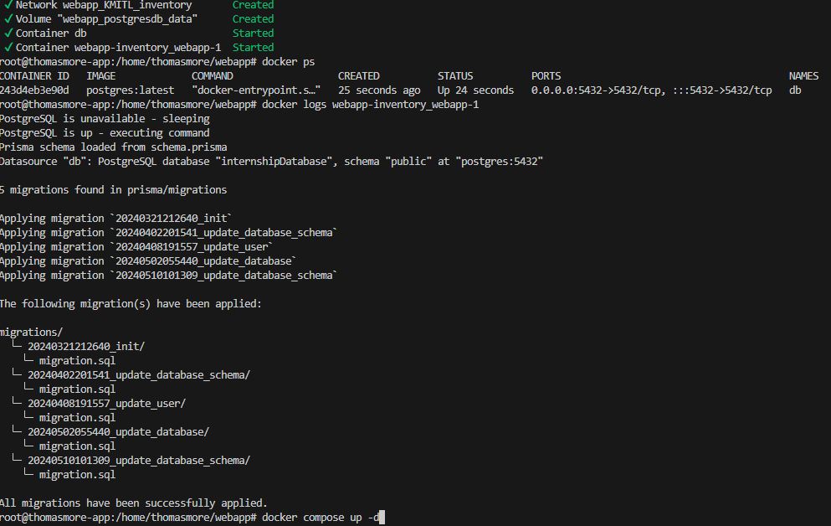

Slide 10
Planning ccs

Slide 11
Webserver
Fixing errors (Dr. James?)
Launching the application
Adding API keys

Slide 12
What next?

Slide 13
What do we expect next?
Project handover documents check 17/05
Fill in documents for final evaluation
Send email for firebase ownership transfer
Check our application with our word document

