Slide 1

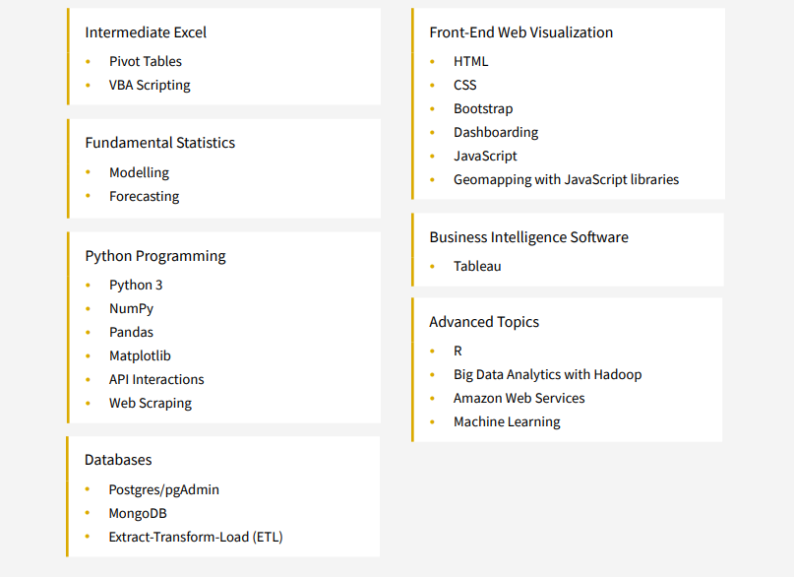
Intensive 24-week online program is fast-paced and focuses on the technical skills needed to solve real-world data problems.
Gain proficiency in numerous in-demand technologies, including Excel, Python, JavaScript, SQL Databases, Tableau, Machine Learning, and more
Final Project due in Mid-August 2022

Slide 2
N-Butane Recycle Build Up
Utilize principal component analysis, and neural networks to develop machine learning methods to predict probably of N-Butane build up.
Input RX, Tower A, Tower B, and Tower C data, twice daily N-Butane samples for qualifier
Outputs are probability percentage that we are building or purging N-Butane.
No side-draw for N-Butane at Tower A, RVP penalty for dropping i-Butane is severe.
Current procedure is relying on twice daily samples.
Operations are blind in-between samples, as is efforts to measure N-Butane balance
Operations have noticed correlations with Tower A overhead temperature ( >135F) as early warning of N-C4 build up.
ML Model goal is to input all tower and reactor data and predict the statistical probability that we are in a “N-Butane Build-Up” mode

Slide 3
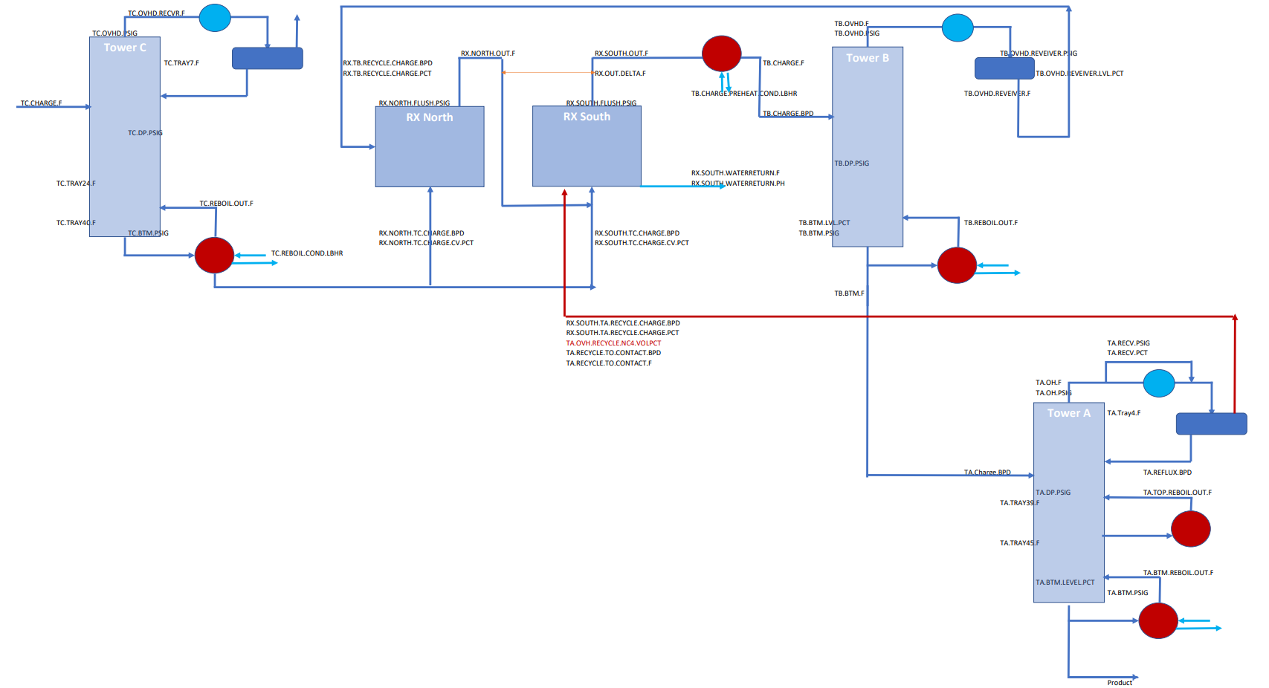
Process Block Flow

Slide 4
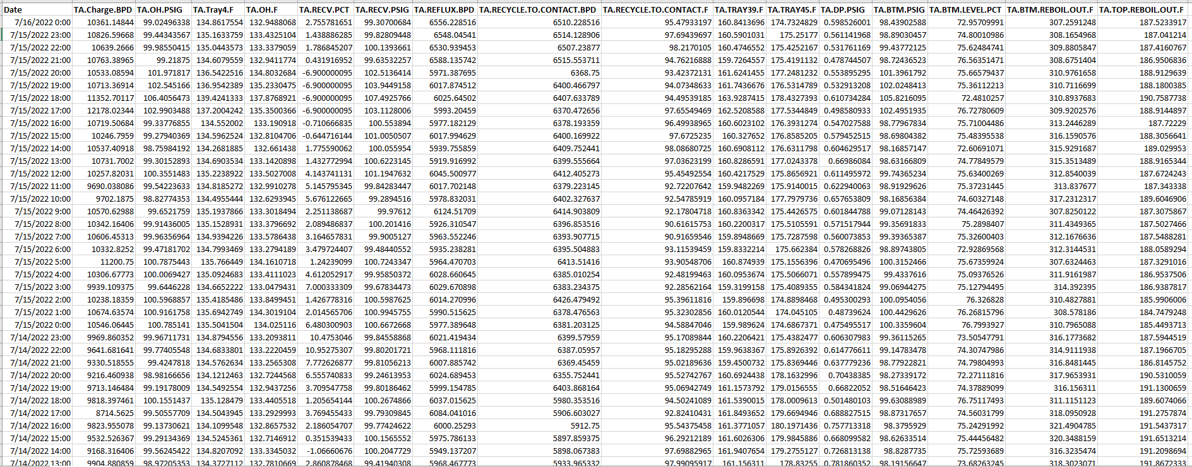
Raw Data Tower A
16 Data Items
All on the same time stamp
Hourly Data from 7/16/2022 – 1/1/2021
927 days * 24 hours * 16 data items = 355,968 Total Data Points

Slide 5
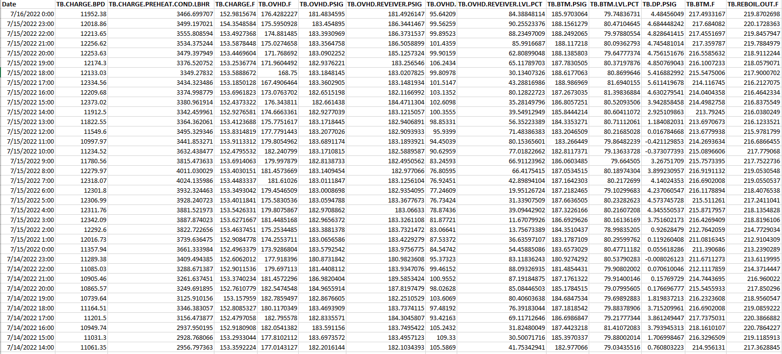
Raw Data Tower B
13 Data Items
All on the same time stamp
Hourly Data from 7/16/2022 – 1/1/2021
927 days * 24 hours * 13 data items = 355,968 Total Data Points

Slide 6
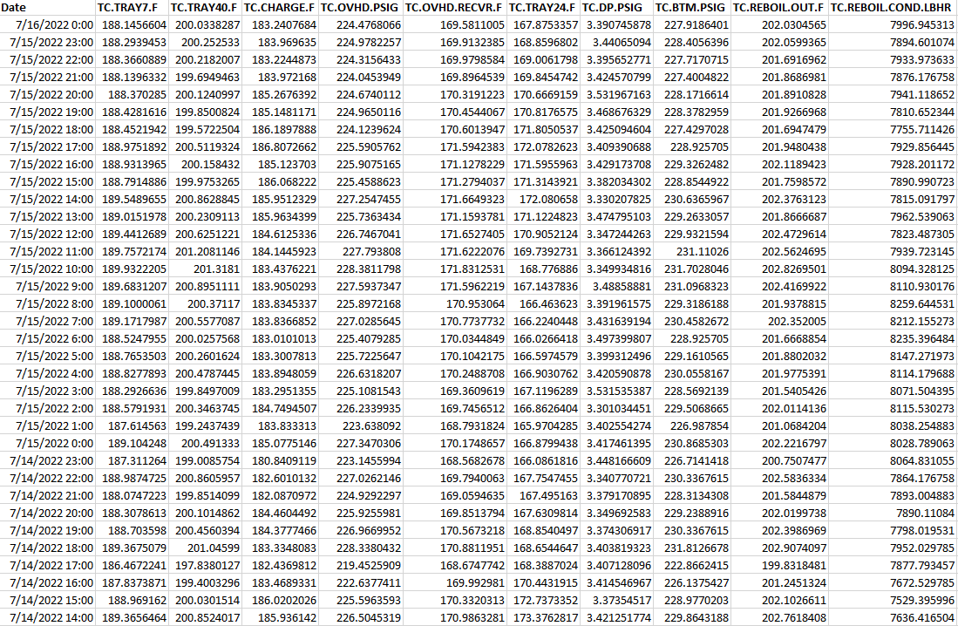
Raw Data Tower C
10 Data Items
All on the same time stamp
Hourly Data from 7/16/2022 – 1/1/2021
927 days * 24 hours * 10 data items = 222,480 Total Data Points

Slide 7
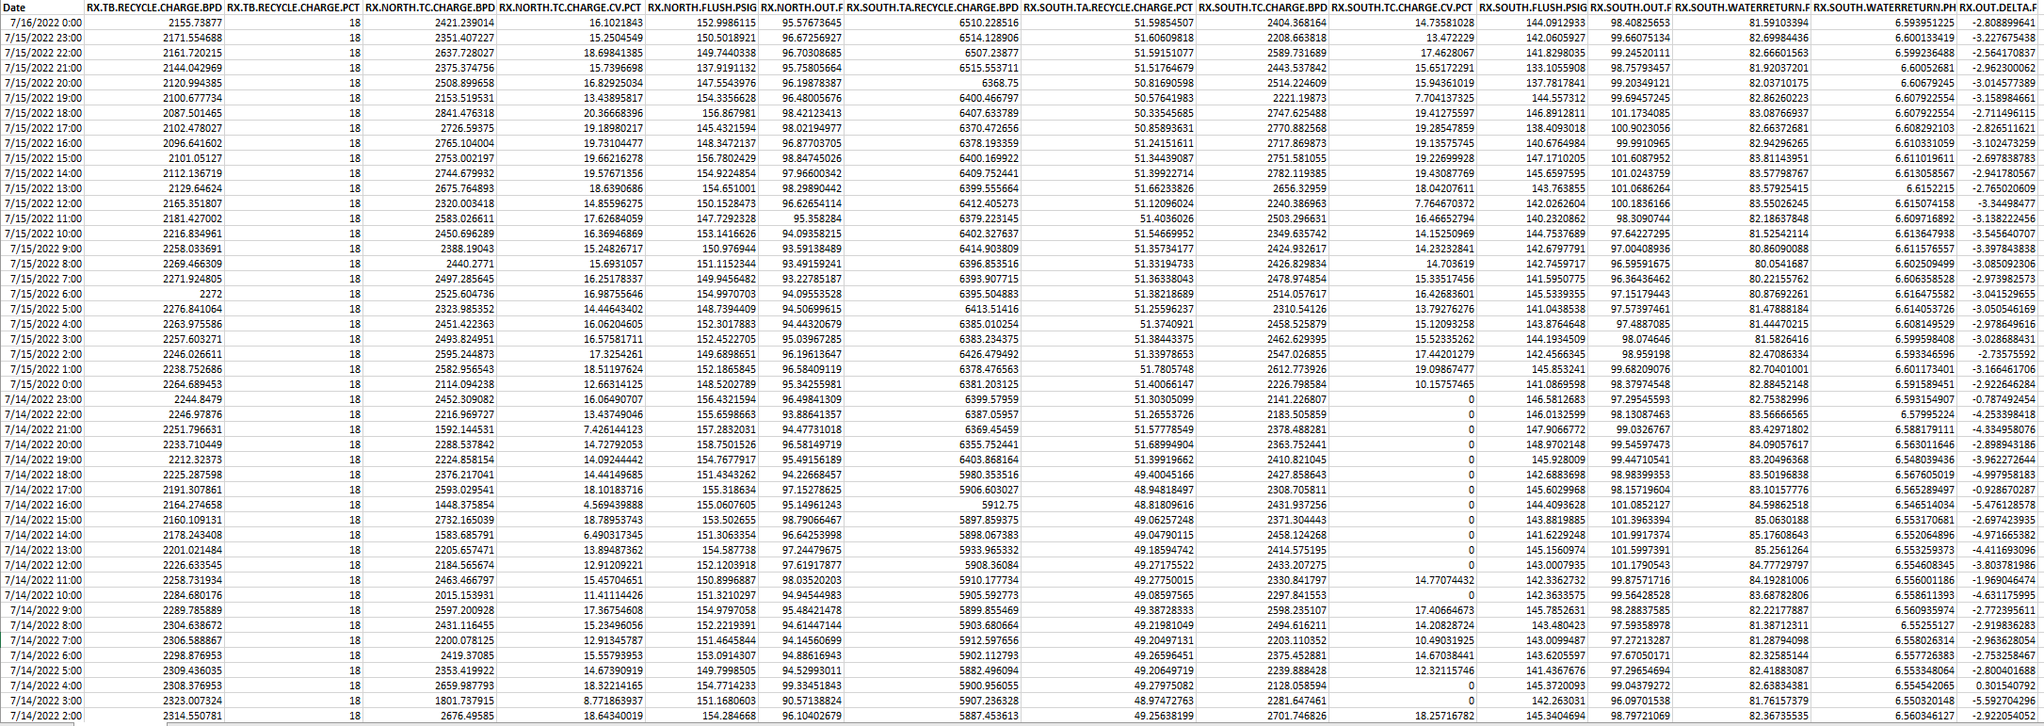
Raw Data RX North / South
15 Data Items
All on the same time stamp
Hourly Data from 7/16/2022 – 1/1/2021
927 days * 24 hours * 15 data items = 333,720 Total Data Points

Slide 8
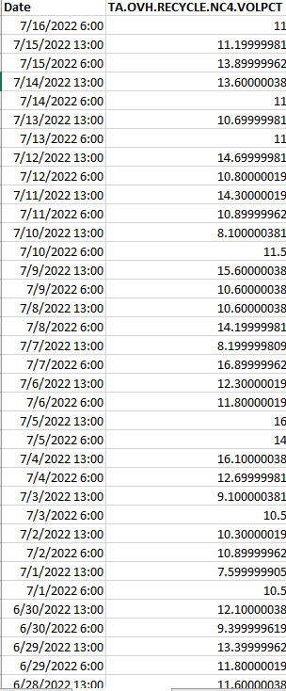
Lab Data – Recycle N.Butane Qualifier
1 Data Item
Twice Daily Lab Sample from 7/16/2022 – 1/1/2021
927 days * 2 samples per day * 1 data item = 1,854 Total Data Points
Total Data Points for Project
1,203,246 Data Points

Slide 9
Project Scope
Extract Transform Load Data
Merge Data to PostgreSQL on Time-Stamp as Parent
Create Pandas DB
Standardize / Scale Data
Principle Component Analysis to Narrow Down Inputs
Utilize Linear Regression Forecast Models
Determine other ML Models to Forecast
Generate Model to Accurately Predict N-Butane Recycle Build Up
Publish Findings in Flask App

Slide 10
Project Scope / Plan
20.1 (Due 7/31): Sketch it Out: Decide on Project, Select Question, Build Simple Model, Connect to fabricated DB using CSV or JSON to prototype idea.
Deliverables:
Readme – Presentation
GitHub One branch per member, 4 commits per member
ML Model works
Provisional Database
Clean Data for TA and LAB Pass 1 (scripts / outliers / datatype)
Plug in and test Linear Regression (discuss other models)
Clean Data for TA and LAB Pass 2 (Binary Qualifier, Standardize)
Narrow Input Data (PCA, Feature Importance (Module 17))
Pull second data source (API / CSV / etc..)
Practice SQL (merging DB, pull into Python)

Slide 11
Project Scope / Plan
20.2 (Due 8/7): Build the Pieces: Train model and sketch out permanent database
Deliverables:
Readme – Presentation
GitHub One branch per member, 4 commits per member, code works
ML Model works
Database Complete
Blueprint for dashboard
Selected and confirmed model type – it works
Complete SQL portion of project / load the data
Blue print for flask app

Slide 12
Technology Used
Microsoft Excel
GitHub
Python / Pandas
PostgreSQL
Scikit-Learn (Possible use of other ML Libraries)
Flask

