Slide 1


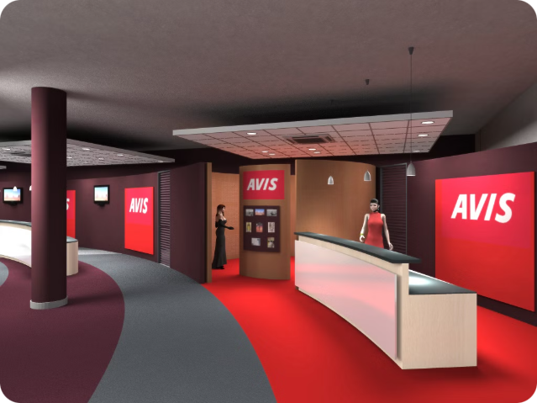


LJ Institute of Engineering and Technology
Vehicle Rental System
Prepared by
Name : Patel Jarnil Rakeshbhai EnrollMentNO : 23002170110124 Batch : D-3 Branch : CE

Slide 2
Vehicle Rental System Overview
The Vehicle Rental System is a comprehensive solution designed to manage the renting of cars and bicycles. It encompasses a wide range of features, from user management and vehicle inventory to booking systems and transaction history. This presentation will provide a detailed overview of the system's main components, key functionalities, and underlying data structures, equipping you with a thorough understanding of this powerful platform.

Slide 3
Main Components
User Management
Vehicle Management
Booking System
The system allows for user registration, login, and profile management, ensuring secure access and personalized experiences for both customers and administrators.
Vehicle inventory is at the core of the system, enabling the addition, viewing, and deletion of cars and bicycles available for rent.
The booking system handles vehicle reservations, validates date availability, and processes payments, providing a seamless rental experience for users.

Slide 4

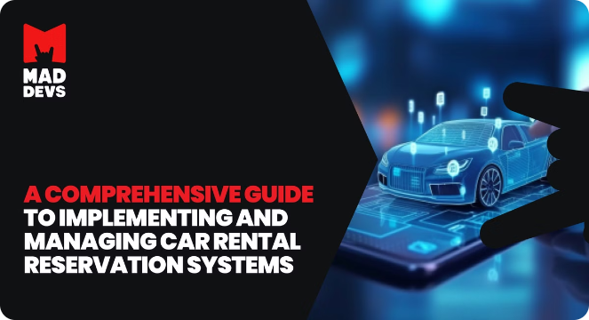
Key Functionalities
1
User Functionality
Users can register, log in, browse and search the available vehicles, and book their desired cars or bikes, handling payments securely.
2
Admin Functionality
Administrators have the ability to manage the vehicle inventory, add or remove vehicles, and view the transaction history for all rentals.
3
Database Schema
car_list : Manage Cars
bike_list : Manage Bikes administrator : Information Of Admin
users : Information Of Users
paymet : Information About Transaction of Rent of cars and bikes
4
Data Structures
Stack : Here Stack is used for add, remove and display for vehicals.
BST : Here Bianry Search Tree is used for serach vehical by it's No.

Slide 5
Class Interactions
CarRental
BikeRental
Search Classes
VehicalRentalSystem
This class handles the booking of cars, including checking availability, processing payments, and updating the database with the rental information.
Similar to the CarRental class, the BikeRental class manages the booking of bicycles, ensuring availability and handling the financial transactions.
The SearchCar and SearchBike classes utilize binary search trees to efficiently search for and retrieve vehicle information based on user queries.
This is our main class it controll folw of our system and this class also contain Stack emplementation for car and bike

Slide 6

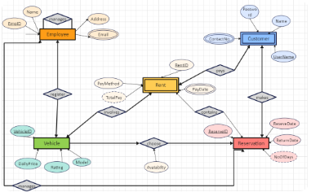
Database Design
Customer
The core entity that represents the users of the system, linked to their accounts, transactions, and rental history.
Transaction
Maintains a record of all monetary actions, including rental payments and other financial activities.
1
2
3
Payment
Stores the financial details and payment information associated with each customer's account.

Slide 7

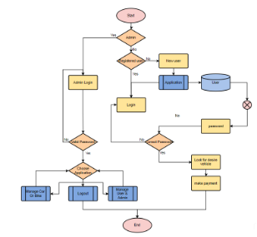


Booking and Search Processes
Booking Process
Search Process
The user logs in, selects a vehicle, enters the desired rental dates, and the system checks availability before processing the payment and updating the database with the booking details.
Users can input a vehicle number, and the system uses a binary search tree to efficiently locate and display the corresponding vehicle information.

Slide 8

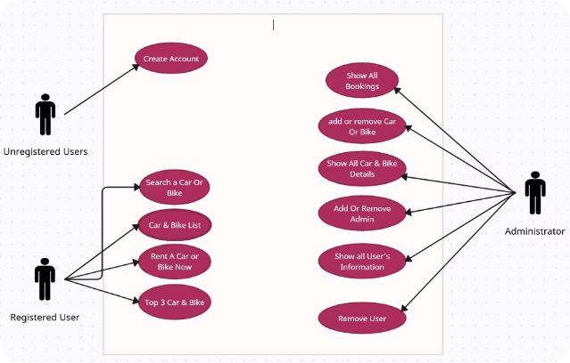
Use Case Diagram
User Actions
Users can search for available vehicles, book their desired car or bike, and view their rental history and transaction details.
Admin Actions
Administrators can manage the vehicle inventory, add or remove vehicles, and monitor the overall transaction history for the rental system.

Slide 9


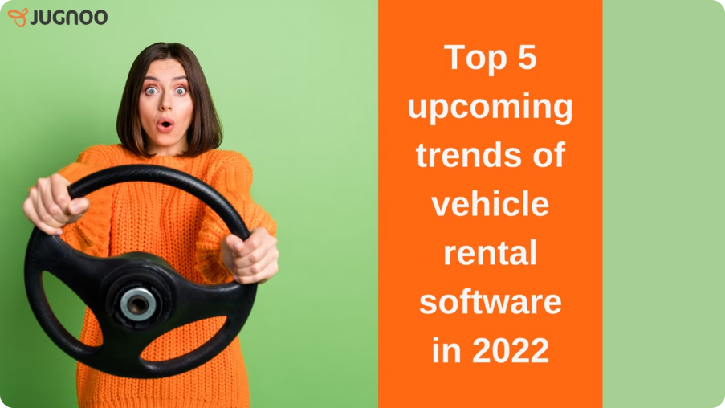


Future Enhancements
Mobile App
Develop a mobile application to provide a convenient and user-friendly interface for customers to access the rental system on the go.
Loyalty Program
Implement a loyalty program that rewards frequent customers with discounts, special offers, and other incentives to encourage repeat business.
Advanced Analytics
Leverage data analytics to gain insights into customer behavior, vehicle utilization, and market trends, enabling data-driven decision-making and strategic planning.

Slide 10
Summary and Conclusion
1
Key Capabilities
2
Underlying Technologies
3
Future Growth
The Vehicle Rental System provides a comprehensive suite of features, including user management, vehicle inventory control, a robust booking system, and transaction history tracking.
The presentation has outlined potential enhancements, such as a mobile app, a customer loyalty program, and advanced analytics capabilities, to expand the system's functionality and meet evolving market demands.
The system integrates with a MySQL database and utilizes efficient data structures like binary search trees and stacks to ensure optimal performance and scalability.

Slide 11
Thank You

